Slide 1
Connect-Four
Section: 303
Dan Wortmann
Hao Liang

Slide 2
Project Objective/Background
To use the BB12 board for playing a connect-four game between two players
The user-interface and the control components like potentiometer and button as well as the wireless connection feature could be feasible to implement a two-player game

Slide 3
Project Approach
We start the game by clearing the board and use the adresses to choose the players('X' and '0' to distinguish diffrent player)
Using Xbees to send the piece from previous player
check win after each move

Slide 4
Project Approach
Using a 2D array for the board seemed to be problematic for wireless transmission → use 1D
The array was laid out from top to bottom by rows: 0-6: 7-13:…:35-41.
This allowed us to send single digit signals for column selection

Slide 5
Project Approach
Calculating the winning scenarios and such required some math…
Index # / 7 - gave us the column
Index + 1 - gave us right neighbor
Index - 1 - gave us left neighbor
Index +/- 7 – gave us down/up cell
Index +/- 6-gave us right-up diagonal
Index +/- 8-gave us left-up diagonal

Slide 6
Example
-32 |  |  |  | -28
 | -24 |  |  | -21 |  |  | -18
 |  | -16 |  | -14 |  | -12
 |  |  | -8 | -7 | -6
-4 | -3 | -2 | -1 | Curr | +1 | +2 | +3
 |  |  | +6 | +7 | +8
 |  | +12 |  | +14 |  | +16
Note: you should only check the winning conditions from the last placed piece, no need to scan the entire board.

Slide 7
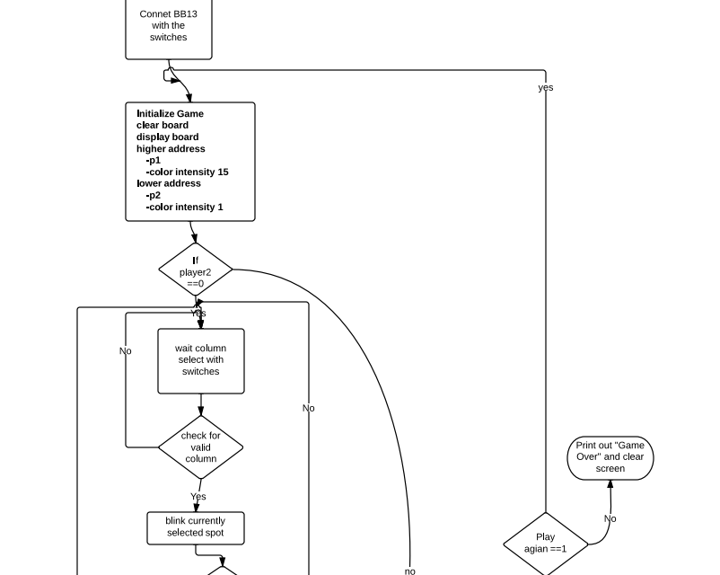
Flow chart

Slide 8
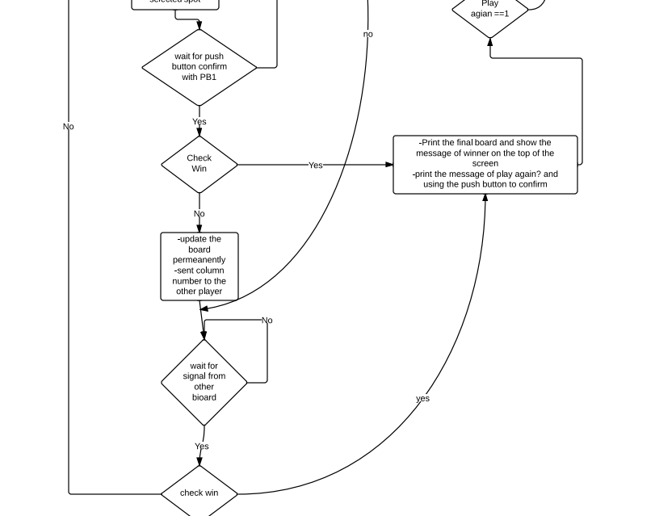
Flow char continued..

Slide 9
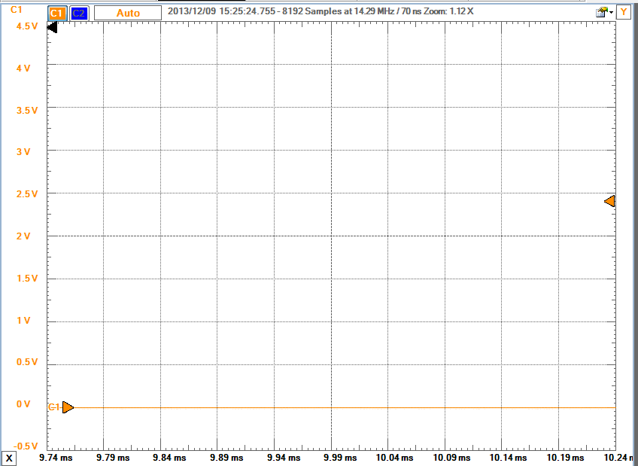
Measurement results
The picture above are the corresponding voltage of using the potentiometer to choose the column by digilent scope.
As you see, that the voltage is going up when we choose bigger number of column since the potentiometer is turned more on the clockwise direction
Fig.1 chose the
first column

Slide 10
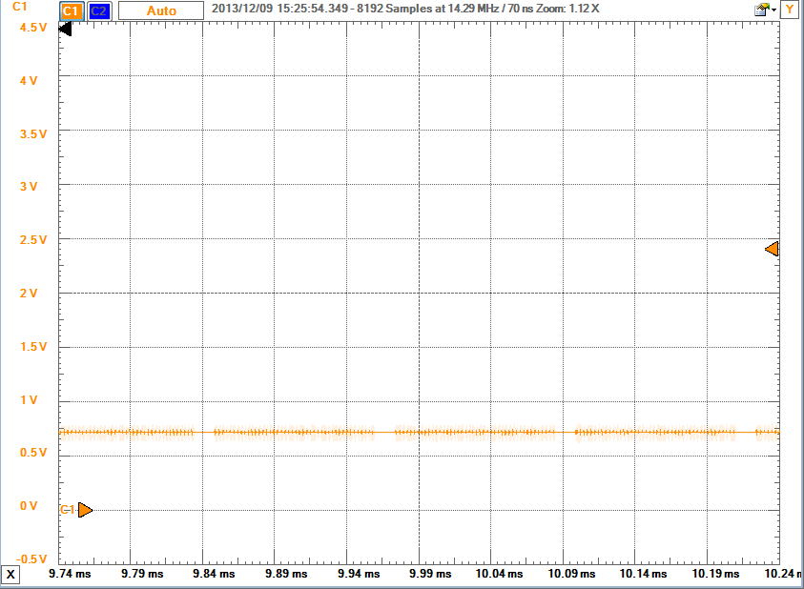
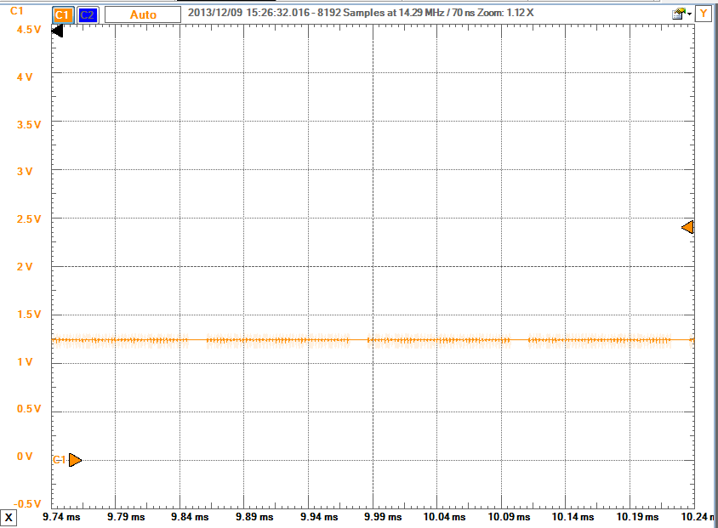
Measurement results
Fig.2 chose column2
Fig.3 chose column3

Slide 11
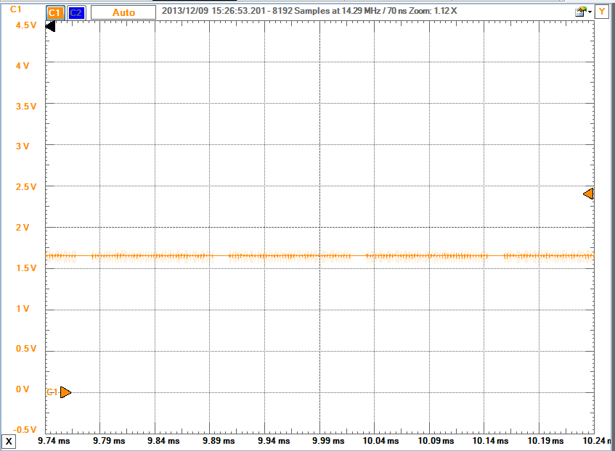
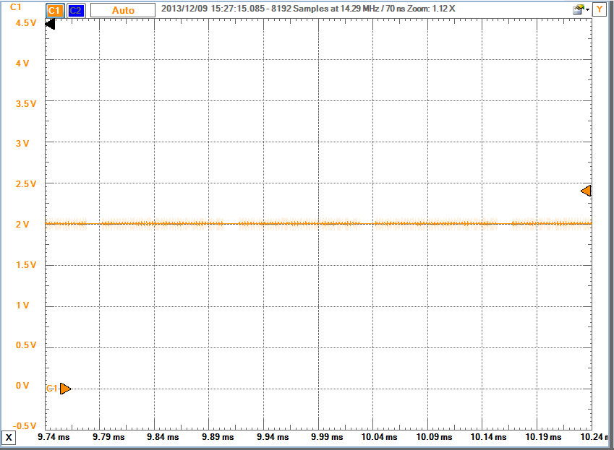
Measure
Fig.4 chose column4 Fig.5 chose column5

Slide 12
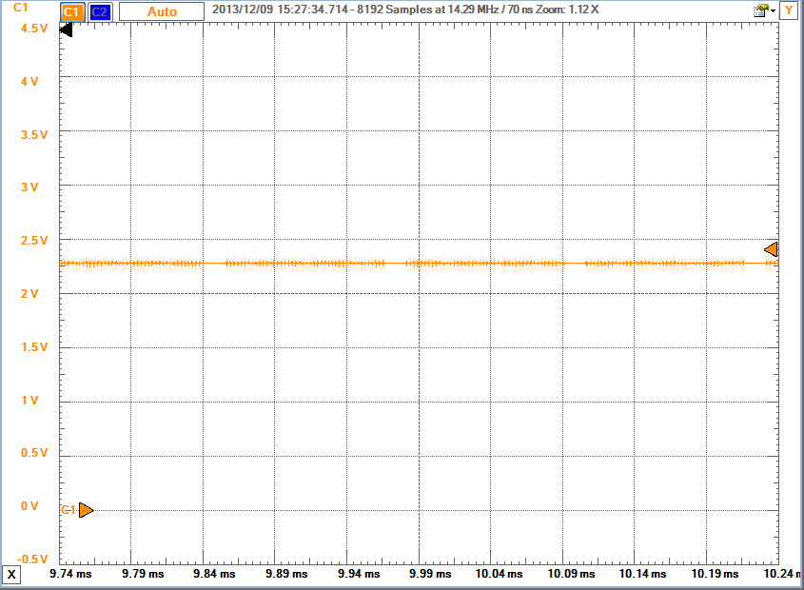
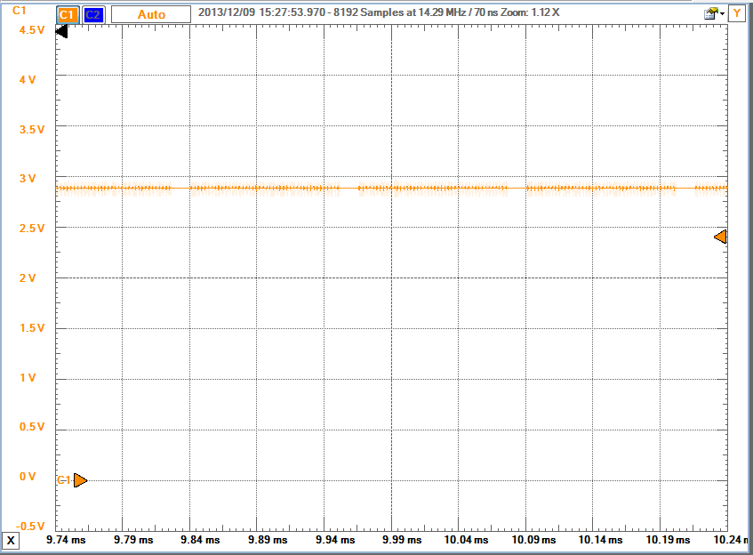
Measure
Fig.6 chose column6 Fig.7 chose column7

Slide 13
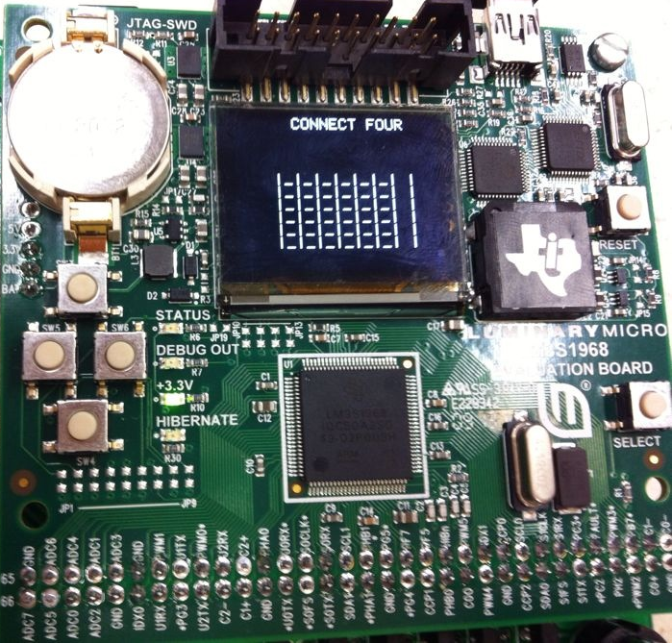
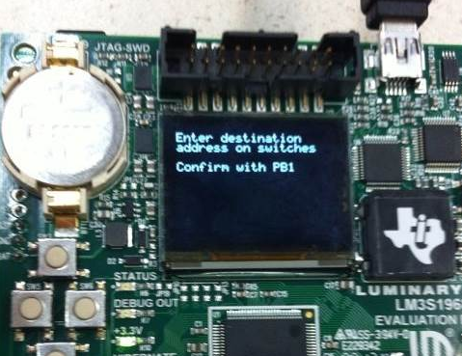
Artifact images

Slide 14
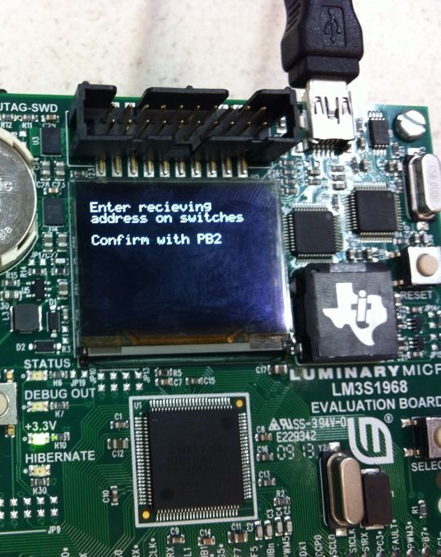
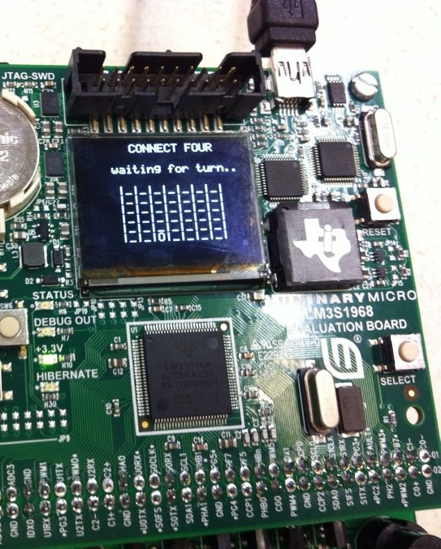
Artifact images

Slide 15
demo video
http://www.youtube.com/watch?v=Y_1A7T8akmQ&feature=youtu.be

Slide 16
Conclusions
The game worked well and consider corner situations(win, lose, tie..)
If the distance between two board is far, sometimes the program will freeze..

