Slide 1
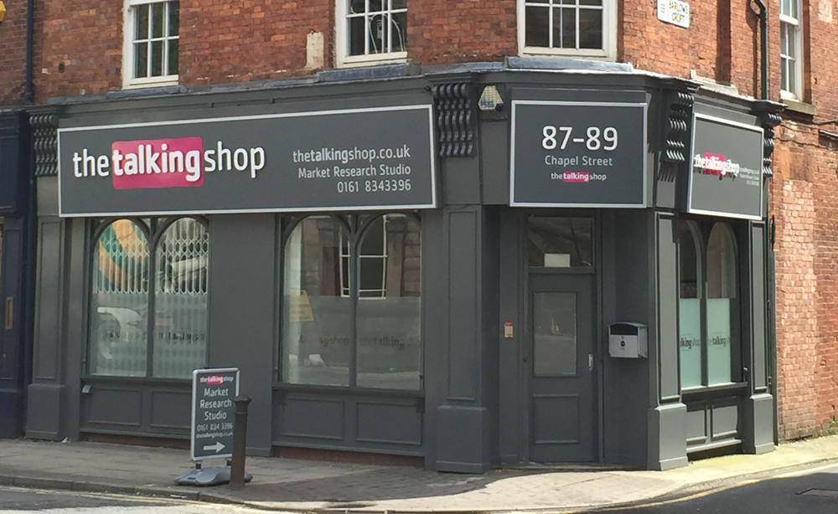
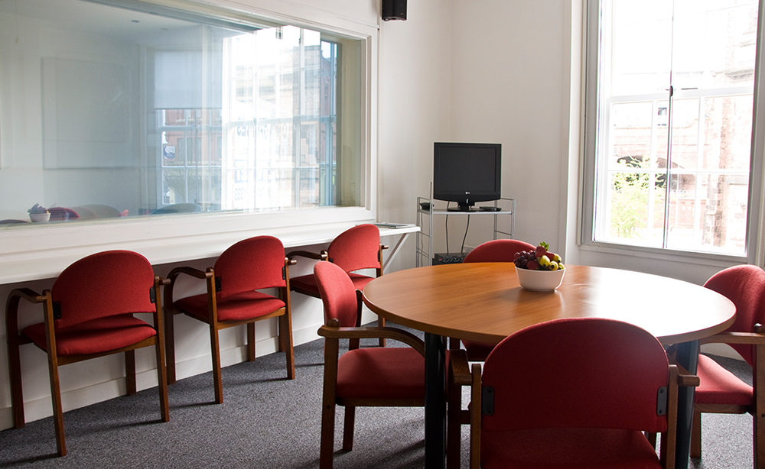
LCWRA curtailment lab research
Feedback from user research held at The Talking Shop Salford on Wednesday 7 August 2019

Slide 2
LCWRA curtailment lab research
Background
Previous lab sessions had suggested that HCPs could successfully curtail but the scenarios used were out of context to some degree
Previous sessions had also failed to produce sufficiently robust recommendations that could be tested with Audit and Decision Makers (DMs)
There were some doubts that the curtailment method previously tested could be successfully adapted to the CAS environment

Slide 3
LCWRA curtailment lab research
Who we researched with…..
4 experienced CHDA face to face health care professionals (HCPs)
Variety of nursing backgrounds
“NHS waits for mental health appointments can take months so we’re often the first people they see. Recently saw a girl who was raped. Need to handle in a sensitive manner but we’re not a counselling service. I try to give them time to talk.” This is an added difficulty with the job nowadays
“I’m good at filework but I find it stressful. Face to face is like a pair of slippers for me.”

Slide 4
LCWRA curtailment lab research
What we were researching…..
We wanted to show that HCPs could curtail a WCA assessment in the current prototype (version 8)
We wanted to show that the HCP recommendations from these curtailed assessments could pass an audit check in CHDA. We need to know just what Audit expect from a curtailed report
We wanted to show that DWP Decision Makers (DMs) could make a robust decision based on the HCP recommendation without the need for re-work
Notes:
The last two bullet points are still being worked on

Slide 5
LCWRA curtailment lab research
How did we do this?
By working with CHDA HCPs to set up some mock assessment cases on UC 50s with matching details in the prototype
By using role play for 2 x functional LCWRA curtailment scenarios and running the whole assessment including preview, face to face and subsequent write up
By adapting the “raw” reports into HTDS versions as if they came out of CAS

Slide 6

LCWRA curtailment lab research
What happened?
All 4 HCPs understood the word “curtail” and would be comfortable using it. This was considered fairly standard
All 4 HCPs were able to successfully curtail the assessment!
All 4 HCPs were able to run a complete end to end assessment including the preparation (unmoderated), face to face and subsequent write up (also unmoderated)
All 4 HCPs completed evidence in Condition History, Social and Work History and Typical Day as well as the curtailment justification and PSS
“For mobility you need a full Condition History and at least 5 examples”
Notes:
Use this section to run through hypos – thanks to Dan and Gareth for articulating these so I could incorporate into topic guide. This was what we conjectured “good” would look like. Deal with physical and mental health later on in presentation. Show video of HCP curtailing!

Slide 7
LCWRA curtailment lab research
What happened?
All 4 HCPs successfully produced reports that are now being prepared for testing with CHDA Audit and DMs
With one exception the HCPs generally coped easily enough with navigation through the prototype including the location of the curtail link when they finally wanted to hit it
All 4 HCPs coped well with the free text boxes though occasionally referenced where existing drop downs in Lima were beneficial
HCPs recognised difference between “abandon” and “curtail” assessment
Notes:
Second bullet x ref hypo 1. Fourth bullet x ref hypo 2. Both hypos validated!

Slide 8

LCWRA curtailment lab research
What happened?
All 4 HCPs spent further time writing things up after the customer had been allowed to go and before hitting the curtail link
One HCP said that it depended on “how the customer was coping” when deciding how long to keep them in the room
Just one HCP struggled a little with navigation though this was mainly driven by a desire to cut and paste from previous text to the PSS or curtailment justification
Notes:
1st bullet = hypo 4 disproved. 3rd bullet = hypo 3 inconclusive and hypo 5 disproved. Bullet point 1 means we may have two separate needs: one for a timer to stop when they leave the room and one for the actual completion of the assessment

Slide 9
LCWRA curtailment lab research
Physical assessment
Two of the mock assessment scenarios were set up to curtail on a physical functional descriptor (mobilising)
We wanted to see if the physical exam might be the “tipping point” where the HCP chose to curtail (which would inform where we place the curtail link) – it wasn’t!
We learnt that HCPs should always offer a physical examination when curtailing on a physical LCWRA descriptor (and customer can of course refuse it, for example if in too much discomfort)
The final participant actually deemed that a physical assessment was inappropriate and so we may need to consider an option for this scenario

Slide 10
LCWRA curtailment lab research
Mental health assessment
“You need to complete a mental health examination to justify your LCWRA recommendation for a mental health activity”
HCPs state there is not always a need to complete all of the MH boxes though we witnessed some completing them as “not assessed” so that the DM would know they hadn’t consciously overlooked it – seems to be audit driven and one user felt it was a “poor use of their time”
“A physical assessment wouldn’t be needed for mental LCWRA”
Notes:
First two quotes are unequivocal!

Slide 11
LCWRA curtailment lab research
What goes in the report - curtailment justification and Personal Summary Statement (PSS)
We saw a variety of practices here with some of the curtailments taking longer than others
HCPs were generally trying to complete the justification from memory but there was undoubtedly some “back and forth” especially between curtailment justification and PSS
Although one HCP decided to curtail more or less straight after reading the customer statement they still took a comprehensive Condition History, Social and Work History and Typical Day
The same HCP subsequently reflected that “they need to see this, we’ve had lots of C grades coming back because they needed more information” (referring to Audit)
Notes:
First two quotes are unequivocal!

Slide 12
LCWRA curtailment lab research
What goes in the report - curtailment justification and Personal Summary Statement (PSS)
One HCP reflected that “there’s a button that lets you see everything you’ve captured so far in a different screen. It would be useful to have this”
Another HCP got really confused with the navigation after the customer had left the room
“When I first started at ATOS we didn’t use the PSS we just wrote mini justifications at the end” (PSS has actually evolved and can be traced back to the influential Harrington Report
There may be a case for tagging the chosen descriptor and following the same path as in the “make your recommendation” journey (need separate hypothesis if we decide to research this)
Notes:
First two quotes are unequivocal!

