Slide 1
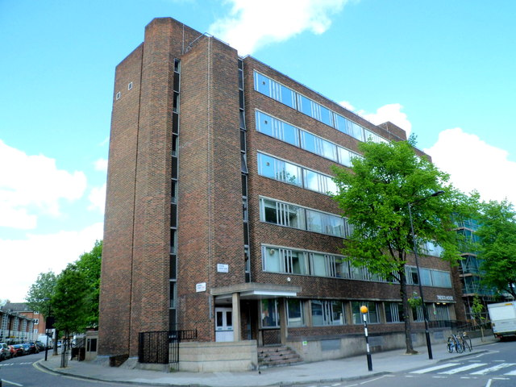
LCWRA user research in Tresco House on 16 September 2019

Slide 2
LCWRA user research in Tresco House on 16 September 2019
What were we researching?
Curtailed assessment scenarios
New “guard question” to determine LCWRA or other assessment route
Introducing a new field for referencing senior HCP in LCWRA sign off
Further test to see if tagged statements for chosen descriptor would help in “proceed to LCWRA” scenario and maybe reduce confusion between the curtailment justification and the Personal Summary Statement (PSS)
Trialling two versions of “surfacing” tagged statements to help complete the subsequent justification
Utilising assessment prototype version 0.5 scenarios 1, 2 and 3
Notes:
Some of the LCWRA findings also have implications for the full end to end journey. Also looking for consistency with tagging in live service.

Slide 3
LCWRA user research in Tresco House on 16 September 2019
Who did we research with?
5 x experienced HCPs from a variety of backgrounds including one new to the research and who had previously helped in plastic surgery
All of the HCPs had some experience of using the live HTDS service
The HCPs confirmed that proceed to LCWRA had already been an issue in “live” and welcomed the prototype development
“It would be good if you could justify the descriptor without the PSS”
Notes:
Split between 2 sessions so that we could also test a non-LCWRA scenario. Mark checking suggestion from National Audit that 40% of face to face assessments get curtailed. If this is the case then it’s a very significant feature that needs introducing a s a p.

Slide 4
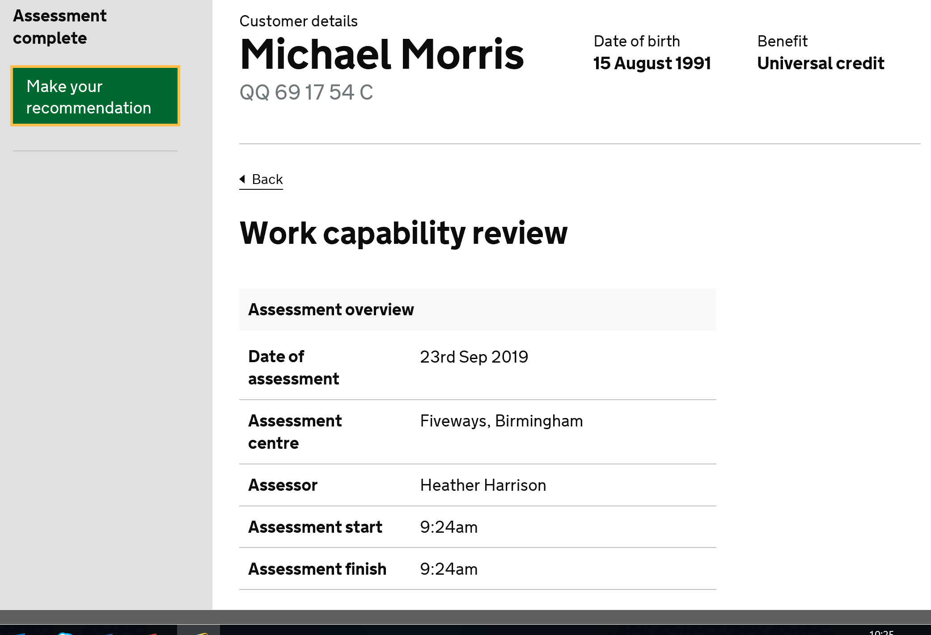
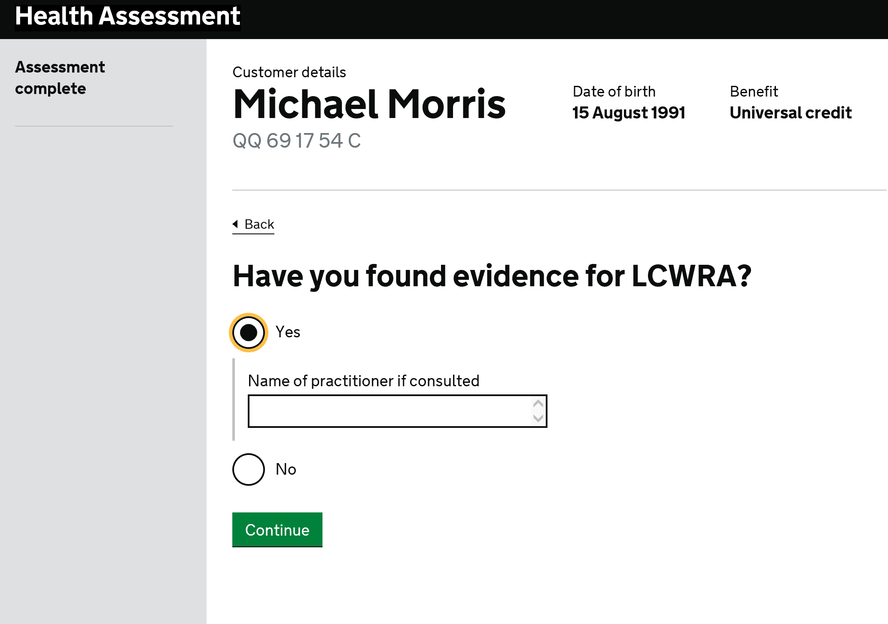
LCWRA user research in Tresco House on 16 September 2019
Make Recommendation and “Guard Question”
All users advanced successfully through this section
Some slight issues with scrolling but users were still able to move on
All users also understood the “practitioner consulted” box though it would not apply in their case
Users understood the word “practitioner” but suggested that Customer Service Desk (or CSD) would probably make more sense in a CHDA context
2 of the users were given a non-LCWRA scenario and chose the correct route from this page
Notes:
Explain context – Salford lab personas, starting scenario from midway through assessment. In Lima the practitioner line is greyed out when training successfully completed.

Slide 5
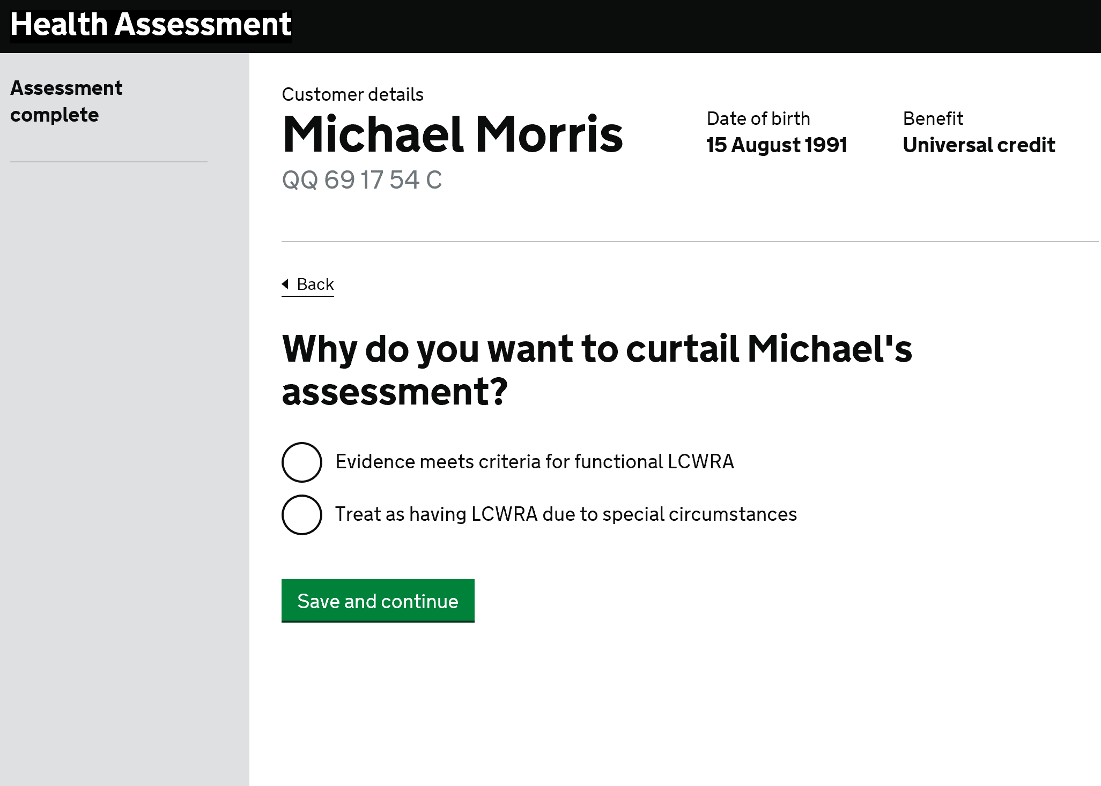
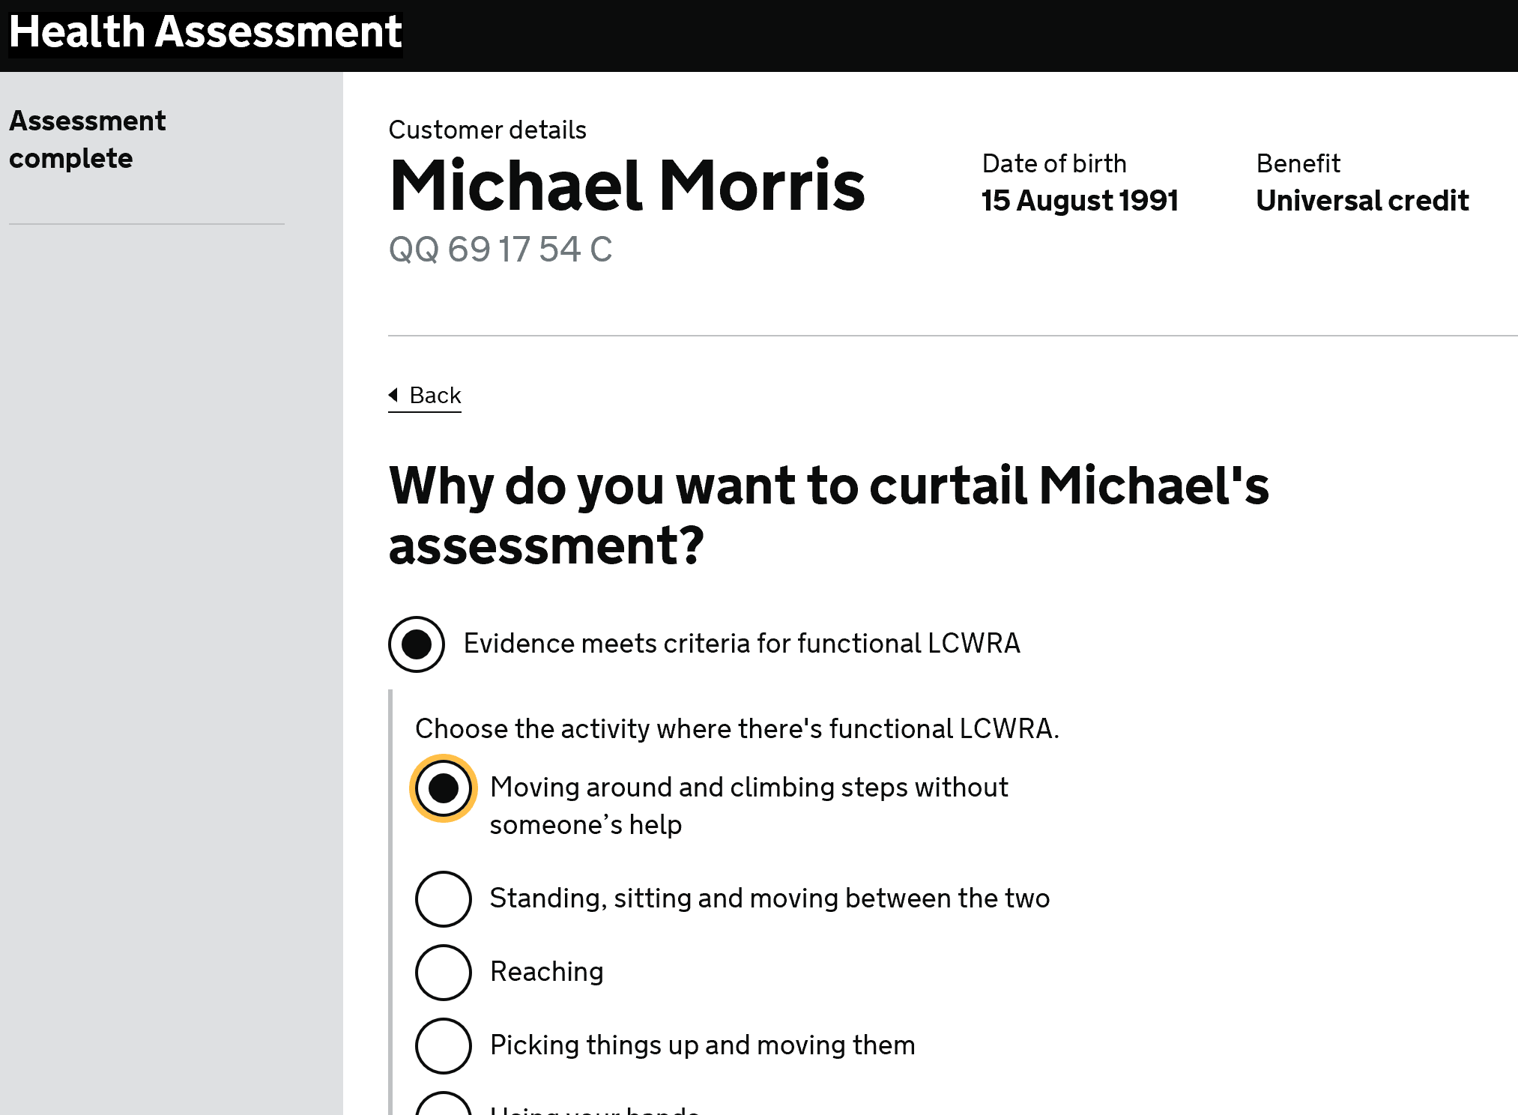
LCWRA user research in Tresco House on 16 September 2019
Why do you want to curtail?
Users flew through this page
There were no issues with the options presented and the language used
Users successfully chose the functional descriptor that the scenarios had been constructed around
HCPs agreed that “treat as” scenarios are rare but the same reporting principles apply
Notes:
.

Slide 6
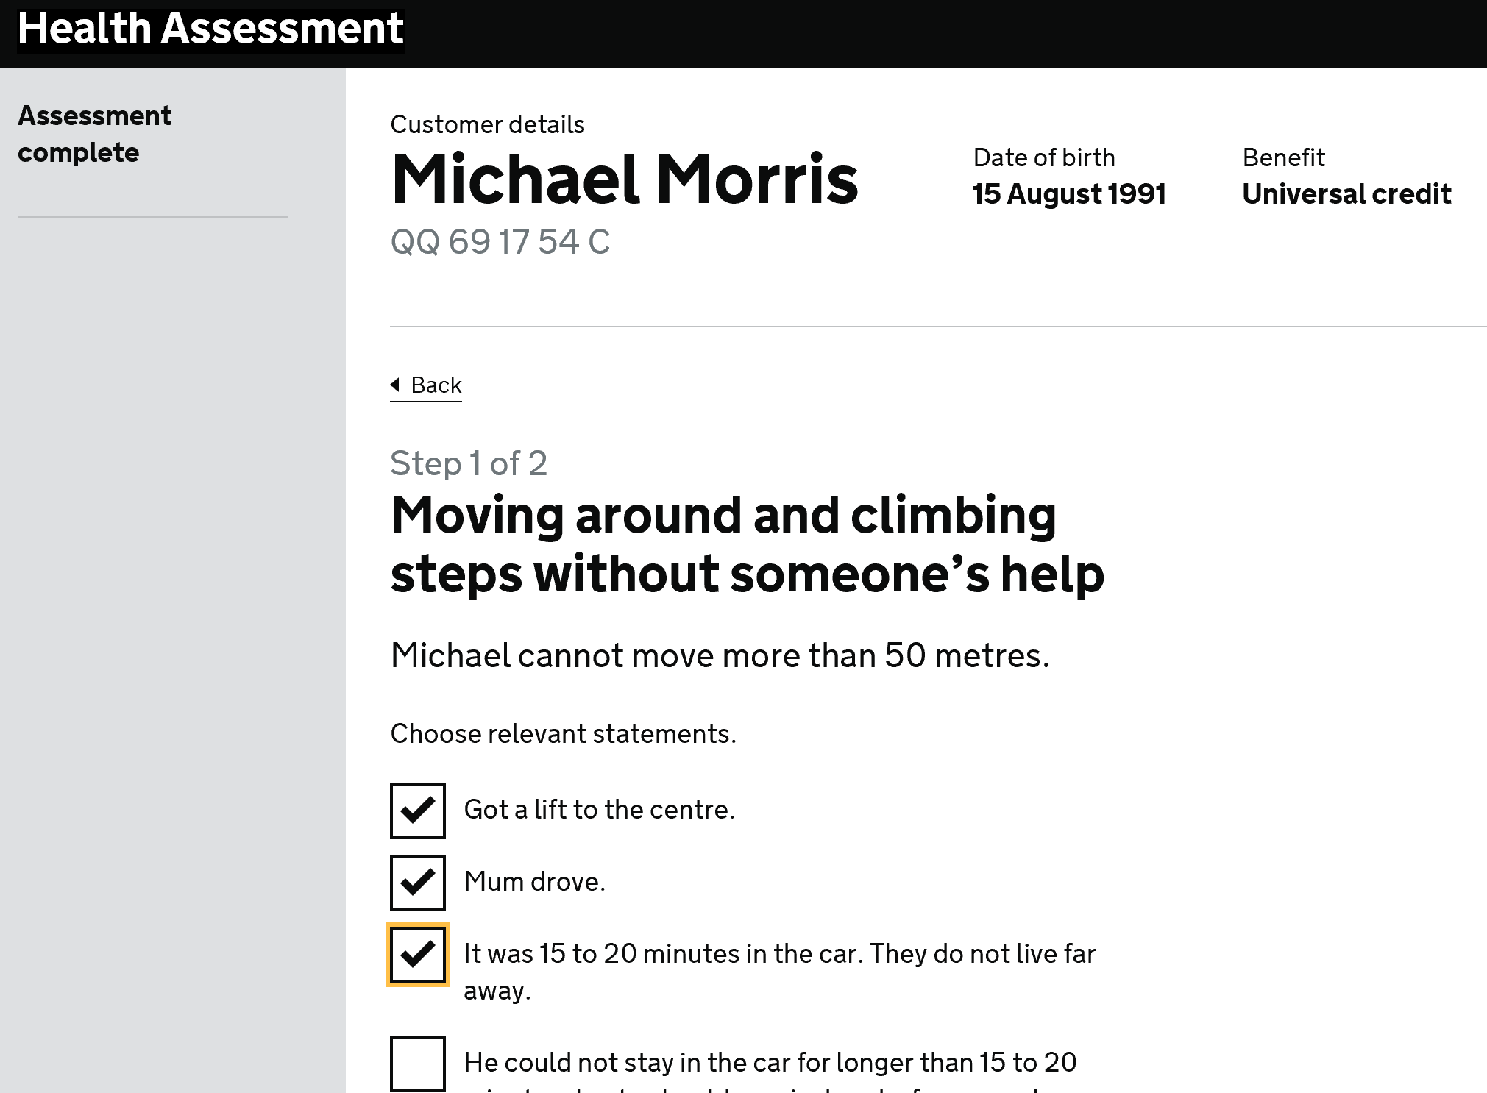
LCWRA user research in Tresco House on 16 September 2019
Tagging statements
Users recognised where the statements had originated from despite not having completed the assessment themselves
One user was specifically looking to capture the “3 pieces of evidence” that would support the recommendation
The same user was enthused about this but added “it would be good if I don’t have to repeat these and it saves me time later on”
All users actually tagged more than 3 statements though it perhaps needs to be clearer that you can select multiple statements
One user pointed out that she would expect to see evidence of mental health examination on her particular case (David Lowe)
The tagging feature ultimately confused users but this confusion only became clear as the following pages were revealed
Notes:
Same issues will be true in live when tagging introduced. Would also need sight of physical exam in appropriate cases.

Slide 7
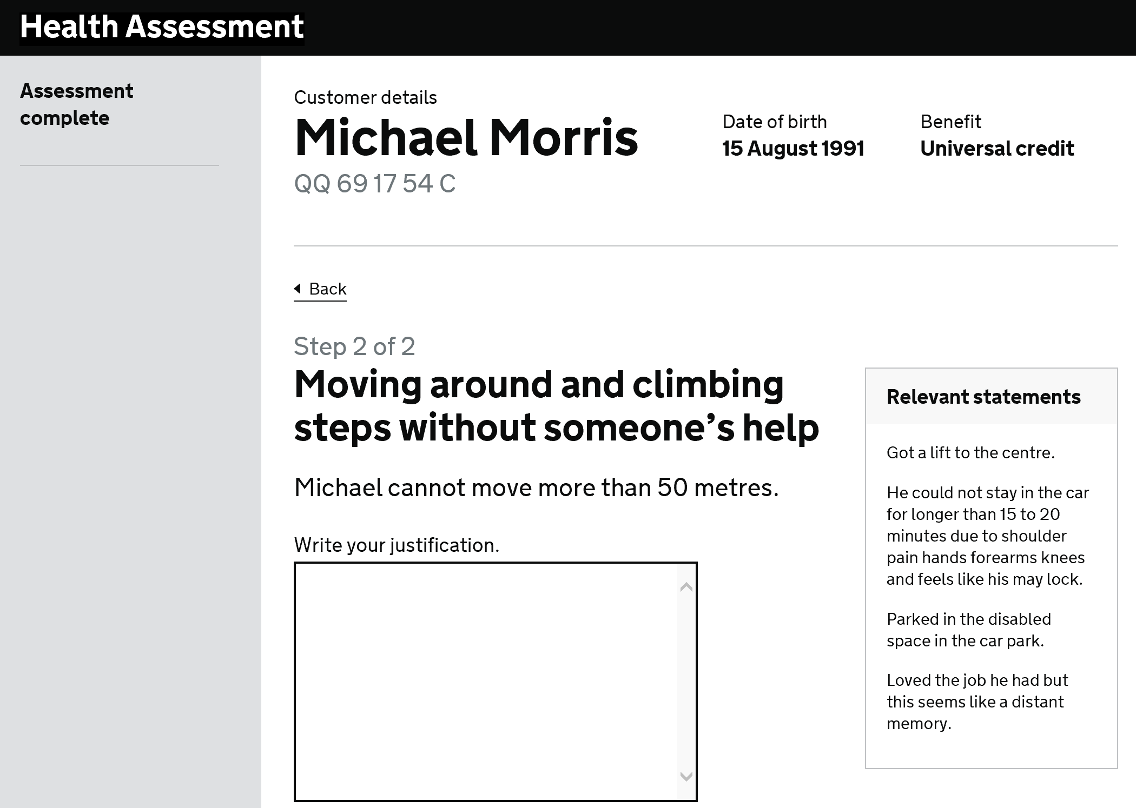
LCWRA user research in Tresco House on 16 September 2019
Write your justification
Of the two methods of accessing previously tagged statements, users preferred having the statements in view. They struggled with the hyperlink version
That said, it quickly became apparent that users wanted to cut and paste from the surfaced statements into the justification box
Users believed that they were effectively now completing the Personal Summary Statement (PSS)
“I feel like I’m doing the PSS!”
This being the case, users now expressed frustration that they couldn’t have access in screen to the full Condition History and Typical Day (as opposed to the tagged statements)
Based on this session, users need access to the previous boxes when completing their justification/PSS
Notes:
Explain A/B testing.

Slide 8
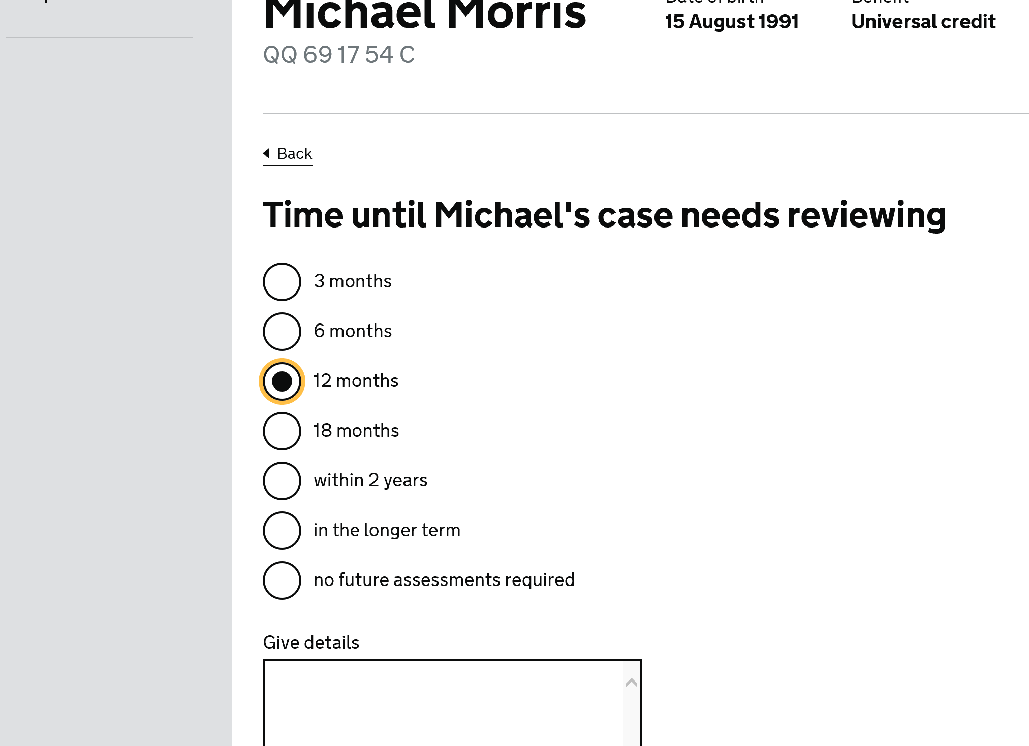
LCWRA user research in Tresco House on 16 September 2019
Prognosis
Users were slightly confused by the justification box on a curtailment case, especially for a physical descriptor
Users felt that prognosis justification on curtail cases was exceptional with one possible example being imminent surgery where recovery could be reasonably expected, however this was very rare
One user emphasised that you would only really justify on risk cases
The same user said they might put something in here about the level of medication
Another user said that she felt obliged to put something in the blank box or it may get picked up by Audit
Notes:
Nina checking exceptions to prognosis justification

Slide 9
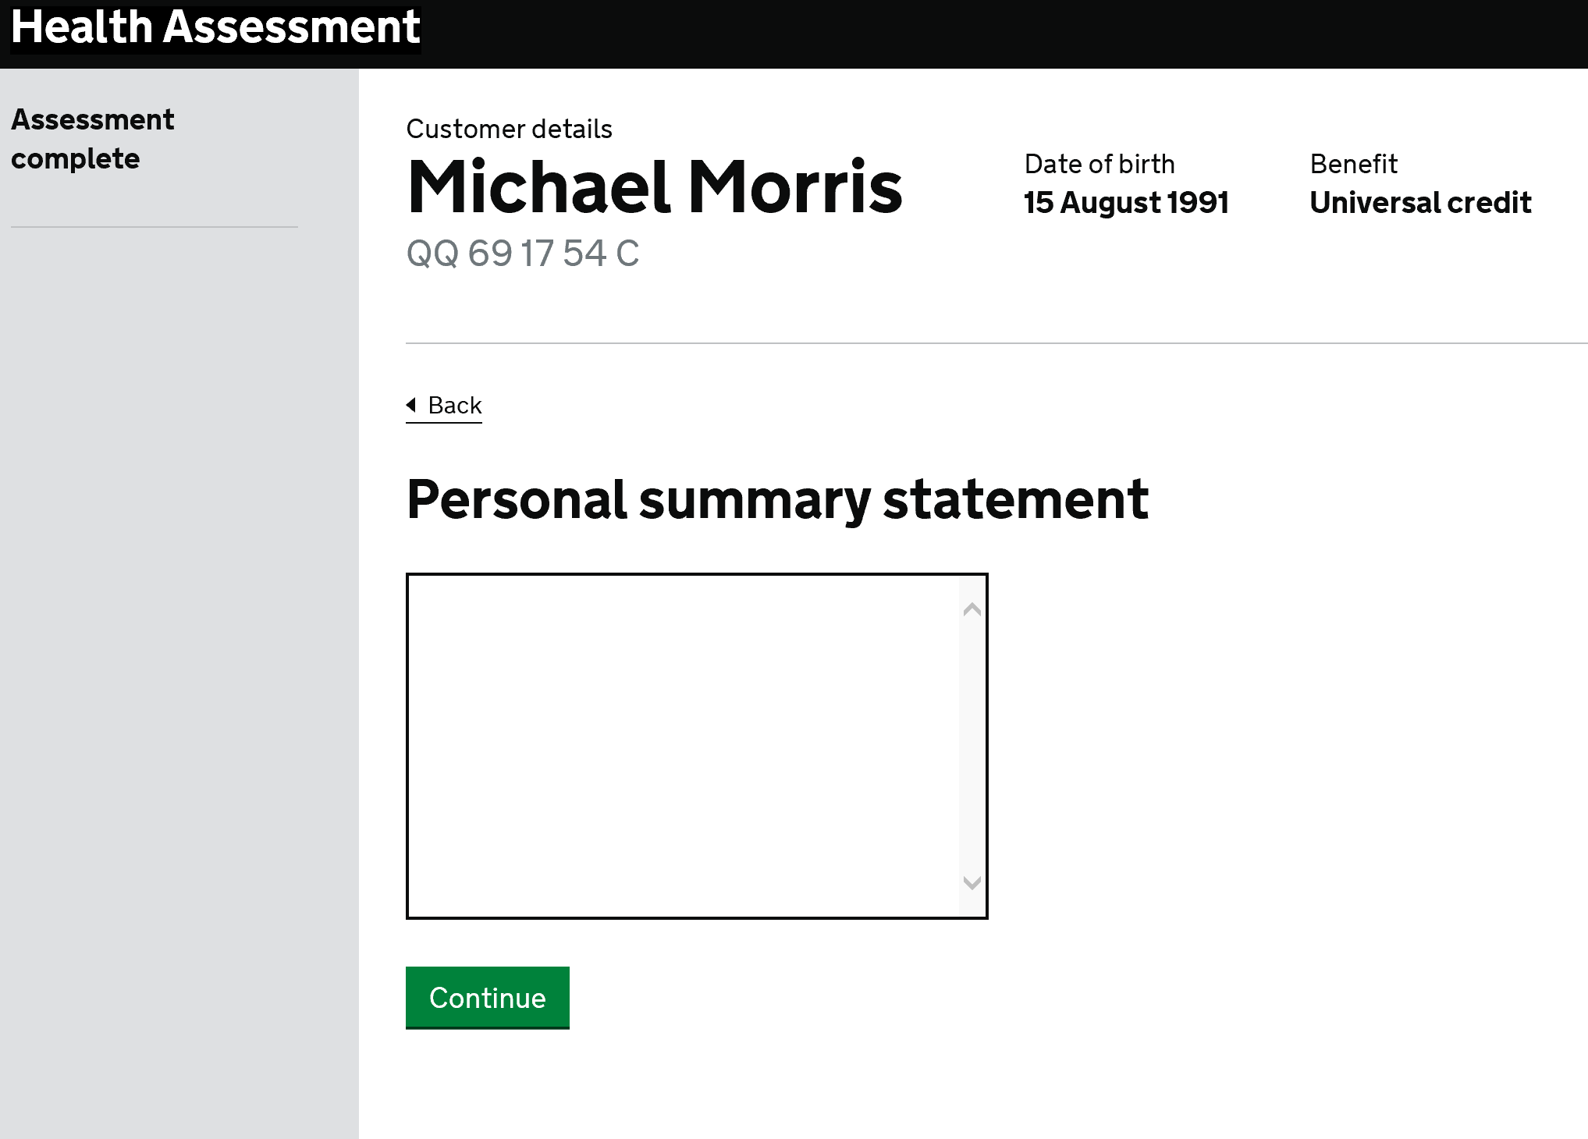
LCWRA user research in Tresco House on 16 September 2019
Personal Summary Statement (PSS)
Users reacted badly to being presented with the PSS after completing tagging and justification
Users’ confusion was increased!
“I feel annoyed at this!”
“Now I’m confused!”
“So now it’s the PSS??”
“I would copy and paste! What we did was enough for the PSS!”
“I’ve already done this, I would just state I’ve done before”

Slide 10
LCWRA user research in Tresco House on 16 September 2019
Personal Summary Statement (continued)
One user also pointed out that in HTDS they currently have to complete the PSS from memory and consequently “we don’t want to do both justification and PSS!”
It transpires that users in Private Beta are using Word docs and all sorts of workarounds to complete the PSS
Users emphasised that they would want to see all of the previous narratives at this point and not just selected statements
Notes:
HCPs bring together Condition History, Typical Day, exams and observed behaviour in PSS

Slide 11
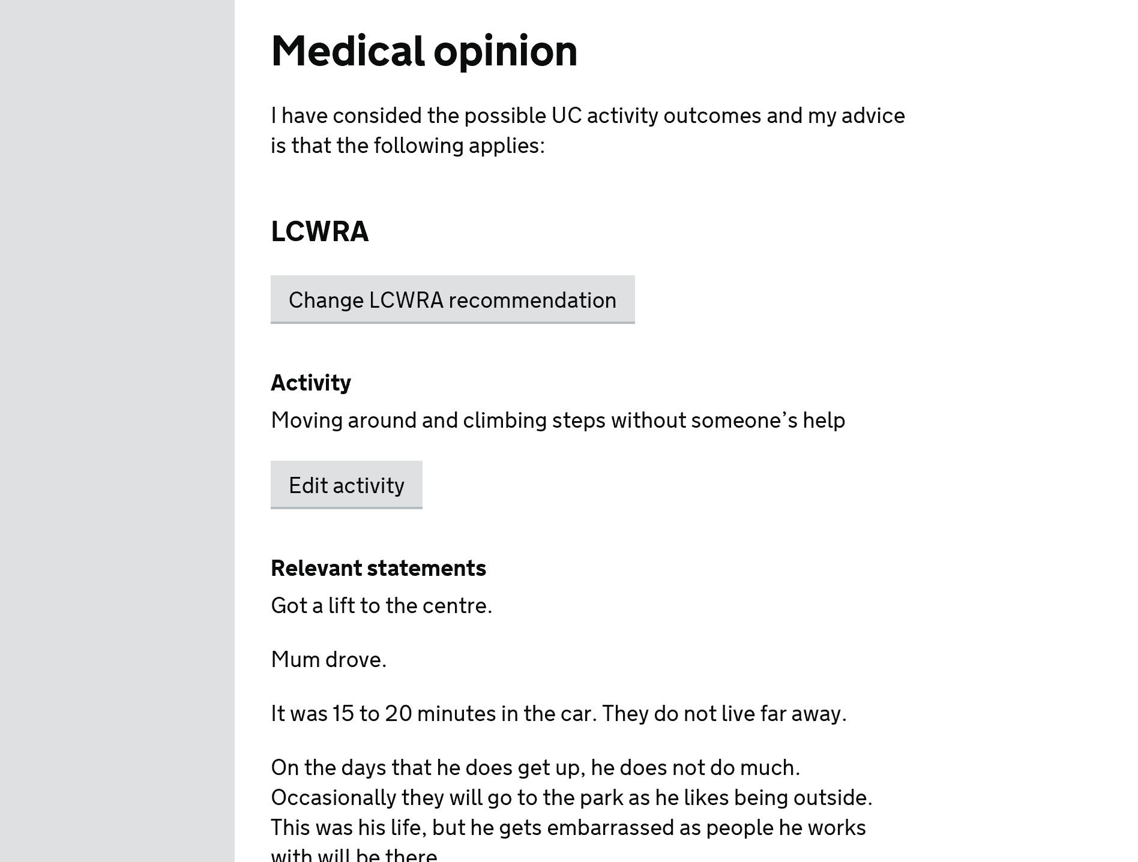
LCWRA user research in Tresco House on 16 September 2019
The report
There were a few concerns around the report with one HCP pointing out that a standard LCWRA report would not be as detailed as the one we had shown here
The same user also pointed out that they would have to cover all medical conditions and descriptor choices (other than the one chosen for LCWRA) otherwise they would have issues with Audit
Still a bit of uncertainty as to whether the need to edit LCWRA choice and activity was actually a genuine requirement*
Notes:
KIV that reporting standards have been an issue in Private Beta to date. Our scenarios were very simple. Reporting separately on Audit research. Nina looking into final bullet point. *This will remain until the audit side of things has been worked out.

Slide 12
LCWRA user research in Tresco House on 16 September 2019
Conclusions
Justification via tagging doesn’t work in a proceed to LCWRA scenario
Need to remove tagging option from this flow
Need to remove justification step from this flow as it is confused with PSS
Possibly remove “give details” from prognosis page (subject to further checks)
All of this is set against a backdrop of users needing access to full Condition History and Typical Day etc when completing the PSS/justification
Need to keep in view that HCPs will typically be dealing with more complex cases and sight of what they have already written is critical
Notes:
Context that this was admittedly a small scale test but tagging confused users.

Slide 13
LCWRA user research in Tresco House on 16 September 2019
What good looks like…..
HCPs will understand that replying “no” to the guard question will take them down the standard assessment route
HCPs will understand the requirement to reference consultation with another practitioner in certain cases
HCPs will then successfully navigate the curtailment flow through to the report
HCPs will understand the word “curtail” and, if not, will present us with more meaningful alternatives
HCPs will tag statements without prompting
HCPs will spot the surfaced tagged statements (or hit the hyperlink) and use them as an aide memoire to help them complete their justification for LCWRA
We will see that using tagged statements can help HCPs complete the justification for the chosen descriptor
HCPs will complete PSS without confusion and without unnecessary duplication
Notes:
Green = good, amber = mixed, red = didn’t work! The supplementary need here is to see what has previously been completed in Condition History, Typical Day etc.

