Slide 1
User research summary – Authentication as a Service
May 2020
Research conducted on version 1 of the prototype
Link to prototype - https://citizen-2fa.herokuapp.com/start
username: citizen-2fa
Passwords: af2-nezitic

Slide 2
Contents
Methodology and recruitment strategy
Demographics
Headline findings
Detailed findings
Next steps

Slide 3



Recruitment and Methodology
Mirror screening and telephone interviews: Happy path only
Remote research
Recruitment Methods
Via Simple Usability
https://citizen-2fa.herokuapp.com/research
citizen-2fa
af2-nezitic
Icons made by <a href="https://www.flaticon.com/authors/freepik" title="Freepik">Freepik</a> from <a href="https://www.flaticon.com/" title="Flaticon"> www.flaticon.com</a>

Slide 4
Demographics
Eight users spoken to 5F, 3M Age range 21-58 1 User affected by bi-polar All digitally capable All with recent experience of DWP (7 online) Widely dispersed geographically: Wales, Scotland, London, Yorks, Bristol

Slide 5
Headline Findings
All pages tested well for comprehension
Email content tested less well (difficult testing conditions)
Users are highly appreciative of having email and mobile number playback
Participants spontaneously express positive sentiments around security BUT where security restrictions are not made explicit they complain: e.g. about specificity of error

Slide 6
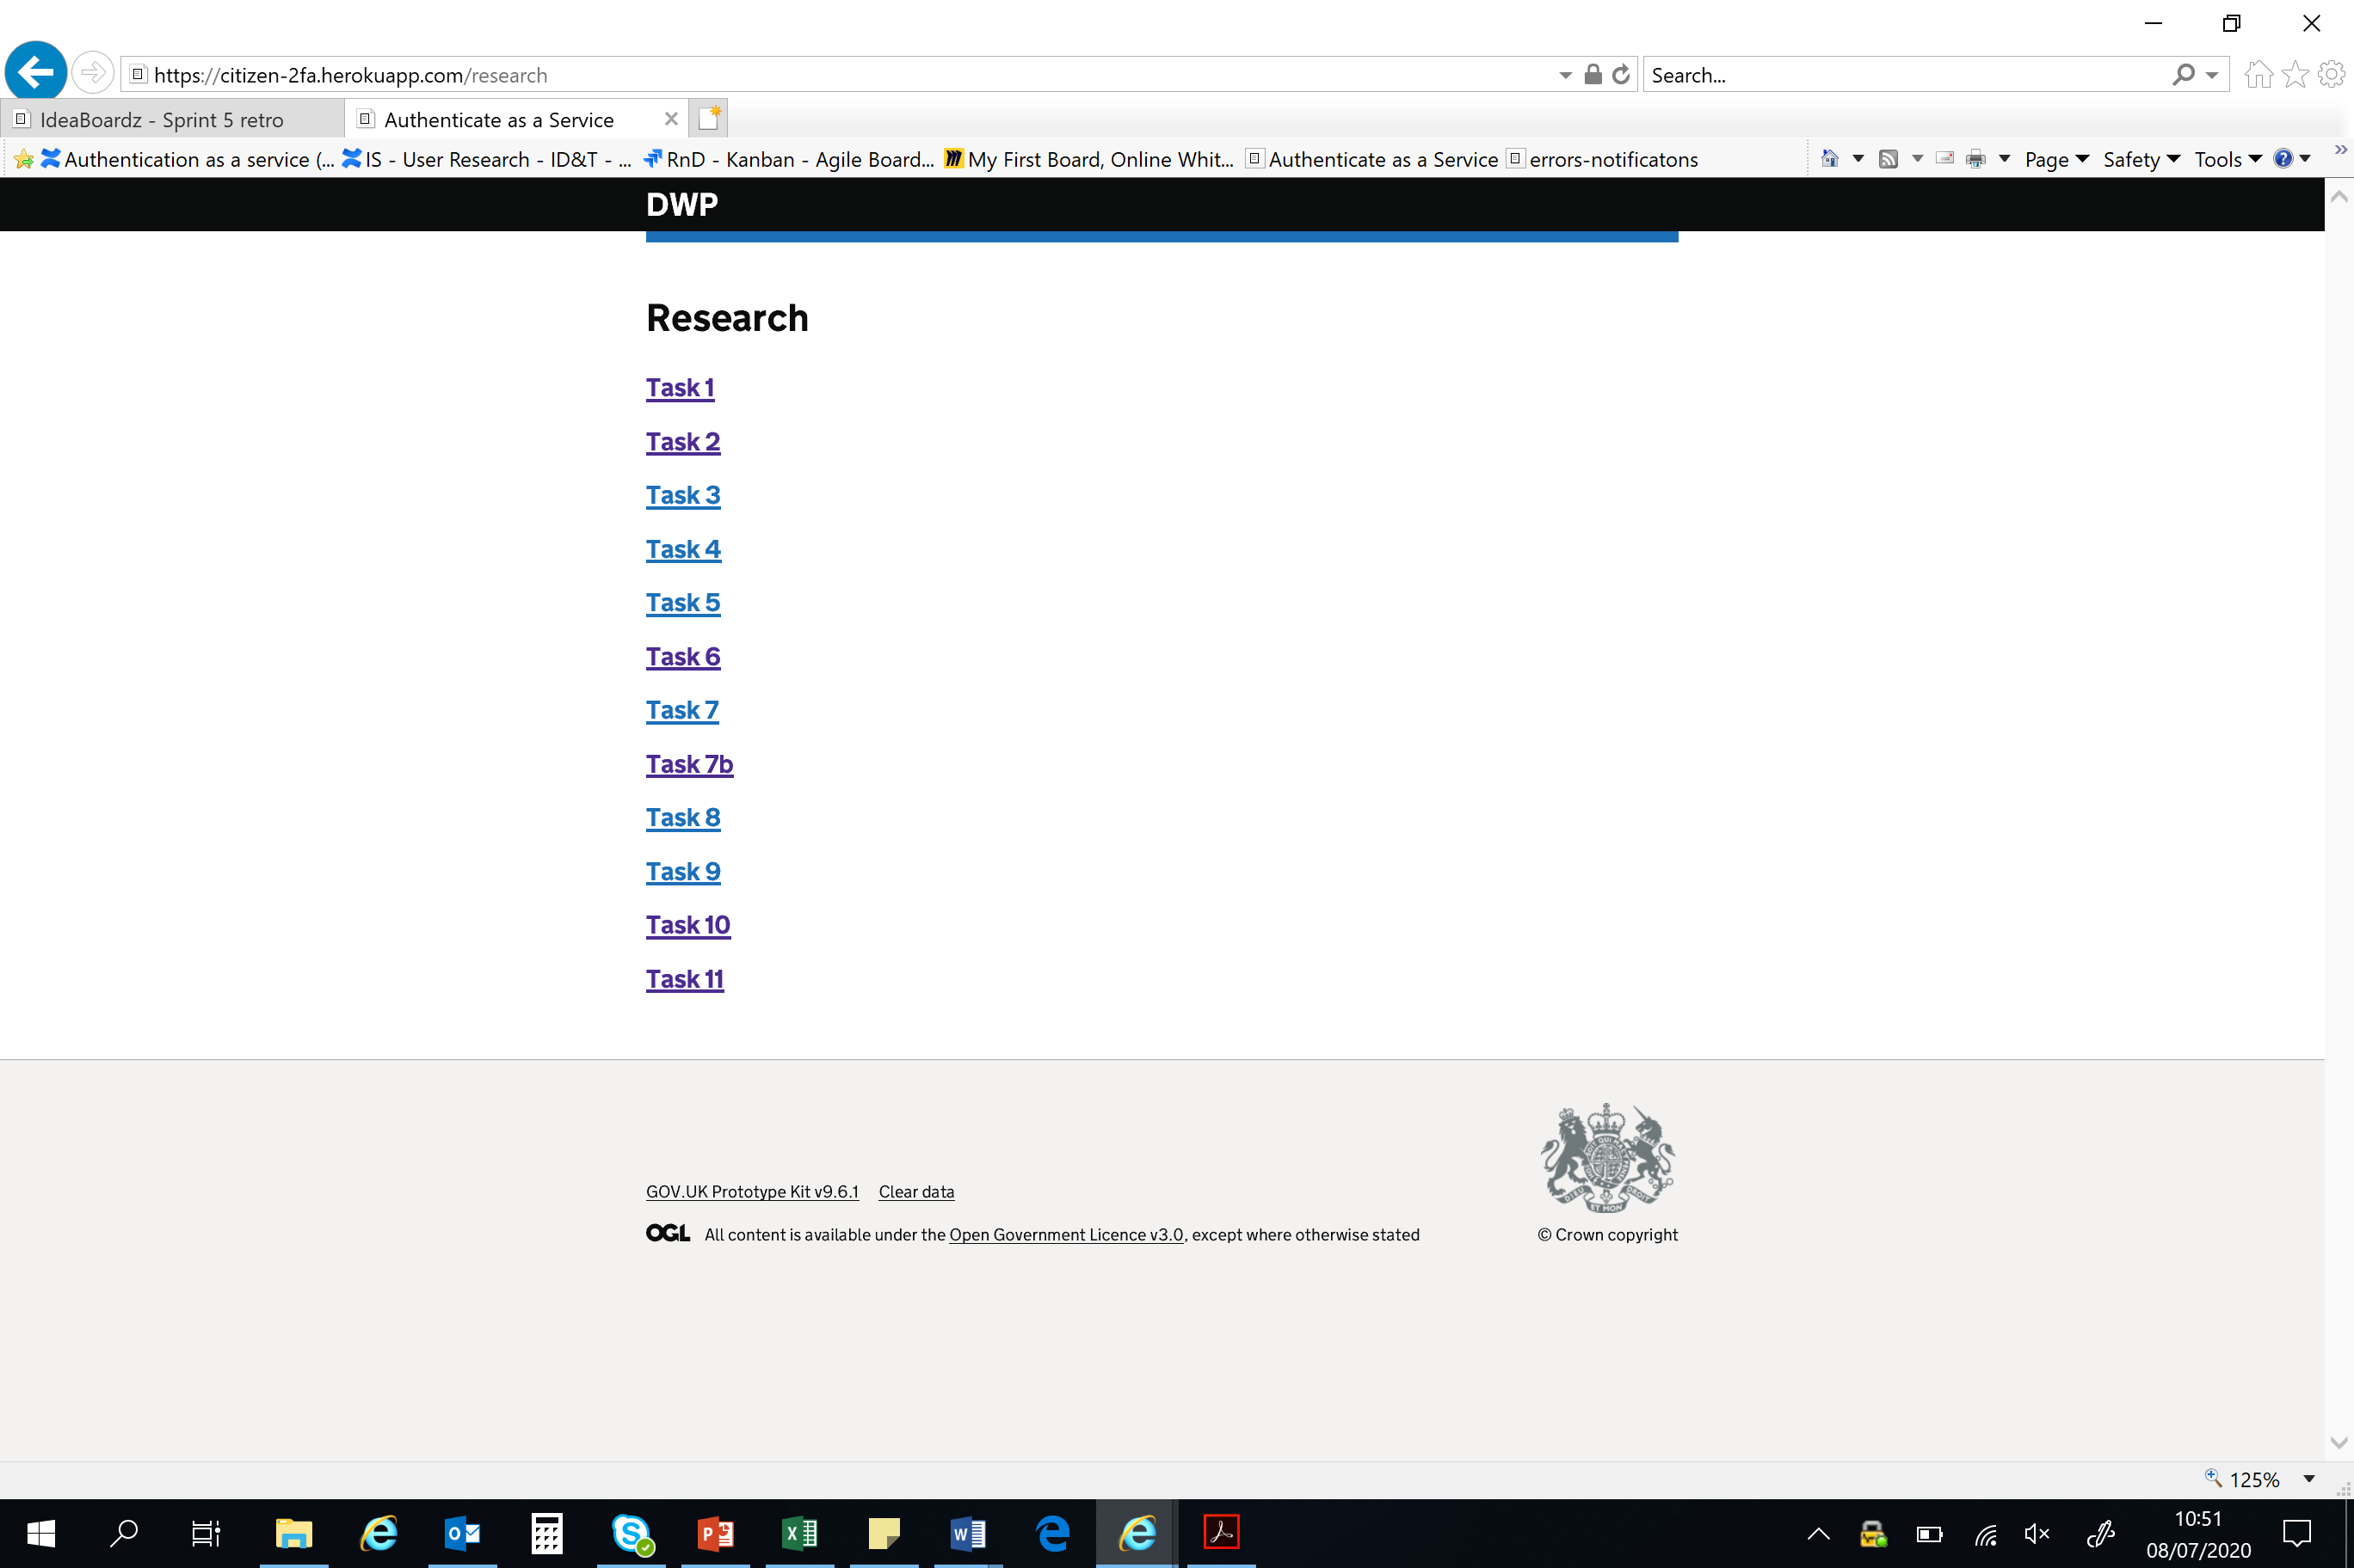
Detailed Feedback
We set up a standalone task list:
https://citizen-2fa.herokuapp.com/research
citizen-2fa
af2-nezitic

Slide 7
Tasks
Task 1 Registration journey
Task 2 Sign in journey + interstitial page and sign-out
Task 3&4 Sign in “There is a problem”
Task 5 There is a problem - Phone number error
Task 6 There is a problem – Codes to not match
Task 7 There was a problem – we’ve sent an email
Task 7b Email content
Task 8 There is a problem – security code expired
Task 9 There is a problem – security code not matched
Task 10 Time out modal
Task 11 Registration stopped – timeout

Slide 8
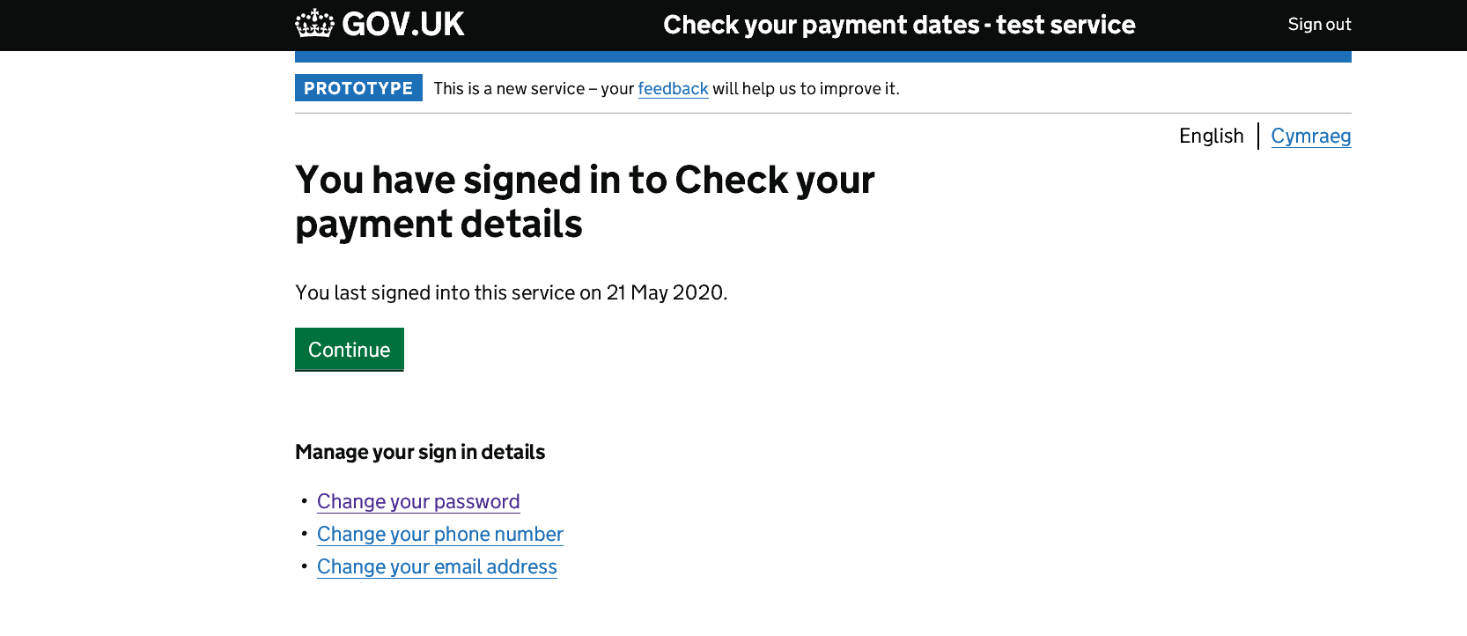
From Task 2 Interstitial page – previously untested
8/8 fully understood
5/8 spontaneously mentioned usefulness of last sign in: for security and self-organisation
3/8 mentioned past changes of phone/email
P31 wanted a single account management link
P38 suggested account management options should be on all pages

Slide 9
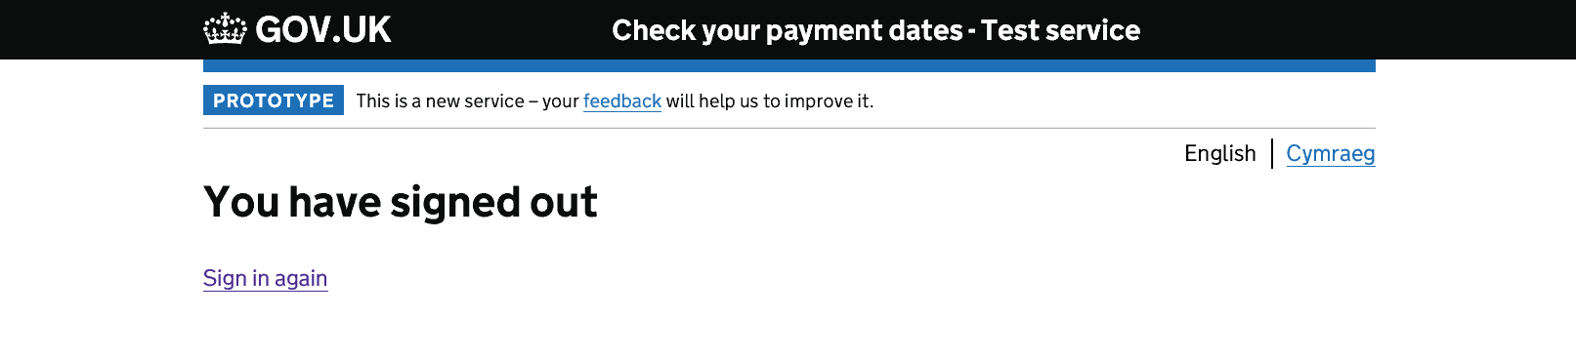
From Task 2 Sign out page – previously untested
8/8 fully understood
P32 “It’s not awkward or any problems: smooth and efficient”
2/8 appreciated ability to sign straight back in

Slide 10
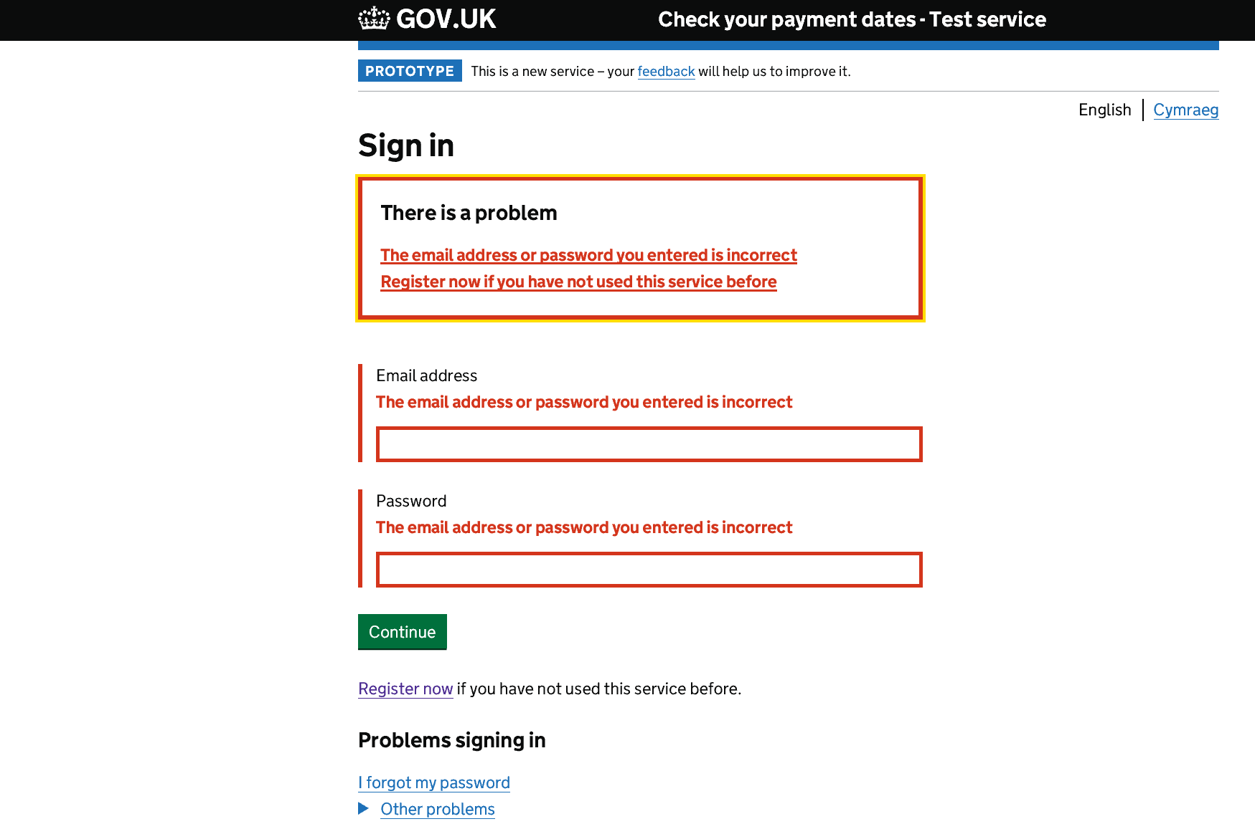
Task 3 Sign in: Incorrect email or password
4/4 Fully understood
P31 & P32 wanted explicit reason for failure
(ie 2/4)
P31 was confused by hyperlink in validation text
P33 “It’s like other messages I’ve seen elsewhere”

Slide 11
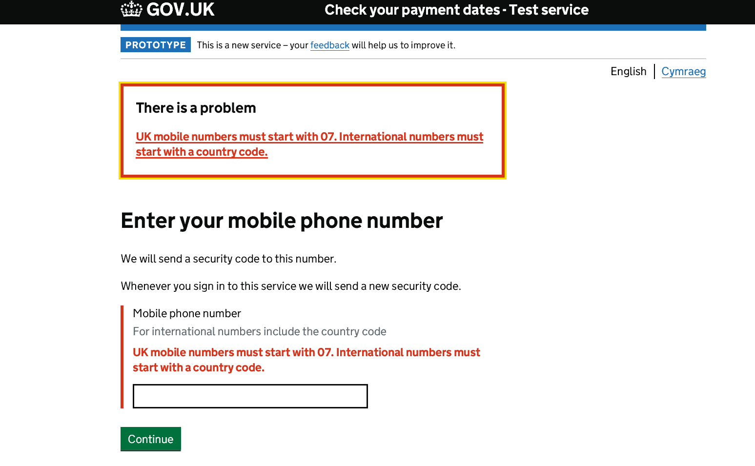
Task 5 There is a problem: phone number
¾ confused by international numbers
(out of context)
P33’s iPhone auto inserts +44. She routinely deletes this manually
P33 thought +44 was fro numbers outside London: “foreign”
P32 “Country code confused me a bit”

Slide 12
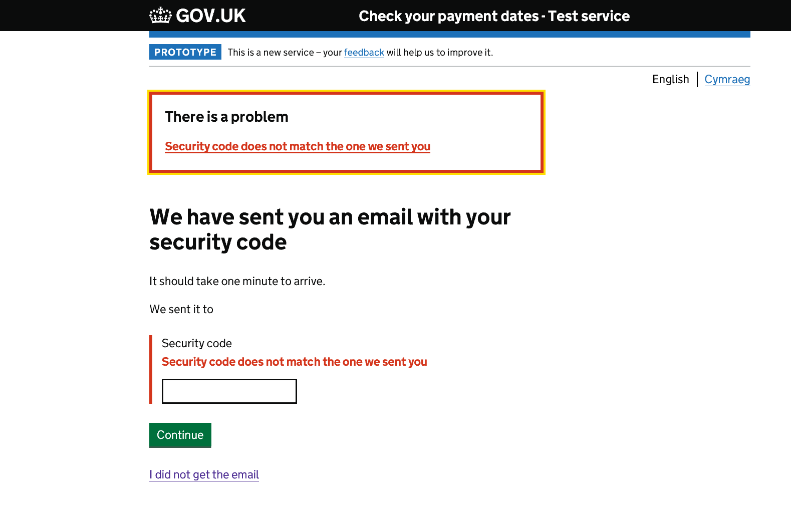
Task 6 There is a problem Codes do not match
3/4 valued email address playback
P34 did not see “I did not get the mail” link and suggested he’d use back button
4/4 understood the page and were able to use successfully
P32 “If I see an error there [email address] I know something’s not right”
Notes:
On resend-email page P34 interpreted “this is the wrong email address” as an advisory relating to his input not a link. Ie, whatever was displayed as his email, he’d interpret that as being “the wrong email address”.
If the policy decision is to not play back emails, then this is immaterial.

Slide 13
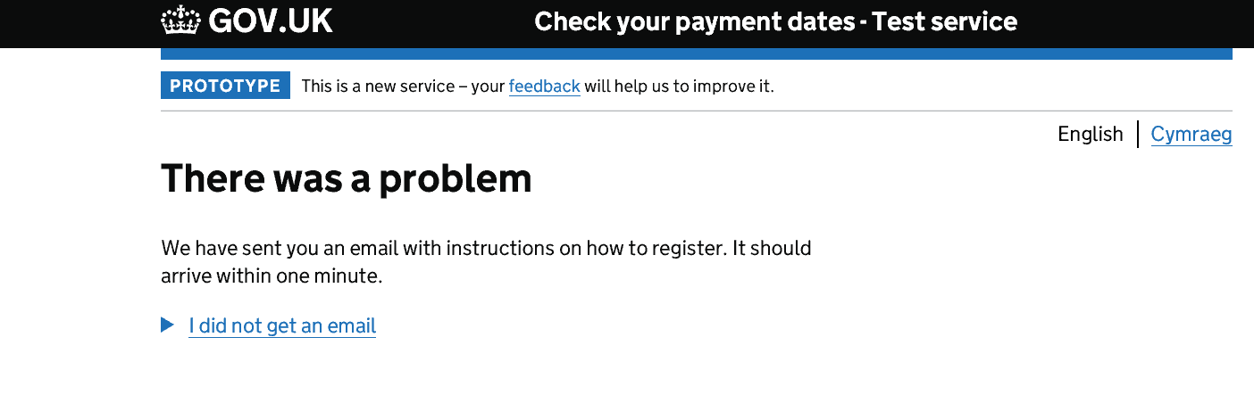
Task 7 There was a problem (sign in) email sent
4/4 Understood and used without issue
P32 “It’s good to know there’s a back-up and you’re not hitting a brick wall”

Slide 14
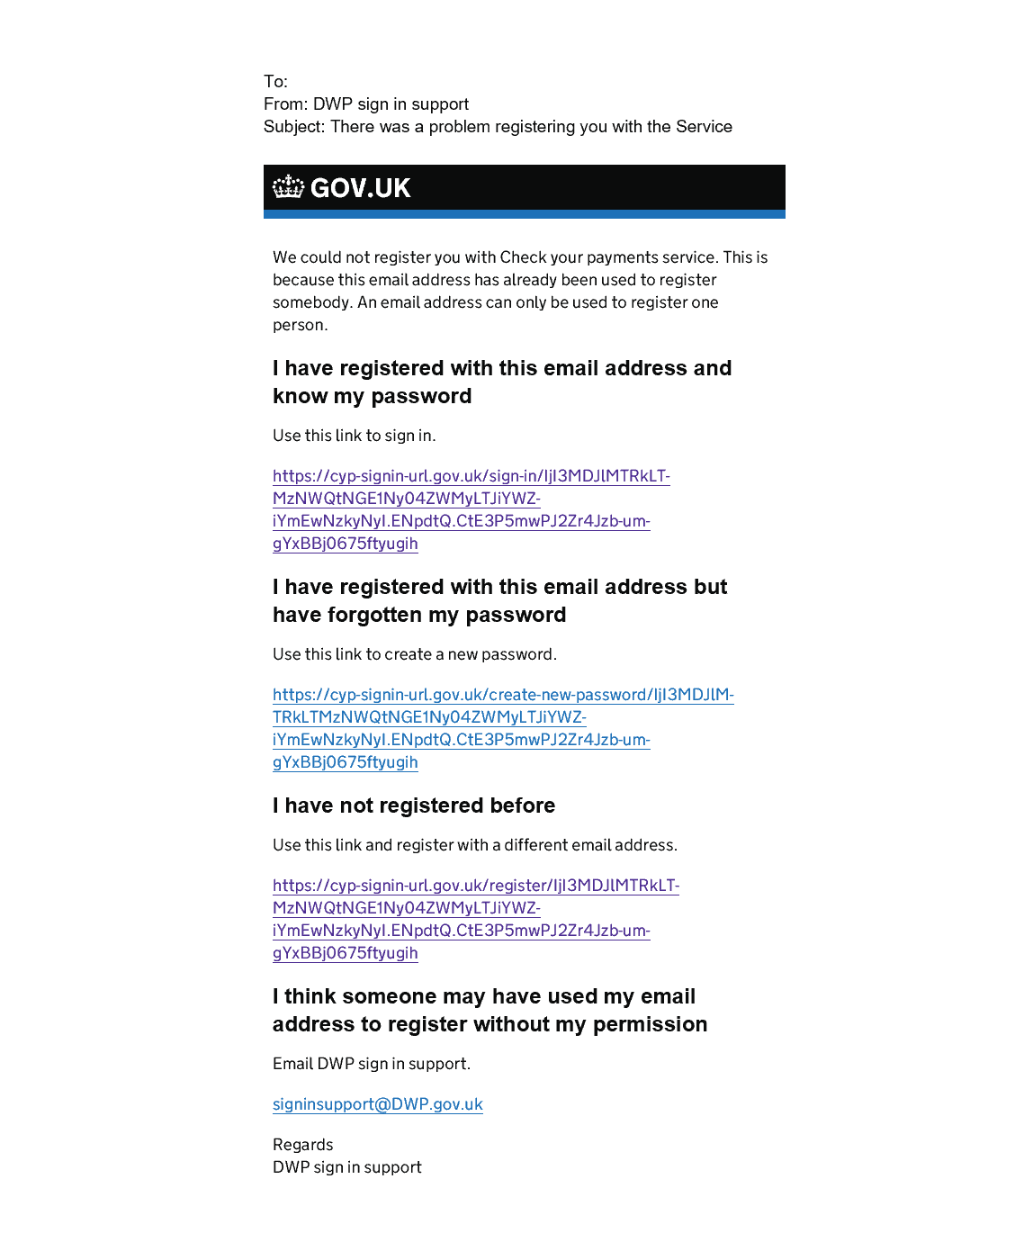
Task 7b Email content comprehension
Tested problematically: possibly due to testing methodology
P33 & P37 had trouble with sign-in support link– see notes
4 possible scenarios identified, but without a specific context it was impossible to fully assess
P32 “It covers all options, it's trying to lead you along the correct path and holding your hand, not treating you as stupid”
Further refinement required - content
Notes:
P37 suggested her default email setting would be problematic for generating an email from the sign-in support link
She also pointed out it would be difficult to copy and paste (her preferred option) in its current form
P33 did not recognise that the sign in support was a link

Slide 15
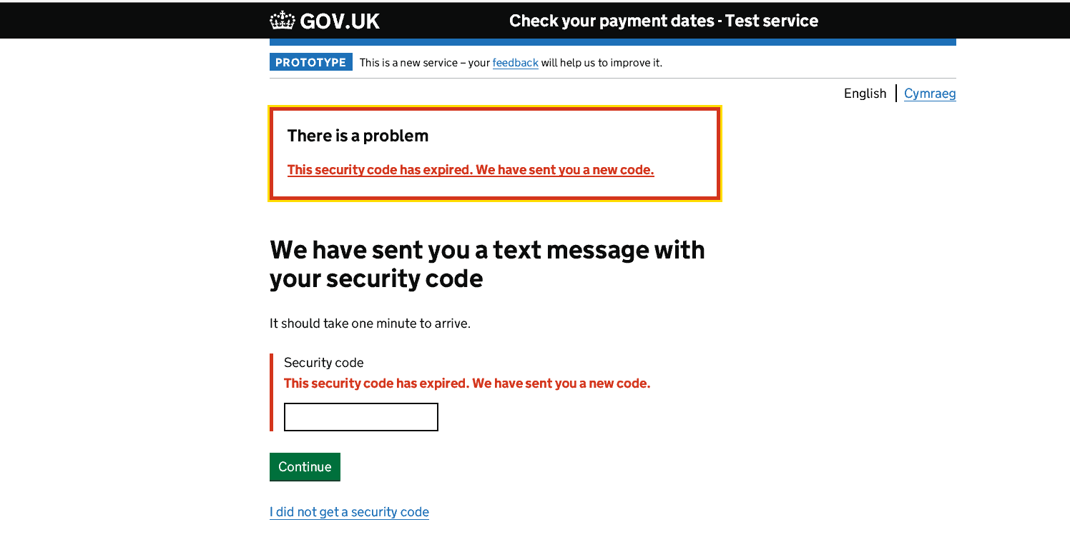
Task 8 There is a problem code has expired
4/4 fully understood
P36 “It’s in layman’s terms. That’s good”

Slide 16

Task 9 There is a problem Codes do not match
4/4 fully understood

Slide 17
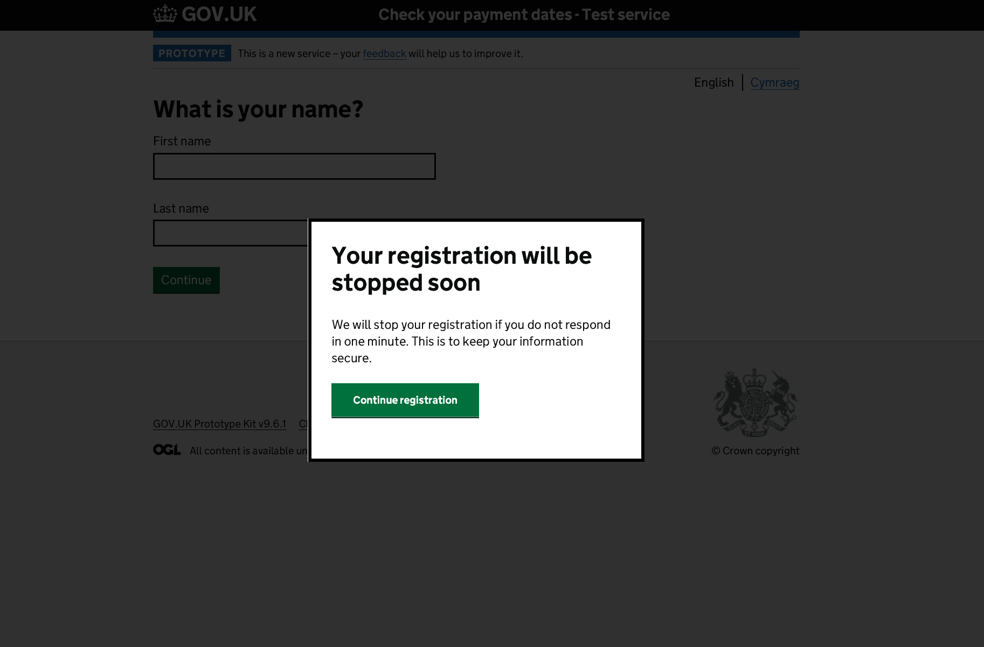
Task 10 Time out modal
4/4 fully understood and appreciated
P37 & P38 expressed reservations about wording
P36 “This is a really good security feature”
P38 “This would send me into a panic that
they're going to stop everything” [ie full registration]
Further refinement required - content

Slide 18
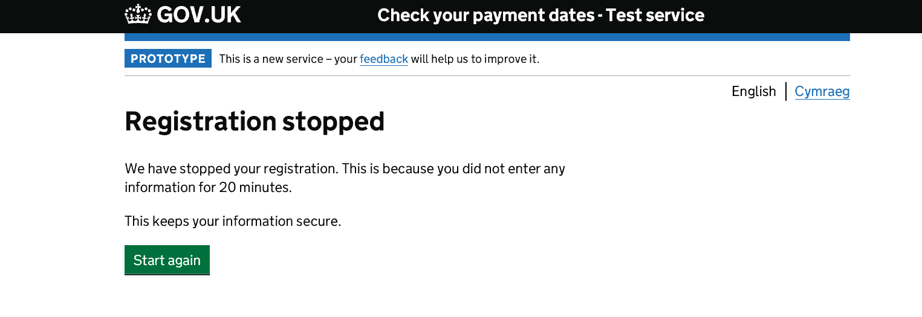
Task 11 Registration stopped
4/4 fully understood and appreciated
P37 observed there is no indication of whether input has been saved
P37 “It’s like being told off for not doing your homework”

Slide 19
Additional observations
P33’s iPhone auto-creates passwords. This may be problematic and may need to be disabled – to check with security
P34’s difficulties with password creation were odd as well as profound. They seemed to be resolved once he’d refreshed the browser window. He reported a similar issue with a live .gov service so this is one to watch
Users appeared appreciative of security measures – but only where these were familiar to them or obvious. Unexplained security restrictions tended to provoke complaint e.g. not knowing whether a password or a username is incorrect. This needs thinking about.

Slide 20
Next iterations
Possible content revisions to email
Possible softening of language around time out
Removal of email and mobile playback & related error messages

Slide 21
Methodological observations & research debt
As per previous – covid limitations apply

