Slide 1
Digital Self Service User Research Overview
Sept–Oct 2020 will.turner@dwp.gov.uk
Prototype: https://dth-prototype.herokuapp.com/
username: dth
Passwords: htd

Slide 2
What this deck is for
To summarise the research findings on the Digital Self Service project to date.
See Confluence link to sprint by sprint reports and original notes
https://confluence.service.dwpcloud.uk/display/IDNT/CxP+User+Research

Slide 3
MVP brief for Digital Self-Service
Digital Self Service: CxP will design and build a Digital Self Service Citizen User Interface (DSS Citizen UI) enabling a customer to self-serve simple, routine enquiries online: Next Payment date and amount data
https://confluence.service.dwpcloud.uk/display/IDNT/CxP+Home?preview=/175294547/176915701/CxP%20Terms%20of%20Reference.docx

Slide 4
MVP assessment from UR perspective Oct 2020
The MVP meets user needs in certain use cases, notably where users have limited capacity to recall dates and payments.
The date and payment information conveyed in the MVP are necessary components of any more developed service, e.g. one that explains the breakdown of awards or payments.
Notes:
Note – in the case of PIP and ESA claimants, participants are apt to treat next payment and previous payment as the same thing. This isn’t surprising as those payments are highly consistent.
BUT there is nothing inherent in “next payment” specifically that makes it a precondition for any more developed service features. As long as that information is current, it will give the necessary point of reference.
Ie Our assumption in is that for more developed versions of a service, it appears that ‘next payment’ information could be substituted for ‘most recent payment information. This has not been explored, since cuts against the grain of the MVP project direction.

Slide 5
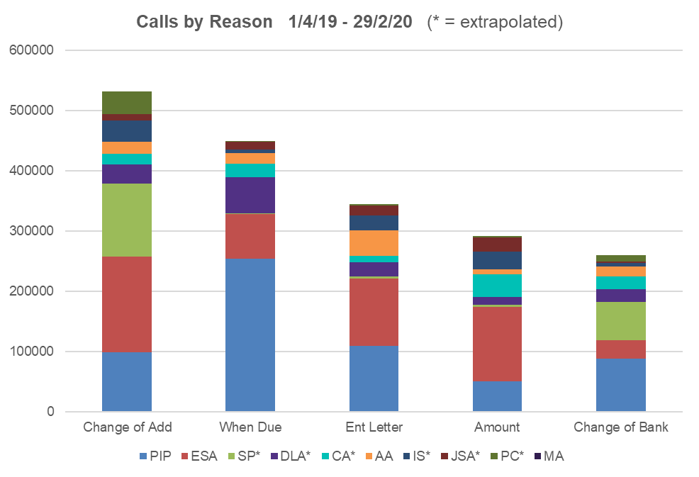
The business driver: calls
Data from CC https://confluence.service.dwpcloud.uk/display/IDNT/CxP+CCI+Data+and+Analysis
Notes:
Although they’re free to callers, DWP has to pay for calls. And they have to pay to service the calls as well.
Waiting times for callers are up to 40 minutes… DWP are paying for those dead minutes!!!!
Key observations:
ESA claimants more concerned with the amount being paid 124,017/291000
PIP claimants relatively more concerned with when payment is due to be made: 254,371/ 440,000
Note that we have heard repeatedly that callers phone in with a bundle of queries. There is no one-to-one marriage between call numbers and, for example, the demand to know next payment date. That may just be a factor of the way call handling staff categorised calls.
Routine correspondence for things like change of address, and change of bank warrant attention in their own right.

Slide 6

UR direct Engagement
Four rounds of interviews with a total of 27 PIP/ESA claimants (Sept-Oct 2020)
Iterating prototype designs whilst capturing ‘continuous discovery’ observations
Round 1 focused primarily on User Needs
Round 2 focused primarily on UI
Round 3 focused primarily on iterated UI, specifically Benefits Summary presentation
Round 4 focussed on iterated UI
https://confluence.service.dwpcloud.uk/pages/viewpage.action?spaceKey=IDNT&title=CXP+User+testing
Participants recruited via Simple Usability

Slide 7
PIP and ESA claimants we spoke to
DWP Inexperienced
Less capable
More capable
DWP Experienced
Notes:
This is for illustration only – the point is, we’ve not really spoken to many people who are not already well into a relationship with DWP.
We have not explored new claimant activity at all. It is possible that there will needs in this area.

Slide 8
User need 1
People needing to be reminded of their regular payment dates and/or amounts
"For me, I'm always saying, ‘When does my money go in?’ My memory's really shocking, I blame it on the meds….I never leave contacting them more than a couple of months. I’m paranoid about it…” R6
“With the medication I'm on, I've got a tendency to forget so I use the reminders on my phone… I just check my bank account really to make sure I've got the right date.” R20
“I haven’t a clue [when payments are made]” R14 [memory impaired]
Notes:
Not articulated directly – but the need a this extreme is for a proactive ‘push’ notification – not in scope, but a logical extension of MVP.
“Future payments are more important [than past payments] so you know what you might be getting” R3
Note that it is PIP claimants who make up the majority of calls about payment date. This warrants its own line of enquiry, beyond what we’ve heard so far.
“It always falls a little different, so if it's a weekend it can be paid on a different day… I you have 5-week months your payment day can move, so it would be useful to see roughly when a payment is due.” R7

Slide 9
User need 1
As someone who struggles to remember my payment date and amount
I need a way to access that information repeatedly
So that I can organise my finances proactively
Notes:
Not articulated directly – but the need a this extreme is for a proactive ‘push’ notification – not in scope, but a logical extension of MVP.
“Future payments are more important [than past payments] so you know what you might be getting” R3
“It always falls a little different, so if it's a weekend it can be paid on a different day… I you have 5-week months your payment day can move, so it would be useful to see roughly when a payment is due.” R7

Slide 10
User need 2
People for whom telephony is inadequate
"I like to do everything on line, so I wish I could do it online, I don't like speaking to people, I find it very hard. I prefer the least contact possible - it's a phobia I have with phones… R3
“When your head's all over the place, you don't want to be waiting on the phone... This is a lot better, then you don't have that contact.” R14
“I had to ring them to find out why I was getting JSA as well as ESA.
I noticed both payments on my banking app. I panicked and had to ring
them, I had a total meltdown” R5
Notes:
R14 cognitive impairment affecting memory + anxiety
The point about the R5 quote is that it was the telephone call, and the stress associated with it, that triggered this person’s ‘meltdown’.

Slide 11
User need 2
As someone who is unable to communicate over the phone
I need another way to find out about my next payment
So that I can manage my finances
Notes:
Telephone exchanges require immediate recall and responses – some struggle with this e.g. medicated users (R1 R6), highly agitated users (R5), and those who are easily fatigued (R1, R3).
Two respondents talked in terms of difficulty working at different times of day and the benefit of a facility that was available out of hours.

Slide 12
User need 3
People with sight issues for whom letters are not accessible
As someone who is unable to see well enough to read printed material
I need another way to find out about my next payment
So that I can manage my finances
Notes:
We’ve heard that letter are particularly poor for sight affected users who are much better equipped to read online using their screen readers.
We’ve also heard that letters are easily lost. Only the most super-organised keep all their correspondence and are able to refer to it when they need to, and to access the information they need to find when they do so. In short: letters are hard to retain, difficult to store hard to search through.
We’ve also heard, in practice, that letters are slow to arrive – often arriving after a change in payment has taken effect.
They’re also routinely described disparagingly as triggers for anxiety. We’ve heard accounts of people ignoring them altogether because theya re so scary.

Slide 13
User needs 4
People requiring a comprehensive overview of their award & payment
“It would be brilliant for you to show the breakdown. That's why I had to call PIP, because I've moved from London… I've got a blue badge and I had to have all the components of the claim, the award, the points etc.
I had to call them to find out everything.
That was stressful. If it was here, and it told you the points system, that would be really helpful and you could screen shot it.“ R14
Notes:
BUT note – this is not about MVP. This is not even about ‘next’ anything, other than the generic proof of a ‘promise to pay’ that an award comprises
We heard from several people that letters are hard to manage – they get lost or thrown away, the information within them is hard to dig out etc…

Slide 14
Users’ payment needs (from Sept 7th 8th)
Users need persistent, reliable and accessible help to know their benefit payment amounts and payment dates
So they can manage their household budgets
Users need to be able to understand why their payments are as they are
So they can manage their claim effectively
Users need to know why any changes in payment will occur in advance
So they can plan their budgets and/or challenge the change
So that they are not forced to react to an unannounced change in their income
Users need to be confident that any change/unusual payment is not an error
So that they can make an informed decision about what to do with the money
OR So they get the money they are entitled to
Notes:
At least two participants told us about their experience of errors (R3 R5) they’d be inclined to check any irregularities against a forum or some such to see if it was just them or a general change

Slide 15
Beyond MVP

Slide 16
‘Nice to haves’ 1
Potential other needs/features that have been identified require more detailed interrogation. They include:
Push notifications of forthcoming payments and dates
A means to share information with third parties: letters of entitlement
A list of all current benefit payment dates and amounts including UC
Copies of correspondence
Notes:
We heard a lot about the need to share information with third parties: Blue Badge, housing, Drayton Manor theme park!
Going back to that graph of calls – between PIP and ESA there were something above 220,000 calls about/for a LoE

Slide 17
‘Nice to haves’ 2
Potential other needs/features that have been identified require more detailed interrogation. They include:
Breakdown of award categories
Breakdown of payments associated with award categories
Award start date
Next assessment date/end date
A view of past payments
Notes:
This list is not exhaustive

Slide 18
Nice to haves 3
People seeking clarification of an adjusted award in light of a change of some sort
“I had to ring them to find out why I was getting JSA as well as ESA.
I noticed both payments on my banking app. I panicked and had to ring
them. I had a total meltdown” R5
“The reason Iʼd be on here is if itʼs not come or the amount is different.” R17
“The £10 bonus might have been at Christmas; I can't remember because of my meds. It was a bit random… I don't have the time for randomness." R1
Notes:
This can include erroneous payments, and repayments
We continuously heard spontaneous ‘explanations’ that cited DWP errors. There is an expectation that DWP make errors quite routinely.

Slide 19
Nice to haves 4
People seeking clarification of an adjusted award in light of a change of some sort
“I had to ring them to find out why I was getting JSA as well as ESA.
I noticed both payments on my banking app. I panicked and had to ring
them. I had a total meltdown” R5
“The reason Iʼd be on here is if itʼs not come or the amount is different.” R17
“The £10 bonus might have been at Christmas; I can't remember because of my meds. It was a bit random… I don't have the time for randomness." R1
Notes:
Much of this activity takes place retrospectively, BUT much of it describing the lag between one event and actually being paid. There is scope for a ‘next payment’ service to answer some of those questions – albeit not evidenced above.

Slide 20
Additional observations and insights
Users expect to be able to do everything online
Users expect online to be two way, ie user input, update capability etc
Couples talk about jointly managing a claim
Anxiety materially affects some participants’ engagement with DWP
Users routinely expect errors on the part of DWP
Out-of-routine events tend to trigger user engagement ie calls
Many users are keen to see the detail of their award
Much correspondence is to request ‘proof of benefit’ for third party organisations - letters of entitlement
When security features are explained they are accepted positively
Users anticipate 24/7 availability of information
There are very different information requirements from different users
Users expect payment information to be definitive

Slide 21

Anxious PIP claimant: Working archetype 1
Characteristics
Incapacitated Adult
Highly anxious
Nervous of DWP engagement
Attention/energy limited
Gets assistance (carer, partner/3rd party)
IT capable to 7/10 on DI scale
Literate to reading age 11
‘Disorganised’
Reactive, responding to DWP on short term/urgent basis
Resigned to government bureaucracy
Entirely financially dependent on DWP benefit payments
Key emotions:
Fear, anxiety, uncertainty
Needs
Headline Information
Reassurance
Accessible services
Signposting
Help
Breaks
Obstacles
Poor DWP signposting
Telephone issues
‘Dreaded brown envelope’
Notes:
Headline information is pretty much “payment dates and amounts”

Slide 22

Comfortable PIP claimant: Working archetype 2
Characteristics
Incapacitated Adult
IT capable to 8/10 on DI scale
Literate to graduate level
Self-confident
Unafraid of DWP engagement
Organised and informed
Proactive in terms of claim management
Activity planned and attended to in detail
Resigned to government bureaucracy
Only partially dependent on DWP benefit payments
Key emotions:
Self-confident, impatient, wary
‘Needs’
Detailed Information
Accessible services
Signposting
Detailed information
Obstacles
Poor DWP signposting
Timing of calls

Slide 23
Recommendation based on UR (Oct 2020)
Proceed with MVP development and iterate to establish feasibility of addressing additional/secondary needs.
Further research is required to fully inform our understanding of these needs, not least in respect of users who are relatively new claimants.

