Slide 1
CXP User Research Report from Telephone Interviews 7th & 8th Sept 2020
From prototype v.0 https://dth-prototype.herokuapp.com/
Username: dth
Password htd
Will Turner
15th Sept 2020 will.turner@dwp.gov.uk
See also speaker notes for additional explanatory material

Slide 2

Research objectives
Determine user needs (or not!) for a digital self service offering focussed on providing payment information to PIP and ESA claimants
Establish what (if any) additional information requirements users have in relation to DWP
Obtain initial feedback on working Design prototype

Slide 3

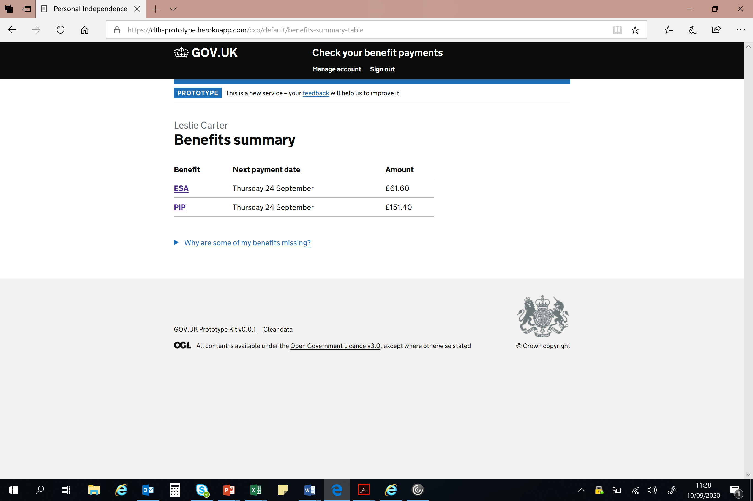
Methodology
8X45 minute telephone depth interviews including discussion of preliminary design ideas
Notes:
This methodology is designed to address WHY & HOW questions

Slide 4

Demographics
8 users
3 male 5 female
1 carer/proxy user
7 using a tablet/laptop/Mac
1 using a phone
All bank online
6 claiming PIP + ESA
2 claiming PIP only
2 claiming/have claimed UC
2 Visually impaired using assistive technology
2 Being treated for anxiety/panic disorders (+ 1 no-show)
7 Recruited via Simple Usability, 1 friend/family member

Slide 5

PIP Claimants’ health
Anxiety is a widespread clinical issue amongst PIP & ESA claimants
(3/8 recruits being treated for anxiety)
Clouded minds
Misreporting
Memory lapses
An inclination to delay, ignore and avoid contact altogether
51% ESA claimants affected by mental health/ behaviour disorder as their main condition
https://researchbriefings.files.parliament.uk/documents/CDP-2019-0005/CDP-2019-0005.pdf
Notes:
People claim PIP because they are ‘incapacitated and/or unwell.
We heard that fatigue is an issue with many of the same consequences (R1)
Last round of research the figure for anxiety/mental health disorder was 5/8 = 8/16
The reason for labouring this is that it has material effects on how people interact with DWP
Cf UR with PIP claimants from Authenticate 5th 6th August
https://confluence.service.dwpcloud.uk/pages/viewpage.action?pageId=179046169&preview=/179046169/179046278/Prototype%20%20v6a%20testing%20August%205th%20and%206th%20PIP%20claimants.ppt

Slide 6

If anxiety was a virus…..
Everyone gets fearful when they get those brown envelopes through the post… I get so anxious“ R1
“I've got anxiety, depression and I panic. I overthink things and panic” R5
“Phobia”, “triggers”, “worried”, “don’t know…” R3,
“This [protoype] is more reassuring than a brown envelope coming though the door. They spark the fear of God into you, they're a powerful trigger” R5
See https://www.ncbi.nlm.nih.gov/pmc/articles/PMC3656338/ on the health impacts of anxiety
Notes:
Since contact from users is often when something unexpected and unwelcome has occurred this anxiety is a live issue for DWP
We’ve heard (twice) reports of the side effects of condition or medication affecting mental acuity/memory R1 R6
We’ve heard (twice) about how managing a claim and payments is a shared activity
And then there are fears around using the technology that we have to be aware of: “Itʼs the fear of locking your account that puts you off logging into your gateway account” R1

Slide 7
Users’ expectations/habitual behaviour
Why can't I do this online? It would be so much better! The sooner the better for something like this [digital self service] for me. It would make my life a lot easier and reduce my anxiety levels…. It would be so much better for me" R1
If I could do that [answer a simple query] online, I would as it would be so much easier and quicker.” R2
“I don't understand why you can't do all this stuff online… You can do all this stuff on PayPal” R3
“You can do everything else online, why can't you use that facility?” R3
“If I could do it online and be confident it's done properly and securely, I'd always do it online” R4
“My first impression is ‘Wow, this would be brilliant !’ because I can do it online without phoning them” R5
“It [online] seems like the way forward…everything is paperless now. It’s much easier”. R6
“If it can be done online it's easier". "If it can be done online and I know it will save a little bit of time I will use it. Going online is timesaving". R7
“If that's all I have to do, it would save me an hour’s wait on a phone on average. God I'd be happy to do that!'. R8
Notes:
The point of adding this here is not to declare these as ‘needs’. They’re here to demonstrate the cultural context in which the research was carried out.
These people are ‘digital first’ - and note everyone we spoke to 8/8 is represented here!

Slide 8
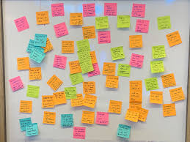
User needs: emergent themes
Life management
DWP claim management
Information about ‘business as usual’
Information about changes
  Notice of unusual payments/missing payments
  Suspected error checking
Timely explanation of why changes/irregular payments occur
  Telephony limitations
  Limitations of letters
Notes:
DWP claim management = Record keeping/information access, specific to DWP
Telephony and letters are here as pointers to evidence that these channels fail to meet user needs in some way
Forums! = Information need
Letters out of date = produce calls!

Slide 9
Life management: regular payment amounts
“I get a statement in February that tells me how much I'm getting in the next year and that's it… like to check it weekly as it's something I like to keep an eye on” R3
“I never leave contacting them more than a couple of months [to check payment amount]. I’m paranoid about it… I want to make sure everything is ok with it…” R6
“Future payments are more important [than past payments] so you know what you might be getting” R3
“What I see here [prototype] is showing what I might need as a user and what I might need to show others”. R8
Notes:
Overview Practical management of all finances relies on knowing what happens when – and in an up to the minute way.
The assumption that just because payments are regular (in timing and amount) users ‘need to know’ what’s going on does not stand. Users make serial calls to NGCC to establish exactly this information (~6% of all calls) – often putting up with long wait times to do so ie – they’re prepared to walk over hot coals to get to this information – they need it!
Future payment information is more valued than past payment information (although both are useful)
Users report wanting to have a view of upcoming payments for peace of mind and for practical budgeting
R2 PIP payment “Every four weeks it goes into the bank like clockwork”
R8 had lots of examples of having to demonstrate DWP status to other organisations

Slide 10
DWP claim management: regular payment amounts
“The payment stuff is useful but the award and background stuff would be more useful so I know what's happening” R4
Re prototype: Itʼs giving me the maths behind my payment, thatʼs quite good” R5
Notes:
Payment amounts are just the tip of the iceberg
Future payment information is more valued than past payment information (although both are useful)
Users report wanting to have a view of upcoming payments for peace of mind and for practical budgeting
Overview Practical management of all finances relies on knowing what happens when.
R2 PIP payment “Every four weeks it goes into the bank like clockwork”

Slide 11
DWP claim management: irregular payments
“I had to ring them to find out why I was getting JSA as well as ESA”
“I noticed both payments on my banking app. I panicked and had to ring
them, I had a total meltdown” R5
“I was worried if I could used that money [£2000 back-pay] in case it was a mistake. I've heard of people spending the money then needing to pay it back. It was 10 days till I found out if I could use the money, it was a long time.” R3
“The £10 bonus might have been at Christmas; I can't remember because of my meds. It was a bit random… I don't have the time for randomness." R1
“I had to call recently because we got money in the account but no letter”. R8
Notes:
It’s the type of stuff you’d type into other things. I have no problem with it. If that’s all I have to do – normally that would 1hr wait on the phone – that’d be great!
I had to call recently because we got money in account but no letter. And I need decision letters to prove stuff. For a day out to prove you’re a carer for example (Alton Towers for example). I know the money’s coming in monthly, it’s there and goes out to pay for certain things. R8
R5 talked about “Itʼs giving me the maths behind my payment, thatʼs quite good”
Users report having had short term, one-off needs to understand irregularities, change of award, or to adapt to changes of circumstance
Note the urgency of their reactions
Some needs are immediate, short term and may be urgent. These are not necessarily the same as those that we’ve talked about in terms of regular payments.
R2 would check PIP site in case there was a general change, rather than something specific to them.

Slide 12
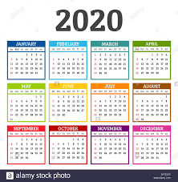
Life management - scheduling
"For me, I'm always saying ‘When does my money go in?’ "My memory's really shocking, I blame it on the meds.“ R6
“It always falls a little different, so if it's a weekend it can be paid on a different day… I you have 5-week months your payment day can move, so it would be useful to see roughly when a payment is due.” R7
“I've got an Excel spreadsheet on my phone to keep track of my finances” R5
Notes:
Note that PIP and ESA are quite regular amounts
We know that changes in bank account are quite common. Users have suggested that being able to update this online would be prefereable to current routes
R1 “I donʼt think thereʼs anywhere online where I can just update my details,
thereʼs letters and addresses but I want to do it online”
“Why canʼt I do this online?”
“It would be so much

Slide 13
Users’ payment needs
Users need persistent, reliable and accessible help to know their benefit payment amounts and payment dates
So they can manage their household budgets
Users need to be able to understand why their payments are as they are
So they can manage their claim effectively
Users need to know why any changes in payment will occur in advance
So they can plan their budgets and/or challenge the change
So that they are not forced to react to an unannounced change in their income
Users need to be confident that any change/unusual payment is not an error
So that they can make an informed decision about what to do with the money
OR So they get the money they are entitled to
Notes:
At least two participants told us about their experience of errors (R3 R5) they’d be inclined to check any irregularities against a forum or some such to see if it was just them or a general change

Slide 14
Telephony issues
"I like to do everything on line so I wish I could do it online, I don't like speaking to people, I find it very hard. I prefer the least contact possible - it's a phobia I have with phones". R3
I don’t understand why I have to ring up to change anything. PayPal does it all online…” R3
Telephone exchanges require immediate recall and responses – some struggle with this e.g. medicated users (R1 R6), highly agitated users (R5), and those who are easily fatigued (R3)
For some speaking to people is difficult (R2, R3)
Previous research has highlighted second language issues
For couples/carers who jointly administer a claim, a telephone call cuts one of them out of the conversation (R2 R7 R8)
Notes:
Telephony here is treated in general terms ie all phone calls. That means the complaints about waiting times is not given as much prominence as users gave it. (DWP could just employ more call handlers). Call waits are a material factor in claimants’ lives, but that’s not what’s in focus here.
A 15 minute was was described as “a miracle” – standard waits appear to be 45 mins to a hour (paid for by DWP!)
Timing of contact is an issue for some (24/7 availability of information was pointed to as valuable.

Slide 15
Telephony issues as user needs
As someone who struggles with social interactions, I need a way to communicate with DWP that allows for my limited social skills
As someone who struggles to think quickly and clearly and to remember things accurately, I need to communicate with DWP at my own pace.
As someone who is in a heightened state of anxiety when I engage with DWP, I need to be able to double check my understanding and any answers I give.
As someone jointly managing a claim, I need to be able to check with my partner/carer as part of any exchange.
So that I do not give the wrong information
So that I can retain and accurately remember what I have been told and act on it appropriately
So that the exchange does not make me ill

Slide 16
Letter issues and record keeping
”For me letters are no good [screen reader for visual impairment] R2
It's easier to do it online because you can't lose anything. I can never find my award to claim half price car tax” R2
“I keep a back-up, certainly with DWP - it can be a nightmare, given my conditions and issues I have when it comes to being reassessed after 2-3 years. It's hard to know where you're going, what you're doing, who you've seen, what to expect… any information that's been given to us, or that you've sent to them.” R7
“I didn't get a letter to explain anything” R3
(change of address is a high call volume generator – Change of address matters disproportionately if correspondence is by letter)
Notes:
The needs identified here do not pay any attention to complaints about the quality/content of specific letters:
“Sometimes they send letters that don't make sense and I have to call to ask what it means” R4
Lots of expressions of preference for online rather than letter or phone R1, R2 R3, R8
R2’s visual impairment made reading online with a screen reader/narrator easier than letters
Lots of talk of stuff hidden away in drawers
We heard serial complaints about correspondence being impossible to understand – that’s a separate need.
We repeatedly heard of correspondence not being received and/or not being supplied to explain changes in payment.

Slide 17
Letter issues as user needs
As someone who needs to provide or refer to information on my claim, I need to be able to save, find and search my correspondence record.
So that I can provide or refer to the right documents or information
As someone with limited visibility I need information to be presented in a way that is compatible with my assistive technology
So that I can access it and be able to manage my claim and my household budget
Notes:
This is about the technology of letters – all letters – as distinct from complaints about the quality and content of the letters DWP send out.
Like phone delays, they get a really bad press.

Slide 18
A two-way relationship
A sense of control is particularly important for those affected by anxiety
“… it's not a two way conversation. It feels like there's a barrier up at the moment” R1
“You can also challenge something if you think itʼs wrong” R2
“My worry is if you send your evidence separately, does it all go into my case files?” R5
"You can't always remember what you've sent“ R2
Re prototype: “I've got a bit of control and insight, it feels like DWP are sharing my information back with me… I think that's pretty fabulous!” R5
Notes:
We’ve heard lots about people wanting to check, to challenge and to update information: all these point to a 2-way understanding of the relationships between DWP and citizens.
Needs in respect of the user side of this dialogue are not well met currently
Evidence - screenshots

Slide 19
Third party information sources
“I've read through the Facebook forums of people who've touched the money then had to pay it back”. R3
Hearsay
Third sector organisations
Notes:
The point of all this third party input is that there is no guarantee that it is accurate BUT it is clearly fulfilling some sort of information need that DWP are not (yet) meeting (in the eyes of claimants).
Ie the reality in this scenario is not what DWP thinks or says is ‘real’, it’s what claimants experience as real. If they don’t read or remember the letters, then the letters don’t count for much.

Slide 20
Big takeaways
Need for information for management and oversight (of DWP and Household issues)
Dates and amounts alone do not meet user needs
Telephony doesn’t work for some
Letters have issues (particularly storage and retrieval of information
Users’ expectation is that they will be able to source and provide information online
We need to design with anxiety in mind

Slide 21
Other observations
We have restricted this to payments: there are needs around letters of entitlement, for example that are not addressed here (R8)
R2, R6, R7, R8 describe managing DWP claims as a collective process – “we”.
R3, R6 mentions doubling up requests on a call ie call about one thing and while I’m on…”
There is a need to demonstrate DWP information/documentation to 3rd parties
“If anybody needed my award I could find it and print it” R2
R3 talked about Facebook forums as a source of information
Notes:
What I see here is showing what I might need as a user and what I might need to show others. R8
I file all my letters, I’m organised. But if you were in different circumstances, you might not be able to file everything and you might need to call DWP all the time for decision letters. They’re really important for discounts and so on. R8
Use of Facebook forums points to information needs not being met by DWP. It also represents a source of potential mis-information since the discourse there cannot be controlled by DWP.

Slide 22
Artificial MVP limitation 1
For our users “payment” information is not separate from what DWP call “assessment” information.
The distinction we are making represents a DWP view of the world. Participants don’t’ make the same neat separation.

Slide 23
Artificial MVP limitation 2
PIP and ESA claimants are paid regular amounts on a regular schedule. Their ‘needs’ around payment information may under-represent those of other benefit claimants where payments are more irregular.
“Every four weeks it goes into the bank like clockwork” R2
Notes:
This regularity does not mean that there are not needs around the management of those payments….

Slide 24
Caveats and counter arguments
R7 “belt and braces” - Doesn’t trust online service not to lose stuff BUT says that sifting through paper work for specific tasks is difficult
Fear /loathing of long winded log-ins R1, R7
“It's the fear of locking your account that puts you off logging into your
gateway account” R1

Slide 25
Thank you!
Rough notes logged at: https://confluence.service.dwpcloud.uk/display/IDNT/Observers%27+notes
Will.turner@dwp.gov.uk

Slide 26
R1 quotes
“I donʼt think thereʼs anywhere online where I can just update my details,
thereʼs letters and addresses but I want to do it online”
“Why canʼt I do this online?”
“It would be so much better!”
“Brown envelopes make me anxious because I canʼt access the information, itʼs not a two way conversation”
“It feels like thereʼs a barrier up at the moment”
Random payments sometimes arrive in his account causing confusion and
concern
“I donʼt have time and sometimes I donʼt understand what they are if Iʼm
honest”
“If you were allocated a case worker to speak to that would be good”
“Iʼm a big, big fan of Live Chat or even WhatsApp”
“Somewhere you could get an answer to the smallest of questions”

Slide 27
R2 Quotes
“If I could do that [answer a simple query] online I would as it would be so much easier and quicker [than phoning]” [Online first, then phone.]
“Payments and award would be useful actually”
“I can never find my award to claim half price car tax”
“If anybody needed my award I could find it and print it”
“Iʼve got a bit of control and insight, it feels like DWP are sharing my
information back with me… I think thatʼs pretty fabulous!”
Payment-History
Very happy with this page
“Thatʼs going to give me a history”
“Sometimes you get asked how long youʼve been on benefits and you donʼt
know”
“I now know Iʼve got the information if anyone asks me”

Slide 28
R2 quotes cont
“Itʼs one less thing to worry about because the information is there for me, itʼs
one in the bag!”
“Itʼs all a bit more transparent”
“The information is all there, you know where you are, what youʼve been paid
and when”
“You can also challenge something if you think itʼs wrong”
“Itʼs useful to see what youʼre going to get as you might be relying on that
money”
“It takes some of the stress away”
“Itʼs giving me the maths behind my payment, thatʼs quite good”

Slide 29
R3 Quotes
“Iʼve almost got a phobia about phone calls”
“I donʼt have a lot of energy because of my health and a 45 minute call is too
much”
“You can do everything else online, why canʼt you use that facility?”
“Iʼve had to call them in the past about why Iʼve received a random amount in
my account, it was back pay. It was over an hour waiting to get through and I
was very agitated”
“It was very, very difficult”
“I didnʼt get a letter to explain anything”
“I was worried if I could used that money in case it was a mistake”
“Iʼve heard of people spending the money then needing to pay it back”
“It was 10 days till I found out if I could use the money, it was a long time

Slide 30
R3 cont
“Future payments are more important so you know what you might be getting
from your next 5 or 6 payments”
“I get a statement in February that tells me how much Iʼm getting in the next
year and thatʼs it”
“I like to check it weekly as itʼs something I like to keep an eye on”
“Iʼve no idea how theyʼve worked it out or if itʼs connected to PIP or ESA, Iʼd like to know but I canʼt double check anywhere at the moment”
“Good to see what youʼre getting in the past but it would be good to see 10
payments in the future as well”
“Show the last 3 or 4 payments and your next 3 or 4 payments, you donʼt need to go back that far as youʼve already been paid it”
“The future payments would be more useful”
“If I take out a budgeting loan I can see when they start taking payments back”
“I donʼt understand why you canʼt do all this stuff online?”
“You can do all this stuff on Paypal”

Slide 31
R4 quotes
“Itʼs [payment history] useful as I can see what was paid before, I canʼt remember what I was paid before”
“If I noticed in my bank account my payment had gone down down Iʼd check on
here rather than spending 45 minutes on the phone
“The payment stuff is useful but the award and background stuff would be
more useful so I know whatʼs happening”
“If I could do it online and be confident itʼs done properly and securely, Iʼd
always do it online”

Slide 32
R5 quotes
“I find it extremely stressful contracting DWP”
“Iʼve not got good experiences of customer service on the phone”
“I had to ring them to find out why I was getting JSA as well as ESA”
“I noticed both payments on my banking app, I panicked and had to ring them, I
had a total meltdown”
“Iʼve got anxiety, depression and I panic, I overthink things and panic”
“I panic if a brown envelope comes through the door”
“I avoid contacting DWP at all costs”
“If email was available Iʼd email but sometimes you have to pick up the phone”
“My first impression would is Wow, this would be brilliant because I can do it
online without phoning them”
“Online gives you flexibility and availability, 24/7 availability”

Slide 33
R6 quotes
It seems like the way forward…everything is paperless now. It’s much easier.
Rang last month as changing bank accounts. Wanted to confirm benefits are still coming [note doubling up of activity]
[Never leaves contacting them more than a few months. Paranoid about it.]
I want to make sure everything is ok with it… it’s never really something I’ve understood. [ checking national insurance thru ESA is being paid]
Would normally ring them, e.g. Changed to PIP and had 3 years left on car but only 18 months left of claim so needed an assessment. Relies on car for mobility and needed this clarifying so needed to call.
I do get quite anxious about things like that [car uncertainty] … it stresses me for a few weeks before I ring them.
If you had this would you still call?
I wouldn’t need to call as I could look at this and it would tell me where I am.

Slide 34
R6 quotes
"UC you've got the online journal so you can just type in a question and a couple of days later they'll send you the answer or you can make an appointment to go in"
We've only had one problem which is that once a year my partner gets paid twice in one month so UC gets cancelled
How do you find using the journal?
  "It's a lot easier. You're not on hold for however long"
  You get an email telling you to check your journal
"For me, I'm always saying "When does my money go in"?"
  I could just pop on to here and see
Is there anything else you periodically want to know?
"My memory's really shocking, I blame it on the meds"
Normally I'd have to ring them up
For example, I've got a year and half left on my car, what happens?
  "I do get quite anxious about things like that"
"You can also just tap on your ESA“ [found this unprompted]

Slide 35
R7 quotes
If it can be done online it's easier". "If it can be done online and I know it will save a little bit of time I will use it" going online is "timesaving".
Back in March when we had to contact DWP with no work or earnings. We plodded our way through the gov site, answered accordingly, filled everything in, then the next day - they'd said it would take 5 days - the next day we got an in depth telephone call from them telling us everything we needed to do. We would get texts saying we had something to do in our journal, it was very straightforward and easy to do. [positive appreciation of dialogue]
"we had to budget more carefully because of salaries, and know when income was coming in so we knew when the bills were going out the income was there".
"We get bumph loads of paper from DWP - I always keep the letters but to go through it and to find out what you're going to get paid and when is quite difficult".

Slide 36
R7 quotes cont
I keep a back-up, certainly with DWP - it can be a nightmare, given my conditions and issues I have when it comes to being reassessed after 2-3 yrs.
It's hard to know where you're going, what you're doing, who you've seen, what to expect, any information that's been given to us, that you've sent to them.
If they've given you appointments and can't make it, and you have to go through the hamster’s wheel to explain why you can't make that date, and to have the paper work to show and explain to them, they can see it and understand
it's showing when the next payment is due, but what's the payment frequency, ie. 4 weekly so you know whether the following payment will be the same day or a day either side - would be useful to see a schedule of upcoming payments, if you have 5-week months your payment day can move, so it would be useful to see roughly when a payment is due.

