Slide 1
Share Your Information
User Research Report
Visit to Rotherham Neighbourhood Hub
26th June 2019
V1.0
David Niland & Stuart Bamforth

Slide 2
User Research Recruitment update
DWP User Research Participants for Identity and Trust Services
DOS Timeline
24th June 19
Notice Published
1st July 19
Last day suppliers can ask questions
5th July 19
DWP must have published answers to all suppliers’ questions
8th July 19
The last day suppliers can apply.
26^{th –} 30th July 19
DWP to Evaluate proposals
25th July 19
The last day for suppliers to submit their proposal
17th July 19
DWP Moderation Day
16th July 19
DWP to Short List suppliers & issue RFP
31st July 19
DWP Moderation Day
1st August 19
DWP tell the winning supplier you will award them the contract
1st Aug – 15th 19
Contract drafting
16th August 19
Contract start date

Slide 3
User Research visit to Rotherham Neighbourhood Hub
Research goals
To expose the prototype to users, and research:
  • Positioning of prototype
  • Data matching and elevated trust
  • Understanding of what happens to the displayed data
  • Completion messaging

Slide 4


Slide 5


Slide 6
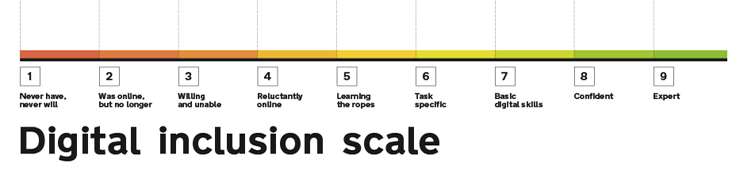
User Research visit
Prototype
£10 incentive
5 participants
All age ranges

Slide 7
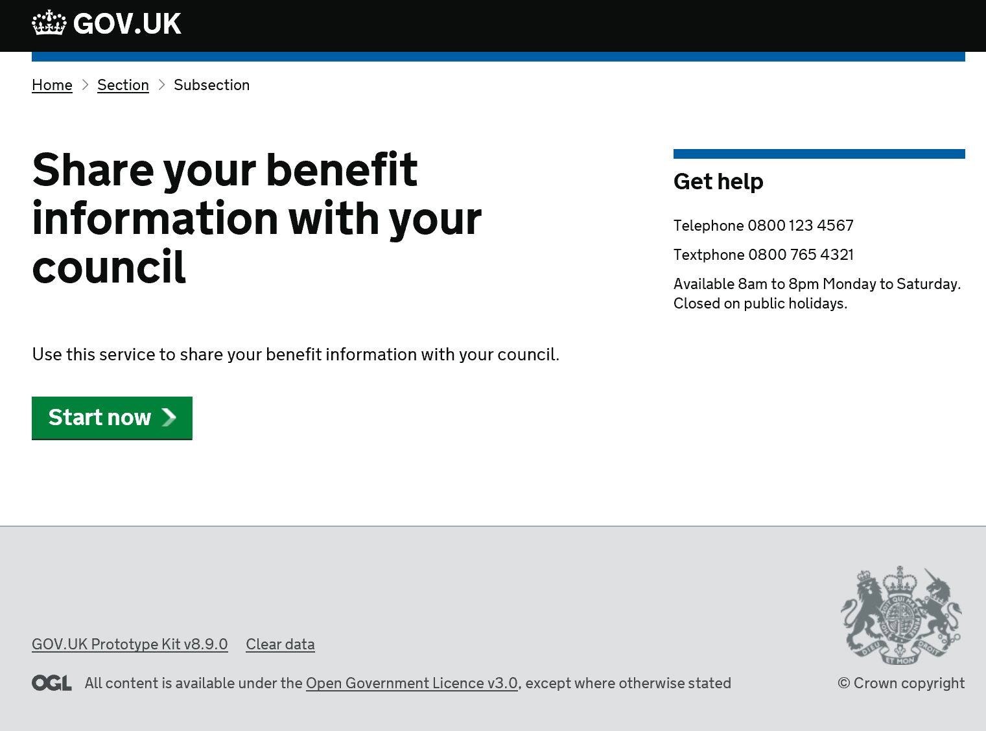

Slide 8
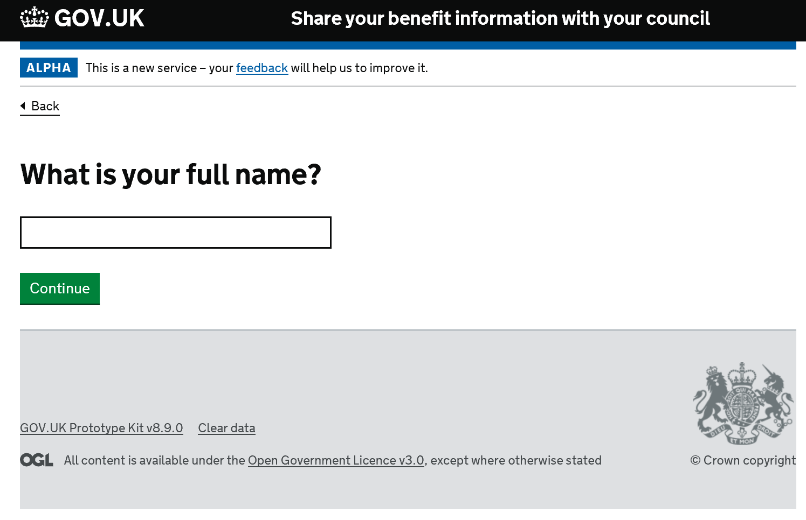

Slide 9
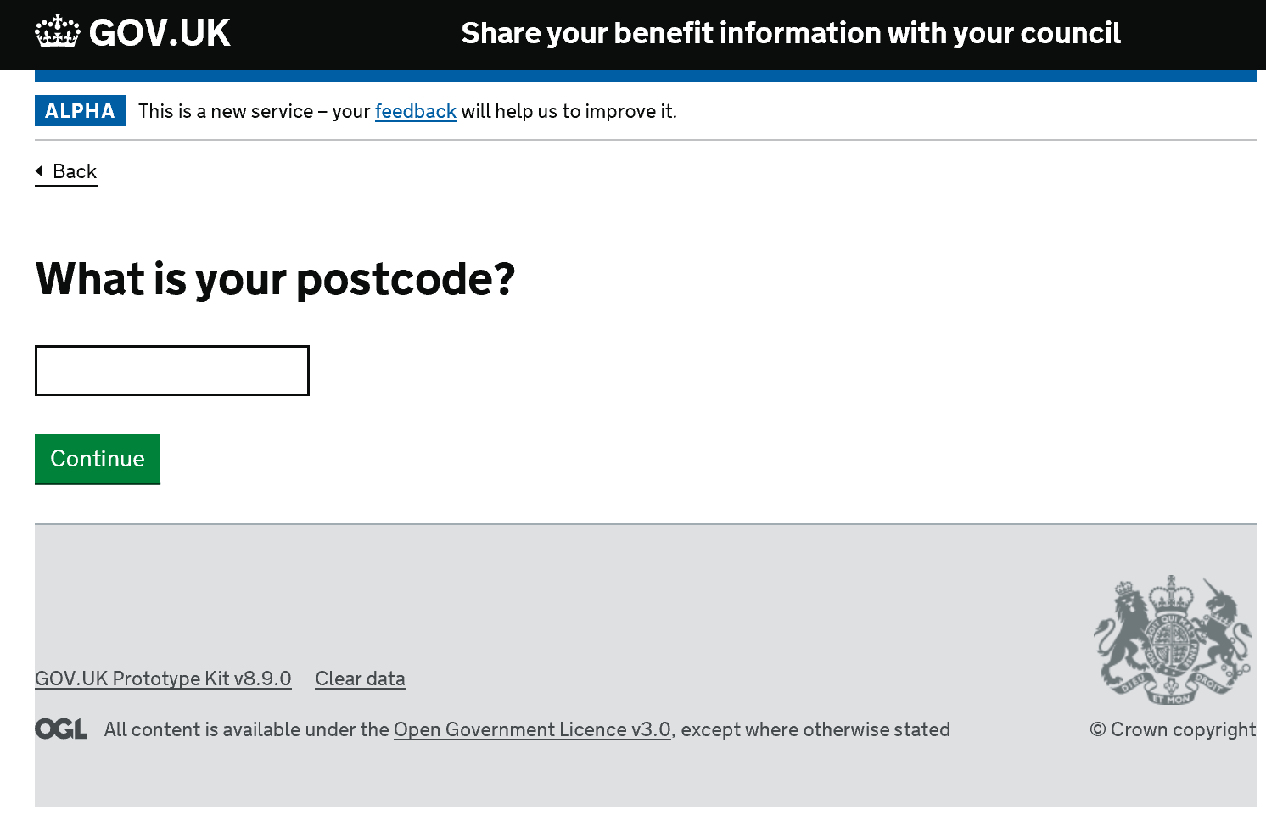

Slide 10
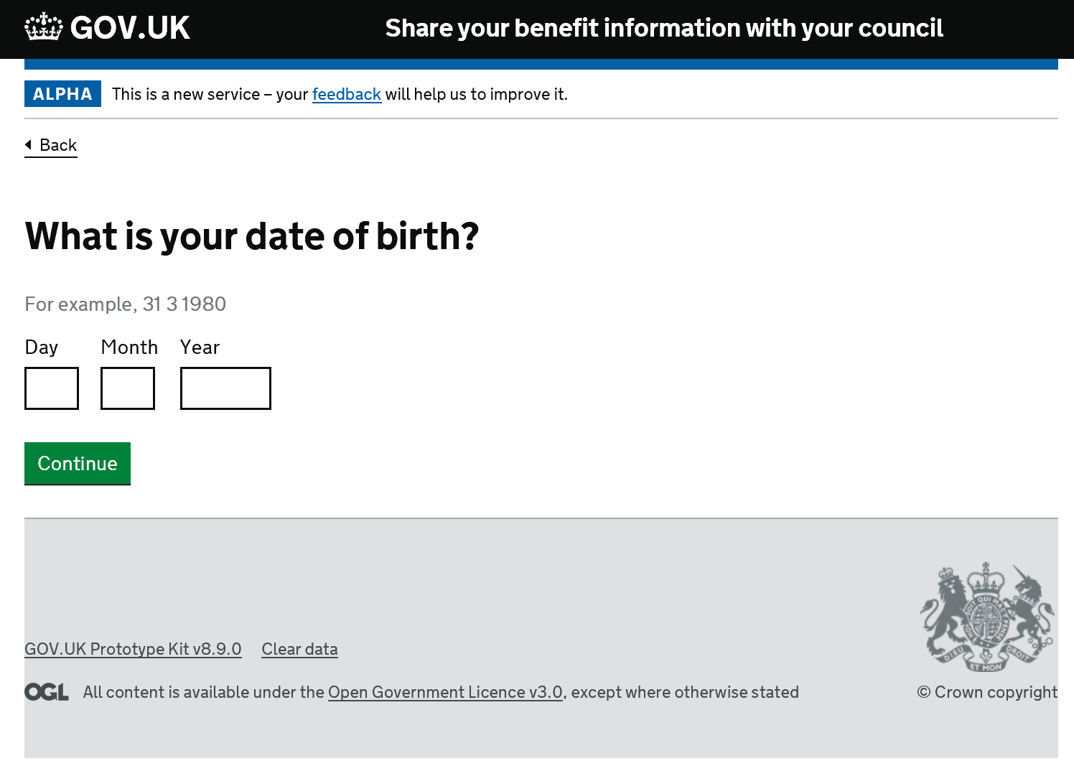

Slide 11
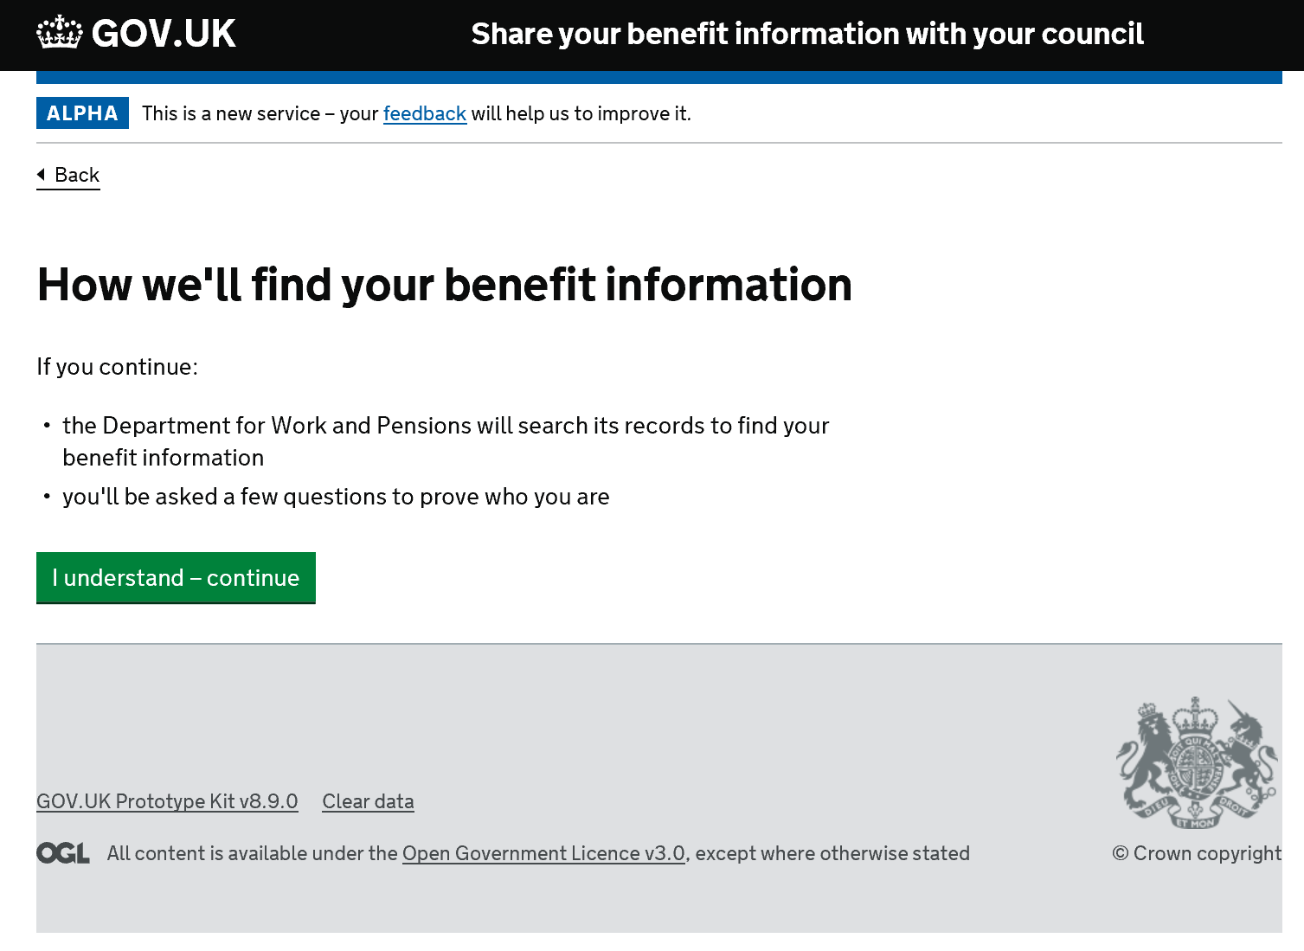

Slide 12
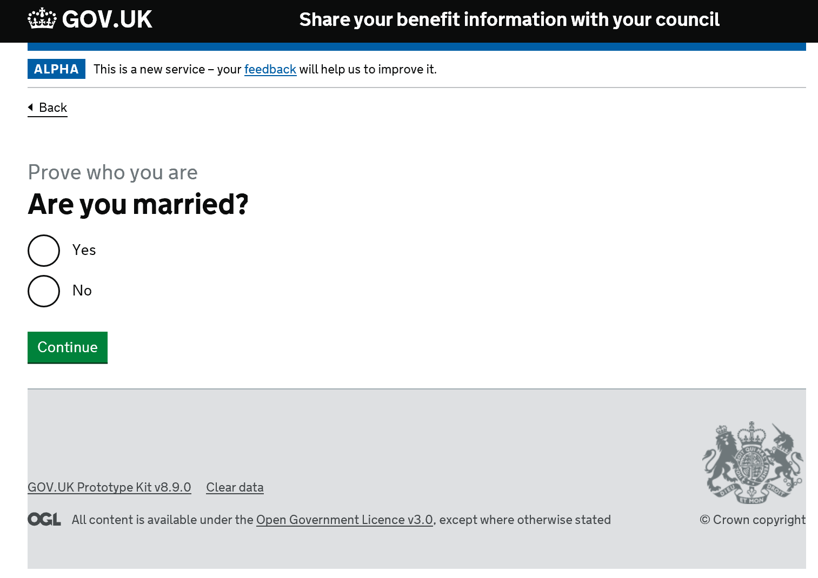

Slide 13
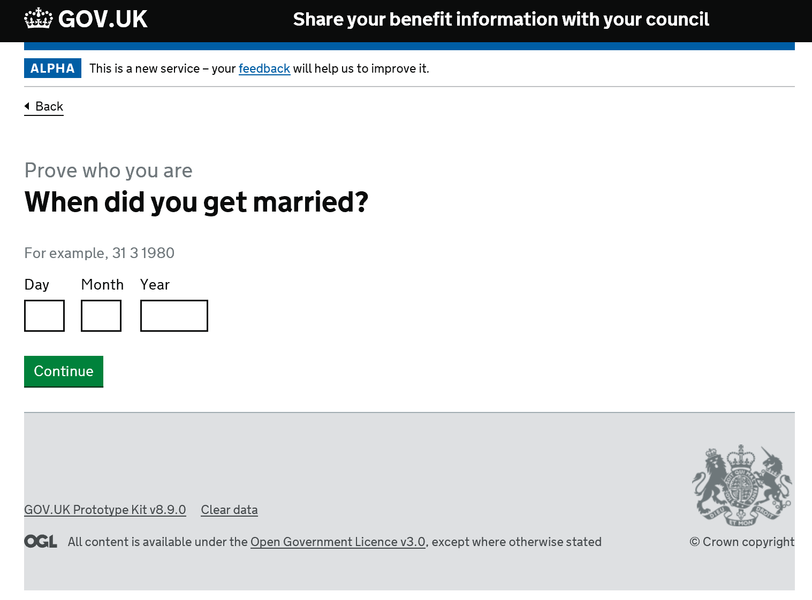

Slide 14
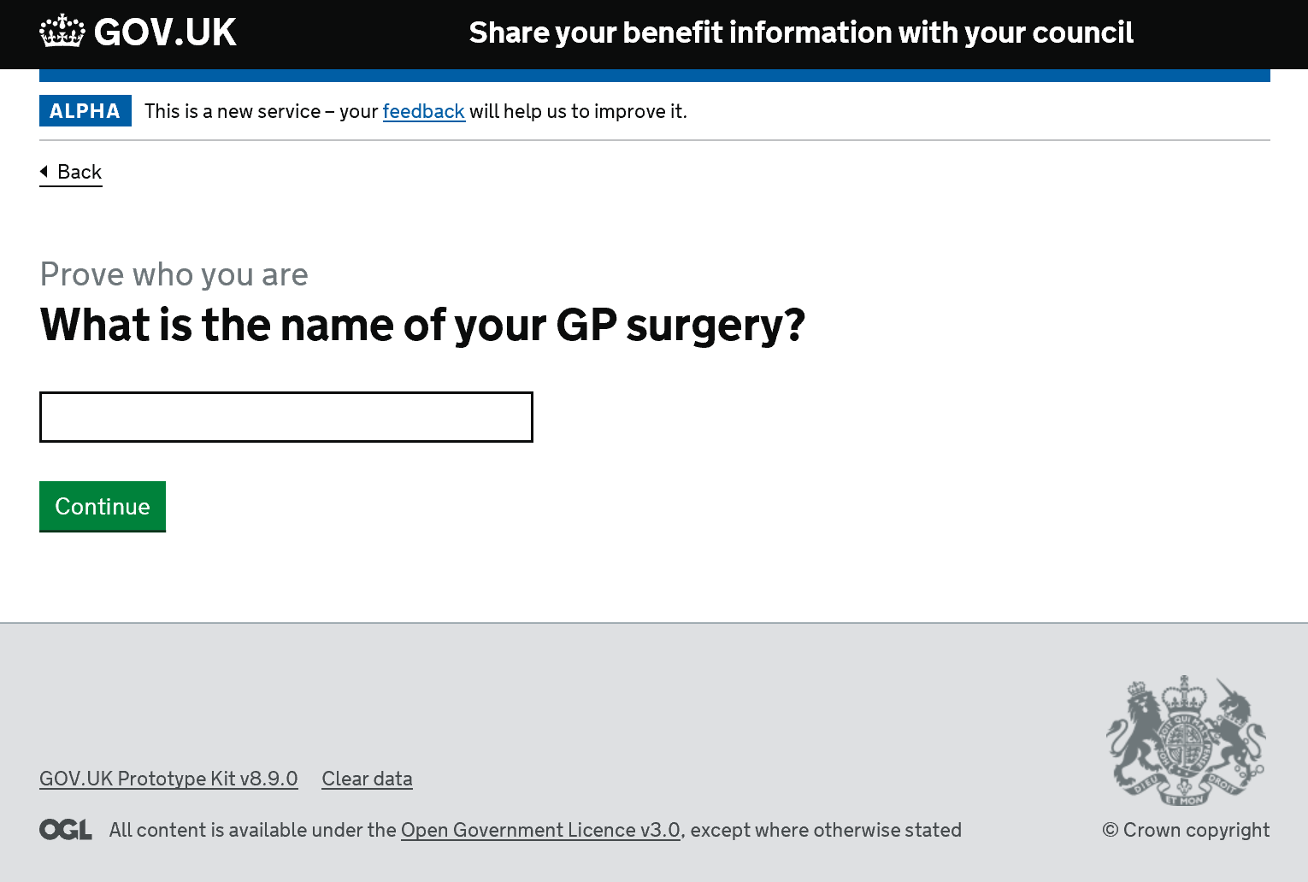

Slide 15
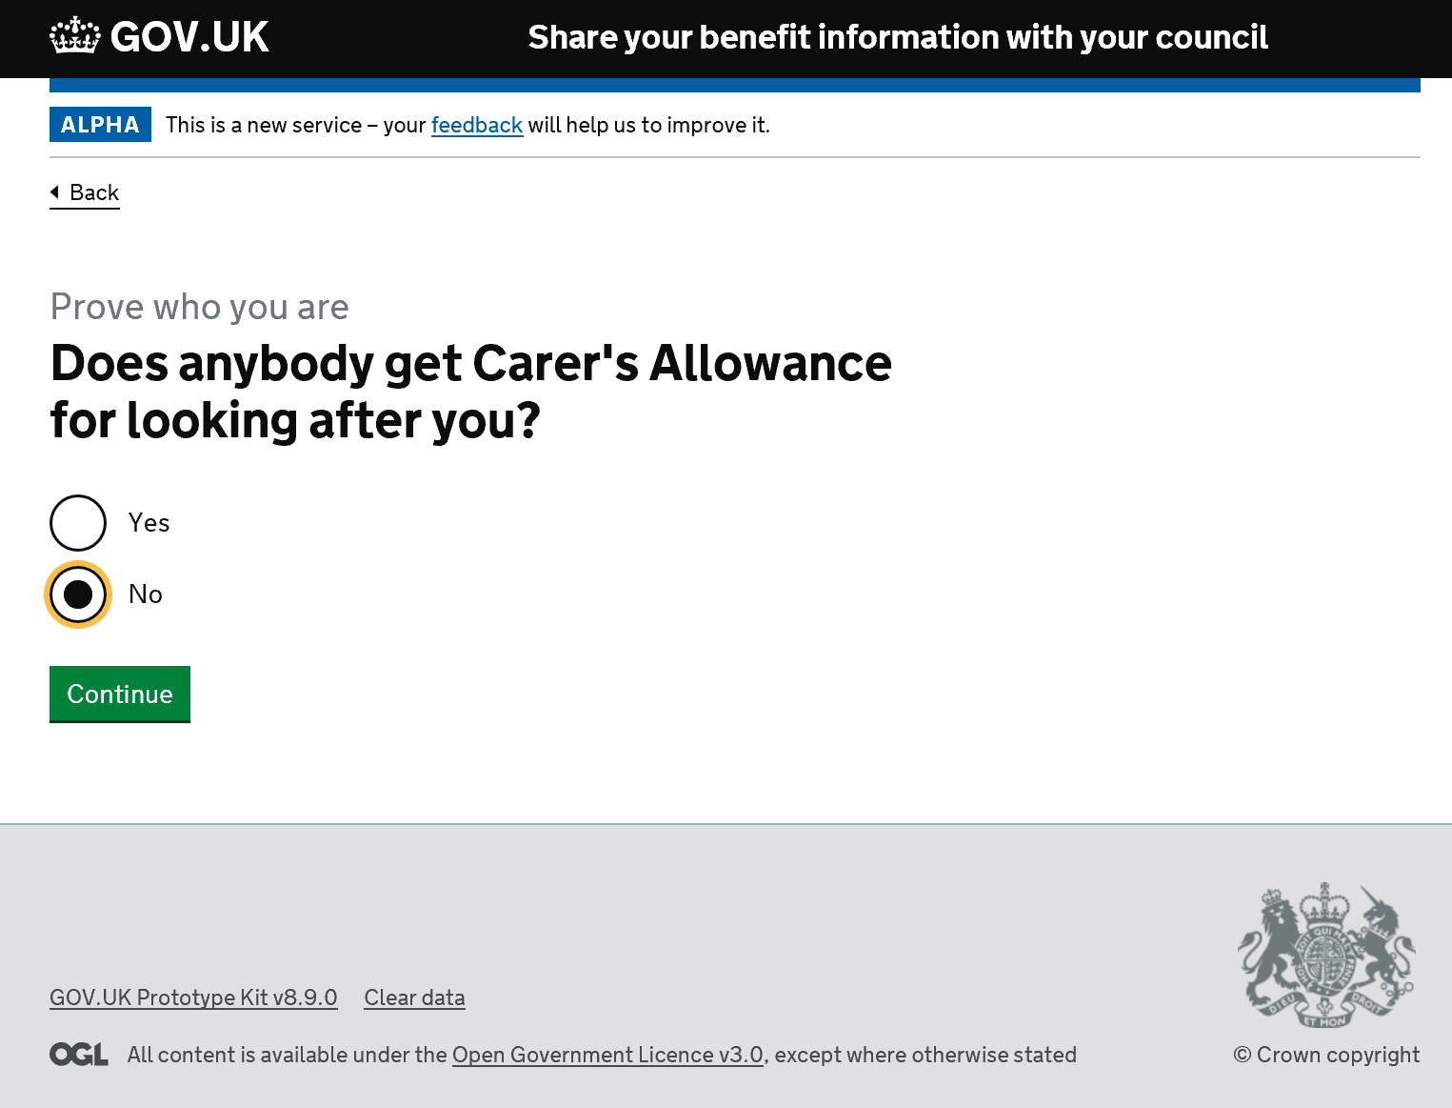

Slide 16
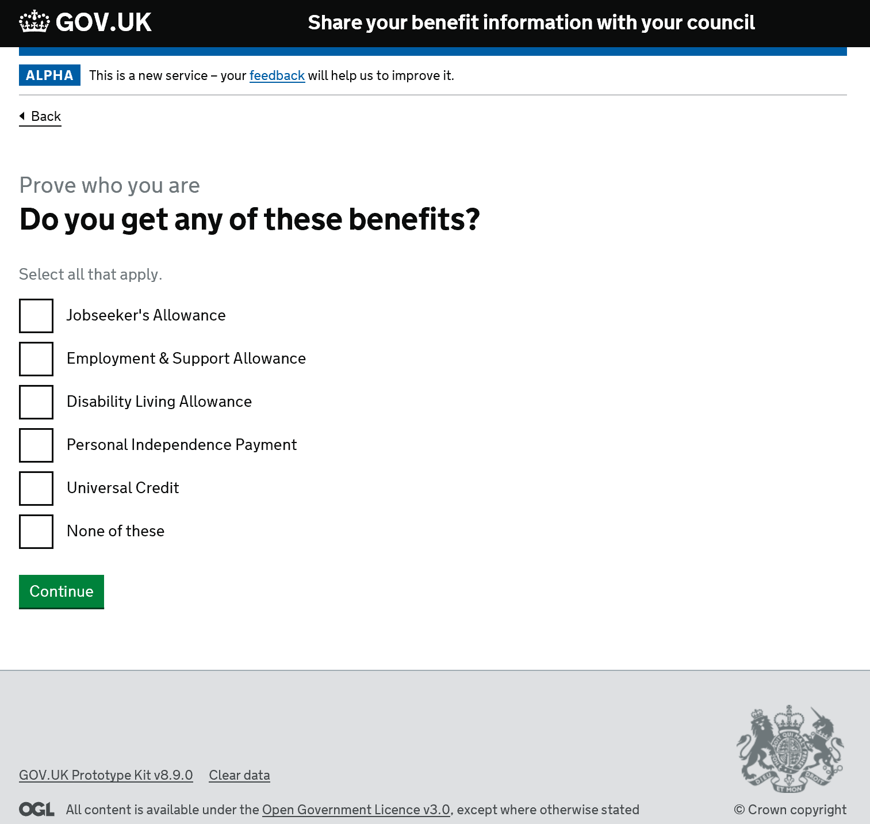

Slide 17
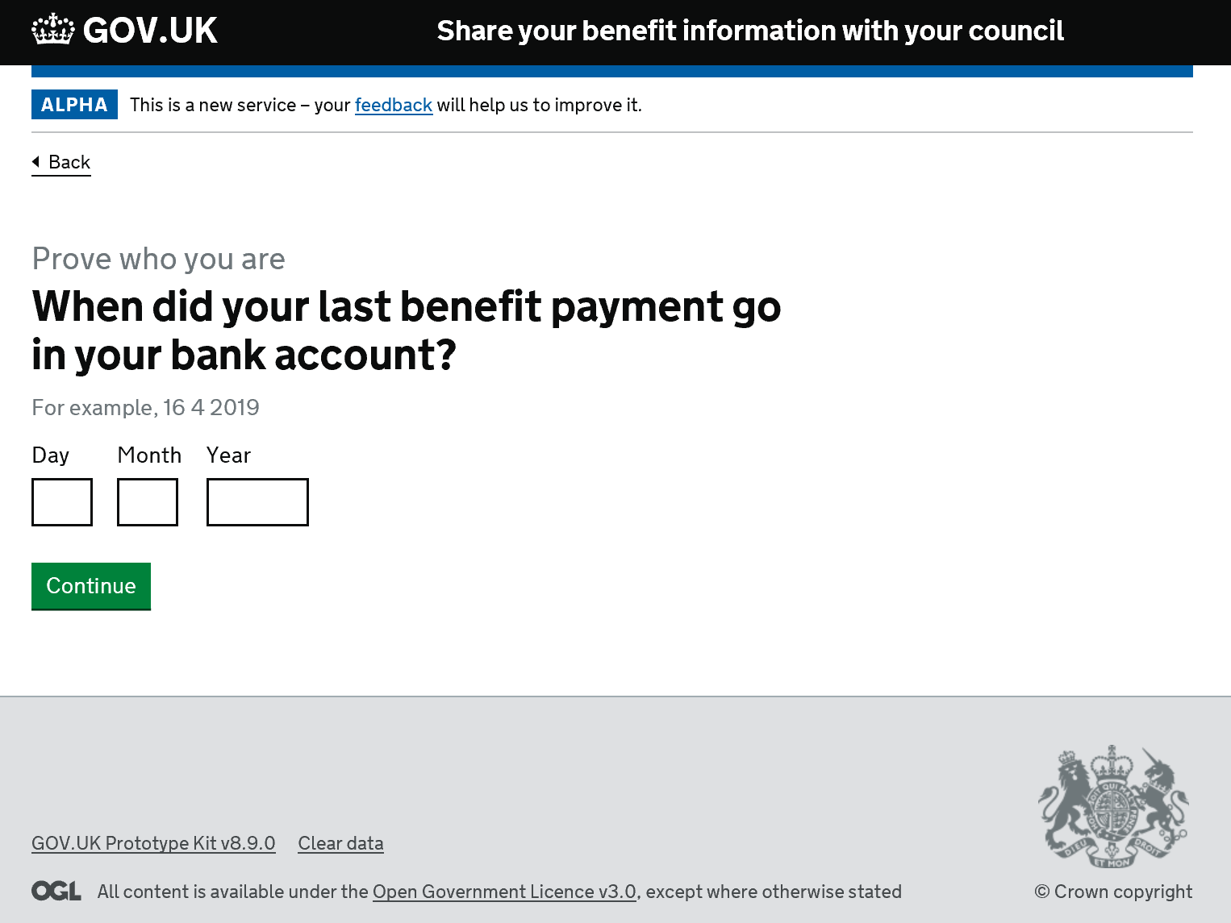

Slide 18
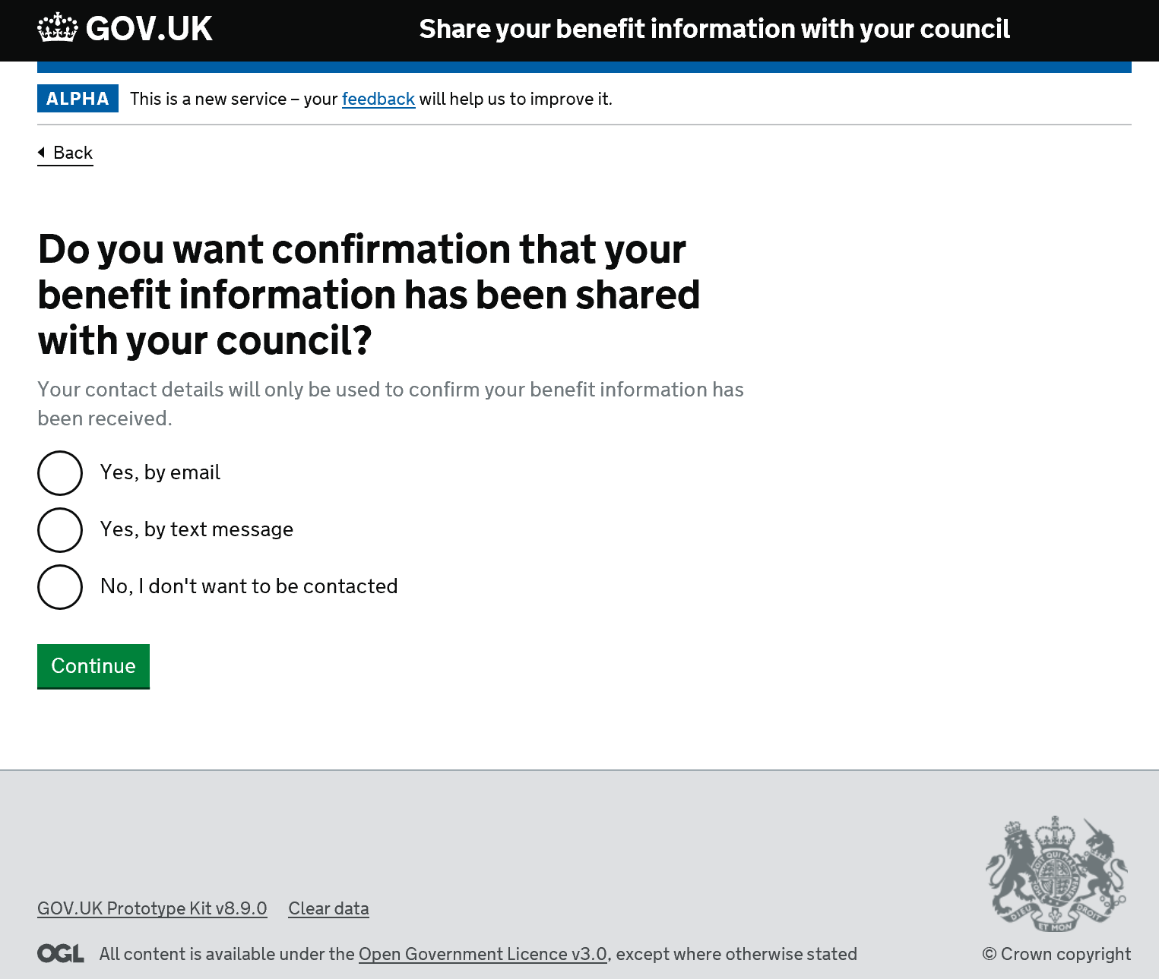

Slide 19
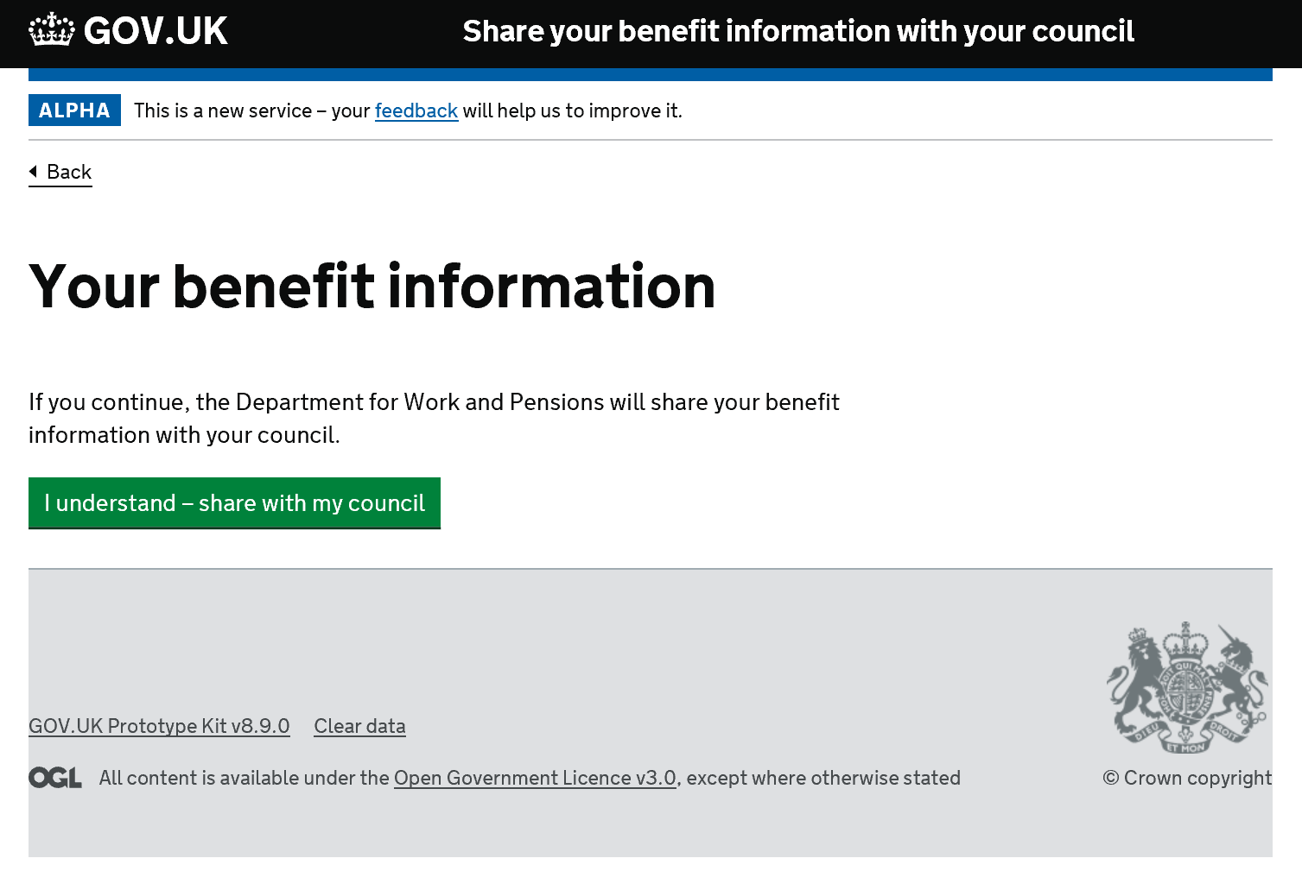

Slide 20
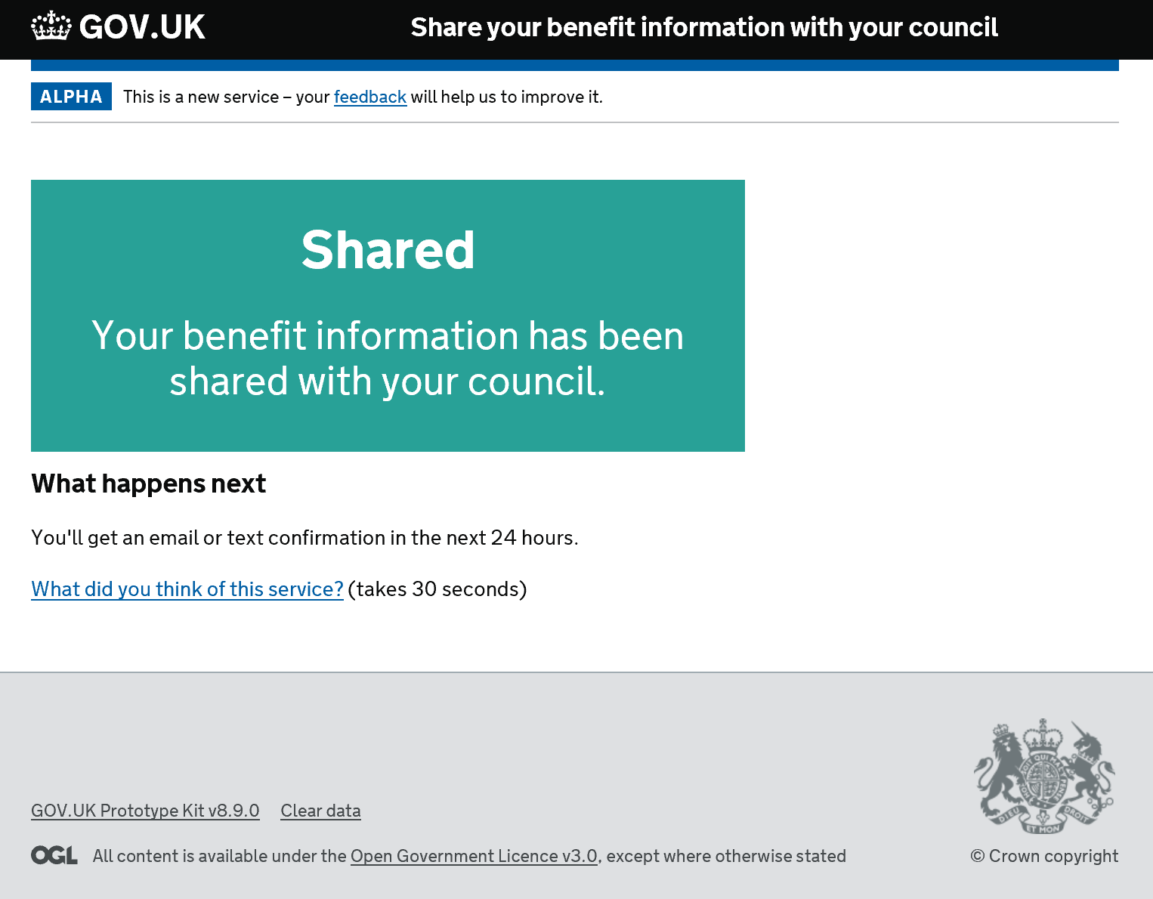

Slide 21


Slide 22
UR09 – User Research – Key Findings
• None of the participants really gained a proper understanding about what the service was for from the information on the start page.
• All participants seemed to think that the answers they had provided to the data matching and elevated trust questions would be shared with their council.
• Although 3 out of 5 thought further ‘background information’ would be shared along with their answers.
• It became apparent that none of the participants truly understood the purpose behind the elevated trust questions.

Slide 23
UR09 – User Research – Key Findings
Add additional content to the start page to explain the service in more detail. Make service specific.
Add realism to the prototype by adding; select your council to the journey.
Add additional content to explain the reasons why we’re asking the data matching questions and the elevated trust questions.
Display the DLA specific benefit information that is going to be shared with the LA. Show it in a way that reveals it is retrieved data, not data typed in.

Slide 24
UR09 – User Research – Hypotheses to test
• All participants would like to see the information being shared either on screen during the process or in a confirmation email.
• More detail is required on what actual information is being shared.
• The information sharing transaction between DWP and LA needs to be explained in a clearer manner.

Slide 25
UR09 – User Research – Hypotheses to test
Move the email/text confirmation question forward to create a break between it and the DM/ET.
Add ‘Don’t Know’ option to elevated trust questions?
Test people reactions to e-mail received as part of confirmation.

Slide 26
UR09 – User Research – Actions
Research Universals Credits question set, logic, and policy.
Research if we can put the benefit information in the confirmation e-mail/text.
Design ‘applying on behalf of someone else’ journey.

Slide 27
Share Your Information – journey, component parts
Positioning – start page
Account creation
Login
Applying for someone else
Select council
Data Matching & Enhanced Trust
Display benefit information
Sharing information
Confirmation e-mail/text
Error messages

