Slide 1
Share Your Information
User Research Report
UR11 - Visit to Rotherham Neighbourhood Hub
17th July 2019
V1.0
David Niland & Chris Philip

Slide 2
User Research visit to Rotherham Neighbourhood Hub
Research goals
To expose the prototype to users, and research:
  • Positioning of prototype
  • Understanding of what happens to the displayed data
  • Completion messaging

Slide 3
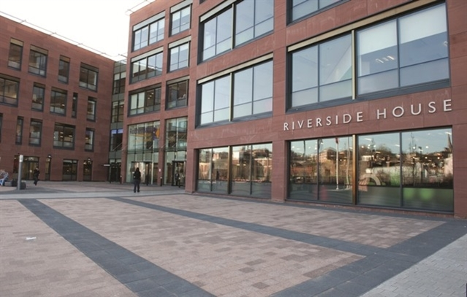

Slide 4
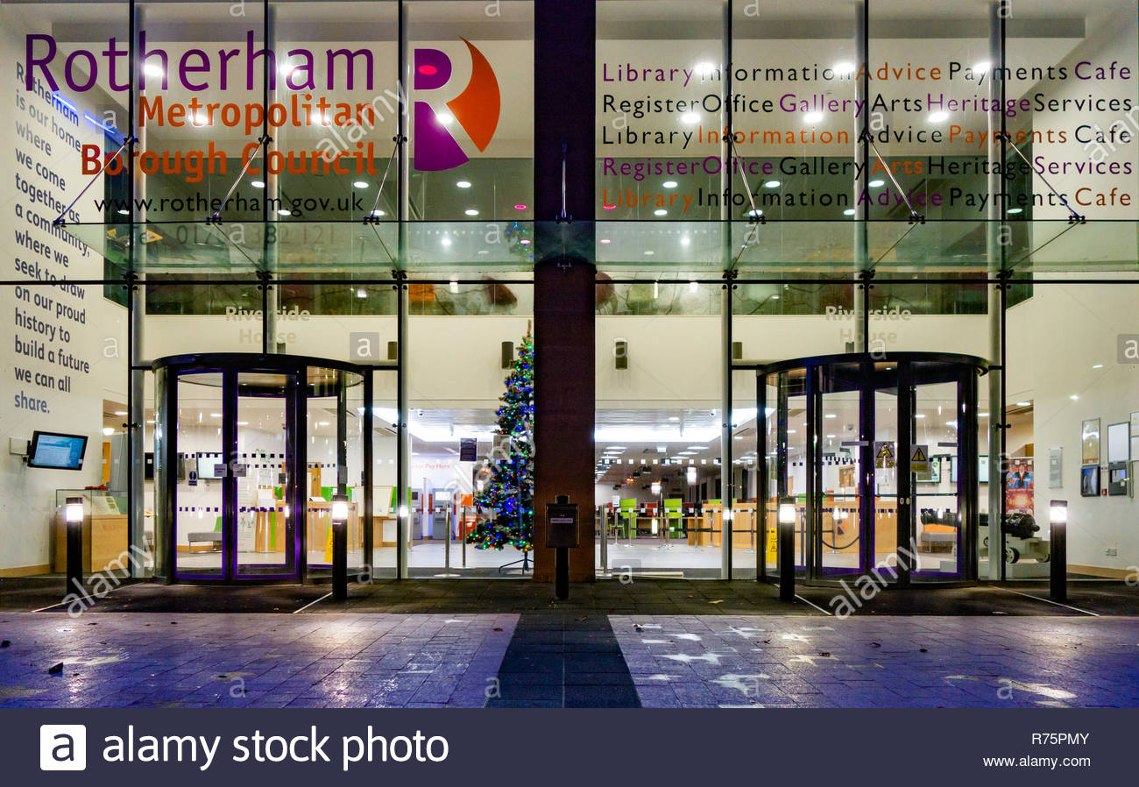

Slide 5
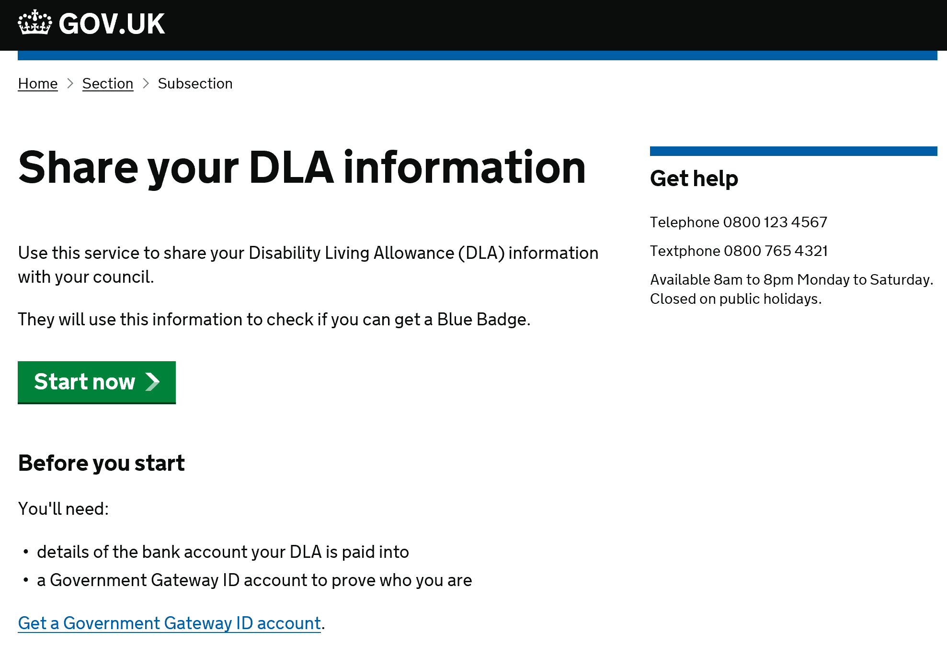

Slide 6
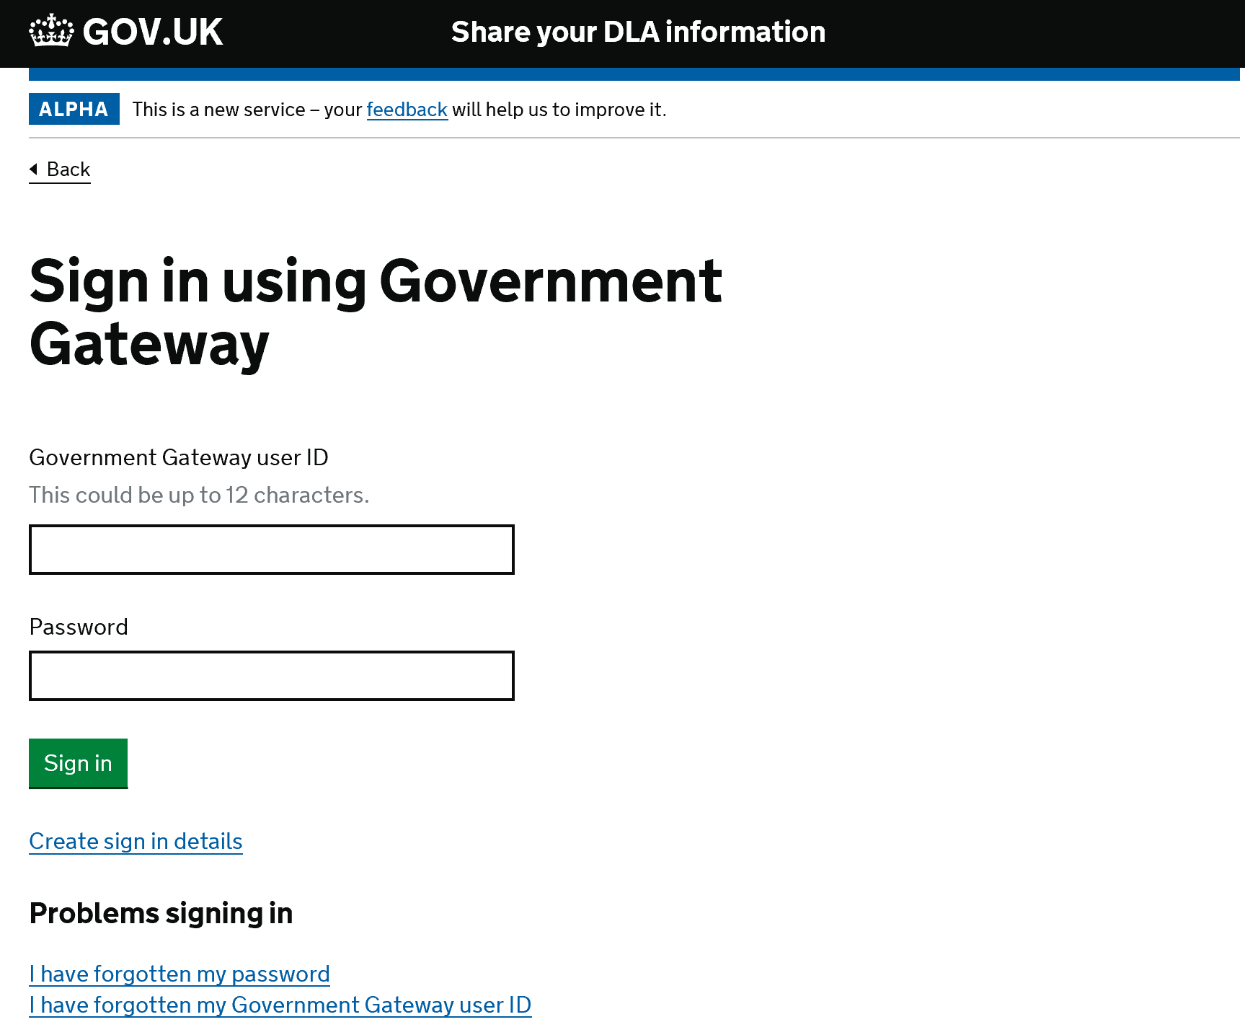

Slide 7
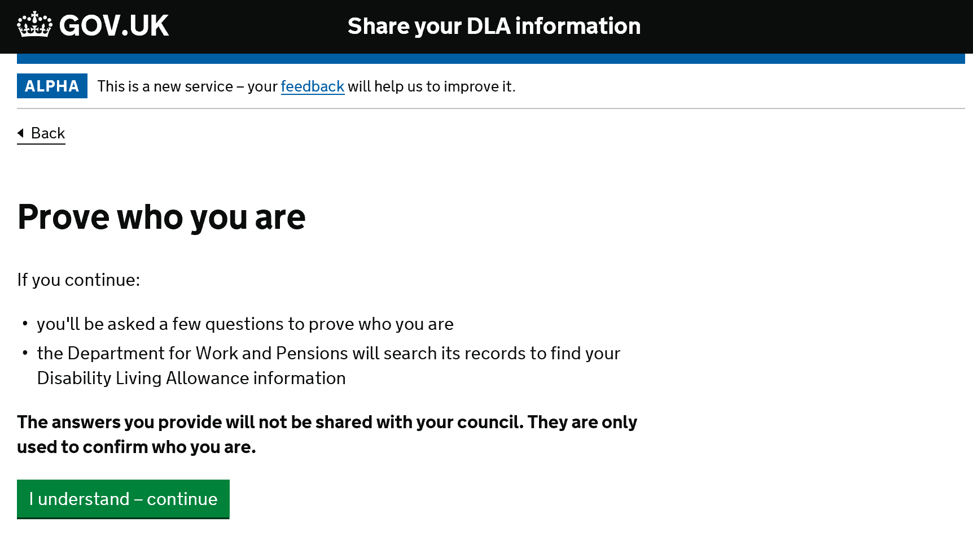

Slide 8
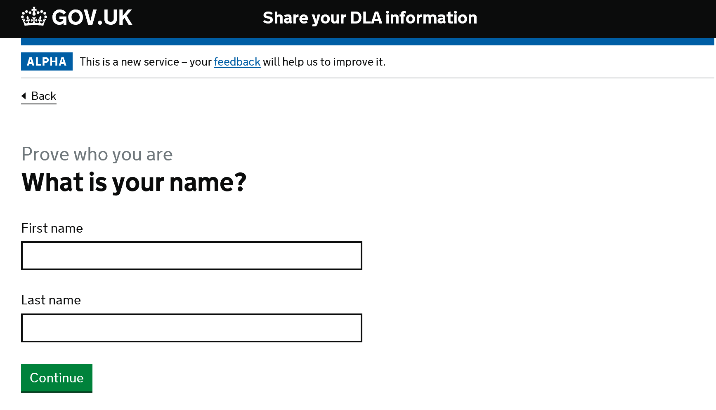

Slide 9
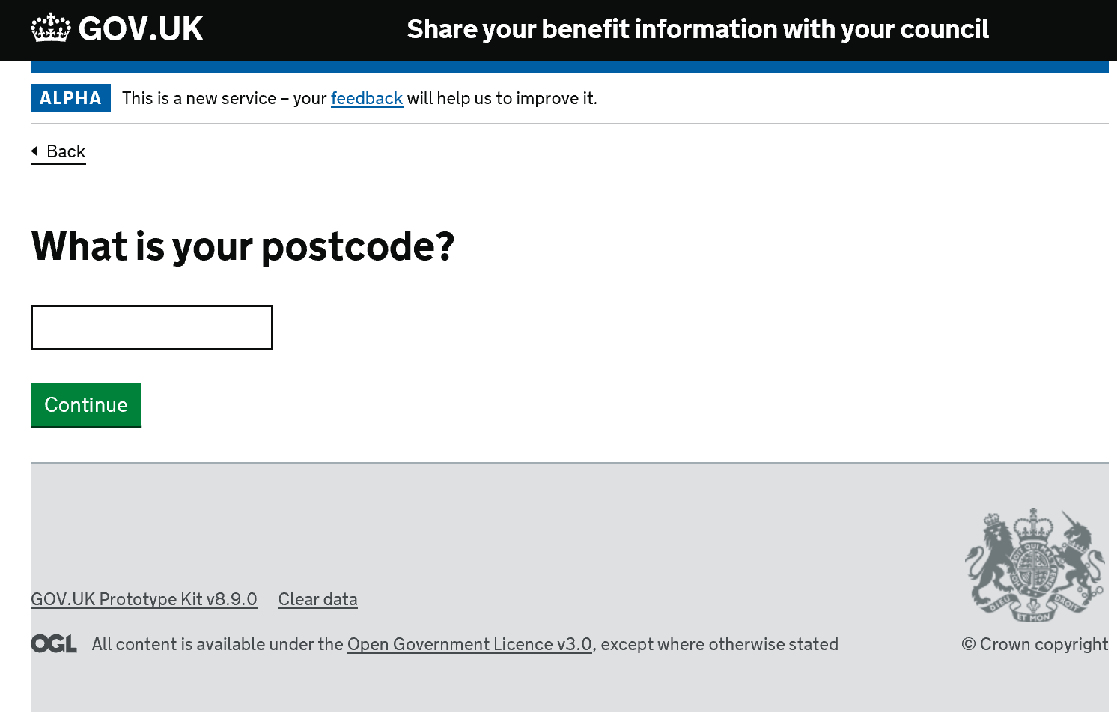

Slide 10
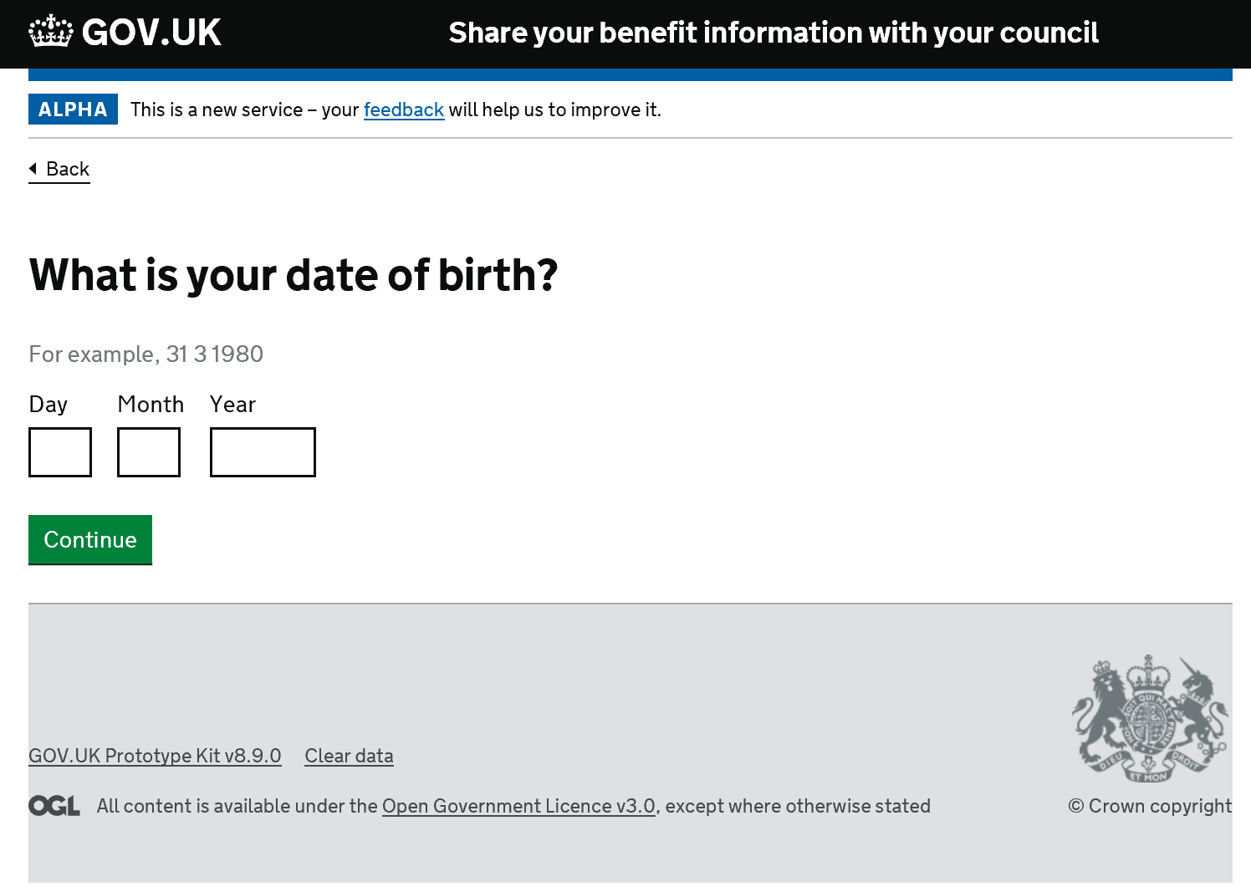

Slide 11
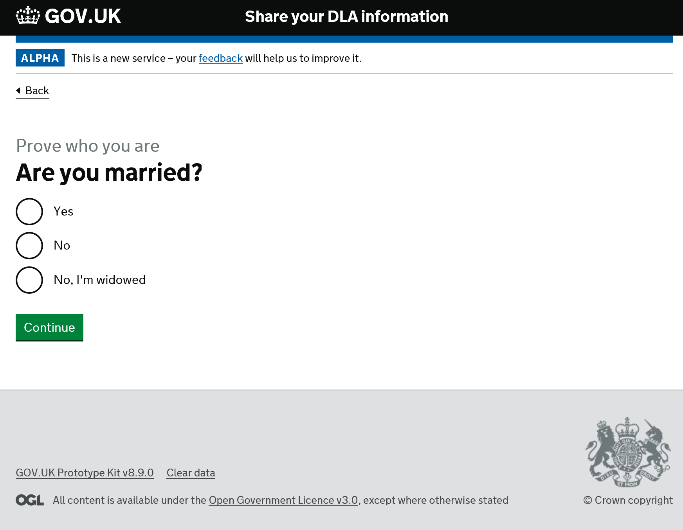

Slide 12
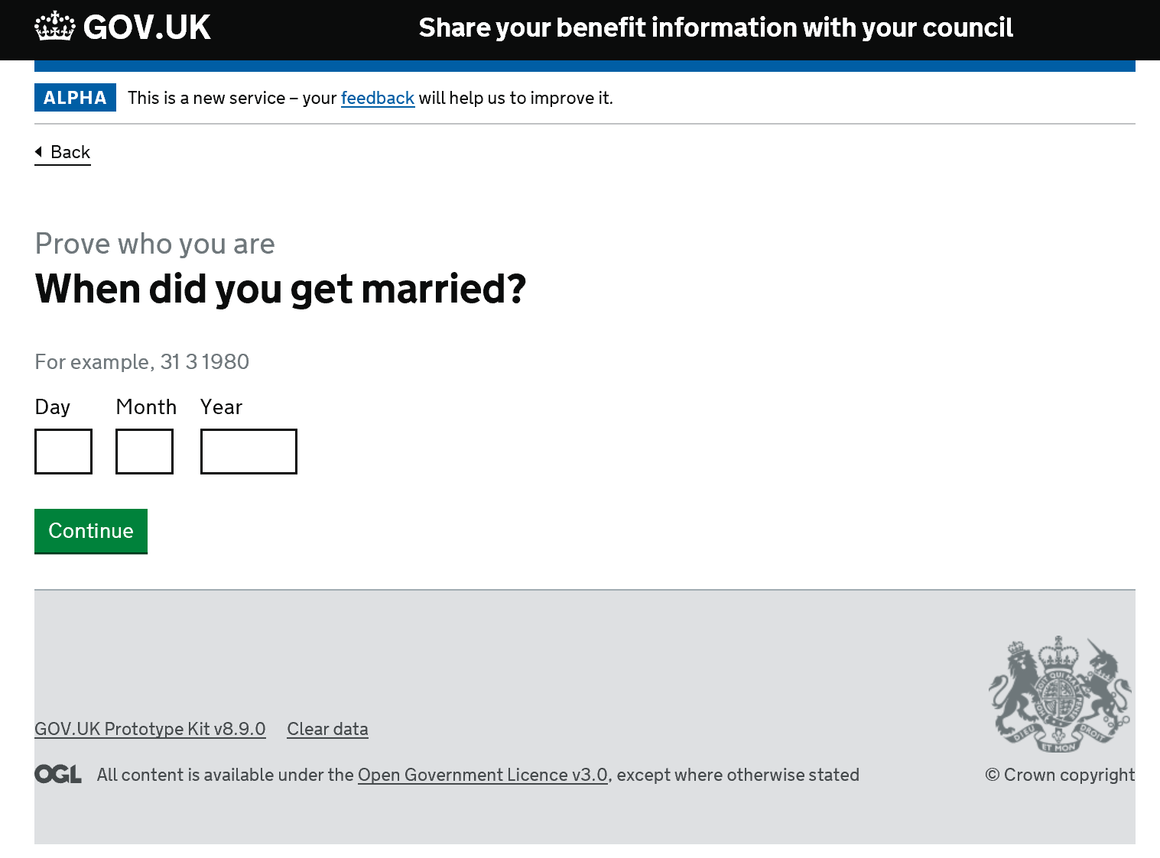

Slide 13
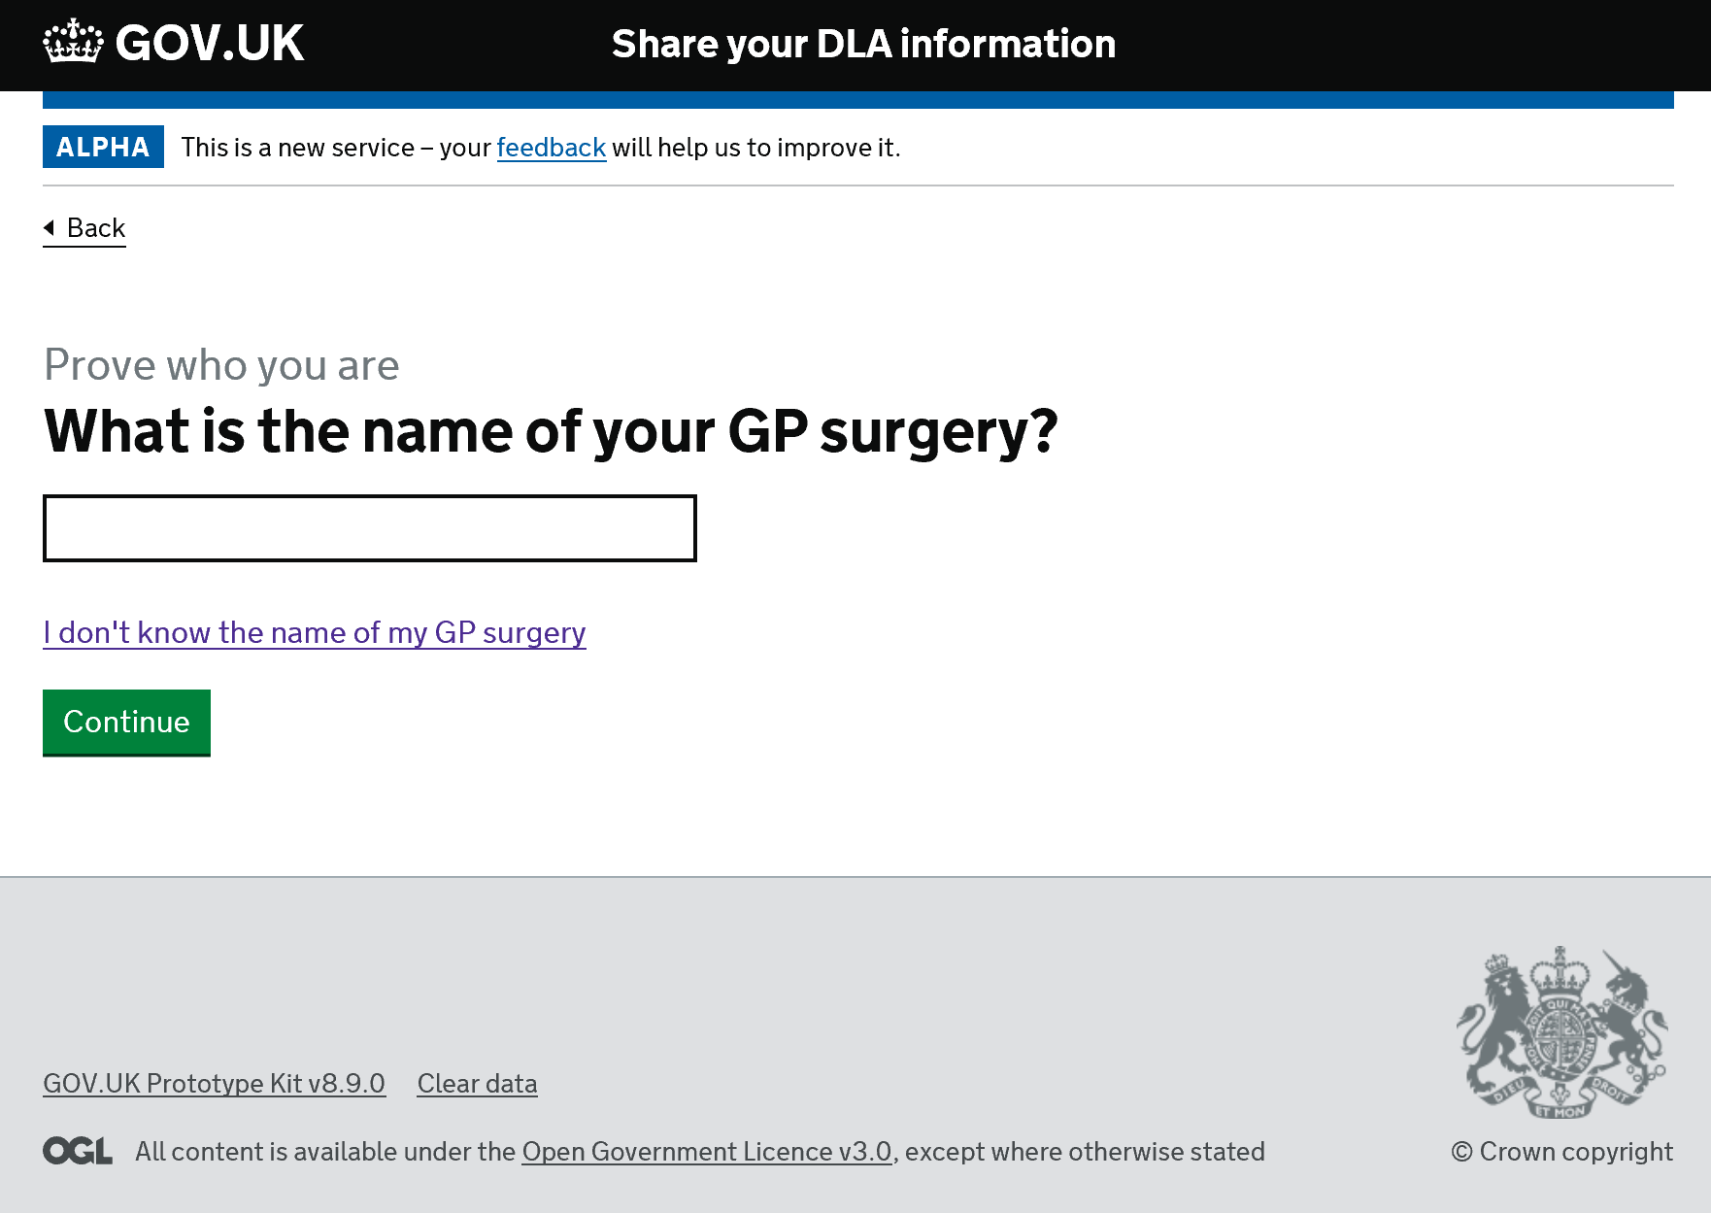

Slide 14
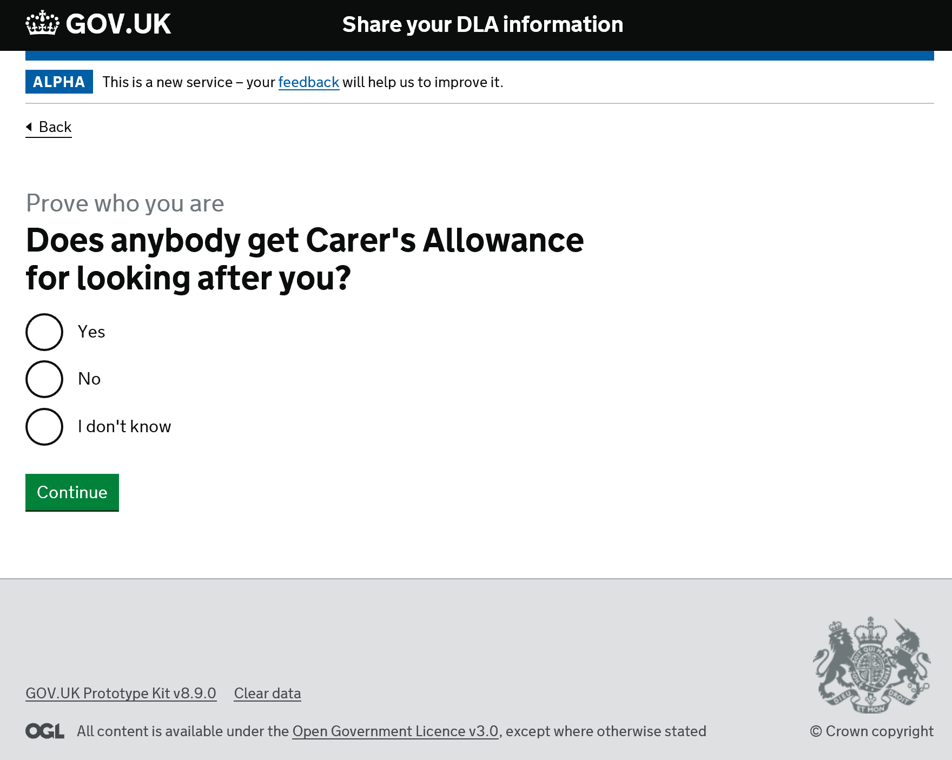

Slide 15
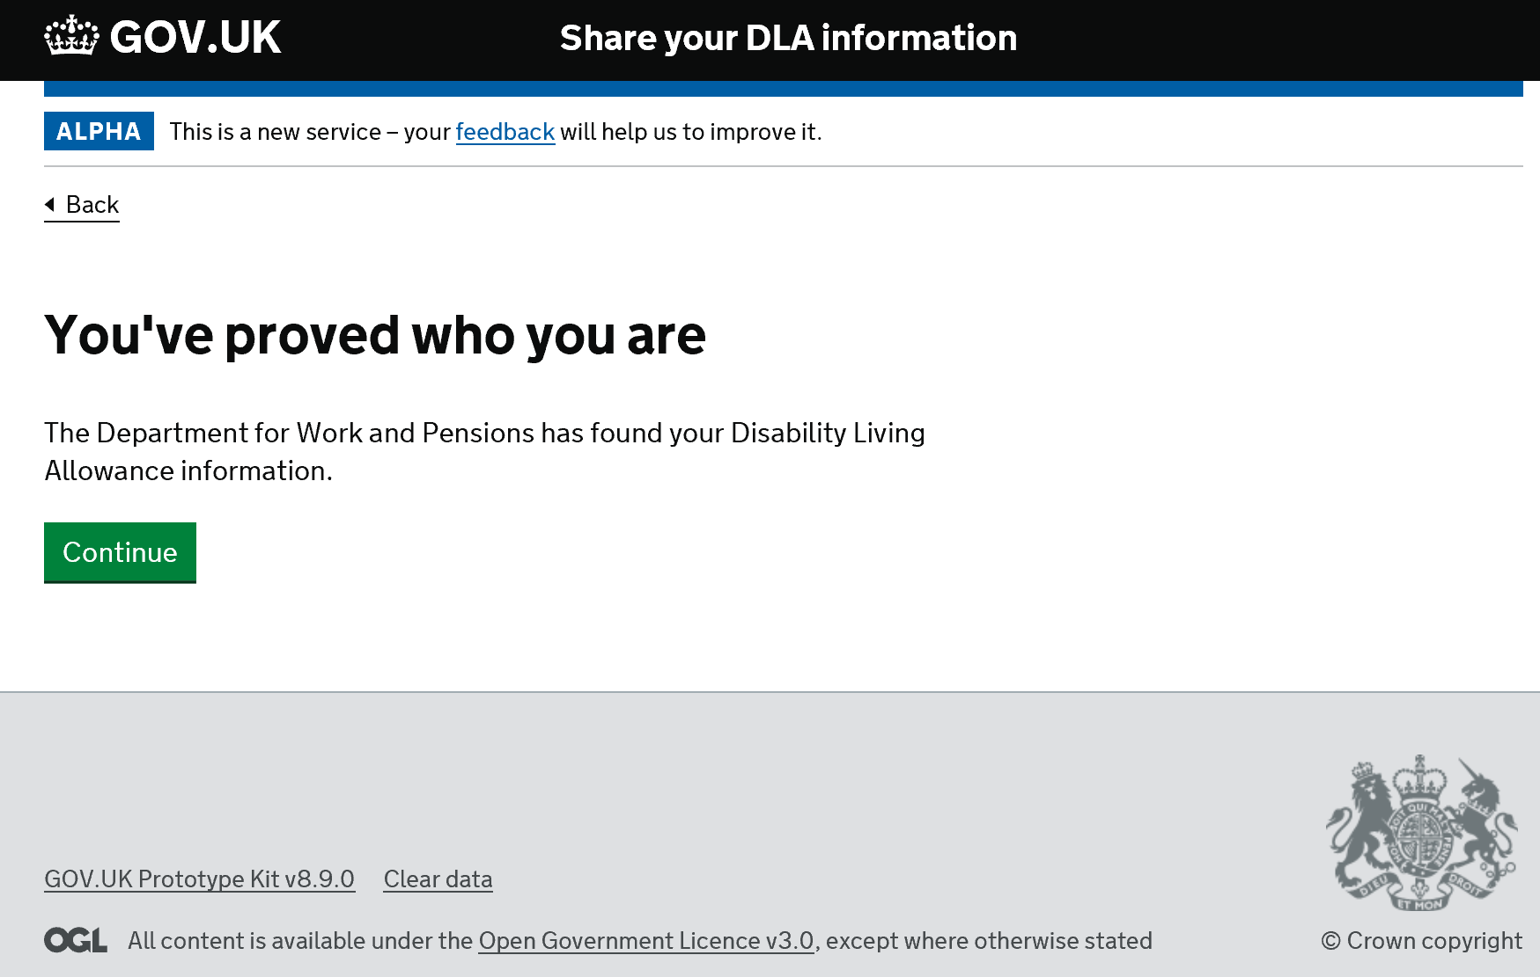

Slide 16
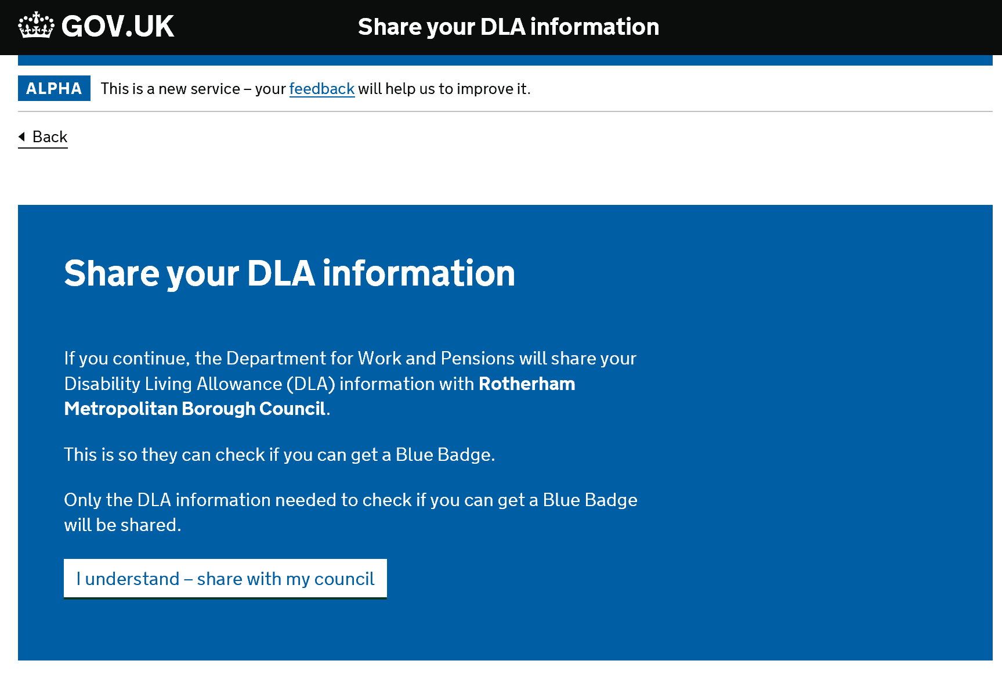

Slide 17
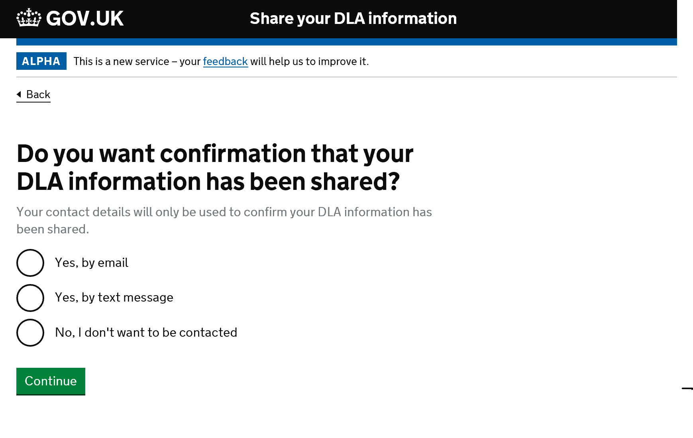

Slide 18
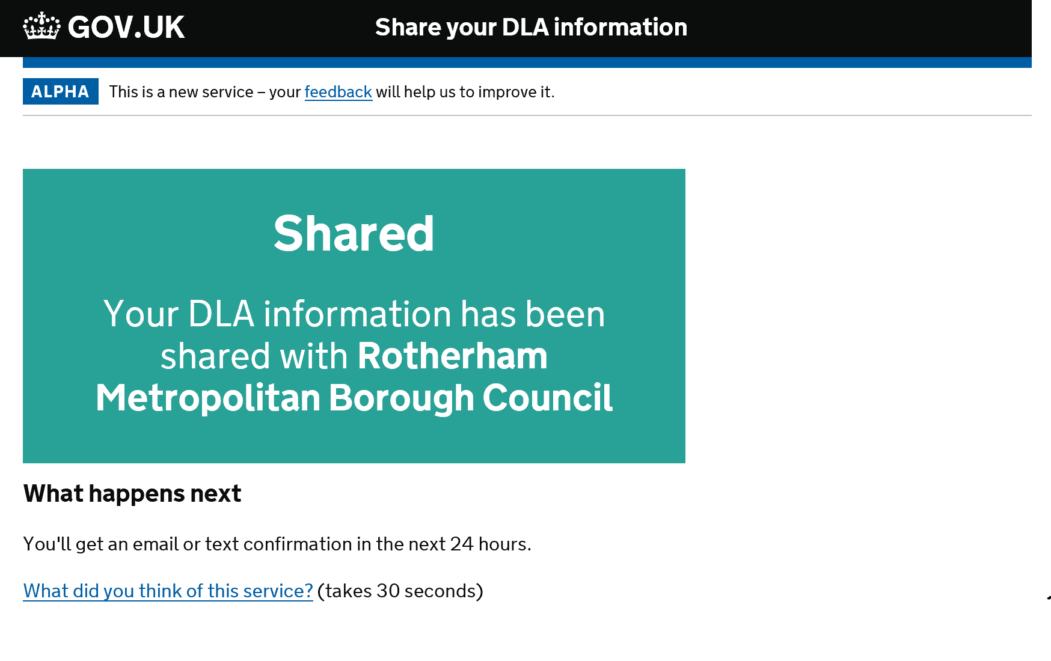

Slide 19
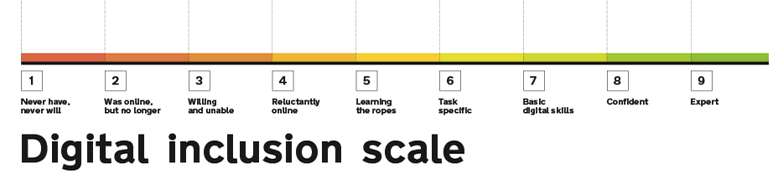
UR11 - Participants
Michael – 18
Tauseef – 54
Joanne - 44

Slide 20
UR11 – User Research – Key Insight
Role out of Universal Credit is increasing the number of citizens with a Government Gateway account
No usability issues with questioning
Without showing the data that will be shared participants still not certain what data has been shared.
DLA/PIP users see this service through a different lens.
Future participants need to be PIP/DLA recipients
Current Universal Credit scam was mentioned.
Not convinced by security questions. Thought people could game the system to get through. Didn’t understand why we didn’t ask for NI number. Telephone calls to DWP lead with NI number.

Slide 21
UR11 – User Research – Key Insight
DLA/PIP recipient wanted confirmation that we had found their records by displaying their data.
This would add to their confidence that the right data had been shared.

Slide 22
UR11 – User Research – Local Authority Key Findings
No usability issues with questioning
Rotherham LA journey: Insight: PIP: Hidden disabilities need to pass over different information from Automatic eligibility.
  Mobility: mobility score
  Hidden disabilities: planning a journey
Rotherham Blue Badge team happy to be involved in future research

