Slide 1
Previously
Searching
  Linear (Sequential): O(n)
  Binary: O(log n)
  Hash: O(1)
    Must generate a (hopefully) unique integer from the key (hash function)
    Collisions (Separate chaining, linear probing, quadratic probing)
    Must worry about table size
Sorting
  Bubble: Awful: O(n²)
  Selection: Awful: O(n²)
  Insertion: Awful: O(n²)

Slide 2
The Lecture Portion for Today
Sorting
  Shell sort
  Merge sort
  Quick sort

Slide 3
Timeline
Sexagesimal number system (3100 BC)
Pi (2000 BC)
Pythagorean theorem, quadratic equations (600 BC)
Recursion ((see Panini) 500 BC)
Euclid’s algorithm (300 BC)
Logarithms (400 CE)
Modern algebra (750 CE)
Newton & Leibniz independently develop Calculus (1760 CE)
George Boole -The Mathematical Analysis of Logic (1847), and
An Investigation of the Laws of Thought (1854)
Shell sort (1959)
  Hibbard’s Increments (1963)
Quicksort (1962)
Binary Heaps (1964)
TimSort – Tim Peters (2002)

Slide 4
Shellsort
What’s the concept?
Increment sequence
Shell’s sequence {1, 2, 4, 8, …} O(N²)
Hibbard’s sequence {1, 3, 7, 15, …} O(N^{3/2})

Slide 5
Shell Sort
Strategy: set a gap (initially let gap = n/2), insertion sort elements separated by a distance of gap, reduce the gap by increments after each iteration until it is = 1, and continue.

Slide 6
Shell Sort
Example: an array of int, length n = 9
gap = n/2 = 4
gap = max(1, (int) gap /2) = 2
1
0 1 2 3 4 5 6 7 8
A
24
10
3
3
31
10
44
24
41
27
25
3
31
27
10
41
27
24
25
47
27
31
41
44
25
41
27
44
47
3
25
44
47
i
for i in range(start+gap,len(alist),gap):
currentvalue = alist[i]
position = i
while position>=gap and alist[position-gap]>currentvalue:
alist[position]=alist[position-gap]
position = position-gap
alist[position]=currentvalue
i
i
i
i
i
i
i
i
i
i
i

Slide 7
def shellSort(alist):
sublistcount = len(alist)//2
while sublistcount > 0:
for startposition in range(sublistcount):
gapInsertionSort(alist,startposition,sublistcount)
sublistcount = sublistcount // 2
def gapInsertionSort(alist,start,gap):
for i in range(start+gap,len(alist),gap):
currentvalue = alist[i]
position = i
while position>=gap and alist[position-gap]>currentvalue:
alist[position]=alist[position-gap]
position = position-gap
alist[position]=currentvalue

Slide 8
Why is Shell Sort better than Insertion Sort?
Every pass makes the list “more sorted”
The more sorted a list is, the less work has to be done in subsequent passes.
Another way to look at it:
  By swapping items that are far apart, we can “fix” several out of order elements all at once.

Slide 9
Mergesort
Based on divide-and-conquer strategy
Divide the list into two smaller lists of about equal sizes
Sort each smaller list recursively
Merge the two sorted lists to get one sorted list
How do we divide the list? How much time needed?
How do we merge the two sorted lists? How much time needed?

Slide 10
In order to analyze the mergeSort function, consider the two distinct processes that make up its implementation. First, the list is split into halves. We already computed (in a binary search) that we can divide a list in half logn times where n is the length of the list. Not using the slice operator here. The second process is the merge. Each item in the list will eventually be processed and placed on the sorted list. So the merge operation which results in a list of size n, requires n operations. The result of this analysis is that logn splits, each of which costs n for a total of nlogn operations. A merge sort is an O(nlogn) algorithm.

Slide 11
Mergesort
Divide-and-conquer strategy
  recursively mergesort the first half and the second half
  merge the two sorted halves together

Slide 12
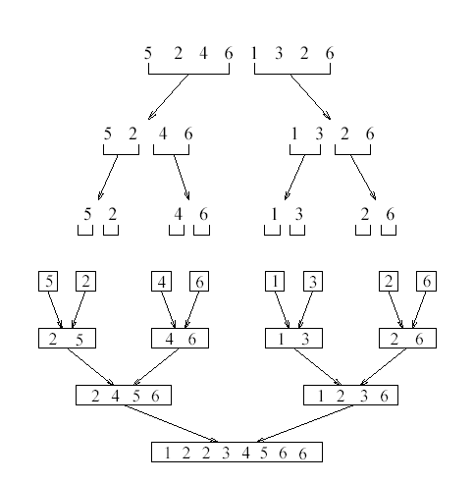
http://www.sorting-algorithms.com/merge-sort

Slide 13
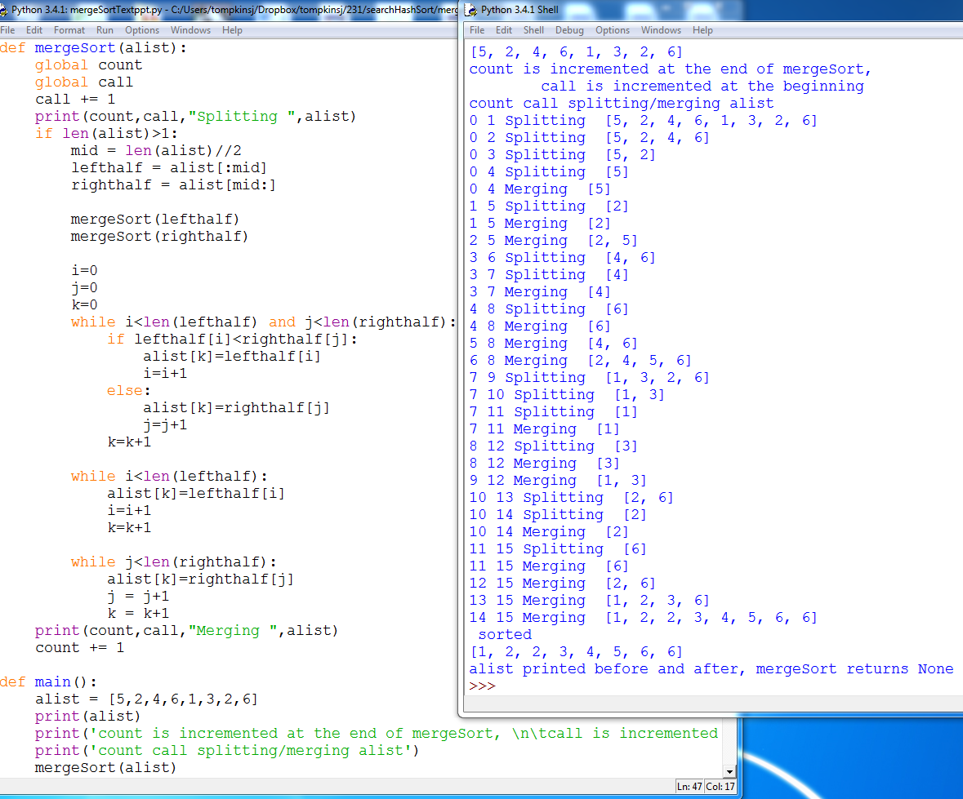

Slide 14
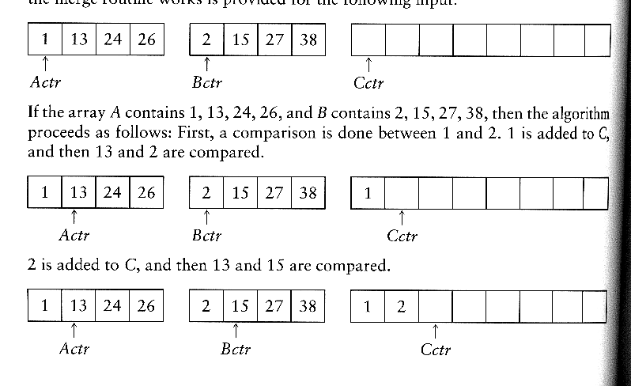
How to merge?
Input: two sorted arrays A and B
Output: an output sorted array C
Three counters: Actr, Bctr, and Cctr
  initially set to the beginning of their respective arrays
(1) The smaller of A[Actr] and B[Bctr] is copied to the next entry in C, and the appropriate counters are advanced
(2) When either input list is exhausted, the remainder of the other list is copied to C

Slide 15

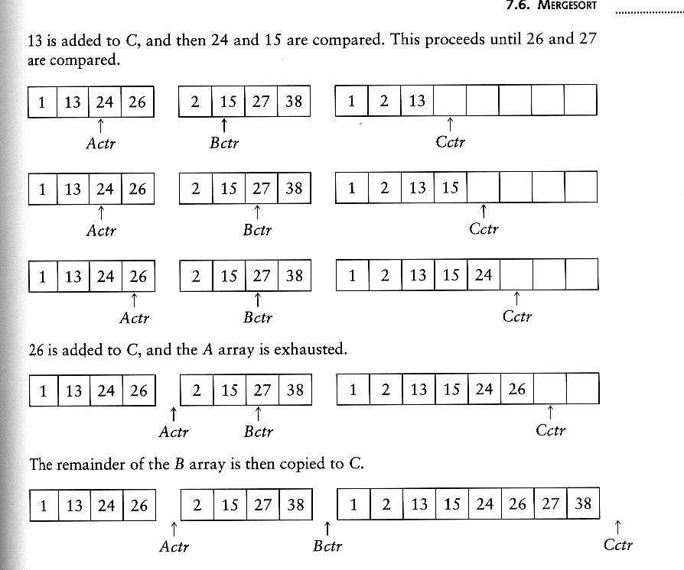
Example: Merge

Slide 16
Example: Merge...
Running time analysis:
  Clearly, merge takes O(m1 + m2) where m1 and m2 are
the sizes of the two sublists.
Space requirement:
  merging two sorted lists requires linear extra memory
  additional work to copy to the temporary array and back

Slide 17
def mergeSort(alist):
if len(alist)>1:
mid = len(alist)//2
lefthalf = alist[:mid]
righthalf = alist[mid:]
mergeSort(lefthalf)
mergeSort(righthalf)
i,j,k = 0,0,0
while i<len(lefthalf) and j<len(righthalf):
if lefthalf[i]<righthalf[j]:
alist[k]=lefthalf[i]
i=i+1
else:
alist[k]=righthalf[j]
j=j+1
k=k+1
while i<len(lefthalf):
alist[k]=lefthalf[i]
i, k = i+1, k=k+1
while j<len(righthalf):
alist[k]=righthalf[j]
j, k = j+1, k=k+1

Slide 18
Analysis of mergesort
Let T(N) denote the worst-case running time of mergesort to sort N numbers.
Assume that N is a power of 2.
Divide step: O(1) time
Conquer step: 2 T(N/2) time
Combine step: O(N) time
Recurrence equation:
  T(1) = 1
  T(N) = 2T(N/2) + N

Slide 19
Solving the Recurrence Relation
Covered in Discrete Mathematics
Other important recurrence relations
  T(n) = T(n – 1) + 1
    O(n)
  T(n) = T(n/2) + 1
    O(log n)
  T(n) = T(n – 1) + n
    O(n²)

Slide 20
Quicksort
Fastest known sorting algorithm in practice for many data types
Average case: O(N log N)
Worst case: O(N²)
  But, the worst case seldom happens.
Another divide-and-conquer recursive algorithm like mergesort

Slide 21
Quicksort
S
Divide step:
  Pick any element (pivot) v in S
  Partition S – {v} into two disjoint groups
  S1 = {x ∈ S – {v} | x ≤ v}
  S2 = {x ∈ S – {v} | x ≥ v}
Conquer step: recursively sort S1 and S2
Combine step: combine the sorted S1, followed by v, followed by the sorted S2
v
v
S1
S2

Slide 22
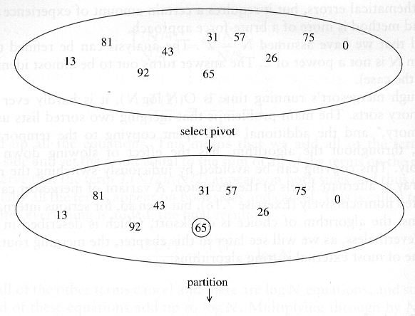
Example: Quicksort

Slide 23
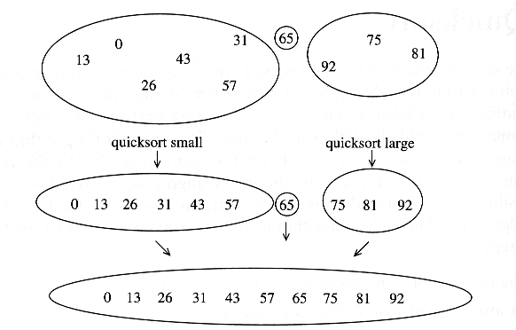
Example: Quicksort...

Slide 24
Pseudocode
def quicksort(alist)
if length(alist) > 1 pivot := select any element of alist
left := first index of alist
right := last index of alist
while left ≤ right
while alist[left] < pivot
left := left + 1
while alist[right] > pivot
right := right - 1
if left ≤ right
swap alist[left] with alist[right]
left := left + 1
right := right - 1
quicksort(alist from first index to right)
quicksort(alist from left to last index)

Slide 25
Partitioning
Partitioning
  Key step of quicksort algorithm
  Goal: given the picked pivot, partition the remaining elements into two smaller sets
  Many ways to implement
We will learn an easy and efficient partitioning strategy here.
How to pick an effective pivot will be discussed later

Slide 26

Let’s make the first value the pivot
(safe if the numbers are truly random)

Slide 27
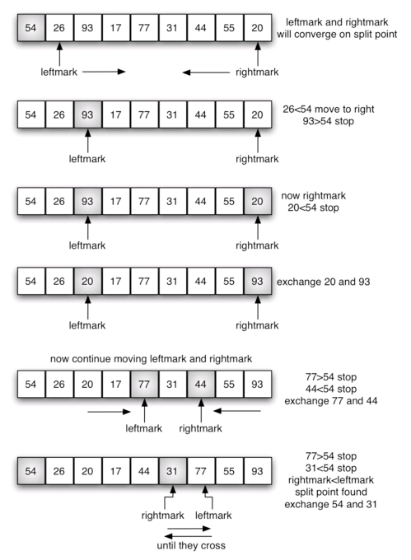
Swap elements that are on the “wrong” side of the pivot

Slide 28
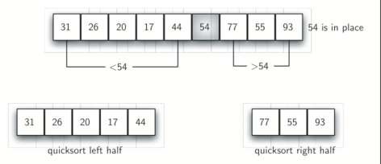
When leftmark and rightmark cross …. Swap the pivot with the value at rightmark
http://www.sorting-algorithms.com/quick-sort

Slide 29
Quick Sort
def quickSort(alist):
quickSortHelper(alist,0,len(alist)-1)
def quickSortHelper(alist,first,last):
if first<last:
splitpoint = partition(alist,first,last) #code on next slide
quickSortHelper(alist,first,splitpoint-1)
quickSortHelper(alist,splitpoint+1,last)

Slide 30
def partition(alist,first,last):
pivotvalue = alist[first]
leftmark = first+1
rightmark = last
done = False
while not done:
while leftmark <= rightmark and alist[leftmark] <= pivotvalue:
leftmark = leftmark + 1
while alist[rightmark] >= pivotvalue and rightmark >= leftmark:
rightmark = rightmark -1
if rightmark < leftmark:
done = True
else:
temp = alist[leftmark]
alist[leftmark] = alist[rightmark]
alist[rightmark] = temp
temp = alist[first]
alist[first] = alist[rightmark]
alist[rightmark] = temp
return rightmark

Slide 31
Picking the Pivot
Use the first element as pivot
  If the input is random, ok
  If the input is presorted (or in reverse order)
    All the elements go into S2 (or S1)
    This happens consistently throughout the recursive calls
    Results in O(n²) behavior (Analyze this case later)
Choose the pivot randomly
  Generally safe
  Random number generation can be expensive

Slide 32
Picking the Pivot
Use the median of the array
  Partitioning always cuts the array into roughly half
  An optimal quicksort (O(N log N))
  However, hard to find the exact median
    e.g., sort an array to pick the value in the middle

Slide 33
Pivot: median of three
We will use median of three
  Take the median of three elements
    The element at first
    The element at last
    The element at the middle index (first + last)//2

Slide 34
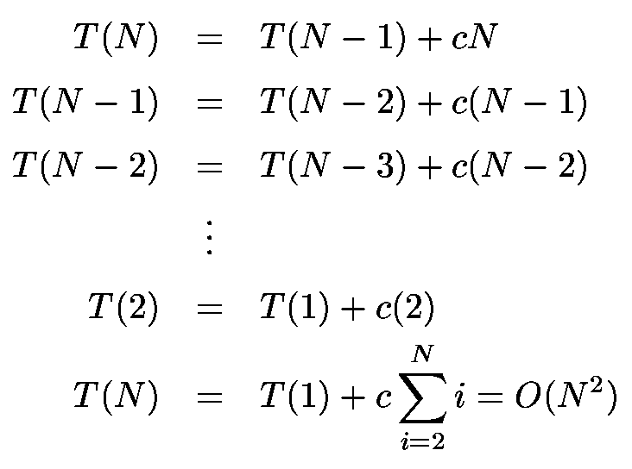
Worst-Case Analysis
What will be the worst case?
  The pivot is the smallest element, all the time
  Partition is always unbalanced

Slide 35
Best-case Analysis
What will be the best case?
  Partition is perfectly balanced.
  Pivot is always in the middle (median of the array)

Slide 36
Average-Case Analysis
Assume
  Each of the sizes for S1 is equally likely
This assumption is valid for our pivoting (median-of-three) and partitioning strategy
On average, the running time is O(N log N)

Slide 37
Quicksort Faster than Mergesort
Both quicksort and mergesort take O(N log N) in the average case.
Why is quicksort often faster than mergesort?
  The inner loops consists of an increment/decrement (by 1, which is fast), a test and a jump.
  There is no extra juggling of memory as in mergesort.
When might mergesort be faster than quicksort?
  For lists with many duplicate elements
  For partially sorted lists
  In programming languages where comparison is expensive (comparing objects in Java is expensive)
    Mergesort will use less comparisons than quicksort

Slide 38
Quicksort has a reputation as the fastest sort. Optimized variants of quicksort are common features of many languages and libraries. One often contrasts quicksort with merge sort, because both sorts have an average time of O(n log n).
"On average, mergesort does fewer comparisons than quicksort, so it may be better when complicated comparison routines are used. Mergesort also takes advantage of pre-existing order, so it would be favored for using sort() to merge several sorted arrays. On the other hand, quicksort is often faster for small arrays, and on arrays of a few distinct values, repeated many times." — http://perldoc.perl.org/sort.html

Slide 39
Quicksort is a conquer-then-divide algorithm, which does most of the work during the partitioning and the recursive calls.
Merge sort is a divide-then-conquer algorithm. The partitioning happens in a trivial way, by splitting the input array in half. Most of the work happens during the recursive calls and the merge phase.
With quicksort, every element in the first partition is less than or equal to every element in the second partition. Therefore, the merge phase of quicksort is trivial!
Quicksort and merge sort at the opposite ends of the divide-and-conquer algorithm spectrum.

Slide 40
What does Python use when you call the built-in sort?
Timsort http://svn.python.org/projects/python/trunk/Objects/listsort.txt
Worst case: O(n log n)
Modified version of mergesort
  Uses insertion sort for small list segments
  In a nutshell, the main routine marches over the array once, left to right, alternately identifying the next run, then merging it into the previous runs "intelligently". Everything else is complication for speed, and some hard-won measure of memory efficiency.

Slide 41
Is N Log N the best we can do?
For comparison-based sorting, yes.

