Slide 1
DS-MITM Attack
2025/05/22
邓卫青

Slide 2
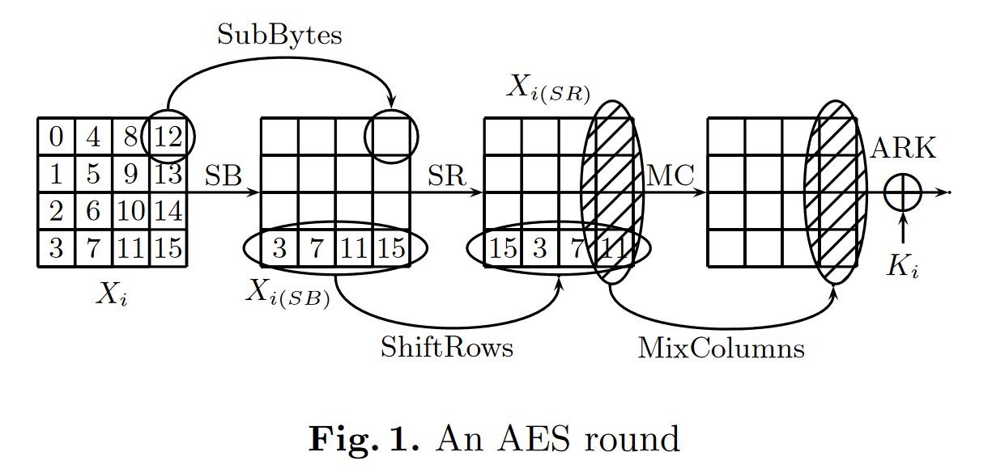
AES

Slide 3
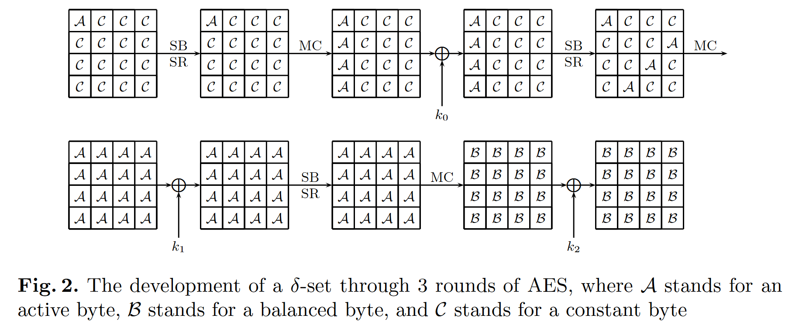
The Square Property of AES
$$∑E=c_{1}∑X+c_{2}∑Y+c_{3}∑Z+c_{4}∑W$$
Notes:
S盒是双射，所以遍历的字节经过S盒还是遍历的字节；
E=c1*X+c2*Y+c3*Z+c4*W.

Slide 4
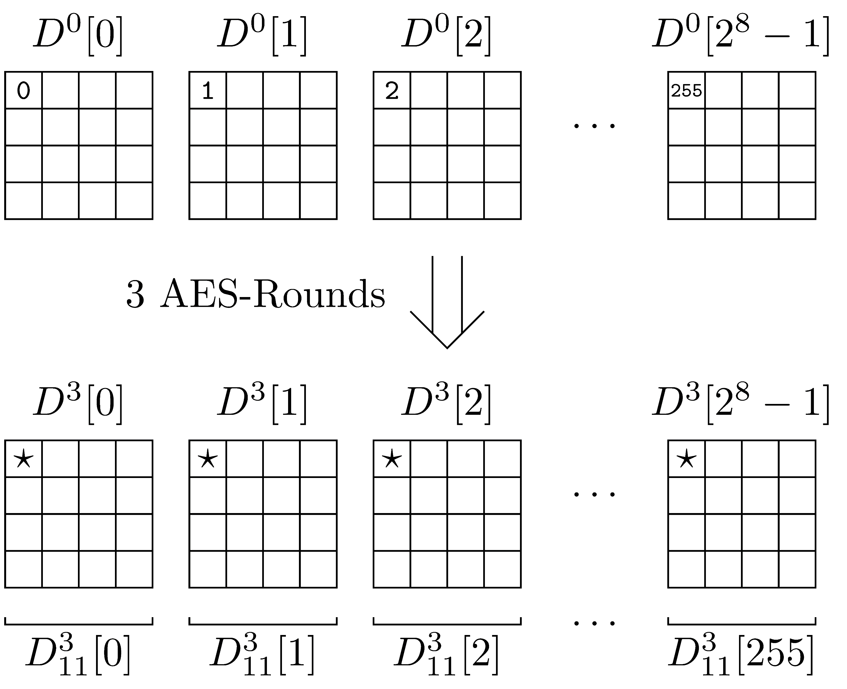

A 3-Round Distinguisher of AES
The 256 bytes sequence can assume $2^{72}$ values at most (out of the $2^{256×8}$ theoretically possible values).
Notes:
DS-MITM的思路是利用一组delta-set经过几轮加密后，密文序列的不随机特性来进行攻击。

Slide 5
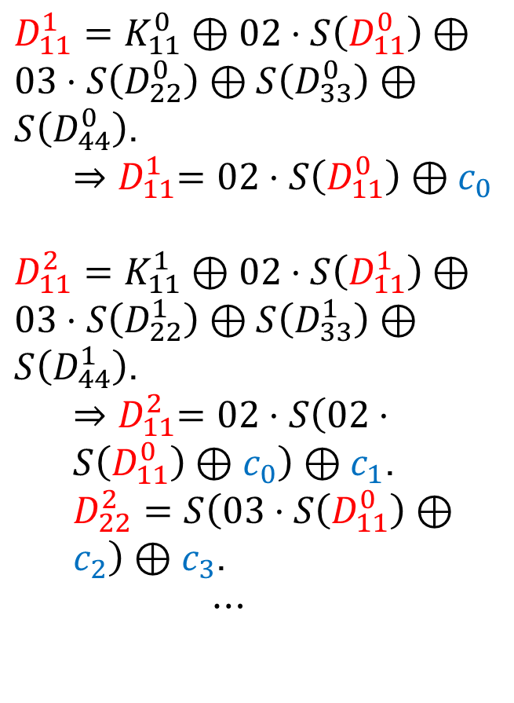
A 3-Round Distinguisher of AES
$D_{11}^{1}=K_{11}^{0}⊕02⋅S\left(D_{11}^{0}\right)⊕03⋅S\left(D_{22}^{0}\right)⊕S\left(D_{33}^{0}\right)⊕S\left(D_{44}^{0}\right)$.
$${⇒D}_{11}^{1}=02⋅S\left(D_{11}^{0}\right)⊕c_{0}$$
$D_{11}^{2}=K_{11}^{1}⊕02⋅S\left(D_{11}^{1}\right)⊕03⋅S\left(D_{22}^{1}\right)⊕S\left(D_{33}^{1}\right)⊕S\left(D_{44}^{1}\right)$.
${⇒D}_{11}^{2}=02⋅S\left(02⋅S\left(D_{11}^{0}\right)⊕c_{0}\right)⊕c_{1}$.
$D_{22}^{2}=S\left(03⋅S\left(D_{11}^{0}\right)⊕c_{2}\right)⊕c_{3}$.
$$⋯$$

Slide 6
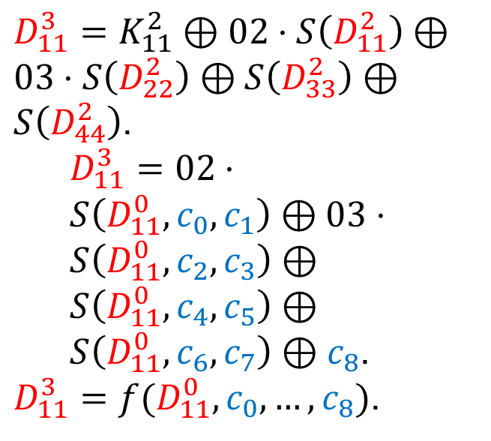
A 3-Round Distinguisher of AES
$D_{11}^{3}=K_{11}^{2}⊕02⋅S\left(D_{11}^{2}\right)⊕03⋅S\left(D_{22}^{2}\right)⊕S\left(D_{33}^{2}\right)⊕S\left(D_{44}^{2}\right)$.
$D_{11}^{3}=02⋅S\left(D_{11}^{0},c_{0},c_{1}\right)⊕03⋅S\left(D_{11}^{0},c_{2},c_{3}\right)⊕S\left(D_{11}^{0},c_{4},c_{5}\right)⊕S\left(D_{11}^{0},c_{6},c_{7}\right)⊕c_{8}$.
$D_{11}^{3}=f(D_{11}^{0},c_{0},…,c_{8})$.

Slide 7
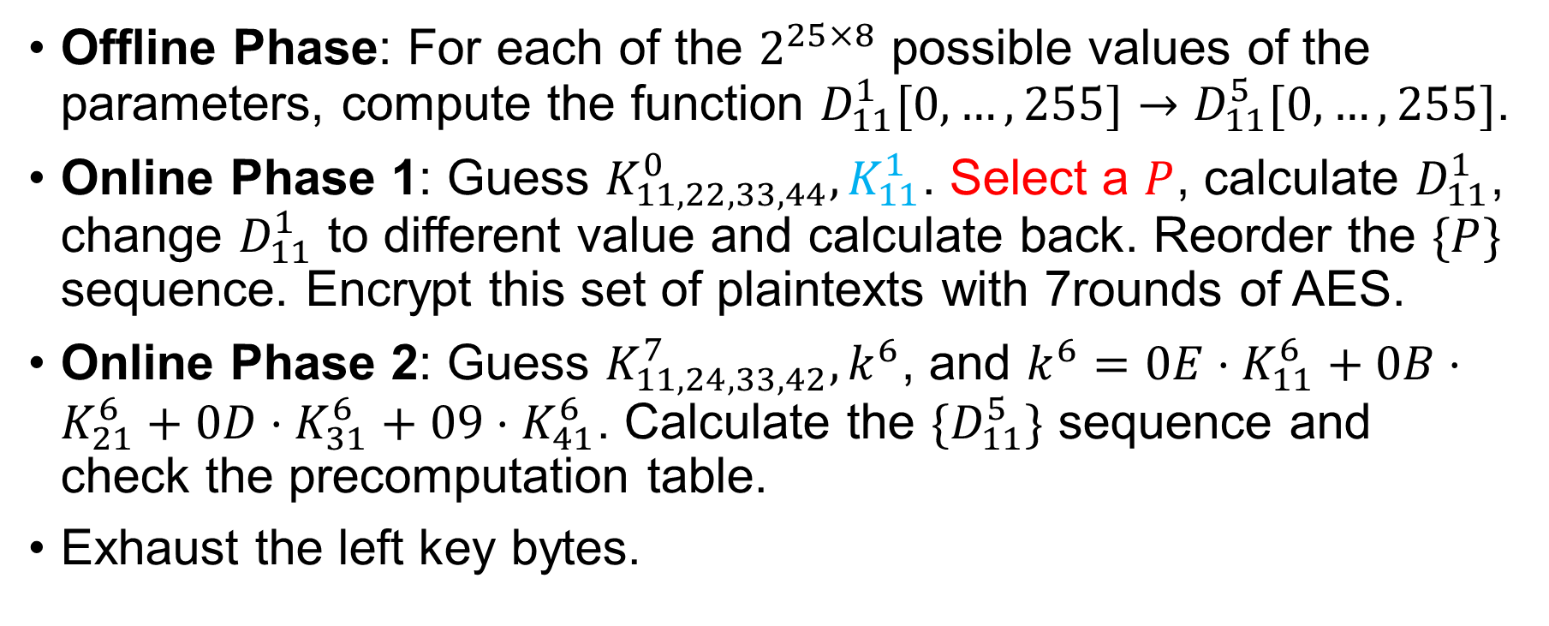
A 7-Round Attack on AES-256
Offline Phase: For each of the $2^{25×8}$ possible values of the parameters, compute the function $D_{11}^{1}[0,…,255]→D_{11}^{5}[0,…,255]$.
Online Phase 1: Guess $K_{11,22,33,44}^{0},K_{11}^{1}$. Select a $P$, calculate $D_{11}^{1}$, change $D_{11}^{1}$ to different value and calculate back. Reorder the $\{P\}$ sequence. Encrypt this set of plaintexts with 7rounds of AES.
Online Phase 2: Guess $K_{11,24,33,42}^{7},k^{6}$, and $k^{6}=0E⋅K_{11}^{6}+0B⋅K_{21}^{6}+0D⋅K_{31}^{6}+09⋅K_{41}^{6}$. Calculate the $\{D_{11}^{5}\}$ sequence and check the precomputation table.
Exhaust the left key bytes.
Notes:
对于四轮区分器来说，参数个数并非想象的4*9+1=37而是25，这是因为中间涉及到的常数有重复的情况。

Slide 8

Complexity
$T_{off}=256×2^{25×8}=2^{208}$.
$T_{on}=256×2^{10×8}=2^{88}$.
$D=2^{32}$.
$M=2^{208}$.

Slide 9
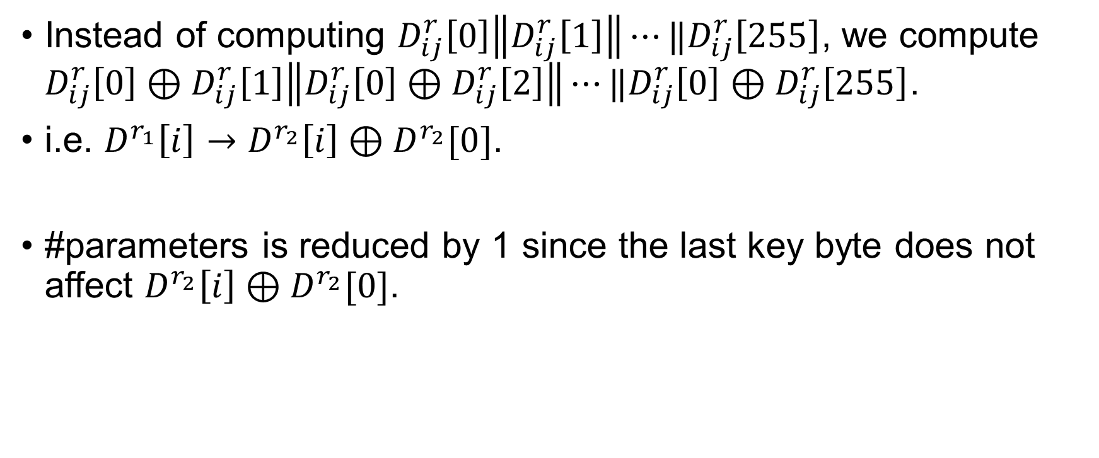
Improvement: XOR Sequence
Instead of computing $D_{ij}^{r}\left[0\right]\left\|D_{ij}^{r}\left[1\right]\right\|⋯‖D_{ij}^{r}\left[255\right]$, we compute $D_{ij}^{r}\left[0\right]⊕D_{ij}^{r}\left[1\right]\left\|D_{ij}^{r}\left[0\right]⊕D_{ij}^{r}\left[2\right]\right\|⋯‖D_{ij}^{r}\left[0\right]⊕D_{ij}^{r}\left[255\right]$.
i.e. $D^{r_{1}}\left[i\right]→D^{r_{2}}\left[i\right]⊕D^{r_{2}}[0]$.
#parameters is reduced by 1 since the last key byte does not affect $D^{r_{2}}\left[i\right]⊕D^{r_{2}}[0]$.
Notes:
Difference instead of Value.

Slide 10
Observation (How to determine #parameters)
Notes:
Intersection of determination and differential.

Slide 11
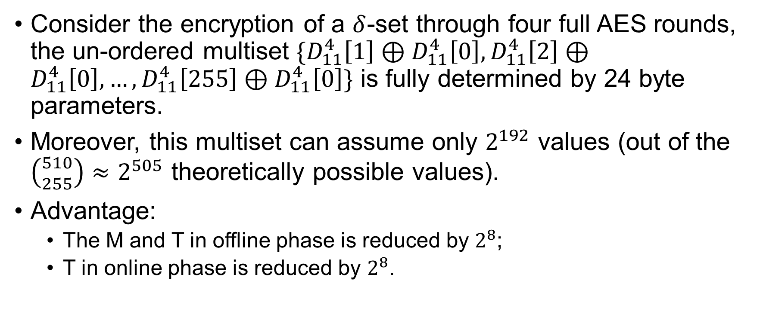
Improvement: Multiset
Consider the encryption of a $δ$-set through four full AES rounds, the un-ordered multiset $\{D_{11}^{4}\left[1\right]⊕D_{11}^{4}\left[0\right],D_{11}^{4}\left[2\right]⊕D_{11}^{4}\left[0\right],…,D_{11}^{4}\left[255\right]⊕D_{11}^{4}\left[0\right]\}$ is fully determined by 24 byte parameters.
Moreover, this multiset can assume only $2^{192}$ values (out of the $\left({510 \atop 255}\right)≈2^{505}$ theoretically possible values).
Advantage:
The M and T in offline phase is reduced by $2^{8}$;
T in online phase is reduced by $2^{8}$.
Notes:
进一步的，我们可以将256字节的序列看作一个多重集，这能带来一些好处。
Online phase时间减少是因为，我们不关心区分器头0号字节的顺序（Multiset），所以不需要猜测K1的0号字节（直接在第二个ARK之前遍历就行）。

Slide 12
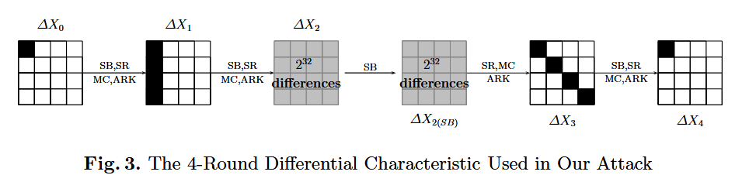

Improvement: Differential Enumeration
First we find a pair $(P_{0},P_{1})$ satisfy this truncated differential.
Take both of them as $D[0]$.
$2^{128}→2^{64}$, so $T_{off}=256×2^{192−64}=2^{136}$.
Lower precomputation complexities, higher data complexities.
Notes:
利用截断差分的特性构造delta-set（本质上是需要让这个delta-set的头一个满足特殊的性质），首先分析这条差分路径，若有一对满足差分路径的pair，则X2处期望只有2^{64}种取值而非2^{128}种。
我们预计算需要猜测SubBytes前D[0]的具体值（例如四轮区分器），这样就可以减少复杂度。

Slide 13
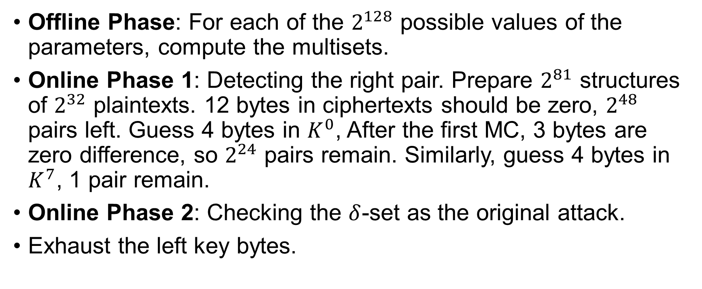
Improved Attack on AES
Offline Phase: For each of the $2^{128}$ possible values of the parameters, compute the multisets.
Online Phase 1: Detecting the right pair. Prepare $2^{81}$ structures of $2^{32}$ plaintexts. 12 bytes in ciphertexts should be zero, $2^{48}$ pairs left. Guess 4 bytes in $K^{0}$, After the first MC, 3 bytes are zero difference, so $2^{24}$ pairs remain. Similarly, guess 4 bytes in $K^{7}$, 1 pair remain.
Online Phase 2: Checking the $δ$-set as the original attack.
Exhaust the left key bytes.
Notes:
每个structure能产生2^63对，63+81-96=48.
注意：并非delta-set中每一个和D[0]的差分都满足truncated differential，但是我们知道D[0]是满足的，所以取值范围有限制，而我们正是需要猜测D[0]的具体值。

Slide 14

Complexity
$T_{off}=256×2^{128}=2^{136}$.
$T_{on}=2^{81+32}+2^{32+48}+2^{32+24+32}+2^{8+32+32+8}=2^{113}$.
$D=2^{113}$.
$M=2^{128}$.

Slide 15
References
Demirci, Hüseyin, and Ali Aydın Selçuk. "A meet-in-the-middle attack on 8-round AES." Fast Software Encryption: 15th International Workshop, FSE 2008, Lausanne, Switzerland, February 10-13, 2008, Revised Selected Papers 15. Springer Berlin Heidelberg, 2008.
Dunkelman, Orr, Nathan Keller, and Adi Shamir. "Improved single-key attacks on 8-round AES-192 and AES-256." Advances in Cryptology-ASIACRYPT 2010: 16th International Conference on the Theory and Application of Cryptology and Information Security, Singapore, December 5-9, 2010. Proceedings 16. Springer Berlin Heidelberg, 2010.
Shi, Danping, et al. "Programming the Demirci-Selçuk meet-in-the-middle attack with constraints." International Conference on the Theory and Application of Cryptology and Information Security. Cham: Springer International Publishing, 2018.
Shi, Danping, et al. "Exploiting non-full key additions: full-fledged automatic Demirci-Selcuk meet-in-the-middle cryptanalysis of skinny." Annual International Conference on the Theory and Applications of Cryptographic Techniques. Cham: Springer Nature Switzerland, 2023.

Slide 16
Thanks!

