Slide 1
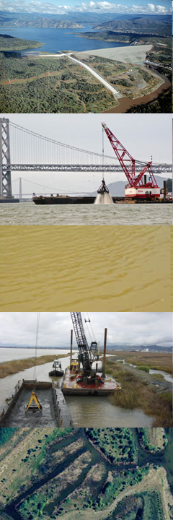

DSM2 Sediment Transport Module
DSM2 User Group and CWEMF sponsored
Technical Advisory Committee Meeting
January 13, 2010
Jamie Anderson, Ph.D., P.E.
Department of Water Resources
Modeling Support Branch
Bay-Delta Office

Slide 2
Thanks for the refreshments

Slide 3
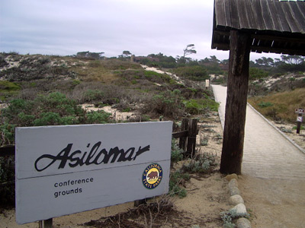
California Water and Environmental Modeling Forum Conference
Feb 22-24, 2010
Asilomar near Monterey
STM update in DSM2 session
http://cwemf.org

Slide 4

Agenda
Welcome and Introductions
Questionnaire
Project Overview Jamie Anderson, DWR
Project Progress Jamie Anderson, DWR and Fabian Bombardelli, UCD
Issues for TAC Input Fabian Bombardelli, UCD
Discussion and wrap up
Web site for materials:
http://baydeltaoffice.water.ca.gov/modeling/deltamodeling/models/stm/stm.cfm

Slide 5
Name
Affiliation
Interest / experience with sediment transport

Slide 6
Questionnaire
What features are important to you for the Sediment Transport Model and its application to the Delta?
Do you know of any data sets or Delta sediment transport studies that you think that the model development team should investigate?
Is there anything else that you would like us to know and/or consider when developing STM?

Slide 7
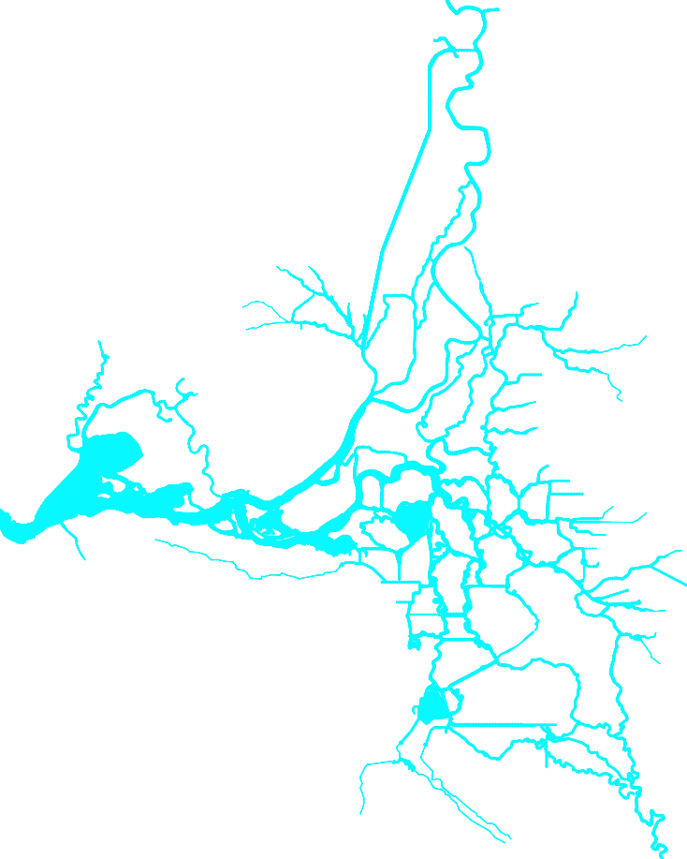
Questionnaire: Sediment in Delta
Mostly
Cohesive
Mostly
Non-cohesive
Mixed Cohesive and
Non-cohesive
Mixed Cohesive and
Non-cohesive
Non-cohesive
Other draw your own
Cohesive
Cohesive
Mixed Cohesive and
Non-cohesive
Non-cohesive

Slide 8
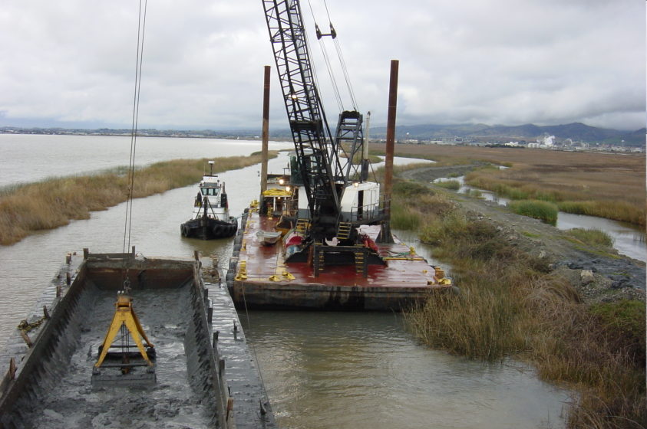
Issues Related to Sediment Transport in the Delta
Dredging
Levee failures
Marsh restoration
Turbidity / fish migration
Mercury/heavy metal transport
Channel bed level changes
Erosion
Deposition

Slide 9
Contract to Develop STM
2 year MACHRO contract with UC Davis
PI Fabian Bombardelli Civil & Env. Engineering
Graduate student Kaveh Zamani (modeling)
Graduate students Jamie Kohne & Joseph Waltz (data)*
Project products
Web site with available sediment data in the Delta
Sediment Transport Module (STM) for DSM2
Suspended sediment and bed load
Multiple sediment class sizes
One-dimensional model
STM=Sediment Transport Module
*supported by another funding source

Slide 10
DSM2 Sediment Transport Module
HYDRO
Hydrodynamics
QUAL
Water Quality
PTM
Particle Tracking
STM
Sediment Transport

Slide 11
STM Project Deliverables
Establish Technical Advisory Committee
Meet twice a year
1-D sediment transport code-STM
Website with available Delta sediment data
Documentation
Progress reports
Complete code documentation and user manual
Journal articles
Training on how to use STM
STM=Sediment Transport Module

Slide 12

STM Code Development Plan
Flexible, modular design
Separate input/output routines to aid in generalization to other codes
Generalize Eulerian transport that could be adapted to other constituents
STM=Sediment Transport Module Eulerian=fixed frame of reference

Slide 13
Why did we create a new transport code instead of using QUAL?
QUAL is a moving frame of reference (Lagrangian) model
STM is a fixed frame of reference (Eulerian) model
Compatibility with other Eulerian codes/methods
Clean slate, develop testable code
Separate sources from transport
Sediment is one of the sources, but model could be applied to other sources as well
Sharing resources with a companion project
Future benefits
Could incorporate baroclinic term from HYDRO (couple HYDRO and transport)
Could be used for salinity based operating rules

Slide 14
STM Code Development Plan
Flexible, modular design
Separate input/output routines to aid in generalization to other codes
Generalize Eulerian transport that could be adapted to other constituents
Self-documenting code using Doxygen
STM=Sediment Transport Module Eulerian=fixed frame of reference

Slide 15
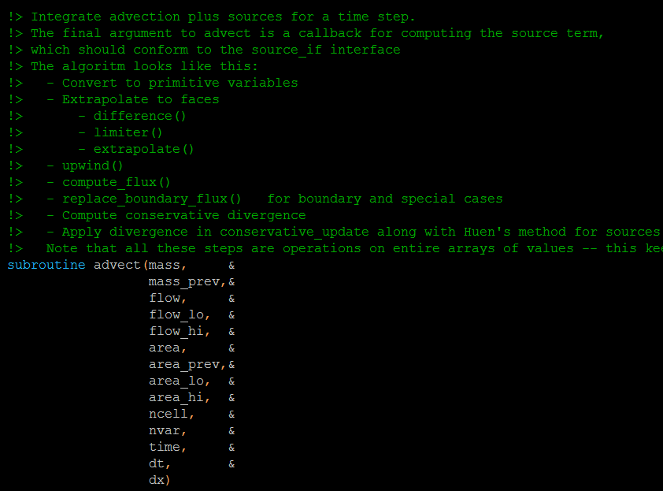
Self-Documenting Code using Doxygen

Slide 16
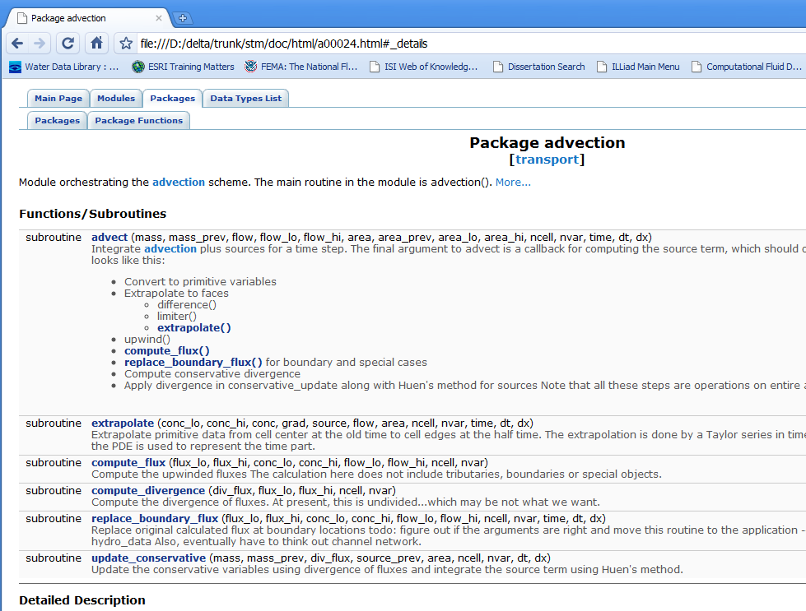
Self-Documenting Code using Doxygen

Slide 17
STM Code Development Plan
Flexible, modular design
Separate input/output routines to aid in generalization to other codes
Generalize Eulerian transport that could be adapted to other constituents
Self-documenting code using Doxygen
Companion testing routines
STM=Sediment Transport Module Eulerian=fixed frame of reference

Slide 18
STM Code Testing
STM Code
Testing Code
Calls STM functions
Each function in STM has companion testing code
Code and analytical tests
Test wide range of scenarios
Produce report of pass/fail result for all tests
Run tests regularly, in future automatic daily running of tests
STM=Sediment Transport Module

Slide 19


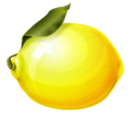




Fortran Unit Test Framework (FRUIT)
Unit testing
a software verification and validation method in which a programmer tests if individual units of source code
FRUIT
open source
written in Fortran 95
has assertion (true/false pass/fail), fixture, setup, teardown, report, spec generation, driver generation

Slide 20
Code Tests
Test all functions in the code
Provide input with known output, call code function ⇨ pass/fail
Test common and more importantly uncommon uses of that function
Example: Gradient
High value to low value, low value to high value
Low value to low value, high value to high value
End of channels
Positive and negative values, mixture of values

Slide 21
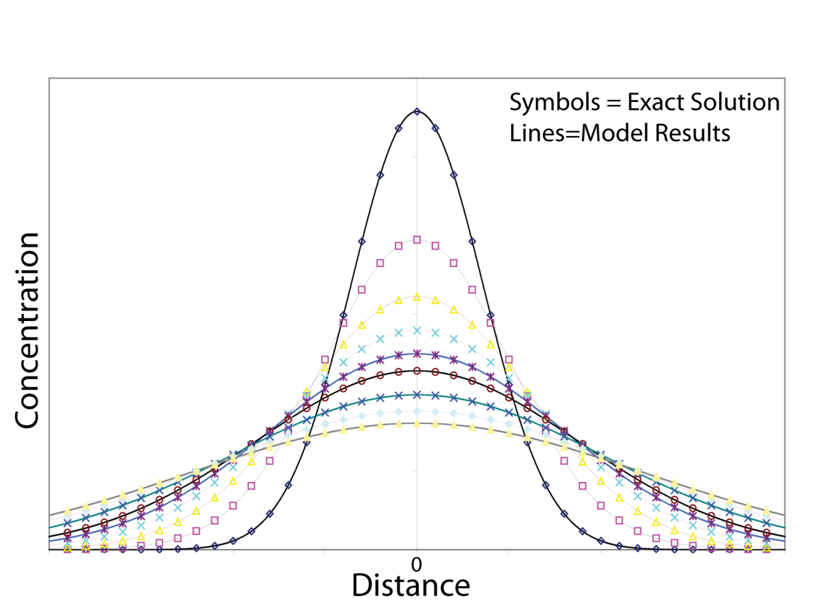
Analytical Test: Diffusion of one unit of mass
Symmetrical C=1/∆X at X=0 c=0 everywhere else

Slide 22
STM Code Development Plan
Flexible, modular design
Generalize Eulerian transport that could be adapted to other constituents
Self-documenting code using Doxygen
Companion testing routines
Assistance with code development from DWR staff
lead by Kevin Kao guidance from Eli Ateljevich and Nicky Sandhu
version control
Training on use of the model
STM=Sediment Transport Module Eulerian=fixed frame of reference

Slide 23
Sediment Transport Processes
Dispersion
Spreading out
Erosion /
Entrainment
Deposition/
Settling
Advection
Go with the flow
+ ^{and} –
Sources and Sinks
Advection
Dispersion
Erosion
Deposition
Source/Sink
Tributaries
Progress to Date: Single Channel
Advection
Dispersion
Erosion
Next step: Complete single channel model
Advection
Dispersion
Erosion
Deposition
Source/Sink
Tributaries
Next step: Extend model to a channel network

Slide 24
Highlights from TAC July 2009: Code
Initial STM plan
Suspended sediment
Single sediment particle size
Deposition only
STM runs after DSM2 HYDRO and doesn’t provide info to HYDRO
Revised STM plan after TAC
Suspended sediment
Ability for multiple sediment particle sizes, use 2 initially
Deposition and erosion
STM runs after DSM2 HYDRO and doesn’t provide info to HYDRO
Deposition dominates over longer time scales, but on a tidal timescale, both erosion and deposition are important
Resolving bed forms would not be possible in STM due to the spatial scale of DSM2
STM may never need to be integrated with HYDRO because bed changes in the Delta are typically small relative to the depth and flow

Slide 25
Highlights from TAC July 2009: Data
TAC members provided feedback on available field data sets
Partial data sets can be tricky. Where, when and how the data were collected is essential for putting the data in perspective, especially in a tidal system (spring/neap, ebb/flood)
It is important to identify data needs and strategies for dealing with data deficiencies.
Rick Oltmann from USGS looked at flow and sediment data around 2000 and found relating the data to be very challenging and frustrating.

Slide 26
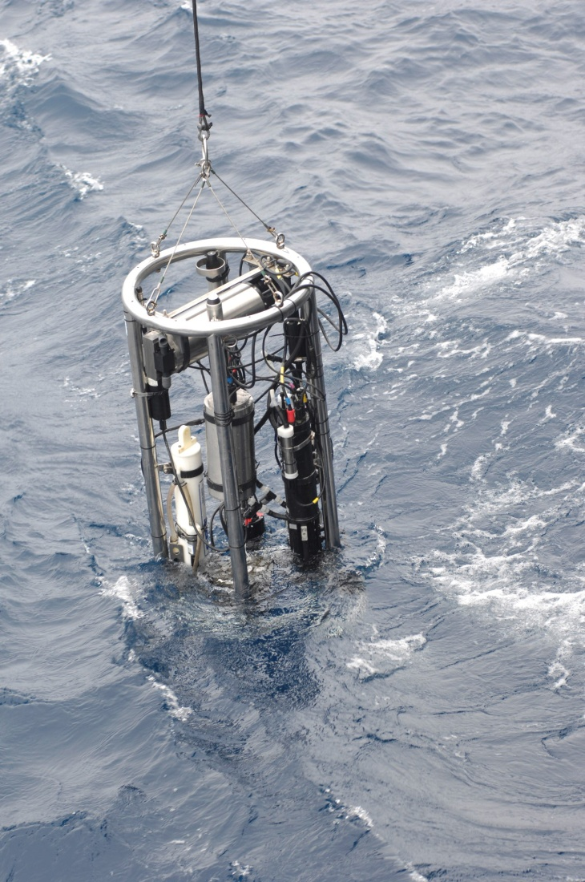
Available Field Data
What data do we need?
What data are available?
How do we deal with any data deficiencies?
Compiled by Jamie Kohne and Joseph Waltz at UCD
Report and links will be posted on the web

Slide 27
Technical
Details

Slide 28

Thank You!
Jamie Anderson
jamiea@water.ca.gov 916-654-5455
Fabian Bombardelli
fabianbombardelli2@gmail.com
530-752-0949
Photo by Ralph Finch Jan 4, 2006

Slide 29
Extra Slides

Slide 30
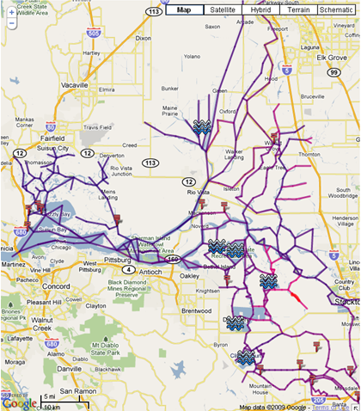
Delta Grid shaded by Manning’s n
Value range
0.018 (dark blue) to
0.045 (pink)
DSM2 Mini-calibration Grid

Slide 31
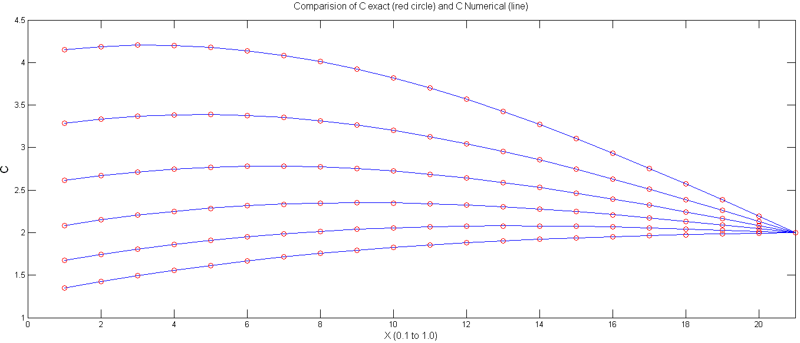
Analytical Test: Diffusion
Neumann boundary condition at x=0.1 (specify slope)
Dirichlet boundary condition at x=1.0 (specify value)
Exact solution
Numerical solution at
various times
Concentration
Distance from 0.1 to 1

Slide 32
Modes of Application
DSM2
Modes of Application
Historical
Replicate historical conditions
Forecasting
(Real-Time)
Project conditions for the near future
Planning
Hypothetical Delta changes

Slide 33
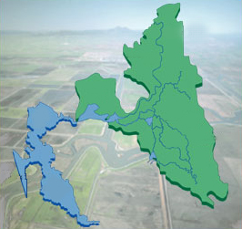
Delta Simulation Model 2 Domain
HYDRO-flow and velocity
QUAL-water quality
PTM-particle tracking
DSM2 Domain
Sacramento
Sacramento
River
Redding
Stockton
San
Joaquin
River
San
Francisco
San
Francisco
Los Angeles
San Diego
Bay-Delta detail image from CALFED

Slide 34
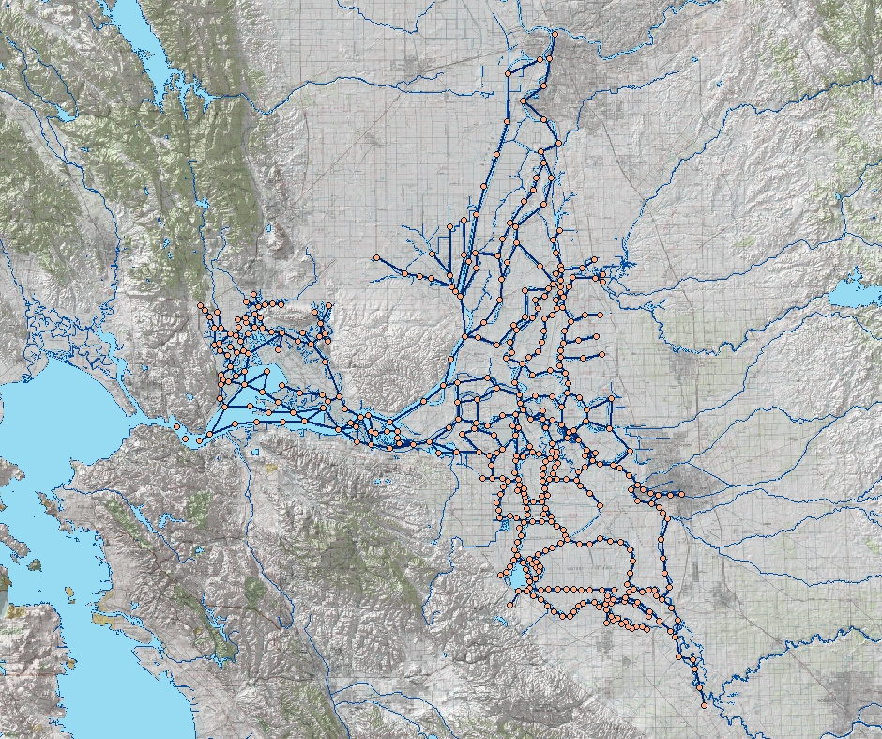
DSM2 Boundary Conditions
Sacramento
River
Sacramento
Inflow or concentration
Withdrawals
Tributaries
Consumptive Use
Martinez
Tidal Stage or Concentration
Stockton
Exports
Grid Image from USBR GIS Group
San Joaquin River
San Joaquin River

Slide 35
Hydro
Unsteady, one-dimensional, open channel flow model
Uses four-point-implicit solution scheme
Engine Developed by Lew DeLong (USGS). Module for Delta Developed by DWR Staff
Input Required
Delta geometry
Mannings n (calibration parameter)
Gate operation
Boundary Flows – inflows, exports, diversions
Boundary Stage (currently at Martinez)
Initial Conditions
Time step (usually 15 minutes)
Output Type and Locations
Notes:
NAME
FourPt - An unsteady, one-dimensional, open-channel flow model
ABSTRACT
FOURPT is a numerical model for simulating unsteady, one-dimensional
flow in networks of open channels. Options particularly useful in
training or prototyping include selection of governing equations
(kinematic, diffusion, or dynamic), boundary-value perturbation, and
user-programmable constraint equations. The model can simulate non-
trivial concepts, such as flow in complex interconnected channel
networks, meandering channels with variable effective flow lengths,
hydraulic structures defined by unique three-parameter relations,
and density-driven flow. Channel geometry may be rectangular,
trapezoidal, or irregular depending upon which of three channel-
property modules is linked with the program.
METHOD
As implied by the name, FOURPT uses the four-point-implicit solution
scheme. Simultaneous equations are solved by Gaussian elimination
using an indexed, asymmetric, sparse-matrix solver that is
particularly useful in application to large (hundreds of channels),
complex networks of interconnected channels. All relations
constraining unknown variables, discharge and water-surface
elevation, at boundaries and channel junctions are implemented
implicitly. The model is coded in Fortran 77, and data
encapsulation is used extensively to simplify modification and to
encourage the modification and use of FOURPT modules by other
programs and programmers.

Slide 36
Qual
Branched Lagrangian Transport Model
Engine Developed by Harvey Jobson (USGS), Qual Module developed by DWR Staff
Models dispersion of conservative constituents
Models kinetics and dispersion of non conservative constituents
Input
Delta geometry
Dispersion Coefficients (calibration parameter)
Rate Coefficients (calibration parameter for Non conservative coefficient)
Gate operation
Velocities and flow areas from Hydro output (Tide File)
Inflow and Ocean Boundary Quality
Atmospheric Inputs if needed for non conservative constituent modeling
Boundary Stage (currently at Martinez)
Initial Conditions
Time step (usually 15 minutes)
Output Type and Locations

Slide 37

Model Dimensionality
DSM2
a) 1-D representation
b) 2-D depth-averaged representation
Characteristics
Averaged
Characteristics
Averaged
c) 2-D laterally-averaged representation
d) 3-D representation
Characteristics
Averaged

Slide 38
STM Project Tasks
Task 1: Development of a sediment transport module for DSM2 able to deal with cohesive and non-cohesive sediment.
Task 2: Verification and validation of STM with laboratory tests taken from the literature.
Task 3: Organization of an inventory of datasets with information on sediment transport in the Delta.
Task 4: Selection of scenarios from datasets corresponding to sediment transport in the Delta, and validation of the sediment transport module with those scenarios.
Task 5: Application of the resulting numerical model to assess historical and future conditions in the Delta
STM=Sediment Transport Module

Slide 39
Sediment Data Sources
Suspended Sediment
USGS
continuous monitoring 1989-2007
Quarterly reports for water year 1998
Total Suspended Solids
Bay and Delta Tributaries Project
Sacramento Regional County Sanitation District (6xyr)
Turbidity
USGS real time water quality monitoring
Bay and Delta Tributaries Project (BDAT)
Sacramento Regional County Sanitation District (6xyr)
IEP 15 min for year 2000
Sacramento Municipal Utility District (SMUD) seasonal
Bathymetry
DWR Central District (twice per year), Division of Engineering
Particle Size Distribution
Ted Swift, DWR 6 distributions from throughout the Delta

