Slide 1


Using Software Quality and Algorithm Testing to Verify a 1-Dimensional Transport Model
World Environmental and Water Resources Congress
Palm Springs, May 23, 2011
Kaveh Zamani
Fabian Bombardelli
Eli Ateljevich
Jamie Anderson
Civil & Environmental Engineering Dept.
University of California, Davis
Modeling Support Branch, Bay-Delta Office
Department of Water Resources

Slide 2

Verification: how to find a bug in a forest?

Slide 3


There were 8/12 serious static faults per 1000 lines of executable files in C/Fortran! (SAND 2002-0529)

Slide 4
How to develop a fully testable and tested transport code?
This Talk:
STM (Sediment and Transport Module)
Software testing
Verification measures
Transport test suite
Challenges
Result

Slide 5
STM:Software testing: Verification:Transport test: Challenges:Results : Governing Equation and Solution Algorithm
HYDRO
Hydrodynamic
STM
1-D sediment transport model
QUAL
1-D fate and transport
PTM
Quasi 3-D particle Tracking
Structure of Delta Simulation Model 2 (DSM2)
Operator splitting to combine:
Modified Lax Two Step method + ODE integrator (Advection, Reaction )
Crank- Nicolson in FVM framework (Dispersion)

Slide 6
STM:Software testing: Verification:Transport test: Challenges:Results : STM Project Goals
Modular design
Applicable in tidal environments
Generalize Eulerian transport solver that could be adapted to other constituents
Second order accuracy
Shock capturing
Mass conservative
Well tested
Associated dynamic testing for development

Slide 7


STM:Software testing: Verification:Transport test: Challenges:Results : STM Code Testing
(Fortran Unit Test Framework)
Each function in STM has tests
Code and analytical tests
Each test puts light of a part
Test wide range of scenarios
Test for bad/incomplete input
Produce report of pass/fail result
Run tests regularly
STM=Sediment and Transport Module

Slide 8
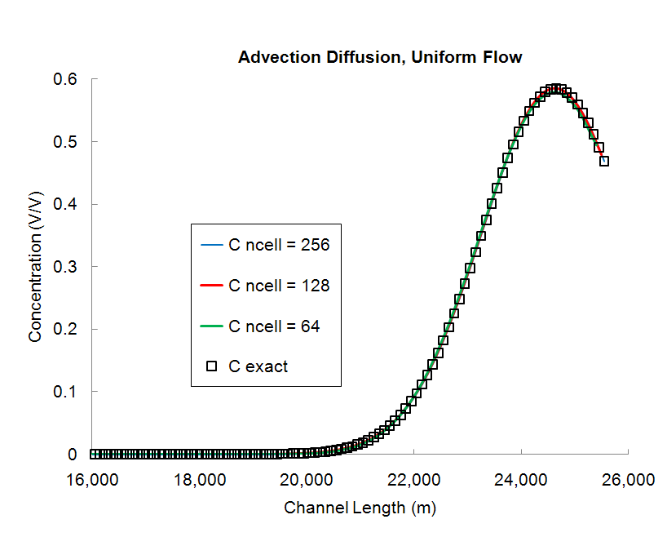
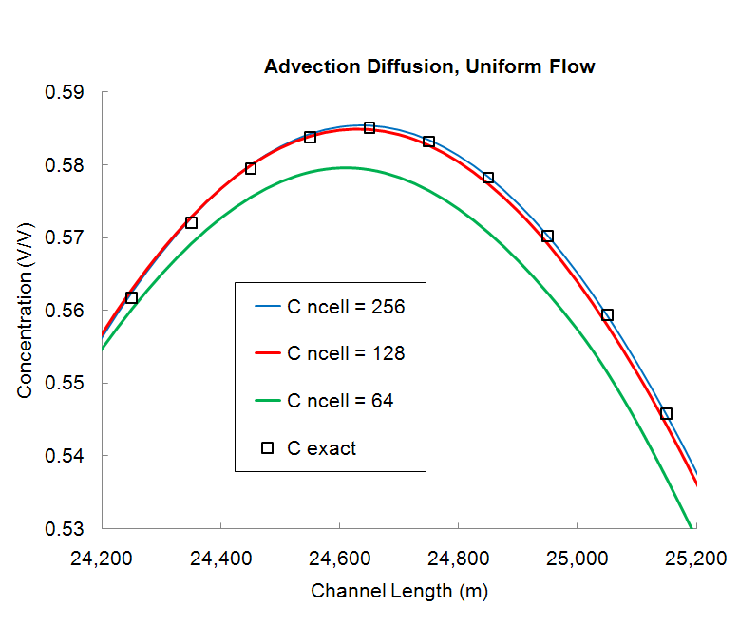
STM:Software testing: Verification:Transport test: Challenges:Results : Convergence
Testing versus analytical solution
Richardson Extrapolation
Method of Manufactured Solution
Prescribed Forcing Method
Perturbation
Using symmetry
Error analysis
Dense mesh solution

Slide 9
STM:Software testing: Verification:Transport test: Challenges:Results :
Are convergence tests enough?
No! They are brutal. They expose bugs. But they leave behind some bugs as well.
A
Error
B
a
b
1
1
Nominal scheme’s order of accuracy (2)
2≈a > b
1
Grid Size
After Leveque, 2002

Slide 10
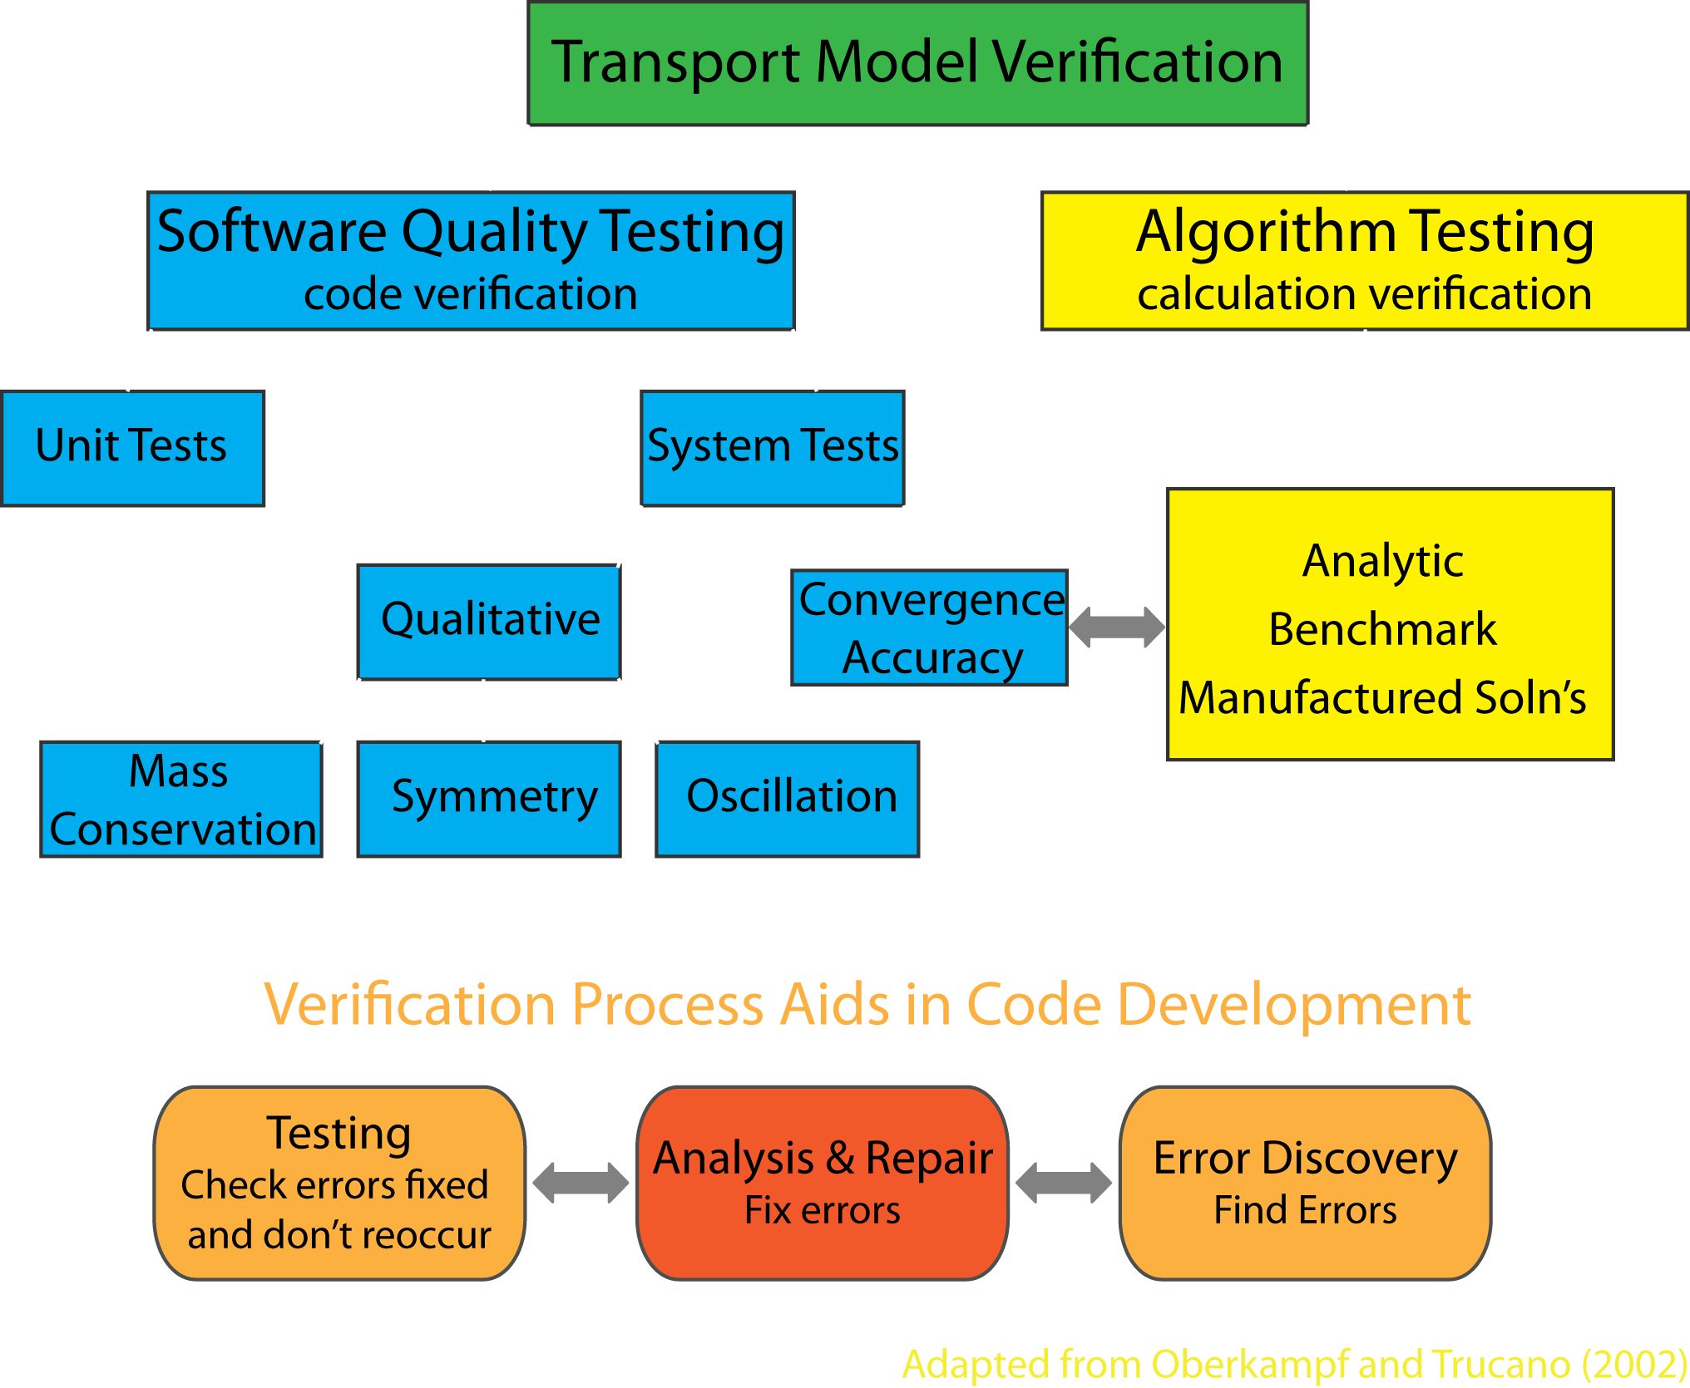
STM:Software testing: Verification:Transport test: Challenges:Results :
Transport Test Suite
Adapted from Oberkampf and Trucano, 2002

Slide 11
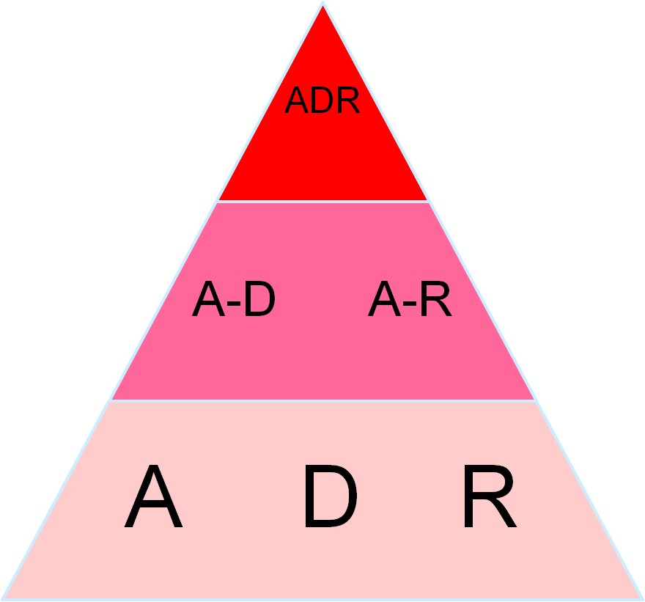
STM:Software testing: Verification:Transport test: Challenges:Results :
Incremental nature of the tests
Boundary values: remote Active
Flow field and coefficients: constant Variable
Single process Double process Triple process
2nd order
accuracy

Slide 12
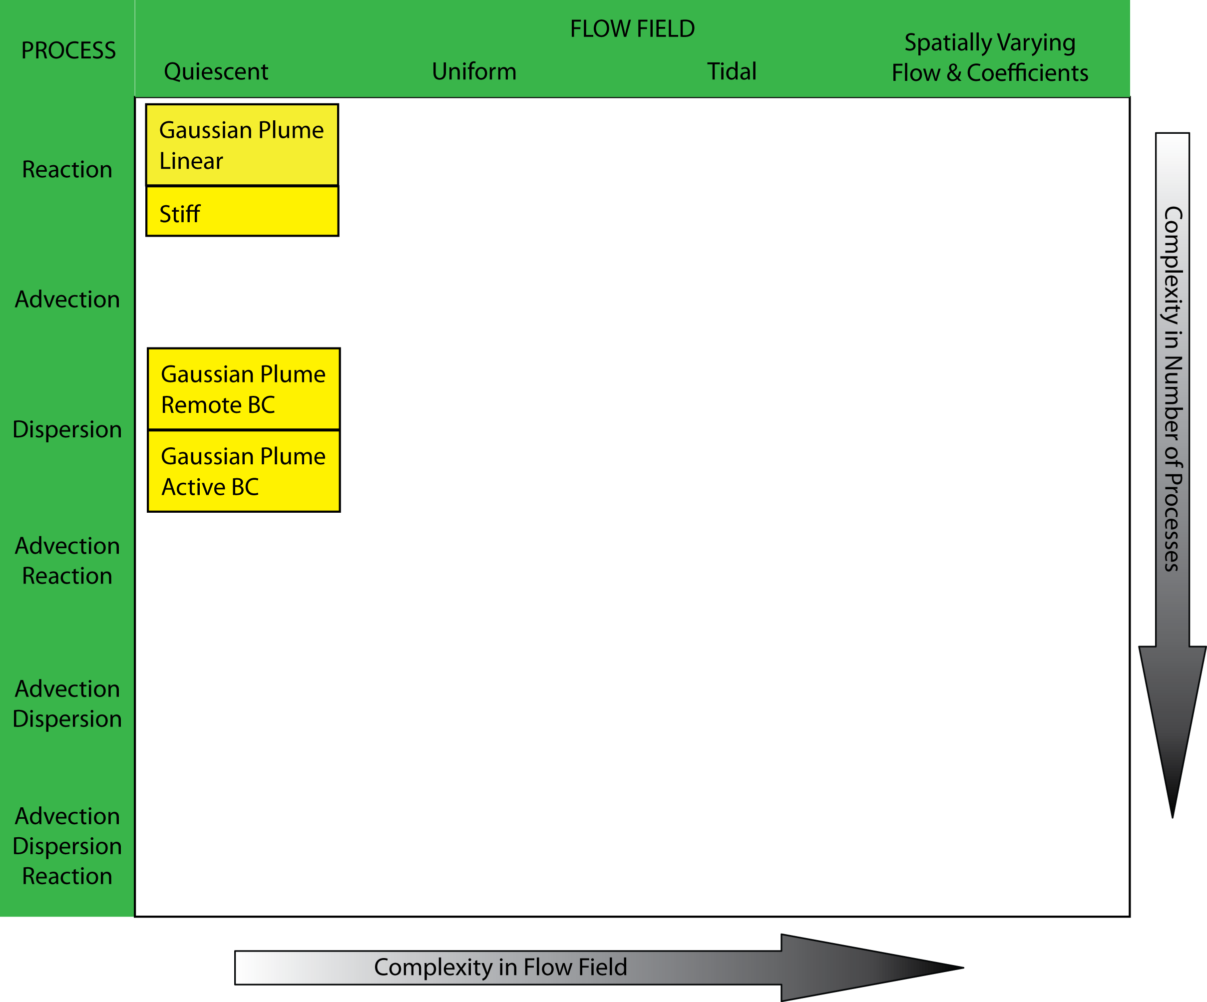
STM:Software testing: Verification:Transport test: Challenges:Results :
Layering in complexity

Slide 13
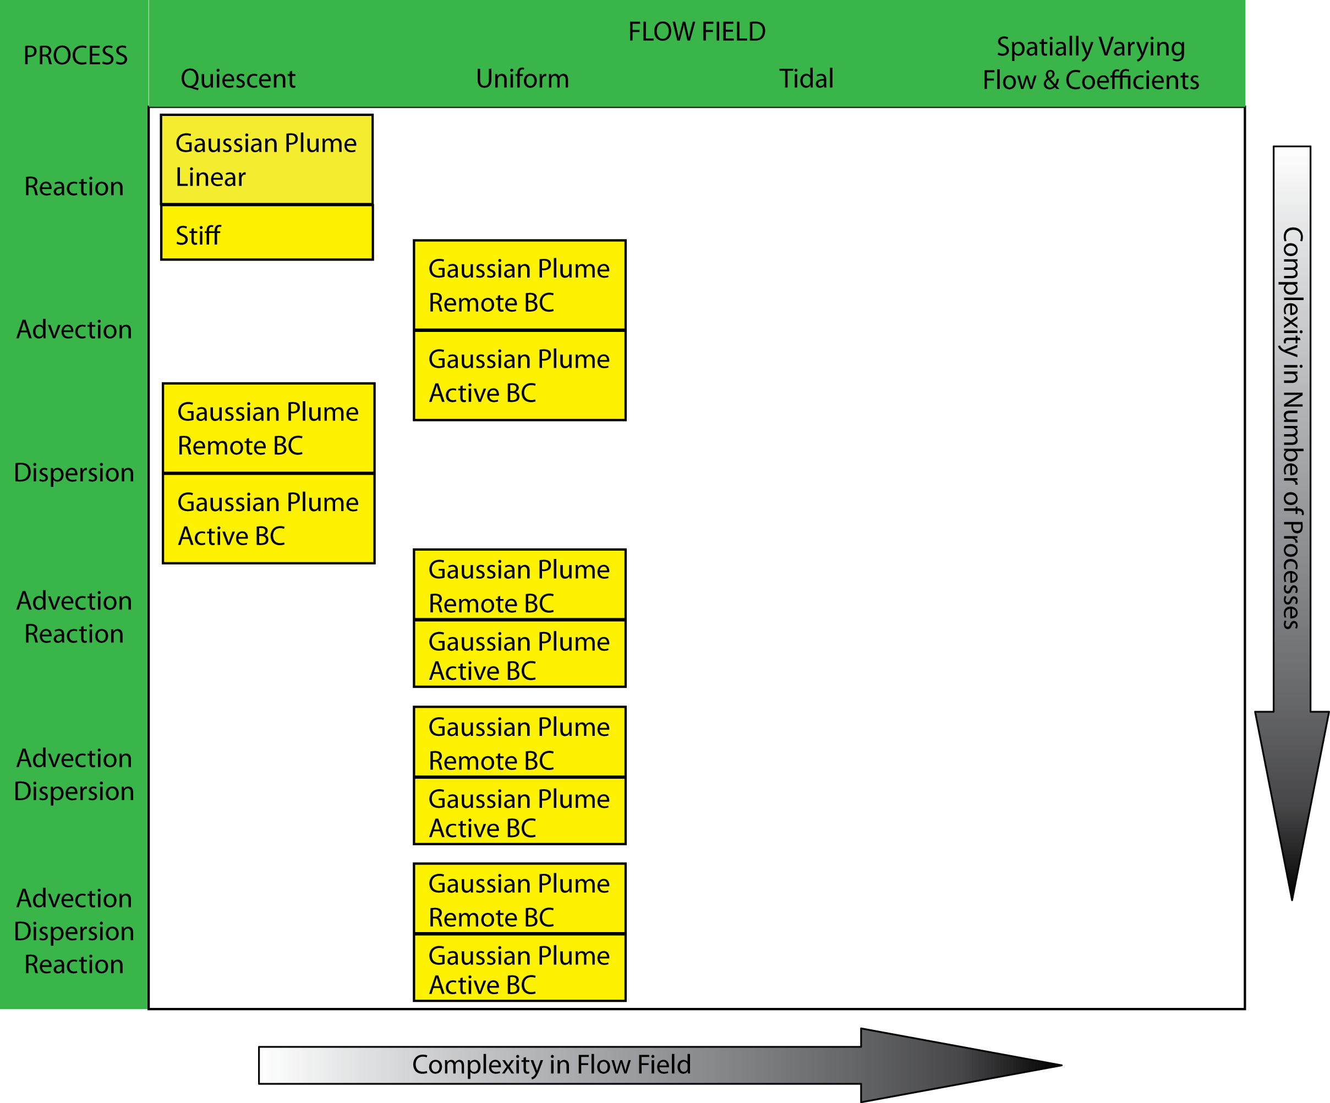
STM:Software testing: Verification:Transport test: Challenges:Results :
Layering in complexity

Slide 14
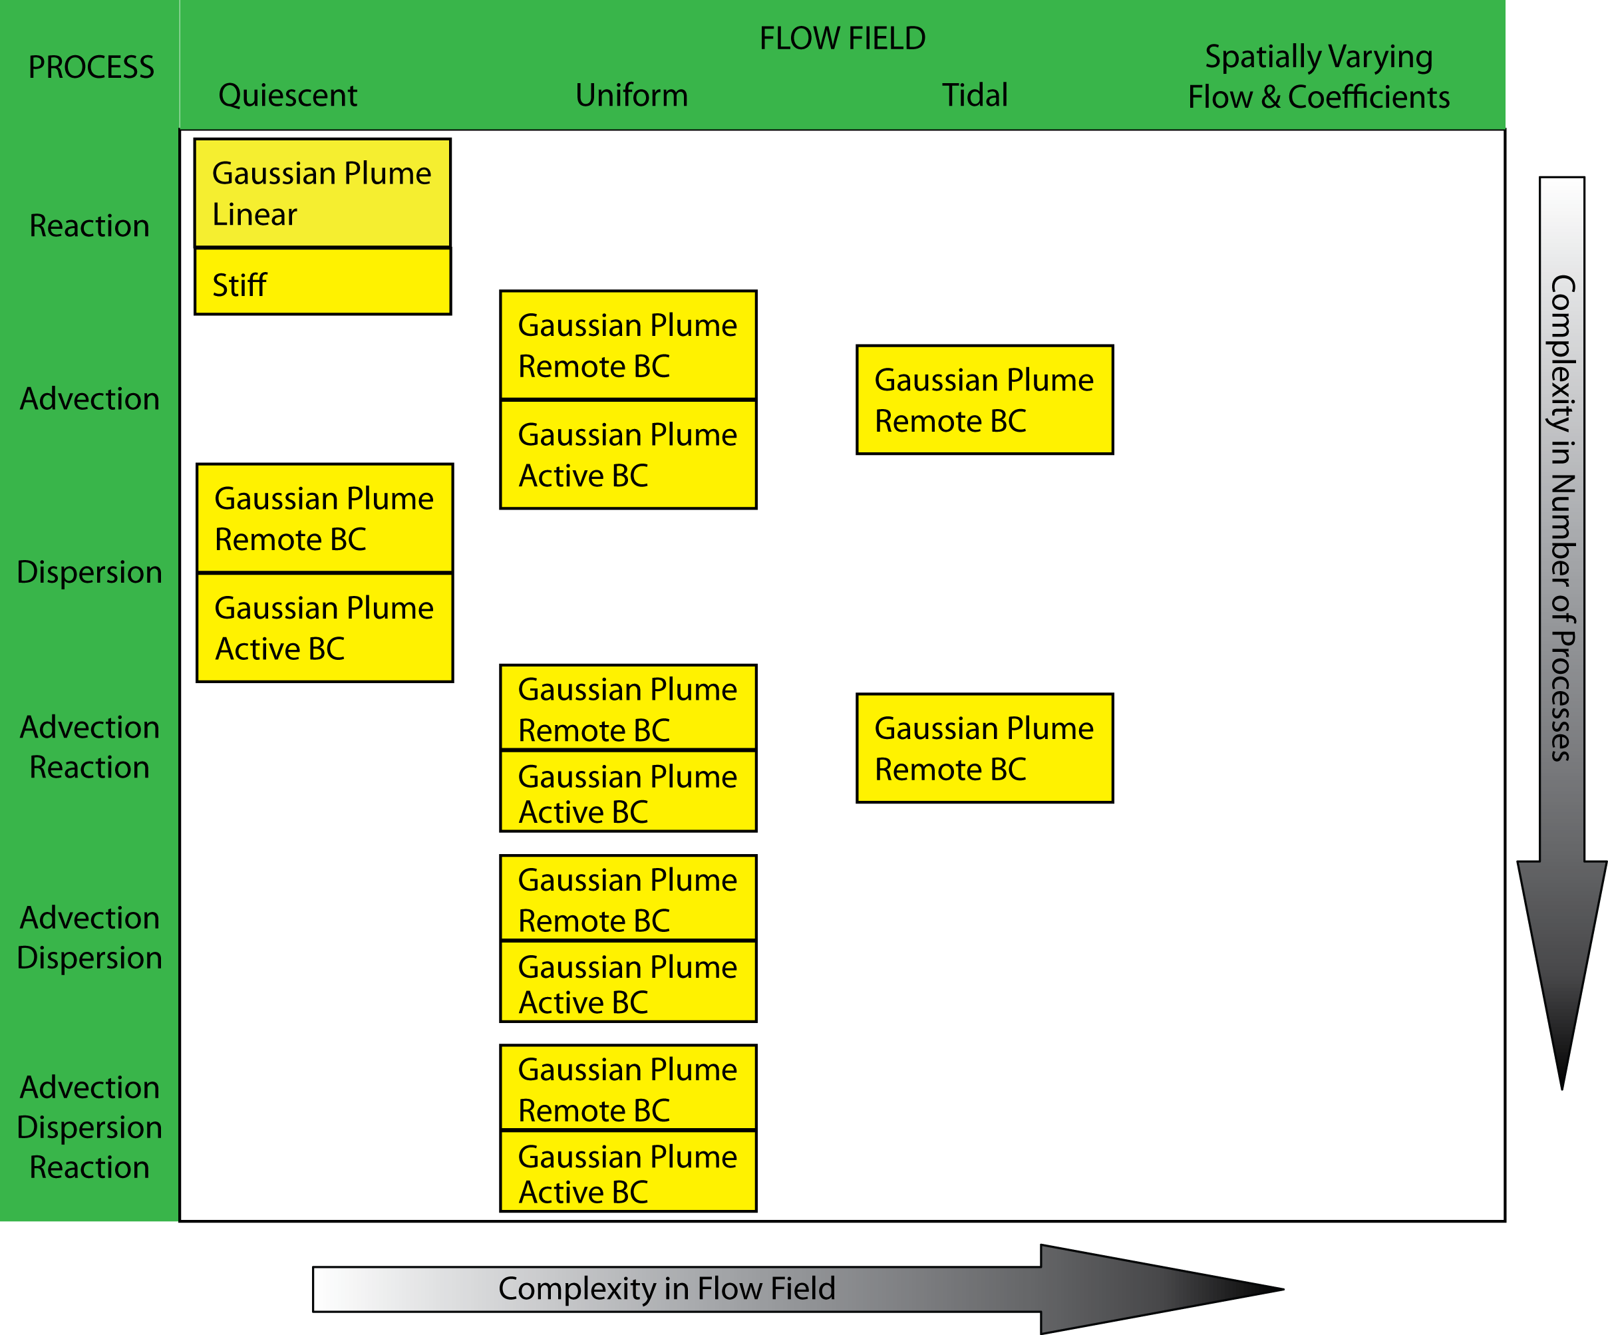
STM:Software testing: Verification:Transport test: Challenges:Results :
Layering in complexity

Slide 15
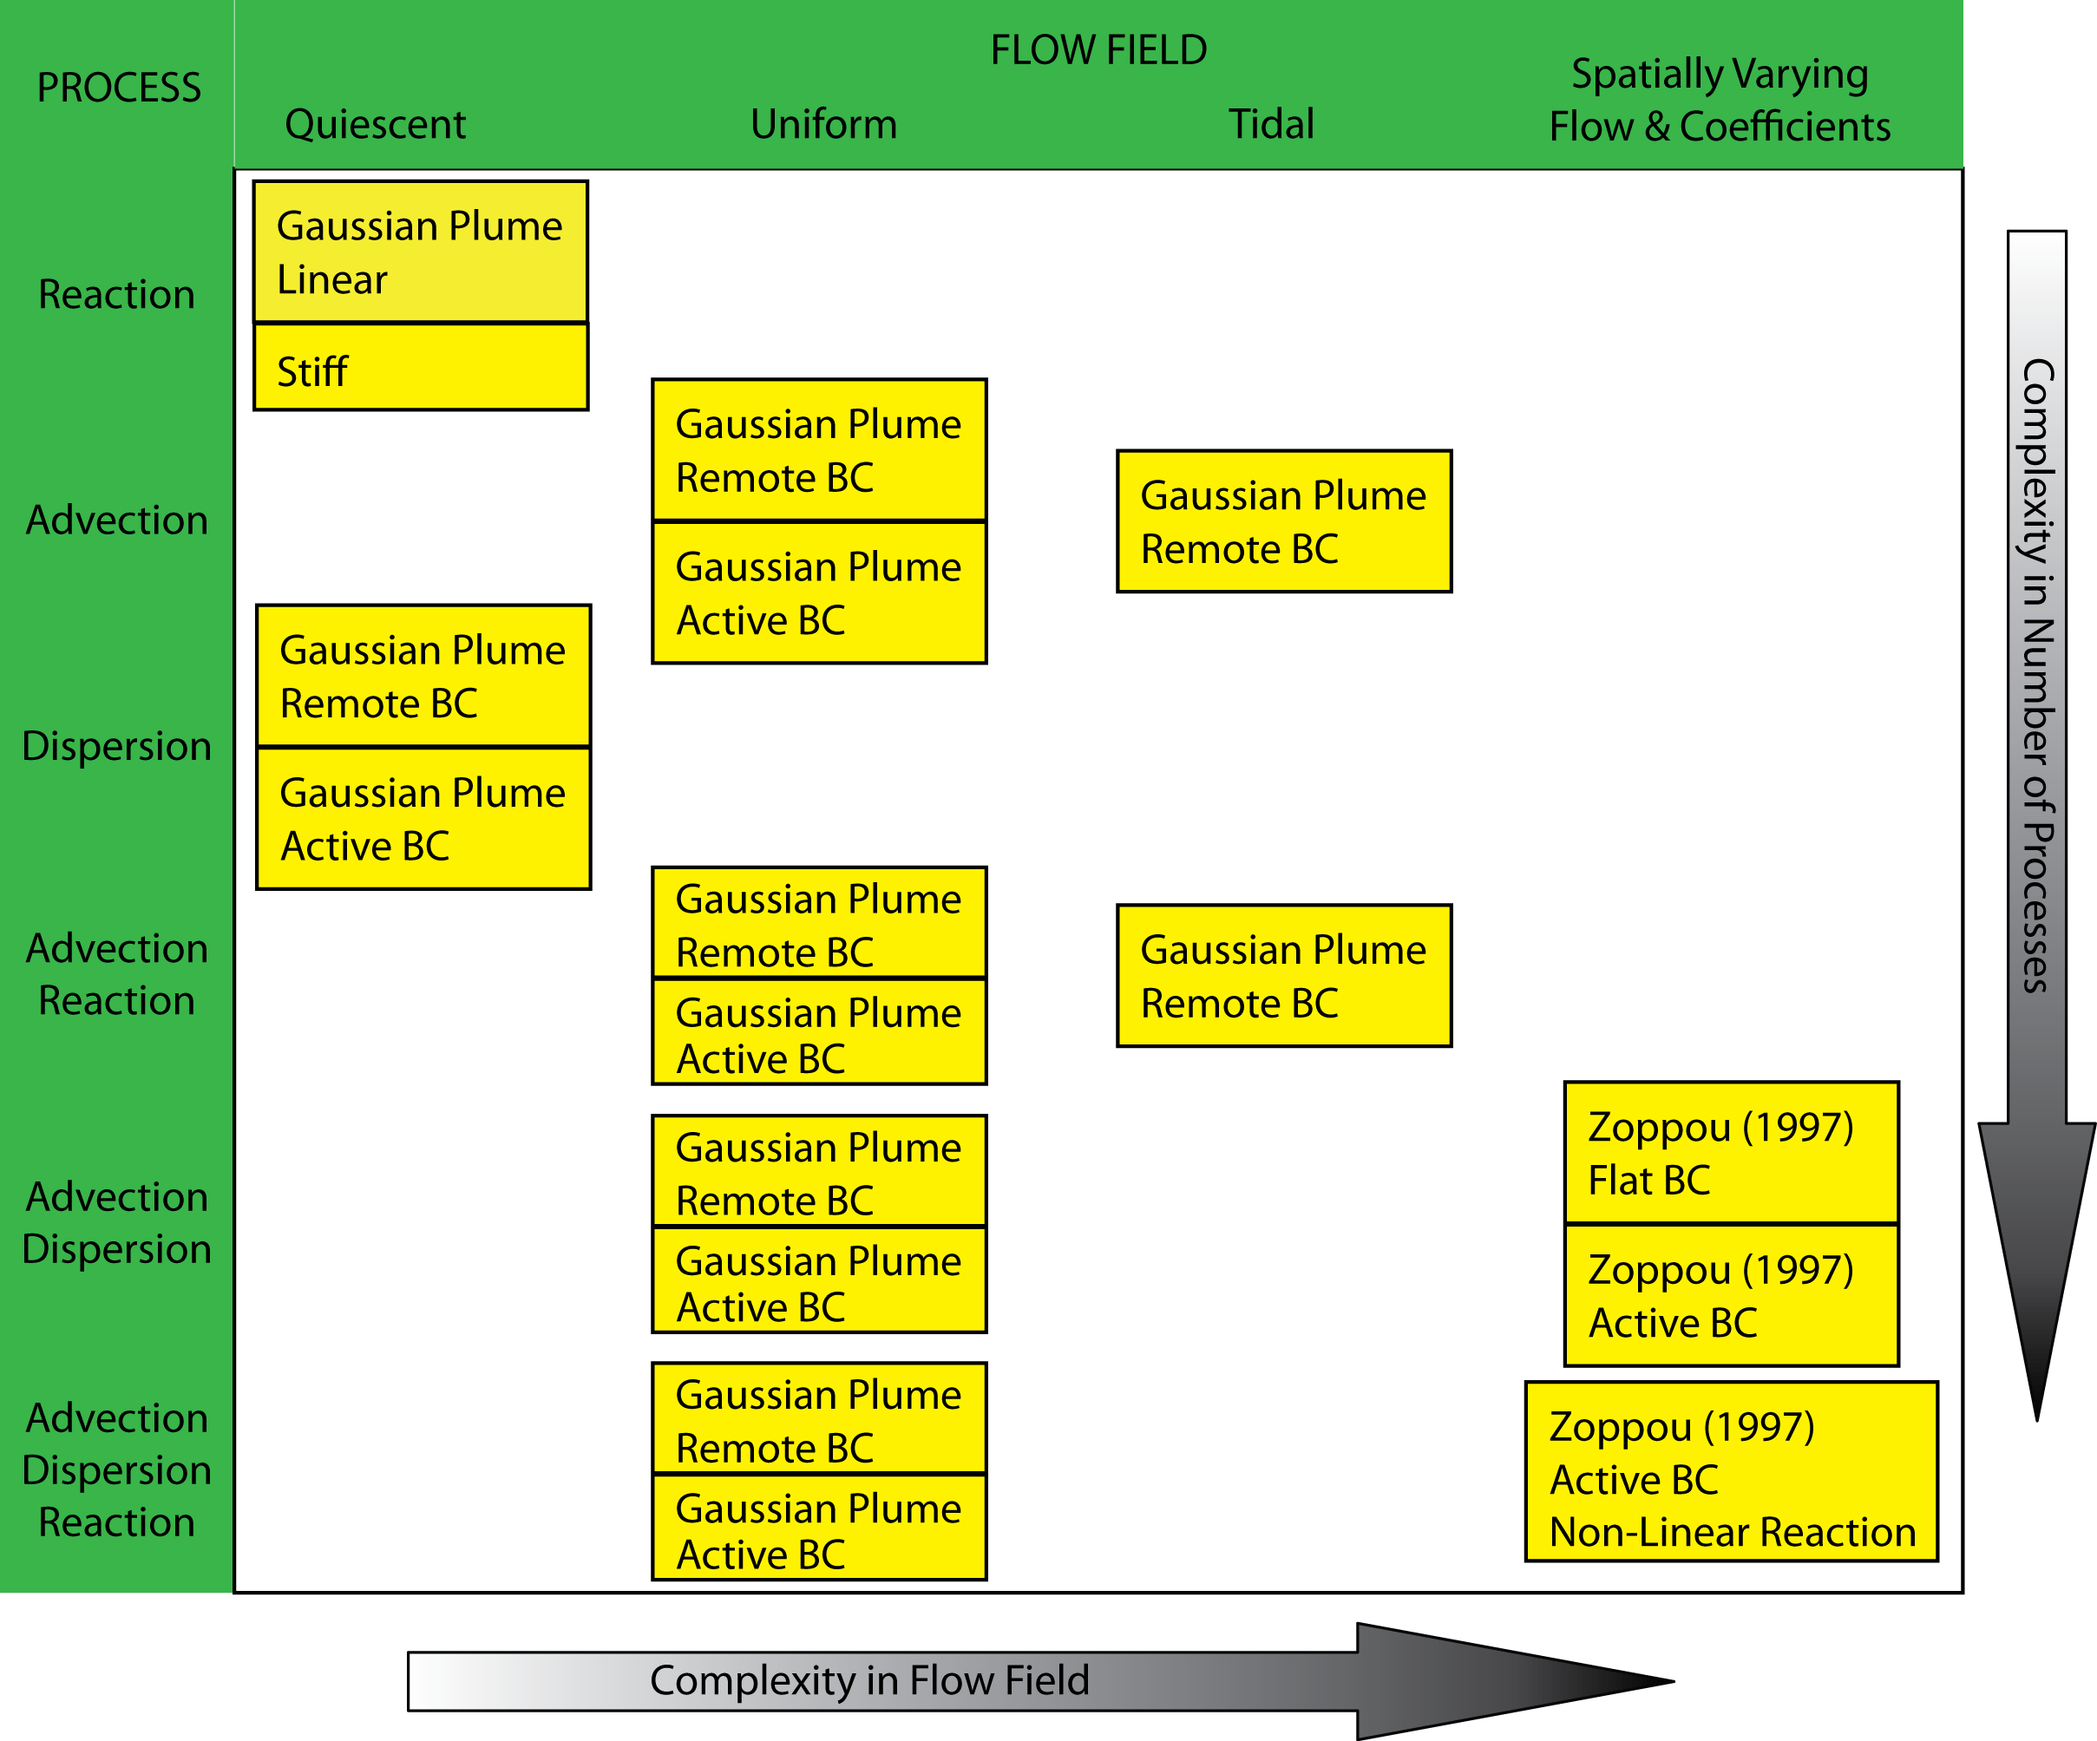
STM:Software testing: Verification:Transport test: Challenges:Results :
Layering in complexity

Slide 16
STM:Software testing: Verification:Transport test: Challenges:Results :
Layering in complexity

Slide 17
STM:Software testing: Verification:Transport test: Challenges:Results :
General consideration
Considering error distribution
Dimensionless numbers of natural phenomena
Preserving the basic shape
Oscillation
Smoothness of initial condition
Non-linear/stiff source term
Error
Machine precision
exceeds round off error
I
II
III
Order of Converge
Computer
precision
1
Grid Size

Slide 18
STM:Software testing: Verification:Transport test: Challenges:Results :
Logical error in Advection-Reaction

Slide 19
STM:Software testing: Verification:Transport test: Challenges:Results :
Syntax error in Diffusion
In boundary cells, local reduction up to 2 order does not reduce the global convergence rate.
Inside the domain cells, local reduction up to 1 order does not reduce global convergence rate.
✔

Slide 20
STM:Software testing: Verification:Transport test: Challenges:Results :
Example Advection Reaction, Tidal Flow

Slide 21
STM:Software testing: Verification:Transport test: Challenges:Results :
Accomplishments and final remarks
We developed a step by step roadmap for complete verification of a transport code
Approximately 350 tests - 280 unit tests and 70 system/algorithm tests are there.
We designed a really complete test suite
May help solve the “grey literature” issue in testing transport
Methods of Computer Science are there to guarantee the results in computational fluid mechanics
STM is, an open source, well tested, and nice bedrock for further development
Notes:
Competition between code users and writers on one side and experimentalist prevents collaboration

Slide 22
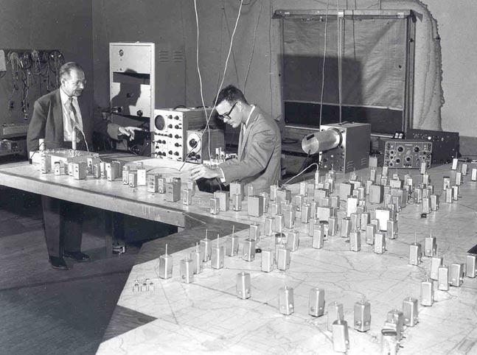
Thank You
Kaveh Zamani: kzamani@ucdavis.edu
Fabian Bombardelli, PhD: fabombardelli@ucdavis.edu
Eli Ateljevich, PhD, PE: eli@water.ca.gov
Jamie Anderson, PhD, PE: jamiea@water.ca.gov
Analog Delta Model

