Slide 1


Using Software Quality and Algorithm Testing to Verify a 1-Dimensional Transport Model
World Environmental and Water Resources Congress
Palm Springs, May 23, 2011
Kaveh Zamani
Fabian Bombardelli
Eli Ateljevich
Jamie Anderson
Civil & Environmental Engineering Dept.
University of California, Davis
Modeling Support Branch, Bay-Delta Office
Department of Water Resources
Notes:
Thanks to Mr/Dr Chairman, ….

Slide 2

Verification: how to find a bug in a forest?
Notes:
My presentation is on Verification

Slide 3


There were 8/12 serious static faults per 1000 lines of executable files in C/Fortran! (SAND 2002-0529)
Notes:
Development of public policy, preparation of safety procedures, legal liability and …. Are depends on scientific computation in environmental fluid mechanics
Definition by IEEE: The process of evaluating the product of a software development phase to provide assurance they meet the requirement defined in the previous phase

Slide 4
How to develop a fully testable and tested transport code?
This Talk:
STM (Sediment and Transport Module)
Software testing
Verification measures
Transport test suite
Challenges
Result

Slide 5
STM:Software testing: Verification:Transport test: Challenges:Results : Governing Equation and Solution Algorithm
HYDRO
Hydrodynamic
STM
1-D sediment transport model
QUAL
1-D fate and transport
PTM
Quasi 3-D particle Tracking
Structure of Delta Simulation Model 2 (DSM2)
Different methods of splitting to combine:
Modified Lax Two Step method + flux limiter (Advection )
Heun’s method embedded in predictor step of Advection ( Reaction)
Crank- Nicolson in FVM framework (Dispersion)
Notes:
Mention that this methods are FVM, STM operator algorithms, Splitting , Conservative form of governing equation possibility of use for any kinetically controlled reactive transport
It is going to replace qual in future and it is designed

Slide 6
STM:Software testing: Verification:Transport test: Challenges:Results : STM Project Goals
Flexible, modular design
Generalize Eulerian transport that could be adapted to other constituents
Well tested
Second order accuracy
Shock capturing, mass conservative
Associated dynamic testing for development

Slide 7

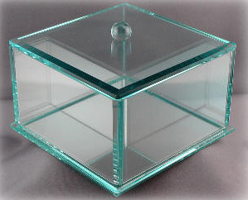
STM:Software testing: Verification:Transport test: Challenges:Results : General Concepts
Black/glass box testing
Silent testing
Dynamic vs. static testing
Testing of legacy programs
Regression testing
Ongoing nature of activity
Notes:
System testing: Black box testing versus glass box.
Grey box testing happens when you know what the code is like but lack of testability makes it impossible, which is common with legacy models

Slide 8


STM:Software testing: Verification:Transport test: Challenges:Results : STM Code Testing
Each function in STM has tests
Code and analytical tests
Each test puts light of a part
Test wide range of scenarios
Produce report of pass/fail result
Run tests regularly
Main Unit
Test Module
Test Sub A
Test Sub A
Sub_ A
Test_B
Subroutine C
Subroutine C
Sub_B
Subroutine A
Subroutine A
Subroutine A
Test Sub B
Test Sub B
Test_C
Sub_C
Subroutine B
Subroutine B
Subroutine B
Test Sub C
Test Sub C
Test_A
(Fortran Unit Test Framework)
Sub_D
Test Sub D
Subroutine D
Test Sub D
Test_D
Unit testing frame work in software QC
Unit testing frame work in software QC
STM=Sediment Transport Module
Notes:
Test each “unit” of code (unit test)
We can not prove model is correct, we can just prove they are not incorrect
Verification is the first step of validation

Slide 9
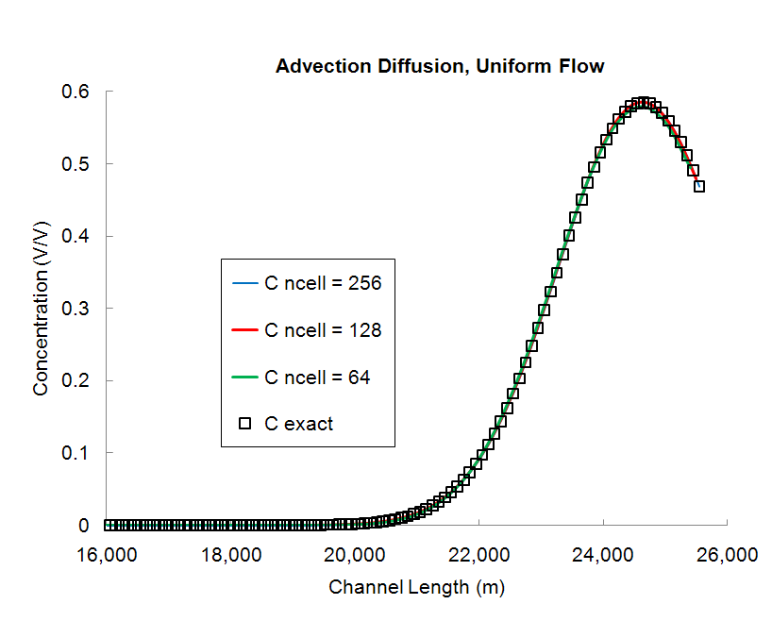
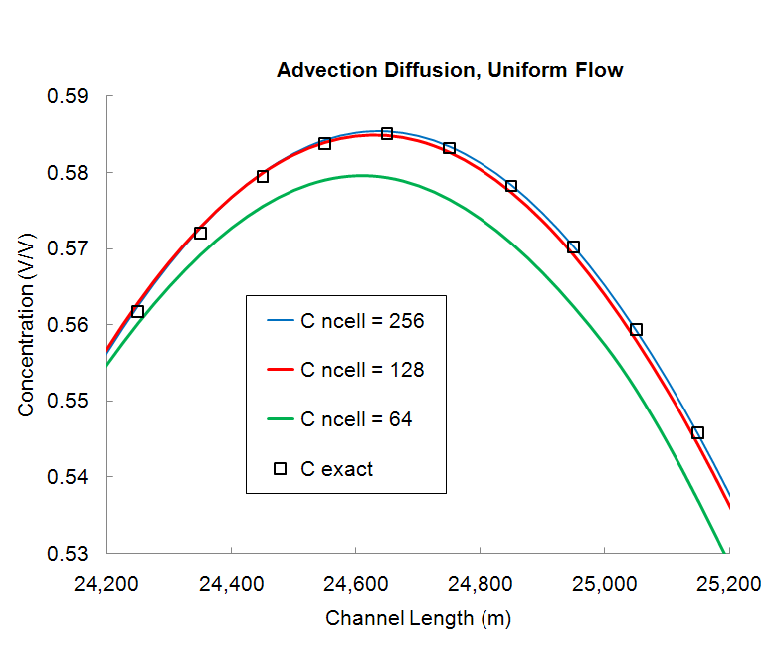
STM:Software testing: Verification:Transport test: Challenges:Results : Convergence
Testing versus analytical solution
Richardson Extrapolation
Method of Manufactured Solution
Prescribed Forcing Method
Perturbation
Using symmetry
Error analysis
Dense mesh solution
Notes:
Mesh convergence study , lax theorem

Slide 10
STM:Software testing: Verification:Transport test: Challenges:Results :
Are convergence tests enough?
No! They are brutal. They expose bugs. But they leave behind some bugs as well.
A
Error
B
a
b
1
1
Nominal scheme’s order of accuracy (2)
2≈a > b
1
Grid Size
After Leveque, 2002
Notes:
They have reputation for being enough, but:
Conflicting job description between obtaining results for publication and finding bugs.
Some features are turned off during convergence testing
Impossible to arrange for special cases to be triggered
Traversing these issues requires some experience
ADD the figure by Leveque 2002

Slide 11
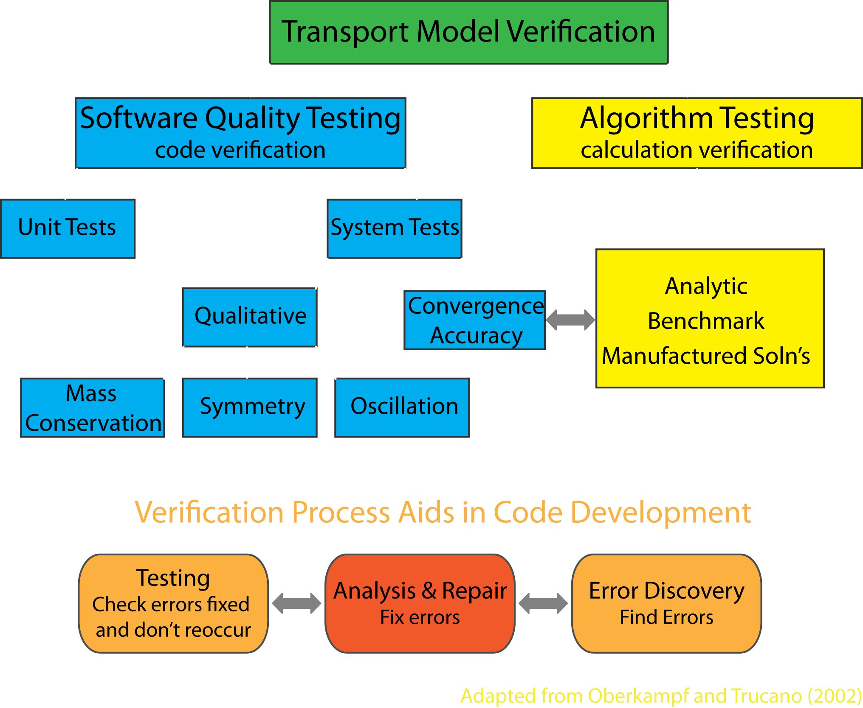
STM:Software testing: Verification:Transport test: Challenges:Results :
Are convergence tests enough?
Adapted from Oberkampf and Trucano, 2002

Slide 12
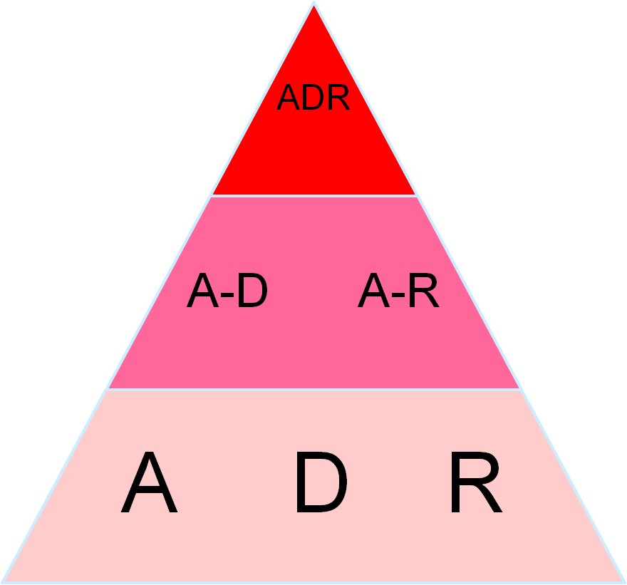
STM:Software testing: Verification:Transport test: Challenges:Results :
Incremental nature of the tests
Boundary values: remote Active
Flow field and coefficients: constant Variable
Single process Double process Triple process
2nd order
accuracy
Notes:
Three dimensions in adding to complexity

Slide 13
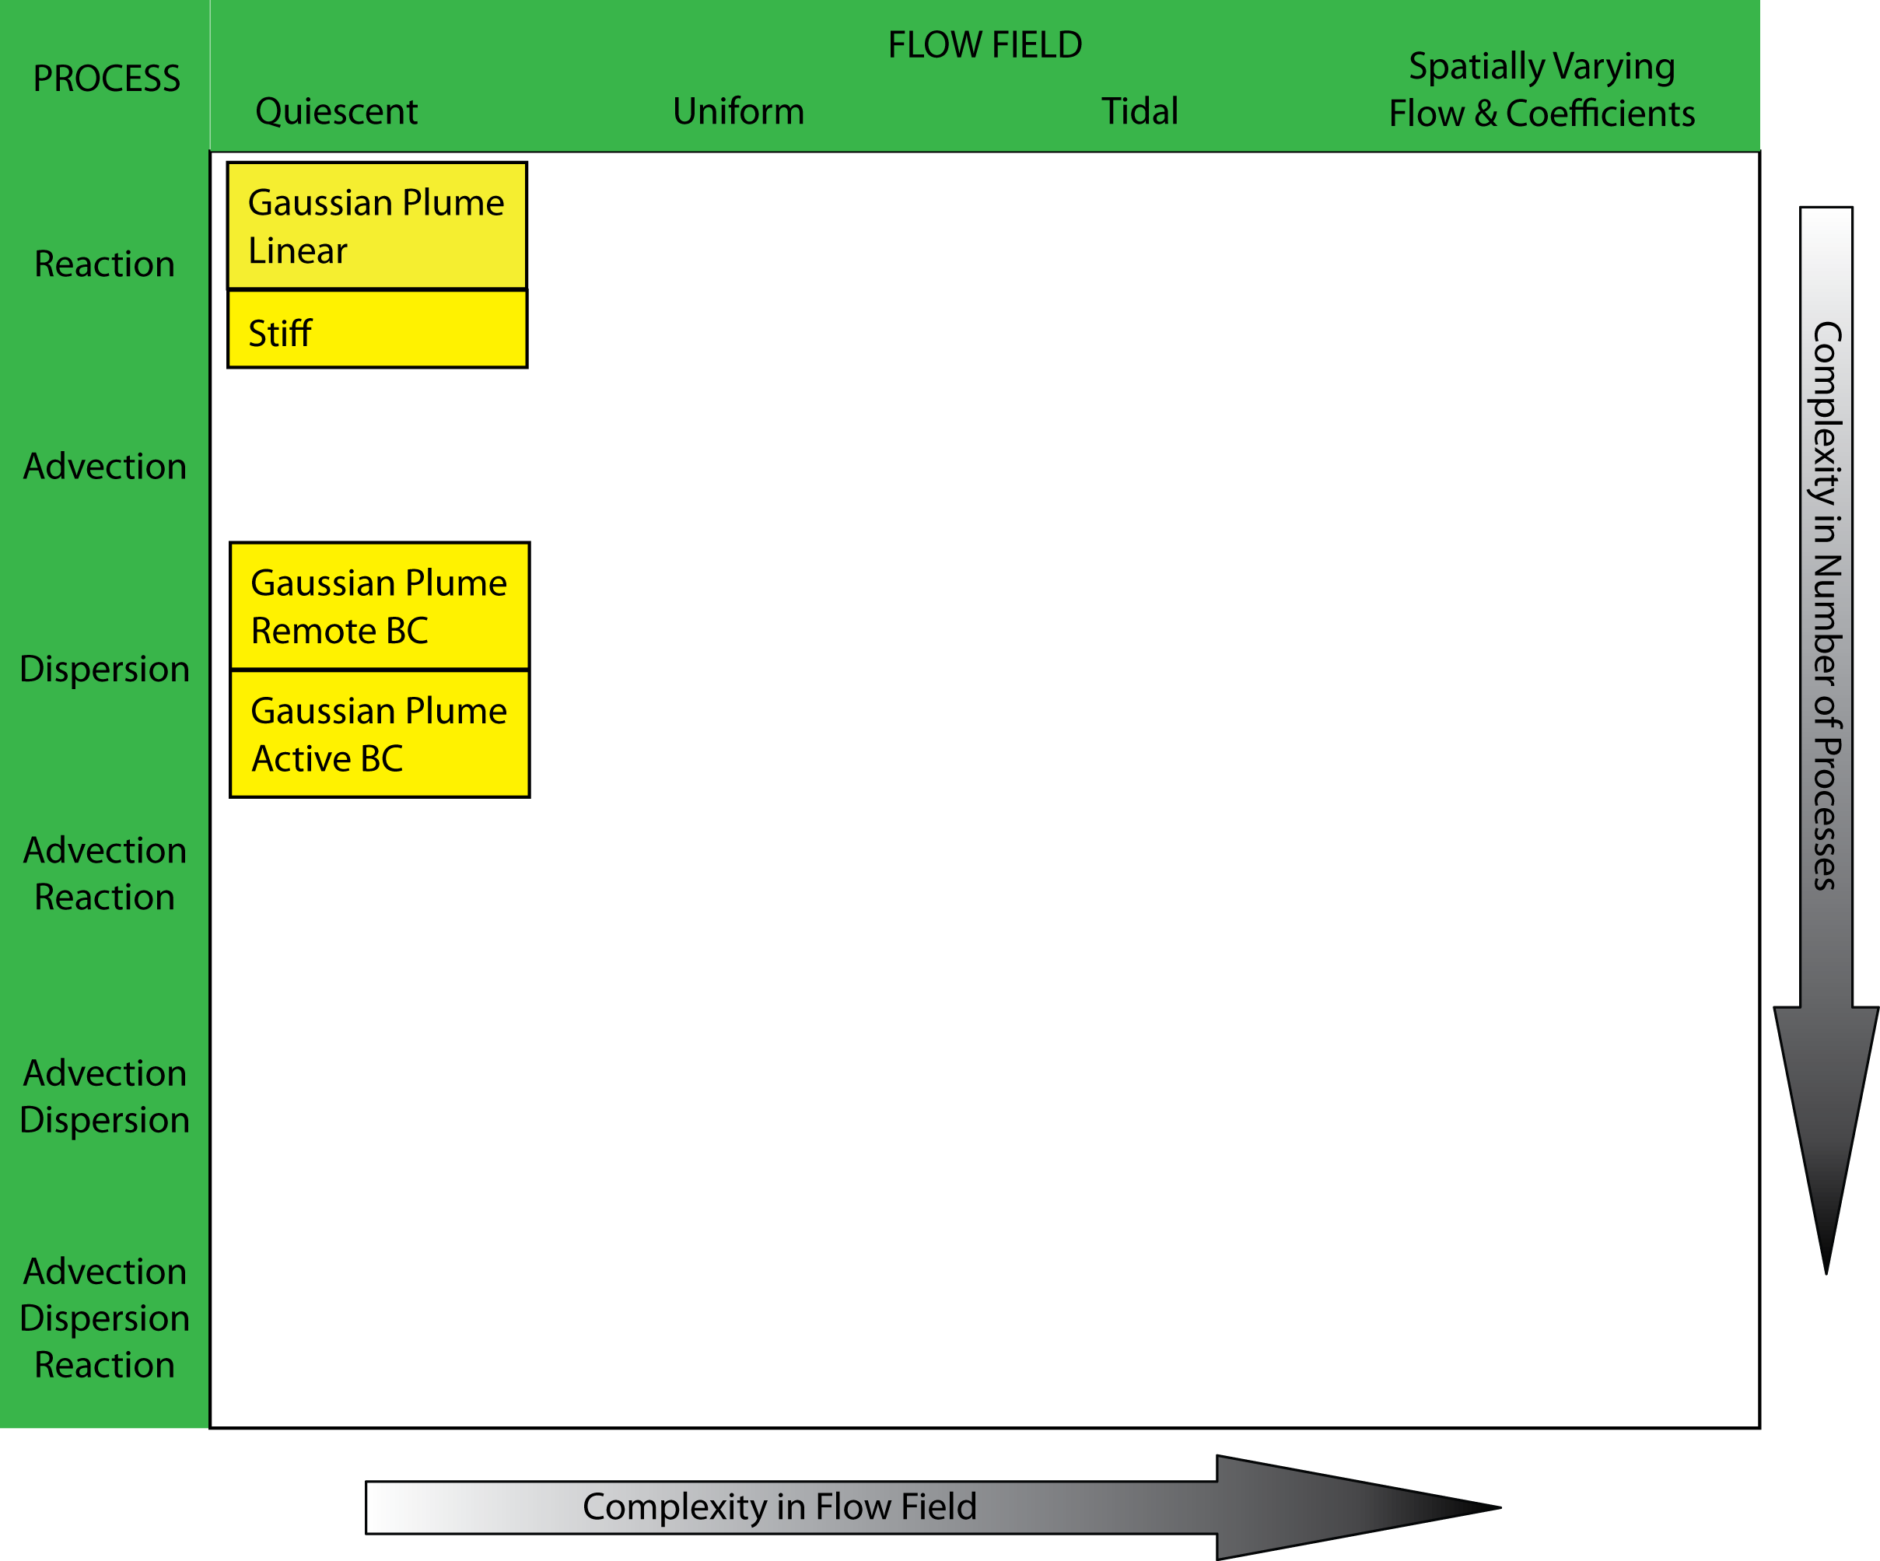
STM:Software testing: Verification:Transport test: Challenges:Results :
Layering in complexity

Slide 14
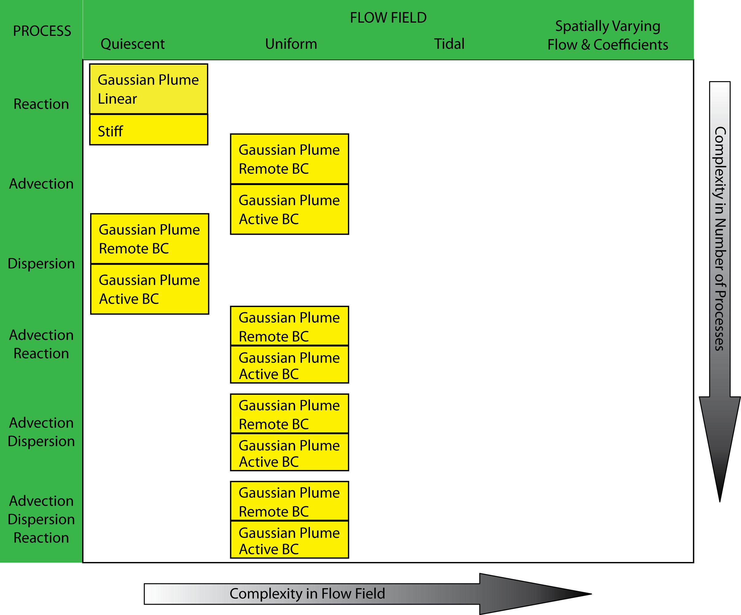
STM:Software testing: Verification:Transport test: Challenges:Results :
Layering in complexity

Slide 15
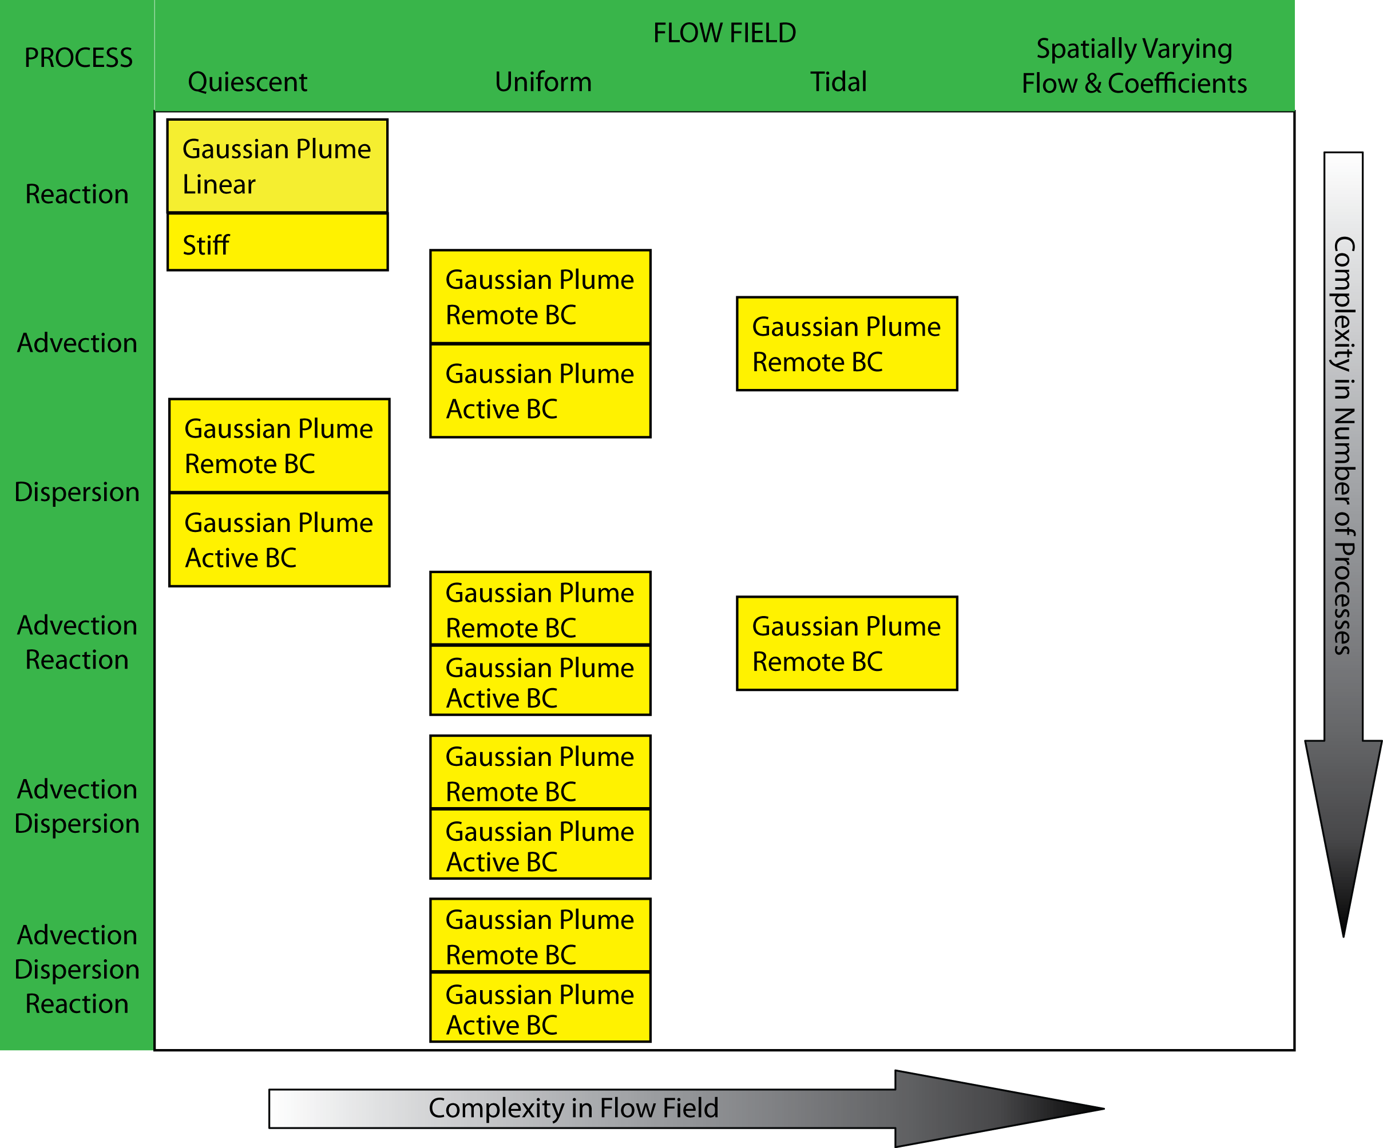
STM:Software testing: Verification:Transport test: Challenges:Results :
Layering in complexity

Slide 16
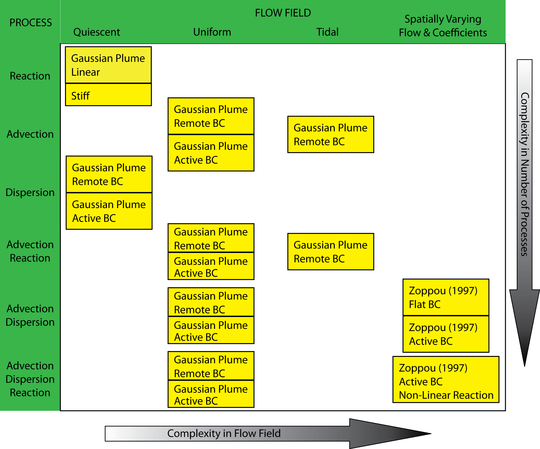
STM:Software testing: Verification:Transport test: Challenges:Results :
Layering in complexity

Slide 17
STM:Software testing: Verification:Transport test: Challenges:Results :
Layering in complexity

Slide 18
STM:Software testing: Verification:Transport test: Challenges:Results :
General consideration
Considering error distribution
Dimensionless numbers of natural phenomena
Preserving the basic shape
Oscillation
Smoothness of initial condition
Non-linear/stiff source term
Error
Machine precision
exceeds round off error
I
II
III
Order of Converge
Computer
precision
1
Grid Size

Slide 19
STM:Software testing: Verification:Transport test: Challenges:Results :
Logical error in Advection

Slide 20
STM:Software testing: Verification:Transport test: Challenges:Results :
Syntax error in Diffusion
In boundary cells, local reduction up to 2 order does not reduce the global convergence rate.
Inside the domain cells, local reduction up to 1 order does not reduce global convergence rate.
✔

Slide 21
STM:Software testing: Verification:Transport test: Challenges:Results :
Example Advection Reaction, Tidal Flow

Slide 22
STM:Software testing: Verification:Transport test: Challenges:Results :
Accomplishment and final remarks
Approximately 350 tests, 280 unit tests and 70 system/algorithm tests.
We designed a really complete test suite
May help solve the “grey literature” issue in testing transport
Methods of Computer Science are there to guarantee the results in computational fluid mechanics
STM is well tested
Nice bedrock for further development
The only issue is cultural issue with testing framework
Notes:
Competition between code users and writers on one side and experimentalist prevents collaboration

Slide 23
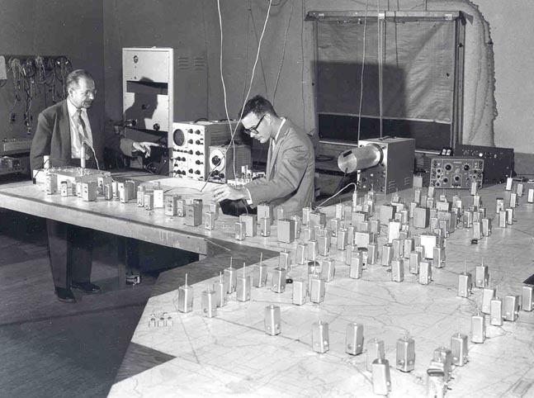
Thank You
Kaveh Zamani: kzamani@ucdavis.edu
Fabian Bombardelli, PhD: fabombardelli@ucdavis.edu
Eli Ateljevich, PhD, PE: eli@water.ca.gov
Jamie Anderson, PhD, PE: jamiea@water.ca.gov
Analog Delta Model

