Slide 1
Incorporating sediment-transport capabilities to DSM2
Kaveh Zamani and Fabián A. Bombardelli
Department of Civil & Environmental Engineering
University of California, Davis
Technical Advisory Committee, Department of Water Resources, January 13, 2010

Slide 2


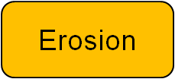

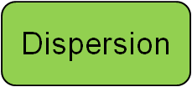
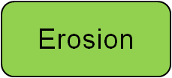



Background
Background Sediment Transport Math Treatment Num. Method Tests Questions
Dispersion
Spreading out
Erosion /
Entrainment
Deposition/
Settling
Advection
Go with the flow
+ ^{and} –
Sources and Sinks
Advection
Dispersion
Erosion
Deposition
Source/Sink
Tributaries
Progress to Date: Single Channel
Next step: Complete single channel model
Next step: Extend model to a channel network

Slide 3
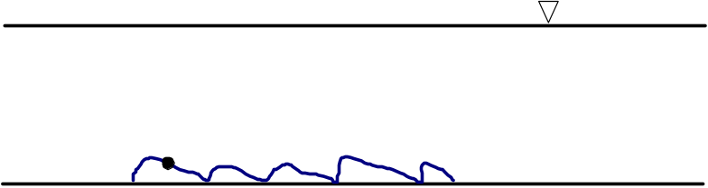
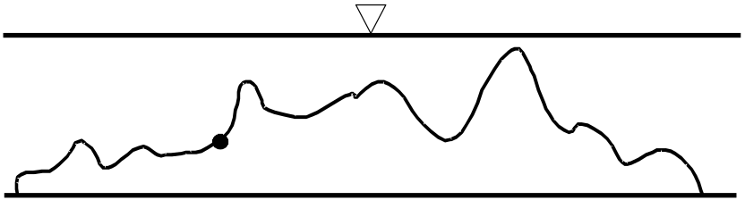
Background Sediment Transport Math Treatment Num. Method Tests Questions
Modes of sediment transport
1-Bed Load
Mainly empirical formulas
Lagrangian solution for each particle
2-Suspended Load
Advection-Dispersion-Sink/Source
3-Wash Load
There is a third mode of sediment transport called wash load, whereby very fine particles are transported downstream with very little interaction with the bed sediments.
During floods, the wash load is deposited in the floodplains (usually ignored in numerical simulations).

Slide 4
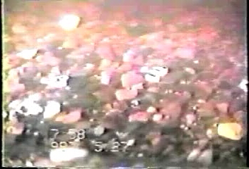
Background Sediment Transport Math Treatment Num. Method Tests Questions
Modes of sediment transport
Sediment transport as bed-load in rivers
Source: Prof. Dietrich’s website

Slide 5
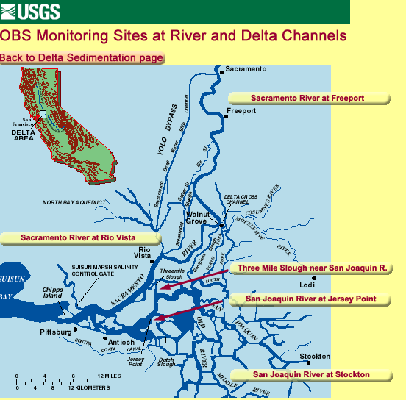
Background Sediment Transport Math Treatment Num. Method Tests Questions
Modes of sediment transport in the Delta
We find the transport of sediment as bed-load and in suspension. Not much information exists about wash load.
In large portions of the Delta, the sediment can be cohesive.
The USGS has numerous stations in which sediment in suspension is monitored via optical backscatter sensors (OBS).

Slide 6
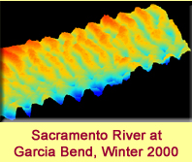
Background Sediment Transport Math Treatment Num. Method Tests Questions
Modes of sediment
transport in the Delta
Bed-forms at Garcia Bend in Winter 2000.
Source: USGS website

Slide 7
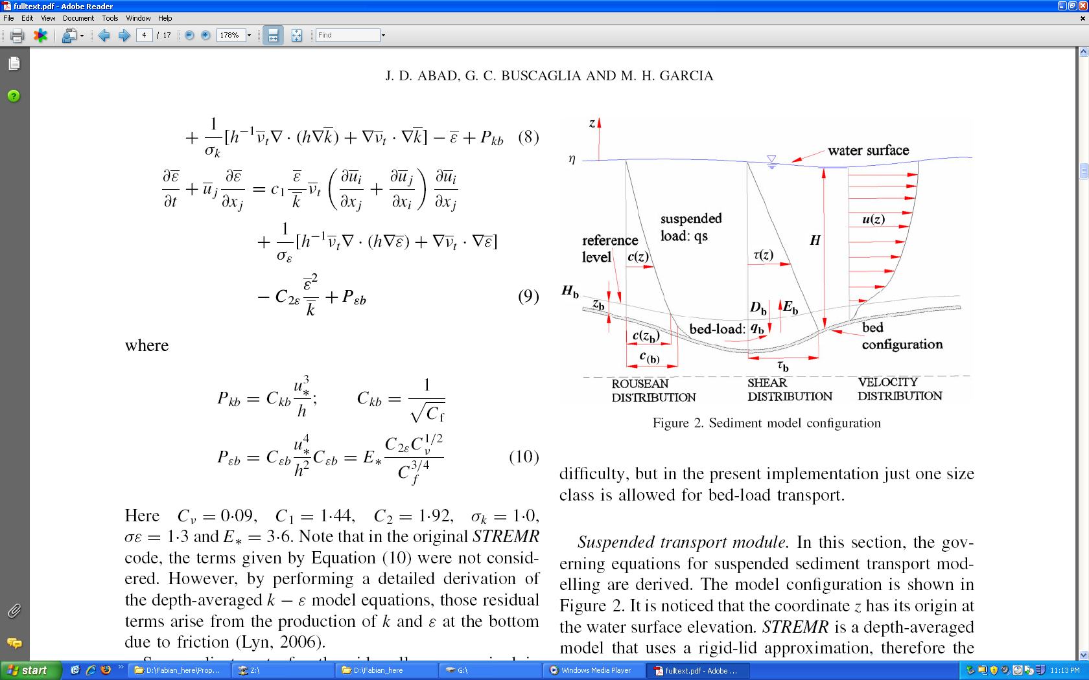
Background Sediment Transport Math Treatment Num. Method Tests Questions
Mathematical treatment of the problem
Tracking individual particles is not feasible for a system of the size of the Delta. Then, we need to use the continuum approach.
Source: Abad et al., 2007

Slide 8
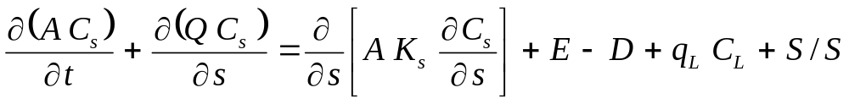









Background Sediment Transport Math Treatment Num. Method Tests Questions
Mathematical treatment of problem: Sediment in suspension
Sediment transport in suspension:
: cross-sectional wetted area (m²)
: volumetric cross-sectional-averaged concentration of
sediment in suspension (-)
: flow discharge (m³/s)
: non-point sources/sinks
(m²/s)
: dispersion coefficient (m²/s)
: entrainment rate of sediment into suspension
and deposition rate of sediment per unit width,
respectively (m²/s)
: lateral discharge (m²/s), and concentration (-), respectively

Slide 9
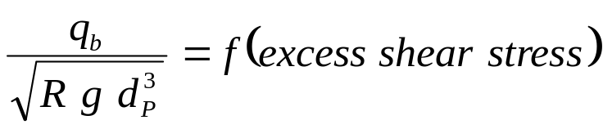

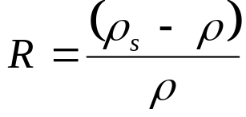


Background Sediment Transport Math Treatment Num. Method Tests Questions
Mathematical treatment of the problem: bed-load transport
Sediment transport as bed-load:
: bed-load solid discharge per unit width (m²/s)
: specific gravity (-)
: sediment particle diameter (m)
: acceleration of gravity (m/s²)
The equation for sediment in suspension comes from the integration in the
cross section up to z_{b}.

Slide 10



Background Sediment Transport Math Treatment Num. Method Tests Questions
Mathematical treatment of the problem: Entrainment and Deposition
: sediment concentration at the bottom (-)
w_{s} : settling velocity
Recent developments in sediment transport refer to several active
layers, which could be incorporated in a second stage of the
model development.

Slide 11

Numerical Method: Operator Splitting
Background Sediment Transport Math Treatment Num. Method Tests Questions
2nd order accurate Strang type splitting algorithm

Slide 12
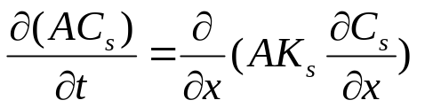
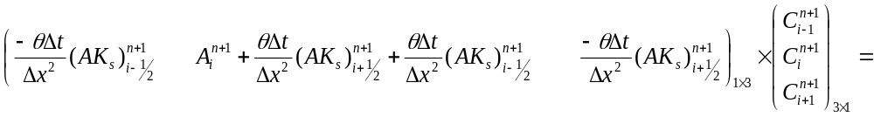
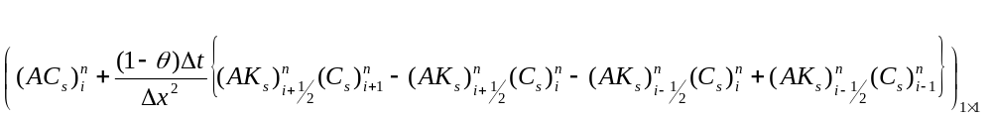
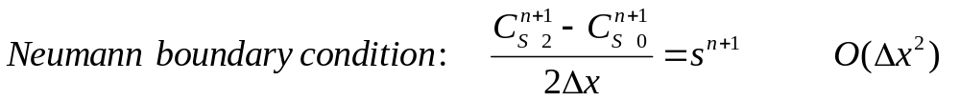
Numerical Method: Diffusion
Background Sediment Transport Math Treatment Num. Method Tests Questions
2nd order, implicit

Slide 13
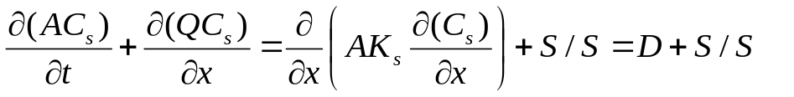
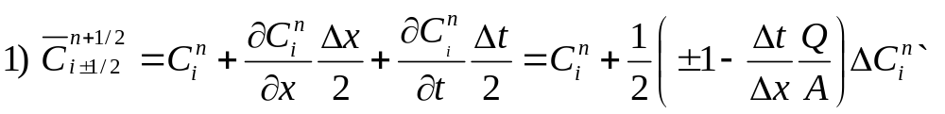
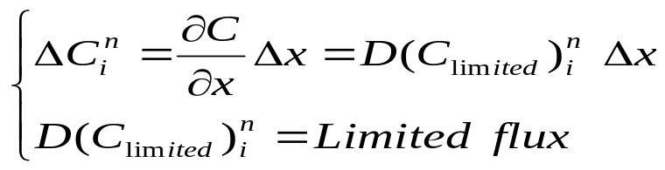
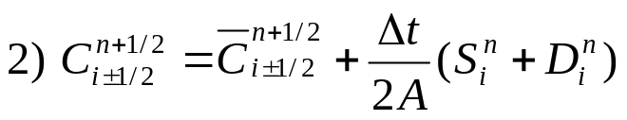
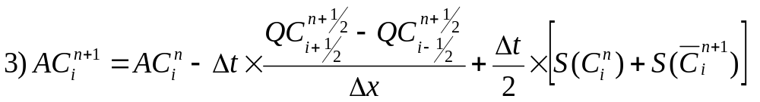
Numerical Method: Advection
Background Sediment Transport Math Treatment Num. Method Tests Questions
2nd order explicit
n+1
n+½
t
n
i-1
i
i+1
x

Slide 14
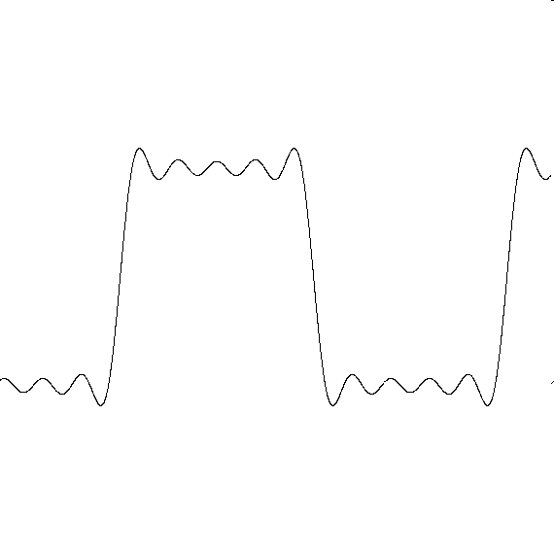
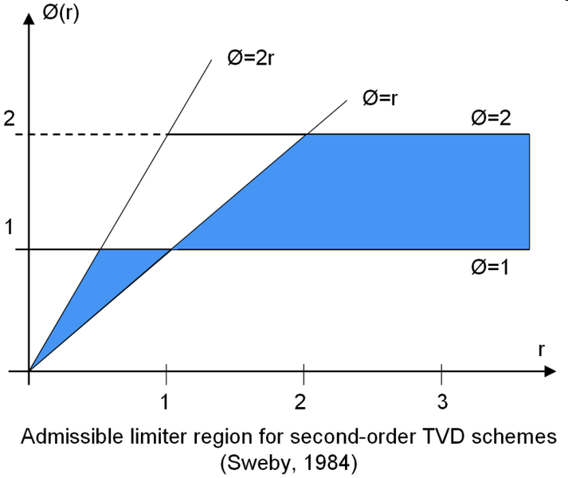
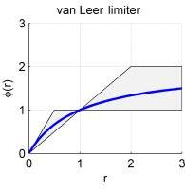

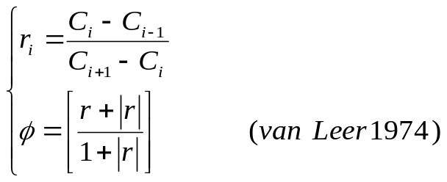

Numerical Method: Flux limiter
Background Sediment Transport Math Treatment Num. Method Tests Questions
Gibbs phenomenon
Admissible limiters region for 2nd order schemes (Sweby 1984)
van Leer limiter (1974)

Slide 15

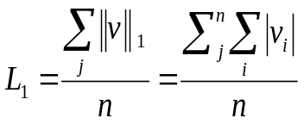
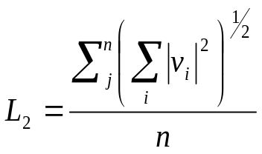
Test: Mesh Convergence
Background Sediment Transport Math Treatment Num. Method Tests Questions
Norms as measure of functions
(The most restrictive norm)
(The less restrictive norm )

Slide 16
Test: Mesh Convergence II
Background Sediment Transport Math Treatment Num. Method Tests Questions
Second order
`Table 1: Errors and Norm of Errors in Different Mesh Sizes for Θ=0.5
Num of volumes | L1 | Rate of L1 change | L2 | Rate of L2 change | L∞ | Rate of L∞ change | Ddt/dx² | Stability
25 | 2.030E-03 | 1.094E+00 | 8.407E-07 | 5.355E+00 | 3.622E-04 | 3.844E+00 | 3.858E-01 | O.K
50 | 1.855E-03 | 1.025E+00 | 1.570E-07 | 5.797E+00 | 9.422E-05 | 4.090E+00 | 1.482E+00 | O.K
100 | 1.809E-03 | 1.006E+00 | 2.708E-08 | 5.760E+00 | 2.304E-05 | 4.072E+00 | 6.050E+00 | O.K
200 | 1.798E-03 | 1.001E+00 | 4.701E-09 | 5.845E+00 | 5.657E-06 | 4.151E+00 | 2.445E+01 | O.K
400 | 1.796E-03 | 1.000E+00 | 8.044E-10 | 6.301E+00 | 1.363E-06 | 4.611E+00 | 9.827E+01 | O.K
800 | 1.795E-03 | 1.993E+00 | 1.277E-10 | 6.708E+00 | 2.956E-07 | 3.385E+00 | 3.941E+02 | O.K
1600 | 9.008E-04 | 1.002E+00 | 1.903E-11 | 1.518E+00 | 8.732E-08 | 1.000E+00 | 1.578E+03 | O.K
3200 | 8.991E-04 | X | 1.254E-11 | X | 8.732E-08 | X | 6.317E+03 | O.K

Slide 17
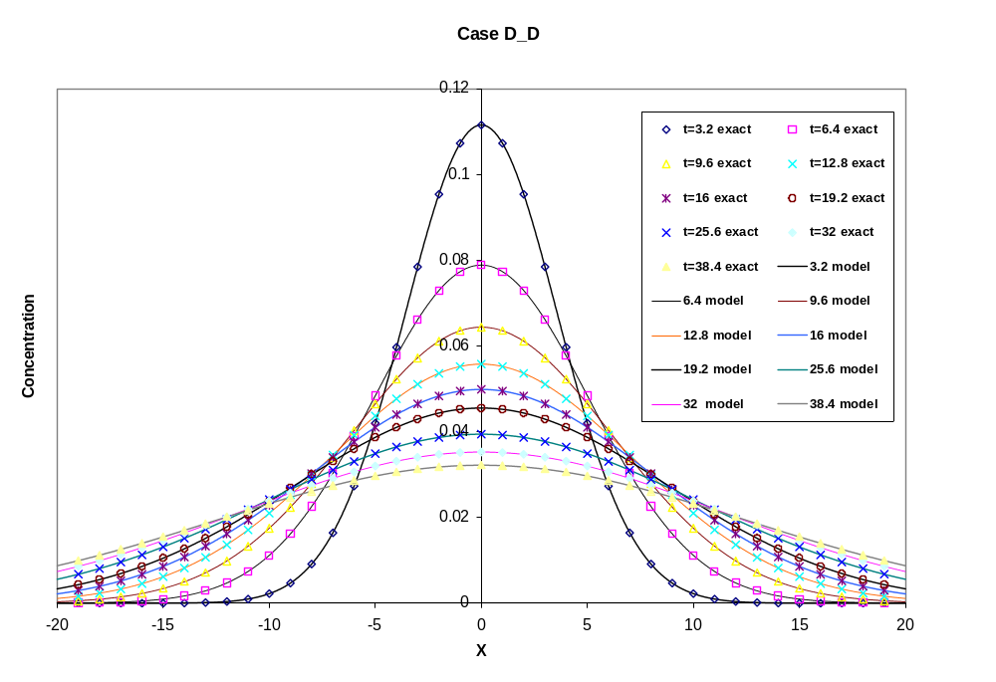
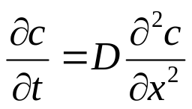
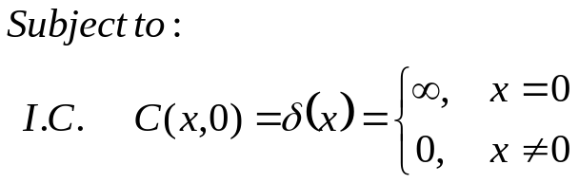

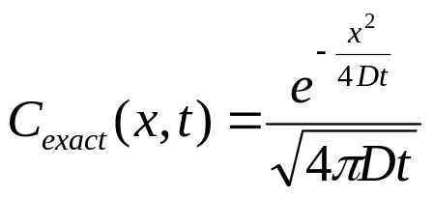
Tests: Analytical Solutions I (Diffusion)
Background Sediment Transport Math Treatment Num. Method Tests Questions

Slide 18
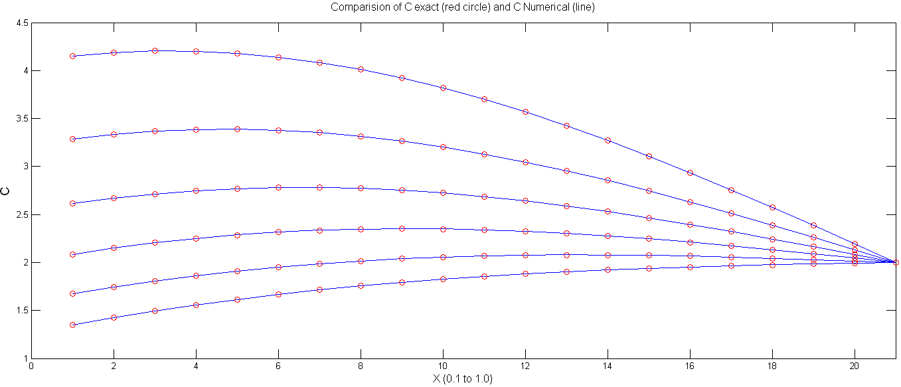
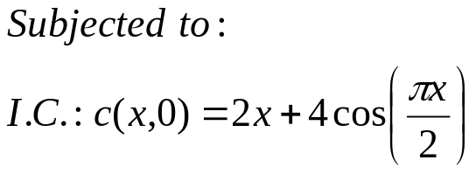
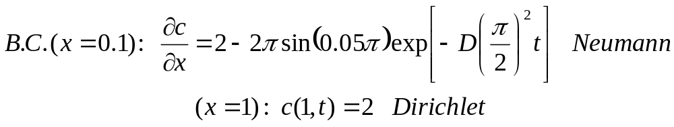
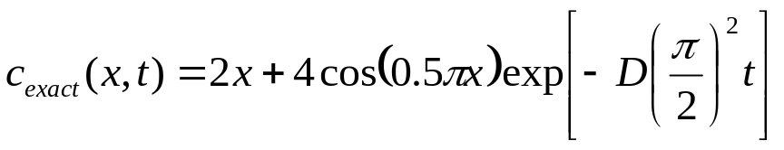
Tests: Analytical Solutions II (Diffusion)
Background Sediment Transport Math Treatment Num. Method Tests Questions
Cell number

Slide 19
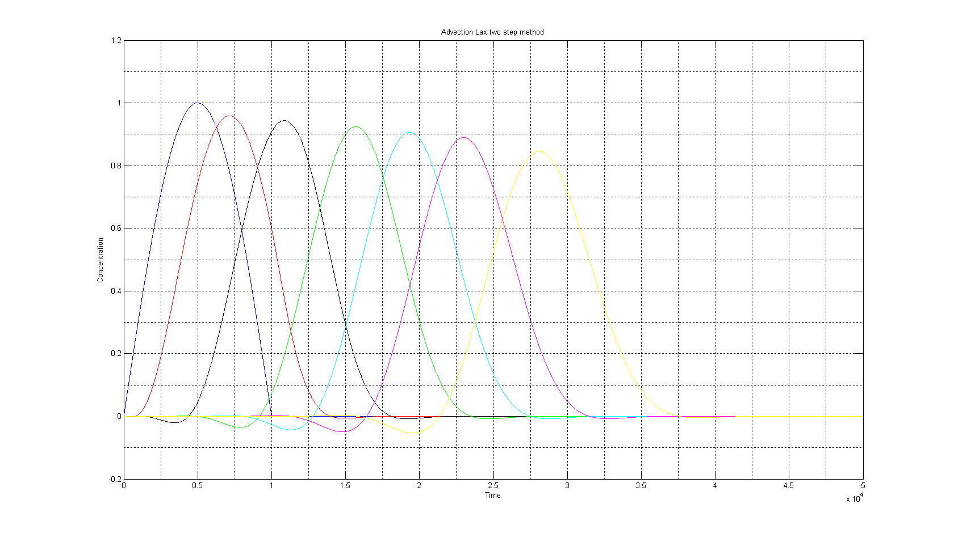
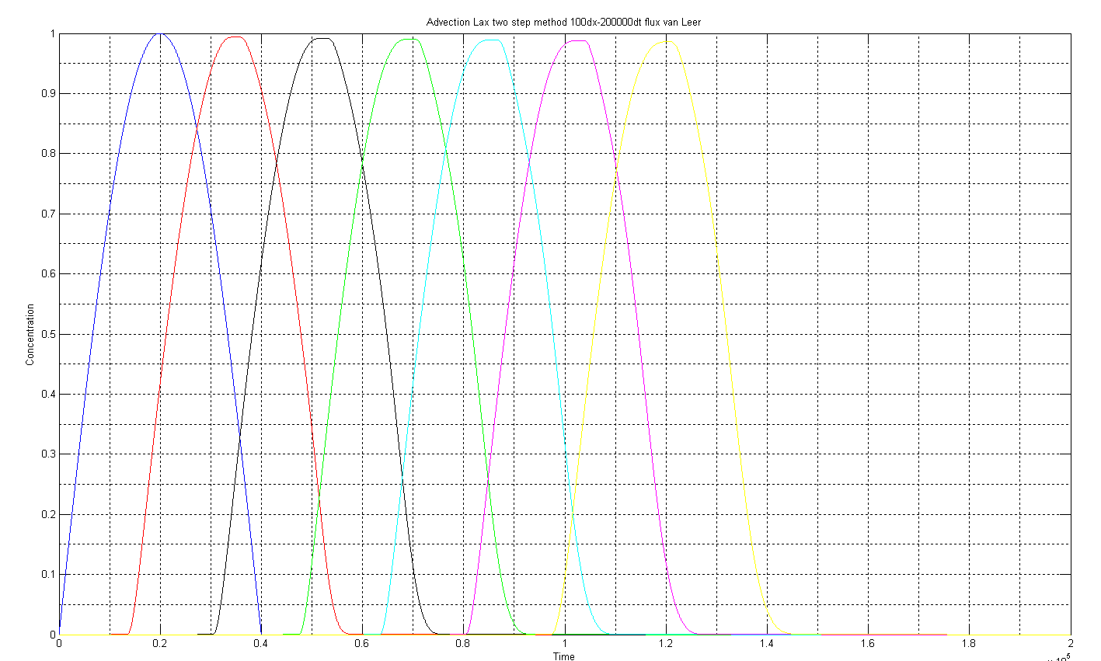
Tests: Advection
Background Sediment Transport Math Treatment Num. Method Tests Questions
Numerical diffusion
Flux limiter

Slide 20
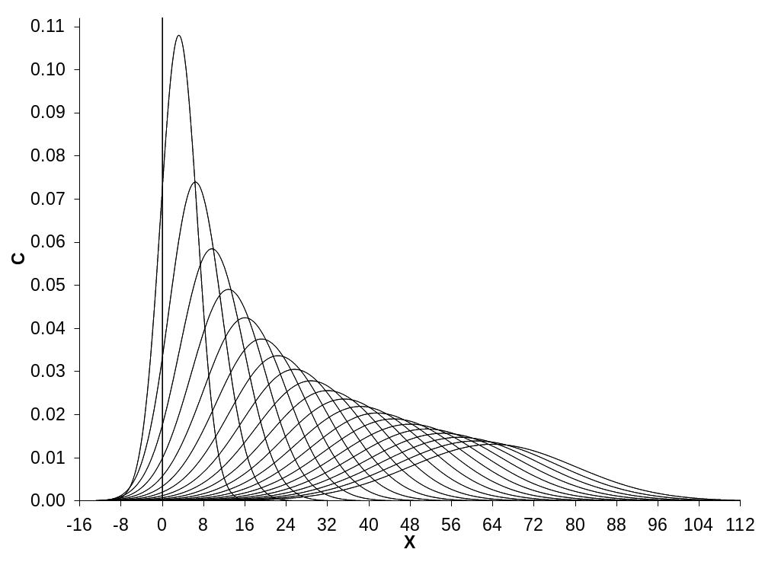
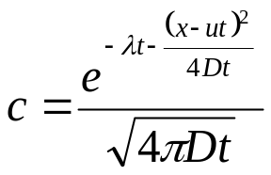
Tests: A-D-R (to be included)
Background Sediment Transport Math Treatment Num. Method Tests Questions
Source: McDonald, 2007

Slide 21
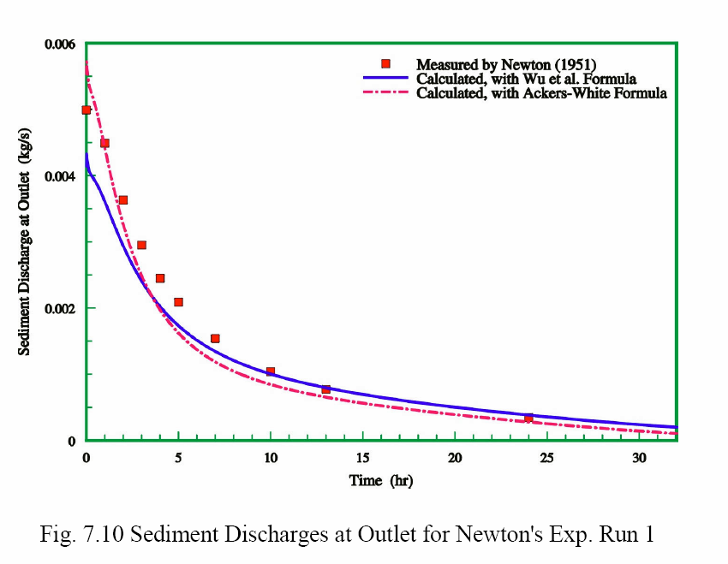
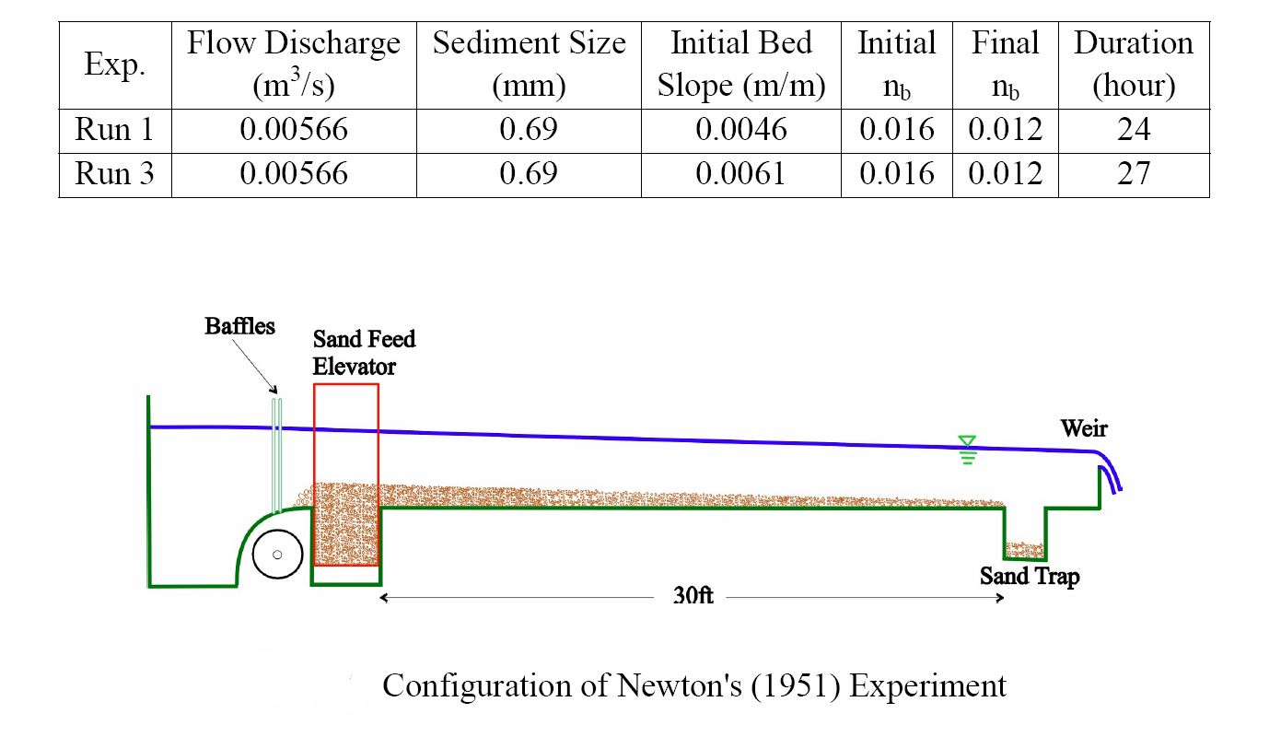
Tests: Experimental Data I (to be done)
Background Sediment Transport Math Treatment Num. Method Tests Questions
Comparison with experimental lab data
Newton (1951).
Source: Wu and Vieira, 2002

Slide 22
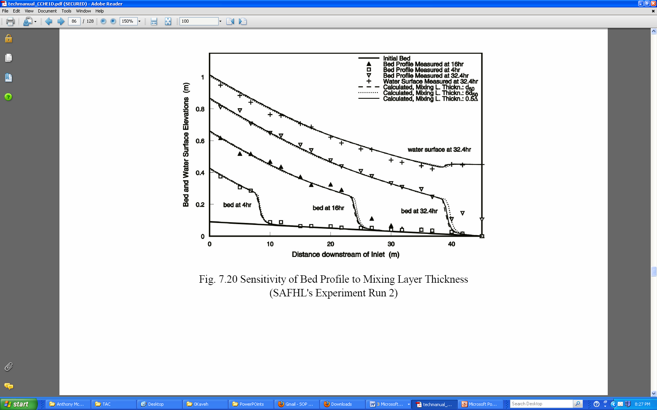
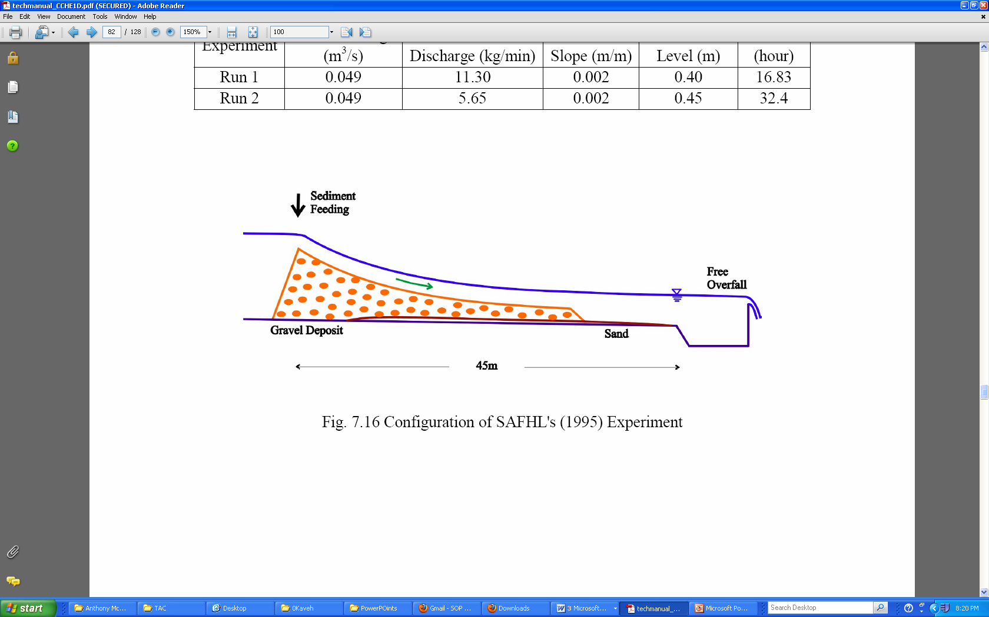
Tests: Experimental Data II (to be done)
Background Sediment Transport Math Treatment Num. Method Tests Questions
Comparison with experimental lab data
Cui et al. (1995/6).
Source: Wu and Vieira, 2002

Slide 23

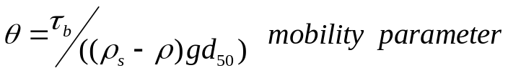
Question: Physical
Bed roughness
Background Sediment Transport Math Treatment Num. Method Tests Questions
K_{s} = K_{s}’( skin friction )+ K_{s}”( form drag )
1-Methods based on bed-forms and grain-related parameters such as bed-form length, height, steepness and bed-material size:
K’_{s} min= 0.01 m
K’_{s} = 3 d₉₀ for θ <1 (lower regime)
K’_{s} = 3 θ d₉₀ for θ >1 (upper regime)
Is there information on d₉₀,d₅₀, and Δ available for the Delta?
2-Methods based on integral parameters such as mean depth, mean velocity and bed material size

Slide 24
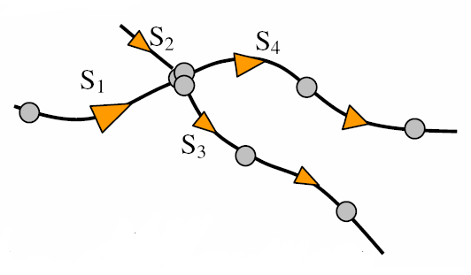
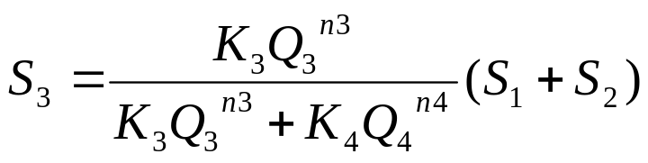
Background Sediment Transport Math Treatment Num. Method Tests Questions
Question: Physical – Distribution in Junctions
Do you know of any studies of sediment transport at junctions in the Delta or in other systems?
Source: Mike11, DHI

Slide 25
Question: Physical
Treatment of Bed-load
Background Sediment Transport Math Treatment Num. Method Tests Questions
1- Solve an advection-diffusion-reaction equation for suspended load, and use empirical formula for computing bed-load
2- Solve an advection-diffusion-reaction equation for both the bed-load and the suspended load, following the proposal by Greimann et al. (2008):
S_{e}= Erosion source term
f = Transport load parameter, fraction of suspended load to total load
h = Flow depth
a = Angle of sediment transport
b = Ratio of sediment velocity to flow velocity
V_{t} = Total flow velocity

Slide 26
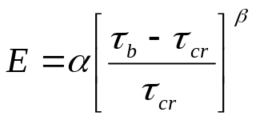
Question:
Physical - Entrainment & Deposition
Background Sediment Transport Math Treatment Num. Method Tests Questions
1-In the Delta, is there any tested method for representation of settling velocity (or deposition instead) for cohesive sediment particles beyond Krone’s (1962) work?
2-In the Delta, is there any tested expression for entrainment of cohesive sediment particles beyond the work by Krone (1962)?
3-To reduce the number of variables for description of cohesive sediment, which are the most important variables for the Delta?
W_{s} = W_{s} (Salinity, Concentration, ...)
4-In the Delta, is there any tested method for representation of settling velocity (or deposition instead) for cohesive sediment particles?
i) W_{s}= constant, ii) W_{s,m}= W_{s}(1- ac)^{b} , iii) W_{s,m}= Kc^{m}

Slide 27
Question: Numerical
Background Sediment Transport Math Treatment Num. Method Tests Questions
1-Do you know of any reliable second order methods for updating boundary conditions for advection-diffusion-reaction equations with operator splitting?
2-What order, in the splitting procedure, should we solve the advection-diffusion-reaction equations? Our initial thought is to solve advection first, then reaction and finally diffusion. Advection is always the dominant term and it should come first.

Slide 28
Questions:
User need/request
Background Sediment Transport Math Treatment Num. Method Tests Questions
What kinds of analytical tests and comparisons to data (field and laboratory) would you like to see in the STM code?
What units for sediment/constituent concentration you would like to see in DSM2-STM? Volume per volume or mass per volume?
Is it desirable for STM to have a feature that allows the user to select the numerical scheme to be used to solve the advection part?
Initial non-cohesive implementation has:
1) Garcia and Parker (1991); 2) van Rijn (1984); 3) Smith and McLean (1977); 4) Zyserman and Fredsoe (1994)
Is there any other formulation you prefer to have in DSM2-STM?

Slide 29
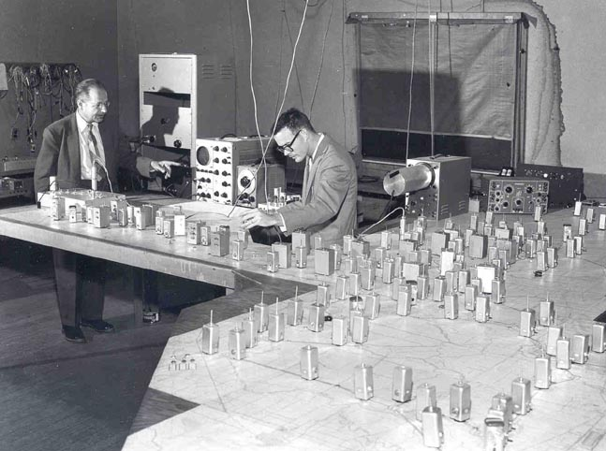
Analog Delta Model
Thank you!

