Slide 1
Lecture 5
Regional CGE Modeling
David Roland-Holst and Samuel Evans
UC Berkeley
Computable General Equilibrium (CGE) Model Training Workshop
Workshop on Regional Economic Cooperation Database and Modeling
2-4 December 2015
CAREC Institute, Urumqi, PRC
dwrh@berkeley.edu

Slide 2
Overview
Regional economic integration is accelerating in Central Asia, significantly because of determined national and international commitments to infrastructure and other investments.
This has been complemented by substantial progress on the institutional side, promoting a more open multilateral trade and investment environment.
In a rapidly evolving regional economy, however, decision makers need support for more evidence-based strategic planning and engagement.
This project develops a new generation of decision tools for economic assessment and policy dialog, nationally, regionally, and with international development partners.

Slide 3
Information Sharing
At our last ADB meeting on this subject, an expert group proposed a four-part information services strategy:
Host an online data portal covering trade, infrastructure, and related economic activity.
Develop indicators related to trade, corridors, and infrastructure generally.
Develop decision tools that make effective use of the first two resources.
Disseminate these data, indicators, and decision tools across the regional policy community, with emphasis on capacity building.

Slide 4
Monitoring: Indicators and Metrics
System performance - how effective are regional commitments/investments?
Public Agency: Metrics and indicators
Trade Facilitation
Infrastructure and logistics performance
Private Agency: Investment climate, standards and indicators

Slide 5
Impact Evaluation
How are economic activities and livelihoods changed by regional integration?
Need to capture heterogeneity and net benefits across diverse stakeholder groups
Beyond macro aggregates - Explicitly spatial and more detailed
Beyond point estimates - Need to recognize and estimate the role of risk and uncertainty

Slide 6
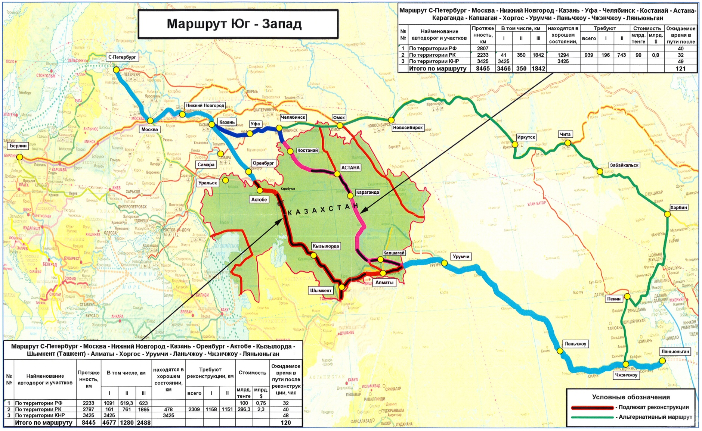
Example 2: Kazakhstan Corridor

Slide 7
The Project is Very Large at Inception

Slide 8
Scenarios
To elucidate the effects of this large scale infrastructure project, we decompose it’s properties into one business as usual and four incremental policy impact scenarios:
0. Baseline (“no investment”) scenario
Vehicle Operating Costs – Includes complete project outlays and estimated economic benefits from improved safety, travel time, and reduced vehicle depreciation.
Productivity – Includes above and estimates of productivity gains for transport and distribution sectors.
Losses – Includes above and reductions in product losses due to spoilage, damage, delays, and other adverse effects of roadway inefficiency.
Trade – Includes above and estimates of reduced trade and transport cost margins.

Slide 9
Real GDP Growth (Percent of 2010, annual with respect to Baseline)
The main beneficiaries in relative growth terms are Kazakhstan and proximate economies.
Regional spillovers are quite significant.

Slide 10
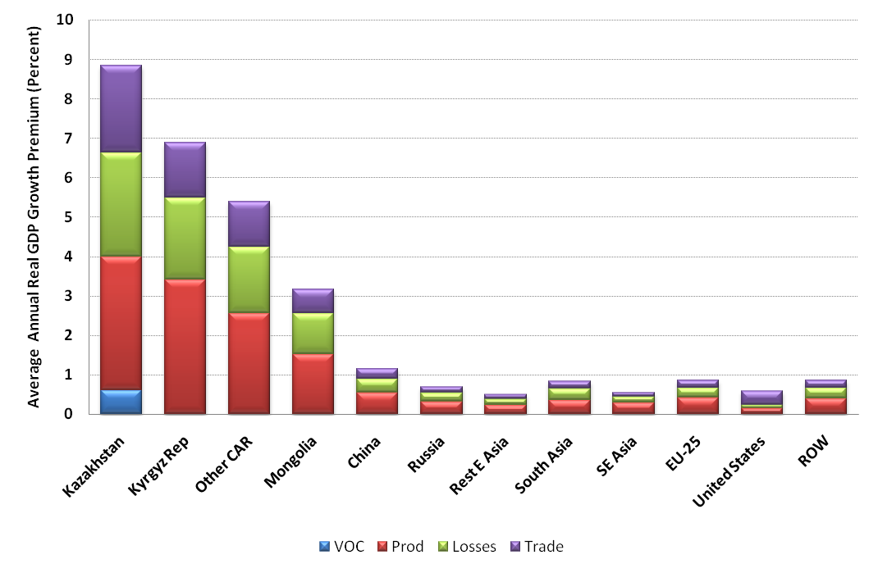
Real GDP Growth Premium by Scenario (Percent wrt 2030 Baseline)
Neoclassical effects dominate the growth stimulus, but trade and product conservation are also significant.

Slide 11
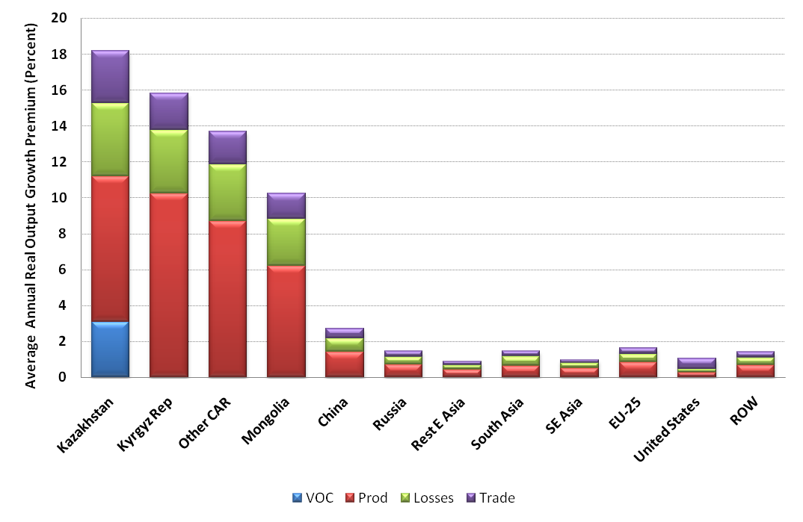
Growth of Output by Sector and Scenario (Percent wrt 2030 Baseline)
Productivity effects are even more important to supply and employment responses.

Slide 12
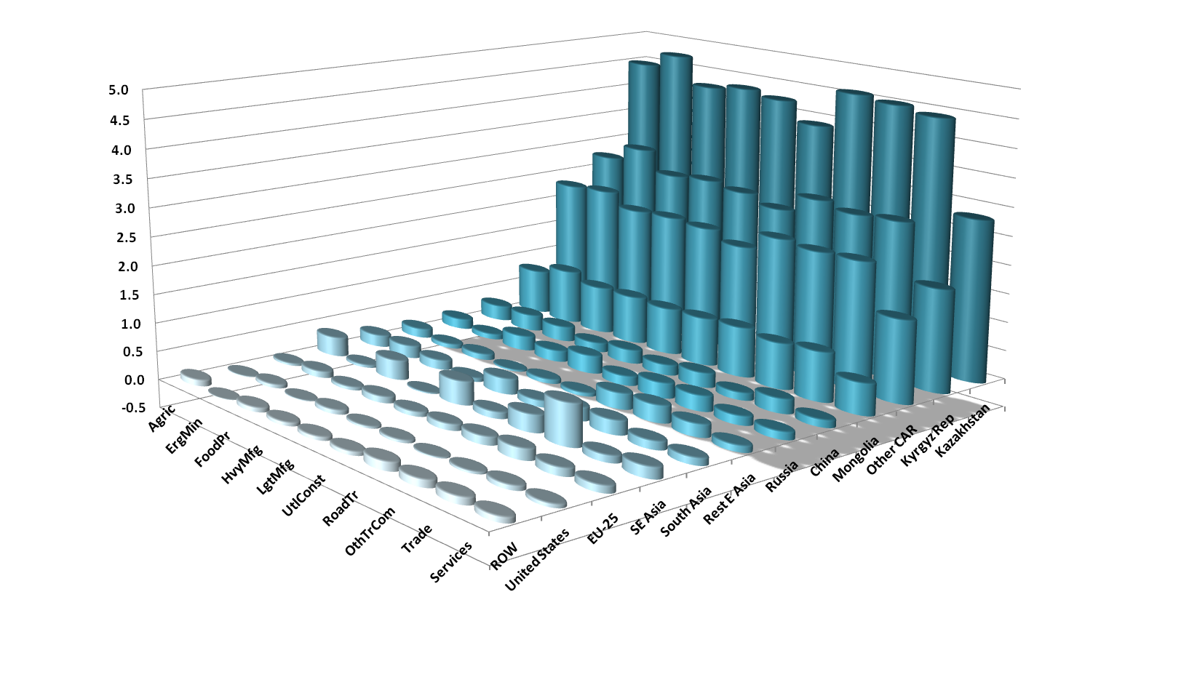
Sectoral Output Growth (Multiple of Baseline in 2030)
Sectoral benefits are relative uniform for local economies, more varied for trading partners.

Slide 13
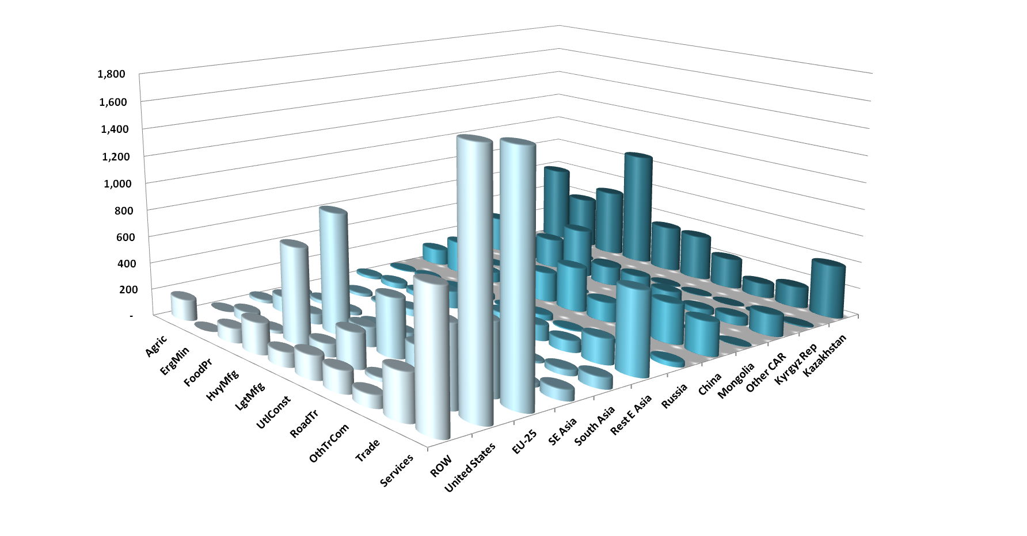
Sectoral Output Growth (USD 2010 Millions wrt Baseline in 2030)
Nominal gains are much more varied, depending on initial scale and trade shares.

Slide 14
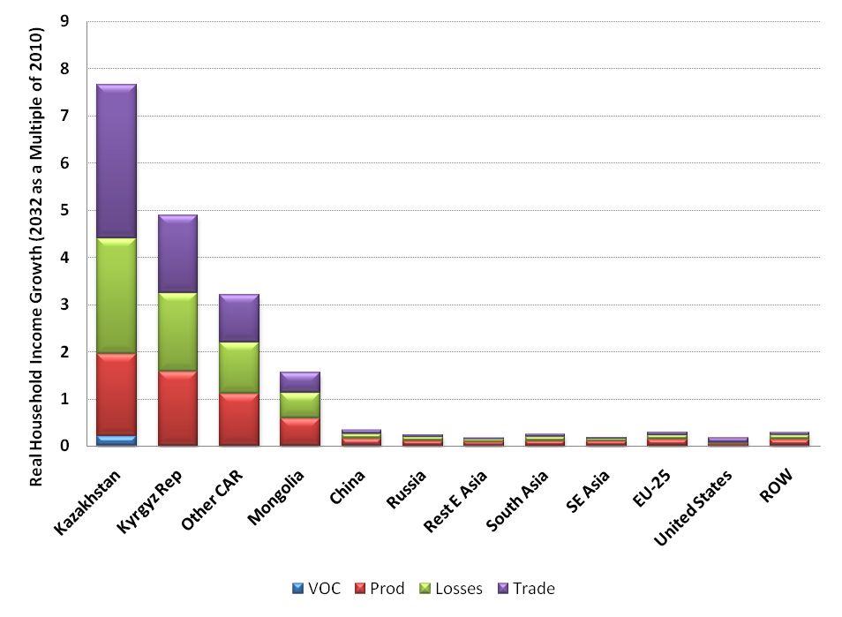
Real Household Income Growth (Percent wrt 2030 Baseline)
Households gain as much from trade as other sources of stimulus, with greater marketing opportunities and increased purchasing power for imports.

Slide 15
Scenarios for Asian Food Trade
Substantial uncertainty remains about China’s future food self-sufficiency
If import trends continue, there are significant opportunities to alleviate rural poverty at home and elsewhere in Asia
If China’s agricultural productivity accelerates sharply, expanded agricultural capacity in Asia will need other outlets
We are developing a global GE model to assess these issues empirically

Slide 16
How evidence-based forecasting can help policy
Ex ante perspective: look before you leap
Identify/quantify real impacts: - how much and for whom?
Reduced costs (TTT, VOC, time, etc.)
Expanded investment horizons
Larger markets
Transport vs. Development – capture integrated, indirect, and longer term impacts
Second-generation infrastructure – find the next level
Adjustment assistance
Identify adjustment needs before they lead to problems
Support dialog
Public: local, national, regional coherence/coordination
Private: arouse private stakeholders to complete the Commitment Game

Slide 17
CARGO: Central Asian Policy Simulation Model
The basic architecture of this regional modeling facility is based on a global prototype designed at the University of California, Berkeley.
This combines a multi-country Computable General Equilibrium (CGE) forecasting model with an interactive, user-friendly, browser-based “dashboard” for decision makers.
These tools are designed to be implemented on local computers/tablets with a browser interface.

Slide 18
Basic CARGO Ingredients
Like all good economic policy, CARGO stands on two legs, highest quality data and analytical methods:
Data: A country-by-country, integrated database for assessing economic linkages, policy and market outcomes, energy flows, and environmental impacts
Calibrated to GTAP-8, plus estimated Social Accounting Matrices for other CAREC economies
Up to 57 sectors/commodities
Annual projections to 2050
Model: A state-of-the-art, economic scenario forecasting tool – downscaled from a global CGE developed at UC Berkeley

Slide 19
Regional Modeling Capacity
A new CAREC regional model has been developed as part of TA-8259, Assisting The Central Asia Regional Economic Cooperation Institute Knowledge Program
The most advanced, up-to-date, and detailed model of its kind.
The current version has 19 countries/regions, up to 57 sectors
Could be decomposed into individual member country models (e.g. TA-8259, Phase II)
Results communication takes two forms:
Traditional technical reporting
A user-friendly data/results browsing app for dissemination to decision makers

Slide 20
Central Asian Regional General equilibrium mOdel (CARGO)

Slide 21
How we Forecast
Global GE Model
Transport
The CARGO model has been developed in four components:
1. Core Economic model
Emissions
Energy
2. Transport module
3. Energy production/distribution
4. Emissions module

Slide 22
Detailed CARGO Framework
National and International Initial Conditions, Trends, and External Shocks
Use Data
Engineering Estimates
Infrastructure Data
Global GE Model
Prices
Demand
Sectoral Outputs
Resource Use
Transport
Trade promotion
Financial and labor reform
Industrial Policies
Investment
TT Policies
Innovation:
Production
Consumer Demand
Detailed Emissions
of C02 and non-C02
Emissions
Detailed State Output,
Trade, Employment,
Income, Consumption,
Govt. Balance Sheets
Energy
Efficiency incentives
Emissions standards
Energy Regulation
Oil Market
Detailed Emission
Database
IEA Energy Balances
Elect Generation Data
Engineering Estimates
- Data
- Results
- Policy Intervention

Slide 23
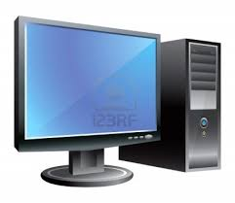

CARGO System Architecture
National Models
Regional Model
Graphic User Interface
Afghanistan
.…
CAREC
Xinjiang
ADB
National Capitals
Policy Makers

Slide 24


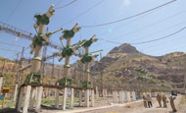
Sample Model Inputs: CAREC Modeling Scenarios
Transport and Infrastructure Policies
Regional corridor schemes for national, regional, and global perspectives
Regional implications of national investments
Motorization and urbanization
Trade Facilitation and Trade Policies
Asian regional integration – national, regional, and global implications
Bilateral and regional TT measures
Integrated Trade Facilitation
Energy Policies
Strategy for Regional Cooperation in the Energy Sector
Energy Action Plan Framework
Regional energy security

Slide 25
Sample Model Outputs: What we forecast
Category | Variables
Economic Structure | Sectoral output, demand, imports, and exports for each country.
Income | Total and per capita GDP by region Value added and employment by sector and country Household income by household category
Employment | Total employment by sector and country Employment rates by household category
Energy | Total energy use by sector and country Energy trade, production and usage mix by country Energy use by household type
Emissions | GHG emissions (CO₂, CH₄, N₂O) by source, use, and region

Slide 26
Extensions
Regional assessment of trade and investment potential.
Transport pathways: Detailed regional impact evaluation.
Energy pathways: Detailed regional impact evaluation.
Dynamics of regional growth and poverty reduction.
Policy impacts on development indicators, MDG’s, etc.
Trends in urbanization and rural development.
Resource development, public investment, and fiscal impacts.
Demographic assessment, including migration, labor force development and employment patterns, and other socioeconomic trends.
More detailed agent-based GIS modeling to improve policy targeting and impact evaluation.

Slide 27
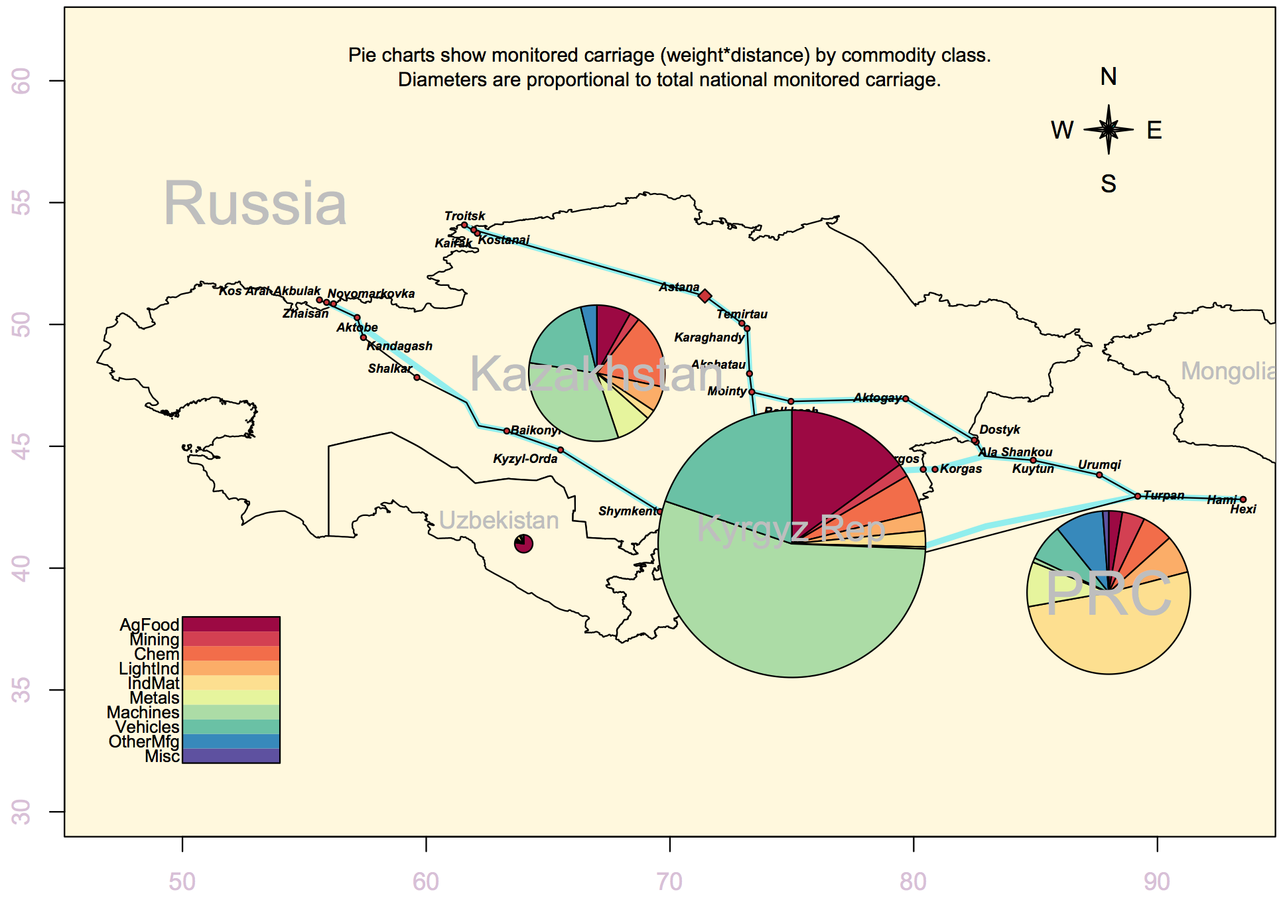
Sample CARGO Map 1: CAREC Corridor Shipments by Country and Commodity

Slide 28
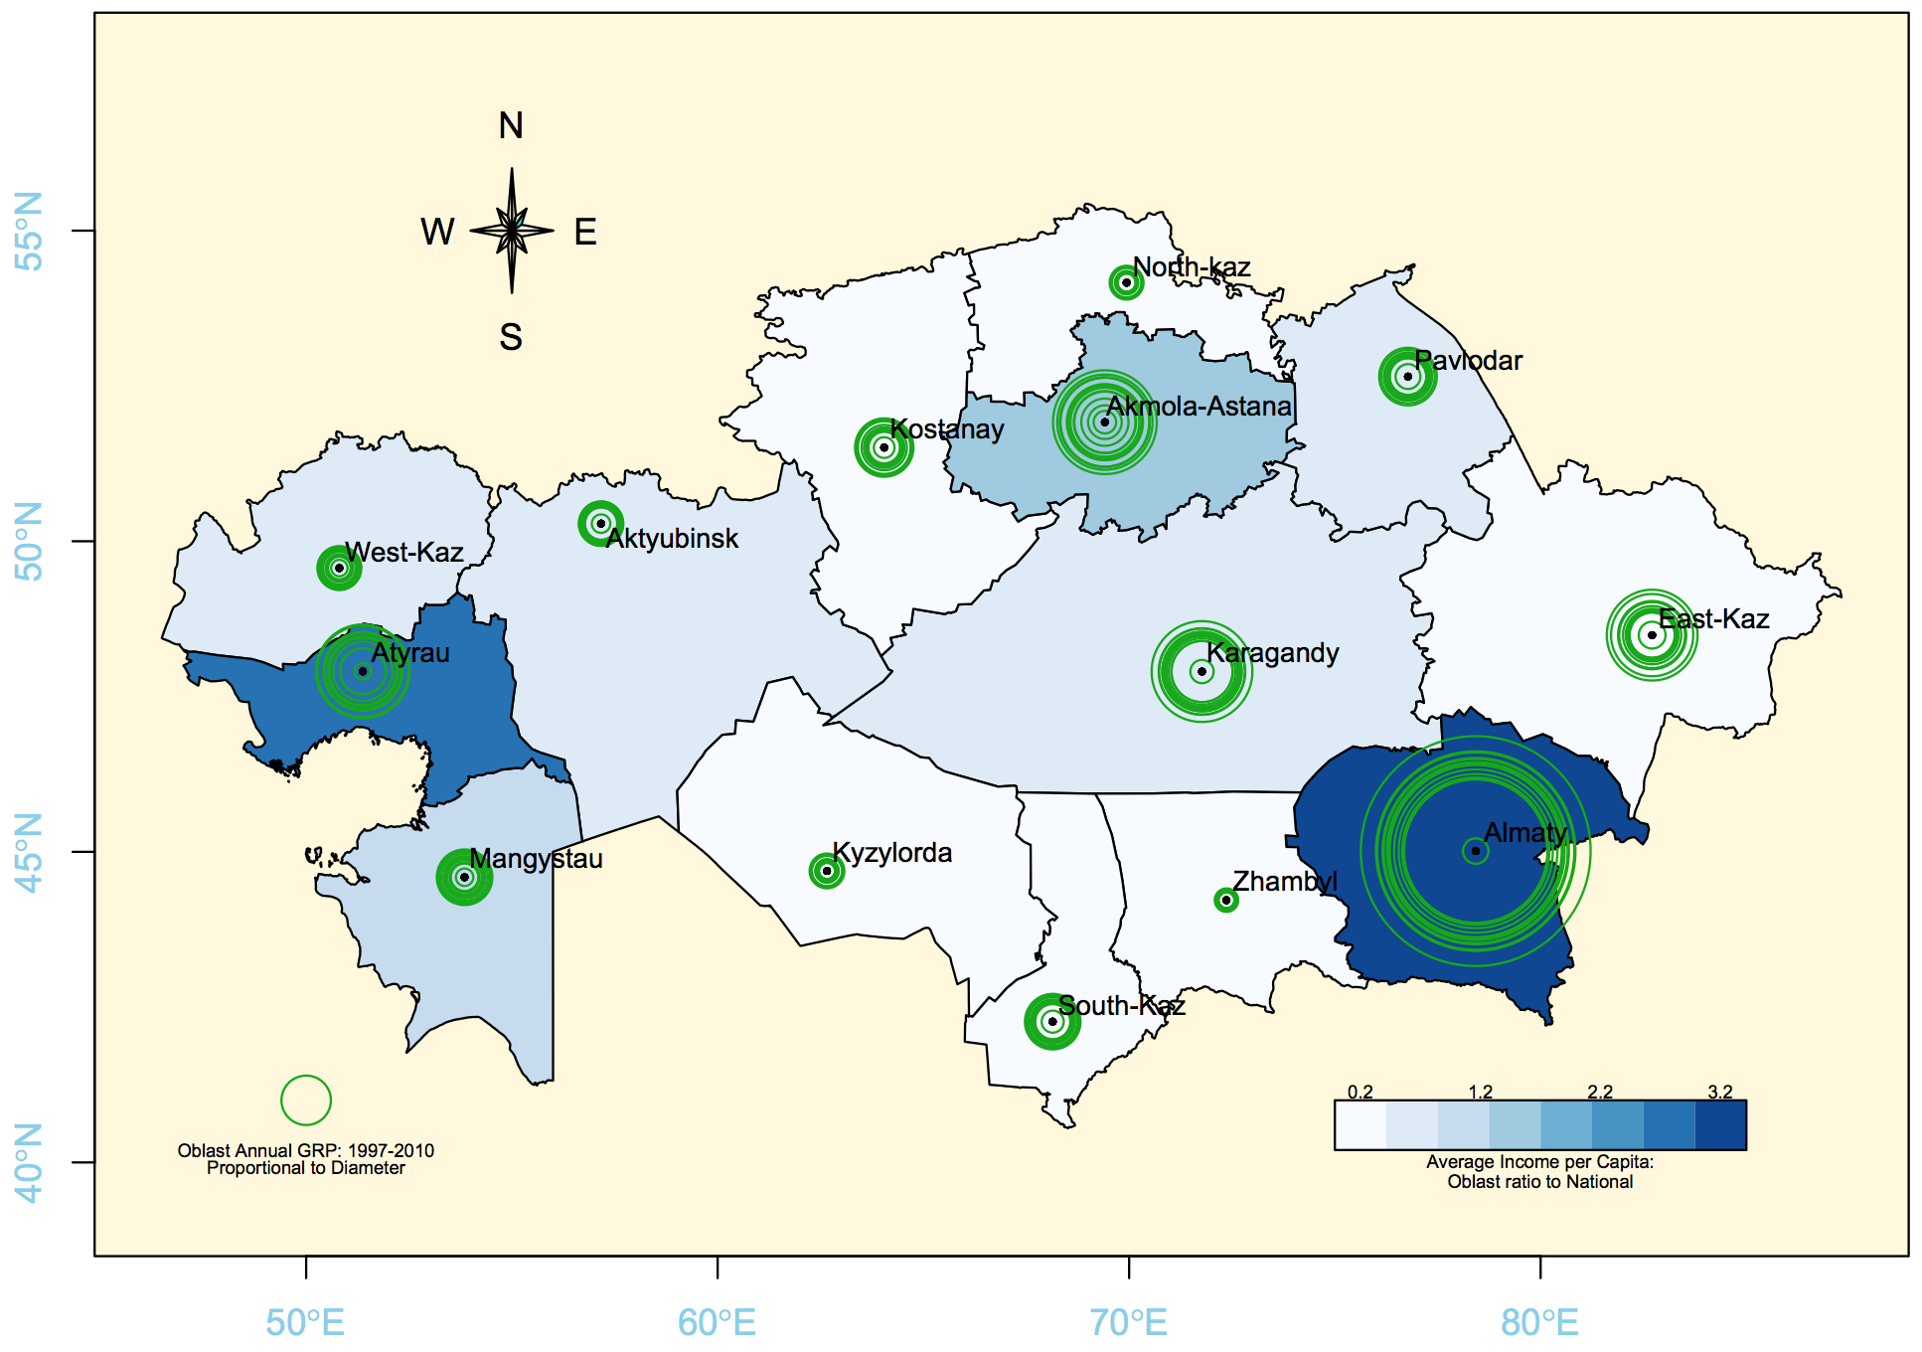
Sample CARGO Map 2: Kazakhstan - Oblast GRP and Income per Capita

Slide 29
The Policy Dashboard
CARGO represents a new generation of policy simulation models, combining
Detailed structural data
A state-of-the-art forecasting model
The Policy Dashboard is a user-friendly, graphic interface that allows visualization of policy impacts.

Slide 30
Demonstration
Now we switch to a browser.

Slide 31
Thank you

Slide 32
Discussion

