Slide 1
Lecture 2.2
1-2-Sim?
Easy CGE Modeling
David Roland-Holst and Enkhbayar Shagdar
UC Berkeley and ERINA
Training Workshop
A Prototype CGE Model for Mongolia
9 July 2013
National Statistical Office of Mongolia, Ulaan Baatar

Slide 2
1-2-3 CGE Model
1 country, 2 activities, 3 commodities
2 activities, producing D and E.
E not consumed domestically.
Additional commodity, M, consumed domestically but not produced.

Slide 3
Sturctural Assumptions
Aggregate GDP (X) is fixed.
Full employment model.
Trade balance set exogenously.
World prices of M and E are fixed.
Total absorption (Q) is endogenous.

Slide 4
Analytical 1-2-3 Model

Slide 5
1-2-3 CGE Model

Slide 6
Definitions for the 1-2-3 CGE Model
Endogenous Variables
E: Export good
M: Import good
D^{S}: Supply of domestic good
D^{D}: Demand for domestic good
Q^{S}: Supply of composite good
Q^{D}: Demand for composite good
Y: Total income
P^{e}: Domestic price of export good
P^{m}: Domestic price of import good
P^{d}: Domestic price of domestic good
P^{x}: Price of aggregate output
P^{q}: Price of composite good
R: Exchange rate
Exogenous Variables
pw^{e}: world price of export good
pw^{m}: world price of import good
B: Balance of trade
σ: Import substitution elasticity
Ω: Export transformation elasticity

Slide 7
SAM 1-2-3

Slide 8
Trade Schematically
CES
CET
Impor t s
Exports
slope=-PD/PE
slope=-PD/PM
slope = E/D = k (P_{E} / P_{D} ) ^{σ}
slope = M/D = k (P_{D} / P_{M} ) ^{σ}
Indifference Curve
PPF
Domestic Goods/Services
Domestic Goods/Services

Slide 9
1-2-3 as a Programming Model

Slide 10
Assumptions
A CET transformation technology between a domestic good D and an export Good E
CES preferences in final demand over D and imports M
A fixed balance of trade
Fixed government demand and investment (example of “macroeconomic closure”)
Fixed terms-of-trade (small country assumption)
Macro identities hold (income constraints, balance of trade, etc.

Slide 11
1-2-3 Model Descriptively
M
P_{M}M=P_{E}E + B
P_{D}/P_{M}
D^{D}
E
P_{D}/P_{E}
D^{D} = D^{S}
D^{S}

Slide 12
Foreign Capital Inflow
B↑

Slide 13
Terms of Trade Deterioration
P_{E}/P_{M}↓

Slide 14
The 123 model in Excel
19 endogenous variables and equations
variables are “scaled” as a share of GDP
Basic inputs are macroeconomic accounts data

Slide 15
The 123 model in Excel
19 endogenous variables and equations
variables are “scaled” as a share of GDP
Basic inputs are macroeconomic accounts data

Slide 16
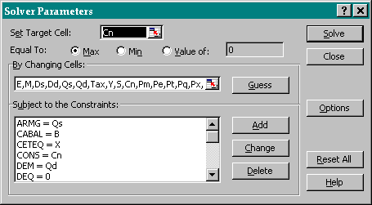
Variables are identified to the solver by name

Slide 17
Calibration
Must run the solver any time parameters or baseline data are changed.

Slide 18
Simulation
To run a counterfactual experiment
Change the Current values of Exogenous Variables (column F of the 1-2-3 Model Sheet)
Run the Solver
Examine Results Summary and Endogenous Variables
NB: Be sure to re-calibrate after each experiment

Slide 19
Moving to GAMS
The Excel version of 1-2-3 is easily accessible, but must be highly simplified to be tractable.
Using a higher level programming language enables us to include more economic structure and behavior.
The Generalized Algebraic Modeling System (GAMS) is the language of choice for this kind of work.

Slide 20
A Model with Consumption, Government, and Investment
Real Flows Prices
(1) X = G(E,D^{S};omega) (10) Pm = (1 + tm)⋅R ⋅ pwm
(2) Q^{S} = F(M,D^{D};sigma) (11) Pe = (1 + te) ⋅ R ⋅ pwe
(3) Q^{D} = C + Z +G (12) Pt = (1 + ts) ⋅ Pq
(4) E/D^{S} = g2(Pe,Pd) (13) Px = g1(Pe,Pd)
(5) M/D^{D} = f2(Pm,Pt) (14) Pq = f1(Pm,Pt)
(15) R = 1
Nominal Flows Equilibrium Conditions
(6) T = tm ⋅ R ⋅ pwm ⋅ M
+ ts ⋅ Pq ⋅ Q^{D} (16) D^{D} ‑ D^{S} = 0
+ ty ⋅ Y ‑ te ⋅ R ⋅ pwe ⋅ E (17) Q^{D} ‑ Q^{S} = 0
(7) Y = Px ⋅ X + tr ⋅ Pq + re ⋅ R (18) pwm ⋅ M ‑ pwe ⋅ E ‑ ft ‑ re = B
(8) S = s ⋅ Y + R ⋅ B+ Sg (19) Pt ⋅ Z ‑ S = 0
(9) C ⋅ Pt = (1 ‑s ‑ ty) ⋅ Y (20) T ‑ Pq ⋅ G ‑ tr ⋅ Pq ‑ ft ⋅ R ‑ Sg = 0
Accounting Identities
(i) Px ⋅ X = Pe ⋅ E + Pd ⋅ D^{S}
(ii) Pq ⋅ Q^{S}= Pm ⋅ M + Pt ⋅ D^{D}

Slide 21
Definitions
Endogenous Variables Exogenous Variables
E: Export good pwm: World price of import good
M: Import good pwe: World price of export good
DS: Supply of domestic good tm: Tariff rate
DD: Demand for domestic good te: Export subsidy rate
QS: Supply of composite good ts: sales/excise/value‑added tax rate
QD: Demand for composite good ty: direct tax rate
Pe: Domestic price of export good tr: government transfers
Pm: Domestic price of import good ft: foreign transfers to government
Pd: Producer price of domestic good re: foreign remittances to private sector
Pt: Sales price of composite good s : Average savings rate
Px: Price of aggregate output X: Aggregate output
Pq: Price of composite good G: Real government demand
R: Exchange rate B : Balance of trade
T: Tax revenue rhot: Export transformation elasticity
Sg: Government savings rhoc: Import substitution elasticity
Y: Total income
C: Aggregate consumption
S: Aggregate savings
Z: Aggregate real investment

Slide 22
123 SAM
Act
Com
Hshld
Gov
Cap
Wrld
Act
D
E
Com
C
G
Z
Hshld
Y
Govt
T_{X}
T_{H}
Cap
S_{H}
S_{G}
S_{F}
Wrld
M

Slide 23
Diagrammatic 1-2-3 model
Slope=P_{D}/P_{M}
M
Balance of Trade
Q = F(M,D)
P_{M}M=P_{E}E + B
Slope =P_{E}/P_{M}
D^{D}
E
Slope =P_{D}/P_{E}
D^{D} = D^{S}
X = G(E,D)
Domestic Market
D^{S}

Slide 24
Foriegn Capital Inflow
M
C*
B
C
Q=F(M,D)
B
Slope = pd/pm
E
D
X=G(E,D)
Slope =pd/pe
Domestic Market
P
D
Real Appreciation

Slide 25
Adverse Terms of Trade Movement
Q=F(M,D)
M
C
P_{E}/P_{M} ↓
C*
Slope = pd/pm
E
D
X=G(E,D)
Slope =pd/pe
D
Real Depreciation
Domestic Market

Slide 26
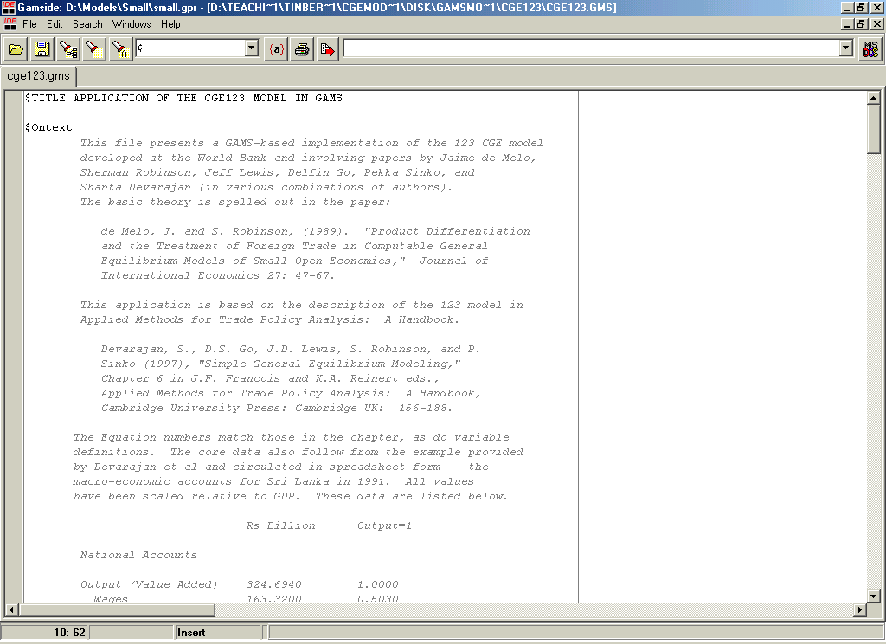
GAMS-based 123 model

Slide 27
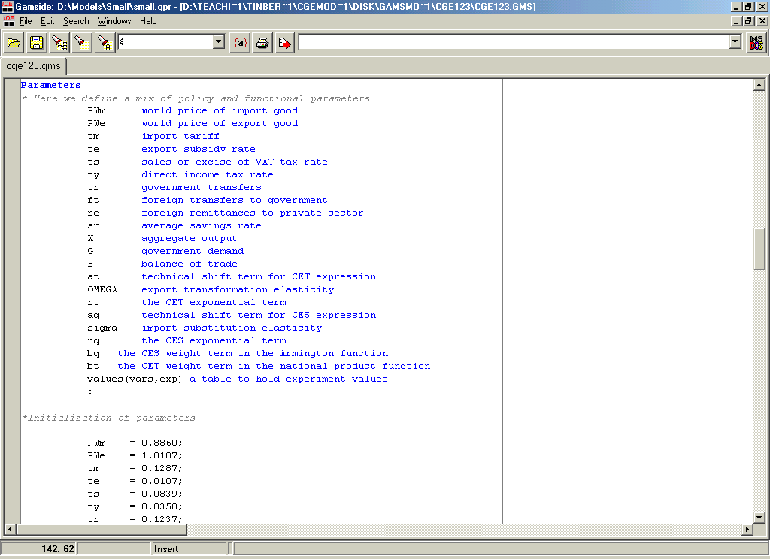
Parameter declarations

Slide 28
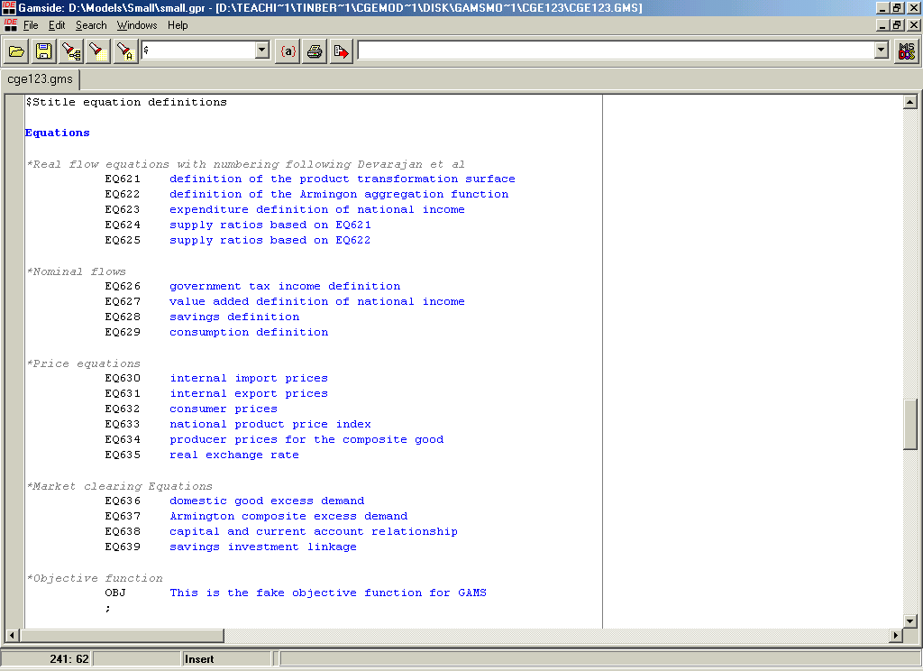
Equation definitions

Slide 29
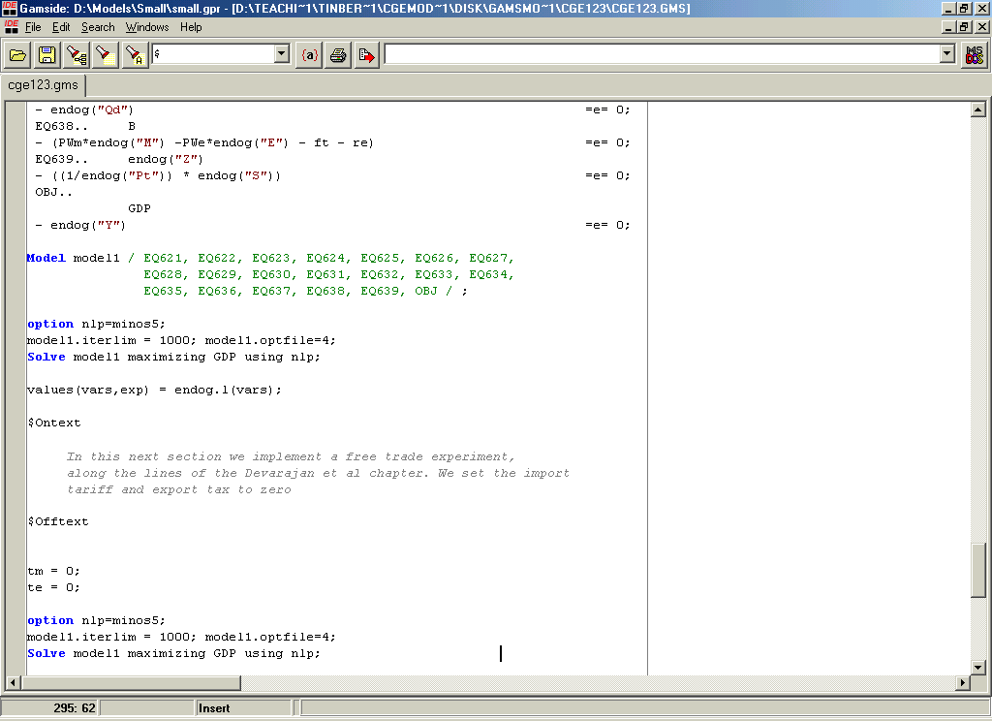
Model specification

Slide 30
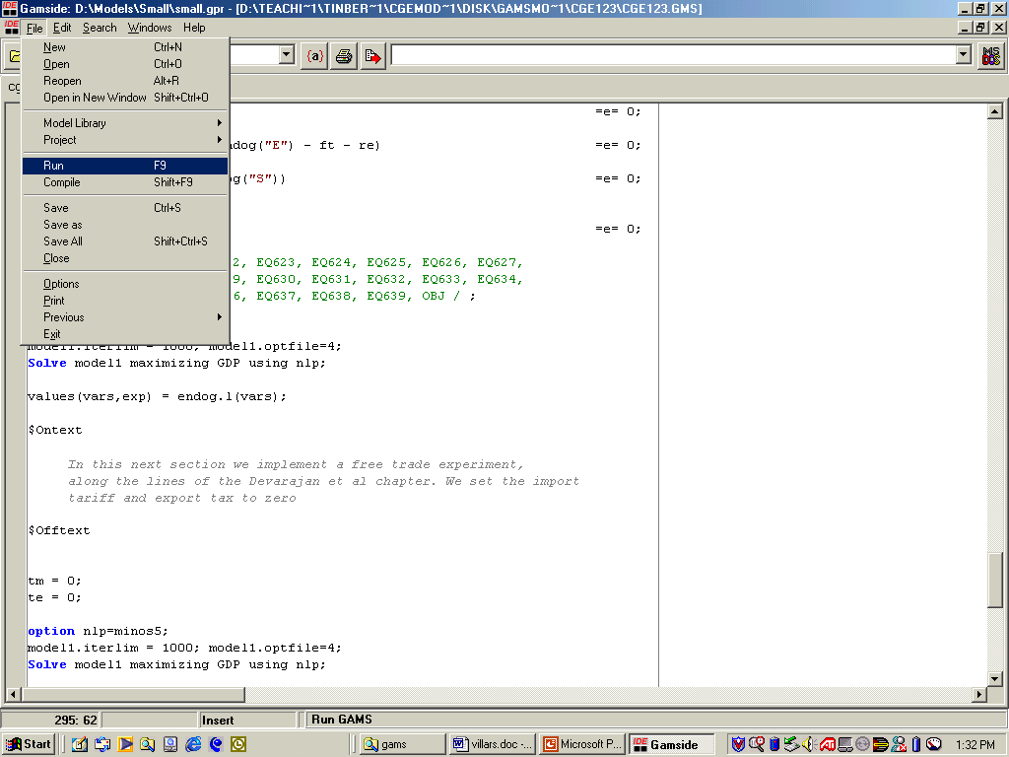
Running in GAMS IDE

Slide 31
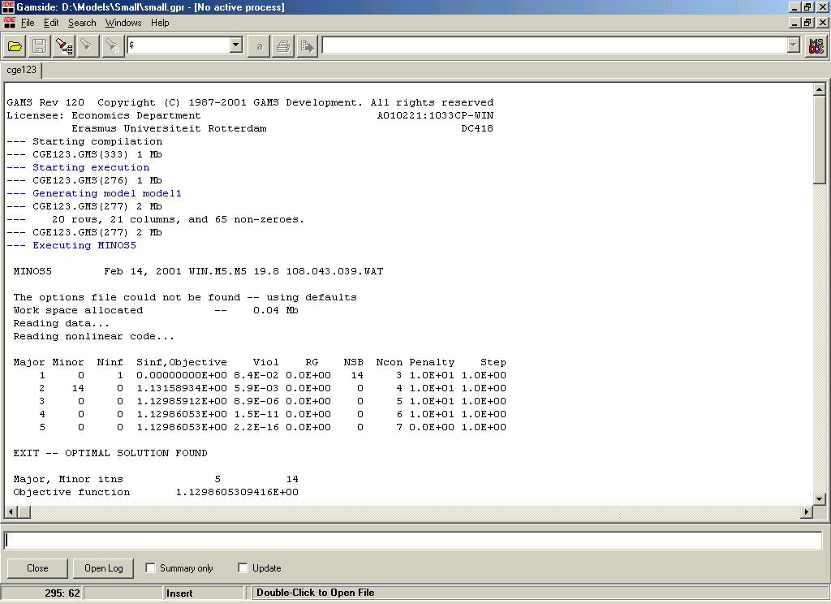
The solution screen

Slide 32
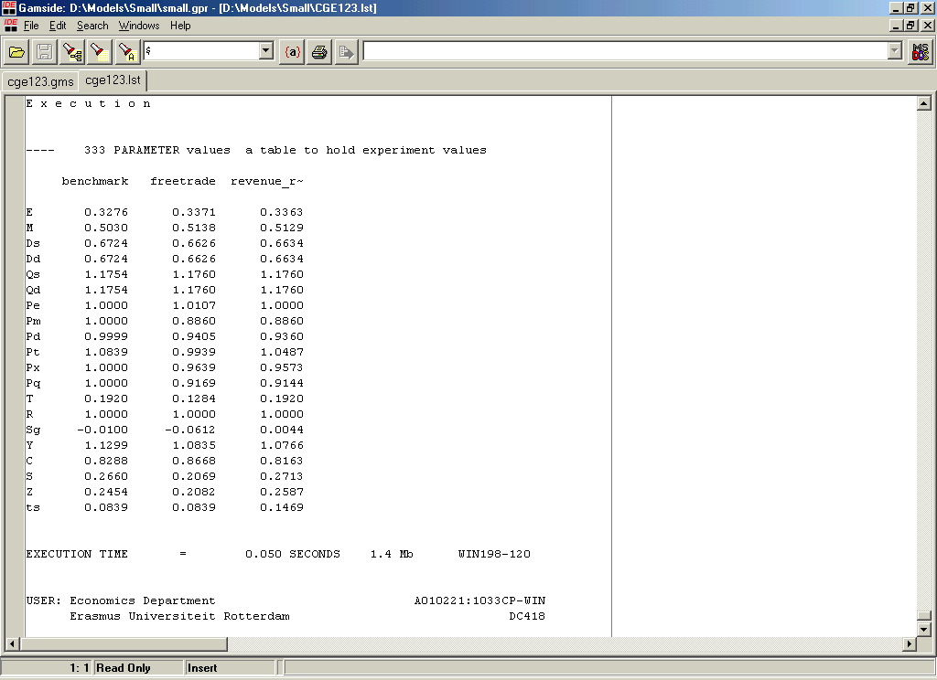
Some results

Slide 33
Questions?

