Slide 1
Lecture 1.1: A Note On Multiplier Analysis
David Roland-Holst and Samuel Evans
UC Berkeley
Central Asian Regional Modeling Analysis (CARMA) Workshop
Sponsored by ADB, CAREC Institute, Narxoz Univerisity
12-15 December 2016
Almaty, Kazakhstan
http://bearecon.com/htdocs/CARMA2016.php

Slide 2
Notes on Multiplier Analysis
The impacts measured by multipliers depend on the source of the demand (e.g. Investment, Government, Exports)
As well as the target of the direct expenditures
The same initial stimulus can lead to
different total impacts and
very different distributional effects
This is an indication of the flexibility of this approach, which can support policy guidance across all sectors of the economy

Slide 3
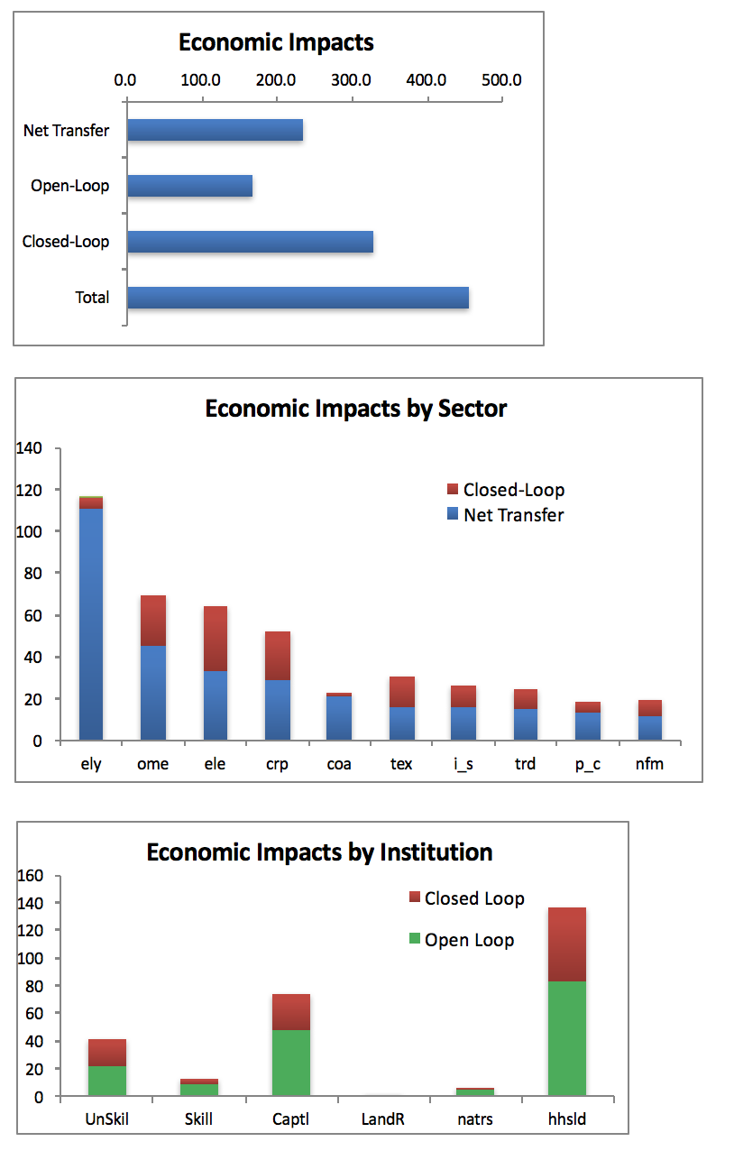
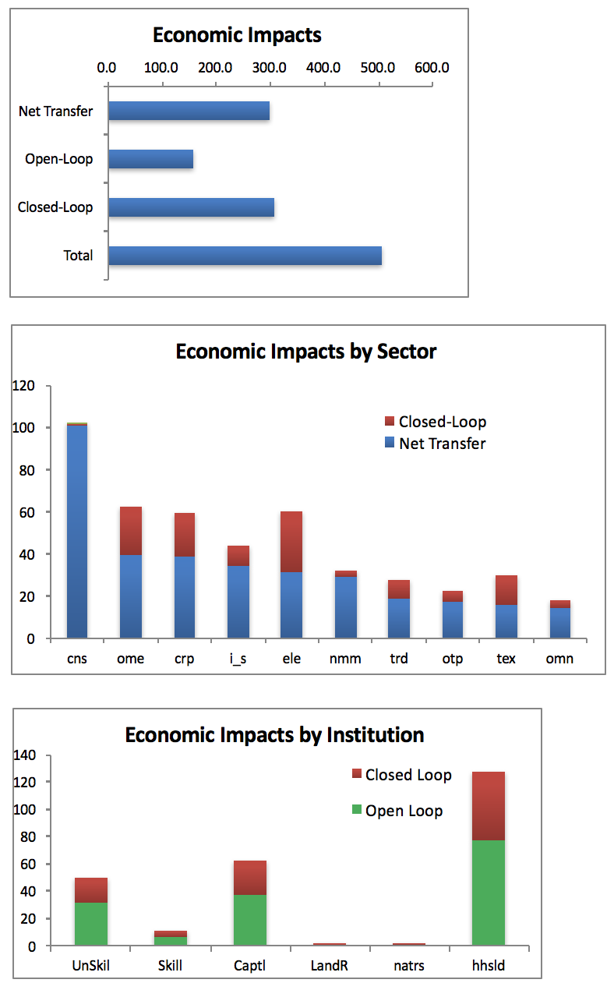
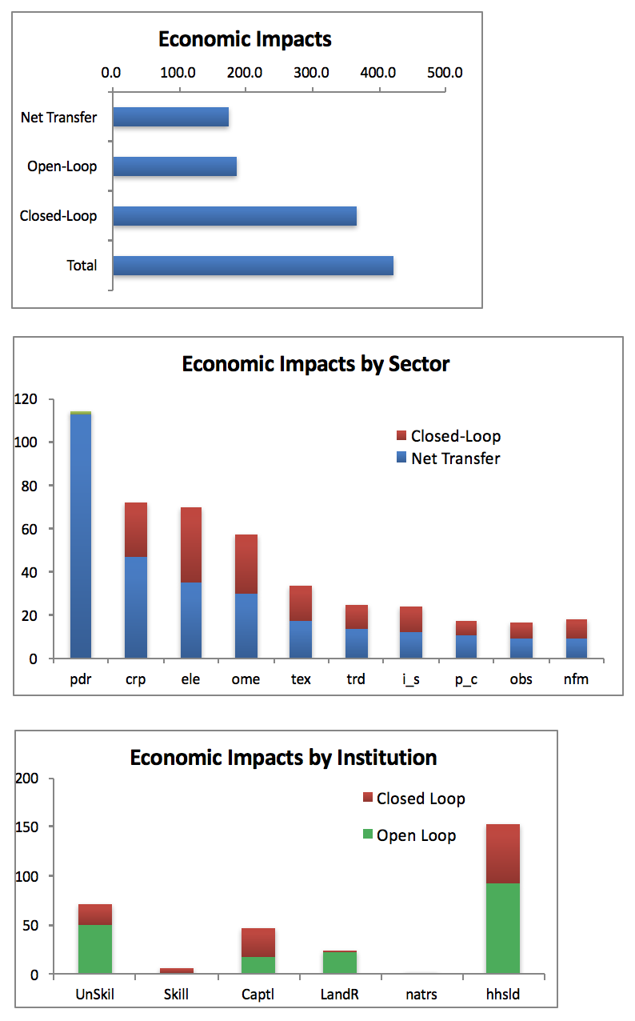
”Bang for the Buck” Depends on the Type of Demand (USD100B)
Investment in Electric Power
Government Construction Spending
Agricultural Export Promotion
GDP

