Slide 1
Decomposition Algebra
While we could do decomposition indefinitely, we typically stop at k = 3 steps because 3 is the number of endogenous accounts within the SAM. In other words, the flow of income around the SAM undergoes 3 steps.

Slide 2
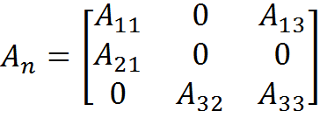
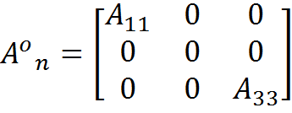
A_{n} and Aº_{n}
We start by defining three matrices: A_{n}, Aº_{n}, and A*.
A_{n} is the A matrix for our complete partitioned SAM
Aº_{n} is the sub-matrix of inter-industry and inter-institutional transfers

Slide 3


A*
Remember that A* = (I – A_{n})⁻¹ (A_{n} – Aº_{n}), where the first term is equivalent to
and the second term is equivalent to

Slide 4
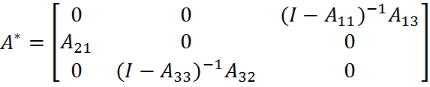
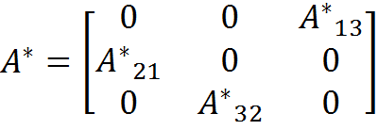
A*
Multiplying these two terms gives
Note that we can define the elements of A* as
(I – A₁₁)⁻¹A₁₃ = A*₁₃ A₂₁ = A*₂₁ (I – A₃₃) ⁻¹A₃₂ = A*₃₂
such that A* follows the circular income flow in the SAM.

Slide 5
M_{a3}M_{a2}M_{a1}
With
y_{n} = (I – A*³)⁻¹ (I + A* + A*²) (I – Aº_{n})⁻¹x = M_{a}x
we can define the SAM multiplier M_{a} as the product of three matrices:
M_{a} = M_{a3}M_{a2}M_{a1}
where
M_{a1} = (I – Aº_{n})⁻¹
M_{a2} = (I + A* + A*²)
M_{a3} = (I – A*³)⁻¹

Slide 6
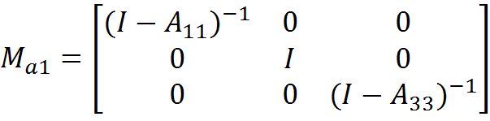
M_{a1}
For M_{a1} = (I – Aº_{n})⁻¹
Remember that in our partitioned SAM
Thus

Slide 7
M_{a1}
From the (I-A₁₁)⁻¹ and (I-A₃₃)⁻¹ elements of M_{a1} you can begin to develop some intuition about how to interpret the decomposed multipliers.
M_{a1} is typically referred to as the transfers, or direct effects, multiplier, because it captures the multiplier effects of transfers within accounts; in this case industries, i.e. (I-A₁₁)⁻¹, and institutions, i.e. (I-A₃₃)⁻¹.
M_{a1} only captures within account effects; it tells us nothing about factors or institutions.

Slide 8

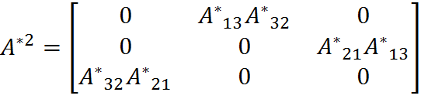
M_{a2}
Similarly, for M_{a2} = (I + A* + A*²), where A*² is
or more simply

Slide 9

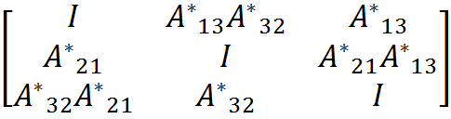
M_{a2}
Thus M_{a2} = (I + A* + A*²) is
or

Slide 10
M_{a2}
M_{a2} is the only matrix with off-diagonal elements, and is referred to as the cross-effects, or open-loop, multiplier.
M_{a2} captures the effects of an injection into the system as it moves through the system without coming back to its origin (hence the name ‘open-loop’). In other words, M_{a2} shows how an external injection travels from endogenous demand to income (“across” institutions), but not from income to demand.

Slide 11
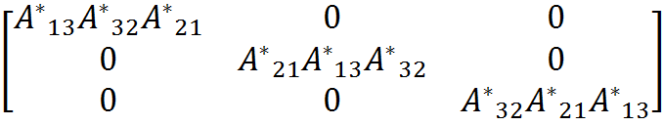
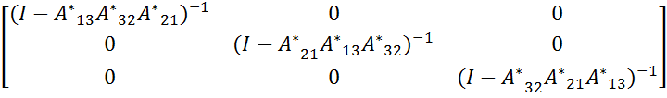
M_{a3}
M_{a3} = (I – A*³)⁻¹, where A*³ is
and (I – A*³)⁻¹ is

Slide 12
Additive Multipliers
All three multiplier forms — aggregate, multiplicative, and additive — are related by
M_{a} = M₃M₂M₁ = I + T + O + C
where
I = Identity multiplier
T = (M₁– I) = Net transfer multiplier
O = (M₂– I)M₁ = (M₂M₁– M₁) = Open-loop multiplier
C = (M₃– I)M₂M₁ = (M₃M₂M₁– M₂M₁) = Closed-loop multiplier

