Slide 1

Central Asian Policy Simulation Model (CAPSIM)
General Model OVErview
Version 1.5, July 2013

Slide 2
Contents
Pages | Section
3-4 | Model Background
5-11 | Production
11-13 | Household Consumption
 | Government
 | Savings-Investment
 | Trade
 | Model Closure

Slide 3
Model Background
The CAPSIM model is a regional/global computable general equilibrium (CGE) model, a descendant of the LINKAGE model developed by Dominique van der Mensbrugghe while at the World Bank. Its development dates back to the 1980s, when early versions of the model were used to study global trade reform. Since then, the model has been used to analyze a variety of policy questions, including, more recently, energy and climate policies.
CAPSIM is a multi-country, multi-sector model, combining a recursive, dynamic modeling framework with a comprehensive, consistent economic database. CAPSIM is implemented in the GAMS programming language and calibrated to national data and the Global Trade and Analysis Project (GTAP) database.
CAPSIM uses a 20 country/region framework and 10 sector aggregation. To make the model tractable for online use, CAPSIM is a comparative static model.
The remainder of this document provides a generic overview of the CAPSIM model, focusing on basic model structure and function. For more detailed documentation, contact David Roland-Holst at dwrh@berkeley.edu.

Slide 4
Model Background
CAPSIM divides national economies into five main, interactive components:
Production
Consumption
Government
Savings-Investment
Trade
Because these components are all interlinked — for instance, how much producers produce depends on demand, but how much consumers demand depends on producer prices — CAPSIM must find a solution that simultaneously satisfies the requirements of each component. The remainder of this document describes the mathematical notation used to represent each component and its requirements.

Slide 5
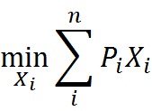

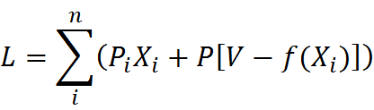
Production
The producer’s problem is to choose inputs to minimize total costs subject to production constraints. For n inputs, this problem can be represented mathematically as
s.t.
X_{i} | Input I
P_{i} | Price i
V | Production function
The Langragean for the producer’s cost minimization problem is

Slide 6
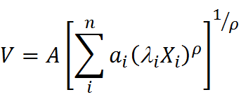
Production
CAPSIM uses a constant elasticity of substitution (CES) production. This CES production function has the generic form
V | Production function
A | Shift parameter (all inputs)
a_{i} | Share parameter (input i)
λ_{i} | Shift parameter (input i)
X_{i} | Input i
ρ | CES exponent

Slide 7

Production
The shift parameters A and λ_{i} capture uniform and input-specific changes in productivity. For instance, an A value of 0.99 would mean that good V could be produced with 1% less of all inputs, whereas a λ value of 0.99 for petroleum inputs would mean that producing good V would require 1% less petroleum.
The share parameter a_{i} is the share of input i used to produce V. For instance, if A and λ_{i} are 1, a_{i} is equal to

Slide 8



Production
The CES exponent ρ is related to the CES substitution elasticity σ by
Substitution elasticities determine how much the use of one input changes with a change in the price of another. As its name suggests, the CES function assumes that the elasticity of substitution (σ) between inputs is constant.
When raised to the power of σ, the share parameter a_{i} can be rewritten as
or

Slide 9
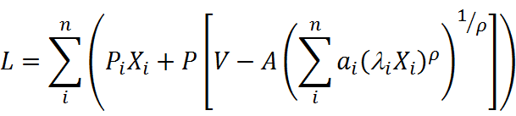
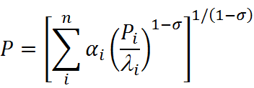

Production
Substituting the CES production function into the Lagrangean from page 5 gives us
Finding the partial derivatives of L with respect to P and X_{i} gives us unit prices
and optimal input amounts

Slide 10
Production
CAPSIM uses a nested CES structure, stratifying input substitution and allowing substitution elasticities to vary over inputs. In the first level, producers choose between intermediate inputs (e.g., steel, fuel, computers) and factor inputs (e.g., labor and capital) with substitution elasticity σ^{p}. The figure below shows a simplified version of the nested CES structure used in CAPSIM. For the complete structure, refer to the detailed CAPSIM documentation.
Total Inputs
σ^{p}
Intermediate Inputs
Value Added
σ^{l}
σ^{v}
Armington Demand
Labor
Land-Capital
σ^{m}
σ^{k}
Domestic
Imports
Land
Capital

Slide 11



Production
Unit prices and demands for the nested components follow the generic CES structure described above. For instance, total unit prices for a given good X are the sum of intermediate and factor prices (PND and PVA, respectively). Using the formula for unit prices from page 9 and the ND-VA substitution elasticity from the previous page (σ^{p}), unit prices are
Similarly, using the formula for input demands on page 9, demand for total intermediate and factor inputs is
where XP is total output of the good.
and

Slide 12
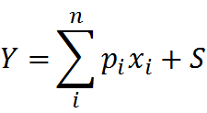
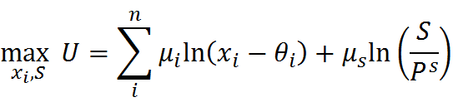
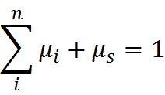
Consumption
CAPSIM uses an extended linear expenditure system (ELES) function to model household consumption. The ELES function separates household consumption into a subsistence minimum (θ) and discretionary spending (total consumption minus the minimum, or C-θ). In the ELES, households maximize utility from discretionary spending subject to budget and accounting constraints
s.t.
U | Household utility
μ_{i} | Income share of good i
x_{i} | Consumption of good I
θ_{i} | Minimum consumption, good i
μ_{s} | Savings share of income
S | Value of savings
P_{s} | Relative price of savings
Y | Total income
p_{i} | Price of good i
x_{i} | Consumption of good i

Slide 13



Consumption
The Lagrangean for the ELES function is
Finding the partial derivative of L with respect to x_{i} gives the ELES demand function
and the partial derivative with respect to S gives household demand for saving

