Slide 1


Slide 2
Key Messages
While there have been substantial reforms in manufactures trade, there is still high protection in agriculture. Reforms are ongoing in agriculture in most developing countries, but there is little reform in industrial and some developing countries
Reforms in agricultural marketing and production in developing countries will increase output, but without trade reforms this will lead to price declines and pressures for greater protection
Global agricultural reforms would generate large welfare gains and even larger changes in output, exports and imports
Multilateral and multi-commodity solutions are the key

Slide 3
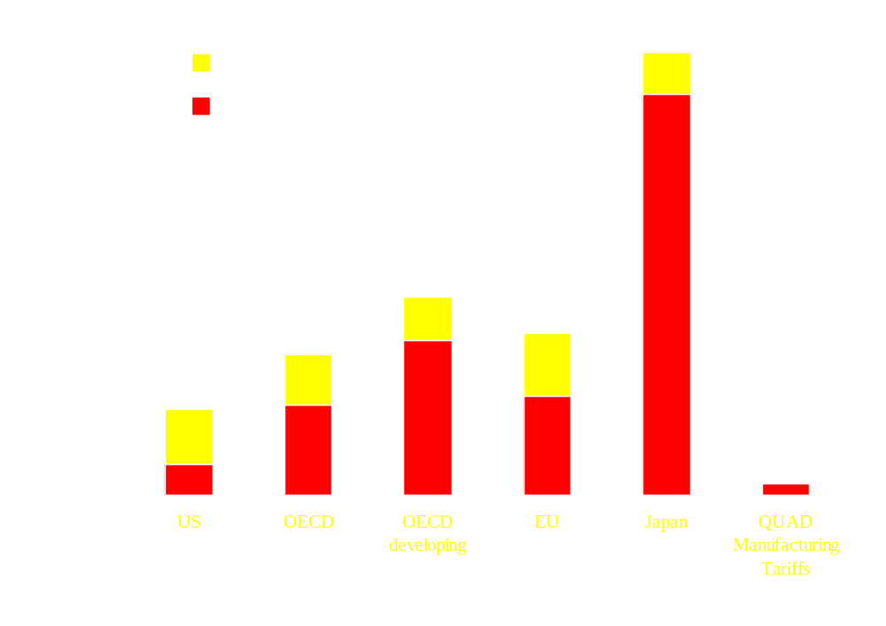
Protection is Still High and Mostly at the Border
Source: OECD

Slide 4
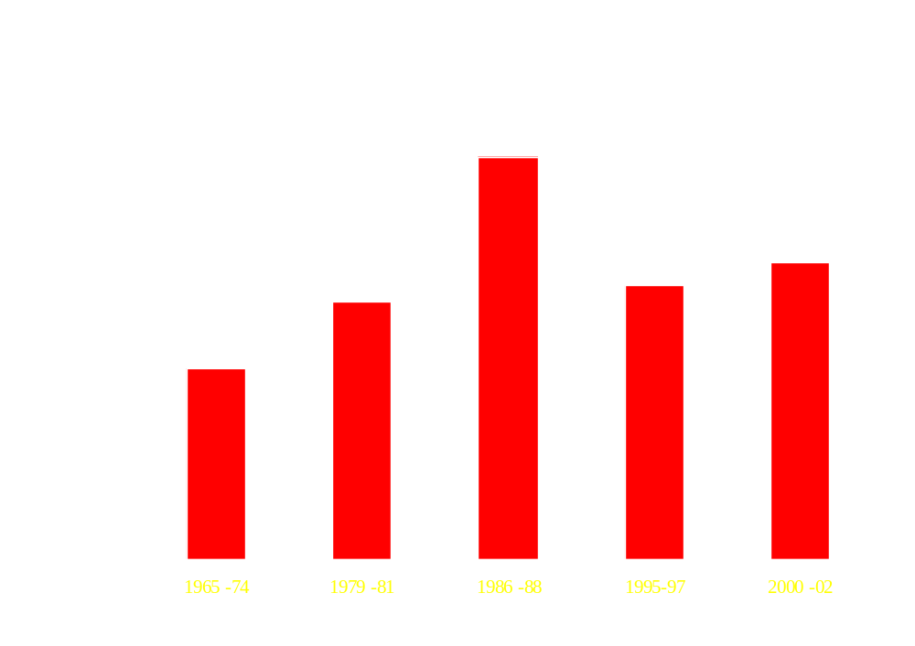
OECD Protection has not decreased significantly
Estimated nominal rates of agricultural protection in OECD Countries (%)
Source: OECD protection estimates (except ABARE for 1965-1974, Author’s calculation for 2000-2002).

Slide 5
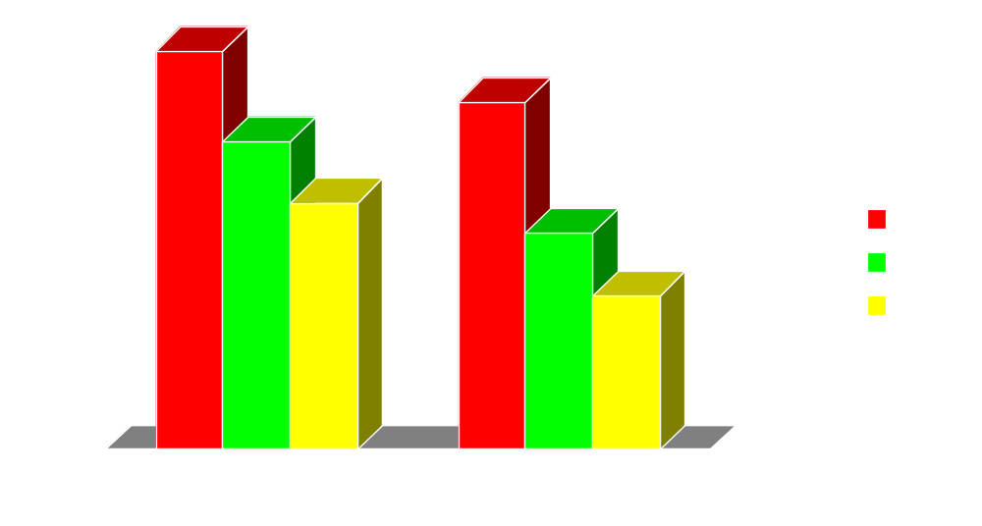
Developing Countries’ Tariffs Have Decreased
Source: TRAINS

Slide 6
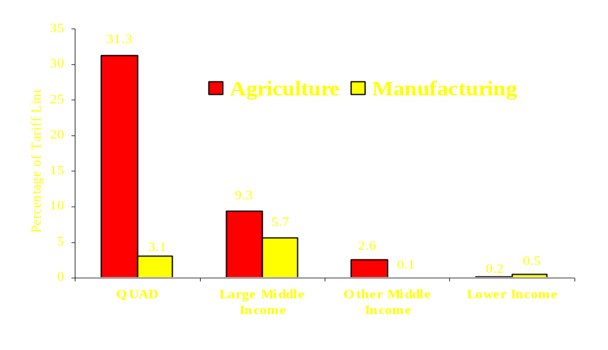
Complicated Protection
Due to Specific Duties
Percentage of Tariff Lines Non Ad-Valorem
Source: WTO IDB (MFN Applied Duties)

Slide 7
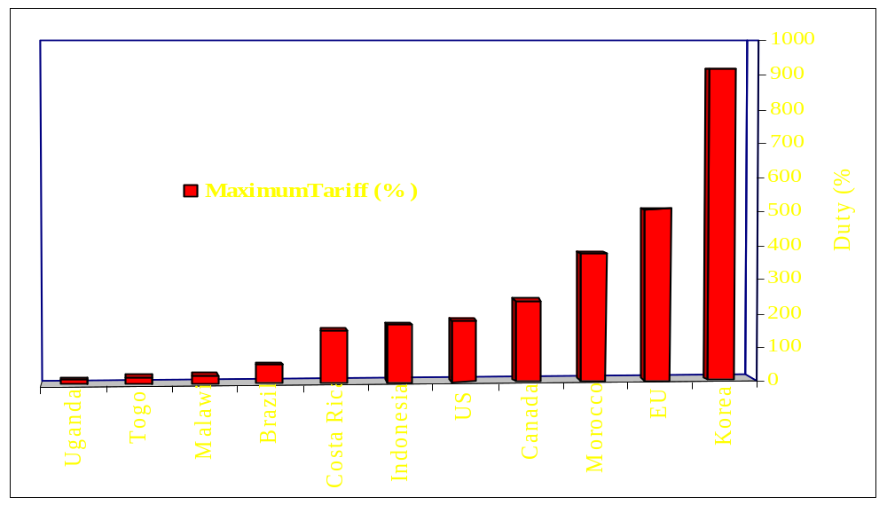
Tariff Peaks Are Very High
Source: WTO IDB (MFN Applied Duties)

Slide 8
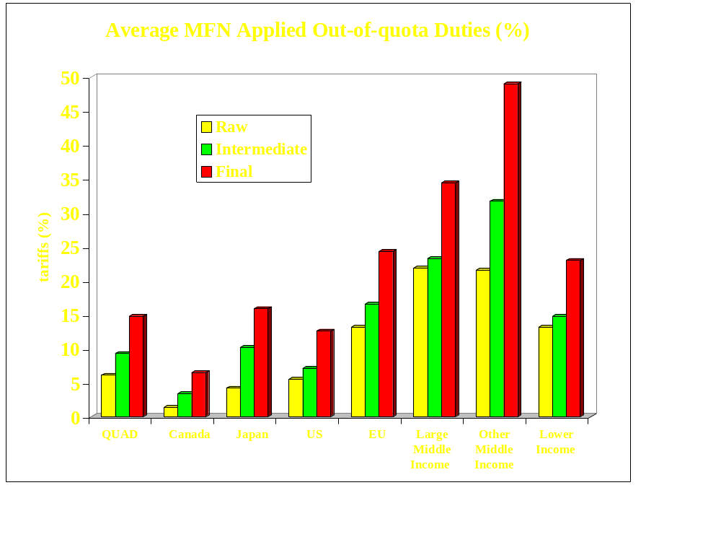
Tariffs Escalate in Final Products
Source: WTO IDB (MFN Applied Duties)

Slide 9
Protection
Dairy
Highest OECD support ($42.1 billion), with tariffs of 30% and higher worldwide
Myriad of instruments used (tariff, TRQ, export subsidy, price discrimination)
Dynamic market fueled by fast-growing trade in components and foreign direct investment

Slide 10
Protection
Rice
Mature but important market
World average tariffs of 43% (217% for short/medium grain rice). Total OECD support of $24.3 billion
Prohibitive tariffs in Japan, Korea, Taiwan, EU
Tariff escalation by stage of milling in EU and LAC
High tariffs in Indonesia, India, and many net importing countries outside Middle East

Slide 11
Protection
Cotton
Low tariffs, significant US and EU production subsidies of $4.4 billion out of $20 billion of production
Sugar
World average tariff: 26.6 percent (sugar and confectionery); OECD support $5.2 billion
High domestic support and trade policies in EU, US, Japan, including TRQs, and export subsidies
80% of production & 60% of trade at prices higher than the world price

Slide 12
Stagnating Trade Share of Developing Countries in Agriculture
(percent)
Developing Countries
Industrialized countries
1980/81
90/91
00/01
80/81
90/91
00/01
Agriculture
Total
37.8
33.0
36.1
62.2
67.0
63.9
To Developing
13.4
10.5
13.7
18.9
14.5
15.6
To Industrialized
24.3
22.4
22.4
43.4
52.5
48.3
Manufacturing
Total
19.3
22.7
33.4
80.7
77.3
66.6
To Developing
6.6
7.5
12.3
21.7
15.2
19.0
To Industrialized
12.7
15.2
21.1
59.0
62.1
47.6
Source: COMTRADE

Slide 13
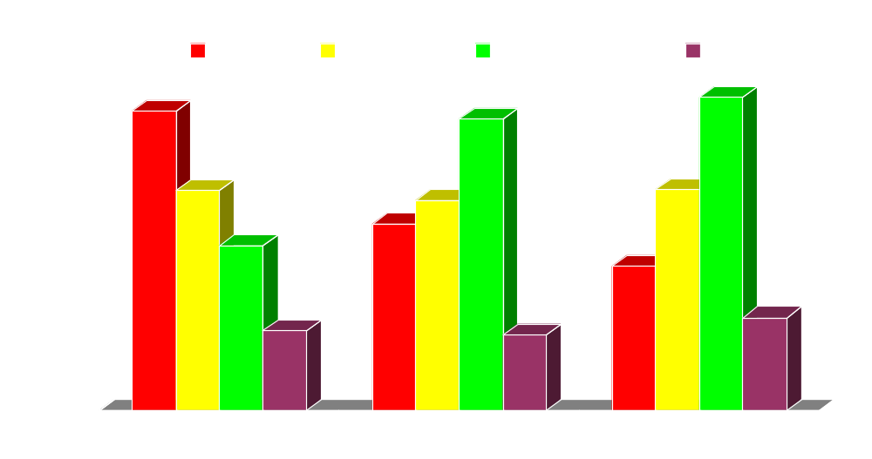
Developing Country Exports have Surged in Non-Traditional Products with Low Protection
(shares, %)
Tropical Products: Coffee, cocoa,,tea, nuts, spices, textile fibers, sugar and confectionery;
Temperate Products: Meats, milk, dairy, grains, animal feed, edible oil and oil seeds
Other Processed Products: Tobacco and cigarettes, alcoholic and non-alcoholic beverages and other processed food

Slide 14
Reforms would deliver large welfare gains and structural changes
Most global gains are due to agriculture and food processing
Without reforms trade surpluses will increase for industrial countries
Predicted changes in output, imports and exports are many times the welfare gains
Results are robust to changes in key assumptions

Slide 15
Reform Effects
Cotton
Removing US and EU production subsidies is key for growth
Eliminating distortions would increase world prices by 10-20%
Expansion expected in West Africa, Central Asia, and Australia, contraction in EU, US
Dairy
Removing distortions would increase world prices by 20-40% and welfare by $3.5 billion

Slide 16
Reform Effects
Sugar
Removing all support would increase world prices by 20 to 40 percent, with aggregate welfare gains of up to $4.7 billion
Gainers: Producers in Brazil, Thailand, Latin America, Africa and Australia; consumers in US, Japan, and EU
Adjusters: Producers in US, EU, Japan, and all northern developing countries, and import quota license holders

Slide 17
Decoupling Support
Move to reduce tariffs and replace production linked subsidies with decoupled support payments
Little effect on output so far
  Not all support replaced
  No time limit and reversals
  Require land to be in agricultural use

Slide 18
Preferences for Low Income Countries
Small number of products have large benefits (sugar, bananas)
Products and rules by major industrial countries are very different
No major diversification has taken place as a result of preferences
In Caribbean the preferences have held back diversification

Slide 19
Agro-Food Standards
Proliferation and tightening of standards, both official and private sector
New demands are manageable for middle-income countries and organized industries in poorer ones
20 low and 28 lower middle countries export fish to EU with reduced inspections

Slide 20
Implications
Difficult to initiate reforms in developing countries without global reform
The Uruguay Round, NAFTA, and EBA, are bringing some discipline, but much deeper multilateral reform needed
Significant reduction of border protection is a crucial first step
Border reforms alone are not sufficient. Real reductions of domestic support needed—not just the “color box” game

Slide 21
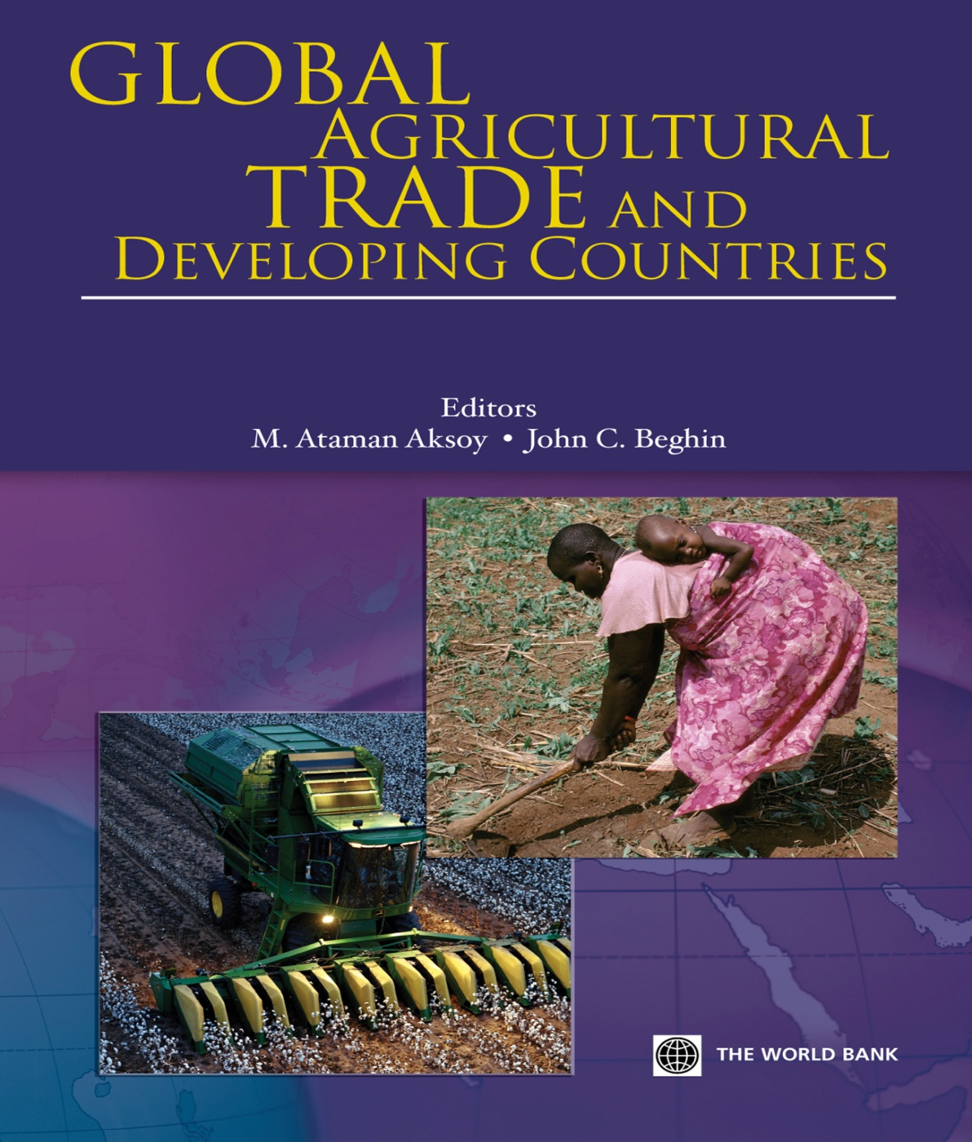
www.worldbank.org/prospects/globalag

Slide 22
Cotton
Mature market, slow demand growth intense competition from synthetic fiber (60 % share)
Low tariffs, significant US and EU production subsidies of $4.4 billion—trade distortions. “Reactive” support in many developing countries
Removing US and EU production subsidies is key for growth, although reforms unlikely soon
Eliminating distortions would increase world prices by 10-20%
Expansion expected in West Africa, Central Asia, and Australia, contraction in EU, US
Strong poverty links in low income countries

Slide 23
Dairy
Highest OECD support ($42.1 billion), with high tariffs of 30% plus worldwide
Myriad of instruments used (tariff, TRQ, export subsidy, price discrimination)
Dynamic market globally fueled by fast-growing trade in components and FDI
New trade in casein, whey, and milk components with new technology, bypassing trade barriers
Removing distortions would increase world prices by 20-40% and welfare by $3.5 billion
Relocation of production would take place away from QUAD, and High-income Asia to CAIRNS (minus Canada), and India

Slide 24
Groundnuts
Mature markets, cheaper vegetable oils have reduced peanut oil demand; expanding demand for confectionary nuts;
Global tariffs around 13 % for groundnuts, 11 % for groundnut oil, and 5.8 % for cake
In India tariffs of 45% on nuts and cakes, 70% on oil
Tariff escalation in China: 9.7% in-quota for oil, 75% out-of quota oil tariff, but redundant tariffs for nuts; VAT not applied to domestic output

Slide 25
Groundnuts
Reduced US distortion with the 2002 Farm Bill, but redundant high tariff remaining. High tariffs in smaller Asian markets (Thailand, Korea)
Removal of distortions would increase world prices by 15 to 20 percent for groundnuts, oil and cake
Who would gain? Producers in West Africa (if quality issues are resolved), Argentina, South America, and the US
Who would have to adjust? Chinese and Indian producers; EU and US consumers

Slide 26
Rice
Mature but important market—staple food in Asia, small-holder production, potential trade growth
World average tariffs of 43% (217% for short/medium grain rice). Total OECD support of $24.3 billion
Prohibitive tariffs in Japan, Korea, Taiwan, EU
Tariff escalation by stage of milling in EU and LAC
High tariffs in Indonesia, India, and many net importing countries outside Middle East

Slide 27
Rice (con’t)
Gainers will be millers in Thailand, Vietnam, and the US; competitive producers (Vietnam, China, Thailand); consumers in Indonesia, Bangladesh, Philippines, most of Africa….
Losers will be producers in Japan and Korea; net importers of short/medium grain rice and their consumers, especially in unprotected Asia and Middle East

Slide 28
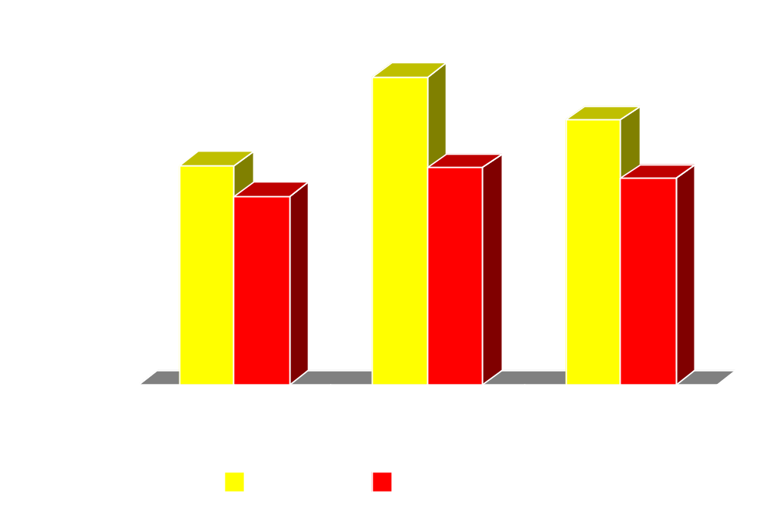
Rice consumer prices in net importing countries after global liberalization

Slide 29
Sugar
World average tariff: 26.6 percent (sugar and confectionery); OECD support $5.2 billion
High domestic support and trade policies in EU, US, Japan, including TRQs, and export subsidies
“Reactive” support caused by low prices
80% of production & 60% of trade at prices higher than the world price. Preferential regimes affect trade patterns

Slide 30
Sugar (con’t)
Removing all distortions would increase world prices by 20 to 40 percent, with aggregate welfare gains of $4.7 billion and up
Who would gain? Producers in Brazil, Thailand, Latin America, Africa and Australia; consumers/users in US, Japan, EU, and other beet producing northern countries
Who would have to adjust? Producers in US, EU, Japan, and all northern developing countries. Import quota license holders, but partial compensation of lost quota rent by world price increase.

Slide 31
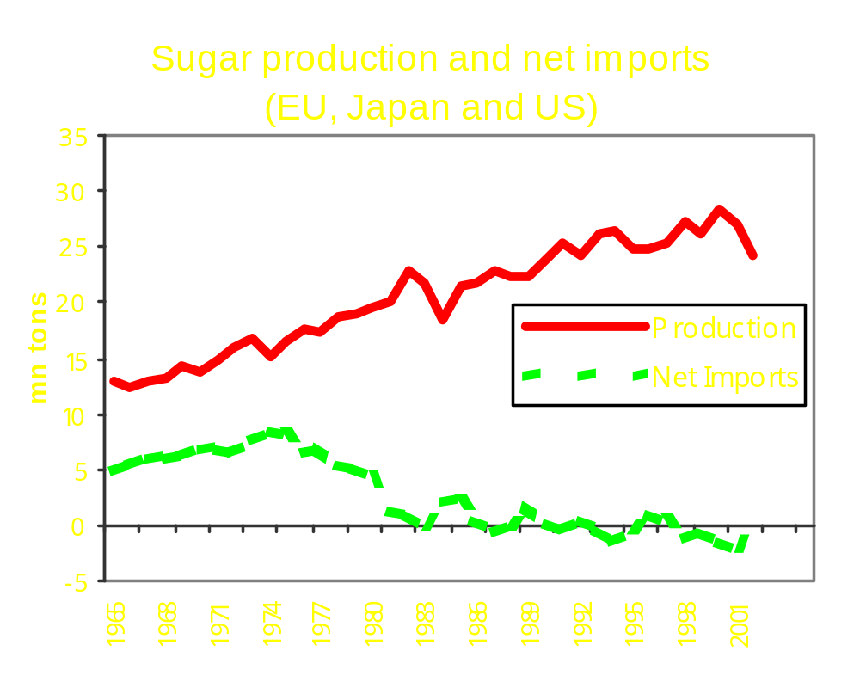
High Protection Reduces Net Imports

Slide 32
Fruits and Vegetables
Second largest export after seafood, 19% of developing country exports
Very dynamic market, decelerated in 1990 mostly due to stagnant EU demand
Almost no subsidies but complex (specific, mixed, seasonal ect.) and sometimes high tariffs
60% of EU tariff lines on fresh vegetables are between 21%-50%; 53% in processed fruits are above 50%.
Each product export is dominated by a few developing countries
Few successful developing countries, Mexico, Chile, Turkey, China

Slide 33
Fruits and Vegetables (con’t)
Threat of preference erosion for ACP countries; AGOA provides limited benefits due to sanitary requirements in US.
Further tariff reform is necessary, especially in EU, but supply capacity is the key in low income countries

Slide 34
Seafood
Most traded food item with global exports of US$ 57 billion in 2001
Now constitute 20% of Food&Agriculture exports of developing countries; more than all traditional exports put together
Biggest item is shrimp with global exports of US$ 10 billion in 2001
Now, 30% of seafood production is in aquaculture
Low tariffs in most countries but subsidies to fleets of industrial countries
Little management capacity in developing countries both for sustainability and higher value added

Slide 35
Coffee
Liberal trade policies
Supply controls have not worked
Slow demand growth, competition from soft drinks
Demand expansion in the top (Organic, Fair Trade, gourmet) and bottom end
New entrants, (Brazil, Vietnam) and limited exit
Strong poverty links in low income countries

Slide 36
Wheat
Slow trade and demand growth in wheat, greater growth in flour, pasta, and bakery and much value added created in retailing
Reforms in many developing countries, but still high subsidies in US, EU and Japan ($17 billion of producer support for the OECD) and some developing countries
Significant tariff escalation in flour, pasta, bakery products, so trade is only within trading blocks such as EU, and NAFTA

Slide 37
Wheat (con’t)
Global reforms will increase prices by only 10-15%
Big gainers will be Argentina and CIS, some reduction by US and EU
Low stocks, and export restrictions, in time of shortages push countries towards self sufficiency

