Slide 1
Lecture 3.2:
A Research Grade Prototype CGE Model
David Roland-Holst and Samuel Evans
UC Berkeley
Computable General Equilibrium (CGE) Model Training Workshop
Workshop on Regional Economic Cooperation Database and Modeling
2-4 December 2015
CAREC Institute, Urumqi, PRC
http://www.carecprogram.org/index.php?page=carec-institute

Slide 2
Introduction
In this lecture, we will introduce you to a research grade prototype for CGE modeling.
This model can be used directly for economywide assessment and high level policy support.

Slide 3
Analytic Overview
Producer Behavior
Household Behavior
Other Final Demand
Trade
Labor
Income Distribution
Closure
Equilibrium
Dynamics
Extensions

Slide 4
1. Producer Behavior
Because of their evolutionary role as institutions that assemble production teams, the fundamental behavioral model for enterprises is the production function.
This mathematical specification of how factor services combine to transform resources and components into goods and services lies at the heart of the neoclassical paradigm.
Here we review a variety of widely accepted specifications for production functions and discuss how they can be implemented empirically.

Slide 5
Producer Optimization
The most elementary production structure considers only two factors, ignoring other factors and intermediate goods. Assuming a given level of output, producers choose inputs in order to minimise costs. In mathematical terms the producer’s decision can be formulated as:
Min(wL+rK) subject to V=F(K,L)
where w is the wage rate, r the rental rate of capital, K and L are the inputs to production, and V is the level of output. The producer chooses K and L, with V, w, and r given. In most GE models, the levels of output V, w, and r are determined not by producers but by market equilibrium conditions.

Slide 6
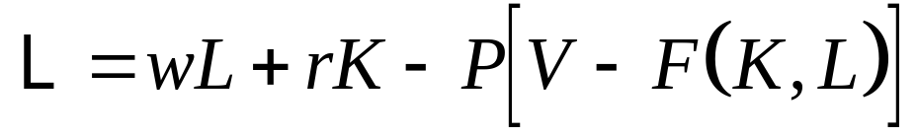
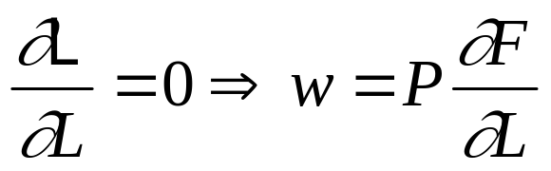
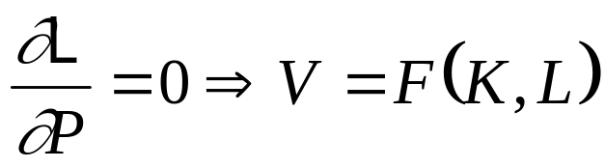
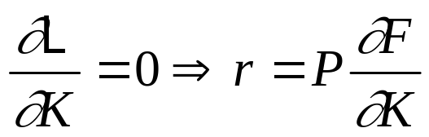
First-order Conditions
Setting up the Lagrangian to the problem above, we have:
Setting the partial derivatives with respect to K, L and P equal to zero, we have the following three first order conditions:

Slide 7
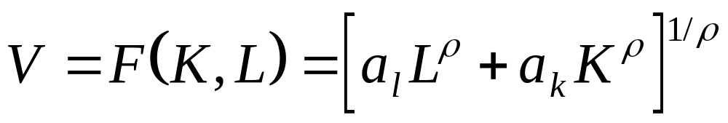
CES Production
Let’s explore this relation a bit further by assigning a functional form to F, notably the Constant-Elasticity-of-Substitution function, otherwise known as the CES function. The primal form of the CES function is:
where the coefficients al and ak are called the labour and capital share parameters, respectively, and r is the CES exponent (which will be related to the CES substitution elasticity).

Slide 8
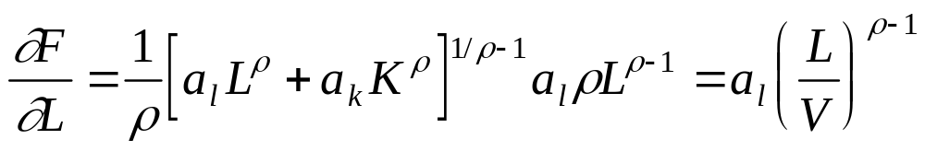
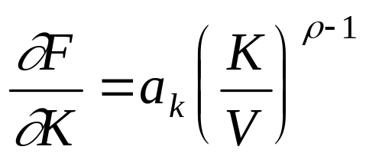
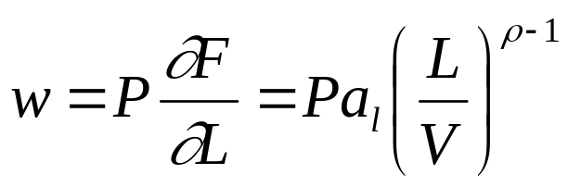
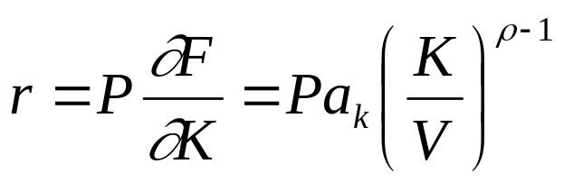
First-order CES
Differentiating this expression yields
which implies

Slide 9
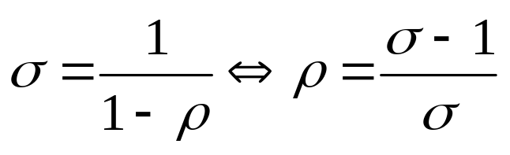
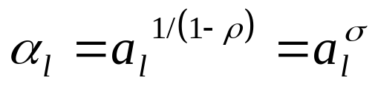
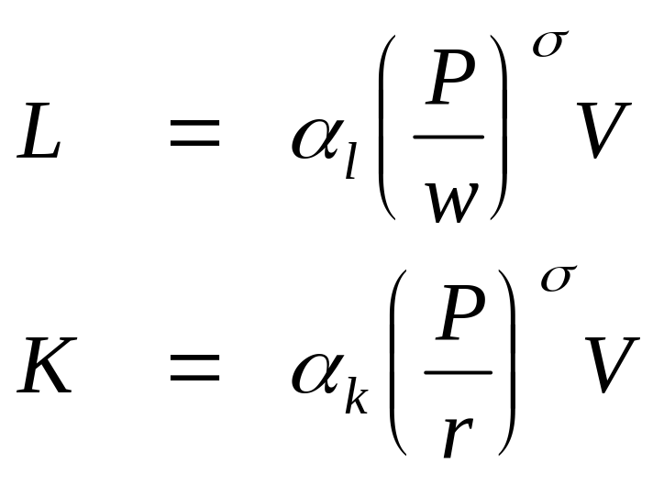
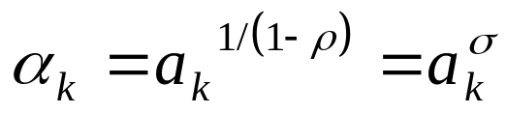
CES Factor Demand
Three simplifications,
then lead to relatively transparent derived factor demands:

Slide 10

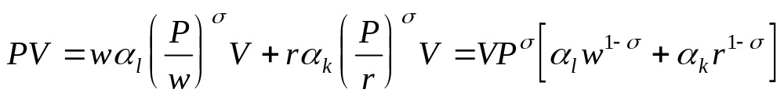
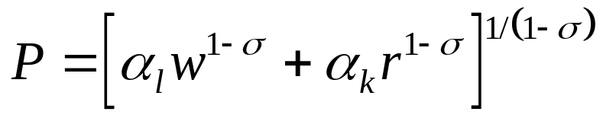
CES Unit Cost and Pricing
Consider now the total cost function:
and substitute the reduced form expressions for L and K
This yields the unit price-cost equivalence from duality

Slide 11
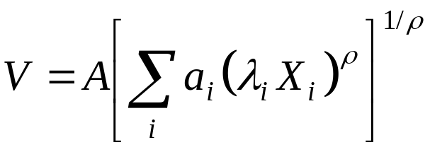
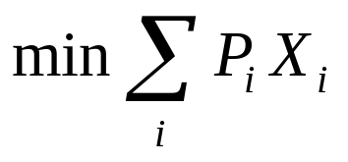
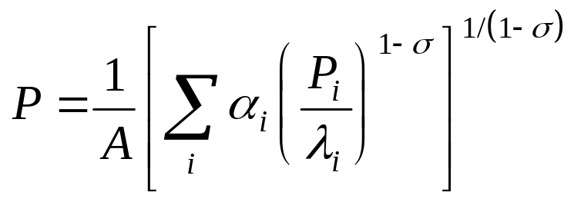
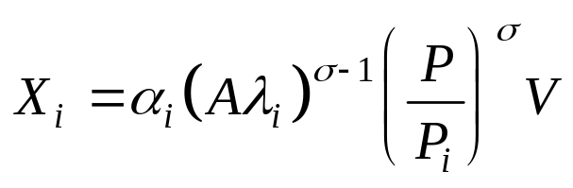
Generalized CES
The CES can be extended to i=2,…,n inputs as
with these reduced-from factor demands and unit costs

Slide 12
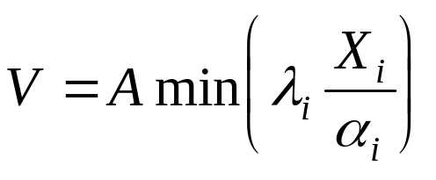
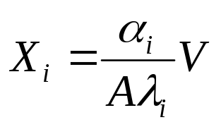
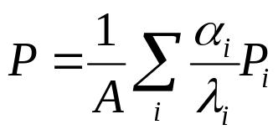
Special Case 1: Leontief
In the case where σ=0, there is no input substitution and we have the Leontief
linear production technology
and the output price is simply the weighted average of input prices

Slide 13
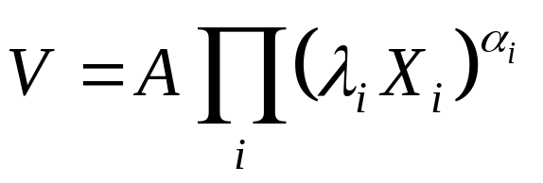

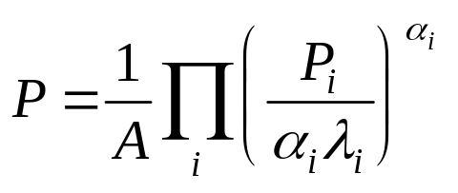
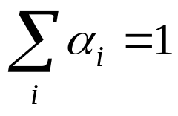
Special Case 2: Cobb-Douglas
In the case where σ=1, we have the most widely used production specification, Cobb-Douglas
linear production technology
and the output price is simply the weighted average of input prices
Where we assure constant returns to scale with the added assumption that

Slide 14
A Complication: Stratified Input Substitution
It is generally unrealistic to assume a single elasticity of substitution between all input types.
To overcome this limitation, we stratify input choice into generic sub-groups, each with their own substitution properties.
Consider an example with four types of inputs: Intermediates, Labor, Energy, and Capital.

Slide 15
Stratified Production Structure
Output
CES
Non-energy Intermediate Bundle
Capital-Energy-Labor Bundle (KEL)
CES
CES
Capital-Energy (KE)
Intermediate Demand by Region
CES
Labor Bundle
Energy Bundle
Capital Demand
CES
CES
CES
Labor Demand by Skill Type
Energy Demand by Fuel Type
Capital by Vintage

Slide 16
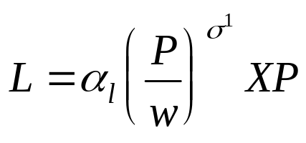
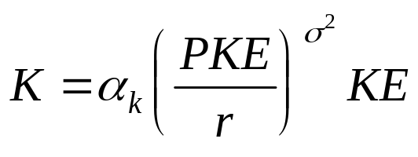
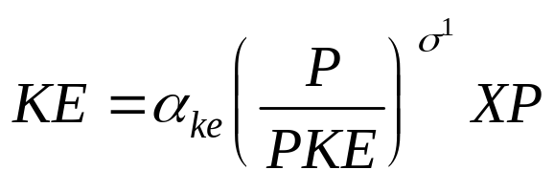
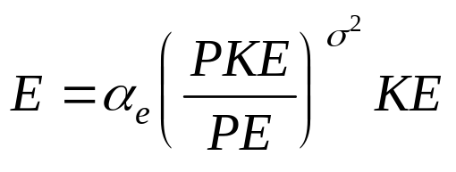
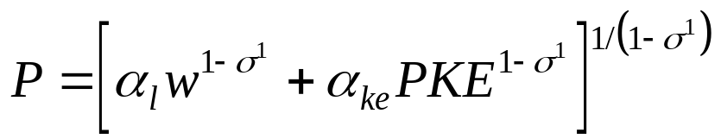
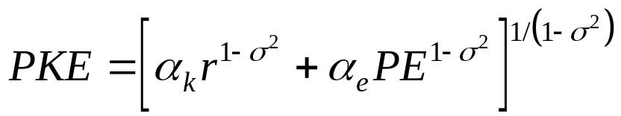
Input Demand and Prices for
Two Strata
Upper level (Labor, Non-labor) Lower level (Capital, Energy)

Slide 17
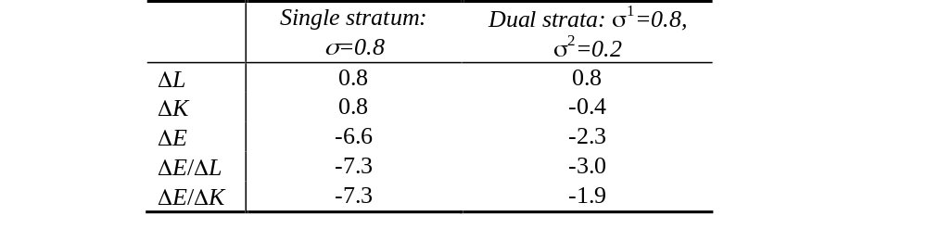
CES Comparison
Consider a classic comparative static example, a 10% energy tax.
The results differ in important ways. In the stratified case, energy and capital are both substitutes and complements, sharply reducing the substition away from energy.

Slide 18
2. Household Behavior
Ten representative household categories, by income tax bracket
Income from all factors, enterprises, public and private transfers
Consumption modeled with the Extended Linear Expenditure System
Extensive tax and transfer mechanisms
Demographic dynamics (population, labor force participation)

Slide 19
Consumer demand
Consumer demand theory must represent the complexity of human behaviour in a mathematically tractable fashion, and is in many respects more difficult than production theory.
Whereas, production theory essentially consists of an adequate representation of technology, and minimising the cost of production subject to the representation of technology, consumer demand theory must explain personal tastes and preferences.
There are many subjective factors which influence consumer decisions. Economists have developed a set of axioms which are generally believed to hold in many situations:
  Complete: preferences for any two goods can be ordered.
  Transitive: x preferred to y, and y preferred to z means that
  x is preferred to z
  Non-satiation: more is always better.

Slide 20
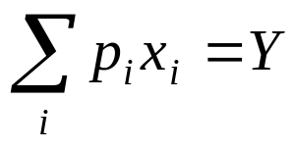
Linear Expenditure Systems
Economists have devised a tool to analyse preferences which meet these axioms, it is known as a utility function.
The utility function represents consumer preference ordering for alternative bundles of goods, subject of course to remaining within the limits of their budget. If x represents the bundle of goods (where x is an n-dimensional vector), then the consumer problem can be set up as follows:
  Max U(x) subject to
  where U is a single valued function with n inputs, p is the vector
  of consumer prices, and Y is disposable income. The constraint
  is of course the consumer budget constraint, which restricts
  expenditures to available income.

Slide 21
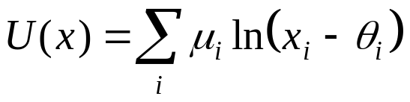
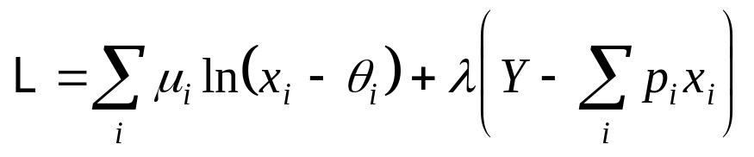
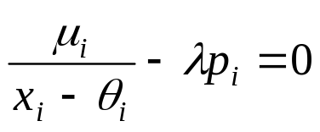
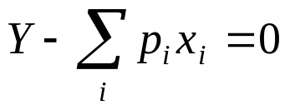
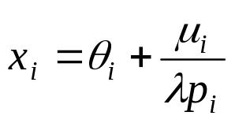
Linear Expenditure Systems
A commonly used utility function is known as the linear expenditure
system (LES), also known as the Stone-Geary expenditure function.
The form of the LES utility function,
which corresponds to the Lagrangian
whose first-order conditions
and
yield the individual commodity demand function

Slide 22
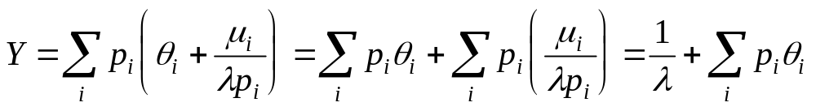
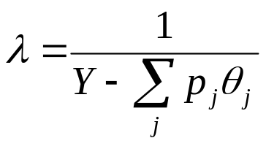
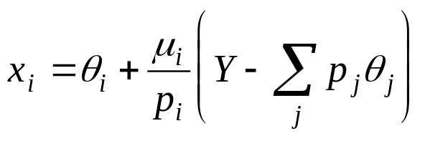
LES Derived Demand
To express demand as a reduced-form in prices, note that
so the Lagrange multiplier can be expressed as
which can be substituted back to yield the final demand equation
consisting of “subsistence minimum” demand θ_{i} and a defined share of “supernumerary income,” the term in parentheses.

Slide 23
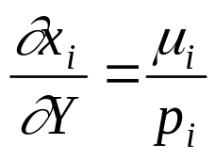
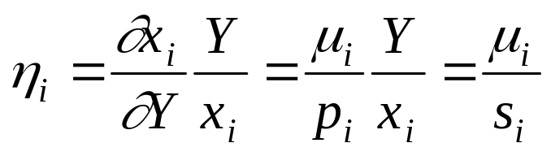
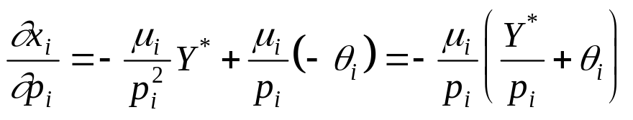
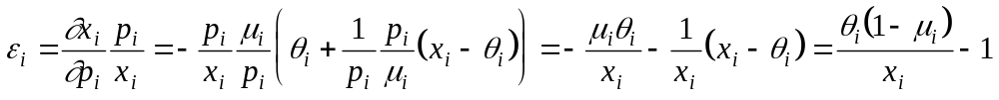
LES Elasticities
Income elasticities can be obtained directly from
and, by extension
In words, LES income elasticities are the ratios of marginal (μ_{i}) to average (s_{i}) expenditure shares.
Price elasticities follow from as
Notes:
These are important for policy analysis.

Slide 24
3. Other Final Demand
Other final demand accounts are represented by a single demand matrix.
Examples are
  government current spending
  government capital spending
  private capital spending
  trade and transport margins for domestic and imported goods
All these final demand vectors are presently assumed to have fixed (linear) expenditure shares .

Slide 25
Government
Government is a passive actor in the baseline, adhering to established expenditure patterns and fiscal programs
The model details extensive accounting for transfer relationships between institutions (fiscal, capital flows, remittances, etc.).
Government behavior is a primary driver of scenarios, but this behavior remains largely exogenous (subject to fiscal closure)

Slide 26
4. Trade
Trade is the final critical component of demand. In this section we will discuss exports and imports separately.
The most widely used assumption in models of imports is that they are different from domestic goods.
The degree of differentiation is critical. If there are no differences, i.e. imports are exactly the same as there domestic counterpart, then imports are just the residual between domestic production and domestic demand.
If production is greater than demand, then imports will be zero, and exports will be positive. If, on the contrary, domestic demand is greater than production, then imports will be positive (i.e. the gap between demand and production), and exports will be zero.
There are few commodities which are truly homogeneous, though some are close, e.g. cereal grains and crude oil.

Slide 27
Trade Stratification
Demand is thought to combine in-state and imported goods in each product category with a nested CES aggregation
Output is modeled symmetrically with a dual nested CET structure
Aggregate Demand/Supply
CES/CET
In-State Goods
Imports/Exports
CES/CET
Rest of Thailand
Rest of World

Slide 28
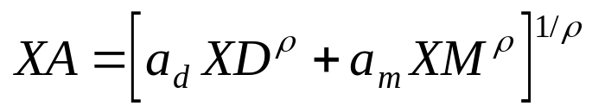

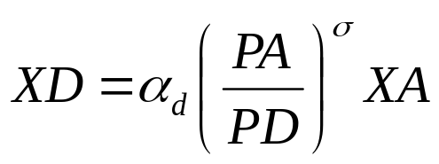
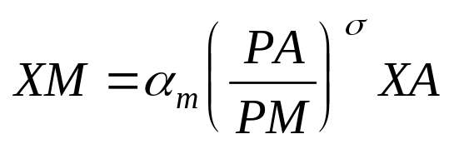

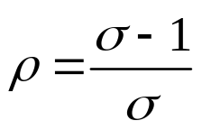
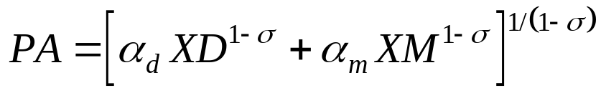
Trade Analytically - Imports
Denoting domestic demand by XD and imports by XM, total demand is modeled with the CES preference function
Min(PD•XD+PM•XM) subject to
where PD and PM denote prices for domestic and imported goods
and XA is aggregate demand. Passing over derivations from the
production analytics, we have the following reduced forms
where
and denotes the price index of XA.

Slide 29






Trade Analytically - Exports
Denoting domestic supply by XD and export supply by XE, total supply is modeled with the CET production frontier
Max(PD•XD+PE•XE) subject to
where PD and PM denote prices for domestic and imported goods
and XA is aggregate demand. Passing over derivations from the
production analytics, we have the following reduced forms
where
and
denotes the price index of XP.

Slide 30
Trade Schematically
CES
CET
Impor t s
Exports
slope=-PD/PE
slope=-PD/PM
Indifference
Curve
PPF
Domestic Goods/Services
Domestic Goods/Services

Slide 31
Trade Prices
A single domestic price equilibrates demand and supply of each domestic good.
Each trade node clears with a market-clearing price. The model thus has (nxr)(r+1) trade prices, for n goods and r trading partners.
FOB/CIF wedges are modeled using trade and transport margins.

Slide 32
5. Labor
Supplied by households in response to a labor-leisure choice
Employed by sector and occupation, with perfect mobility between the former and none (currently) between the latter
Labor markets are perfectly competitive
Migration is not currently modeled

Slide 33
6. Income distribution
The prototype model has a rich menu of income distribution channels—factor income and intra-household, government and foreign transfers (i.e. remittances). The prototype also includes corporations used as a pass-through account for channeling operating surplus.

Slide 34




Factor Income
Income accrues directly to labor, capital, land, and resources:

Slide 35



Profit Distribution
Profits are distributed to enterprises (E), households (H), and to the Rest of the World (W):

Slide 36




Enterprise Income
Enterprises have earnings that are retained (S) or distributed to households (H) or foreigners (W) :

Slide 37



Household Incomes
Household income comes from many sources:

Slide 38




Household Component Accounts
Households also have several secondary accounts:

Slide 39
7. Macroeconomic Closure
Government fiscal balance is exogenous, achieved with an endogenous direct tax schedule
Private investment is endogenous and is driven by available savings
The volume of government current and investment expenditures is exogenous
The volume of demand for international trade and transport services is exogenous
The volume of stock changes is exogenous
The trade balance (i.e. capital flows) is exogenous. The real exchange rate equilibrates the balance of payments.

Slide 40
8. Equilibrium Conditions
Goods and Services: Combined domestic and external demand equals supply for every good and service
Factors: Domestic factor (labor, capital, land) supply equals in-state factor demand
Trade: Thailand’s net outflow of goods and services equals its net claims on external financial assets

Slide 41
9. Dynamics
Labor force and population growth are currently exogenous.
Capital stock is driven by past investments and depreciation.
Total factor productivity is calibrated in baseline to achieve a GDP growth target.
Productivity is currently exogenous.

Slide 42
10. Model Extensions
Health sector reform, productivity, and fiscal sustainability
Demographic change and public health management
More labor market structure and conduct (occupations, unemployment, migration, bargaining, rigidities, etc.)
Trade and regional economic integration
Emissions, Climate Change, and Public Health
Energy and other strategic commodities
Location/mapping

Slide 43
Discussion

