Slide 1
Distributional and Poverty Impact Analysis within a General Equilibrium Framework
B. Essama-Nssah
The World Bank
DEC Course on Poverty and Inequality Analysis
Module 7: Evaluating the Distributional and Poverty Impacts of Economy-Wide Policies
April 28, 2009

Slide 2
Introduction
Impact Analysis
  An assessment of variations in individual and social welfare attributable to an exogenous shock or implementation of a policy.
  Attribution based on a comparison of the policy state and the counterfactual, ceteris paribus.

Slide 3
Introduction
Economy-Wide Shocks and Policies
  Affect potentially the whole population
  Are bound to have both macroeconomic, structural and distributional effects that work through a number of flow-of-fund variables and individual good or factor markets.
  Need for an analytical framework that accounts for interdependence between stabilization, structural and distributional issues.
  General equilibrium analysis offers such a framework.

Slide 4
Introduction
Approaches
  Standard Representative Household (RH)
    Impact on functional distribution of income, mean welfare within a few representative socioeconomic groups, and between-group inequality, but not on poverty.
  Extended Representative Household
    Extends the RH approach by modeling the size distribution within group, hence allowing poverty analysis in addition to what RH allows.
      e.g. Lognormal (Dervis, de Melo and Robinson 1982) or Beta (Decaluwé, Savard and Thorbecke 2005) or Parameterized Lorenz (Essama-Nssah 2005)

Slide 5
Introduction
Approaches, continued
  CGE-Micro-Simulation
    Use unit record data from household survey to build a household model of expenditure, or income generation to allow a rich analysis of poverty and inequality.
Focus of Presentation
  A Stylized ERH Framework
    Positive component: a two-sector model of an open economy
      Structure
      Specification

Slide 6
Introduction
  Stylized ERH, continued
    Normative component: the Lorenz model of income distribution
      Structure
      Parameterization
      Recovering Inequality and Poverty Measures
    Numerical Implementation
  Impact of Budgetary Policy
    Policy Options
    Outcomes

Slide 7
A Two-Sector Model of an Open Economy
Structure
  A logical representation of a socioeconomic system wherein the behavior of all participants is compatible.
  Organized around the standard Walrasian template.

Slide 8
Structure, continued
  Two categories of agents: producers and consumers, or firms and households.
  Supply and demand behavior: an observable consequence of the optimization assumption.
  Market interaction: method of social coordination by mutual adjustment among participants based on “quid pro quo” (Lindblom 2001).
  Behavioral compatibility entails equilibrium on all markets.

Slide 9
Structure, continued
  Comparative statics entails comparison of equilibrium states associated with changes in the socioeconomic environment.
  Social desirability depends on chosen criterion
    Pareto efficiency focuses on how well the system promotes individual objectives: efficiency implies no other situation is unanimously preferred by all participants.
    Poverty-focused criterion: less poverty is preferred to more.

Slide 10
Structure, continued
  Incentives configuration such that amount of effective demand equals amount supplied.
    Alternatively:
      No feasible change in individual behavior is worthwhile.
      No desirable change in individual behavior is feasible.

Slide 11
Circular Flow Chart for an Open Economy
Factor services
Factor markets
Factor markets
Producers
Intermediate goods
Households
Product markets
Final goods
Exports
Imports
Rest of
the world

Slide 12
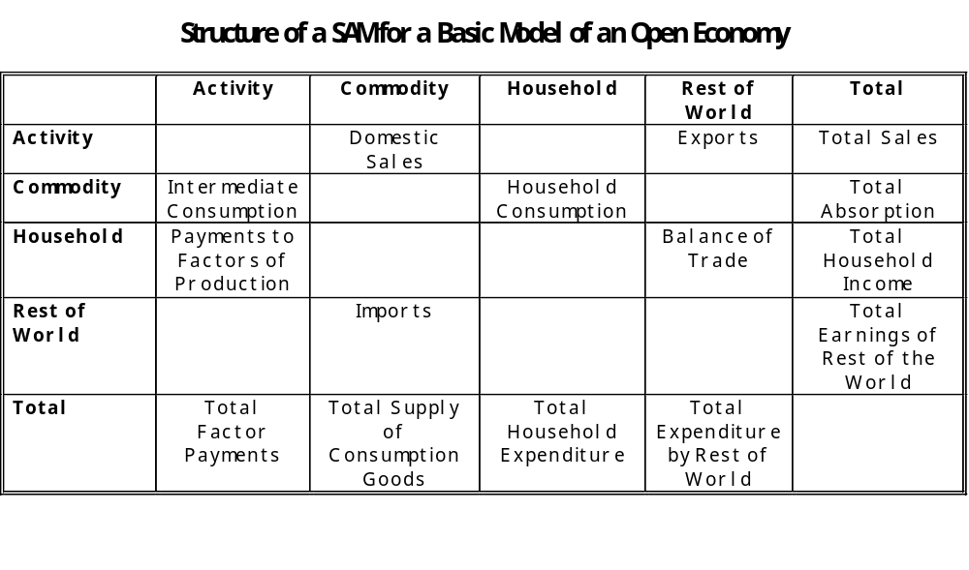

Slide 13
Structure, continued
  Social Accounting Matrix (SAM)
    An accounting framework that reflects the circular flow of economic activity.
    A square matrix: dimension based on the number of sectors and agents considered.
    Each entry represents a payment to a row-account by a column-account.
    Consistency implies that row total must equal corresponding column total.
    Also, if all but one accounts balance, the last one must balance as well (Walras’ law).

Slide 14
Specification
Based on Devarajan, Lewis and Robinson (1990)
  Two sectors of production:
    Export good not sold domestically.
    Home good used for both intermediate and final consumption
  Imported and domestic intermediate goods enter the production process.
  Production process in each sector represented by a Cobb-Douglas function

Slide 15
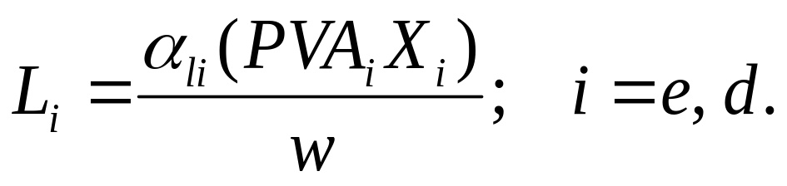
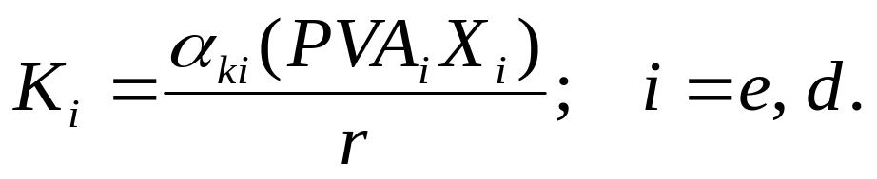
Specification, continued
  The demand for labor is derived from first order conditions for profit maximization
  Similarly for capital [capital is mobile in the long run]

Slide 16
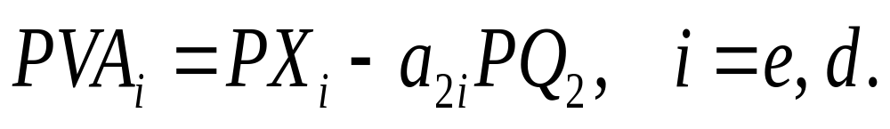
Specification, continued
  The net price in sector i is given by
  a_{2i} is the amount of aggregate intermediate good (Q₂) per unit of output in sector i.

Slide 17

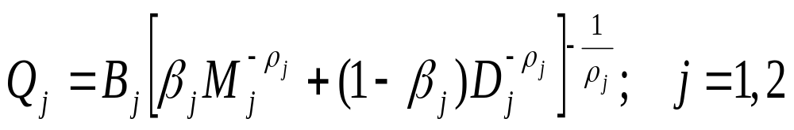
Specification, continued
  Producer price of exports
  Two aggregate commodities for final (j=1) and intermediate consumption (j=2)

Slide 18
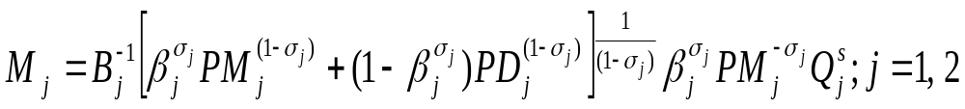
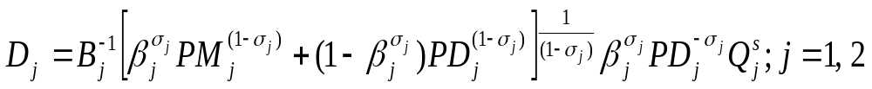
Specification, continued
  Import demand functions derived from cost minimization.
  Demand for domestic components of aggregate goods (implication of cost minimization).

Slide 19
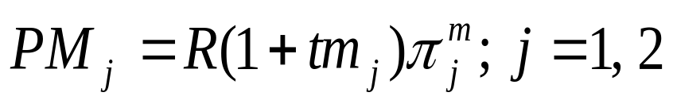
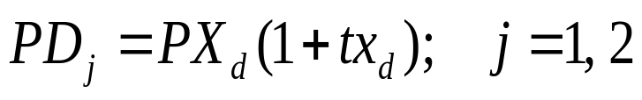
Specification, continued
  Domestic price of imports inclusive of tariffs
  Price of domestic sales includes a sales tax

Slide 20
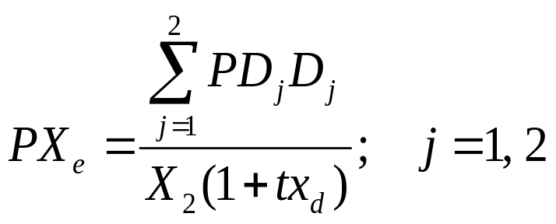
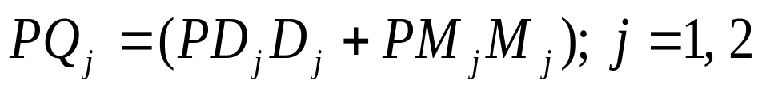
Specification, continued
  Producer price of the domestic good
  Price of composite goods

Slide 21
Specification, continued
  Rural household represents 60 percent of the population, and owns a fraction θ_{RL} of labor and a fraction θ_{RK} of capital (to be determined by data in SAM).
  Urban household represents 40 percent of the population, and owns a fraction (1- θ_{RK} ) of capital and a fraction (1- θ_{RL}) of labor.

Slide 22
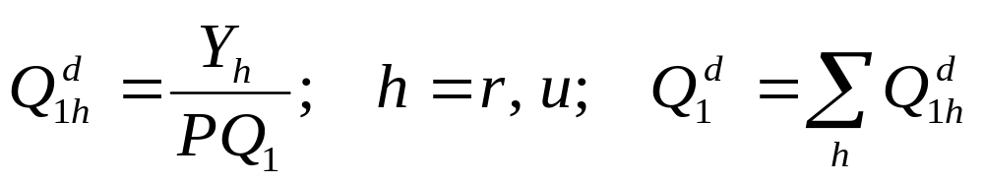
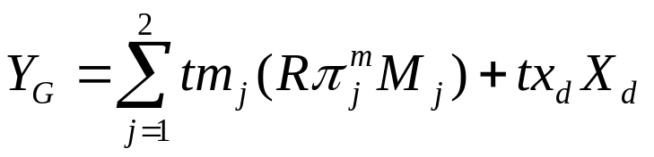
Specification, continued
  Household income
  Household demand for final good (no savings)
  Government fiscal revenue

Slide 23
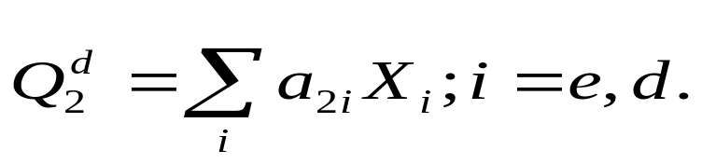
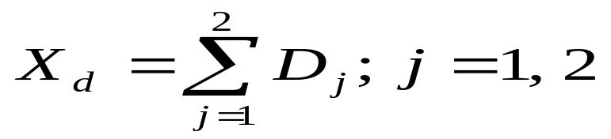
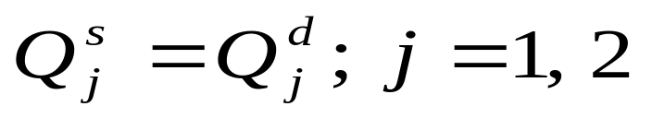
Specification, continued
  Total demand for intermediate good
  Equilibrium in the home good market
  Material balance for composite goods

Slide 24
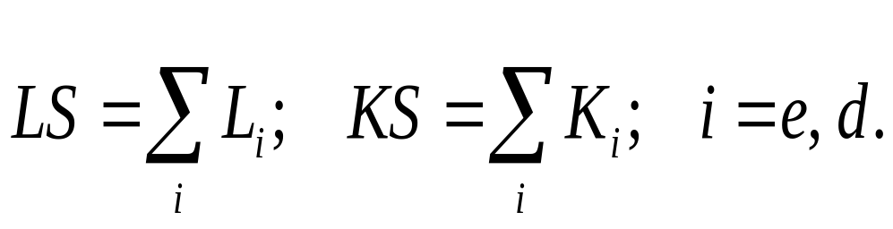
Specification, continued
  Equilibrium condition for each factor market under full employment of given amounts of capital and labor.

Slide 25
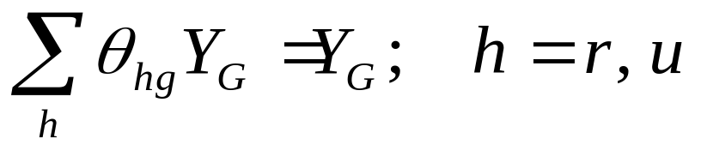
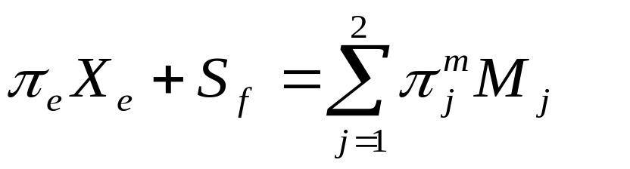
Specification, continued
  Government budget balance
  Trade balance

Slide 26
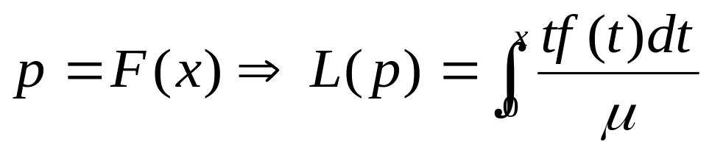
The Lorenz Model of Income Distribution
Structure
  A flexible statistical model of the distribution of some welfare indicator, x, among the population.
  The Lorenz curve maps the cumulative proportion of the population (horizontal axis) against the cumulative share of welfare (vertical axis), where individuals have been ranked in ascending order of x.

Slide 27
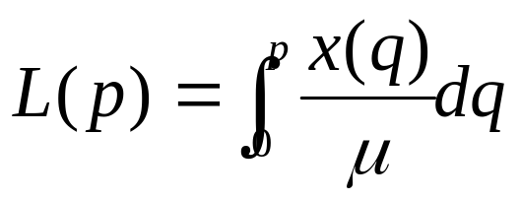
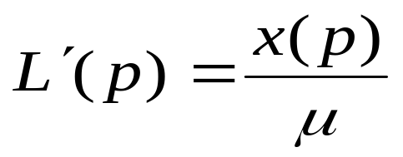
Structure, continued
  Alternative Expression based on : dp=f(x)dx
  First-order derivative

Slide 28
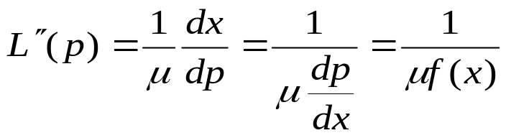
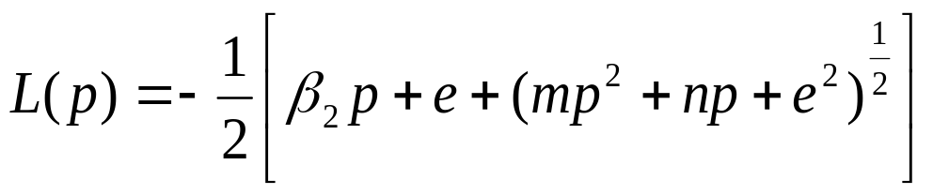
Structure, continued
  Second-order derivative
Parameterization
  Based on General Quadratic (Datt 1992, 1998)
    Lorenz

Slide 29
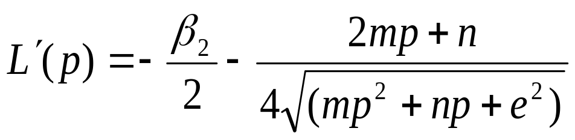
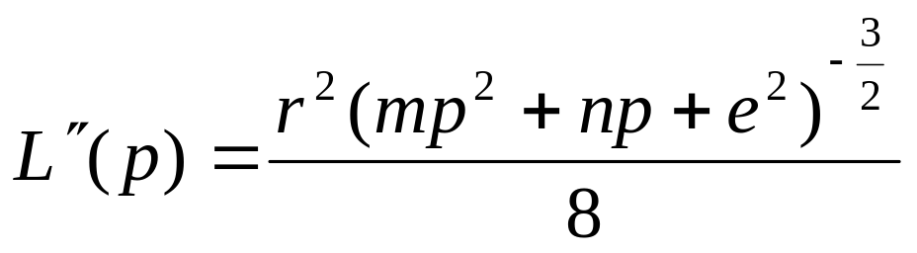
  Quadratic model, continued
    First Derivative
    Second derivative

Slide 30
Recovering Inequality and Poverty Measures
  From a parameterized Lorenz model and the mean of x, we can recover the following:
    X: based on the mean and the first order derivative of the Lorenz function.
    Density function of x, f(x): based on the mean and the second order derivative of the Lorenz function.
This is all we need to compute all inequality and poverty measures.

Slide 31
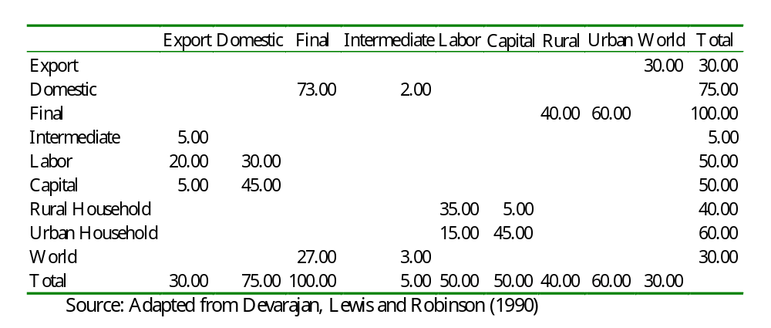
Numerical Implementation
Data
  Base Year SAM

Slide 32
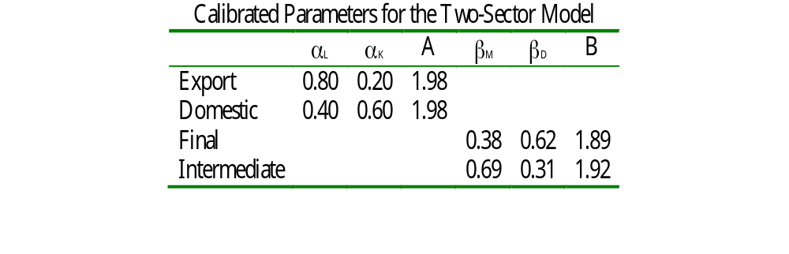
Data, continued
  Calibrated Parameters

Slide 33
Data, continued
  A is tfp (total factor productivity) parameter in the Cobb-Douglas production function
  α’s are factor shares (exponents in the production function).
  β’s are shares in the Armington aggregation function and B is a scale factor.
  Distribution of factor income in base year SAM: θ_{RL}=0.70, θ_{UL}=0.30, θ_{RK}=0.10, and θ_{UK}=0.90
  Distribution of government transfers: θ_{RG}=0.60 and θ_{UG}=0.40

Slide 34
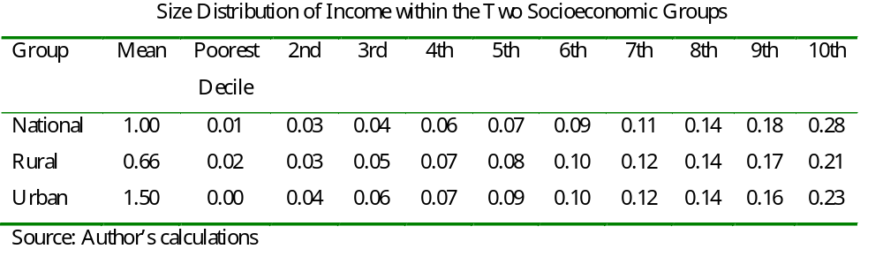
Data, continued
  Distribution of foreign transfers: θ_{RF}=0.20 and θ_{UF}=0.80
  Base Year Income Distribution

Slide 35
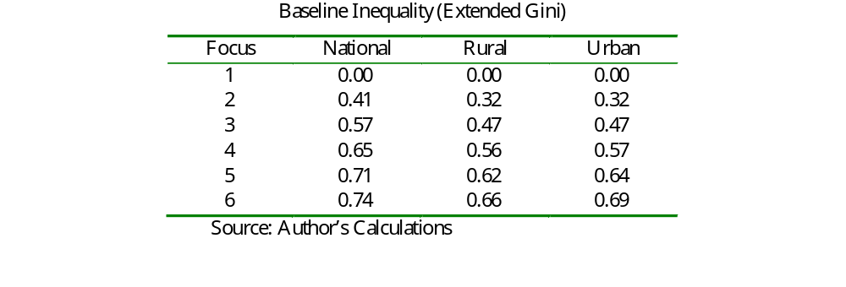
Data, continued

Slide 36
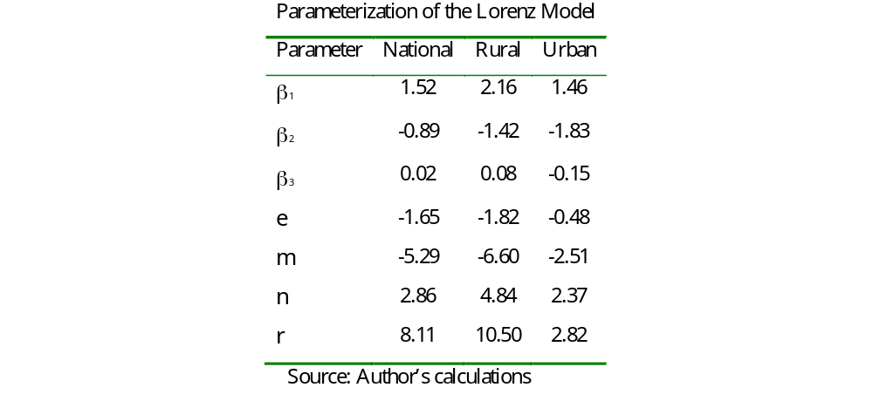
Data, continued
  Parameters underlying the General Quadratic Lorenz Model

Slide 37
Policy Options
Case 1: Reference
  Tax on domestic sales: 15.4 percent
  Tariff on imports of final and intermediate goods: 12.5 percent
Case 2: Reform Option A
  Increase domestic sales tax by 5% (from reference)
  Lower tariff on final import by 17.6%
  Increase tariff on intermediate by 46.4 %

Slide 38
Policy Options, continued
Case 3: Reform Option B
  Lower sales tax by 5%
  Increase tariff on final goods by 18.4%
  Lower tariff on intermediate by 44%

Slide 39
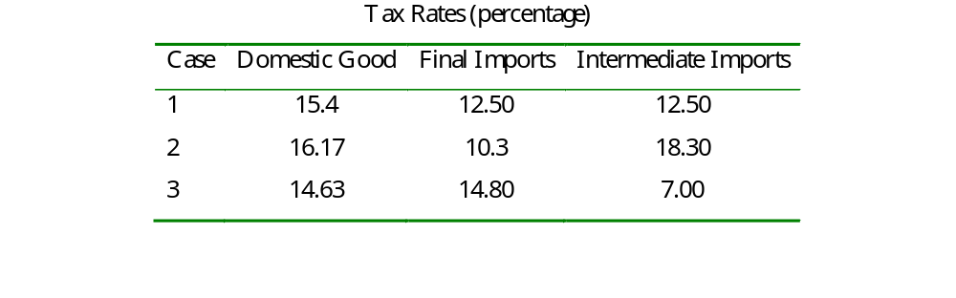
Policy Options, continued

Slide 40
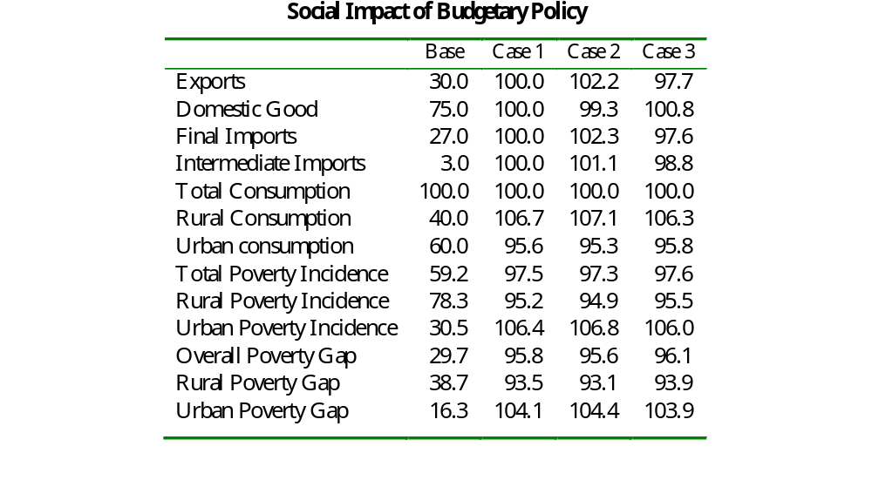

Slide 41
Outcomes, continued
  Case 1:
    Pattern of production and imports unchanged from the base case where there is no government intervention.
    Optimal configuration of taxes to the extent that they do not distort private production decisions.
    The redistributive policy associated transfers to households causes an increase in rural consumption and a decrease in urban consumption.
      As a consequence overall poverty incidence decline by about 2.5 percent.
      Rural poverty decreases by 5 percent while urban poverty increase by more than 6 percent.

Slide 42
Outcomes, continued
  Case 2:
    Production of exports increases, that of the domestic good declines. Both categories of imports increase.
    Pattern of change in poverty incidence is similar to the reference case, but reduction in rural poverty and increase in rural poverty are a bit higher than in the reference case.
  Case 3:
    Production of exports and all imports fall while production of domestic good increases.
    Change in poverty similar to previous cases.

Slide 43
Conclusion
Evaluating the social impact of economy-wide policies requires a social policy model framed within the logic of general equilibrium analysis.
Such a model has two basic components
  A structural representation of individual behavior and social interaction based on the principles of optimization and quid pro quo.
  A social evaluation function reflecting a chosen set of value judgments (e.g. efficiency and fairness).
A stylized analysis of the social impact of budgetary policy revealed the following:
  The outcome hinges crucially on the underlying mechanisms allocating burdens and advantages among individuals.
  Aggregate welfare effects may be negligible while structural and distributional impacts are significant.
    the latter drive the political economy of policy-making.

Slide 44
References
Datt, Gaurav. 1998. Computational Tools for Poverty Measurement and Analysis. Washington D.C.: International Food Policy Research Institute (IFPRI) Discussion Paper No.50 (Food Consumption and Nutrition Division).
Datt, Gaurav. 1992. Computational Tools for Poverty Measurement and Analysis. Washington D.C.: The World Bank (mimeo)
De Melo Jaime and Robinson Sherman. 1989. Product Differentiation and the Treatment of Foreign Trade in Computable General Equilibrium Models of Small Economies. Journal of International Economics, Vol. 27:47-67.
Devarajan, Shantayanan, Jeffrey D. Lewis, and Sherman Robinson. 1990. Policy Lessons From Two-sector Models. Journal of Policy Modeling 12 (4): 625-657.
Dervis, Kemal, de Melo, Jaime, and Robinson, Sherman. 1982. General Equilkibrium Models for Development Policy. Washington, D.C.: the World Bank.
Decaluwé, B., Savard. L. and Thorbecke, E. 2005. General Equilibrium Approach for Poverty Analysis: With an Application to Cameroon. African Development Review, Vol. 17, No.2: 213-243.

Slide 45
Dinwiddy, C.L. and F.J. Teal. 1988. The Two-Sector General Equilibrium Model: A new Approach. Oxford: Philip Allan.
Essama-Nssah, B. 2006. Macroeconomic Shocks and Policies. In Aline Couduel and Stefano Paternostro (eds) Analyzing the Distributional Impact of Reforms. Washington, D.C.: The World Bank.
Essama-Nssah, B. 2005. Simulating the Poverty Impact of Macroeconomic Shocks and Policies. World Bank Research Working Paper No. 3788. Washington, D.C.: The World Bank.
Lindblom Charles E. 2001. The Market System: What Is It, How It Works and What to Make of It. New Haven: Yale University Press.
Varian Hal R. 1984. Microeconomic Analysis (Second Edition) New York: Norton & Company.

Slide 46
THE END

