Slide 1
THE LOGIC OF SOCIAL IMPACT ANALYSIS
B. Essama-Nssah
The World Bank
DEC Course on Poverty and Inequality Analysis
Module 7: Evaluating the Distributional and Poverty Impacts of Economy-Wide Policies
April 28, 2009

Slide 2
Foreword
“To respond adequately to concerns about the impacts of development programs it is necessary to determine (a) whether the desired social and economic changes have occurred in the intended target populations, (b) the extent to which these changes can be attributed to the development projects rather than to other independent factors (such as general changes in economic environment or the effects of other programs or policies), and (c) the direct and indirect impacts on other population groups .”
Valadez and Bamberger (1994)

Slide 3
Introduction
Monterrey Conference on financing for development (2002) commits the international community to enhancing development effectiveness
  Shift focus from development inputs and outputs onto actual outcomes and impacts.
Intimate relationship between effective policymaking and impact assessment:
  Policy objective defines metric by which to assess effectiveness
    Ultimate goal of public policy: maintaining and improving the living standard of target population (Sen et al. 1987)

Slide 4
Introduction
Effective social impact evaluation should produce reliable information on at least the following:
  Whether the intervention has worked (or will work) as intended or not, and why?
  Who gains and who loses?
Information useful for
  Efficiency: making the most out of limited resources
  External validity: scaling up and generalizability (application to other settings)

Slide 5
Introduction
Focus of presentation
  Explain the basic logic of social impact analysis understood as an assessment of variations in individual and social welfare attributable to a socioeconomic shock or the implementation of a policy or program.
    Exercise in social evaluation that entails a comparison of social states on the basis of individual advantage and social progress.
  Illustration: Pro-poorness of economic growth

Slide 6
Introduction
Outline
  I. Evaluative Framework
    Focal Space
    Winners and Losers
    Causal Inference
    Ranking Social States
  II. Pro-Poorness of Economic Growth
    Local Impact
    Social Impact
    Pro-Poorness
    Case of Indonesia

Slide 7
Focal Space
Living Standard and Social Progress
  Concept of development provides a basis for both the specification of living standard indicators and the definition of social progress
  Over the past half century development thought has evolved from a narrow focus on purely economic aspects to a broader view that embraces the socio-political dimensions of the development process.

Slide 8
Focal Space
The 1950s and 1960s: Focus on expansion of real per capita income with little attention to distribution.
The 1970s: enhancement of human capital to improve factor productivity which in turn will help deal with mass poverty and increased inequality in the distribution of wealth and income experienced by many countries.

Slide 9
Focal Space
The 1980s and the 1990s: further widening of focus to include voice and decision-making power, leading to the perspective of development as empowerment.
  Development entails the expansion of the ability of the participants in the process to achieve their freely chosen life plans.
    Poverty: deprivation of basic capabilities to live the kind of life one has reason to value (Sen 1999)

Slide 10
Focal Space
The Millennium Declaration (United Nations 2000)
    Consistent with the empowerment perspective.
    The Millennium Development Goals (MDGs) identify income, health, education, safe environment and good governance as critical components of the living standard.
    Goals set for the year 2015 relative to 1990.
    meant to provide guidance to both national and international development interventions.

Slide 11
Focal Space
The Original MDGs
  Eradicate poverty and hunger
  Achieve universal primary education
  Promote gender equity
  Reduce child mortality
  Improve maternal health
  Combat major diseases
  Ensure environmental sustainability
  Foster a global partnership for development

Slide 12
Focal Space
Equity and Development (WDR 2006)
  Equity defined in terms of level playing field where individuals have equal opportunities to pursue freely chosen life plans and are spared from extreme deprivation in outcomes.
  Pursuit of equity entails that of poverty reduction
  Complementarities between equity and prosperity
    If correcting for market failure is not feasible or too costly, then improved efficiency can be achieved through some redistribution of:
      Access to services
      Assets
      Political influence

Slide 13
Winners and Losers
Political dimension of policymaking
  A process involving strategic interactions among various stakeholders subject to potential conflict and cooperation.
  Political feasibility hinges on actual weighing of the gains of the gainers and the losses of the losers according to prevailing rules of the game.
  “It is when equals have or are assigned unequal shares, or when people who are not equal, equal shares, that quarrels and complaints break out ” Aristotle (as quoted in Young 1994).

Slide 14
Winners and Losers
Identification and computation of gains and losses
  Identification of winners and losers based on variations in individual welfare.
  Changes in welfare stem from the response of socioeconomic agents to the incentives properties of the policy under consideration.
  Response shaped by individual behavior and social interaction.
    Behavior: principle of optimization
    Interaction: market and non-market institutions

Slide 15
Winners and Losers
Transmission channels from policy to distribution of welfare (Bourguignon and Ferreira 2005).
  Distribution of factor endowments and socioeconomic characteristics among population
  Returns to these assets
  Behavior of socioeconomic agents with respect to resource allocation subject to institutional constraints
Hence three types of policy effects
  Endowment effects due to changes in the amount of resources available to individuals.
  Price effects reflecting changes in the rewards of these resources
  Occupational effects linked to changes in resource allocation.

Slide 16
Causal Inference
Changes in living standard (of target population) associated with policy implementation not necessarily attributable to policy.
Need a credible framework for causal inference for identification and estimation of causal effects.
Effect of a cause can be understood only in relation to another cause (Holland 1986)
  Impact of intervention assessed on basis of a counterfactual.
  Akin to idea of assessing return to a resource engaged in economic activity on basis of opportunity cost.

Slide 17
Causal Inference
Potential Outcome Framework
  Targeted policy intervention akin to medical treatment
    Treated group receives intervention
    Control or comparison group does not
  Each individual has a potential outcome under each state (treatment and no treatment)
  Potential outcomes represented by random variables defined over the population of interest.
  An observed variable indicating the cause (treatment or non-treatment) to which unit is exposed.
  Potential outcome of an individual not affected by potential changes in the treatment exposure of other individuals (Stable Unit Treatment Value Assumption) i.e. ignore general equilibrium effects.

Slide 18
Causal Inference
Fundamental Problem: Missing data on counterfactual
  Impossible to observe outcome for same individual simultaneously under two mutually exclusive states of nature (treatment versus non-treatment)
Basic Identification Strategy
  Model: Observed individual outcomes depend on treatment (exposure/participation) status and individual characteristics (observable and non-observable)
  Impact identification: isolate an independent source of variation in treatment (participation) and link it to outcomes in order to identify a causal effect.
  Implementation : (1) Unit homogeneity; (2) Randomization; (3) Conditioning on observables; (4) Instrumental variable; (5) Control function.

Slide 19
Causal Inference
Unit Homogeneity
  Suppose we can find among non-participants an individual j with the same attributes (both observed and unobserved ) as participant i.
  The only difference between the two individuals is treatment status.
  The outcome of this untreated (j) is a proxy for what would have happened to i had she not received treatment.
      Impact can be estimated in this case as the difference between the outcome of the treated and that of the untreated.
      If entire population is homogeneous, above individual effect measures overall average effect.

Slide 20
Causal Inference
Randomization
  Prior to administration of treatment, it balances observed and unobserved characteristics between treated and control groups.
    Ensuring that the distribution of observed and unobserved characteristics is the same for both groups.
    A process that mimics the homogeneity assumption not at the individual level but at the group level.

Slide 21
Causal Inference
Randomization
  Identified parameters: Average treatment effect (ATE) and average treatment effect on the treated (ATET)
    Group homogeneity implies that average difference in outcome between the two groups is due to treatment alone, hence causal interpretation of the identified parameters.

Slide 22
Causal Inference
Conditioning on observables
  Assume randomization unfeasible, but unobservable characteristics and potential outcome are independent.
  Identification based on comparison of treated and non-treated only within subgroups that share the same values of observed characteristics
    This is the essence of matching methods (including propensity score matching)
    Importance of overlap (common support) between treated and comparison group.
    ATET obtained by averaging group-specific effects over domain of characteristics.

Slide 23
Causal Inference
Instrumental variable method
  Suppose treatment and comparison groups differ both in observable and unobservable characteristics
  Suppose unobserved factors determine both treatment status and outcomes
  Need to control both observables and non-observables
  Method relies on the exclusion restriction
    This requires an observable variable such that changes in this variable affect directly only the causal variable (treatment status), but affect outcomes only indirectly through the treatment variable.

Slide 24
Causal Inference
Instrumental variable method
Validity requires assumption of homogeneous effect (i.e. constant across the treated).
If heterogeneity of impact, IV identify a local average treatment effect (LATE): average treatment effect for those in the population whose treatment choice is induced by the instrument.
  IV interpretation of randomization
    Exogenous process that affects directly treatment status
    Affects outcomes only indirectly via treatment status
      Hence exclusion restriction is satisfied (Ravallion 2009)

Slide 25
Causal Inference
Control function method
  Simultaneous model of selection to treatment and outcome
    Roy (1951) model of choice and consequences
    Corresponding endogeneity problem translated into an omitted variable problem (Heckman 1976).
    Identification also relies on exclusion restriction: at least one variable in selection equation excluded from outcome equation
    Assume observed individual characteristics are independent of unobservable determinants of participation and outcomes
    If unobservable follow a joint normal distribution the control function depends on the inverse Mills ratios
    Consistent impact estimation follows Heckman’s two-step procedure

Slide 26
Causal Inference
Economy-Wide Policies
  Scope of intervention may be so large that the whole population is affected (e.g. structural adjustment program).
  Hence difficult to select a valid control or comparison group.
  Need an economy-wide model such as a computable general equilibrium (CGE) to simulate the state with the policy and the counterfactual, and compare the corresponding distributions of welfare.
  A general equilibrium model is a logical representation of a socioeconomic system wherein the behavior of all participants is compatible.

Slide 27
Ranking Social States
Need for an evaluation criterion:
  A social evaluation criterion such as the Bergson-Samuelson social welfare function assigns to each profile of individual preferences a collective preference relation representing social welfare (welfarism).
    The specification of a social welfare function is based on a set of value judgments
    Such value judgments stem mainly from the demands of either collective rationality or fairness.
Decision rule: Given two social states, the more desirable is the one that ranks higher on the scale of the chosen social welfare function.

Slide 28
Ranking Social States
Collective Choice
  Arrow (1963) offers a general approach for designing social welfare functions based on collective rationality.
    Individual welfare is defined by her choices over the set of all feasible social states.
    Choices are based on a preference scale with no cardinal significance either for a given individual or between any two individuals.
    Rational behavior driven by the objective of preference maximization over set of feasible outcomes.

Slide 29
Ranking Social States
The Impossibility Result
  In search of a social decision-making mechanism that respects both rationality and citizens’ sovereignty Arrow requires the following of the mechanism:
    Must lead to a social prescription for any conceivable preference profile i.e. list of individual preferences over social states (completeness)
      Social choice must be transitive (consistency)
      If everyone ranks alternative a ahead of b, so must society (Pareto principle)
      The ranking of a pair of alternatives is determined exclusively by how people rank these two. (The ranking of other alternatives is irrelevant: Independence of irrelevant alternatives).
      Social ranking should not reflect only those of a single individual (non-dictatorship)

Slide 30
Ranking Social States
  Impossibility Result: There is no such mechanism
    It is impossible to construct a social decision rule that respects both individual rationality and democracy.
    In other words, it is impossible to design a social decision-making mechanism such that the choices of the people are made by the people and for the people (Sen 1998).
    Impossibility stems from the exclusion of welfare comparisons both within and across states of the world (Sen 1997)
      Ordinal welfarism

Slide 31
Ranking Social States
Distributive Justice
  Ordinal welfarism is not suitable for the study of distributional issues because it does not allow interpersonal comparison of welfare.
  Adoption of cardinality and comparability of welfare leads to cardinal welfarism which underpins a family of social welfare functions capable of handling distributional judgments.
    Individual welfare is called utility.

Slide 32
Ranking Social States
Distributive justice relies on the concept of fairness which can be interpreted on the basis of four basic ideas (Moulin 2003)
  Exogenous rights: allocation of resources is based on principles that are independent of both individual responsibility for the production ( contribution ) and the consumption (need) of these resources
    Example: Allocation of organs for transplant based on strict equality of chances (lottery) or according to social status or wealth.
  Compensation: give extra resources to people who find themselves in unfortunate circumstances for which they cannot be held responsible (equality of opportunity).
    Priority to those who can survive the shortest time (or whose life would be most difficult) without a new organ.

Slide 33
Ranking Social States
  Reward: Distribute resources in proportion to individual productive contributions
    Priority to the patient who has waited the longest (first come first served)
  Fitness: focus exclusively on efficiency, paying no attention to needs, merit or rights.
    Resources should go to those who can make the most of them
    Priority to those with highest likelihood of survival (maximize chance of success of transplant)

Slide 34
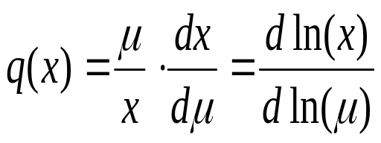
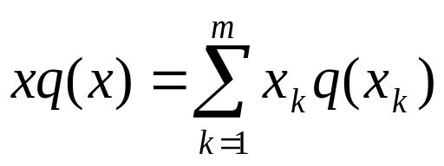
Pro-Poorness of Economic Growth
Local impact
  Impact of growth on individual welfare represented by point elasticity of income w.r.t. a change in per capita income.
  Growth pattern as normalized growth incidence curve.
  Impact on individual level poverty

Slide 35
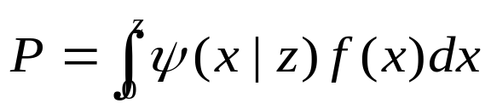
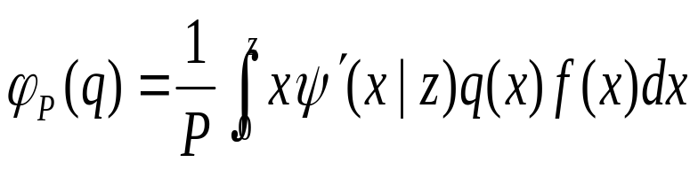
Pro-Poorness of Economic Growth
Social Impact:
  Use members of the class of additively separable poverty measures (e.g. Watts, FGT).
    Deprivation function is convex and decreasing in x. Poverty measure additively decomposable
  Aggregate impact: Growth elasticity of poverty index

Slide 36
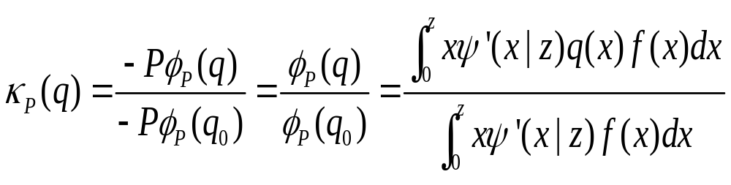
Pro-Poorness of Economic Growth
  Pro-Poorness
    A pro-poor growth pattern achieves a reduction in poverty over and above that which is feasible in a benchmark case (either desirable or counterfactual).
    Choose as benchmark the amount of poverty reduction attainable under distribution neutrality .
    Ratio comparison

Slide 37
Pro-Poorness of Economic Growth
  Ratio comparison for Watts index leads to Ravallion and Chen’s (2003) “mean growth rate for the poor” measure.
  Ratio comparisons also underlie the Kakwani and Son (2008) measure called “poverty equivalent growth rate”.

Slide 38
Pro-Poorness of Economic Growth
Case of Indonesia
Two types of datasets for Indonesia used in this study
    Distribution of household expenditure per decile (in 1993 PPP dollars) from World Bank Global Poverty Monitoring database.
    SUSENAS household surveys (1999, 2002) used to achieve decomposition of pro-poorness across income/expenditure components
    Poverty line: about 2 dollars a day.

Slide 39
Pro-Poorness of Economic Growth
Poverty and inequality profile
1993-1996
  Poverty falls while inequality increases.
  Likely outcome of successful adjustment to oil shock
1996-1999
  Poverty increases while inequality falls
  Likely outcome of the 1997 Asian financial crisis.
1999-2002
  Poverty falls, inequality goes up.
  Signs of recovery: macroeconomic stability associated with reduced vulnerability to external shocks.

Slide 40
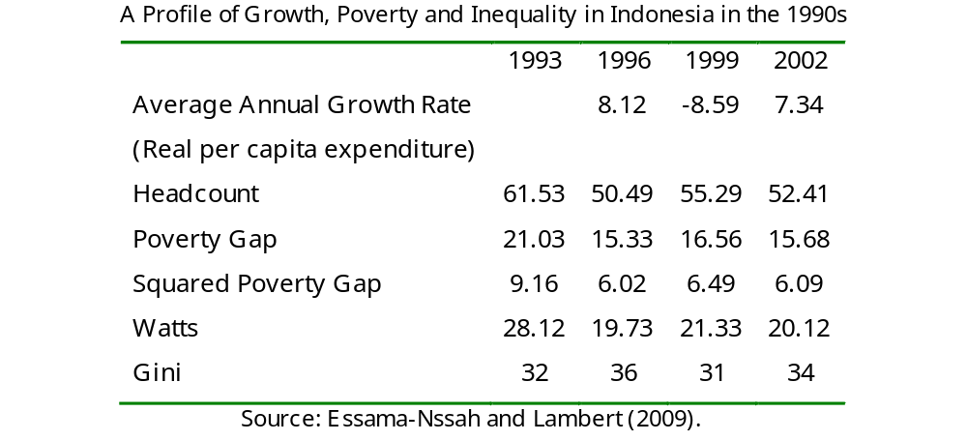
Pro-Poorness of Economic Growth

Slide 41
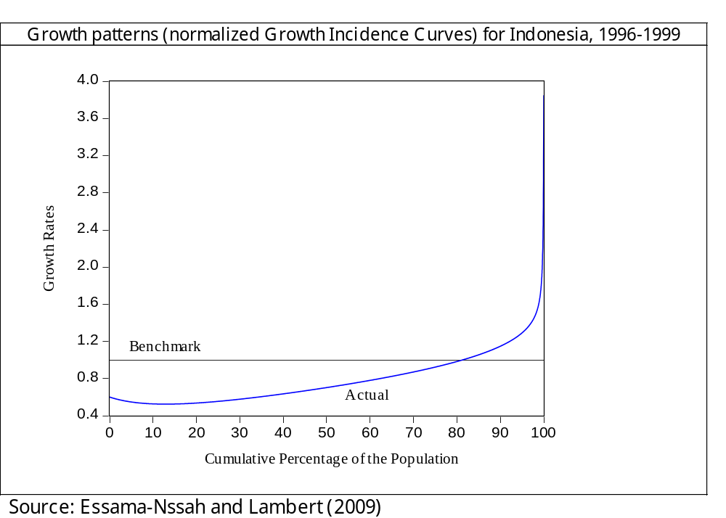
Pro-Poorness of Economic Growth

Slide 42
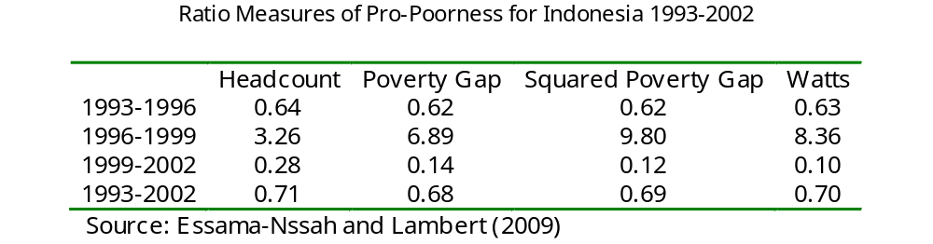
Pro-Poorness of Economic Growth

Slide 43
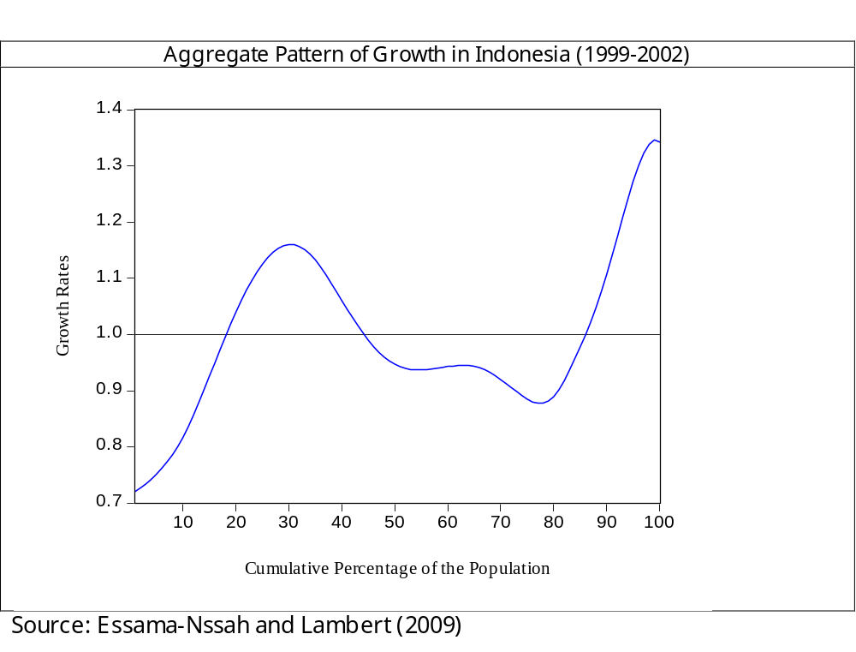
Pro-Poorness of Economic Growth

Slide 44
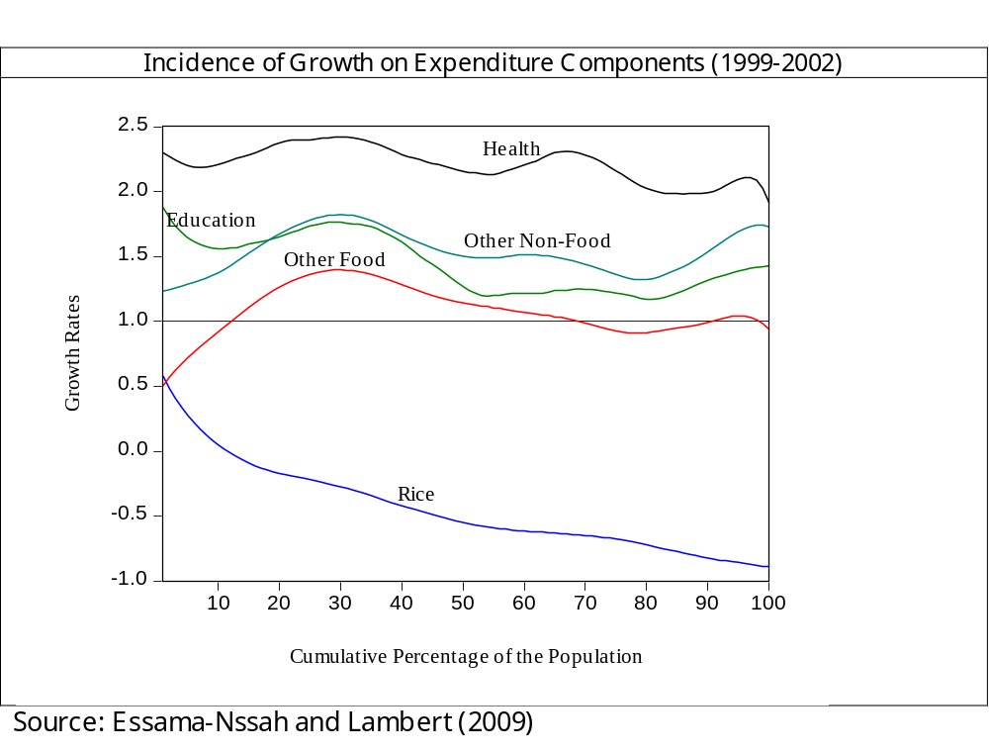
Pro-Poorness of Economic Growth

Slide 45
Pro-Poorness of Economic Growth
Overall poverty reduction achieved over period 1993-2002 far below what distribution neutral growth would have achieved.
Focusing on the 1999-2002 period:
  Some poor people gained from the economic growth that occurred over that period, but these gains do not measure up to the losses suffered by the rest of the poor.
  The behavior of categories of expenditures over the same period reveals that the weak performance is due mainly to changes in food expenditure.

Slide 46
Concluding Remarks
Effective policymaking must go hand-in-hand with reliable impact assessment.
Social impact evaluation should address at least the following questions:
  Whether the intervention has worked (or will work) as intended or not, and why?
  Who gains and who loses?
Analysis of the social impact of a policy requires a reliable social policy model. Such a model has two basic components:
  A positive component (structural model) to predict impact of policy on individual behavior subject to prevailing social interaction.
  A normative component (social evaluation function) to assess the desirability of outcomes.

Slide 47
Concluding Remarks
The potential outcome model which is the workhorse for evaluating the impact of targeted interventions is an instance of the Roy (1951) model of choice and consequences
  The basic identification strategy in this context is to isolate an independent source of variation in the causal variable (treatment or participation) and link it to outcomes to identify a causal effect.
The scope of an intervention may be so large that the whole population is affected, making it difficult to select a valid control or comparison group.
  One can resort to economy-wide modeling (e.g. general equilibrium modeling) to simulate the policy state and a counterfactual.

Slide 48
Concluding Remarks
In the end, social impact analysis entails a comparison of social states on the basis of the value judgments underlying the evaluation criterion.
  These value judgments stem mainly from the demands of either collective rationality or fairness.
  The definition of pro-poorness relies on such value judments.

Slide 49
References
Arrow Kenneth. J. 1963. Social Choice and Individual Values. New York: Wiley.
Bourguignon François, Ferreira Francisco H. G. 2005. Decomposing Changes in the Distribution of Household Incomes : Methodological Aspects. In François Bourguignon, Francisco H.G. Ferreira and Nora Lustig (eds), The Microeconomics of Income Distribution Dynamics in East Asia and Latin America. Washington, D.C.: The World Bank.
Essama-Nssah B. and Lambert Peter J. 2009. Measuring Pro-Poorness: A Unifying Approach with New Results. Review of Income and Wealth (forthcoming).
Essama-Nssah, B. 2006. Propensity Score Matching and Policy Impact Analysis: A Demonstration in EViews. World Bank Policy Research Paper No. 3877
Heckman James J. 1976. The Common Structure of Statistical Models of Truncation, Sample Selection and Limited Dependent Variables and a Simple Estimator for Such Models. Annals of Economic and Social Measurement, Vol. 5, No.4: 475-492.

Slide 50
References
Holland, Paul W. 1986. Statistics and Causal Inference. Journal of the American Statistical Association, Vol. 81, No. 396: 945-960.
Kakwani Nanak and Son Huyn H. 2008. Poverty Equivalent Growth Rate. Review of Income and Wealth Series 54, No. 4: 643-655.
Moulin, Hervé J. 2003. Fair Division and Collective Welfare. Cambridge (Massachusetts): The MIT Press.
Ravallion Martin . 2009. Should the Randomistas Rule? The Economists’ Voice, Volume 6, Issue 2. Berkeley Electronic Press (http://www.bepress.com/)
Roy Andrew D. 1951. Some Thoughts on the Distribution of Earnings. Oxford Economics Papers 3: 135-146.
Ravallion Martin and Chen Shaohua. 2003. Measuring Pro-Poor Growth. Economics Letters 78: 93-99.
Sen, A. 1999. Development as Freedom. New York: Alfred A. Knopf.

Slide 51
References
Sen, A. 1998. The Possibility of Social Choice. Nobel Prize Lecture.
Sen, A. 1997. On Economic Inequality. Oxford: Clarendon Press.
Sen, A., Muellbauer, J., Kanbur, R.,Williams, B. 1987. The Living Standard. Cambridge: Cambridge University Press.
United Nations. 2000. United Nations Millennium Declaration. Resolution adopted by the General Assembly, September. United Nations, New York.
Valadez Joseph and Bamberger Michael (eds). 1994. Monitoring and Evaluating Social Programs in Developing Countries: A Handbook for Policymakers, Managers, and Researchers. Washington, D.C.: The World Bank.
World Bank. 2005. World Development Report 2006: Equity and Development. Oxford: Oxford University Press.
Young, H. P. 1994. Equity: In Theory and Practice. Princeton, NJ: Princeton University Press.

Slide 52
The End

