Slide 1
Analyzing the Macroeconomic and Distributional Impact of an Oil Price Shock – the Case of South Africa
Presentation
Evaluating the Poverty Impacts of Economy-Wide Policies
Delfin S. Go
April 28-30, 2009
Poverty and Inequality Analysis Course
PREM Learning Week

Slide 2
Why worry about economy-wide impact analysis or a “new” economic framework?
Before 2008: Mid-1990s to 2007
  External environment favorable
    Word demand strong
    Commodity prices rising
    Donor assistance/debt relief significant
  Shifts in growth for developing countries
    Emerging economies – China, India etc.
    Africa grew growing in tandem with the world
  Demands from policy –
    Poverty reduction strategy papers (PRSPs)
    Service delivery issues
    Public expenditure and budget management
  Demands on modeling – emphasis on micro aspects & poverty
    Pulic expenditure tracking and benefit incidence analysis
    Macro-micro links
    Introducing government spending and links to MDGs (e.g. MAMS)

Slide 3
Why worry about economy-wide impact analysis or a “new” economic framework?
2008 to present
  Severe External Shocks
    Early 2008 – High oil and food price increases
    Late 2008 – Financial crisis in US and Europe
  Terms of trade shocks – 2009 and beyond (?)
    Falling commodity prices and export demand
    Falling exogenous flows – capital flows, remittances etc.
    Numerical impact on the economy and poverty

Slide 4
Why worry about economy-wide impact analysis or a “new” economic framework?
Demands from policy
  Impact of external price or terms of trade shocks
  Interactions and feedbacks regarding the shocks, the economy, and policy
  Impact on poor households
Demands on modeling
  Direct and indirect effects important
    First generation models – input-output & SAM
      Multipliers tell the importance of linkages and what sectors will be affected most
      Estimates of the numerical impact important
  Introducing feedbacks
    Flexible prices - interaction of supply/demand
    Policy – effects of macro-fiscal adjustment
    Substitution possibilities – economic behavior
  CGE models – external price shocks and adjustment story
    Popular during seventies – oil price shocks
    Eighties – trade reform, debt issues and structural adjustment
  Micro aspects - Impact on poverty and MDGs still important
Purpose of lecture
  Describe a macro-micro model to South Africa
  Illustrate the impact of an oil price shock

Slide 5
Modeling challenges
- linking macro and micro and retaining rich structure
- providing 2 way feedbacks
Macro
Policies
Shocks
Meso Disaggregated
- More sectors,
- Factors of production
CGE models?
Micro
Household data
Micro simulation
Incidence analysis
Service delivery

Slide 6
Macro-micro Modeling Issues
  The difficulty of full integration of 2 very different approaches –
    On the top side - aggregative macro/econometric models
    on the bottom - very micro and large household data sets (benefit-incidence analysis, poverty analysis, PETS etc.)
    Top-down causality: macro to micro
  Remaining problems
    Introducing dynamics and feedbacks
    Determinants of long-term growth (?)
    Firm and investment climate (?)
  Trade-offs:
    Simplicity vs sophistication
    More contents vs black boxes

Slide 7
Ex-ante Tools:
 |  | CGE/Macro Models
 |  | Aggregate |  | Disaggregate
Poverty/ Micro- simulation | Simple | 123 Model & extensions- Macro+PAMS etc. (many countries) |  | Input-Ouput & SAM (many countries)
 |  |  |  | Disaggregated CGE model –India, South Africa etc.
 | Complex | Occupational Choice (Indonesia, South Africa etc.) |  | CGE+micro simulations -Madagascar, Brazil, South Africa, etc.

Slide 8
The case of South Africa – part of a TA
  A disaggregated CGE model
  (now operating at South Africa National Treasury)
    SAM , 2001 and subsequent updates (C. de Mewre)
    Dimensions of the CGE model
      43 production sectors: agriculture, 30 industries, 12 services
      15 labor categories - by skill, formal/informal workers, and self-employed by broad sectors
      Over 10 household groups
      Separate tax tables: import tariffs, consumption taxes (value added, excise, fuel), production taxes, income taxes
    Documentation:
      Application to VAT issues by Delfin S. Go, Marna Kearney, Karen Thierfelder, and Sherman Robinson
    Other features:
      Rich in economic structure and behavioral contents for policy analysis
      But limited heterogeneity in individuals/households for analysis of poverty, income distribution or more detailed social impacts

Slide 9
TA for South Africa
2. Micro-simulation framework
    Micro data: combined IES and LFS data for 2000
        26,265 households
        103,732 individuals
    Econometric estimations (Korman 2005) :
      Wage functions for formal wage earners by skills by sector
      Earning functions for self-employed and informal workers by broad sector – primary, secondary and tertiary sectors
      Occupational-choice (multinomial-logit) functions similar labor categories
    Features:
      Full heterogeneity of households/individuals/labor force estimated through cross-section data
      Limited detail in structure of productive sector for policy analysis

Slide 10
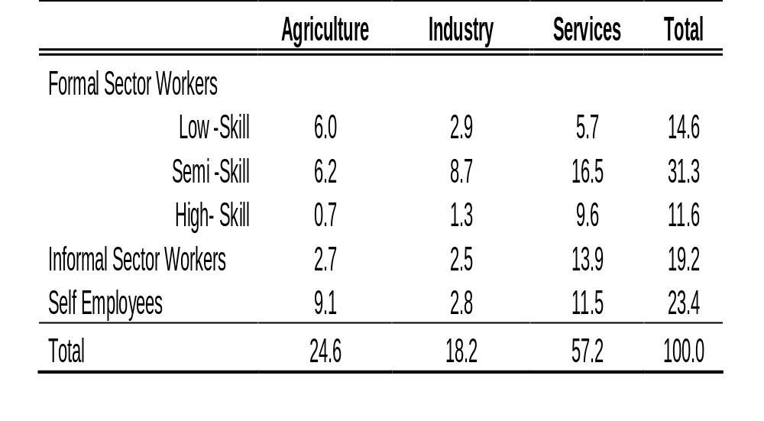
Distribution of Employment by Sector and Occupation

Slide 11
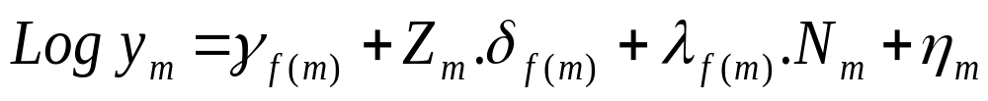
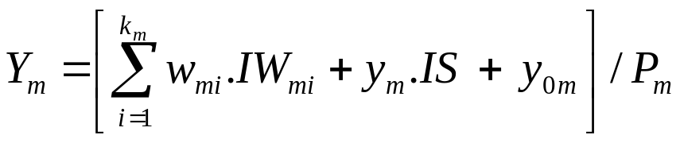
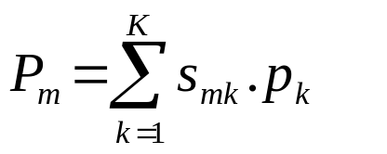
Micro-simulation model for South Africa
Wage and self-employment earnings of each household
by primary, secondary, and tertiary sectors
by low, medium and high skill for formal workers

Slide 12
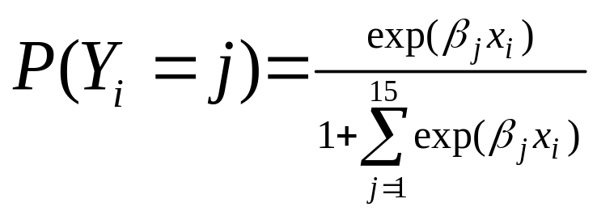
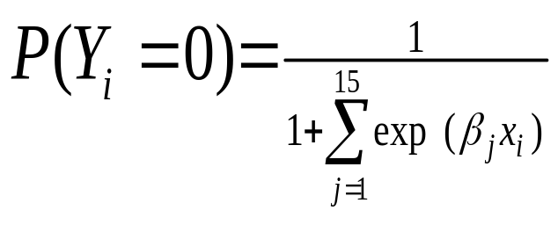
Micro-simulation model for South Africa
Next, each individual chooses the occupation that gives the highest utility (table 6)
Occupational status or choices are:
  Self-employment by sector (3)
  Informal wage employment by sector (3)
  Formal wage employment by skill and sector (9)
  Unemployed and inactive (Base Group)
Multinomial Logit Probabilites (P) calculated using:

Slide 13
Some observations from the wage equations
  Statistical
    Key variables like education and experience have expected signs and are significant;
    OLS regression similar to Heckman 2 stage model that corrects for problem of selection bias (exclusion of non-wage earners);
  Education has significant impact for low-skilled workers
    Primary sector – 3 additional years increases wage by 5.7%;
    Manufacturing – 3 additional years increases wage by 2.4%;
    Tertiary sector – 3 additional years increases wage by 9.6%;
  Others
    Union wages for low-skill higher than non-union wages by 60% in primary sector (mining?); 40% in manufacturing; and 62% in tertiary sector;
    Urban wages are >30% higher;
    Male employees are paid 9-51% higher than female employees;

Slide 14
Macro-micro integration
  Top-down approach
    Most common, because of different dimensions and statistical packages used for macro and micro components;
    Macro and micro are run separately;
    No sacrifice in the rich structure of the economy in the macro/CGE model
  Full integration
    Madagascar (Ann-Sophie Robillard etc. ) - macro/CGE component has few sectors;
    U.S. (Hechman and Lochner) – overlapping generations general equilibrium model for the macro part is aggregative
  Recursive dynamics and feedbacks for South Africa
    Retain the rich structure of the economy in the CGE model (e.g. 49 sectors)
    Upward Feedback through the structure of labor and households

Slide 15


The feedback mechanism
CGE model
Linkage AggregatedVariables
-prices, wages, employment levels
Feedback variables for next period–labor supplies, household distribution by groups
Household income micro-simulation model

Slide 16
The recursive feedback mechanism from micro to macro
Factor Accumulation
  New labor supplies are calculated for t+1 from the micro simulation
    Aggregation consistent with CGE labor market categories and story
    Simple demographic growth rates (as a start)
  Aggregate/sector investment determined in the CGE model (no micro-firm story)

Slide 17
The Impact of a Large Oil Price Shock
Two Scenarios
  125% increase in the world import price of oil
  (similar to the shock during 2003-06; to about $65/bbl)
  The same oil price shock plus spill-over effects:
    30% increase in the world import price of basic chemicals, plus
    6% increase in the world import price of all other goods.
    In the long run all factors are fully mobile across all sectors .
    In the short run, capital is activity specific and labor is mobile within subsets of activities: agriculture, industry, and services.

Slide 18
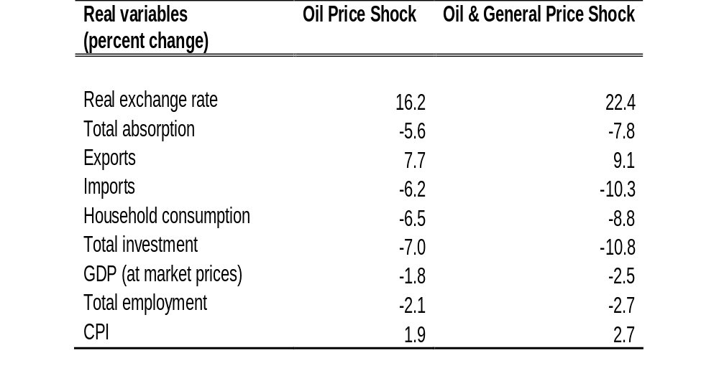
Macroeconomic Results

Slide 19
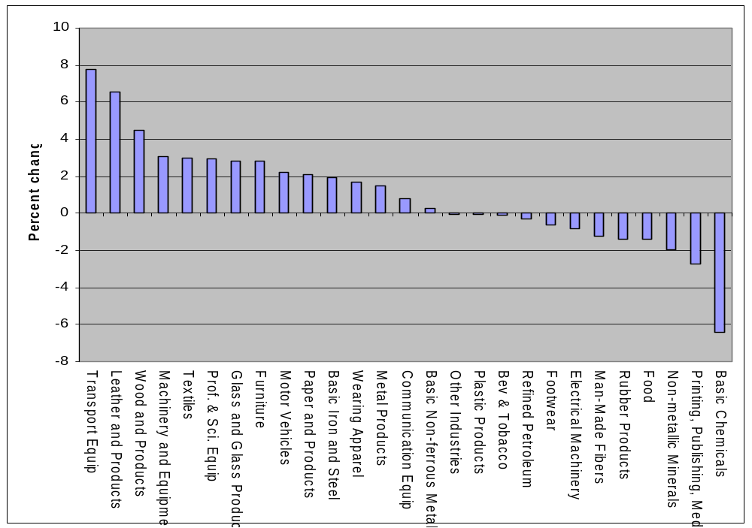
Output Adjustment in the Industry Activities
Oil Price Shock

Slide 20
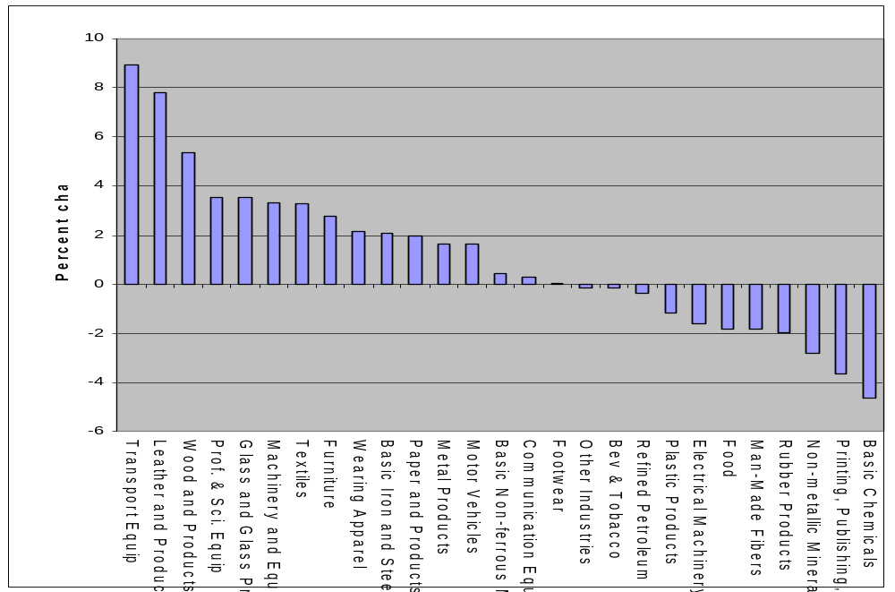
Output adjustment in the Industry Activities
Oil & General Price Shock

Slide 21
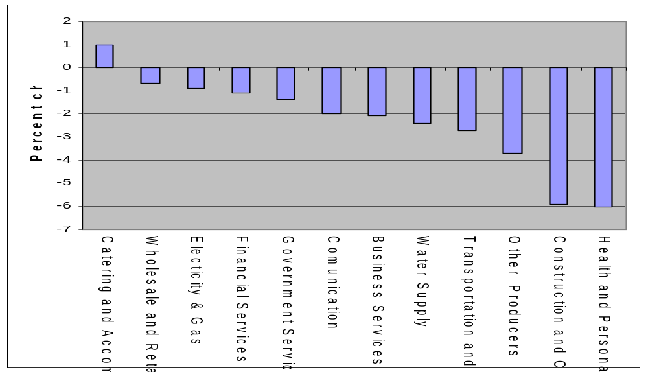
Output Adjustment in the Service Activities
Oil Price Shock

Slide 22
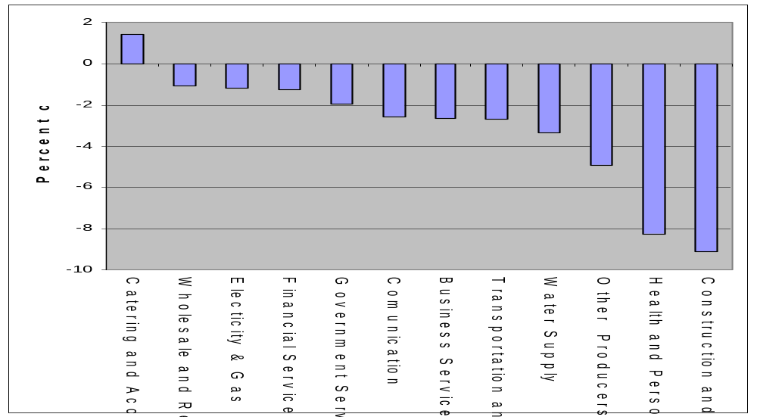
Output adjustment in the Service Activities
Oil & General Price Shock

Slide 23
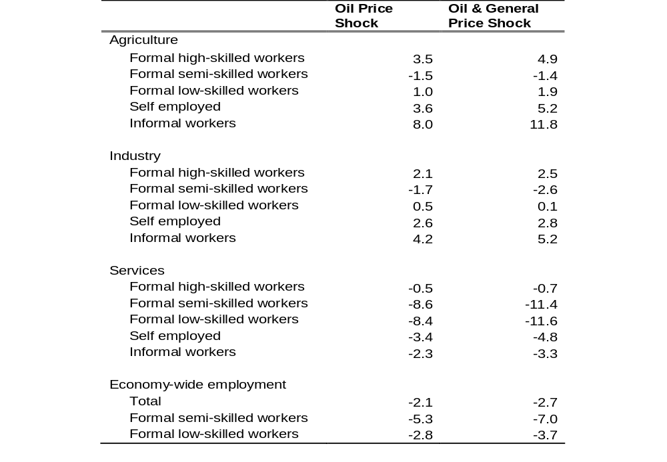
Employment Changes (percent change)

Slide 24
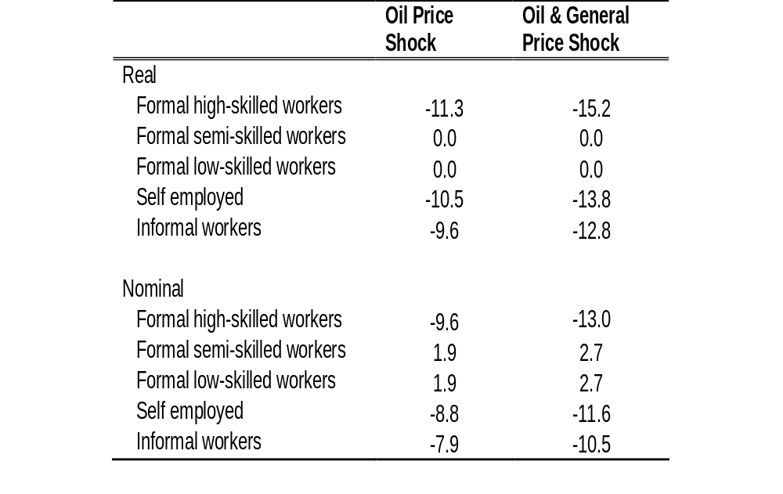
Wage Changes (percent change)

Slide 25
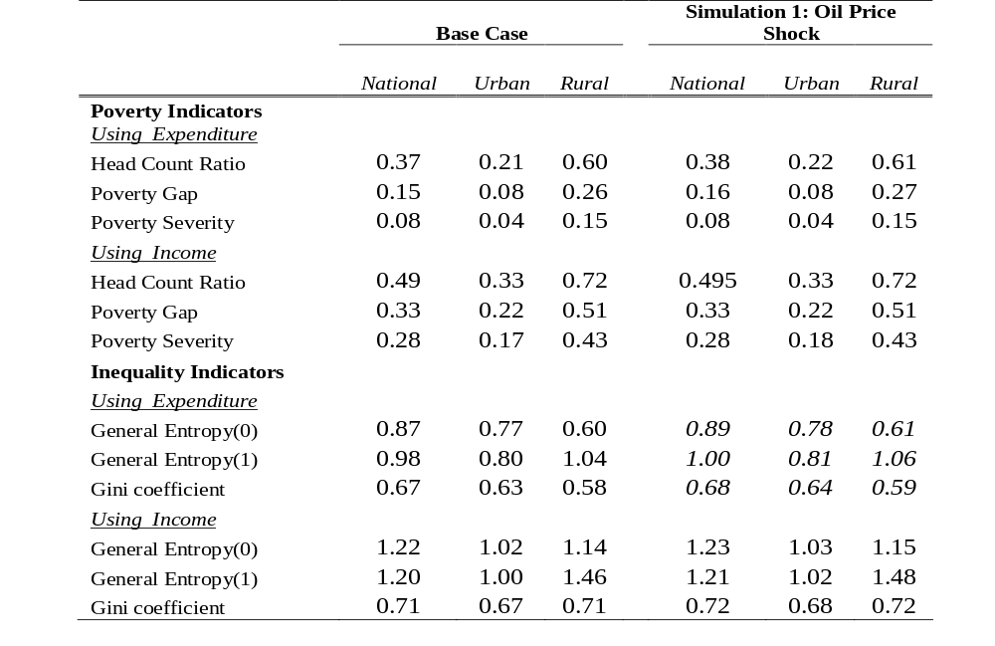
Impact of Oil Shock on Poverty and Income Distribution

Slide 26
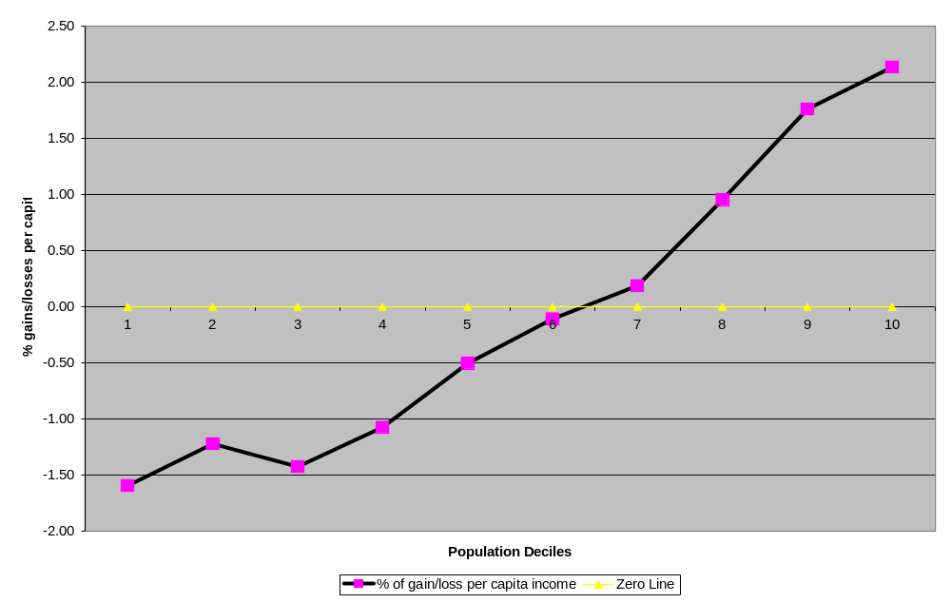
Distribution of Gains and Losses to Households by Deciles

Slide 27
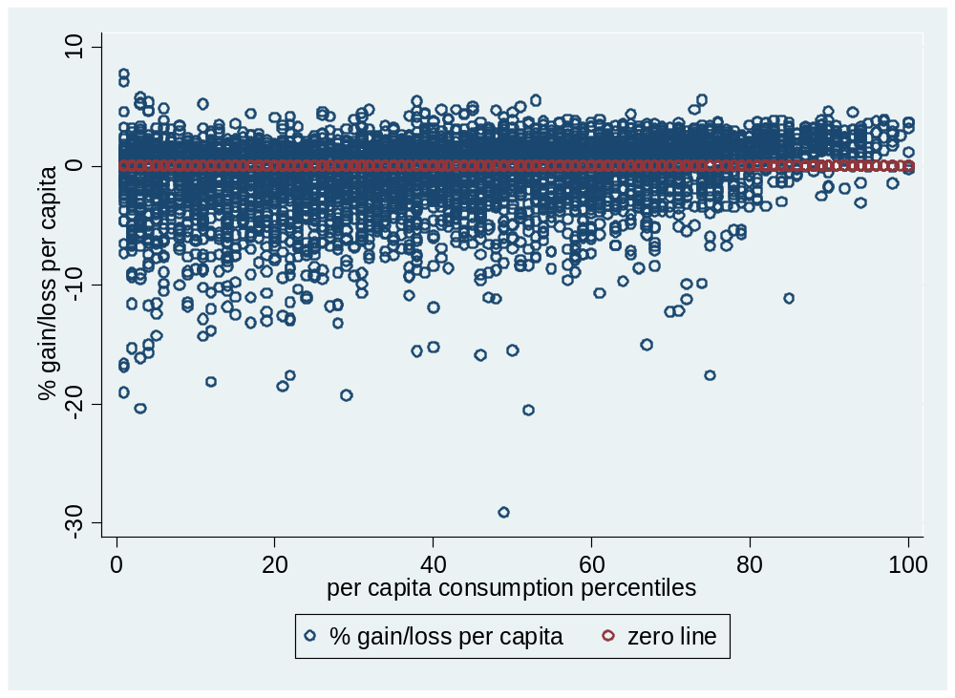
Gains and Losses from Oil Price Shock for Low Skill Households

Slide 28
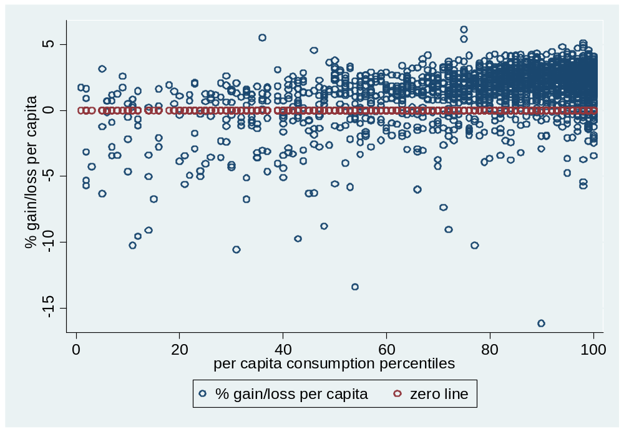
Gains and Losses from Oil Price Shock for High Skill Households

Slide 29
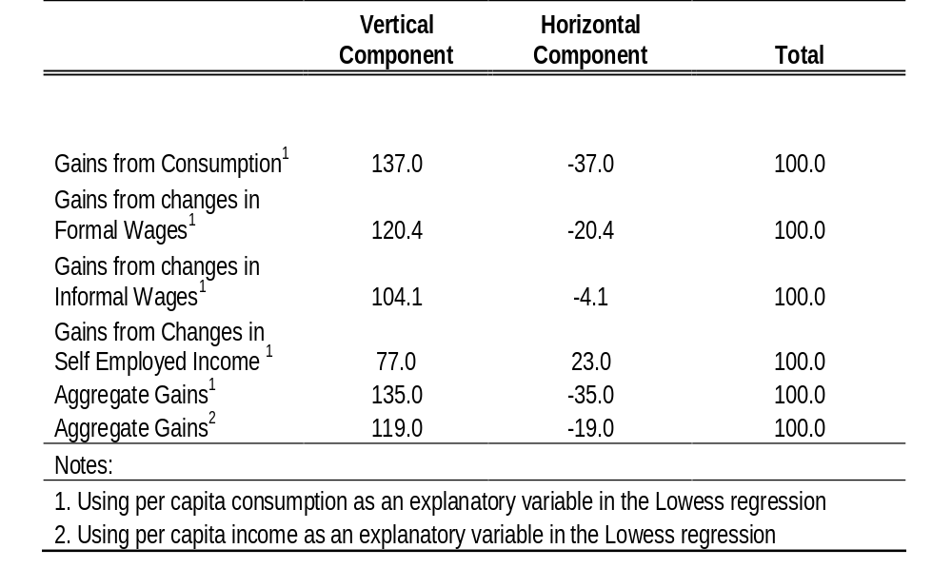
Decomposition of the Impact on Inequality

Slide 30
Conclusions/further research……
Oil shock simulations did not include offsetting factors
The elaborate macro-micro framework has several potential policy applications;
For the bottom-up feedback, positive and negative effects tends to cancel out with income classification;
But the potential is there to look at the micro aspects much more thoroughly for winners and losers by alternative household characteristics;
Questions/issues –
  Is the upward feedback with household classification worth exploring further more?
  Next applications
    impact of a wage subsidy issue (done)
    carbon tax (done – w/o micro simulations)
    falling export prices and exogenous flows
    combined incidence of taxation and public expenditures in South Africa
  Applications to external shocks – what’s hapenning to the efficiency parameters (of investment, public expenditures et.)

