Slide 1
Global Economic Modeling using GTAP
Future Directions
presented to the
Third Annual Conference in Global Economic Analysis, Melbourne
by
Thomas W. Hertel
Center for Global Trade Analysis

Slide 2
Outline
Demand parameter estimation:
  import demand elasticities: maximum entropy
  consumer demand: AIADS
Supply-side innovations:
  industrial structure
  productivity convergence
Policy modeling: TRQs
Dynamics

Slide 3
Demand #1
Estimating Armington Parameters
Most controversial parameters in GTAP:
  “Structuralist” economists favor smaller values -- gives strong TOT effects, lower welfare gains
  “Market oriented” economists favor larger ones -- gives larger gains from liberalization
  Basically an empirical question
This study (led by Arndt and Liu) estimates trade parameters most consistent with historical experience.

Slide 4
Methodology
Follows Arndt and Robinson work on Mozambique
Vary parameters and re-solve model to obtain best fit to historical data
Maximum Entropy criterion for evaluating how well the model tracks historical experience
Implemented using modified version of Rutherford’s GTAPinGAMS model
GTAP v4 database is starting point - shocks to factor endowments, govt cons, investment, and protection levels from 1995 to 1992, 1989, and 1986

Slide 5

ME Estimates of _{D}

Slide 6
Future Directions
Provides ideal laboratory for testing alternative model specifications:
  2x rule relating _{D} and _{M}
  CET between domestics and exports
In long run offers approach to model validation
Need for common historical data series

Slide 7
Demand #2
Modeling Consumer Behavior
Longer run projections hinge on demand specification
Income elasticities of demand change as individuals become wealthier
Econometric work always outdated – GTAP uses estimates from from 1980’s
Use Powell and Rimmer’s AIDADS demand system to track behavior over wide range and update elasticitiess

Slide 8
Estimating AIDADS
Research with Cranfield, Eales and Preckel
1985 International Comparisons Project
    64 countries ranging from Ethiopia to USA
    113 goods
MLE estimation

Slide 9
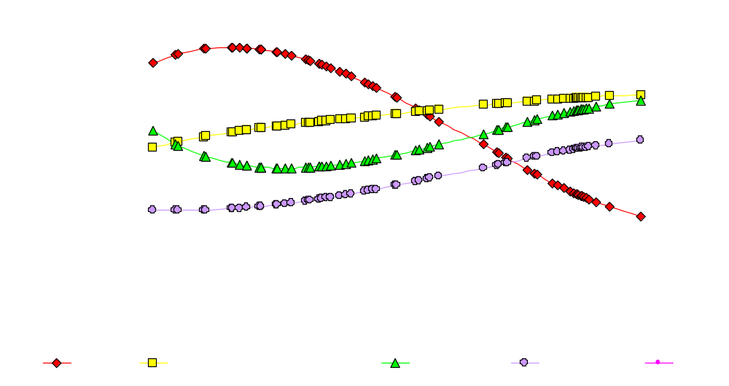
Consumer budget shares vs. income

Slide 10
AIDADS in GTAP
9 good version incorporated AIDADS into GTAP (Wusheng Yu’s paper)
Introduce margins sectors to bridge difference: producer – consumer prices
Project to 2020:
  demand at consumer prices
  demand at producer prices
  output requirements

Slide 11
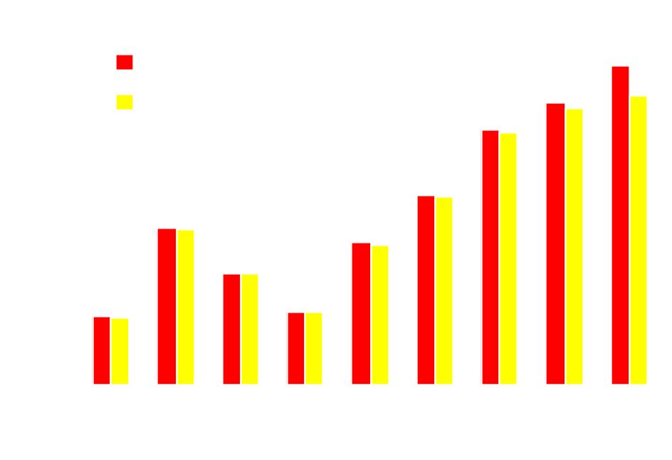
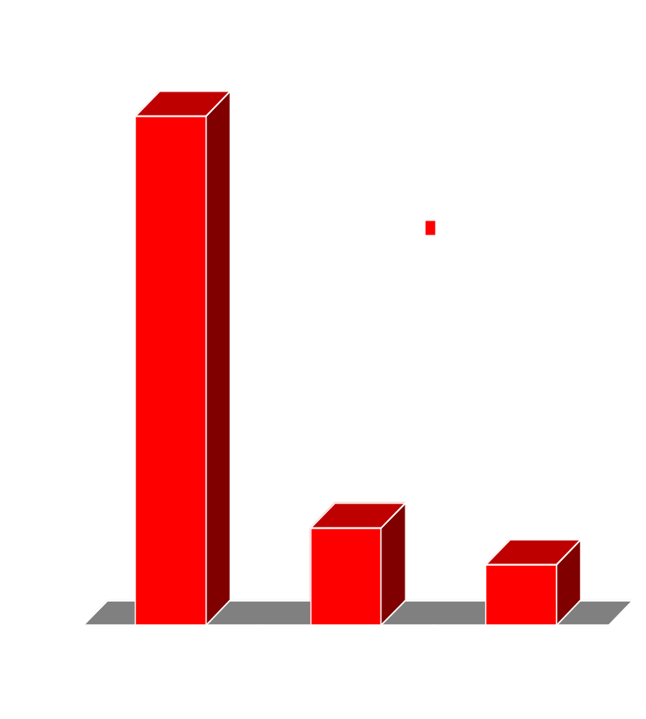
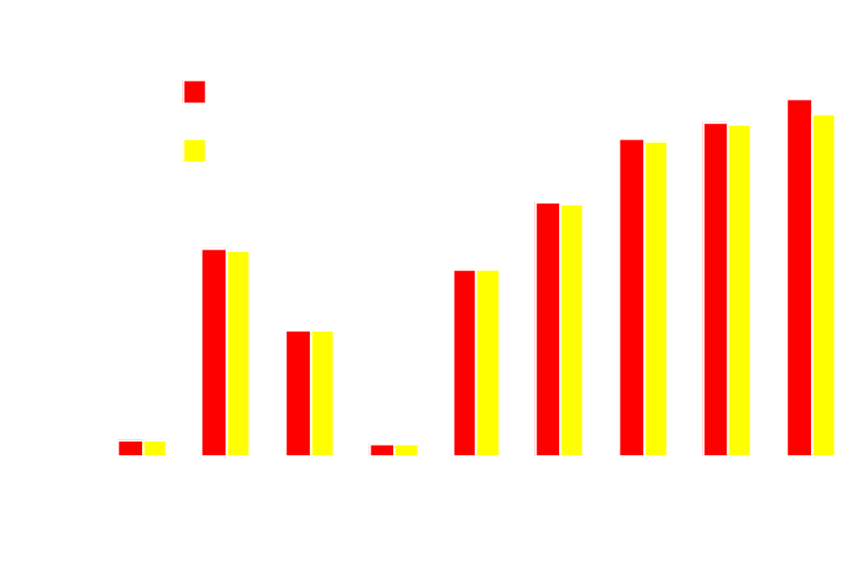
Estimated vs. Calibrated Elasticities
The Case for Newly Industrialized Economies

Slide 12
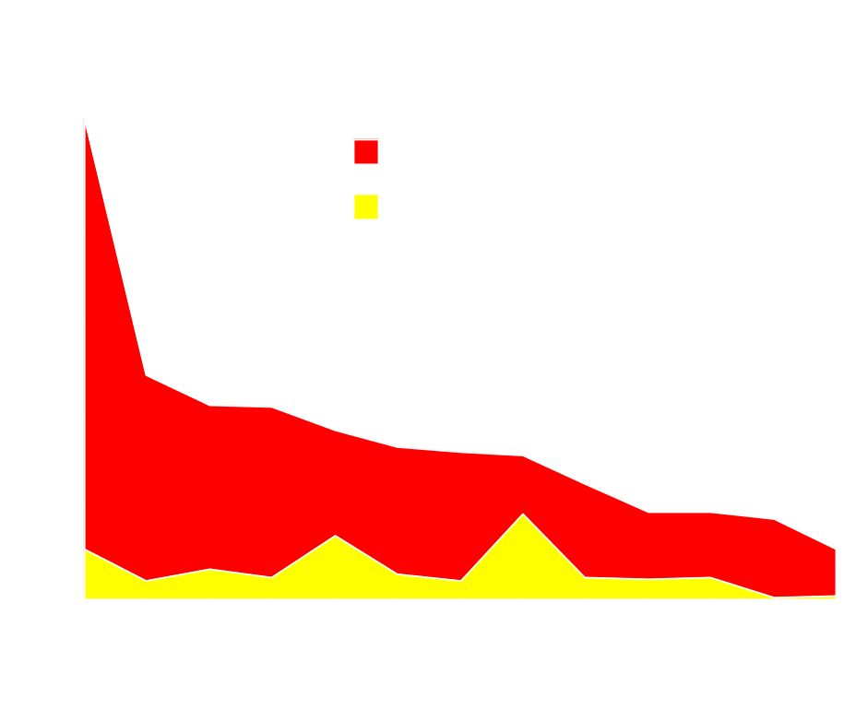
Demand Side Experiment
Population and income growth
PE closure
  no resource constraints
  therefore pr. factor costs and prices fixed
Data
  GTAP Baseline

Slide 13
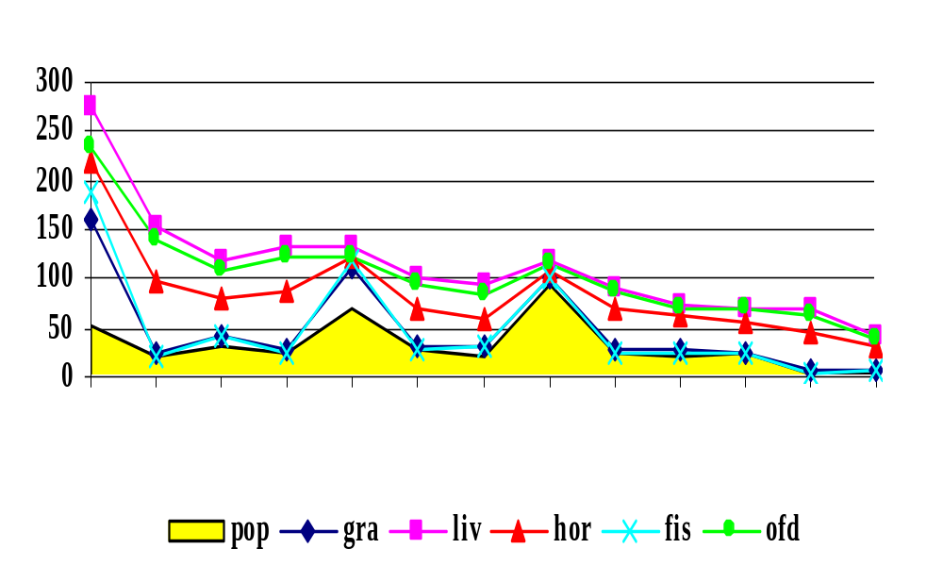
A focus on food: meat demand increases
fastest for consumers

Slide 14
Supply #1
The Role of Industrial Structure in Morocco-EU FTA
Based on research conducted by Aziz Elbehri
Relationship with EU shapes Moroccan economy
  access in agriculture restricted
  privileged access in manufactures
FTA = free trade in industrial products by 2008
  primary impact on Moroccan manufactures
  manufactures production highly concentrated
  potential for rationalization – or wholesale collapse of manufactures

Slide 15
Model Structure
Application of GTAP tech paper by Francois
Key assumptions:
  Cournot competition among domestic producers who produce homogenous good
  Domestic and foreign markets integrated
  Foreign products differentiated
  Domestic producers assume import prices fixed in calculating perceived demand elasticity
Data from industrial census

Slide 16
Market structure and Model Calibration (Morocco; 1995)
4-plant
Economies
Concentration
Herfindhal
Price-cost
of scale
Ratio
Index
Markup
(CDR)
Meat products
66.43
0.2173
1.11
0.24
Vegetable oils & fat
87.27
0.4250
1.33
0.16
Dairy products
87.65
0.4254
1.49
0.13
Sugar
90.27
0.4893
2.39
0.11
Other food products
32.52
0.0790
1.06
0.10
Beverages & Tobacco
95.84
0.7907
2.45
0.10
Textiles
36.91
0.1214
1.07
0.19
Wearing apparel
25.67
0.0434
1.02
0.19
Wood products
81.48
0.3236
1.26
0.11
Paper & Publishing
51.72
0.2218
1.21
0.20
Chemical products
68.39
0.3892
1.35
0.16
Metal products
56.55
0.2315
1.19
0.09
Motor vehicles
86.56
0.2867
1.10
0.25
Light manufacturing
88.52
0.4138
1.21
0.15
Other manufacturing
93.25
0.5141
1.49
0.14
Source:
Authors' calculations from annual manufacturing survey (Ministry of Commerce and Industry).
Notes:
- To calibrate the market structure features of the model, I used plant-level data for 1995 manufacturing census.
- For each industry, H index of concentration was calculated using market shares and aggregated up to the model aggregate level.
- Given the H values, the benchmark price-cost markups were derived using intitial market shares and the GTAP model elasticity of substitution. This means that the initial industry profits are reflected in the benchmark markups. And under the fixed entry assumption, these profits are allowed to adjust in response to FTA.
- For scale economies, we derived industry estimates of CDR for Morocco based on a scaled ratio of output per worker in smaller firms divided by output per worker in larger firms. This ratio is commonly used in the I/O literature as a proxy for unrealized scale economies.
[In other studies MES estimates were used derived from engineering studies. In addition to the limited number of published estimates, MES are also found to be very correlated with the H indices.

Slide 17
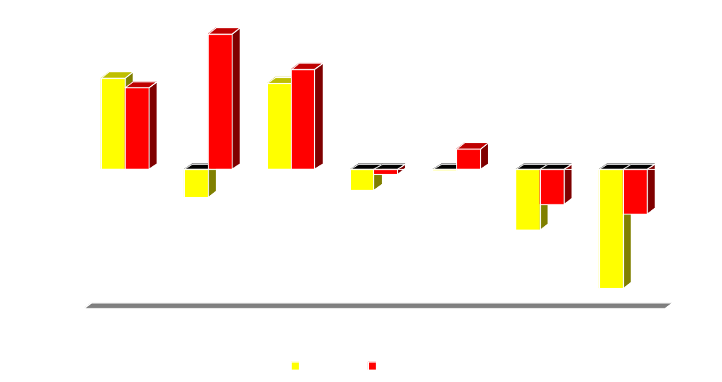
Market Structure makes a difference
EU-Morocco FTA: IC/IRTS vs. PC/CRTS
% change in output
Notes:
.

Slide 18
Supply #2
Technology Convergence
Controversy over China’s future trade position for meat products
  everyone predicts rapid growth in demand
  but less work on the supply-side
China’s livestock productivity still far below intn’l frontier – but catching up is occurring
What are implications for trade?
Based on research led by Alejandro Nin

Slide 19
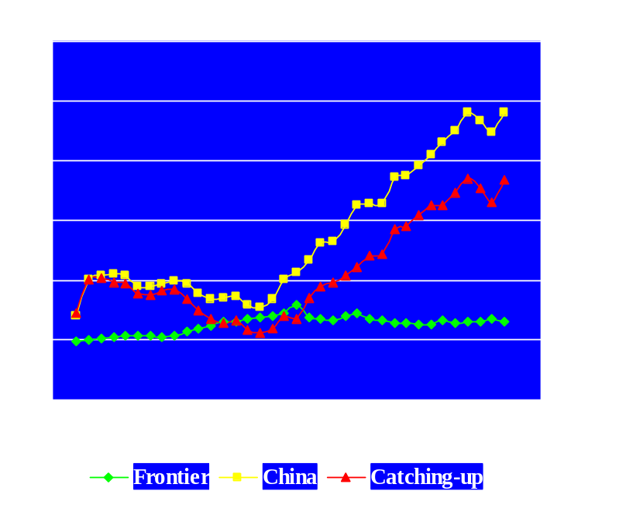
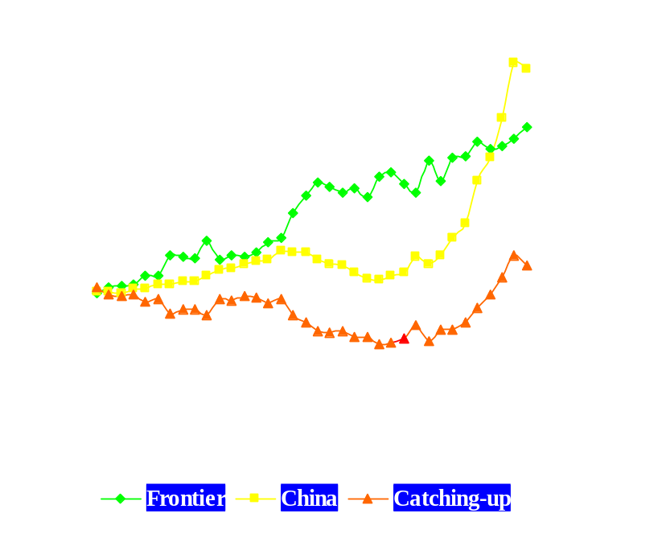
Cumulative Productivity Growth Rates for China (PFP)
Pigs
Poultry
Notes:
1) To show the pattern of productivity growth and its components in the period 1961-97, the graphs show the cumulated productivity indexes over this period (total productivity and its components).
2) Pigs
a. Not surprisingly, the sustained growth began after the political reforms at the end of 70’s.
b. As shown before, this productivity growth is explained by the efficiency gains in China’s pig production (catch-up curve above the technical change curve).
3) Poultry
a. Productivity growth in poultry was determined basically by technical change (the curve of technical change growth is above the catch-up and total productivity curves).
B. Only after the political reforms there is a clear and sustained growth in efficiency which combined with technical change resulted in a period of high growth rates in poultry’s productivity.

Slide 20
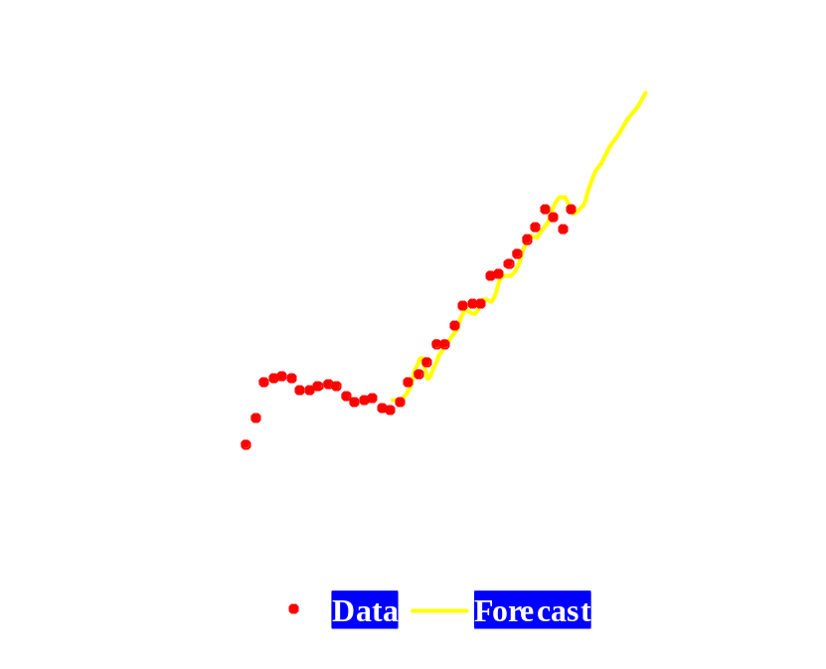
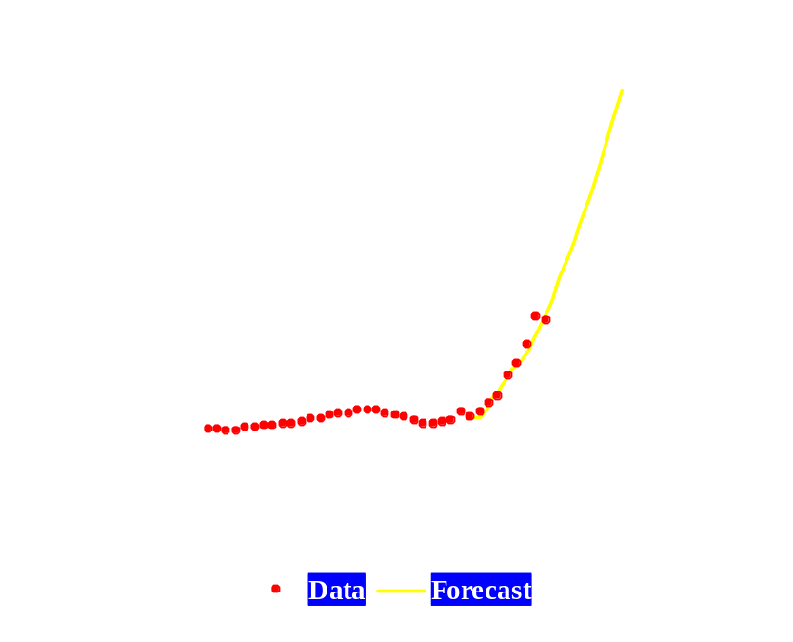
Productivity Forecasts for China Using the Logistic Functional Form
Pigs
Poultry
Notes:
1) …and this is how the logistic forecast looks like, where the lines are the forecasts.
2) In poultry, the logistic was fitted over the period 1985-97 (post-reform period) because that was the period where there was convergence to the frontier.
3) For purpose of forecasting, it is useful to have some idea of the possible distribution of outcomes, not just a single point estimate.

Slide 21
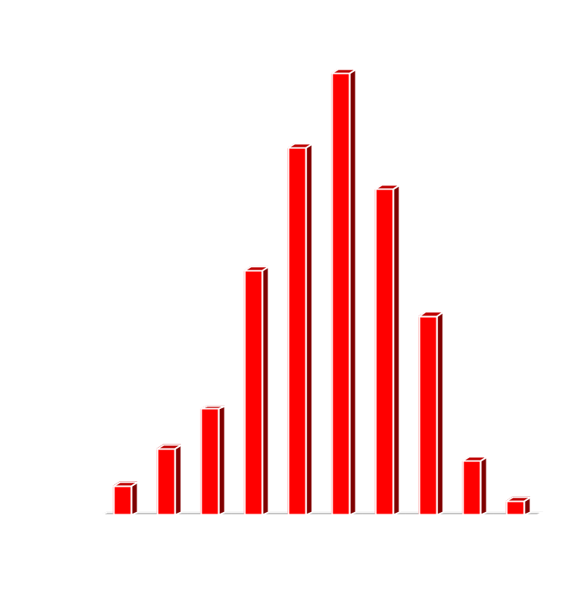
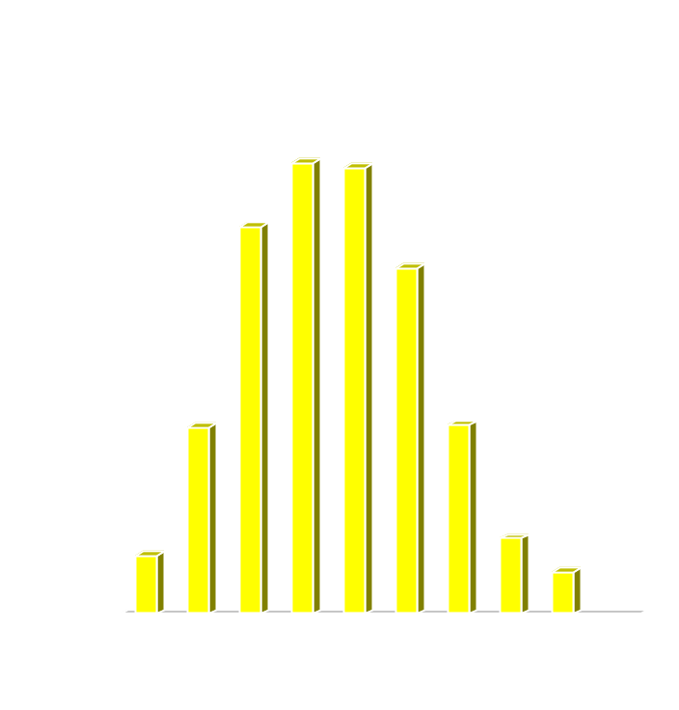
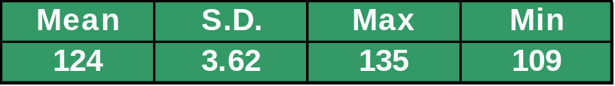
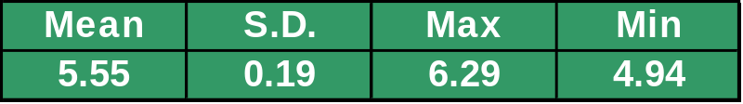
Bootstrapped Distribution of Productivity Forecasts

Slide 22

Uncertainty in Productivity
Impact on Projected Trade Balances
95% confidence intervals

Slide 23
Recent Developments in Policy
Modeling TRQs
Introduced in UR as way of ensuring minimum access in presence of very high tariffs
Makes analysis of partial liberalization vastly more complex
Who gets rents initially? What happens to these rents when enlarge quota or cut tariffs?
Based on:
  GTAP technical paper by Elbehri and Pearson
  sugar application led by Aziz Elbehri

Slide 24
TRQ generates economic rents
Price
Pw(1 + T2)
Rents
Net Import Demand
Pw(1 + T1)
Tariff Revenues
P_{w}
Q*
Q
Imports
Notes:
- Another important consideration is the quota rents generated under this regime. The distributional issues of these rents is an important factor in assessing the incidence of liberalization options on both importing and exporting countries of the liberalized markets.
- In agricultural commodities under TRQ regime where developing countries do capture a portion of these rents an important question is how will the TRQ regime affect the trade off between quota rent losses and higher earning tobe gained via expanded trade.

Slide 25
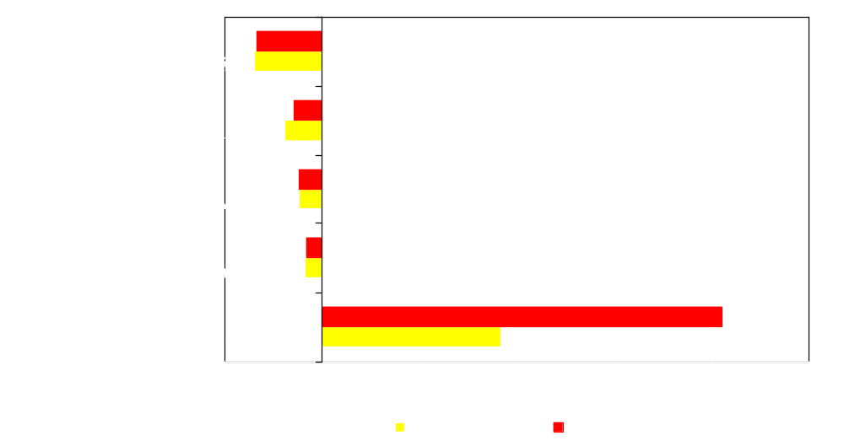
EU TARIFF CUT
Lost Quota Rents Drive Exporters’ Welfare

Slide 26
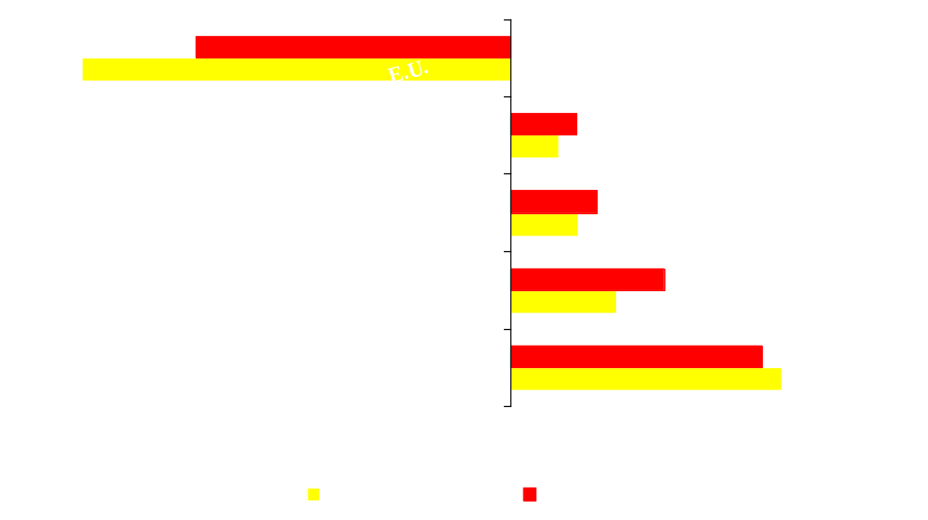
EU EU Quota Expansion
Higher Rents Raise Exporters’ Welfare

Slide 27

EU Tariff Cut & Quota Expansion
Welfare Gains for BOTH EU and Exporters

Slide 28
Recent Developments
Modeling Dynamics
  Dynamic GTAP model developed by Ianchovichina and McDougall
  Builds on standard GTAP Model
  Recursive Dynamic with accumulation of Capital stocks and wealth
  Foreign Capital ownership.
  Disequilibrium theory of Investment.

Slide 29
Foreign Capital Ownership
Households invest either domestically or overseas via a global trust (no bilateral detail on ownership)
Shares of savings held in foreign and domestic assets are held constant, subject to adding-up constraints

Slide 30
Disequilibrium Approach
Problem #1: Equalization of rates of return poses a problem implies perfect capital mobility. This is clearly not the case.
Problem #2: Theory and data are inconsistent: high investment in some regions with low ROR
Solution #1: Gradual equalization of rates of return with perfect capital mobility in long-run only
Solution #2: Introduce errors in expectations

Slide 31
Analysis of China’s WTO Accession
Research by Terrie Walmsley
Baseline from1995 to 2020 (13 periods)
Shocks to labor force and population
Endogenous capital accumulation
TFP calibrated to hit GDP targets
UR agreement 1995-2005
China’s pre-WTO accession tariff cuts 1995 to 2000

Slide 32
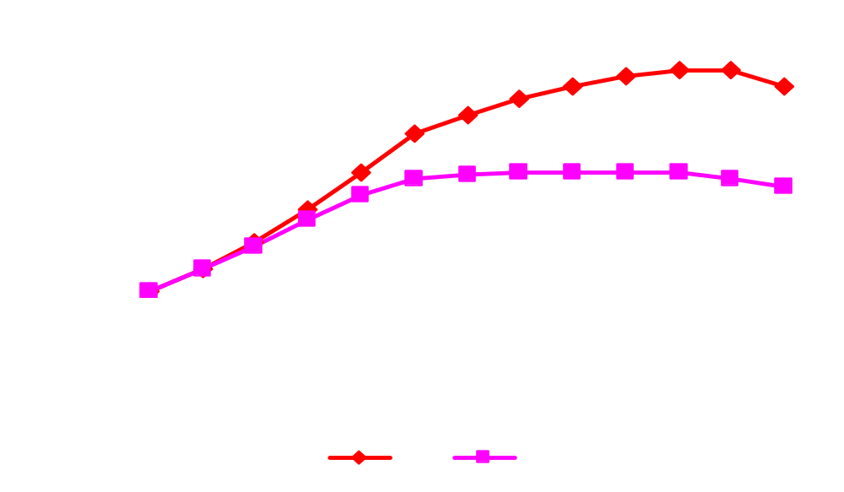
China’s Real GDP and Utility
cumulative % difference from base

Slide 33
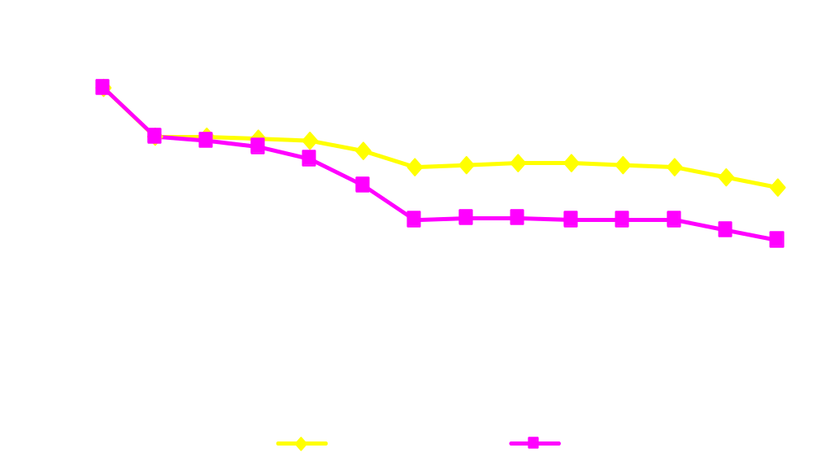
Impact of China’s accession on employment NAM Apparel
Index: 1995 = 100

Slide 34
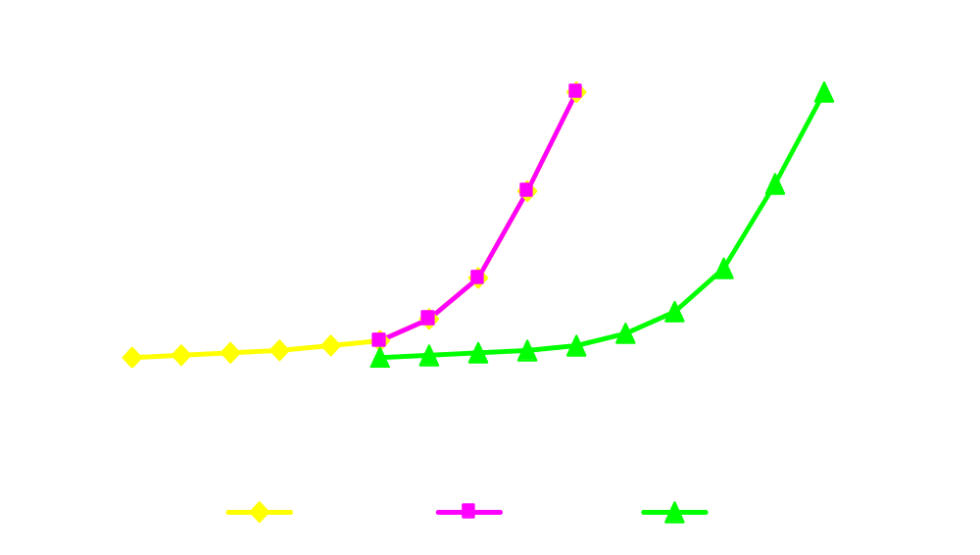
Alternative path for China’s quota abolition
% subject to free trade

Slide 35
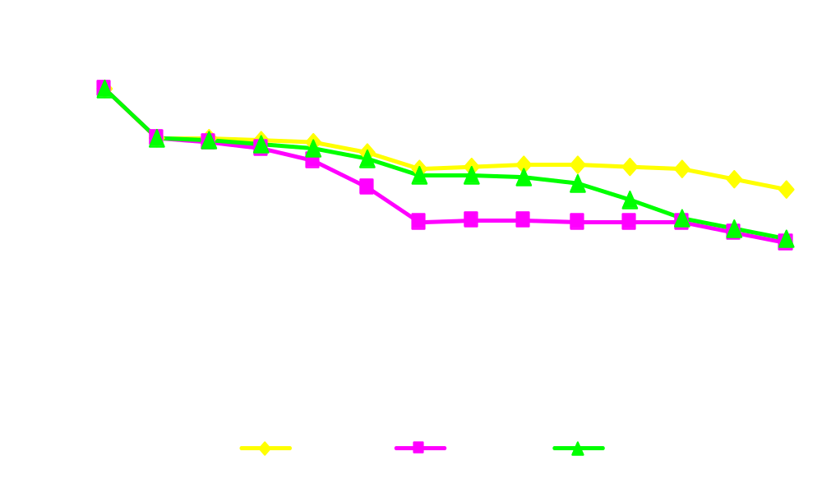
Impact of 10 year phase-out on Employment in NAM Apparel
Index: 1995 = 100

Slide 36
Summary
Forecast Demise of the Generic GTAP Application
In future, applications will be tailored much more closely to the economy/policy at hand
GTAP data base, technical papers and software provide starting point
Researchers must supplement this with:
  econometric work on parameters or shocks
  additional detail on structure of the economy
  careful analysis and modeling of policies

