Slide 1
Time-Scales: Wolff Simulation of the 2D Ising Model
Daniel Ribeiro
10/15/2021

Slide 2
Motivation
Primary Objective
Generate equilibrium configurations for entropy estimation
Determine thermodynamic quantity to use as criterion for convergence
Which is expected to take the longest to equilibrate?
Secondary Objective
Determine simulation resolution for different quantities
Notes:
The equilibration time for different thermodynamic properties
Given say a range of temperatures that we want to simulate, say 0.5→5 with steps 0.1. Which quantity will take the longest to equilibrate and at what temperature

Slide 3
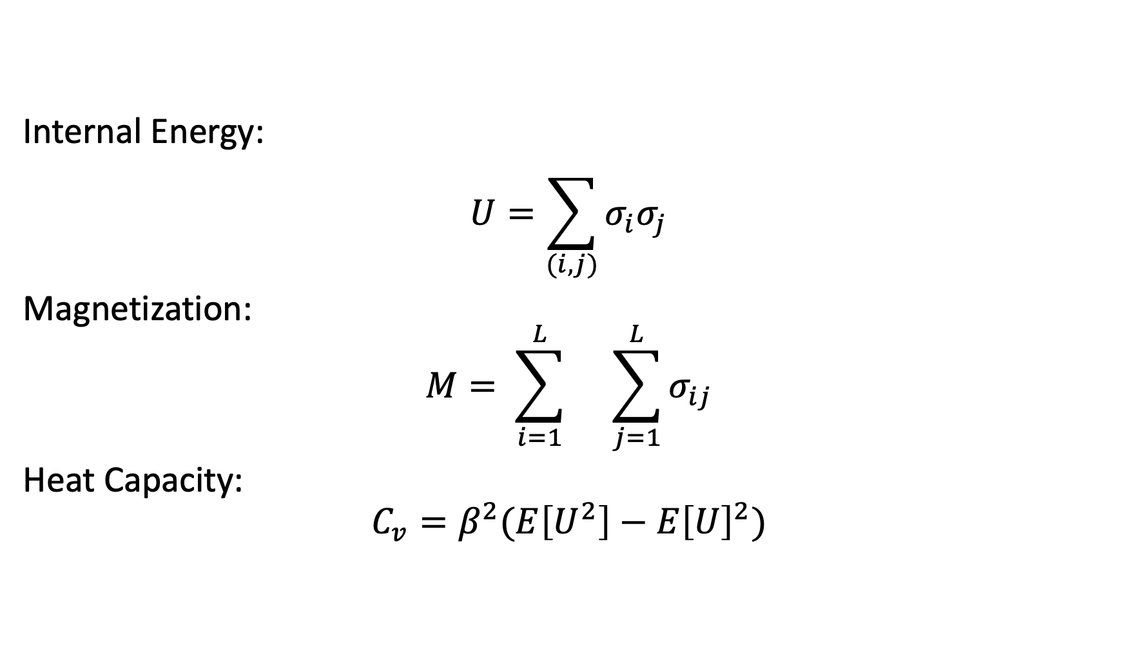
Thermodynamic Properties
Internal Energy:
$$U=\sum_{(i,j)}{σ_{i}σ_{j}}$$
Magnetization:
$$M= \sum_{i=1}^{L}{}\sum_{j=1}^{L}{σ_{ij}}$$
Heat Capacity:
$$C_{v}=β^{2}(E\left[U^{2}\right]−E{\left[U\right]}^{2})$$
Notes:
Assuming
zero external magnetic field
A interaction energy between spins of unity
All quantities above are normalized by the number of spins, so we get the specific values for all

Slide 4

Quick Recap: Wolff Algorithm
Builds spins cluster with probability $p_{ij}=1−\exp\left(−2β\right)$
Doesn’t depend on the internal energy
speeds up the simulation
More accurate results near critical temperature T_{c}
Notes:
So it picks spin i and considers all 4 neighbors j to be added to cluster

Slide 5
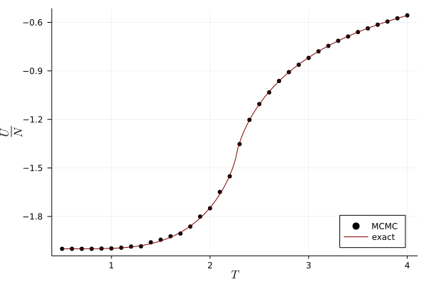
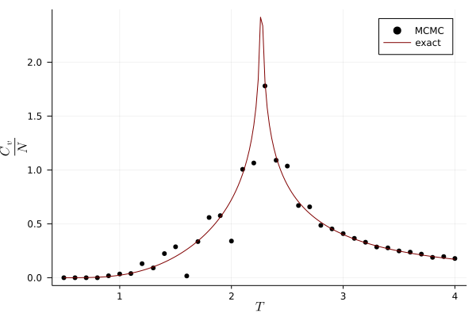
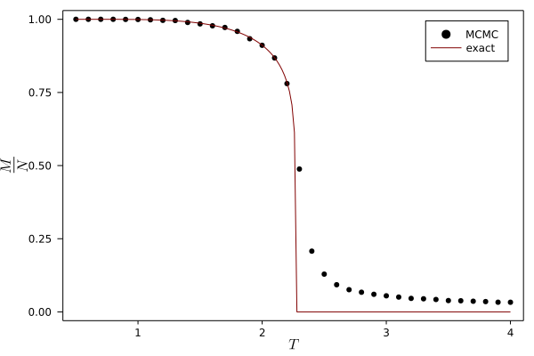
Thermodynamic Properties
Notes:
Time steps = 10^7
Freq = 100
L = 50, so 250k spins
Periodic bcs
Took about 1.5 minutes, so it doesn’t scale too badly

Slide 6
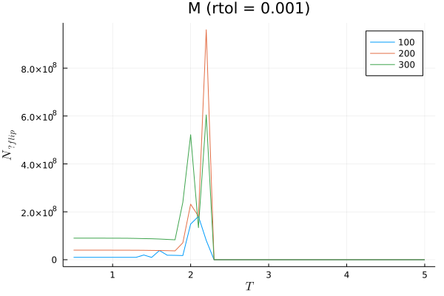
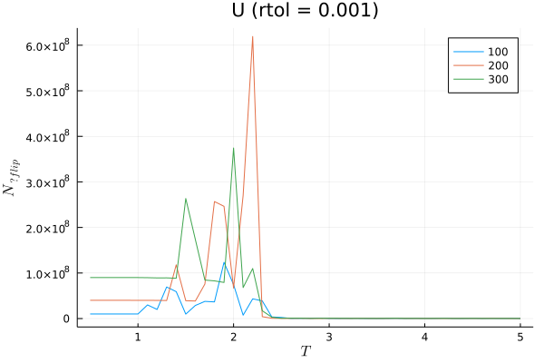
Convergence

Slide 7
Convergence Visualization (M)
Notes:
T = 0.5 for all gifs

Slide 8
Convergence Visualization (U)

Slide 9
Convergence Visualization (Heat Capacity)

Slide 10
Conclusion
Magnetization and internal energy have similar time scales.
Heat capacity has a much greater time-scale than other properties
Resolution is also much lower for the same number of time steps

