Slide 1
Universal Semantic Representation

Slide 2
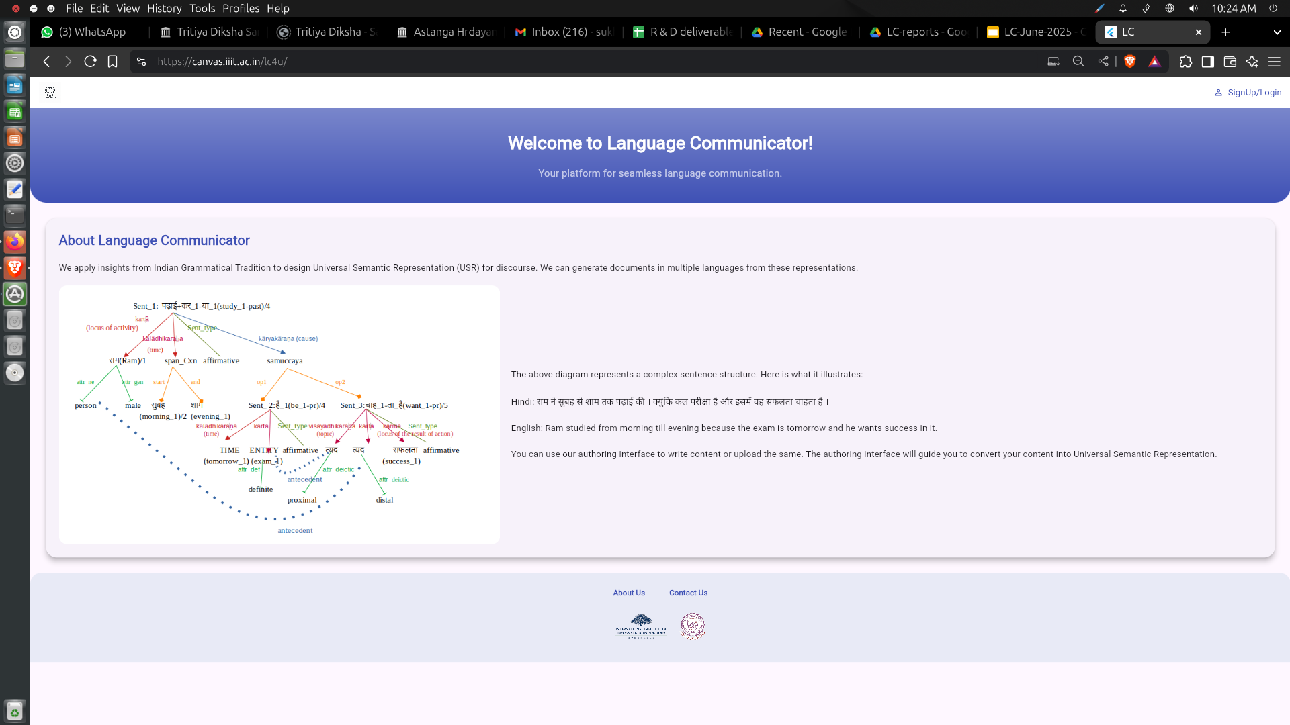
Notes:
The above diagram represents a complex sentence structure. Here is what it illustrates:
Hindi: राम ने सुबह से शाम तक पढ़ाई की । क्योंकि कल परीक्षा है और इसमें वह सफलता चाहता है ।
English: Ram studied from morning till evening because the exam is tomorrow and he wants success in it.

Slide 3
Universal Semantic Representation
For multilingual Natural Language Generation (NLG), there is a need of a design of a Semantic Representation
Universal
Computationally tractable
Unambiguous
Explicit

Slide 4
Universal Semantic Representation
Universal Semantic Representation (USR) is a meaning representation for Natural Language Generation (NLG) which is motivated by Indian Grammatical Tradition (IGT)
USR captures meaning/thought in the mind of a speaker/author.
USR is language independent information package
A text-based data structure.
Captures information at three levels:
  Lexico-conceptual
  Syntactico-Semantic
  Discourse
Captures the speaker’s vivakṣa - how speaker views the activity
Objective: Generate multiple natural languages using Natural Language Generators.

Slide 5
Universal Semantic Representation
Level | Layers
Lexico-Conceptual | Concept
 | Index
 | Semantic Category of Noun
 | Morpho-Semantic Information
 | Speaker’s View
Relational | Dependency Relation
 | Construction
Discourse | Discourse Element
 | Sentence Type

Slide 6
Commented Layer
Original Sentence

Slide 7
Commented Layer
Original Sentence commented with a # symbol.
Example:
# राम बस अड्डे पर एक पुराने दोस्त के साथ ही बात कर रहा था ।

Slide 8
Sub-sentence Identification
TITLE
  Used for chapter titles.
  Sentence ID ends with TITLE.
  Sentence type: TITLE
  Example: Recipe_1TITLE
Heading (H)
  For section/subsection headings.
  Sentence ID ends with H.
  Sentence type: heading
  Example: Geo_ncert_10stnd_2ch_0012H
Term (T)
  Term and its definition split into two sub-sentences.
  Term ID ends with T; sentence type: Term
  Example: Hin_Geo_nios_7ch_0029T

Slide 9
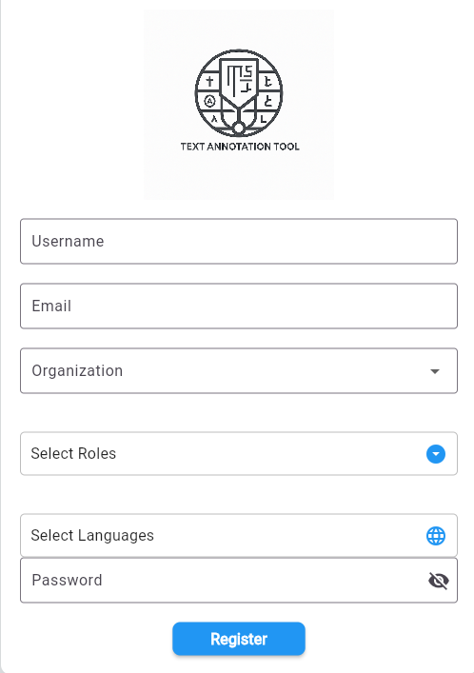
Interface Registration
Username - Your Full Name
Email - Institute Email Address
Organization - IIT (BHU)
Select Roles - Annotator
Select Languages - Hindi or English
Password - According to your choice
Click on Register

Slide 10
Sentence Segmentation
Why Segment Sentences?
Complex sentence USR is difficult.
Automated generation is challenging.
First segment into discourse units.
Avoid segmentation if it breaks coherence.
Segmentation Rules
Each segment has a finite verb.
Discourse unit = simple sentence/clause.
Don’t split relative clauses with in-sentence reference.
Split complement clauses.
Keep connectives with the split segment.

Slide 11
Sentence Segmentation
Discourse Units & Finite Verbs
A discourse unit usually contains a finite verb.
Represents a simple sentence/clause contributing to the discourse.
Example:
Original: Sent_ID_1 → #rāma bīmāra hai isalie vaha skūla nahīṃ gayā.
(Rama is sick. Therefore, he did not go to school.)
Segmented:
Sent_ID_1a → #rāma bīmāra hai.
Sent_ID_1b → #isalie vaha skūla nahīṃ gayā.

Slide 12
Sentence Segmentation
Relative Clauses
Do Not Segment when clause refers to a noun in the sentence.
Example: bhārata kā sabase dakṣiṇī biṃdu jo iṃdirā biṃdu kahā jātā thā, san‌ 2004 meṃ jalamagna ho gayā.
Segment when multiple relative clauses are present
Original: pṛthvī ke dharātala ke ūṁce uṭhe hue bhāga jinakā śikhara hajāra mīṭara se adhika ūṁcā ho aura ḍhāla tīvra ho, tathā jinake banane meṃ jinakā lākhoṃ varṣa lage hoṃ, parvata kahalāte haiṃ.
Segmented:
1a. pṛthvī ke dharātala ke ūṁce uṭhe hue bhāga parvata kahalāte haiṃ.
1b. jinakā śikhara hajāra mīṭara se adhika ūṁcā ho.
1c. aura jinakā ḍhāla tīvra ho.
1d. tathā jinake banane meṃ lākhoṃ varṣa lage hoṃ.

Slide 13
Sentence Segmentation
Complement Clause Segmentation
  Rule: Add yaha (“this”) to the main clause to co-refer to the complement clause.
Example
Original Sentence: hīrā ne kahā ki ūṁṭa mileṃge
(Hira said that the camel will be available there.)
Segmented Outcome
    1a. hīrā ne yaha kahā — “Hira said this.”
    1b. ūṁṭa mileṃge — “Camel will be available there.”

Slide 14
Concept Layer

Slide 15
Concept Layer
Contains atomic words, multiword expressions, or derived words.
Concepts: Semantic constructs; simple or complex.
Format: <Root_ID> Ex. bhāī_1 (brother), paḍha_1 (read)
It resolves polysemy and maps concepts across languages.
Example: paḍha_1 = read; paḍha_2 = study
Hindi | Eng | Marathi | Tamil | German | Jap.
kiwAba_1 | book_1 | puswaka_1 | pustakam_1
puswaka_1 | book_1 | puswaka_1 | pustakam_1
paDa_1 | read_1 | vAca_1 | pati_1
paDa_2 | study_1 | Sika_1 | pati_1
AxamI_1 | man_1 | mANusa_1 | maNiwanY_1 | mann_1
A_1 | come_1 | ye_1 | vA_1 | kommen_1 | kuru_1
A_2 | know_1 |  | weriyum_1

Slide 16
Concepts without Labels
Name of Concept | Example
Named Entity | rāma, bhārata
Pronominal | $speaker, $addressee, $wyax, $yax, $kim
Numeral expression (year/date/cardinal) | 10, 1990
Abbreviation | @ec.sl.yU., @nAsA (NE)

Slide 17
What not to represent in the concept layer
Name of Concept | Example
Connectives | aura ‘and’, yā ‘or’, kyoṃki ‘because’, isaliye ‘therefore’, udāharansvarupa ‘for example’, jaise ‘as such’, yathā ‘as an example’
Discourse Particle | hī, bhī, sirpha,khāsakara, visheshkara
vālā | When vālā comes as suffix and makes the concept adjective
Light verb in V-V compound Verb or Raṃjaka kriyā | khā le ‘eat’; sajā de ‘decorate’
Salutation or Respect marker | jī, srī, Mr., Ms. …
kim in yn_interrogative sentence | kyā āpane cāvala khāye? ‘Did you eat rice?’
pratyeka/ prati as a part of a rate construction/ in-every/ in-each | prārambha meṃ tāpamāna baDne kī ausata dara pratyeka 32 mīṭara kī girāī para 1⁰ selsiyasa hai|

Slide 18
Simple and Complex Concepts
Simple Concepts
  Represent a single, indivisible idea.
  Cannot be broken into smaller semantic units.
  Examples:
mohana, calā (from: mohana pedala 10 ghaṃṭe calā)
pedala_1 (walked)
Complex Concepts
  Formed by combining multiple simple concepts.
  Enclosed in square brackets [].
  Example: basa sṭapa
basa_1
sṭapa_1
[6-tat_1]

Slide 19
TAM in Concept Layer
Events & TAM Representation
  Verbs: Stative or action.
  Format: root-TAM (e.g., kara_1-gā_1 for kregā)
  TAM = Tense, Aspect, Mood
Verb Types
  Finite Verb: With TAM → kara_1-gā_1 (will do)
  Non-finite Verb: Root only → jā_1 for jākara, khā_1 for khānā
  Complex Predicate: bāta kara
bāta_1 (kriyāmūla)
kara_1-yā_1 (verbalizer)
[cp_1]

Slide 20
Pronominals
Not assigned concept IDs
Represented using predefined labels
Mappings:
  1st Person → $speaker → maiṃ, hama, I, we
  2nd Person → $addressee → tū, tuma, āpa, you
  3rd Person → $wyax → yaha, vaha
  Interrogative → $kim → kahāṃ, kyā
  Relative → $yax → jo, jahāṃ
  Reciprocal → $eka+xUsarA → eka dūsare
  Reflexive → $apanA → apanā

Slide 21
Multi-word Expressions
Multi-word Expressions (MWEs)
  MWE: a sequence of words that acts as a single unit, with its overall meaning or properties that are not predictable from the meanings of its individual parts
  MWEs are concepts made of multiple words.
  Components are joined with a plus (+) sign.
Examples:
    Asa+pAsa_1 → around
    xina+prawixina_1 → everyday
    cAroM+Ora_4 → everywhere
    digrI+selsiyAsa_1 → degree Celsius
    mote+wora+para_1 → generally
    hAla+hI_1 → recently

Slide 22
Symbols used in USR
Pronominals → $
  No concept ID assigned
Examples: $speaker, $addressee, $wyax, $kim
Foreign Words → ^
  Not transliterated
Format: ^word_1
Abbreviations → @
  Transliterated in wx notation
Format: @eic.sl.yU., @nAsA

Slide 23
Concept Layer
Original Sentence: #rāma gāyoṃ ke duhane ke liye ghara gayā
‘Ram went home to milk the cows.’
Concepts:
rāma
[ne_1]
gāya_1
duha_1
ghara_1
ja_1-yā_1

Slide 24
Semantic Category Layer

Slide 25
Semantic Category Layer
Semantic Category = Ontological type of a concept
Named Entity Categories: per, org, place, ne
Examples:
- per: Rāma, Sita, Riya, Stuti, Tanishka, Hari
- place: Dillī (Delhi), Jaipur, Varanasi,
- org: Banaras Hindu University, Banasthali Vidyapith, IIT BHU, IIIT
- ne: Football, Pasta

Slide 26
Semantic Category Layer
Temporal entities:
- day_of_week: dow (Śukravāra - Friday, Monday, Sunday)
- month_of_year: moy (Agasta - August, July, November)
- year_of_century: yoc (1947, 1940, 1998, 2010, 2023)
- date_of_month: dom (15th, 10th, 19th, 22nd)
- calendric_unit: calendric_unit (11+ tārīkha – 11th date)
- clock_time: clock_time (5+baje - 5 o'clock)

Slide 27
Semantic Category Layer
Number entity categories
Number Entity Categories: quantity (e.g., 5 +kilo, 10+meter)
Marked with “numex” tag
Animacy Category
Living beings unless a proper noun
Examples: Speaker, addressee, laḍakā (boy)
Gender Category
Gender information of living beings with inherent gender
Marked as m (masculine) or f (feminine)
Example: Sītā baccoṃ ko phala detī hai (Sita gives fruit to the children.)

Slide 28
Morpho-Semantic Layer

Slide 29
Morpho-Semantic Category Layer
Morpho-Semantic Row in USR
Captures the speaker’s intent (vivakṣā) to:
Compare, causativize, adjectivize and more
Reflected in derived forms of root concepts during generation.
Example:
mohana baccoṃ se kama buddhimāna hai.
Mohan is less intelligent than the children.
Original Sentence | #mohana baccoṃ se kama buddhimāna hai.
Concept | mohana | baccā_1 | buddhimāna_1 | hai_1-pres
Index | 1 | 2 | 3 | 4
Morpho-sem |  | pl | comparless

Slide 30
Morpho-Semantic Category Layer
Tag | Meaning | Example | Explanation
pl | Plural | rāma kala kaī chātroṃ[pl] se mile | chātra (student) marked as plural
mawup | Modifier with affix (e.g., -valā) | pūrṇa caṃdramā vālī rāta ko pūrṇimā kahā jātā hai | caṃdramā marked “mawup” as “-valī” makes it an adjectival modifier
comparmore | Comparative – more | gaṃgā yamunā se jyādā laṃbī hai | Ganga is longer than Yamuna.
xviwva | Full reduplication | ghara-ghara patra pahuṁcā | Repeats "house" for distributive sense
causative | Causative verb | māṃ ne bacce ko khānā khilāyā | Mother caused eating

Slide 31
Dependency Relation Layer

Slide 32
Dependency Relation Layer
Format: Index of the head : relation of the dependent with the head
    3:k2 → Index 3 is the head, and the dependent is its k1 (kartā)
    To capture grammatical roles of dependents in relation to heads.
Types of Relations:
  Kāraka Relations – Between verbs and their dependent nouns.
  Kāraketara (Non-Kāraka) Relations –
    Between verbs and their other non-kāraka dependents.
    Between nouns and their modifiers.
Sentence | rāma seba khātā hai
Concept_layer | rāma | seba_1 | khā-tā_hai
Index | 1 | 2 | 3
Dependency layer | 3:k1 | 3:k2 | 0:main

Slide 33
Dependency Relation Layer
Head is always marked as: 0:main
Viśeṣya–Viśeṣaṇa (Noun–Modifier) Relation:
  Format = Index of head : relation
  e.g., rāma (dependent) → 3:k1 (rāma is k1 of verb at index 1)
Example :
rāma [k1] seba khātā hai
Dependency Row: 3:k1
(rāma is the agent (k1) of the verb “eat” at index 2)
Complex Concepts:
Don’t annotate individual dependencies –
They are captured in the Construction Row

Slide 34
Dependency Relation Layer
Kāraketara relations between Verb & Non-Kāraka:
rāma jaldī āyā
Dependency Row: 3:mod (jaldī modifies verb āyā)
Kāraketara between Noun & Modifier:
accā_1 rāma
Dependency Row: 2:mod (accā_1 modifies noun rāma)
Note:
These are non-core participants in the event
Modifiers, degree expressions, etc.

Slide 35
Dependency Relation Layer
kartā | k1 | most independent participant of an action | rāma āma khātā hai ‘Ram eats mango.’
karma | k2 | locus of the result of the action | mōhana nē āma kharīde ‘Mohana bought mangoes.’
karaṇa | k3 | The instrument required for the performance of the action | ratanā ne āma cākū se kāṭe ‘Ratna cut the mangoes with a knife.’
anubhava-kartā | k4a | Experiencer | rāma ko bukhāra hai ‘Ram has fever.’
bhāvalakṣaṇa anantarakālika | rblak | VN precedes VM | sūrya ugane ke bāda khānā khāo ‘Eat after the sun rises.’
samānakālika | rsk | Two events occur simultaneously and the kartā is shared. | rāma sote hue kharrāṭe bharatā hai ‘Ram snores while sleeping.’

Slide 36
layer 7
Discourse Elements

Slide 37
Discourse layer
Language as a mode of communication always occurs as a discourse in which a sentence or elements within a sentence can have a connection with a previous or following sentence. This ensures cohesion and coherence in the discourse.
Types of discourse information:
Discourse Connective Relation
Pronominal coreference

Slide 38
Discourse Connective Relation
Case 1: Originally the segment sentences are connected through a single connective:
Complex sentences are split into two simple segments with one of them containing the connective in the sentence level
Sent_1
    rāma skūla nahīṃ gayā kyoṃki vaha bīmāra hai.
‘Ram did not go to the school because he is sick.
      Sent_1a rāma skūla nahīṃ gayā. ‘Ram did not go to the school.’
      Sent_1b kyoṃki vaha bīmāra hai. ‘because he is sick.’
The two segments are connected through kārya-kāraṇa relation.

Slide 39
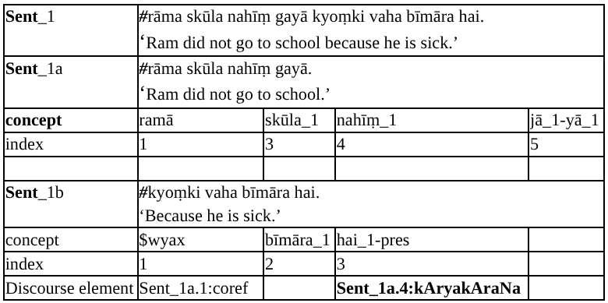
Discourse Connective Relation: Case 1
Single Connective in complex sentence

Slide 40
Discourse Connective Relation: Case 2: Paired Connective
Case 2: Originally the complex sentence is formed with a paired connective and one of the
clauses is sub-ordinate to the other called main clause segmented sentences are connected through a paired connective
● The sentence is split into two.
● The main finite verb of the subordinate clause is chosen for discourse relation annotation
● The connective does not appear in the USR
● The discourse relation tag conveys the relation between the two segmented sentences.
● The format is: <Sent_ID.Verb_Index:Relation_Name>

Slide 41
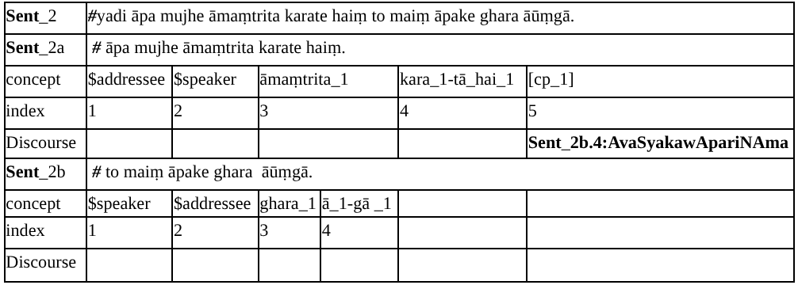
Discourse Connective Relation: Case 2: Paired Connective

Slide 42
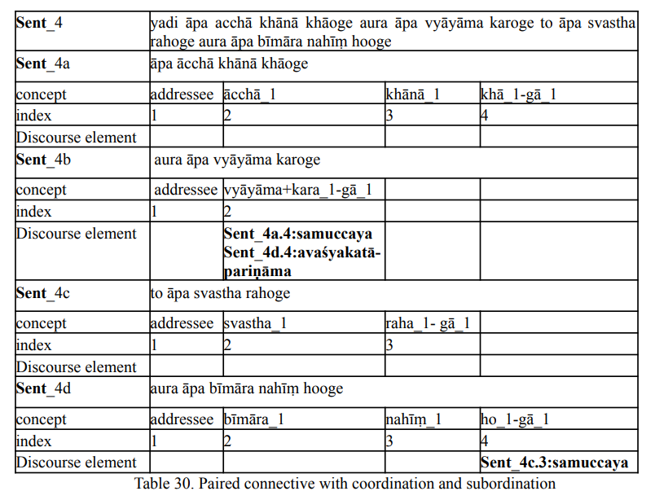
Discourse Connective Relation: Case 2

Slide 43
Discourse Connective Relation: Case 2

Slide 44
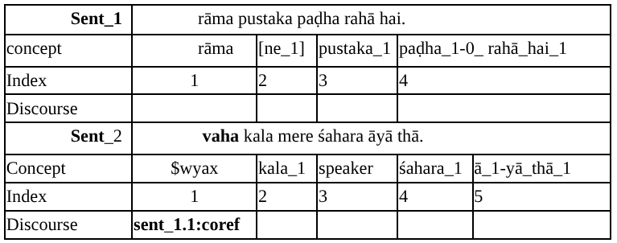
Pronominal Coreference
For anaphoric expression, the discourse element uses co-ref tag and also specify the index ID of the noun it corefers. The index ID of the antecedent is written as Sent_ID.Concept_Index which is shown in the following table.
Representation of Coreference in USR

Slide 45
layer-8

Slide 46

Introduction
layer 8, also known as the "Speaker's View" layer, is a part of the Universal Semantic Representation (USR) framework used to capture and represent the perspective of the speaker in a discourse.
The USR framework aims to create a language-independent and abstract representation of meaning that can be applied across different languages.
It include elements such as discourse particles, honorifics, light verbs, proximal and distal deixis, and salutation markers.

Slide 47
Discourse Particles:
Discourse particles are linguistic elements used in a sentence to convey specific emotions, evaluations.
Example:
English: ‘The Sun shines too.’
Hindi: 'सूरज भी चमकता है।’ (sūrya camakatā bhī hai.)
Determiners:
Determiners are words that introduce nouns and help specify their reference. In layer 8, determiners are used to capture information related to definiteness or specificity, which can be influenced by the speaker's perspective.
Example:
English: "Give me the book."
Hindi: "मुझे किताब दो।" (mujhe kitaab do.)

Slide 48
Light Verbs:
In the context of layer 8, light verbs capture shades of meaning, such as volitionality, intentionality, etc., which contribute to the speaker's perspective on an action or event.
Example:
English: I accidentally dropped his laptop.
Hindi :मैंने गलती से उसका लैपटॉप गिरा दिया।
Honorific, Non-Honorific Pronominal Forms:
When the USR has the salutation or honorific markers with the nouns and pronouns we use respect information in the 8th layer.
Example:
English: "Could you please help me?"
Hindi: "क्या आप मेरी मदद कर सकते हैं?" (Kyā āp merī madad kar sakte hain?)

Slide 49
Proximal and Distal:
Proximal and distal expressions refer to the physical or metaphorical distance between the speaker or addressee and the object or entity being referred to. These expressions are used to indicate whether something is close to the speaker or addressee (proximal) or distant from them (distal). And will write “wyax” in the concept layer.
Example:
English: "Please pass me that book." (Distal)
Hindi: "वह किताब मुझे पास करें।" (Vah kitāb mujhe pās karen.) (Distal)
English: This is a book. (Proximal)
Hindi: यह एक पुस्तक है।(yah ek pustak hai.) (proximal)

Slide 50
Respect and Informal Information for 2nd person pronoun
In the Universal Semantic Representation (USR) framework, the "Respect and Informal Information for 2nd Person Pronoun" category deals with the representation of different forms of the 2nd person pronouns based on their level of respect or formality. The concept layer represents the core propositional content, including the 2nd person pronouns "tū" (informal), "āpa" (respect), and "tuma" (default).
Informal Address (tū):
Hindi: "तू कहाँ रहता है?" (Tū kahā rahatā hai?)
English Translation: "Where do you live?"
Respectful Address (āpa):
Hindi: "आप कहाँ रहते हैं?" (Āpa kahā rahate haiṃ?)
English Translation: "Where do you live?“
Default Address (tuma):
Hindi: "तुम कहाँ रहते हो?" (Tuma kahā rahate ho?)
English Translation: "Where do you live?"

Slide 51
Second person pronominal with speaker’s view information
Addressee | Informal | #तू कहाँ रहता है? #tū kahā rahatā hai?
 | Concept | addressee | kim | raha_1-tā_hai_1
 | Speaker’s view row | informal
 | Respect | # आप कहाँ रहते हैं? # āpa kahā rahate haiṃ?
 | Concept | addressee | kim | raha_1-tā_hai_1
 | Speaker’s view row | respect

Slide 52
Category | Annotation Tag | Example
Discourse Particle | hI_1, hI_2, BI_1 etc. | sūrya camakatā bhī hai.‘The Sun shines too.’
Definiteness | def | #beṭoṃ ko kheta meṃ bīja bonā cāhie.‘The boys should sow the seed in the field.’
Light Verb or raMjaka kriyā | Shade followed by string of the verb-root and concept ID | ramaṇa sārā miṭhāī khā liyā.‘Raman has eaten all sweets completely.’
2nd person pronominal forms | Respect- āpa, informal- tū | tū kahāṃ rahatā hai?‘Where do you stay?’āpa kahāṃ rahate haiṃ?‘Where do you stay?’
Salutation marker | respect | pradhānamaṃtrī jī abhī āe haiṃ.‘The honorable prime minister has just arrived.’
Deixis | proximal and distal | yaha kursī hai.‘This is a chair ’vahāṁ kala bārish hui.‘It rained there yesterday.’

Slide 53
Summary
layer 8 enriches the Universal Semantic Representation by providing a comprehensive view of the speaker's intentions and the linguistic elements used to convey their perspective in different languages and contexts.
It plays a vital role in capturing the subjectivity of the speaker and the emotions conveyed in the discourse.

Slide 54
layer-10
SENTENCE TYPES

Slide 55
INTRODUCTION
In USRs, maintaining the target sentence type aids ease of generation.
Sentence type information is specified in the 10th layer.
This slide discusses various sentence types with examples.

Slide 56
Affirmative Sentences
Negative Sentences
DEFINTITION
Affirmative sentences make statements or declarations.
EXAMPLE
Sentence Type: Affirmative
Example: "ramā cāvala khātī hai"
Translation: "Rama eats rice."
DEFINTITION
Affirmative sentences make statements or declarations.
EXAMPLE
Sentence Type: Negative
Example: "rāma cāvala nahīṃ khātā hai"
Translation: "Ram does not eat rice."

Slide 57
Yes-No Interrogative Sentences
Wh-Interrogative Sentences
DEFINTITION
Yes-No interrogative sentences pose questions that can be answered with 'yes' or 'no'.
EXAMPLE
Sentence Type: yn_interrogative
Example: "kyā āpane cāvala khāyā?"
Translation: "Did you eat rice?"
DEFINTITION
Wh-interrogative sentences ask questions that require more elaborate answers.
EXAMPLE
Sentence Type: interrogative
Example: "tumane cāvala kyoṃ khāe?"
Translation: "Why did you eat rice?

Slide 58
Imperative Sentences
Passive Affirmative Sentences
DEFINTITION
Imperative sentences give commands or instructions.
EXAMPLE
Sentence Type: imperative
Example: "āpa ghara jāo"
Translation: "You go home."
DEFINTITION
Passive affirmative sentences emphasize the action's receiver rather than the doer.
EXAMPLE
Sentence Type: pass-affirmative
Example: "rāma ke dvārā rāvaṇa kā vadha kiyā gayā thā"
Translation: "Ravana was killed by Rama."

Slide 59
Passive Negative Sentences
Passive Yes-No Interrogative Sentences
DEFINTITION
Passive negative sentences negate the passive action's occurrence.
EXAMPLE
Sentence Type: pass-negative
Example: "rāma ke dvārā rāvaṇa kā vadha nahīṃ kiyā gayā thā"
Translation: "Ravana was not killed by Rama."
DEFINTITION
Passive yes-no interrogatives question the reason behind a passive action.
EXAMPLE
Sentence Type: pass-yn_interrogative
Example: "kyā rāma ke dvārā rāvaṇa kā vadha kiyā gayā thā?"
Translation: "Was Ravana killed by Rama?"

Slide 60
CONCLUSION
In conclusion, understanding the diverse sentence types in USRs enriches communication by allowing precise expression of statements, questions, and commands.
This knowledge facilitates effective language generation, enhancing both clarity and engagement
Mastering these sentence types empowers effective communication in various contexts.

Slide 61
layer-11
CONSTRUCTION

Slide 62
INTRODUCTION
Semantic frames, which are linguistically expressed as larger-than-lexical-but-smaller-than-sentential expressions, are considered as Constructions (CxN) in Universal Semantic Representation.
The conceptual schema of the constructions are mentioned below:
  (i) The CxN Frame as the Complex Concept
  (ii) The semantic category of the components of the CxN.

Slide 63
The characteristic features of the Constructions
There is a form or complex concept that maps to a meaning
Each complex concept is given a name that reflects the meaning.
Complex concepts are specified within bracket []
The relations among the components of the construction are specified in the construction row.

Slide 64
Named Entity Construction
A Named Entity (NE) is a word or phrase that refers to a specific entity, such as a person, organization, location, date, or product.
Named entities introduce a complex structured concept, represented as [ne_1].
Each entity is systematically tagged to ensure proper identification.
begin: Used to mark the first word in a named entity (e.g., the first name in a person’s full name).
inside: Applied to subsequent words within the same entity (e.g., middle name, last name, or additional words in an organization name).

Slide 65
Compound Construction
Noun Compound
Noun Compounds consist of two or more nouns with the final noun head and other noun modifiers or two nouns in coordinating relation as two operators.
Noun Compounds can be spaced or hyphenated.
  [[kṛṣi prasāraṇa] udyoga]
  gṛha-śikṣaka
When an adjective modifies the modifier, that adjective will be part of the noun compounds
  [[vanyā jīva] surakṣā]
One proper noun and one or more than nominal is NC
  dillī pulisa

Slide 66
Compound Construction
List of Noun compound
Noun Compound Type
karmaXAraya
nīla kamala
wawpuruRa
2-waw - dhana prāpta
3-waw - cintā grasta
4-waw - guru dakṣiṇā
5-waw - śoka mukta
6-waw - dhūla-kaṇoṃ
7-waw - viśva vitaraṇa
Xvanxva
peḍa-paudhoṃ
bahuvrIhi
[tāpa-abhāva] kṣetra

Slide 67
When NOT to consider as Noun Compound?
We do not consider a noun compound as a construction when it is written together as vidyālaya ‘school’.
We do not consider a noun compound as a construction when any post-position or suffix is posited in between
  lohe kā ciyara
Compound Verb, i.e.- Verb + Light Verb
  kara ḍāl-ā ‘do keep-past’
    rām ne sārā kāma ekadina maiṃ kara ḍālā
‘Ram could do the whole work in one day’

Slide 68
USR
Original Sentence | pitā-putra ne basa sṭapa para cāya pīyā ‘Father and son had tea at the bus-stop.’
Concept | pitā_1 | putra_1 | [xvanxva_1] | basa_1 | sṭapa_1 | [6-waw_1] | cāya_1 | pī_1-yā_1
Index | 1 | 2 | 3 | 4 | 5 | 6 | 7 | 8
Semantic Category | anim/male | anim/male
Dependency relation |  |  | 8:k1 |  |  | 8:k7p | 8:k2 | 0:main
Construction relation | 3:op1 | 3:op2 |  | 6:mod | 6:head

Slide 69
Complex Predicate
A complex predicate consists of a kriyāmūla and a kriyā or verbalizer. They are represented as two different concepts with specific concept ID and the complex concept [cp_1] denotes their complex construction.
rāma ne snāna kiyā. ‘Rama took a bath.’
Concept | ramā | [ne_1] | snāna_1 | kara_1-yā_1 | [cp_1]
Index | 1 | 2 | 3 | 4 | 5
Semantic Category | male | per | – | – | –
Dependency Row | 5:k1 | – | – |  | 0:main
Construction | 2:begin | – | 5:kriyAmUla | 5:verbalizer | –

Slide 70
Conjunction Construction
A conjunction construction consists of more than one element which are conjoined together and are in identical dependency relation with the head.
Components of [conj_1] constructions have the tag of op1, op2… index of [conj_1]:op
rāma aura mohana skūla gaye. ‘Rama and Mohana went to school.
Concept | ramā | mohanā | [conj_1] | skūla_1 | jā_1-yā_1 | [ne_1] | [ne_2]
Index | 1 | 2 | 3 | 4 | 5 | 6 | 7
Semantic Category | male | male | – | – | – | per | per
Dependency Row | 5:k1 | 5:k2p | 0:main | – | – | – | –
Construction | 6:begin | 7:begin | 3:op1 | 3:op2 | – | – | –

Slide 71
Disjunction Construction
A disjunction construction expresses the relation between more than one element which are distinct alternatives.
Relation among the components are given in the construction row as following
Index of [disjunct_1]:opn
rāma roṭī yā cāvala khāyegā ‘Rama will eat bread or rice.’

Slide 72
Calendar Construction
A calendar construction is consists of following elements in an order
Year>Month>Date>Hour>Minute>Second
Semantic Category row gives the semantic tag of each slot of the pattern.
Relation among the components are given in the construction row as following Index of [calendar_1]:component
    15 julāī 2020 rāma paidā huā thā ‘Ram was born on 15th July, 2020.
Concept | 15 | julāī_1 | 2020 | [calendar_1] | rAma | paidā_1 | ho_1-yā_thā_1 | [cp-1] | [ne_1]
Index | 1 | 2 | 3 | 4 | 5 | 6 | 7 | 8 | 9
Semantic Category | dom | moy | yoc | – | male | – | – | – | per
Dependency Row | – | – | – | 8:k7t | – | – | – | 0:main | 8:k1
Construction | 4:component | 4:component | 4:component | – | – | 8:kriyAmUla | 8:verbalizer | 9:begin

Slide 73
Spatial Construction
A spatial construction shows the relation as a part-whole between the places as
whole place> place within
The relation is shown as
Index of [spatial_1]: whole and Index of [spatial_1]:part

Slide 74
Temporal Construction
A temporal construction shows the relation as a part-whole between the times as
whole time> time within
The relation is shown as
Index of [temporal_1]: whole and Index of [temporal_1]:part
manu subaha sāta baje calanā śurū kiyā (‘Manu started walking at 7 in the morning.’)

Slide 75
Temporal Construction
manu subaha sāta baje calanā śurū kiyā (‘Manu started walking at 7 in the morning.’)
Concept | manu | subaha_1 | 7 | [temporal_1] | cala_1 | śurū_1 | kara_1-yā_1 | [cp_1] | [ne_1]
Index | 1 | 2 | 3 | 4 | 5 | 6 | 7 | 8 | 9
Sem. Cat. | male |  | clocktime |  |  |  |  |  | per
Construction | 9:begin | 4:whole | 4:part |  |  | 8:kriyAmUla | 8:verbalizer

Slide 76
Span Construction
A span construction shows the relation as a span of the full extent or range of something from start to end.
Name of this construction is [span_1] and the components are start and end.
The relation is shown as
Index of [span_1]: start and Index of [span_1]:end
Concept | 1990 | 2000 | pragati_1 | ho_1-yā_1 | [span_1]
Index | 1 | 2 | 3 | 4 | 5
Sem. Cat. | yoc | yoc
Dependency Row |  |  | 4:k1 | 0:main | 4:k7t
Construction | 5:start | 5:end

Slide 77
Rate Construction
The concept of rate involves two measurements, often involving time, quantity, amount, or degree of something measured per unit of something else.
Name of rate construction is [rate_1], components are unit_value and unit_every consists of value/per unit.
Value can be a measuring expression or a counting expression (cardinal+noun expression)
Unit can be a measuring unit or measuring noun.

Slide 78
Rate Construction
rāma 10 kimi prati ghaṃṭā cale
‘Rama walked 10 kilometers each hour.’
concept | rāma | 10 | kilomitara_1 | 1 | ghaṃṭā_1 | [rate_1] | cala_1-yā_1 | [ne_1]
Index | 1 | 2 | 3 | 4 | 5 | 6 | 7 | 8
Dep. Rel. |  |  |  |  |  | 7:rmeas | 0:main | 7:k1
Construction | 8:begin | 6:count | 6:unit_value | 6:count | 6:unit_every

Slide 79
THANK YOU

Slide 80
How to write the first layer
Unique Sentence ID Format: [LanguageName_NameoftheBook_ChapterID_SentenceID]
ID Usage: Followed throughout to maintain reference.
Spacing Rule: No space between chapter/sentence and number.
Language name, book name, chapter, and sentence ID separated by an underscore (_).
Original Sentence:
Commented with a # symbol.
Includes the sentence in Roman Indic script and in the original script (e.g., Devanagari for Hindi).
Example: Unique ID: Hin_ABC_Chapter1_001
ABC = name of the book.
Row 1: # राम बस अड्डे पर एक पुराने दोस्त के साथ ही बात कर रहा था । (Original script)

Slide 81
Sub-sentence Identification
TITLE
  Used for chapter titles.
  Sentence ID ends with TITLE.
  Sentence type: TITLE
  Example: Recipe_1TITLE
Heading (H)
  For section/subsection headings.
  Sentence ID ends with H.
  Sentence type: heading
  Example: Geo_ncert_10stnd_2ch_0012H
Term (T)
  Term and its definition split into two sub-sentences.
  Term ID ends with T; sentence type: Term
  Example: Hin_Geo_nios_7ch_0029T

Slide 82
Sentence Segmentation
Sentence Segmentation in USR
  Complex sentences are segmented into discourse units to simplify USR annotation.
  Each segment contains a finite verb and contributes to overall discourse.
  Complement clauses are split; relative clauses (with pronoun referring to a noun) are not split.
  Connectives guide segmentation and stay with the following segment.
  Discourse relations are captured via connectives and annotated in the discourse row.

Slide 83
Sentence Segmentation
Example:
Original: Sent_ID_1 → #rām bīmāra hai isalie vaha skūla nahīṃ gayā
(Ram is sick. Therefore, he did not go to school)
Segmented:
Sent_ID_1a → #rām bīmāra hai
Sent_ID_1b → #isalie vaha skūla nahīṃ gayā
Rough
Post-positions
ne, ko, para, …
Comparative and superlative word
sabse, adhika, jyādā, kama
Comparative and superlative marker
tara, - tama

