Slide 1
Normal Calculation
Vertex Geom
  Point Vertex Noise
    Start=12, 4 orders
  Average normals
    Average face normals at vertex
  Precalculated in adapt pass
    8 FPS (6k nodes, 6k Vertexes)
GPU Geom (tesselation)
  Point Geom noise
    Tess lvl 2 (x16)
    Start=12, 4 orders
  Noise normals
    Finite difference method
  Recalculated in render pass
    0.6 FPS (6k nodes, 384k Vertexes)
Bump Normals
  noise function in texture
  Calculated in render pass (per-pixel)
  Noise function matched to Point noise function
    Start=12, 8 orders

Slide 2
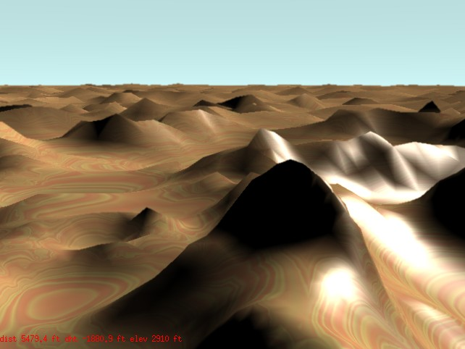
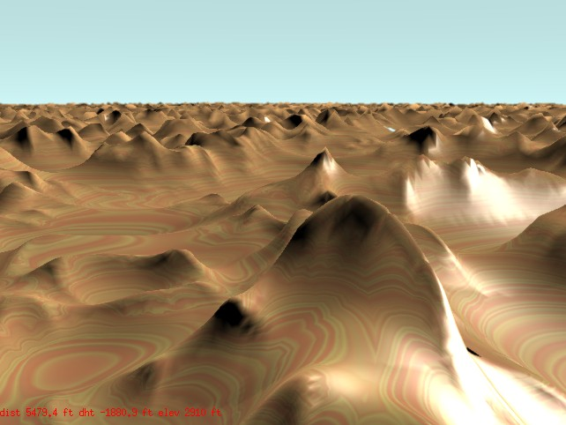
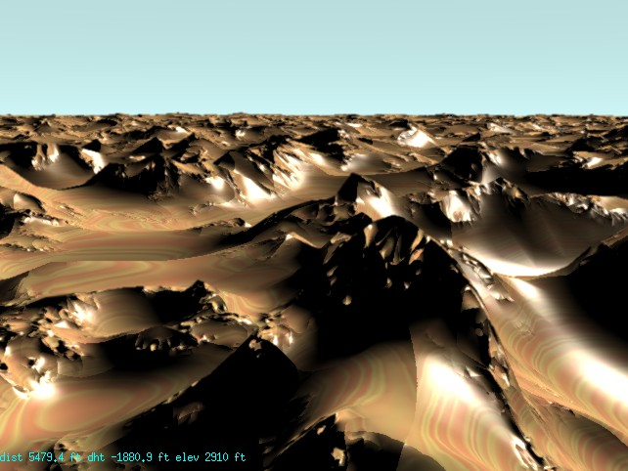
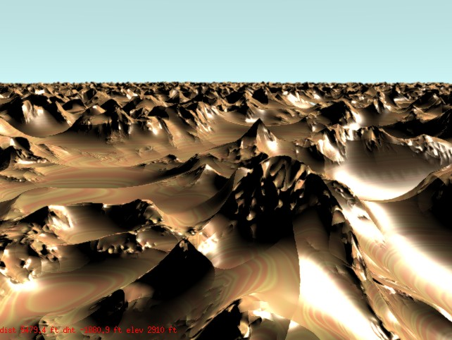
Vertex Geometry Only
Shader Geometry Only (Tess lvl 2)
Vertex Geometry with Matched Bumps
Shader Geometry with Matched Bumps

