Slide 1
Perceptions of Mentoring Among Doctoral Students in Science, Technology, Engineering, and Mathematics [STEM] Disciplines
Blaskowski, L.J.
May 21st, 2015
Notes:
The acronym STEM referring to Science, Technology, Engineering, and Mathematics disciplines.

Slide 2
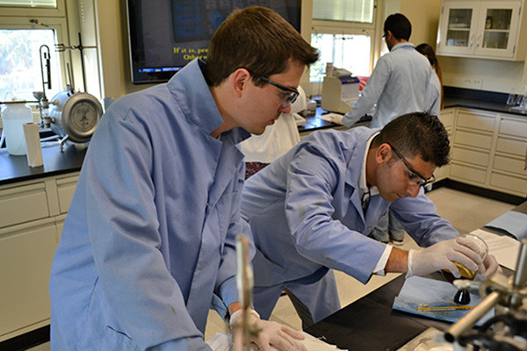

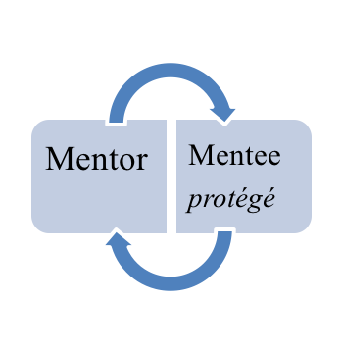
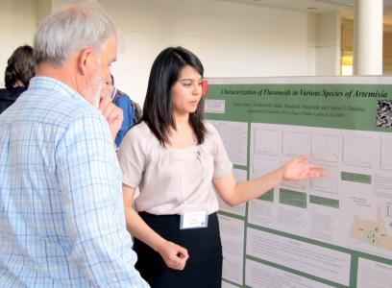
What is mentoring?
Doctoral “mentorship” has been defined as:
A master/apprentice¹ relationship.
A teacher/student² relationship.
A role model/supporter³ relationship.
“a nurturing process in which a more skilled or experienced person, serving as a role model, teaches, sponsors, encourages, counsels and befriends a less skilled or experienced person for the purpose of promoting the latter’s professional and/or personal development.”
⁴(Anderson & Shannon, 1988, p. 38).
¹Hall & Burns, 2009; ²Luna & Cullen, 1995; ³Robbins, 1999.
Notes:
Why study mentoring relationships? Well, before I get to that answer I’d like to first ask you all a question.
How many of you have ever had a mentor?
Now, please keep your hand raised if that mentor ever helped you in your academic decision-making. Maybe they helped you find your passion for science or history. Maybe they helped you with your writing or studying skills. OR – maybe they helped you decide whether or not to go to nursing school, business school, or get a Master’s degree in higher education?
Well, doctoral students have mentors too.
The literature has defined mentorship as…
In which ‘master’ workers teach younger apprentices their research trade; anything from sociology to nanotechnology.
In which mentors provide specialized academic, social, or cultural guidance in particular fields of study.
Where mentors act as professional role models to students interested in their careers.
So you can see that the “mentorship” is a bit of a slippery term, and these examples represent just a few of several dozen operational definitions.
Most researchers can agree that mentorship involves two people: a mentor, who acts as a teacher, sponsor, or role model; and a mentee, who benefits from the social, cultural, academic, research, or psychological guidance provided by a mentor.
I was interested in a broad conception of mentorship in order to capture the greatest range of relationships.

Slide 3
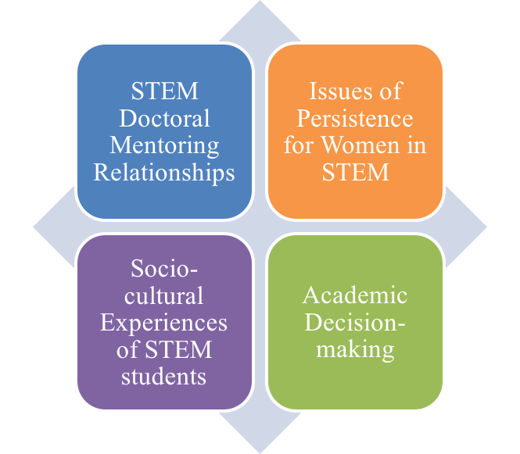
Literature Review: Mentoring Benefits
Doctoral students in STEM disciplines who are mentored are more likely to:
Have positive doctoral outcomes (e.g. increased research productivity)⁵.
Perceive a strong institutional fit⁶.
Enter the STEM workforce⁷.
Women who receive female mentorship are more likely to persist in their graduate programs⁸.
⁵Nettles & Millett, 2006; ⁶Lloyd-Jones, 2011; ⁷Chen, 2013, ⁸Holley & Caldwell, 2012;

Slide 4
What types of mentoring relationships exist for doctoral students in science, technology, engineering, and mathematics (STEM) disciplines at Northwestern University and how does:
(1) gender of the doctoral student,
(2) type of STEM discipline, and
(3) gender of the mentor affect doctoral students’ perceptions of these mentoring relationships?
Research Question
Notes:
Now, I’d like you to think back to that mentoring relationship I just had you reflect on. Who was that person? Was it a parent? A high school teacher? A professor? Maybe a religious leader?
Well, I was interested in learning more about the types of mentoring relationships that exist for doctoral students in STEM fields. Who do they see as mentors? How do they perceive those mentoring relationships?
Three independent variables:

Slide 5
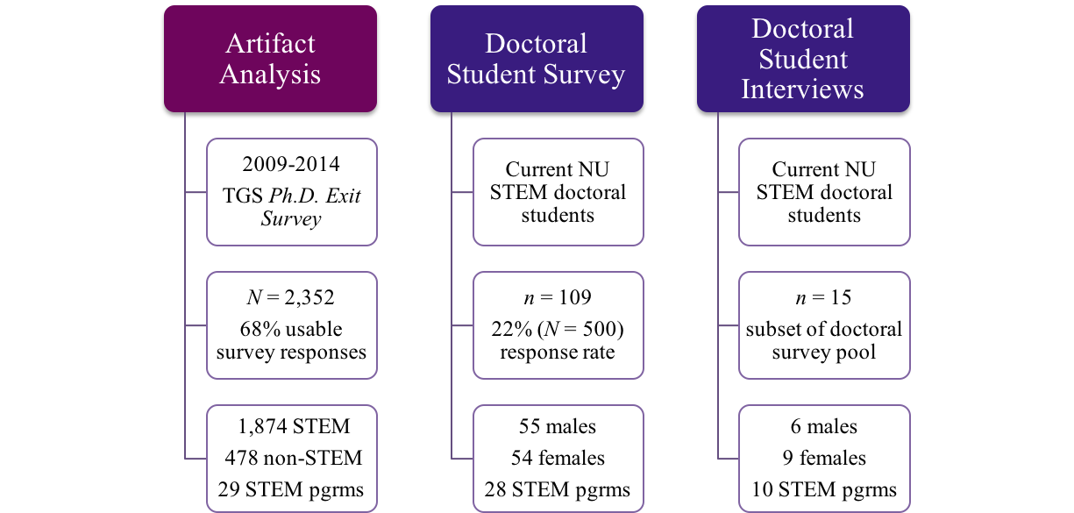
Methods
Types of mentorship.
Functions of mentorship
Mentor and program satisfaction.
Gender and/or program differences.
Alumni perceptions of faculty & program satisfaction.
Notes:
All participants were asked a series of mentoring/doctoral STEM prgrm subscales. Interviewees were also asked to reflect on when they approached their mentors for help.

Slide 6
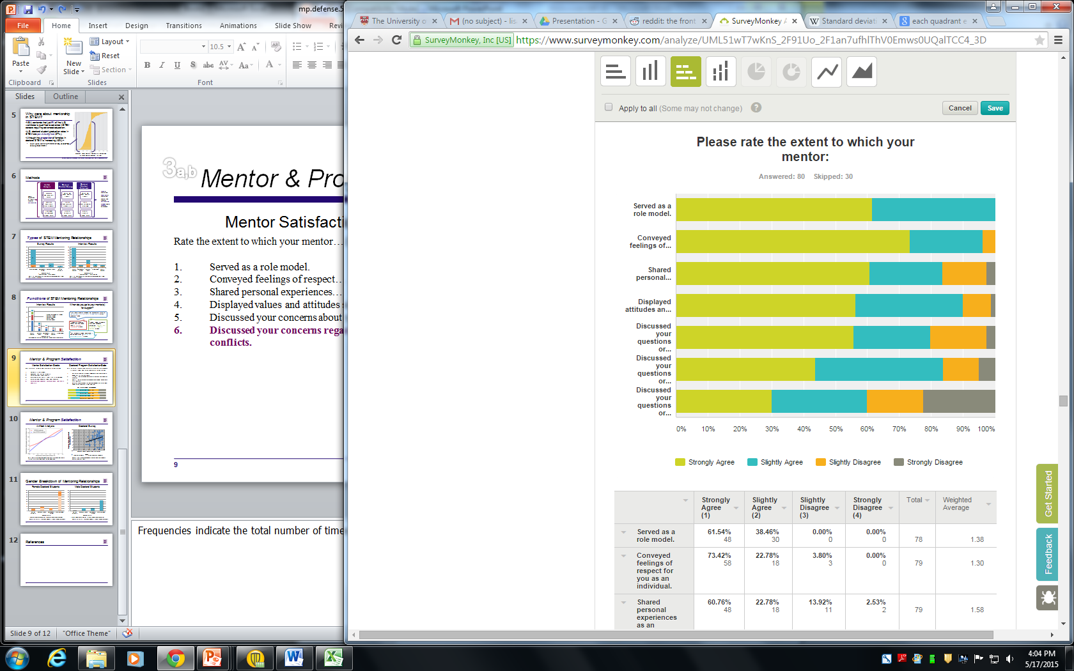
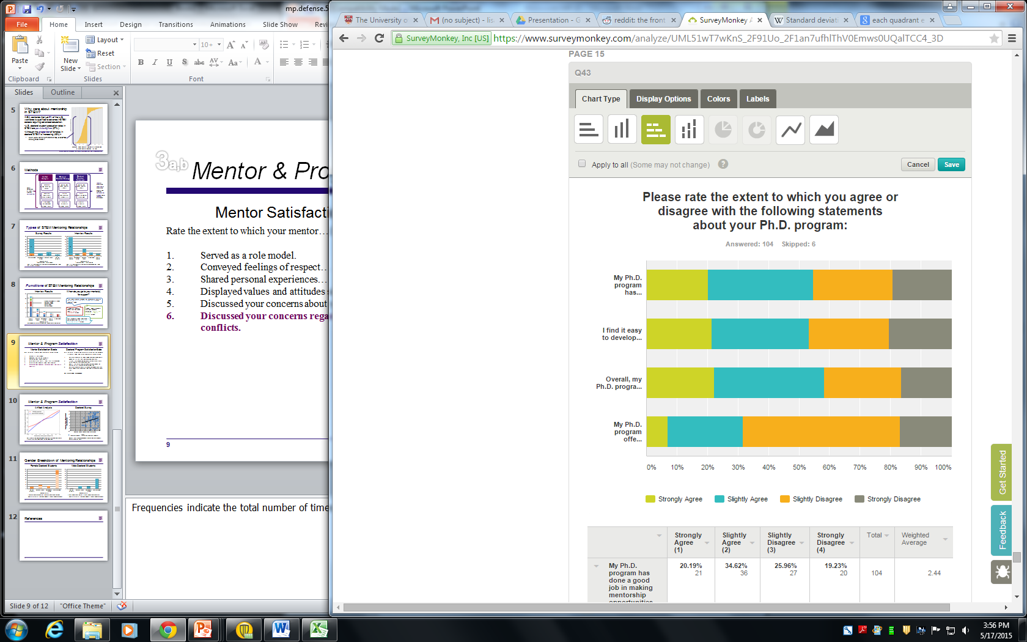
Overall Mentor & Program Satisfaction
Mentor Satisfaction Scale
Rate the extent to which your mentor…(1 = SA, 4 = SD)
Served as a role model.
Conveyed feelings of respect for you as an individual.
Shared personal experiences as an alternative perspective to your problems.
Displayed values and attitudes similar to your own.
Discussed your questions/concerns about your program.
Discussed your questions/concerns regarding work and family conflicts.
SIGNIFICANT GENDER DIFFERENCE
Doctoral Program Satisfaction Scale
Rate the extent to which you agree or disagree with the following statements about your Ph.D. program…(1 = SA, 4 = SD)
My Ph.D. program has done a good job in making mentorship opportunities available to me.
I find it easy to develop mentoring relationships within my Ph.D. program.
Overall, my Ph.D. program encourages development of mentoring relationships.
My Ph.D. program offers less mentorship opportunities than other STEM Ph.D. programs at Northwestern.
Notes:
Frequencies indicate the total number of times a mentoring relationship was mentioned.

Slide 7
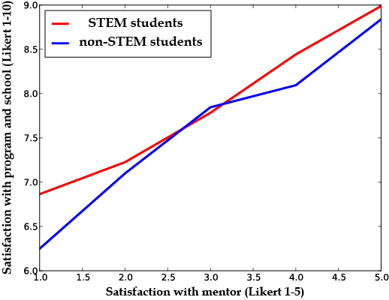
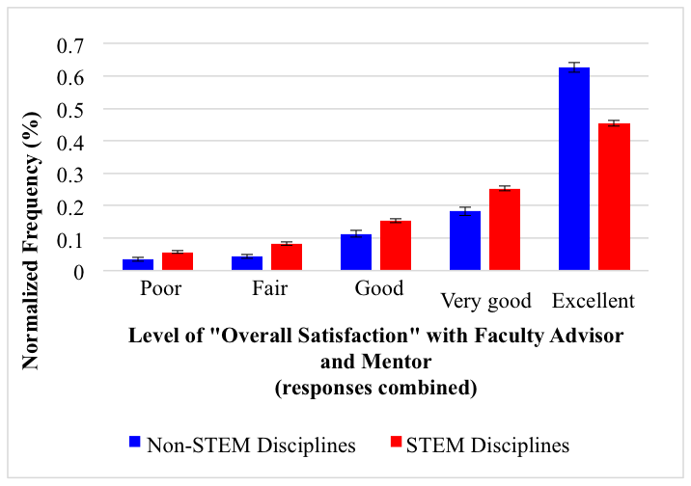
Mentor & Program Satisfaction
Artifact Analysis
Doctoral Student Survey
Relationship between program and mentor satisfaction by averaged 1-5 Likert-scaled responses over the total population.
Notes:
Frequencies indicate the total number of times a mentoring relationship was mentioned.

Slide 8
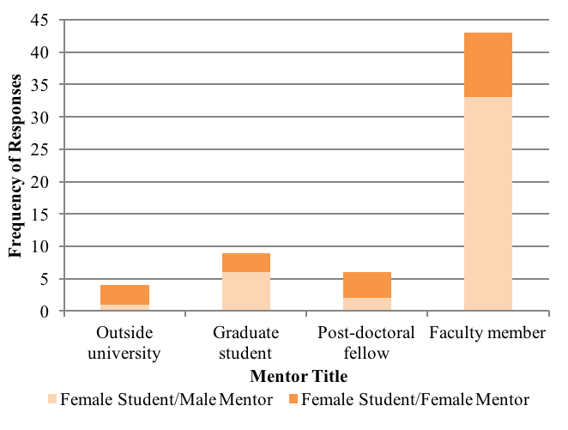
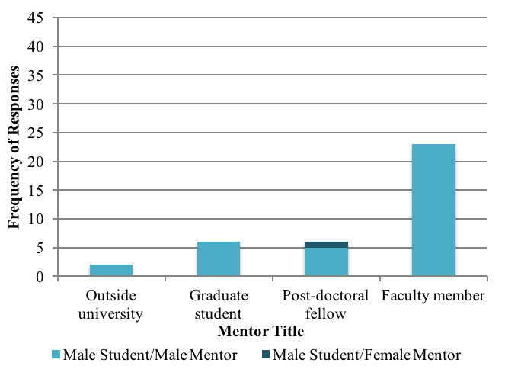
Gender Differences in Types of Mentoring Relationships
Female Doctoral Students
Male Doctoral Students
Cross-tab analysis of female doctoral students by mentor gender.
Cross-tab analysis of male doctoral students by mentor gender.
Notes:
CITE a statement about gender made by a female doctoral student.
FEMALES are SIGNIFICANTLY more likely to draw on FEMALE MENTORS from outside of the faculty. Tend to prefer females. WHY? (Go to next slide).

Slide 9
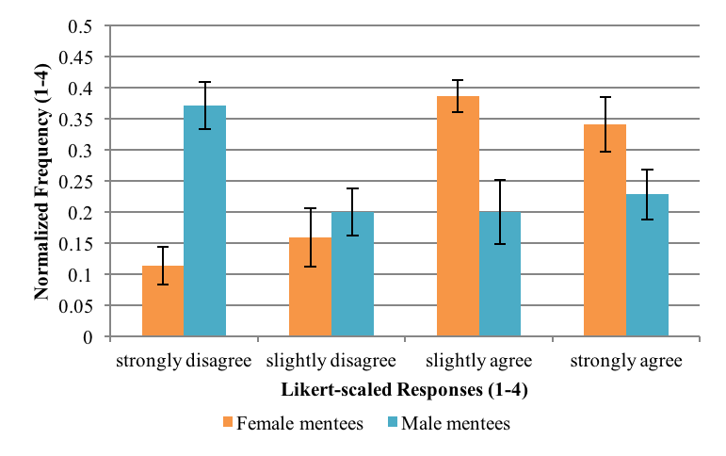
Gender Differences in Mentoring Relationships
“Rate the extent to which your mentor discussed your questions or concerns regarding relationships with work and family conflicts”
Female students are more likely than males to discuss personal issues with mentors.
Data suggests that female students may be searching for gender-specific mentoring characteristics.
  Role modeling.
  Coaching.
  Personal/psychological support.
Notes:
Refer to appendices for information about program differences.
COULD BE OTHER TRENDS, but this is the only statistically significant result.

Slide 10
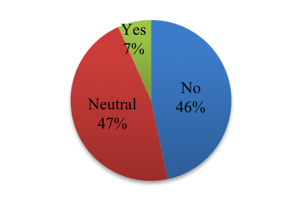
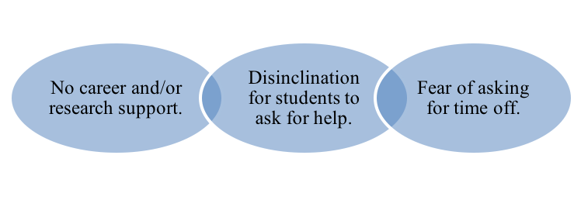
Conclusions
INTERVIEWS
“Do you feel that your Ph.D. program has done a good job in making mentorship opportunities available to you?”
Mentor satisfaction and program satisfaction are highly correlated (p < .001).
Overall, STEM doctoral students are satisfied with their mentoring relationships.
However, having a mentoring relationship does not appear to guarantee positive mentoring outcomes (see appendix for mentoring functions).
Female students have quantifiably more mentors than males. Female students also have significantly more female mentors than male students.
Female students report greater mentor satisfaction when they perceive their programs to be gender balanced.
STEM doctoral students appear neutrally (survey) or negatively (interview) satisfied with their doctoral program’s ability to promote mentoring relationships.
Notes:
Faculty act less as mentors and more like “research role models”. Doctoral students may be referring to faculty as ‘mentors’ but they do not appear to be filling the definition of mentorship as well as peers, for example.
Of all of the mentoring functions served by faculty mentors, doctoral student interviewees were least likely (10%) to approach their faculty member with questions or concerns regarding personal or psychological issues (n = 2). This is perhaps unsurprising given that several studies including Blickenstaff (2005) and Holley & Caldwell (2012) have found that discipline-specific norms in STEM sub-fields can create a disinclination for doctoral students to ask questions or show uncertainty in their subject area for fear of appearing as if they are struggling or less knowledgeable than their peers. These data suggest that doctoral students may avoid speaking to faculty mentors about personal or psychological issues (e.g. asking for time off due to illness) out of fear that they will appear ‘weak’ compared to their peers, or that their concerns will not be adequately addressed.

Slide 11
Conclusions, cont.
Limitations
May not be generalizable to other R1/VH institutions.
No control group.
Utilizes only the perspective of doctoral students.
High self-selection bias.
Over-representation of chemistry/material sciences.
Researcher bias.
Applicability to Practitioners
Explore the potential of peer-to-peer mentoring programs (graduate students/post-doctoral students).
(1) Decrease feelings of isolation.
(2) Introduce female students to fields of practice.
(3) Provide personal/psychological connections missing from faculty relationships.
Data indicates staff members are currently underutilized. Explore using these mentoring relationships to provide a safe space to provide career advice.

Slide 12
Future Research
Examine measures in addition to student gender, mentor gender, and STEM discipline.
e.g. race/ethnicity, student career/academic outcomes, experiences w/mentorship at prior institutions.
Draw from the perspectives of students who have withdrawn from their STEM degree programs (what role does poor mentorship play in mentor satisfaction?).
Add the (faculty) mentor perspective.

Slide 13
Questions?
Acknowledgements:
Lois Trautvetter, Research Advisor
Alison Segal, Research Coach
Bill Artz, Data Collection/Dissemination
Christopher Anderson, Data Analysis
Dedication:
To my grandfather, Gordon L. Dolton
“I thought research was some genius making everything work behind the scenes, but [my mentor] taught me that I could do it.”
– Chemistry Ph.D. candidate (male)

Slide 14
References
¹Hall, L. A., & Burns, L. D. (2009). Identity development and mentoring in doctoral education. Harvard Educational Review, 79(1), 49-70.
²Luna, G., & Cullen, D. L. (1995). Empowering the faculty: Mentoring redirected and renewed (Report No. HE-025-524). Washington, DC: ASHE-ERIC Higher Education. (ERIC Document Reproduction Service No. ED399889).
³Robbins, P. (1999). Mentoring. National Staff Development Council Roles, responsibilities, and relationships in mentoring: A literature review and agenda for research. Journal of Teacher Education, 48, 325-35.
⁴Anderson, E., & Shannon, A. (1988). Toward a conceptualization of mentoring. Journal of Teacher Education, 39(1), 38–42.
⁵Nettles, M., & Millett, M. (2006). Three Magic Letters: Getting to Ph.D. Baltimore, MD: Johns Hopkins University Press.
⁶Lloyd-Jones, B. (2011). Diversification in higher education administration: Leadership paradigms reconsidered. In G. Jean-Marie & B. Lloyd-Jones (Eds.), Women of color in higher education: Changing directions and new perspectives (Vol. 10): Emerald Books.
⁷Chen, X. (2013). STEM Attrition: College Students’ Paths Into and Out of STEM Fields (NCES 2014-001). National Center for Education Statistics, Institute of Education Sciences, U.S. Department of Education. Washington, DC.
⁸Holley, K. A., & Caldwell, M. L. (2012). The Challenges of Designing and Implementing a Doctoral Student Mentoring Program. Innovative Higher Education, 37, 243-254.

