Slide 1
MASTERS OF SCIENCE IN
HIGHER EDUCATION
US DEPARTMENT OF EDUCATION
NATIONAL CENTER FOR EDUCATION STATISTICS (NCES)
POSTSECONDARY DATASETS
Lisa Metzger-Mugg

Slide 3
Overview
Survey design: Longitudinal and cross-sectional data sets
Population focus
Undergraduate students or Graduate/Professional students
Undergrad or Doctoral Graduates/Alumni
Faculty
Institutional level
State level
Quantitative or Qualitative
Secondary Data Analysis or Use of Publications
Public Use or Restricted Use License

Slide 4
Link to Use For Description of NCES Surveys
https://nces.ed.gov/surveys/SurveyGroups.asp?group=2

Slide 5
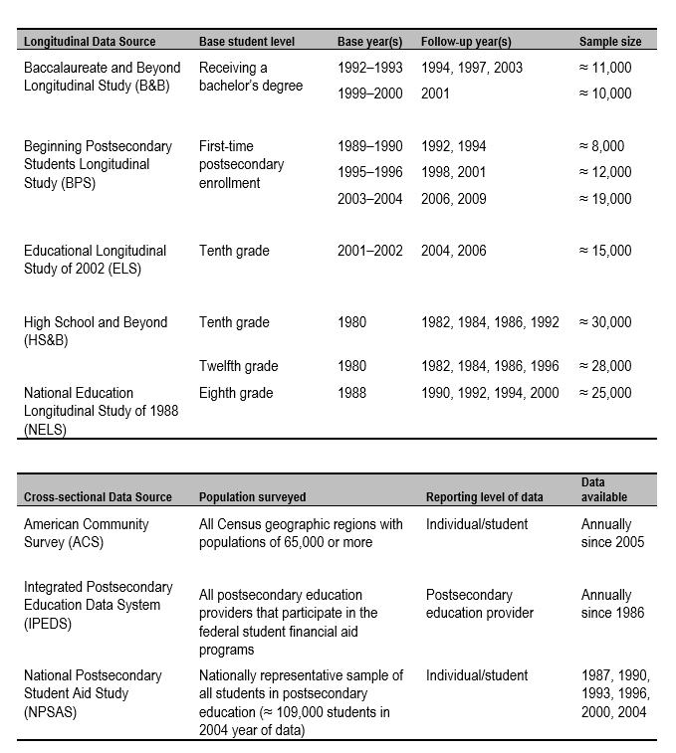
Longitudinal & Cross Sectional Datasets

Slide 6
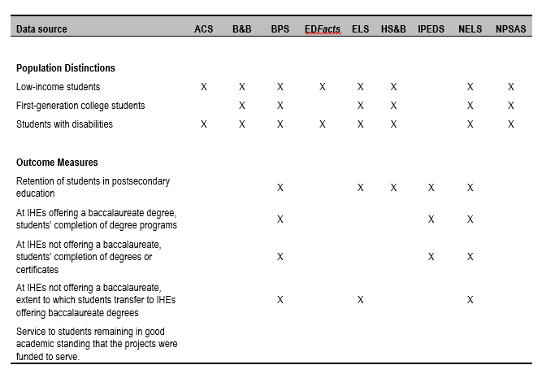
Population Distinctions & Outcome Measures

Slide 7
Advantages
Study design and data collection already completed
Access to cross sectional and longitudinal data that would have been costly and taken years to complete
Data may be higher quality
More representative of the target population
Oversampling of low prevalence groups allows for increased statistical precision
Breadth - datasets contain thousands of variables
Ideal for theses, dissertations, class projects to address research questions in higher education

Slide 8
Disadvantages
Study design already complete; may not be applicable
Data may lack depth
Constructs may not be operationally defined
Information regarding study design and data collection procedures may be scarce or difficult to understand
Need to understand methodological and technical issues relevant to national data collection (Check study website for errors and updates)
May require increased knowledge of data analysis methods or statistics software
Knowledge of sampling, missing data, recoding, creating new variables, use of weights, identifying outliers, non-normality

Slide 9
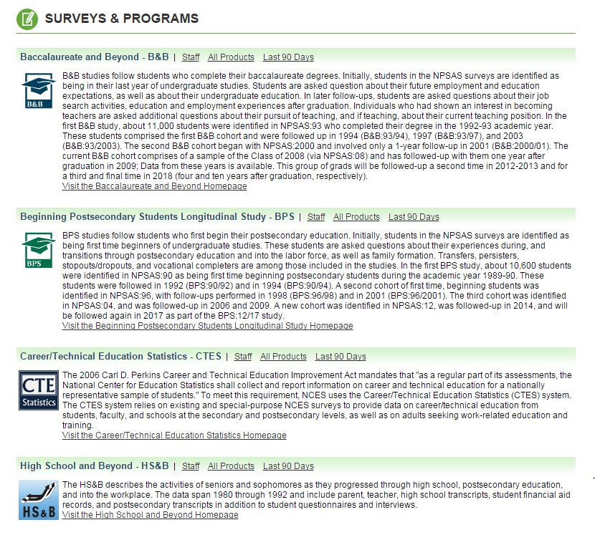
NCES Postsecondary Datasets
Available on the NCES Website https://nces.ed.gov/

Slide 10
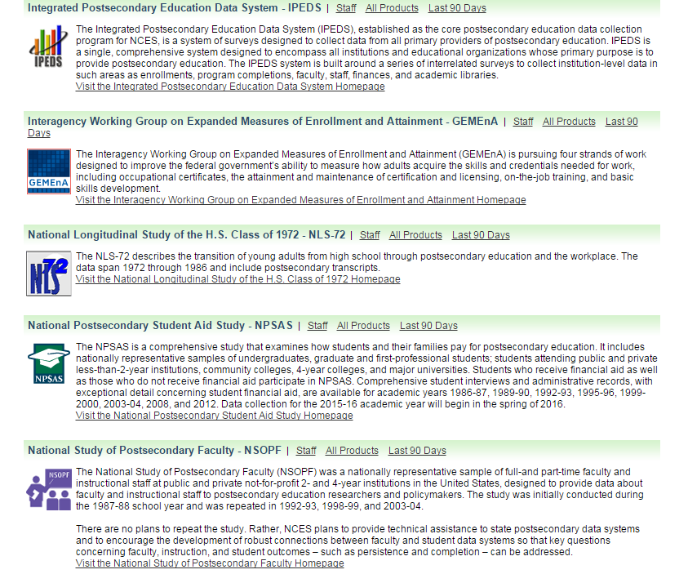
NCES Postsecondary Datasets

Slide 11
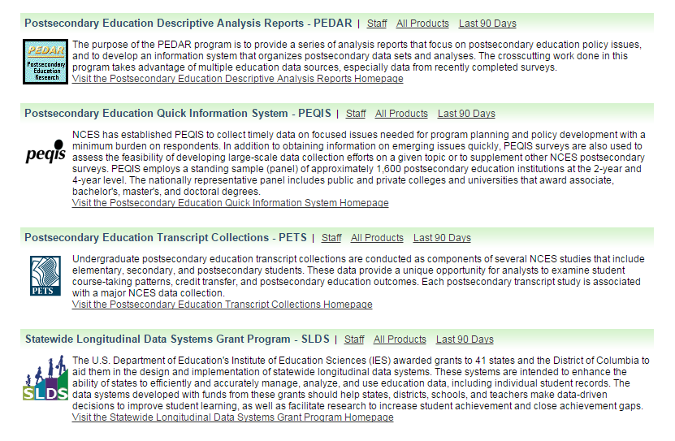
NCES Postsecondary Datasets

Slide 12
Beginning Postsecondary Students (BPS)
Longitudinal
Same cohort of students followed at 3rd and 6th year
National representative of first-time beginning students
BPS:04/09 dataset includes 16,700 students
Transcripts available for this cohort
Focus on student college experience and attainment
Demographics and pre-college characteristics
Persistence and enrollment information
Academic and social experiences
College financing (income, debt, influence on persistence
Transition to employment

Slide 13
Baccalaureate and Beyond (B&B)
Longitudinal
Latest cohort drawn from the 2008 National Postsecondary Student Aid Study (NPSAS) and followed up in 2009 and 2012
National representative of bachelor’s degree recipients
Approximately 19,000 in sample
Focus on college graduate post-baccalaureate experience
Work experience
Entry and persistence in graduate education
Income and debt repayment
Undergraduate experience, participation in community service

Slide 14
National Postsecondary Student Aid Study
Cross-sectional foundation for BPS and B&B
Nationally representative sample; every 4 years
NPSAS:08 contains approximately 114,000 undergrads, 24,000 graduates enrolled between July 1, 2007 and June 30, 2008 at 1,900 institutions
Student-level records on financial aid from federal government, states, institutions, and private agencies
Family circumstances
Demographics
Education and work experiences
Academic and professional expectations

Slide 15
National Study of Postsecondary Faculty
Nationally representative of faculty and instructional staff
NSOPF: 04 includes1,080 Public and private institutions
35,000 faculty and instructional staff
Includes information on:
Backgrounds
Responsibilities
Workloads
Salaries and benefits
Attitutudes
Future plans

Slide 16
Population Distinctions & Outcome Measures

Slide 17
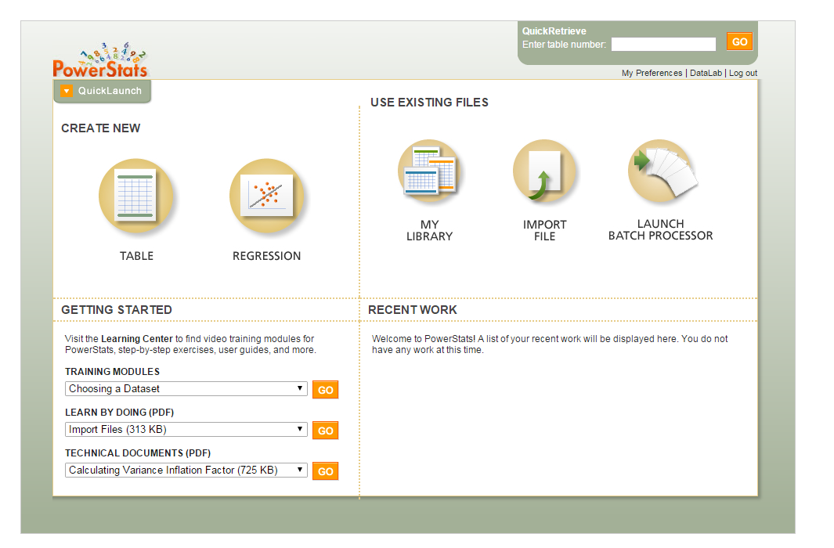
Data Lab

Slide 18
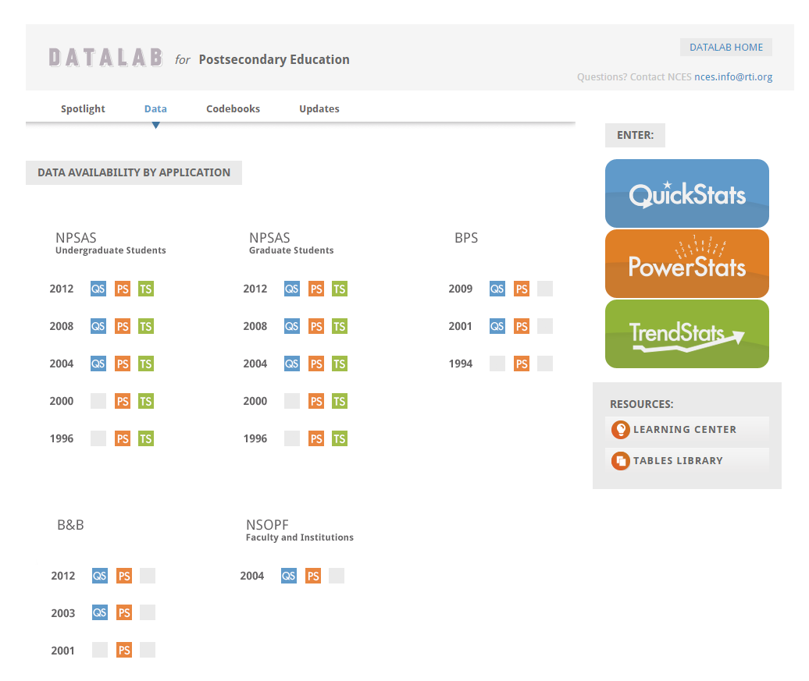
Data Lab

Slide 19
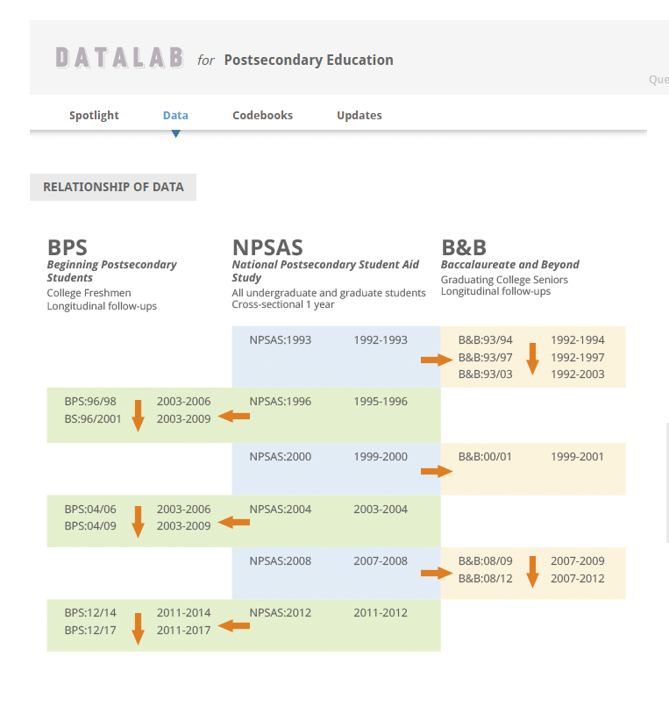
Data Lab

Slide 20
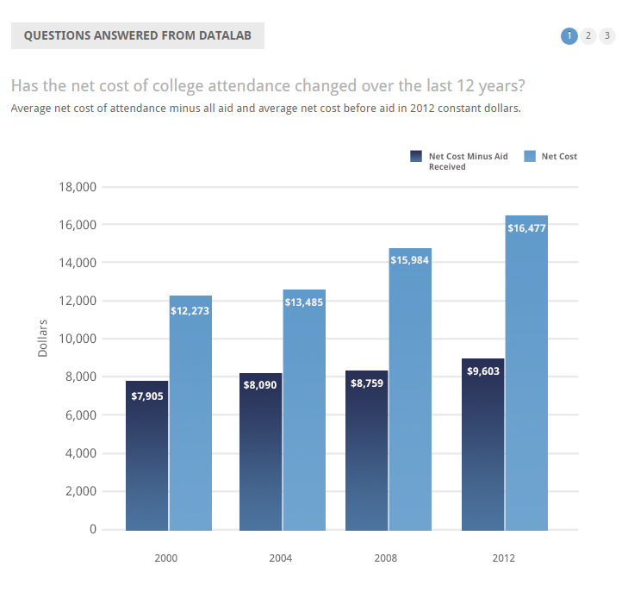
Frequently Used Tables

Slide 21
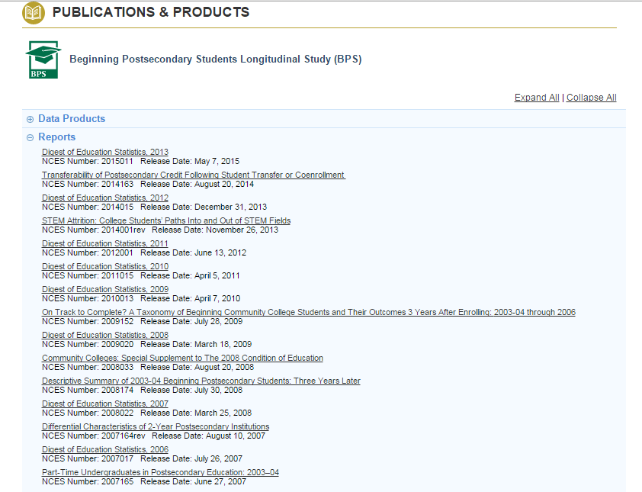
Reports

