Slide 1

Community College
Students, issues and databases
Dr. Pam Schuetz
p-schuetz@northwestern.edu
October 1, 2015
Notes:
My name is Dr. Pam Schuetz. I teach and do research in education – specifically focused on community colleges.
Over the next 10 minutes I’ll be talking about some research issues and databases I hope you’ll find interesting as you think through your research question and plan.

Slide 2
Students
Some of lowest attainment, fastest growing populations – most in need of postsecondary education – enroll in open-access community colleges.
7.4M students (+5M noncredit): 46% of all public credit undergraduates
63% over the age of 21 (49% age 22-39)
60% part-timers
41% part-timers employed full-time
36% first generation
17% single parent
Disproportionately Black and Hispanic, low income, academically underprepared.
Six years after beginning community college:
35% earn degree/certificate; 20% still enrolled somewhere; 46% gone
Notes:
By open access I mean – academic, financial and geographic accessible.
Avg tuition: $3300/year (CA $1,500; VT $7300) vs. $8300 public
Kind of horrible success rates.
However – only 4 yr pub and priv not for profit have better “gone” statistics.
If you are interested in working to improve conditions and outcomes of disadvantaged college students (as well as social justice issues) – cc’s are where it’s at.

Slide 3
Chicago Public Schools High school graduation rate Berlin & Tuma, Chicago Tribune, 10/11/13
30,000 CPS Freshmen
(~85% low income; Black; Latino)
20,000 graduate from high school w/in 5 years
15,000 not academically prepared for college
5,000 are academically prepared for college
10,000 drop out before graduating high school
75% of 18 to 24 year olds are unemployed
Notes:
1470 of male dropouts (180 female) 18-34 years of age will serve time in a correctional institution.
Chances of being a homicide victim is 1/3 higher for high school dropouts and 6x higher for dropouts than for hs grads with at least some college.

Slide 4
CPS student college access Berlin & Tuma, Chicago Tribune, 10/11/13
Of the 20,000 CPS students who graduate from high school
14,000
enter college*
8,400 start second year
6,000
do not enter college
2,400 graduate
*Approximately one-third enroll in City Colleges of Chicago (CCC (2012). Building the Foundation for Success: Reinvention).

Slide 5
Related research issues
High school preparation (community poverty, school funding, violence…)
College transitions (from high school; from/to work; to four-year)
Student affairs/services
Orientation to college, academic placement dynamics
Academic advising
Program pathways and career advising
Developmental education
Student engagement and success
Retention, persistence, completion
Funding, optimizing resources, strategic planning

Slide 6
Research cycle
Review the literature
Locate and collect data
Analyze and interpret data
Evaluate data
and write report
Identify the research problem
Specify a research question and research plan

Slide 7
Education analytics
Measurement, collection, analysis and reporting of data about learners and their contexts,
for purposes of
understanding and optimizing learning and the environments in which it occurs.^{1, 2}
********
More data are being collected than ever before
Relatively little of data are used to optimize learning or environmental dynamics (mostly mandatory reporting).
¹ Long, P., & Siemens, G. (2011). Penetrating the fog: Analytics in learning and education. Educause Review, 46(5), 31–40.
² See NU data analysis tools: SPSS – quantitative analysis of large datasets. Nvivo; Atlas – qualitative analysis of unstructured data

Slide 8
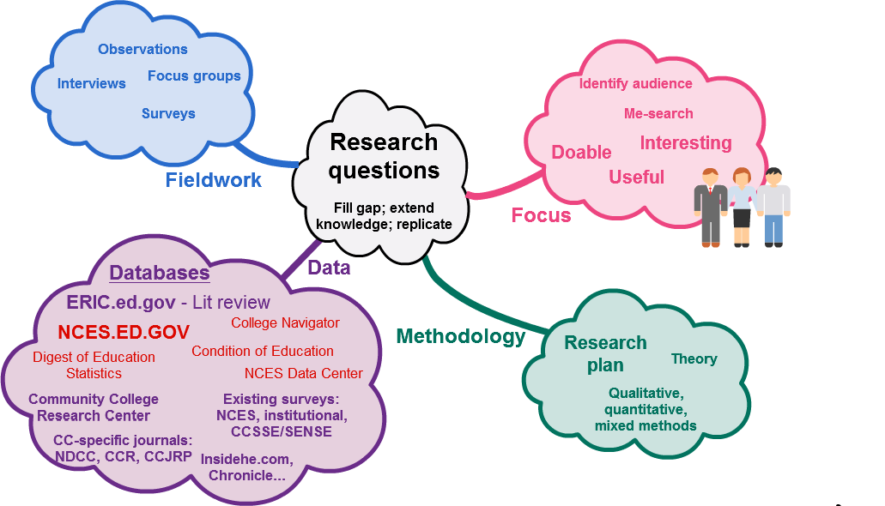
Research tends to be…
…messy
Notes:
All research is mixed methods
Research Question: Fill a gap, extend knowledge or replicate
Data – information – knowledge - wisdom

Slide 9
Available studies and statistics
Collections of studies:
ERIC - archive of >1 million articles and studies
Universities: Community College Research Center (Columbia); OCCRL (U of I Urbana)
Think tanks: MDRC; Jobs for the Future; Education Commission of the States
Associations: College Completion Challenge Toolkit to Help Colleges Help Students (AACC)
Statistics:
NCES/IPEDS
College Navigator (quick overview of college characteristics)
NCES/IPEDS Data Center (detailed comparison of college characteristics)
Digest of Education Statistics
DataLab (QuickStats; PowerStats)
States/IR colleges: For example: CA CC system; IL CC system
Associations: Completion Arch (College Board); Achieving the Dream
Notes:
AND RESOURCES LEAD TO RESOURCES

Slide 10
Limited access databases²
Negotiated access:
Center for Community College Student Engagement survey databases
Community College Student Survey of Engagement (CCSSE) (see embedded bib)
Community College Faculty Survey of Student Engagement
National Student Clearinghouse
Institutional data and studies through negotiation with IR; Student Affairs/Services personnel and/or high level administrators
Subscription access:
New Directions for Community Colleges (NDCC)
Community College Review (CCR)
Community College Enterprise (CCE)
Community College Journal of Research and Practice (CCJRP)
Chronicle of Higher Education
² Reports prepared from controlled databases are often openly available.

Slide 11
Conclusion
Large and growing populations of students – arguably those most in need of postsecondary education - enroll in community colleges.
More research is needed to understand and optimize dynamics of college environments and student learning.
Questions?
Contact:
Dr. Pam Schuetz
p-schuetz@northwestern.edu

