Slide 1



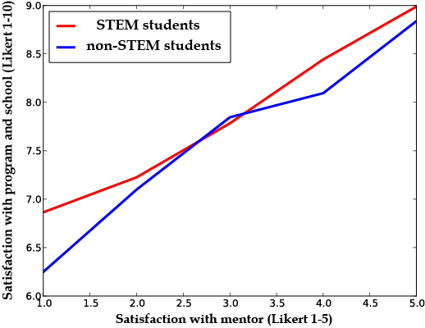

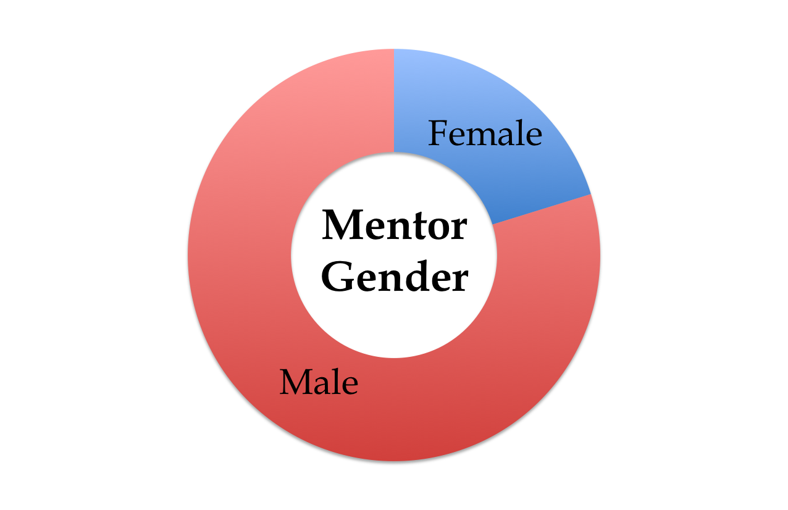
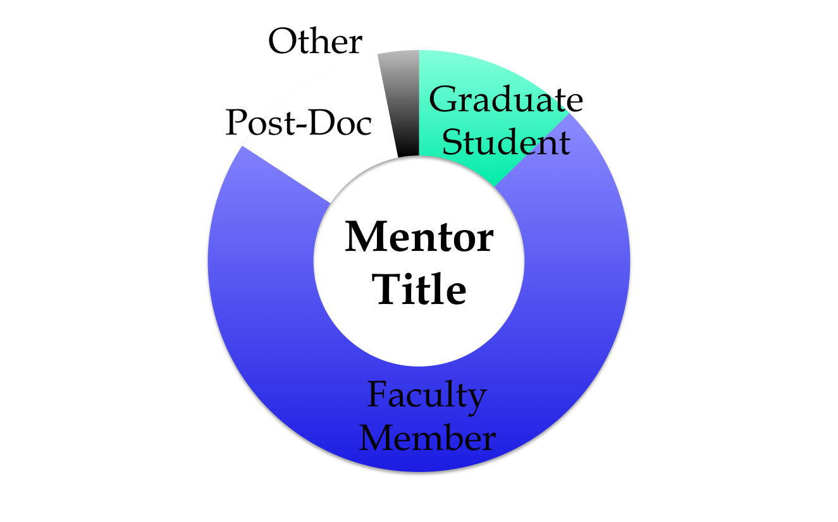
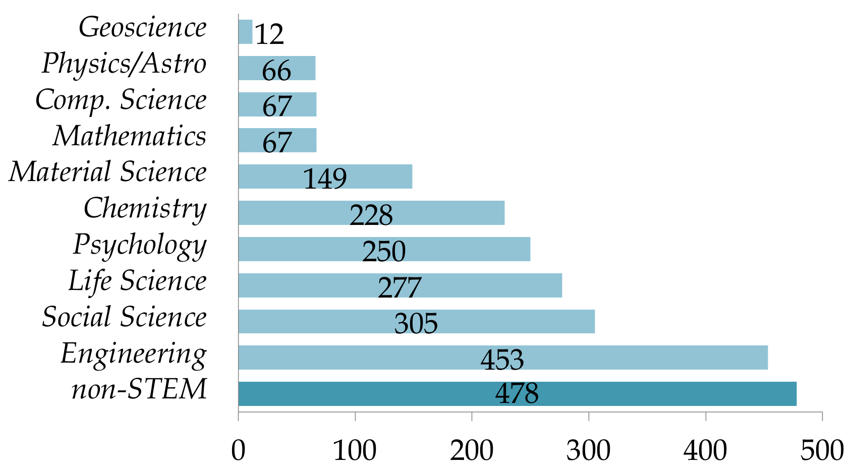
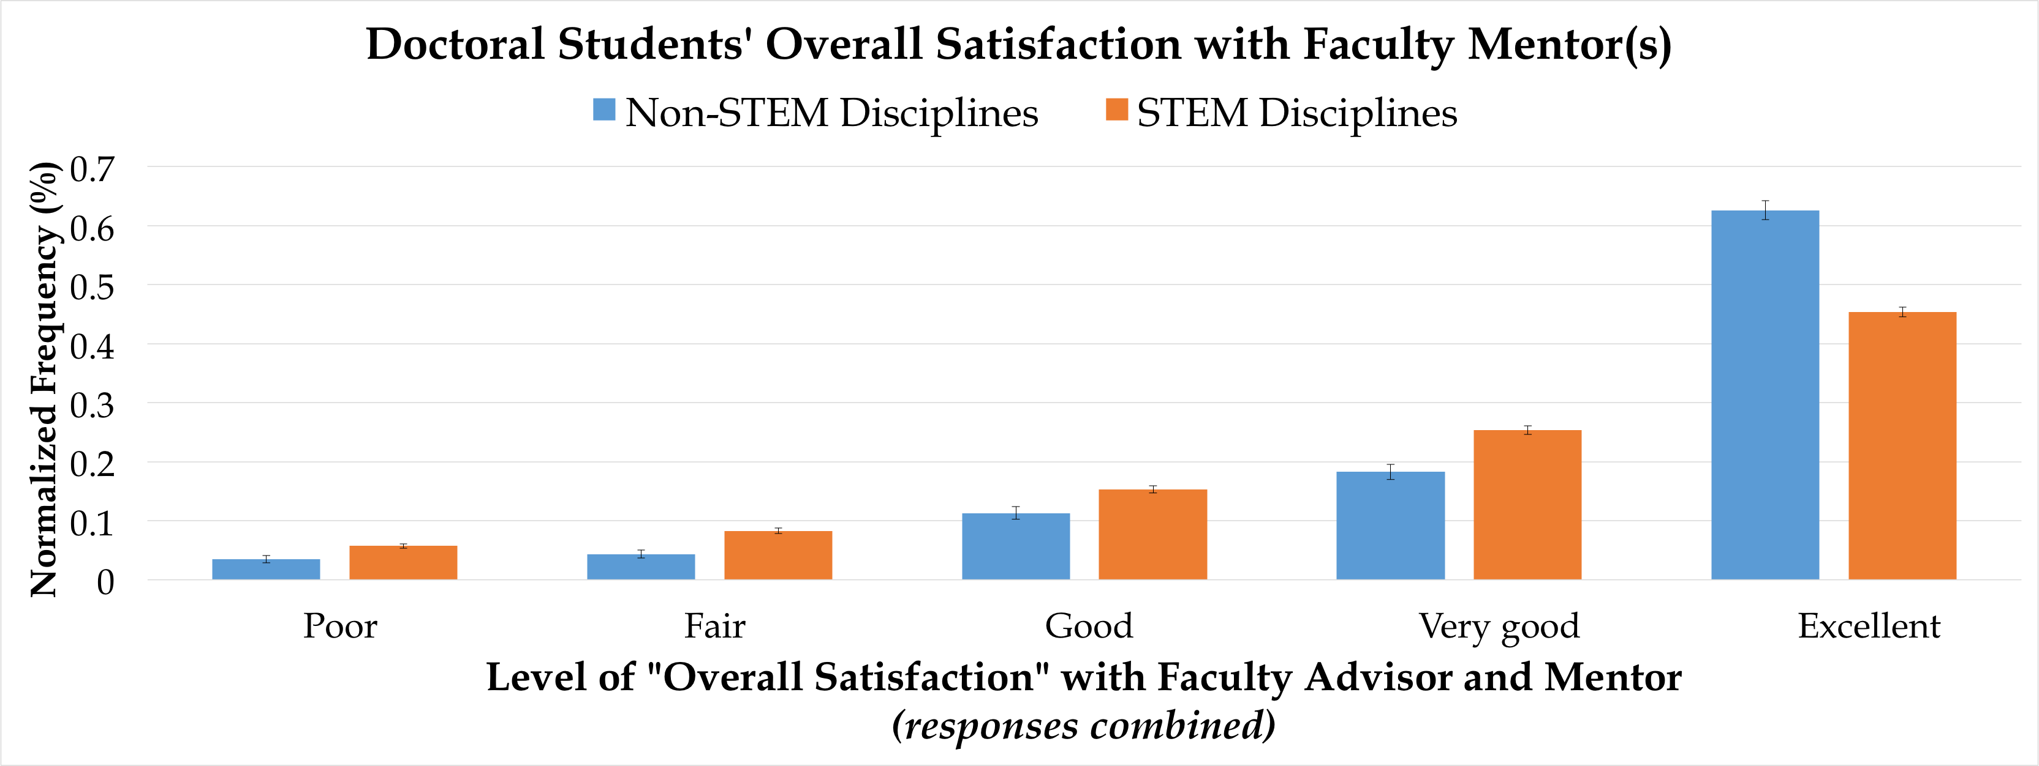

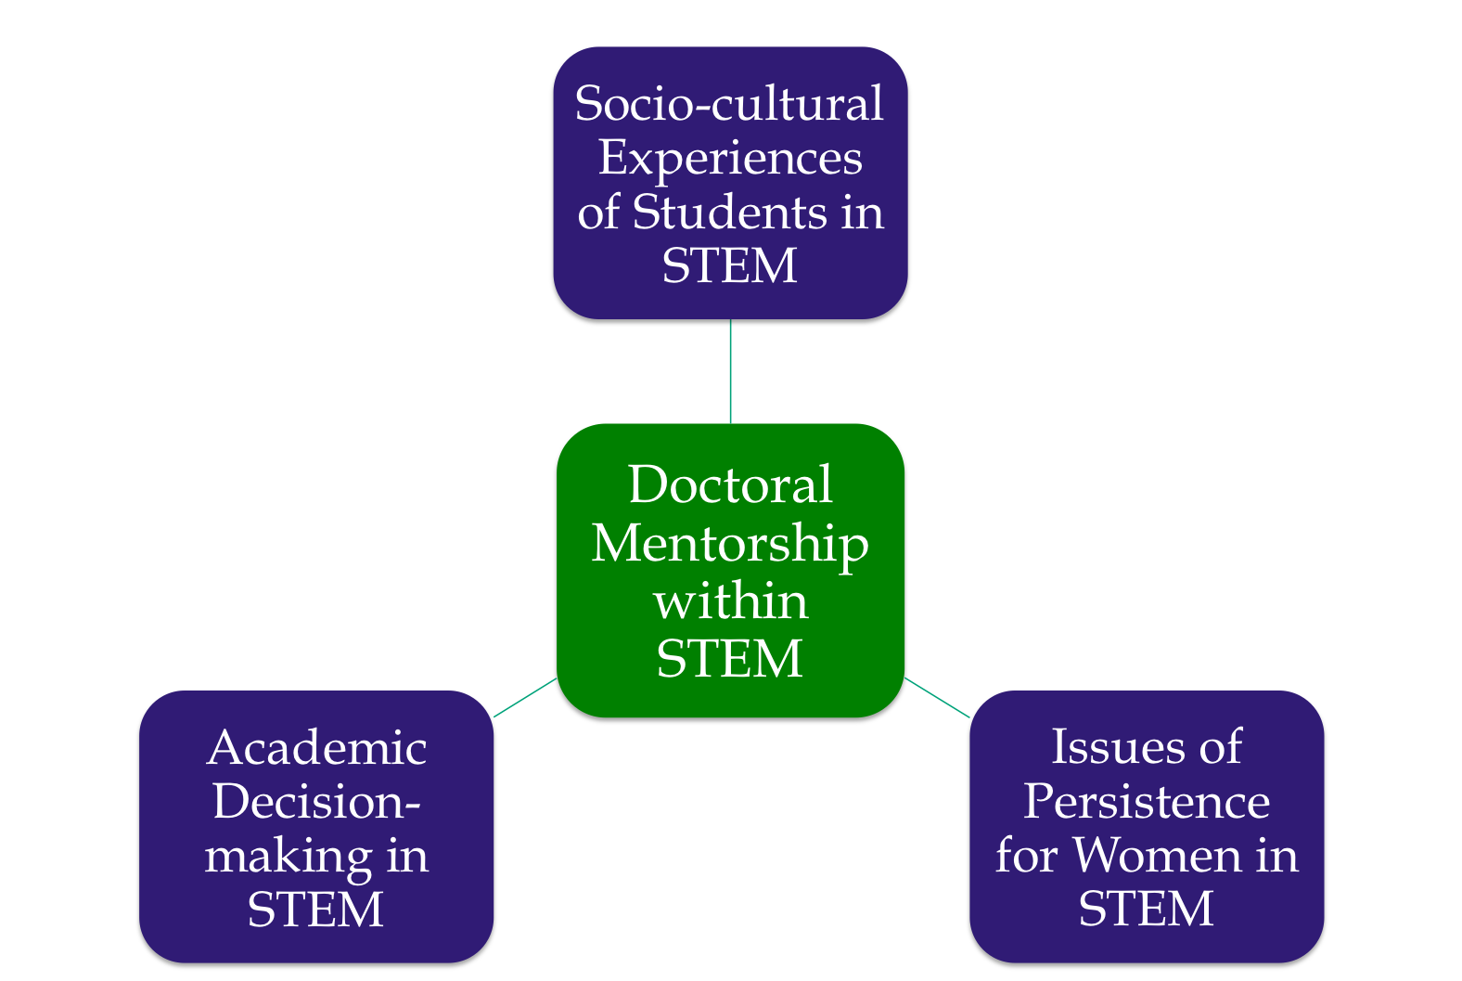

Perceptions of Mentoring Among Doctoral Students
in STEM Disciplines
Blaskowski, L. J.
QUESTION
METHOD
PRELIMINARY RESULTS
What types of mentoring relationships exist for doctoral students in STEM disciplines at Northwestern University and how does:
  gender of the doctoral student,
  type of STEM discipline, and
  gender of the mentor play a role in these mentoring relationships?
“I feel mentoring works better for me with females, but there are few female faculty, and [they] are overwhelmed with other duties.”
- STEM Doctoral Student (survey)
ARTIFACT ANALYSIS
Ph.D. Exit Survey
Participants
2,352 doctoral student alumni from 2009-2014.
2 groups: STEM and non-STEM degree programs.
61 doctoral degree programs (29 STEM).
INTRODUCTION
• U.S. doctoral student 10yr graduation rates in science, technology, engineering, and mathematics [STEM] disciplines are persistently low (57%); attrition rates are as high as 30-50% in ‘critical disciplines’ such as physics and mathematics¹.
• Although the overall proportion of women earning STEM doctoral degrees has increased in the 20th century (48% in 2009)², men were over-represented in 75% of all NSF-designated STEM disciplines in 2014³.
• MENTORSHIP is frequently cited as one of the greatest contributors to doctoral completion⁴, as well as one of the most important elements of doctoral training; particularly for women⁵.
• Doctoral STEM candidates can provide information about the types and/or characteristics of mentoring relationships needed to promote doctoral student interest, study, and success within STEM disciplines.
n = 89
n = 95
Figure. Relationship between program and mentor satisfaction by normalized 1-5 Likert-scaled responses.
SURVEYS
Participants
89 current doctoral students.
1 group: students in 1+ STEM degree programs.
41 females, 47 males (1 non-response).
24 STEM doctoral degree programs.
Procedure
15 minutes, no required questions (online).
  19 demographic and STEM questions (self, faculty, PI)
  12-19 mentorship questions
  6 doctoral degree program questions
LITERATURE REVIEW
IMPLICATIONS
REFERENCES
RETENTION
or ATTRITION
in degree program.
Better understanding of the factors important to STEM doctoral students when choosing mentors.
UNIVERSITIES:
Enables administrators to create or revise mentoring initiatives aimed at improving retention in STEM programs (e.g. for women).
RESEARCHERS:
Increased knowledge of the types of mentoring relationships in different STEM degree programs.
¹Chen, X. (2013). STEM Attrition: College Students’ Paths Into and Out of STEM
Fields (NCES 2014-001). National Center for Education Statistics, Institute of Education Sciences, U.S. Department of Education. Washington, DC.
²Burrelli, J. (2008). Thirty-three years of women in S&E faculty positions (Vol.
1958). National Science Foundation, U.S. Department of Education. Washington, DC.
³Gillen, A., & Tanenbaum, C. (2014). Exploring Gender Imbalance Among STEM
Doctoral Degree Recipients (3094a). American Institutes for Research, U.S. Department of Education. Washington, D.C.
⁴Anderson, M. S. (1998). The experience of being in graduate school: An
exploration. New Directions for Higher Education, 26, 101. San Francisco: Jossey-Bass Publishers.
⁵Benditt, J. (1992). Women in Science: First Annual Survey. Science, 255, 1363-88.
INDIVIDUAL INTERVIEWS
Participants
12-15 current doctoral students.
1 group: students in 1+ STEM degree programs.
Procedure
  40-45 minute, interviewer-led conversations.

