Slide 1
Random walks in semantic memory
Jeff Zemla
11/12/15

Slide 2
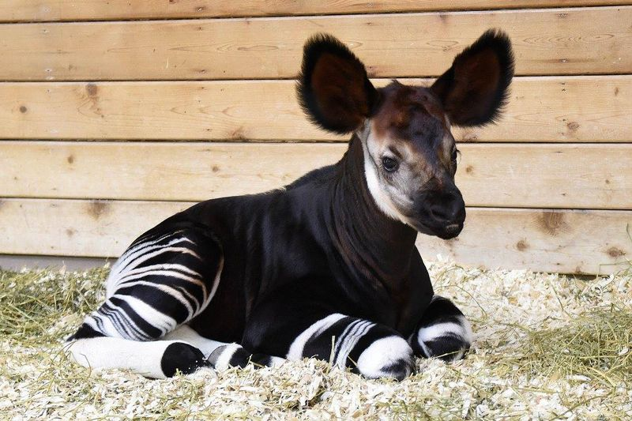
Searching semantic memory
List as many animals as you can in 30 seconds
Semantic fluency task
Adjacent animals in list are more likely to be similar than animals further apart
Loosely grouped by category
Typical category items more likely to be named
What does this list tell us about the organization of semantic memory?

Slide 3
Searching semantic memory
PETS
ZOO
dog, cat, uh, uh, hamster, uh, uh, uh, tiger, lion, uh, monkey, uh, uh, giraffe,...
time
Patchy structure taken as evidence to support a two-stage search process
Search for animals within a sub-category
When it’s hard to retrieve more items, switch to a different sub-category
When do we switch to a new category?
Fixed length: Name 3 “pets” then switch
Fixed time: Name “pets” for 15 seconds then switch
Fixed delay: Switch if I can’t think of a “pet” in 5 seconds
Known as stopping rules
Notes:
Thoughts on two-stage process?

Slide 4
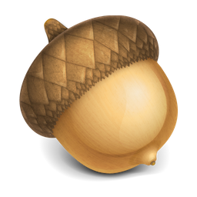
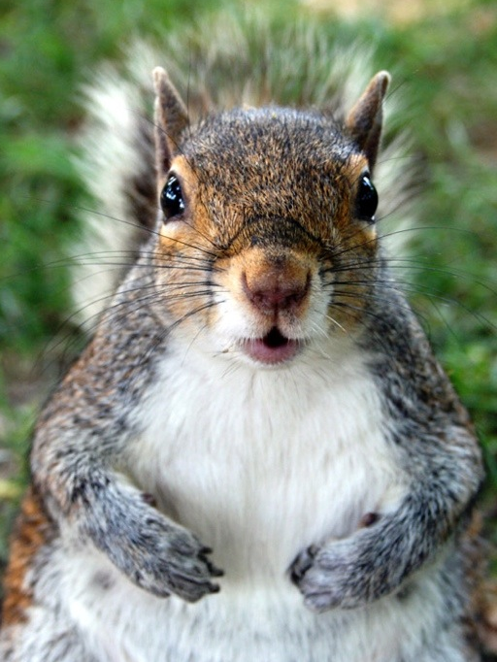
Foraging analogy
When should we switch to a new patch?

Slide 5
Foraging analogy
acorns
time
Time between patches
Marginal value theorem: Exploit patch until the expected gain of switching is larger than the resources you are getting by staying (Charnov, 1976).

Slide 6

Foraging analogy
Marginal value theorem: Exploit patch until the expected gain of switching is larger than the resources you are getting by staying (Charnov, 1976).
mouse
tuna
Two-process model:
(1) exploit: produce words from the current patch by searching locally.
(2) switch: transition from current to different patch.
dog
trout
hamster
bass
cat
salmon
monkey
lion
tiger
giraffe
gazelle
antelope

Slide 7
Searching semantic memory
PETS
ZOO
dog, cat, uh, uh, hamster, uh, uh, uh, tiger, lion, uh, monkey, uh, uh, giraffe,...
time
Inter response time (IRT): time between animals
1.4
1.2
1
IRT/Average IRT
0.8
0.6
“patchy profile”
0.4
0.2
0
-2
-1
0
1
2
Relative “patch” order
(Hills, Jones, & Todd, 2012; Troyer et al., 1997)

Slide 8
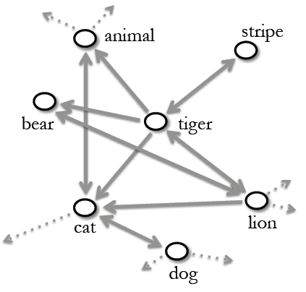
Search as random walk
Is a two-stage search process necessary for explaining optimal foraging?
Build a semantic network from the USF free association database (Nelson, McEvoy, & Screiber, 1998).
5018 nodes (words said by subjects)
63619 edges (associates)
Random walk: “walk” over an edge connected to current node at random.
Say the word corresponding to the next node (if it is an animal and is new).
Does optimal foraging behavior result from randomly walking
on a semantic network?
(Abbott, Austerweil, & Griffiths, 2012)

Slide 9


Search as random walk
Random walk: “walk” over an edge connected to current node at random.
Say the word corresponding to the next node (if it fits criteria and is new).
where is the first time animal was seen on the walk (first hitting time)
and is the length of the word for animal .
1.4
Human results
1.4
Random walk results
1.2
1.2
1
1
IRT/Average IRT
0.8
0.8
0.6
0.6
0.4
0.4
0.2
0.2
0
0
-2
-1
0
1
2
-2
-1
0
1
2
Relative “patch” order
Relative “patch” order
Results averaged over 1000 simulations ran for 1750 iterations each.
(Abbott, Austerweil, & Griffiths, 2012)

Slide 10
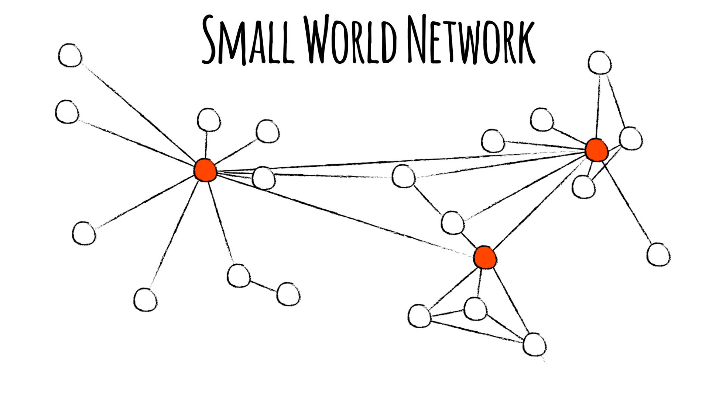
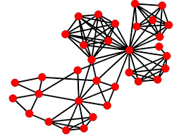
Search as random walk
Why might a random walk produce optimal foraging behavior?
Small world networks are highly clustered
Clusters connected by hubs
Short path between any two nodes

Slide 11
Conclusions
Random walks on semantic networks are sufficient to reproduce optimal foraging theory.
Explains typicality effects too!
Additional support for theory:
People generating words with a particular first letter do so consistent with a random walk on a semantic network (Griffiths et al., 2007).
The random walk model connects to Information Retrieval (e.g., PageRank).
Unified computational model of semantic memory search.

Slide 12
Inverse problem
Previously: Given a semantic network (USF dataset) what would semantic fluency data look like?
Now: Given semantic fluency data, what does an individual’s semantic network look like?

Slide 13
Inverse problem
List:
Tiger, bear, cat, lion
P(list|graph)
= P(bear|tiger) * P(cat|bear) * P(lion|cat)
= 1
Tiger lion
Bear cat
List:
Tiger, bear, cat, lion
Bear, lion, tiger, cat
= P(bear|tiger) * P(cat|bear) * P(lion|cat)
* P(lion|bear) * P(tiger|lion) * P(cat|tiger)
= .5 *…
Tiger lion
Bear cat
How does the likelihood of the data change when we add or remove
links in the graph?
* Ignores IRTs and stationary probabilities for simplification

Slide 14
Patient populations
Lots of special populations have difficulty with semantic memory retrieval
Alzheimer’s, Huntington’s, semantic dementia
Alzheimer’s patients show disrupted clustering
How do their representations of semantic memory differ from healthy controls?
Are these networks still small-world?
How do patient networks degrade over time?
Notes:
Two-stage vs random walk?
How might you differentiate them?

