Slide 1
JAM Tutorial
Dale Visser
WNSL
6 March 2002

Slide 2
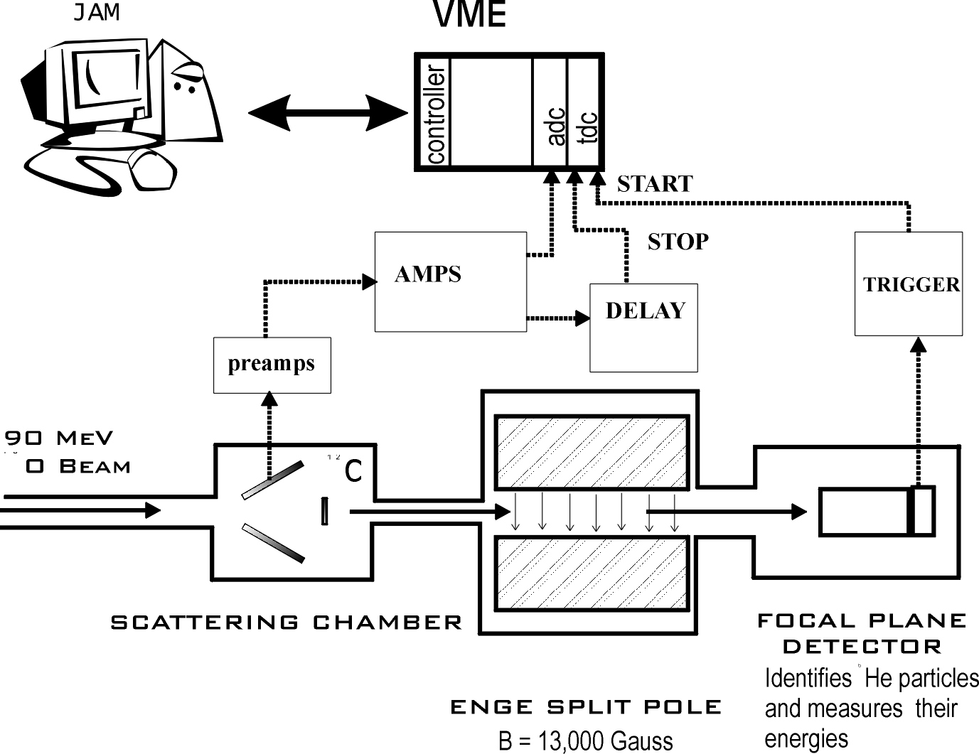

Example of a Jam experiment
Event Data
Messages

Slide 3
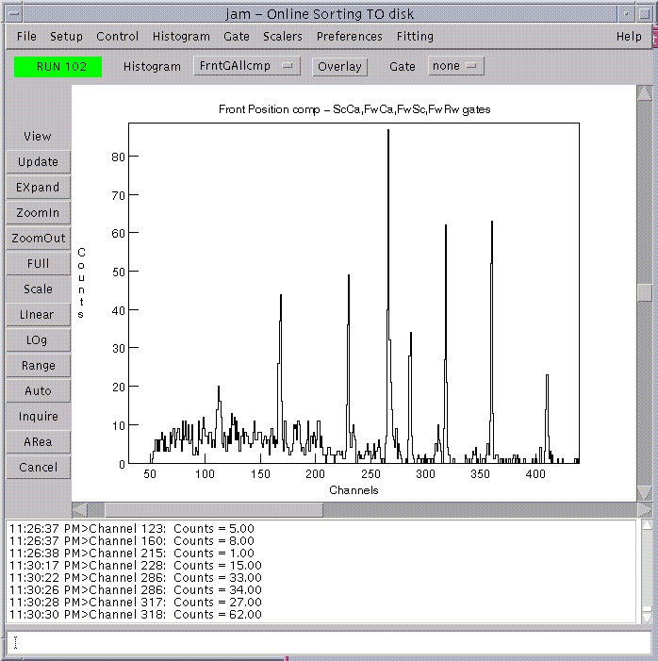
JAM (Java-based data Acquisition Manager)
Histogram
Selector
Gate
Selector
Java = portable
Sorts and displays both online and offline
Displays 1-d and 2-d histograms
Interactive gate-setting
Sort routines written in Java, loaded dynamically
Imports/exports many formats (e.g., Radware)
Command
History
Command
Entry

Slide 4

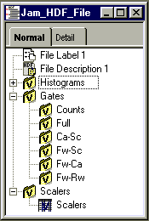
Jam Data is Saved in the HDF 4.1format
HDF stands for Hierarchical Data Format.
  Created at the National Center for Supercomputing Applications.
  Self-describing file format.
Many available programs
  IDL
  MATLAB
  HDFBrowser (Free)
Implemented in Java
  ANSI C program
  libraries available
For more information: http://hdf.ncsa.uiuc.edu
HDFBrowser

Slide 5
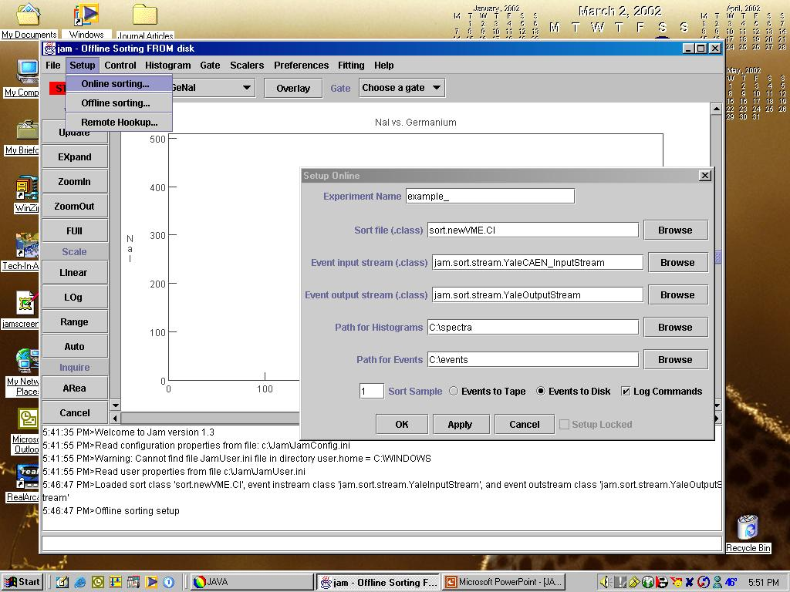
Setting up an experiment

Slide 6
Sample Sort Routine (1/7)
Beginning of file
All java files must belong to a package
package sort.newVME;
import jam.data.*;
import jam.sort.*;
/*
* Test sort file for ADC at LENA. Modified 2 March 2002 for
* example purposes by Dale Visser.
*
* @author C. Iliadis
* @author Dale Visser
*/
public class CI extends SortRoutine {
Imports from Jam always needed
Must extend jam.sort.SortRoutine

Slide 7
Sample Sort Routine (2/7)
Global Declarations 1/2
/*** GLOBAL DECLARATIONS ***/
final int ADC_BASE = 0xe0000000;
final int THRESHOLDS = 100;
final int ADC_CHANNELS = 4096; //num of channels per ADC
final int TWO_D_CHANNELS = 512;
//number of channels per dimension in 2-d histograms
//amount of bits to shift for compression
final int TWO_D_FACTOR =
Math.round((float) (Math.log(ADC_CHANNELS / TWO_D_CHANNELS) / Math.log(2.0)));
Sort routine specifies base
addresses of ADC’s and TDC’s
Bit-shifts are the most computationally efficient way to compress spectra.

Slide 8
Sample Sort Routine (3/7)
Global Declarations 2/2
Parameter id’s
to be used by
sort( )
int idGe, idNaI, idTAC;// id numbers for the signals
Histogram hGe, hNaI, hTAC;// ungated 1D spectra
Histogram hGeNaI;// ungated 2D spectra
Histogram hGe_TAC;//gated on TAC
Histogram hGe_g2d, hTAC_g2d;// gated on Ge vs. NaI
Gate gTAC;// 1D gate
Gate gGeNaI;//2D gate
Scaler sClock, sBeam, sGe, sAccept, sNaI;// scalers
Monitor mDeadTime;
final String DEAD_TIME = "Dead Time (%)";
int lastGe, lastAccept;//for calculating dead time
/*** END OF GLOBAL DECLARATIONS ***/
Data types
imported
from jam.data

Slide 9
Sample Sort Routine (4/7)
initialize() method 1/2
/**
* Method called to initialize objects when the sort routine is loaded.
*/
public void initialize() throws Exception {
/*** SCALER SECTION ***/
sClock = new Scaler("Clock",0);// (name, position in scaler unit)
sBeam = new Scaler("Beam",1);
sGe = new Scaler("Ge",2); //Ge provides trigger
sAccept = new Scaler("Ge Accept",3);
sNaI = new Scaler("NaI",4);
vmeMap.setScalerInterval(3);//insert scaler block in event data every 3 seconds
/*** MONITOR SECTION ***/
//Monitors associated with scalers, window will return scaler rate in Hz
Monitor mClock = new Monitor(sClock.getName(), sClock);
Monitor mBeam = new Monitor(sBeam.getName(), sBeam);
Monitor mGe = new Monitor(sGe.getName(), sGe);
Monitor mAccept = new Monitor(sAccept.getName(), sAccept);
Monitor mNaI = new Monitor(sNaI.getName(), sNaI);
//Monitor associated with Gate, window will show rate of new counts in Hz
Monitor mTAC = new Monitor("TAC window", gTAC);
//User-defined monitor which is calculated in this sort routine
mDeadTime=new Monitor(DEAD_TIME,this);

Slide 10
Sample Sort Routine (5/7)
initialize() method 2/2
/*** ADC CHANNELS SECTION ***/
// eventParameters, args = (slot, base address, channel, threshold channel)
idGe = vmeMap.eventParameter(2, ADC_BASE, 0, THRESHOLDS);
idNaI = vmeMap.eventParameter(2, ADC_BASE, 1, THRESHOLDS);
idTAC = vmeMap.eventParameter(2, ADC_BASE, 2, THRESHOLDS);
/*** HISTOGRAM SECTION ***/
hGe = new Histogram("Ge", HIST_1D_INT, ADC_CHANNELS, "Germanium");
hNaI = new Histogram("NaI", HIST_1D_INT, ADC_CHANNELS, "NaI");
hTAC = new Histogram("TAC", HIST_1D_INT, ADC_CHANNELS, "TAC");
hGe_TAC = new Histogram("Ge-TAC", HIST_1D_INT, ADC_CHANNELS,
"Germanium, gated on TAC");
hGe_g2d = new Histogram("Ge-2dgate", HIST_1D_INT, ADC_CHANNELS,
"Germanium--gated on NaI vs Ge");
hTAC_g2d = new Histogram("TAC-2dgate", HIST_1D_INT, ADC_CHANNELS,
"TAC--gated on NaI vs Ge");
hGeNaI = new Histogram("GeNaI", HIST_2D_INT, TWO_D_CHANNELS,
"NaI vs. Germanium", "Germanium", "NaI");
/*** GATE SECTION ***/
gTAC = new Gate("TAC", hTAC);
gGeNaI = new Gate("GeNaI", hGeNaI);
hTAC_g2d.addGate(gTAC);
}//end of initialize()
Axes may be
labelled, too

Slide 11
Sample Sort Routine (6/7)
/**
* Method for sorting of data into spectra.
*/
public void sort(int[] data) throws Exception {
/*** EXTRACT DATA FROM ARRAY ***/
int eGe = data[idGe];
int eNaI = data[idNaI];
int eTAC = data[idTAC];
int ecGe = eGe >> TWO_D_FACTOR;//bit-shifts are faster than division
int ecNaI = eNaI >> TWO_D_FACTOR;
/*** INCREMENT UNGATED SPECTRA ***/
hGe.inc(eGe);
hNaI.inc(eNaI);
hTAC.inc(eTAC);
hGeNaI.inc(ecGe, ecNaI);// inc(x-channel, y-channel)
/*** INCREMENT GATED SPECTRA ***/
if (gTAC.inGate(eTAC)) hGe_TAC.inc(eGe);
if (gGeNaI.inGate(ecGe, ecNaI)) {
hGe_g2d.inc(eGe);
hTAC_g2d.inc(eTAC);
}
}
sort() method

Slide 12
Sample Sort Routine (7/7)
monitor() method
/**
* Method for calculating values of user-defined monitors.
*/
public double monitor(String name) {
double rval = 0.0;
if (name.equals(DEAD_TIME)){
double Ge_val = (double)sGe.getValue();
double Accept_val = (double)sAccept.getValue();
rval = 100.0*( 1.0 - (lastAccept - Accept_val)/(Ge_val - lastGe) );
lastGe = (int)Ge_val;
lastAccept = (int)Accept_val;
}
return rval;
}
}//end of class CI

Slide 13
Compiling your sort routine
(on a Unix system)
Assume the Jam classes are in /usr/local/Jam.jar
Assume your sort routine is in /jam/sort/Sassyer.java and has
package sort; as its first line
Sassyer.java must contain a declaration
public class Sasser extends SortRoutine {
Compile your sort routine with the following commands:
> cd /jam/sort
> javac –classpath /usr/local/Jam.jar:/jam Sassyer.java

Slide 14
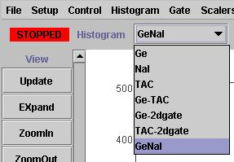

Displaying Histograms and Gates

Slide 15
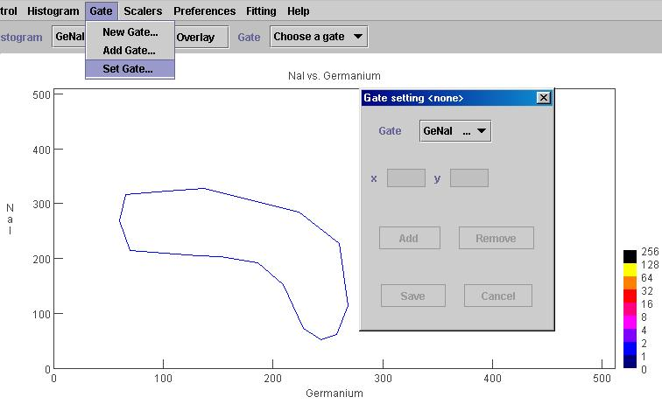
Setting Gates

Slide 16
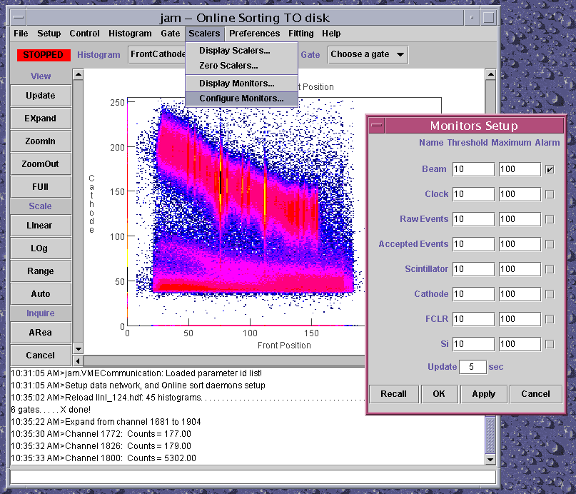
Configuring the Monitors
Audible alarm will sound if Monitor’s value falls below threshold or above Maximum
Monitor display shows range 0..Maximum
Update interval

Slide 17
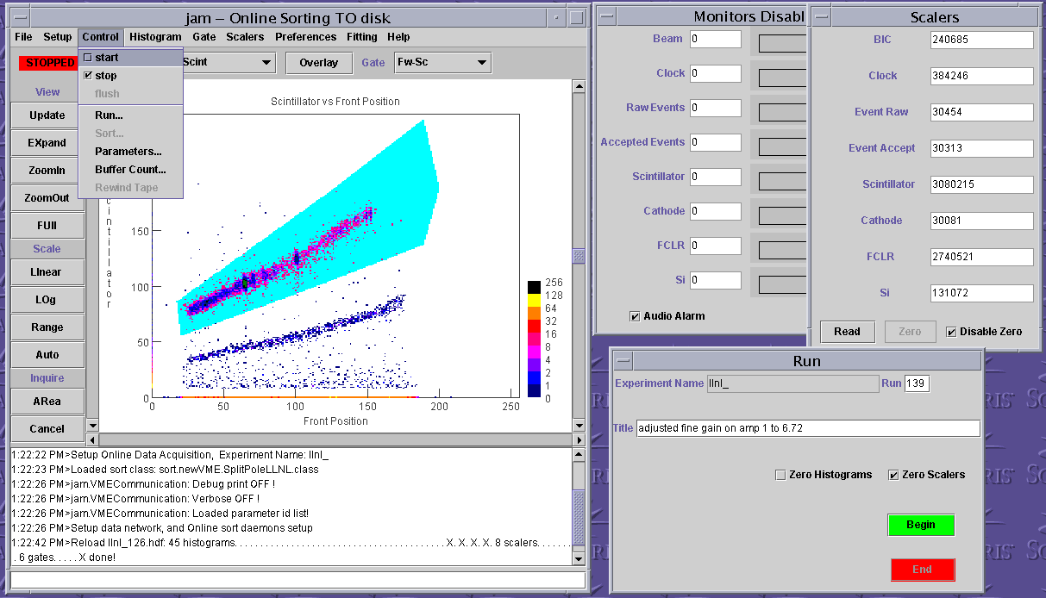
An online session
Begins a new run
Run number incremented automatically
events will be stored to disk
checked actions will occur
During a run…pauses and restarts
Before starting a run…sorts without saving events
HDF run summary saved when runs are ended

Slide 18
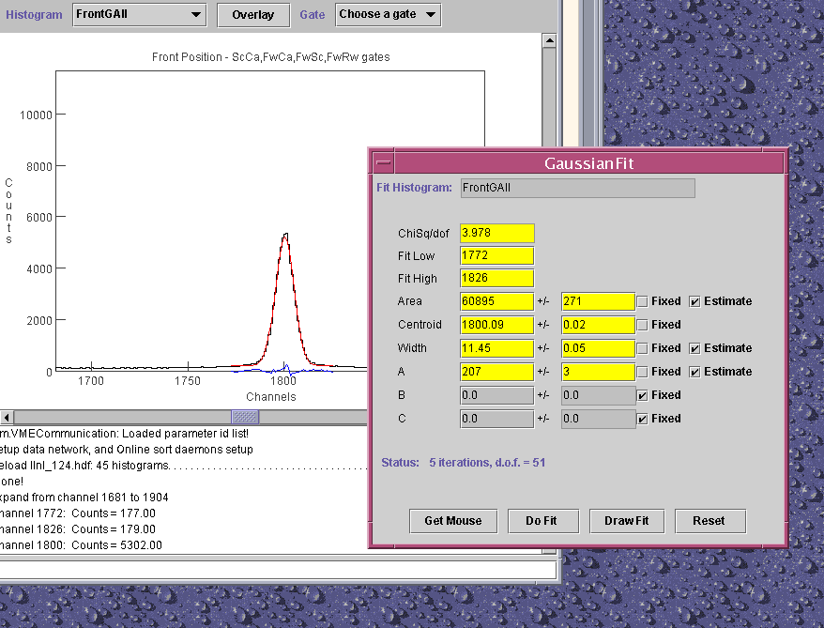
Fitting spectra in Jam

Slide 19
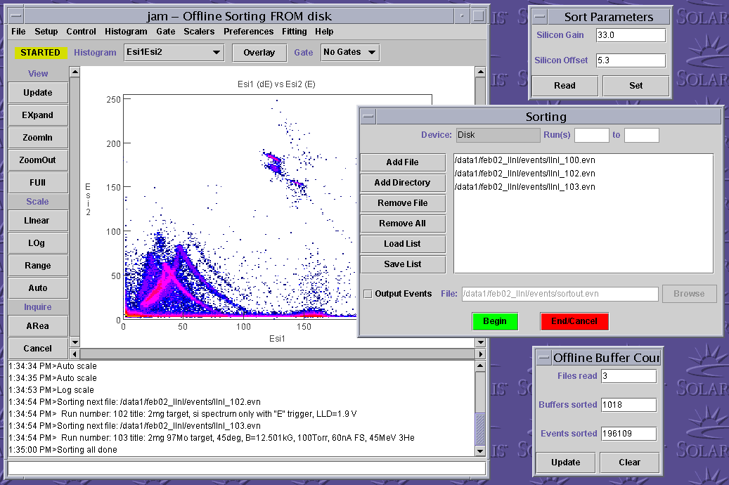
An offline session
Objects of type DataParameter may be defined in the sort routine
Check here to write “pre-sorted” event files with writeEvent( ) in sort routine

