Slide 1
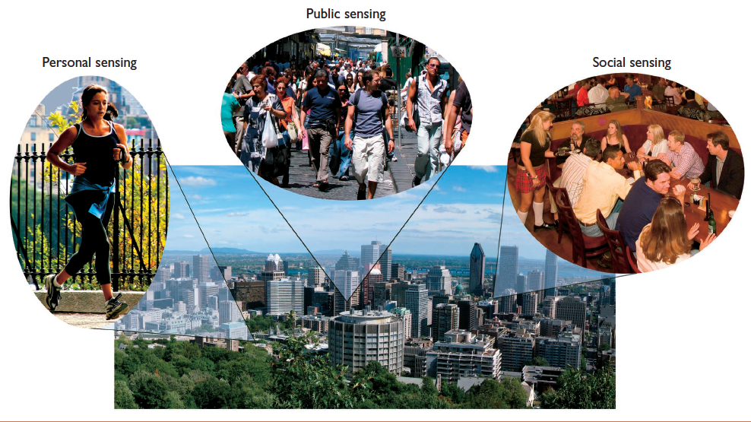
Crowd Sensing
Personal Sensing
Context Sensing

