Slide 1
Selenium Automation
ccao@evictor.com

Slide 2
Test Automation Using Selenium
Selenium IDE
Xpath
CSS selector
Demo

Slide 3
Selenium
Selenium is a robust set of tools that supports rapid development of test automation for web-based applications.
Selenium provides a rich set of testing functions specifically geared to the needs of testing of a web application.
Selenium operations are highly flexible, allowing many options for locating UI elements and comparing expected test results against actual application behavior.

Slide 4
Selenium Features
Supports Cross Browser Testing. The Selenium tests can be run on multiple browsers.
Allows scripting in several languages like Java, C#, PHP and Python.
Assertion statements provide an efficient way of comparing expected and actual results.
Inbuilt reporting mechanism.

Slide 5
Selenium IDE
Selenium IDE is an integrated development environment for Selenium tests.
It is implemented as a Firefox extension, and allows you to record, edit, and replay the test in firefox
Selenium IDE allows you to save tests as HTML, Java, Ruby scripts, or any other format
It allows you to automatically add assertions to all the pages.
https://addons.mozilla.org/en-US/firefox/addon/selenium-ide/
firebug

Slide 6
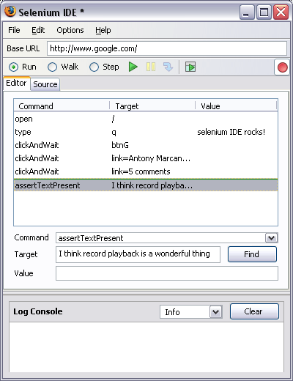
Selenium IDE - UI
Start and Stop
Recording
Replay
Toolbar
Selenese
Script
Editor
Accessor
Area
Selenium Log

Slide 7
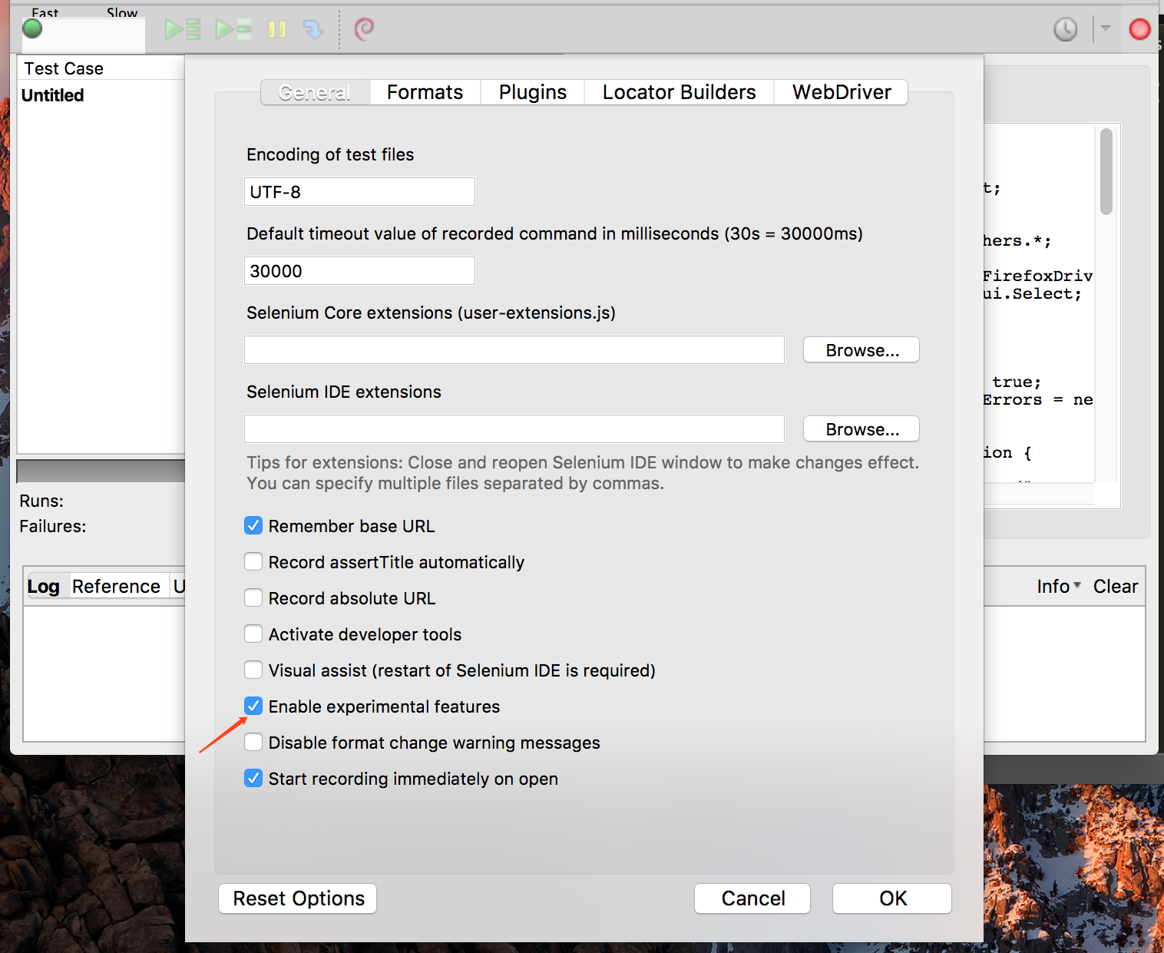
Add auto generate code

Slide 8
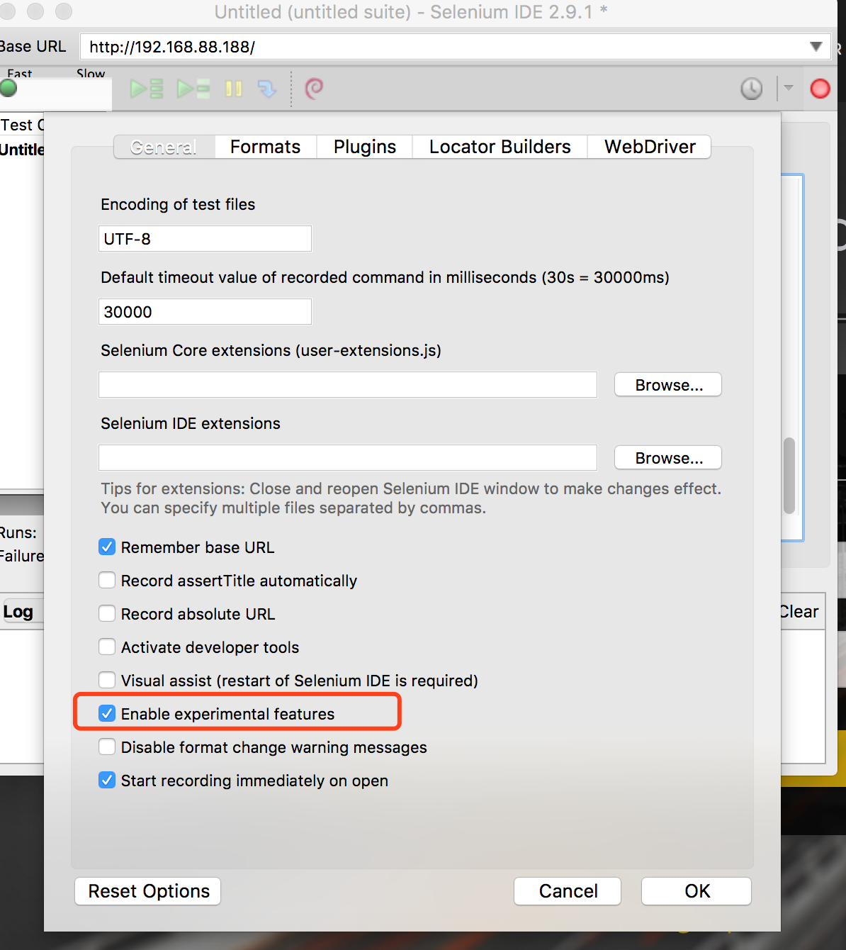
Selenium Recording

Slide 9
XPath in Selenium
http://www.guru99.com/xpath-selenium.html

Slide 10
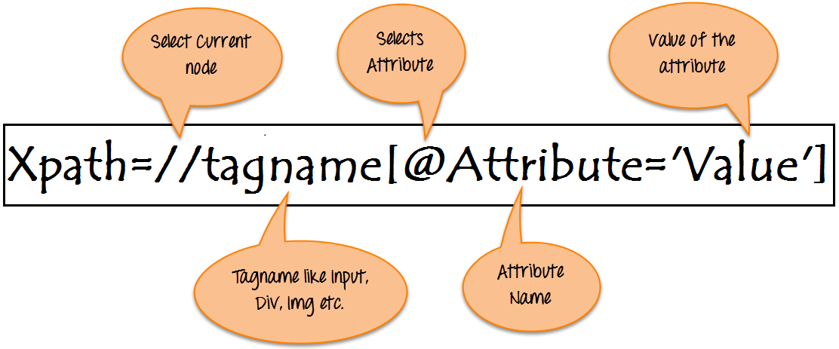
What is XPath

Slide 11
Xpath=//tagname[@attribute='value']
// : Select current node.
Tagname: Tagname of the particular node.
@: Select attribute.
Attribute: Attribute name of the node.
Value: Value of the attribute.

Slide 12
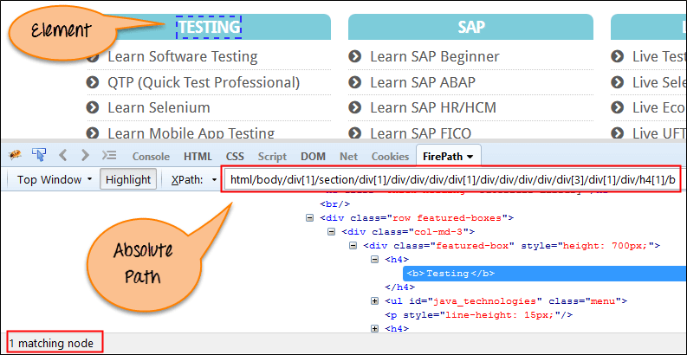
Absolute xpath:

Slide 13
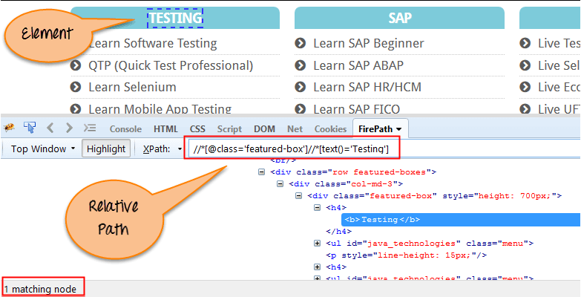
Relative xpath:

Slide 14
CSS Selector
https://www.w3schools.com/cssref/trysel.asp
https://saucelabs.com/resources/articles/selenium-tips-css-selectors
http://toolsqa.com/cucumber/data-driven-testing-using-examples-keyword/

Slide 15
UI Testing Design
Test Plan
Test case(Manual/Automation)
Pre condition
Testing steps
Validation
Post condition
Manual Testing
Automated Testing
Manual Testing
Converting to Automated test cases

Slide 16
Test design: IGA
Test plan
Scope: Desktop only, chrome
Enviroment: QA environment
Smoke Test
Open home page
My account page

Slide 17
IGA Test plan (Part II)
UAT Test
Login
Product detail
Place order
Payment
Regression Test:
Home page test suite
Top Bar Test
Navigator Test
Promotions
RECIPES
Footer
User Account suite
Login /logout
Signup

Slide 18
Page Object Pattern
Adds a layer of abstraction into your code.
Helps to organize your code once it grows large.
All automation is automatically reusable and shareable.
A way to separate tests from re-usable functions.
A way to store information about how the system works.

Slide 19
A way to specify what page functions start on, and what page they end on.
A way to programmatically break your tests when functionality changes.
Makes code maintenance easier.
There is even a PageFactory class available to automatically create them

Slide 20
How does it work?
Each page is defined as it’s own class.
Actions (including navigation) are represented as functions for a class.
Each function returns a new Page object, signifying what page the actions stops on.
Your tests “know” what page you are on, and will only give you access to functions available to that class.
Tests only talk to the page objects.
Page objects only talk to the driver.

Slide 21
Elements on the page are stored as variables for the page object.
Automatic page validations can be stored in the constructor for each page object.
Tests become a string of well defined functions, not meaningless gibberish.
Tests can be grouped by namespace.
Class Inheritance can be used to define functionality to a set of pages.
We can make functional logic transparent to the tests by returning different inherited classes.

