Slide 1
Report on Implementation of Highly Reliable SRA System
Xun Xu, Guanhua Chen, Pengfei Li

Slide 2
Word Sense Based Sentence Semantic Similarity Measurement
Steps:
1. Calculate word weights in reference sentence
2. Pair words based on Wordnet similarity
3. compute the similarity of the sentences based on the similarity of the pairs of words and their weights.

Slide 3
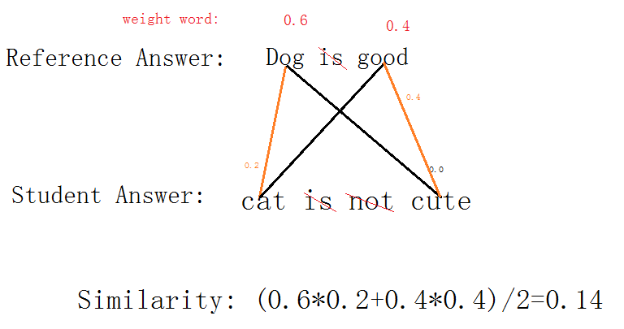
Word Sense Based Sentence Semantic Similarity Measurement

Slide 4
However, this approach is not able to handle some special cases
Work poorly on Non-domain detection and Contradictory detection.
So these 2 cases have to be handled separately.

Slide 5
Non-domain check
Different from others in 5-way task
Need check independently
Method: Populate corpus with
Unigrams of open-class words with occurrence > 1 in all non_domain answers of train set
Bigram of open-class words
Compute score of an answer for corpus
> 0.9 return non_domain
Otherwise continue
Precision: .85, Recall: .95

Slide 6
Contradictory Detection
Contradictory has one or a few of features listed below:
1. Contradictory resulted from negative words: I don’t like him; Dog is not as cute as cat.
2. Contradictory resulted from antonym: The dog is good vs The dog is bad.
3. Contradictory resulted from dierent seq. of words: A dog is larger than a cat vs A cat is larger than a dog

Slide 7
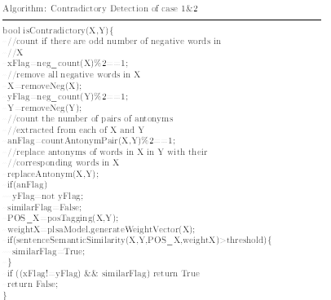
Contradictory Detection

Slide 8
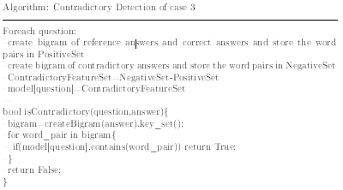
Contradictory Detection

Slide 9
Negative Sense and Antonym
StanfordParser
“He is not stupid.”
nsubj(stupid-4, He-1)
cop(stupid-4, is-2)
neg(stupid-4, not-3)
root(ROOT-0, stupid-4)

Slide 10
Negative Sense and Antonym
HandleAntonym
Searching all negative sense
Govern word is VERB: Replac it with the antonym and remove the dependent-word.
Verb: add one to NOTCOUNTER.
Return NOTCOUNTER%2 and the new sentence.

Slide 11
Implementation details
Preprocess the dataset
Training Procedure
Apply trained model on test set

Slide 12
Implementation details(Cont.)
Platform/Tools
Language: Python
Package: Stanford Parser, NLTK, WordNet, Enchant,

Slide 13
Text Normalization(Preprocess)
Tokenize (NLTK)
Remove stop words and pronunciations
Leave some special “stop words”
Up, down…
Stem(NLTK)/Lemmatize(WordNet)
Choose stem
run faster then Lemmatizing with good performance
Porter Stemmer

Slide 14
Text Normalization (Cont.)
Spell Correct
Performed during tokenization
Word Check
Use enchant to check if a word is correct spelled
Correct word with “edit_distance == 1”
Insert/delete/replace a letter or single quote
Transfer position of adjacent letter
Populate high frequency words list for priority
Using fix list with frequent word in train

Slide 15
Training Procedure
1. Preprocess the data
2. Create word weight vector using plsa for each question on its reference answers
3. Create bigram style co-occurance vector for each question
4. Train non-domain detection model
5. For each student answer:
(a) non-domain detection
(b) contradictory detection
(c) Apply Word Sense Based Sentence Semantic Similarity Measurement
between this answer and each reference answer, use the greatest sim-
ilarity score as this answer's score
6. Collect answer scores and their correct accuracy, determine the best boundaries of irrelevant, partial_correct_incomplete and correct

Slide 16
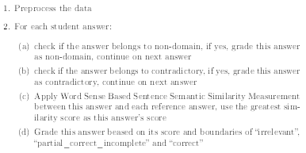
Apply trained model on test set

Slide 17
Future Works
find more accurate algorithm to determine word weights in a sentence other than PLSA which has similar performance with simple unigram approach.
Instead of apply the same boundaries of score to all the answers, we are sure that training different boundaries for each question could improve performance because we observed different best boundaries of score on different questions.
Reduce overfitting

