Slide 1
Ascot Racecourse

Slide 2
GoingStick Data
Regulatory Compliance

Slide 3
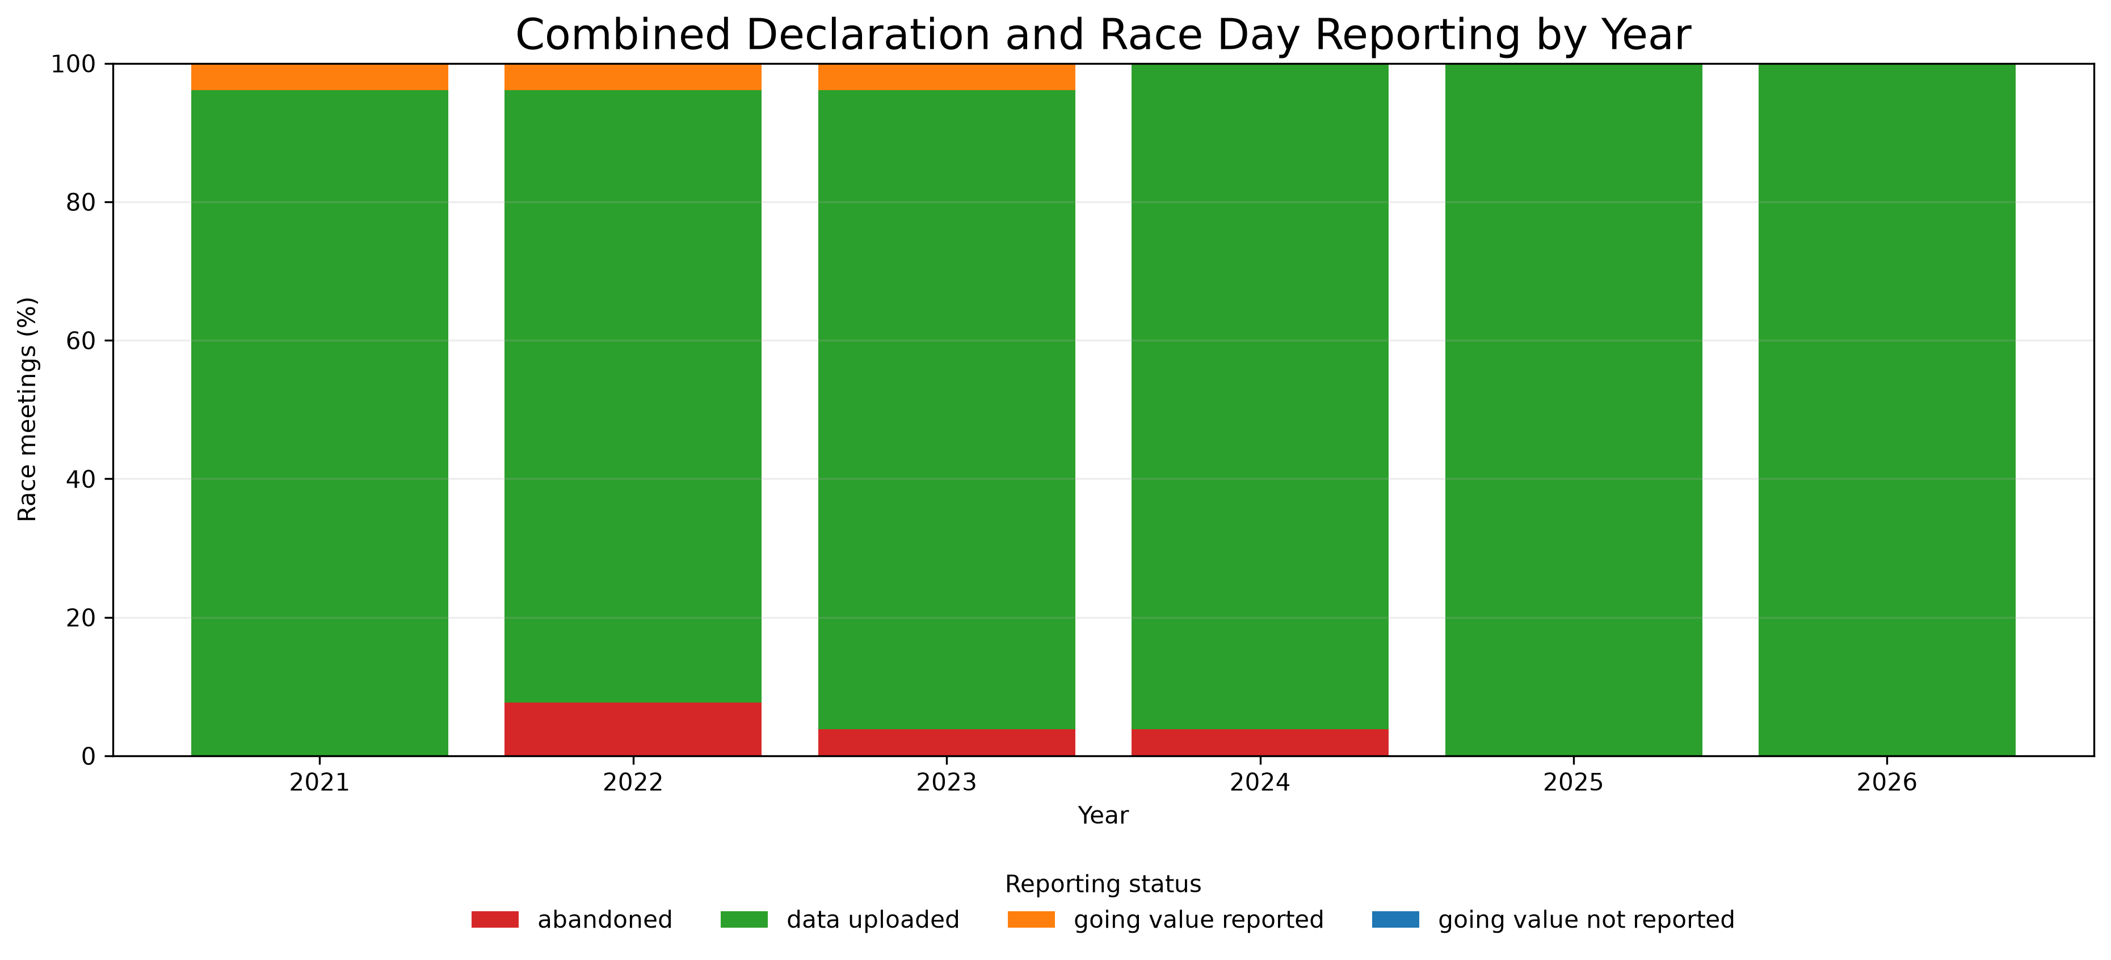
GoingStick Reporting

Slide 4
GoingStick Data
Stats

Slide 5
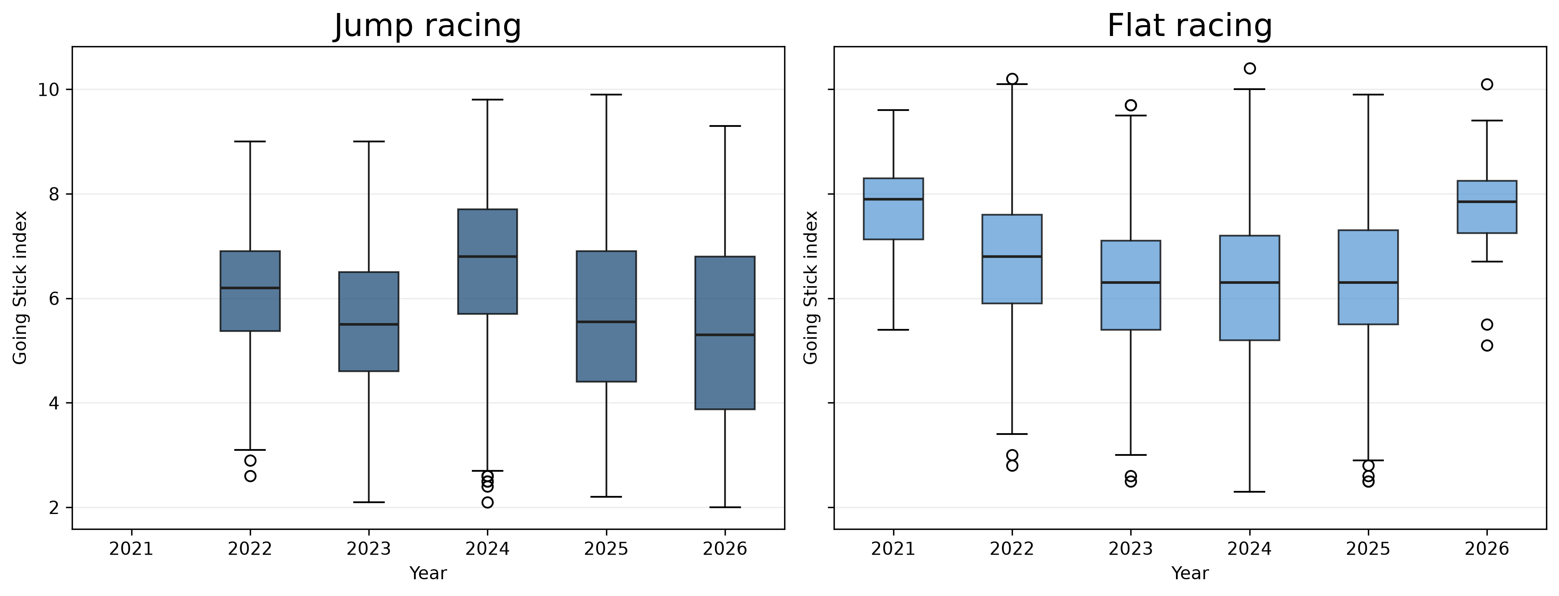
Index Values by Year

Slide 6
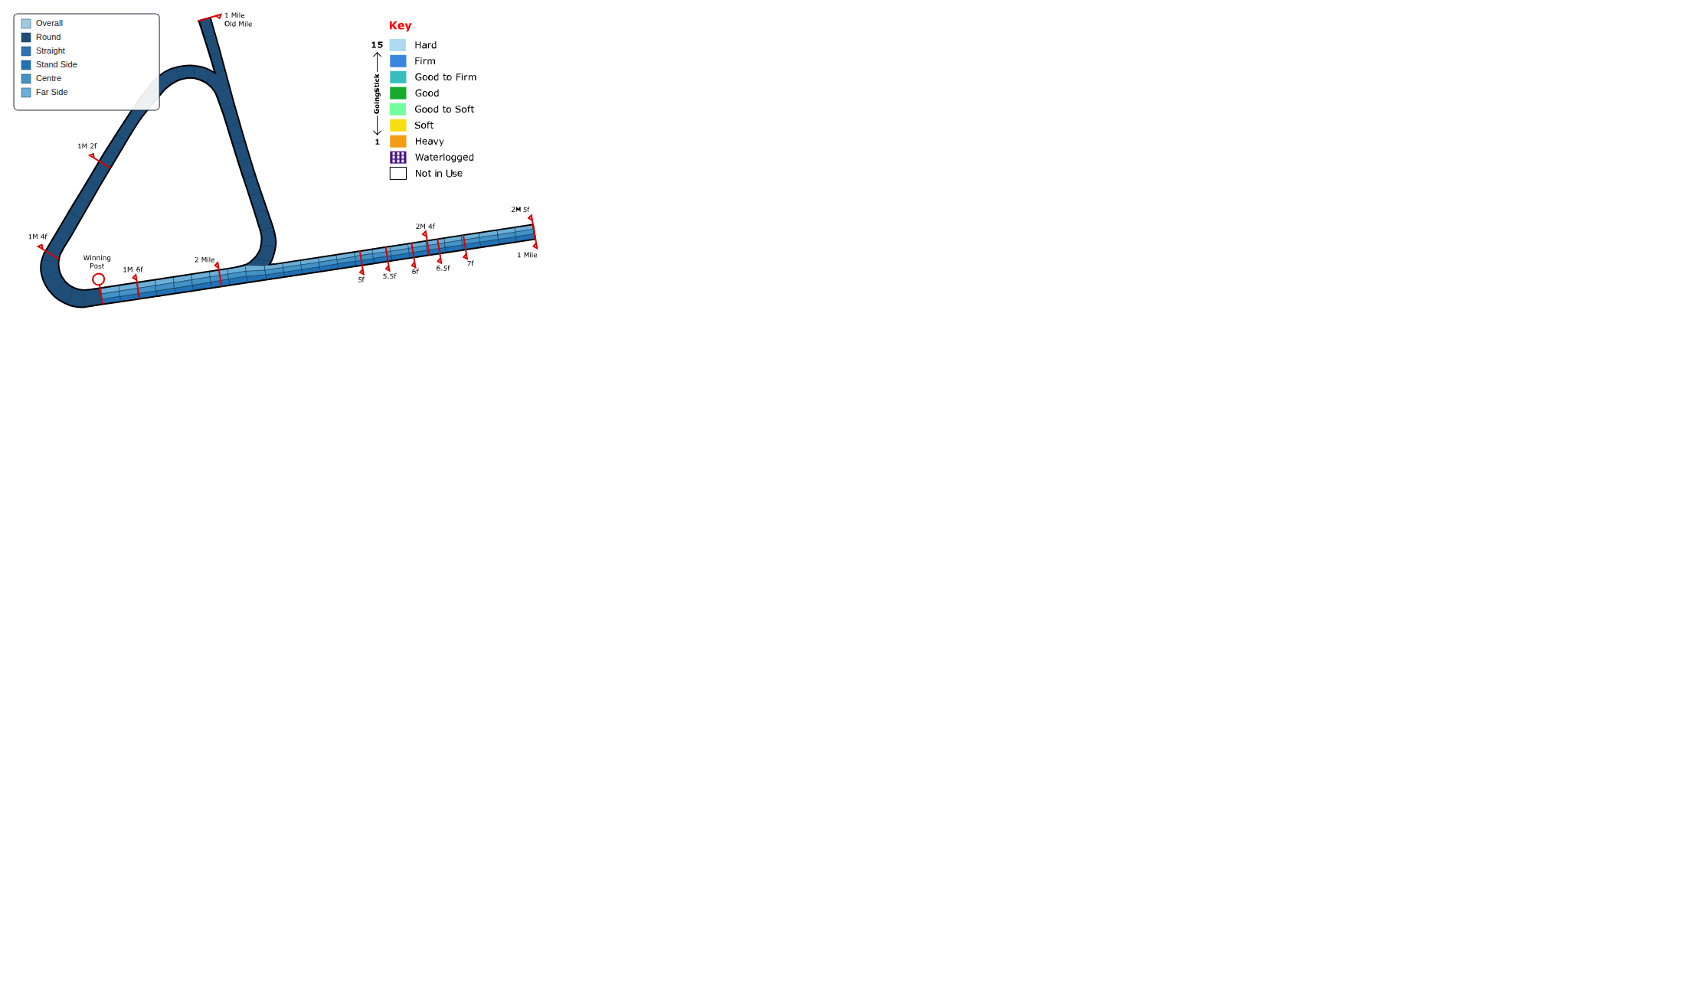
Flat Course Zones

Slide 7
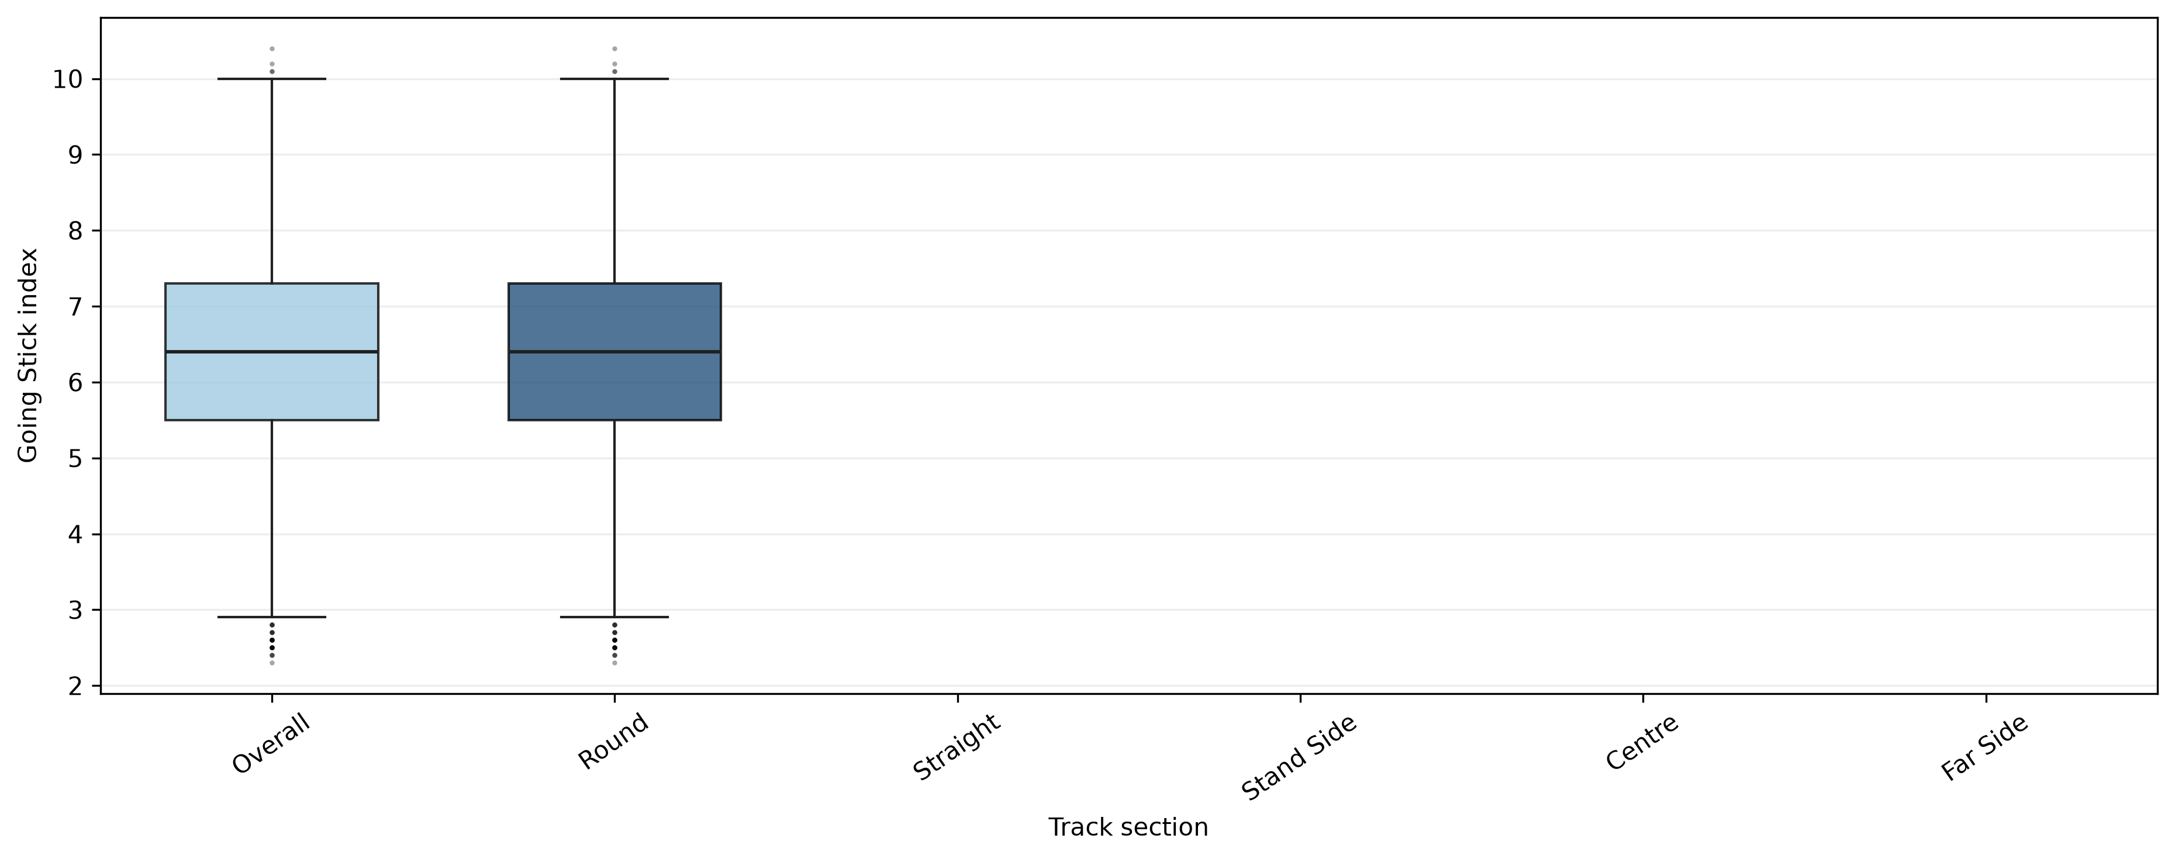
Flat GS Index by Track Section

Slide 8
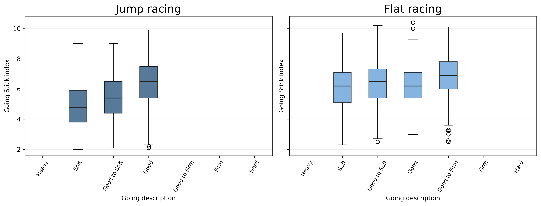
Index Values by Official Going

Slide 9
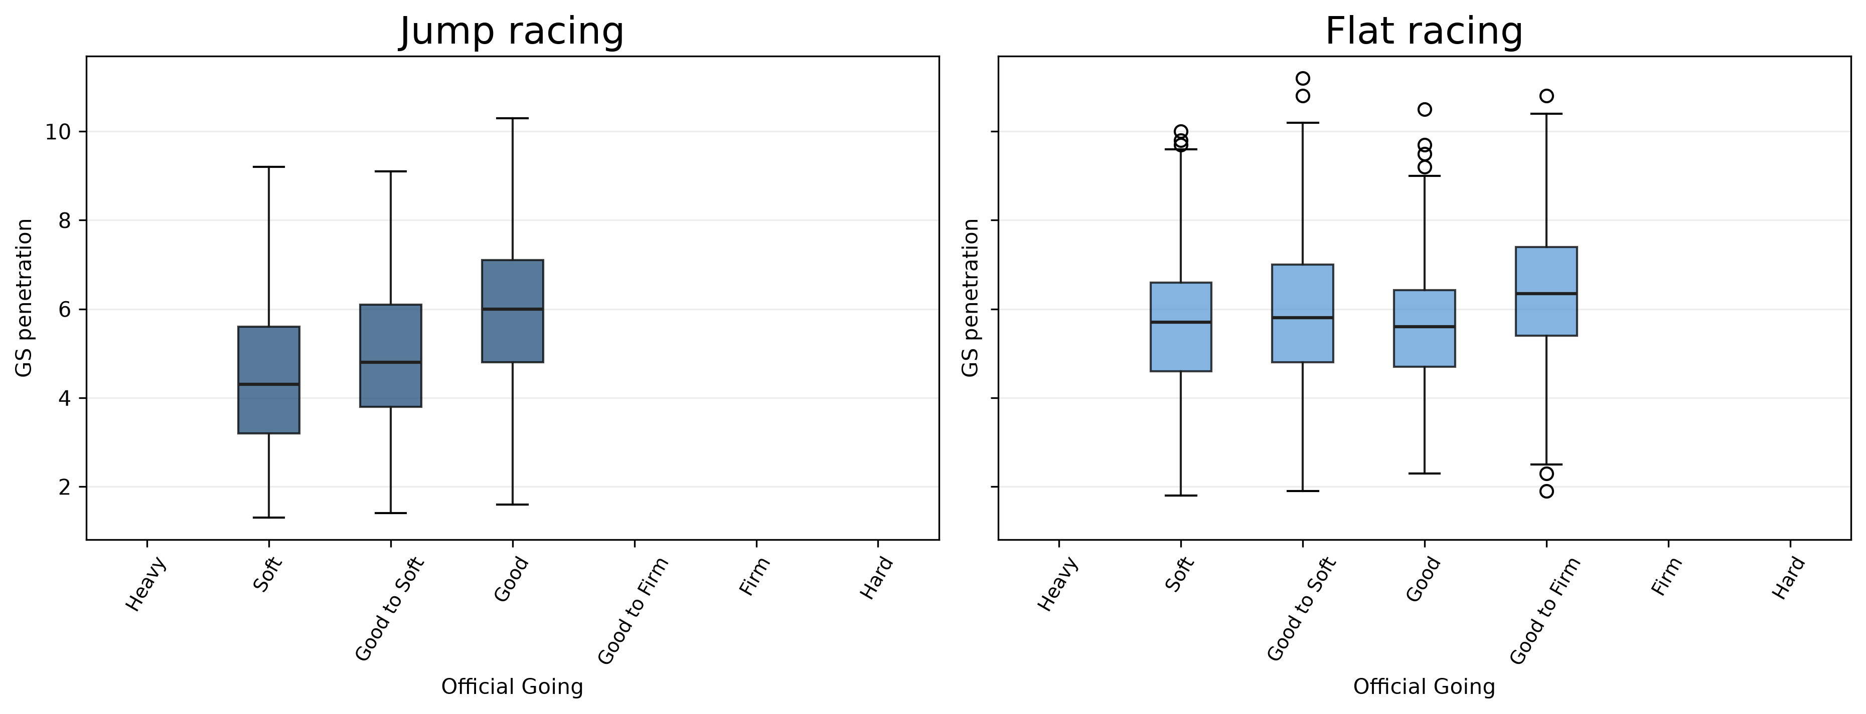
Penetration Values by Official Going

Slide 10
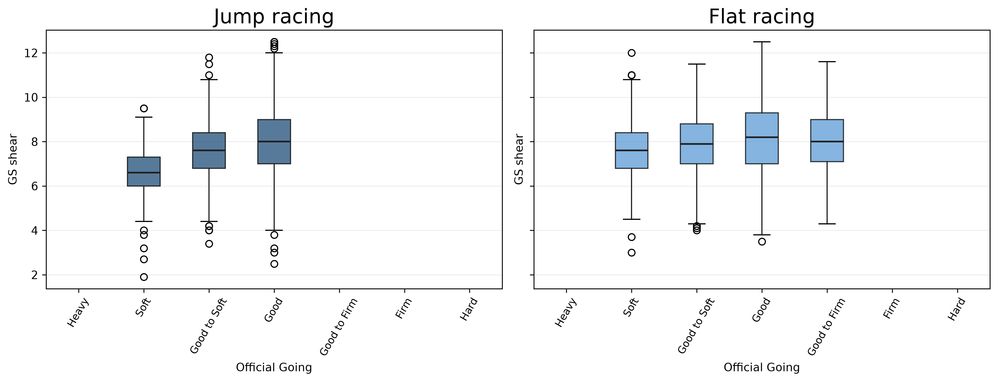
Shear Values by Official Going

Slide 11
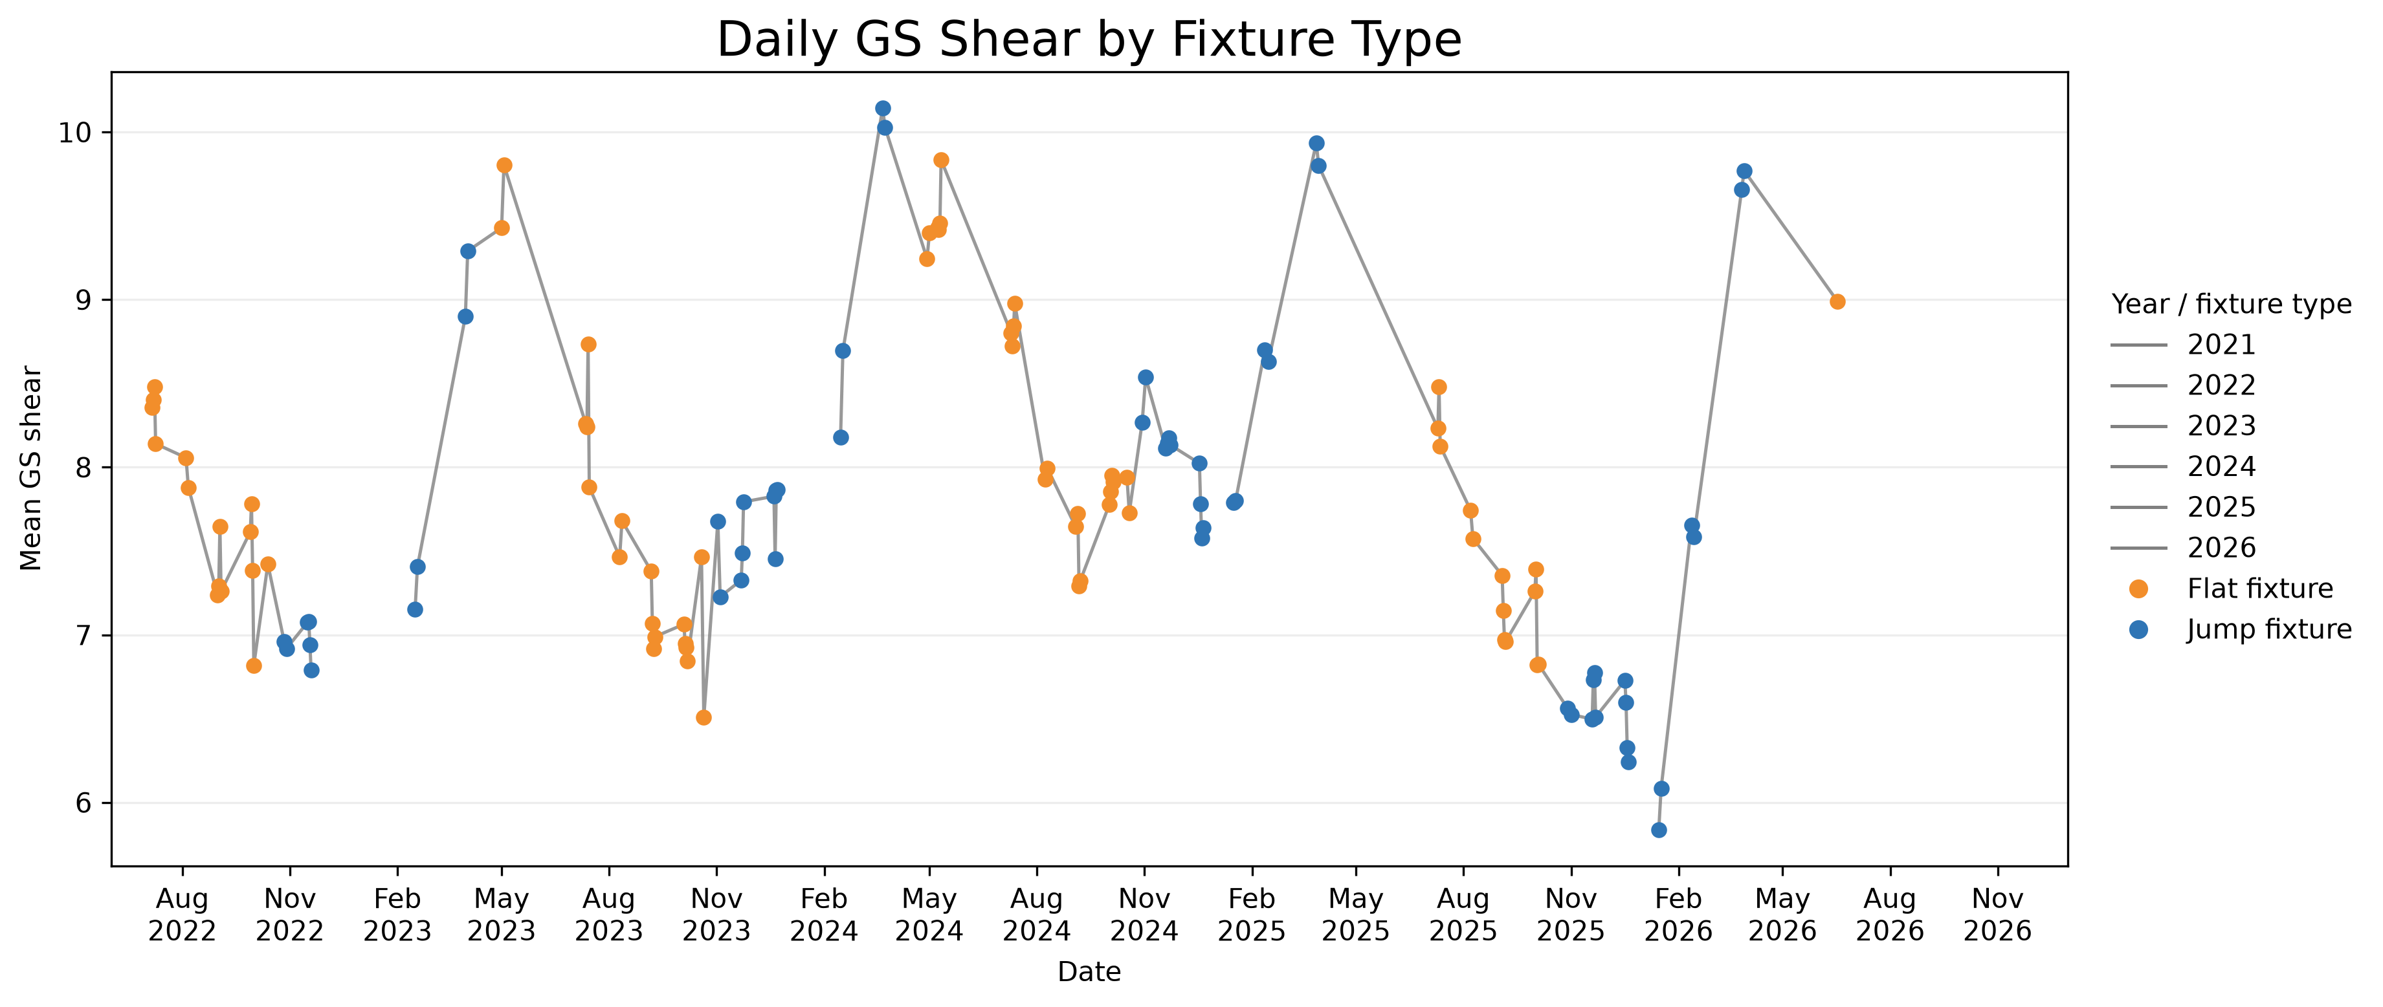
Daily GS Shear

