Slide 1
JCR GoingStick Analysis

Slide 2
JCR GoingStick Data

Slide 3
Scope and data coverage
Scope: Cheltenham | courses=1, maps=20, reports=1424, readings=1921
KeyError: "Label(s) ['race_day_goingstick_uploaded'] do not exist"
[31m---------------------------------------------------------------------------[39m
[31mKeyError[39m Traceback (most recent call last)
[36mCell[39m[36m [39m[32mIn[2][39m[32m, line 9[39m
[32m 5[39m print(f"Scope: {report_title} | courses={course_count}, maps={map_count}, reports={report_count}, readings={reading_count}")
[32m 6[39m
[32m 7[39m coverage = (
[32m 8[39m meetings.groupby([[33m"course_id"[39m, [33m"course_name"[39m], dropna=[38;5;28;01mFalse[39;00m)
[32m----> [39m[32m9[39m .agg(
[32m 10[39m meetings=([33m"race_date"[39m, [33m"nunique"[39m),
[32m 11[39m reports=([33m"going_report_count"[39m, [33m"sum"[39m),
[32m 12[39m going_reported=([33m"official_going_reported"[39m, [33m"sum"[39m),
[36mFile [39m[32m~/Projects/prj059-datatrax_jcr/.venv/lib/python3.13/site-packages/pandas/core/groupby/generic.py:2291[39m, in [36mDataFrameGroupBy.aggregate[39m[34m(self, func, engine, engine_kwargs, *args, **kwargs)[39m
[32m 2288[39m kwargs[[33m"[39m[33mengine_kwargs[39m[33m"[39m] = engine_kwargs
[32m 2290[39m op = GroupByApply([38;5;28mself[39m, func, args=args, kwargs=kwargs)
[32m-> [39m[32m2291[39m result = [30;43mop[39;49m[30;43m.[39;49m[30;43magg[39;49m[30;43m([39;49m[30;43m)[39;49m
[32m 2292[39m [38;5;28;01mif[39;00m [38;5;129;01mnot[39;00m is_dict_like(func) [38;5;129;01mand[39;00m result [38;5;129;01mis[39;00m [38;5;129;01mnot[39;00m [38;5;28;01mNone[39;00m:
[32m 2293[39m [38;5;66;03m# GH #52849[39;00m
[32m 2294[39m [38;5;28;01mif[39;00m [38;5;129;01mnot[39;00m [38;5;28mself[39m.as_index [38;5;129;01mand[39;00m is_list_like(func):
[36mFile [39m[32m~/Projects/prj059-datatrax_jcr/.venv/lib/python3.13/site-packages/pandas/core/apply.py:294[39m, in [36mApply.agg[39m[34m(self)[39m
[32m 291[39m [38;5;28;01mreturn[39;00m [38;5;28mself[39m.apply_str()
[32m 293[39m [38;5;28;01mif[39;00m is_dict_like(func):
[32m--> [39m[32m294[39m [38;5;28;01mreturn[39;00m [30;43mself[39;49m[30;43m.[39;49m[30;43magg_dict_like[39;49m[30;43m([39;49m[30;43m)[39;49m
[32m 295[39m [38;5;28;01melif[39;00m is_list_like(func):
[32m 296[39m [38;5;66;03m# we require a list, but not a 'str'[39;00m
[32m 297[39m [38;5;28;01mreturn[39;00m [38;5;28mself[39m.agg_list_like()
[36mFile [39m[32m~/Projects/prj059-datatrax_jcr/.venv/lib/python3.13/site-packages/pandas/core/apply.py:511[39m, in [36mApply.agg_dict_like[39m[34m(self)[39m
[32m 503[39m [38;5;28;01mdef[39;00m[38;5;250m [39m[34magg_dict_like[39m([38;5;28mself[39m) -> DataFrame | Series:
[32m 504[39m [38;5;250m [39m[33;03m"""[39;00m
[32m 505[39m [33;03m Compute aggregation in the case of a dict-like argument.[39;00m
[32m 506[39m
[32m (...)[39m[32m 509[39m [33;03m Result of aggregation.[39;00m
[32m 510[39m [33;03m """[39;00m
[32m--> [39m[32m511[39m [38;5;28;01mreturn[39;00m [30;43mself[39;49m[30;43m.[39;49m[30;43magg_or_apply_dict_like[39;49m[30;43m([39;49m[30;43mop_name[39;49m[30;43m=[39;49m[30;43m"[39;49m[30;43magg[39;49m[30;43m"[39;49m[30;43m)[39;49m
[36mFile [39m[32m~/Projects/prj059-datatrax_jcr/.venv/lib/python3.13/site-packages/pandas/core/apply.py:1677[39m, in [36mGroupByApply.agg_or_apply_dict_like[39m[34m(self, op_name)[39m
[32m 1672[39m kwargs.update({[33m"[39m[33mengine[39m[33m"[39m: engine, [33m"[39m[33mengine_kwargs[39m[33m"[39m: engine_kwargs})
[32m 1674[39m [38;5;28;01mwith[39;00m com.temp_setattr(
[32m 1675[39m obj, [33m"[39m[33mas_index[39m[33m"[39m, [38;5;28;01mTrue[39;00m, condition=[38;5;28mhasattr[39m(obj, [33m"[39m[33mas_index[39m[33m"[39m)
[32m 1676[39m ):
[32m-> [39m[32m1677[39m result_index, result_data = [30;43mself[39;49m[30;43m.[39;49m[30;43mcompute_dict_like[39;49m[30;43m([39;49m
[32m 1678[39m [30;43m [39;49m[30;43mop_name[39;49m[30;43m,[39;49m[30;43m [39;49m[30;43mselected_obj[39;49m[30;43m,[39;49m[30;43m [39;49m[30;43mselection[39;49m[30;43m,[39;49m[30;43m [39;49m[30;43mkwargs[39;49m
[32m 1679[39m [30;43m [39;49m[30;43m)[39;49m
[32m 1680[39m result = [38;5;28mself[39m.wrap_results_dict_like(selected_obj, result_index, result_data)
[32m 1681[39m [38;5;28;01mreturn[39;00m result
[36mFile [39m[32m~/Projects/prj059-datatrax_jcr/.venv/lib/python3.13/site-packages/pandas/core/apply.py:550[39m, in [36mApply.compute_dict_like[39m[34m(self, op_name, selected_obj, selection, kwargs)[39m
[32m 548[39m is_groupby = [38;5;28misinstance[39m(obj, (DataFrameGroupBy, SeriesGroupBy))
[32m 549[39m func = cast(AggFuncTypeDict, [38;5;28mself[39m.func)
[32m--> [39m[32m550[39m func = [30;43mself[39;49m[30;43m.[39;49m[30;43mnormalize_dictlike_arg[39;49m[30;43m([39;49m[30;43mop_name[39;49m[30;43m,[39;49m[30;43m [39;49m[30;43mselected_obj[39;49m[30;43m,[39;49m[30;43m [39;49m[30;43mfunc[39;49m[30;43m)[39;49m
[32m 552[39m is_non_unique_col = (
[32m 553[39m selected_obj.ndim == [32m2[39m
[32m 554[39m [38;5;129;01mand[39;00m selected_obj.columns.nunique() < [38;5;28mlen[39m(selected_obj.columns)
[32m 555[39m )
[32m 557[39m [38;5;28;01mif[39;00m selected_obj.ndim == [32m1[39m:
[32m 558[39m [38;5;66;03m# key only used for output[39;00m
[36mFile [39m[32m~/Projects/prj059-datatrax_jcr/.venv/lib/python3.13/site-packages/pandas/core/apply.py:762[39m, in [36mApply.normalize_dictlike_arg[39m[34m(self, how, obj, func)[39m
[32m 759[39m cols = Index([38;5;28mlist[39m(func.keys())).difference(obj.columns, sort=[38;5;28;01mTrue[39;00m)
[32m 760[39m [38;5;28;01mif[39;00m [38;5;28mlen[39m(cols) > [32m0[39m:
[32m 761[39m [38;5;66;03m# GH 58474[39;00m
[32m--> [39m[32m762[39m [38;5;28;01mraise[39;00m [38;5;167;01mKeyError[39;00m([33mf[39m[33m"[39m[33mLabel(s) [39m[38;5;132;01m{[39;00m[38;5;28mlist[39m(cols)[38;5;132;01m}[39;00m[33m do not exist[39m[33m"[39m)
[32m 764[39m aggregator_types = ([38;5;28mlist[39m, [38;5;28mtuple[39m, [38;5;28mdict[39m)
[32m 766[39m [38;5;66;03m# if we have a dict of any non-scalars[39;00m
[32m 767[39m [38;5;66;03m# eg. {'A' : ['mean']}, normalize all to[39;00m
[32m 768[39m [38;5;66;03m# be list-likes[39;00m
[32m 769[39m [38;5;66;03m# Cannot use func.values() because arg may be a Series[39;00m
[31mKeyError[39m: "Label(s) ['race_day_goingstick_uploaded'] do not exist"

Slide 4
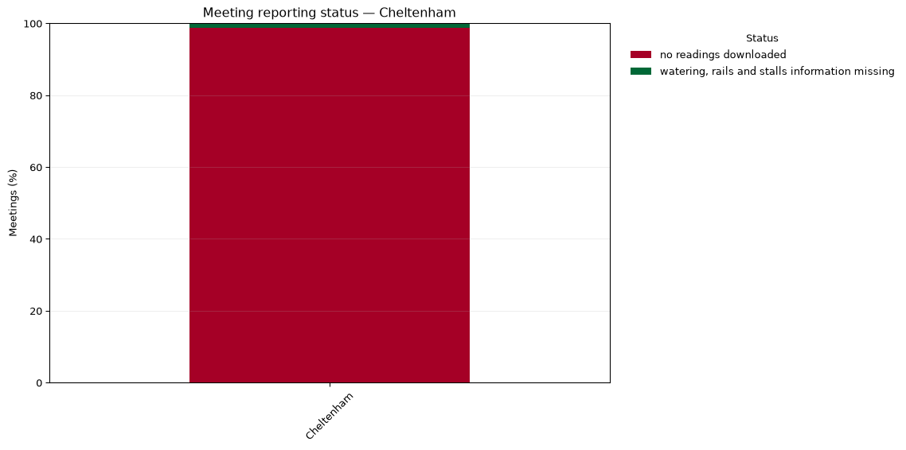
Meeting reporting status

Slide 5
GoingStick measurements

Slide 6
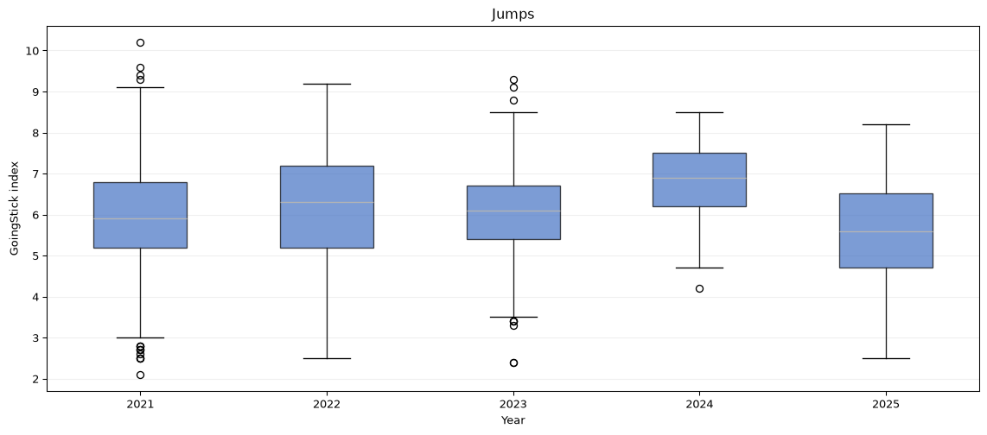
Index values by year and discipline

Slide 7
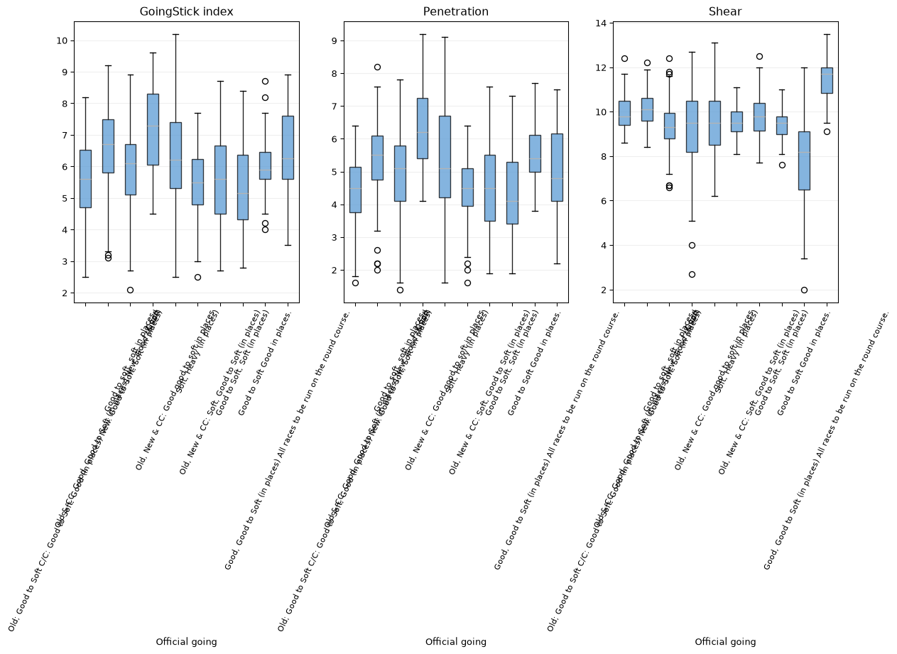
Index, penetration and shear by official going

Slide 8
Spatial summaries by configured section and zone
KeyError: 'map_label'
[31m---------------------------------------------------------------------------[39m
[31mKeyError[39m Traceback (most recent call last)
[36mCell[39m[36m [39m[32mIn[6][39m[32m, line 4[39m
[32m 1[39m spatial = spatial_readings.dropna(subset=[[33m"index"[39m]).copy()
[32m 2[39m section_summary = (
[32m 3[39m spatial.dropna(subset=[[33m"section_label"[39m])
[32m----> [39m[32m4[39m .groupby([[33m"course_id"[39m, [33m"map_id"[39m, [33m"map_label"[39m, [33m"section_label"[39m], dropna=[38;5;28;01mFalse[39;00m)
[32m 5[39m .agg(readings=([33m"index"[39m, [33m"size"[39m), mean_index=([33m"index"[39m, [33m"mean"[39m), median_index=([33m"index"[39m, [33m"median"[39m))
[32m 6[39m .reset_index()
[32m 7[39m .sort_values([[33m"course_id"[39m, [33m"map_id"[39m, [33m"section_label"[39m])
[36mFile [39m[32m~/Projects/prj059-datatrax_jcr/.venv/lib/python3.13/site-packages/pandas/util/_decorators.py:336[39m, in [36mdeprecate_nonkeyword_arguments.<locals>.decorate.<locals>.wrapper[39m[34m(*args, **kwargs)[39m
[32m 330[39m [38;5;28;01mif[39;00m [38;5;28mlen[39m(args) > num_allow_args:
[32m 331[39m warnings.warn(
[32m 332[39m msg.format(arguments=_format_argument_list(allow_args)),
[32m 333[39m klass,
[32m 334[39m stacklevel=find_stack_level(),
[32m 335[39m )
[32m--> [39m[32m336[39m [38;5;28;01mreturn[39;00m [30;43mfunc[39;49m[30;43m([39;49m[30;43m*[39;49m[30;43margs[39;49m[30;43m,[39;49m[30;43m [39;49m[30;43m*[39;49m[30;43m*[39;49m[30;43mkwargs[39;49m[30;43m)[39;49m
[36mFile [39m[32m~/Projects/prj059-datatrax_jcr/.venv/lib/python3.13/site-packages/pandas/core/frame.py:10835[39m, in [36mDataFrame.groupby[39m[34m(self, by, level, as_index, sort, group_keys, observed, dropna)[39m
[32m 10831[39m
[32m 10832[39m [38;5;28;01mif[39;00m level [38;5;28;01mis[39;00m [38;5;28;01mNone[39;00m [38;5;28;01mand[39;00m by [38;5;28;01mis[39;00m [38;5;28;01mNone[39;00m:
[32m 10833[39m [38;5;28;01mraise[39;00m TypeError([33m"You have to supply one of 'by' and 'level'"[39m)
[32m 10834[39m
[32m> [39m[32m10835[39m return DataFrameGroupBy(
[32m 10836[39m obj=self,
[32m 10837[39m keys=by,
[32m 10838[39m level=level,
[36mFile [39m[32m~/Projects/prj059-datatrax_jcr/.venv/lib/python3.13/site-packages/pandas/core/groupby/groupby.py:1095[39m, in [36mGroupBy.__init__[39m[34m(self, obj, keys, level, grouper, exclusions, selection, as_index, sort, group_keys, observed, dropna)[39m
[32m 1092[39m [38;5;28mself[39m.dropna = dropna
[32m 1094[39m [38;5;28;01mif[39;00m grouper [38;5;129;01mis[39;00m [38;5;28;01mNone[39;00m:
[32m-> [39m[32m1095[39m grouper, exclusions, obj = [30;43mget_grouper[39;49m[30;43m([39;49m
[32m 1096[39m [30;43m [39;49m[30;43mobj[39;49m[30;43m,[39;49m
[32m 1097[39m [30;43m [39;49m[30;43mkeys[39;49m[30;43m,[39;49m
[32m 1098[39m [30;43m [39;49m[30;43mlevel[39;49m[30;43m=[39;49m[30;43mlevel[39;49m[30;43m,[39;49m
[32m 1099[39m [30;43m [39;49m[30;43msort[39;49m[30;43m=[39;49m[30;43msort[39;49m[30;43m,[39;49m
[32m 1100[39m [30;43m [39;49m[30;43mobserved[39;49m[30;43m=[39;49m[30;43mobserved[39;49m[30;43m,[39;49m
[32m 1101[39m [30;43m [39;49m[30;43mdropna[39;49m[30;43m=[39;49m[30;43mself[39;49m[30;43m.[39;49m[30;43mdropna[39;49m[30;43m,[39;49m
[32m 1102[39m [30;43m [39;49m[30;43m)[39;49m
[32m 1104[39m [38;5;28mself[39m.observed = observed
[32m 1105[39m [38;5;28mself[39m.obj = obj
[36mFile [39m[32m~/Projects/prj059-datatrax_jcr/.venv/lib/python3.13/site-packages/pandas/core/groupby/grouper.py:901[39m, in [36mget_grouper[39m[34m(obj, key, level, sort, observed, validate, dropna)[39m
[32m 899[39m in_axis, level, gpr = [38;5;28;01mFalse[39;00m, gpr, [38;5;28;01mNone[39;00m
[32m 900[39m [38;5;28;01melse[39;00m:
[32m--> [39m[32m901[39m [38;5;28;01mraise[39;00m [38;5;167;01mKeyError[39;00m(gpr)
[32m 902[39m [38;5;28;01melif[39;00m [38;5;28misinstance[39m(gpr, Grouper) [38;5;129;01mand[39;00m gpr.key [38;5;129;01mis[39;00m [38;5;129;01mnot[39;00m [38;5;28;01mNone[39;00m:
[32m 903[39m [38;5;66;03m# Add key to exclusions[39;00m
[32m 904[39m exclusions.add(gpr.key)
[31mKeyError[39m: 'map_label'

Slide 9
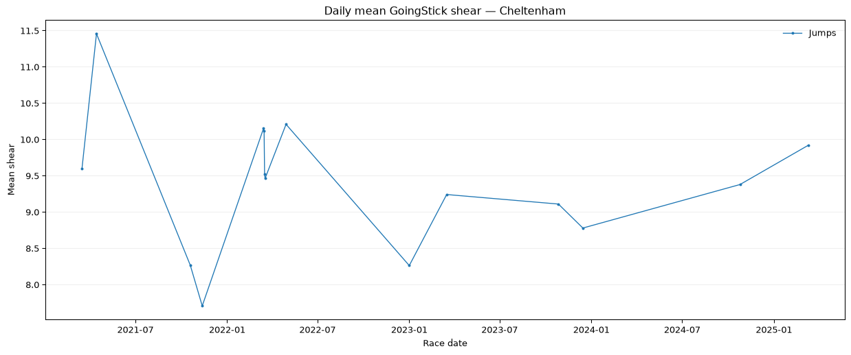
Daily shear trend

