Slide 1
KIRCHER RESEARCH / TEMPERATURE FORECASTING
Building temperature prediction
Project deliverables • Steps 1–5
15-minute data • May 12 – July 8, 2026
Best 24-hour RMSE
Linear baseline
Reduction vs linear
0.464°C
1.166°C
60%
LSTM · retrained checkpoint
Validation 24-hour RMSE
Preliminary validation
All results are validation-only. Independent test data was not supplied.
01 / 10

Slide 2
KIRCHER RESEARCH / TEMPERATURE FORECASTING
Goal & measurement
Predict indoor temperature
Compare five models
15 minutes ahead → then hours ahead
Persistence • Linear regression
XGBoost • Neural network • LSTM
Input: weather, energy, cooling, schedules
Score: temperature RMSE (°C) · lower is better
02 / 10

Slide 3
KIRCHER RESEARCH / TEMPERATURE FORECASTING
Step 1 | Dataset built
Training transitions
Validation transitions
Model input columns
4,127
1,331
13
Through June 24
June 25 – July 8
12 features + cooling power
Rules applied
• Both rows valid and exactly 15 minutes apart
• Chronological split; no random shuffle
• Inputs aligned to the appendix definitions
03 / 10

Slide 4
KIRCHER RESEARCH / TEMPERATURE FORECASTING
Step 2 | Baselines reproduced
Reference values matched to 3 decimals
Model
15 min
8 h
24 h
Open-loop
Persistence
0.190
1.532
2.341
2.058
Linear regression
0.167
0.840
1.166
1.465
Linear model thermal capacitance: 163.4 kWh/°C
All entries are validation RMSE (°C).
04 / 10

Slide 5
KIRCHER RESEARCH / TEMPERATURE FORECASTING
Step 3 | Models trained
XGBoost
Boosted decision trees
0.147°C
Neural network
Feed-forward MLP
0.151°C
LSTM
8-step sequence · 16 hidden units
0.044°C
15-minute validation RMSE · LSTM evaluated on 1,303 eligible sequences
05 / 10

Slide 6
KIRCHER RESEARCH / TEMPERATURE FORECASTING
Step 4 | Full comparison
Model
Train 15m
Val 15m
8h
24h
Open-loop
Persistence
.152
.190
1.532
2.341
2.058
Linear regression
.135
.167
.840
1.166
1.465
XGBoost
.103
.147
.446
.660
1.410
Neural network
.112
.151
.522
1.055
2.708
LSTM
.036
.044
.263
.464
.691
RMSE in °C. LSTM: 4,039 training / 1,303 validation sequences; other models: 4,127 / 1,331.
06 / 10

Slide 7
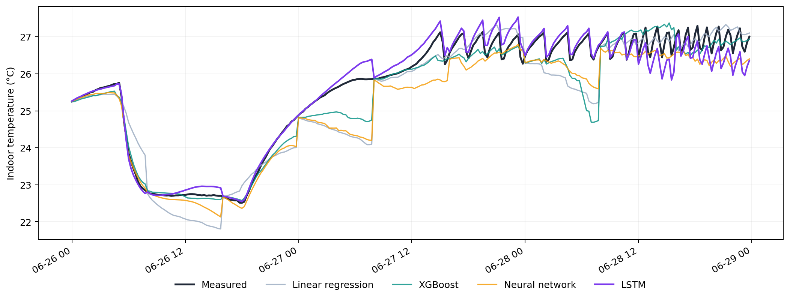
KIRCHER RESEARCH / TEMPERATURE FORECASTING
Step 5 | Measured vs predicted
June 26–28 • 8-hour resets • Validation data
07 / 10

Slide 8
KIRCHER RESEARCH / TEMPERATURE FORECASTING
What the models learned
Time of day (sine)
22.8%
Electricity
12.4%
Occupancy
10.7%
Cooling power
8.8%
Time of day (cosine)
8.1%
Direct sunlight
8.0%
XGBoost feature importance; predictive influence, not proof of causation.
08 / 10

Slide 9
KIRCHER RESEARCH / TEMPERATURE FORECASTING
Findings & limitations
Key findings
What is still unverified
• LSTM lowest error in this run
• XGBoost strong simpler option
• MLP open-loop drift is high
• Long-horizon tests matter
• Only one LSTM seed completed
• Model selection used validation data
• No held-out July 9–23 test file
• Different LSTM sample eligibility
Earlier LSTM 24-hour RMSE was 0.525°C; retrained checkpoint yields 0.464°C.
09 / 10

Slide 10
KIRCHER RESEARCH / TEMPERATURE FORECASTING
Deliverables & next actions
Completed artifacts
• Dataset + baseline verification script
• Model-tuning CSV
• Five-model evaluation CSV
• Common-sample comparison CSV
• Feature-importance CSV
• Measured/predicted plot + LSTM checkpoint
Next: repeat LSTM seeds, then evaluate the untouched held-out test data when supplied.
10 / 10

