Slide 1

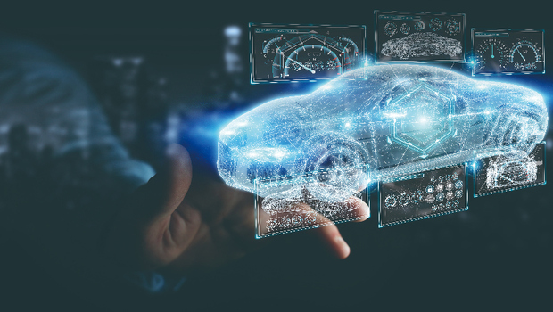

AI Smart Car
2721714K Chung-Chun Kao
2729479C Chen Che
2785471L Bin Lou
2785563F Qiushi Feng
Introduction
Specifications
A middle-sized car which includes basic functions and automatic navigation system based on Google Map
1 x Raspberry Pi
1 x Camera Module
1 x Ultrasonic Module
Goals
Cost
Enables to transfer from A to B by using Google Map
Enables to detect obstacles or any other situation while moving
Around £60
(Raspberry Pi and Modules £50, Car £10)
Main Functions
Extended Functions
Basic movements
Obstacle Detection and Avoidance
Line tracking
Navigation extraction and processing
Automatic follow
Traffic lights recognition
Github
https://github.com/dxc4598/AI-Smart-Car

