Slide 1
Recognition of Harmful Phytoplankton from Microscopic Images using Deep Learning
Authors: Rohaifa Khaldi Dept. of Computer Science and Artificial Intelligence, DaSCI, University of Granada, 18071 Granada, Spain
Aymane Khaldi
School of Science and Engineering, Al Akhawayn University, Ifrane, Morocco

Slide 2
Motivation
Monitoring plankton is crucial for maintaining aquatic ecosystems, regulating the global climate, and ensuring environmental protection.
We need an accurate and efficient automated system to monitor plankton distribution, particularly harmful phytoplankton.
Automated systems using deep learning can improve this process of classifying harmful phytoplankton by providing rapid, scalable, and more reliable solutions.

Slide 3
Problem statement
Plankton is crucial for producing around 90% of Earth's oxygen, but its decline threatens ocean ecosystems, while excessive growth can release harmful toxins. Certain phytoplankton species rapidly proliferate under abnormal water conditions, causing harmful algal blooms.
Traditional methods for monitoring algae are time-consuming, costly, and often error-prone, requiring highly skilled professionals. These manual methods are prone to errors and may not provide the necessary precision to differentiate harmful phytoplankton species that have similar morphological characteristics.
To address this, several studies have applied deep learning and advanced computer vision techniques to automate the identification, counting, and analysis of plankton.

Slide 4
Objectives
To develop an automated system using state-of-the-art Convolutional Neural Networks (CNNs) such as ResNet, ResNeXt, DenseNet, and EfficientNet for the classification of harmful phytoplankton genera.
To evaluate the performance of three transfer learning approaches (linear probing, fine-tuning, and a combined approach) in classifying harmful phytoplankton from microscopic images.
To assess the models’ ability to differentiate harmful phytoplankton species, particularly those with similar morphological features.
To identify the most effective CNN model and transfer learning approach for the accurate classification of harmful phytoplankton species.

Slide 5
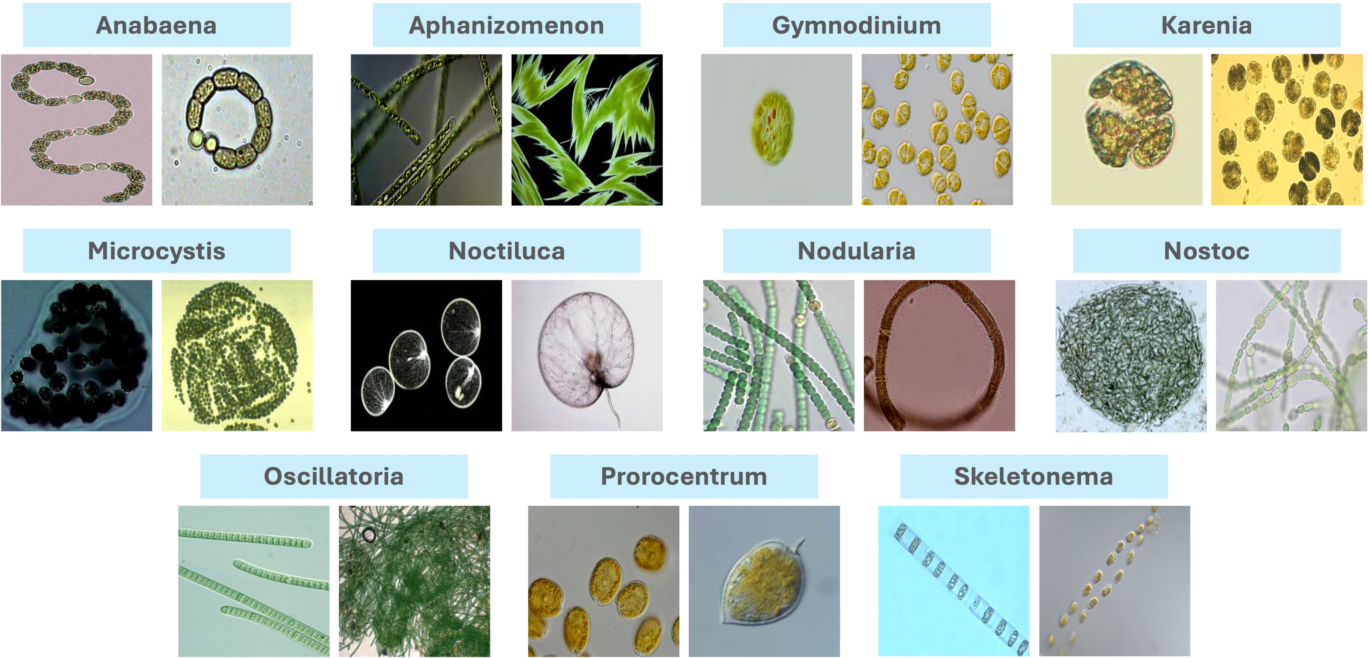
Contributions
Utilized a publicly available dataset of phytoplankton (Yang et al. 2023). This dataset includes eleven common harmful phytoplankton genera, encompassing a total of 1650 images, both original and augmented as shown in figure.
The dataset was partitioned into three subsets: (1) training data, (2) validation data, and (3) test data.

Slide 6
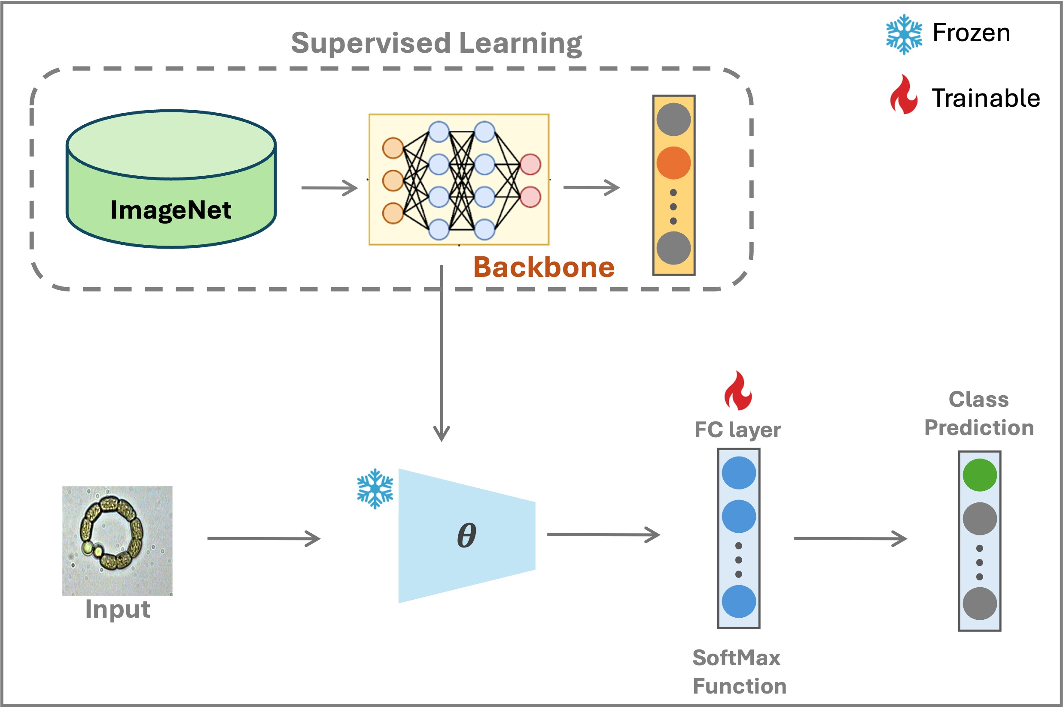
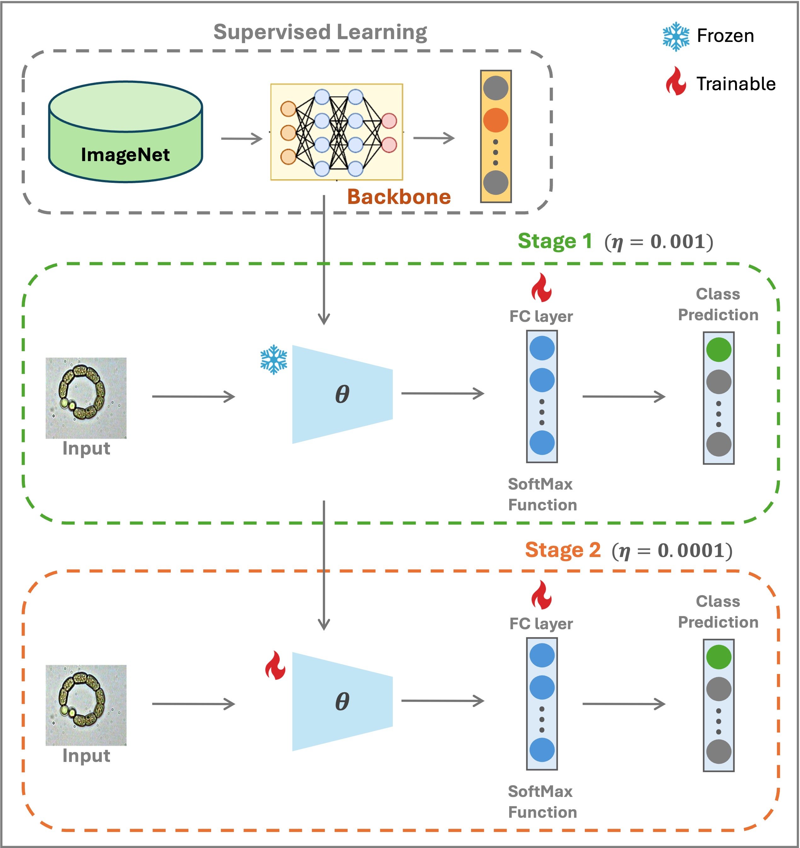
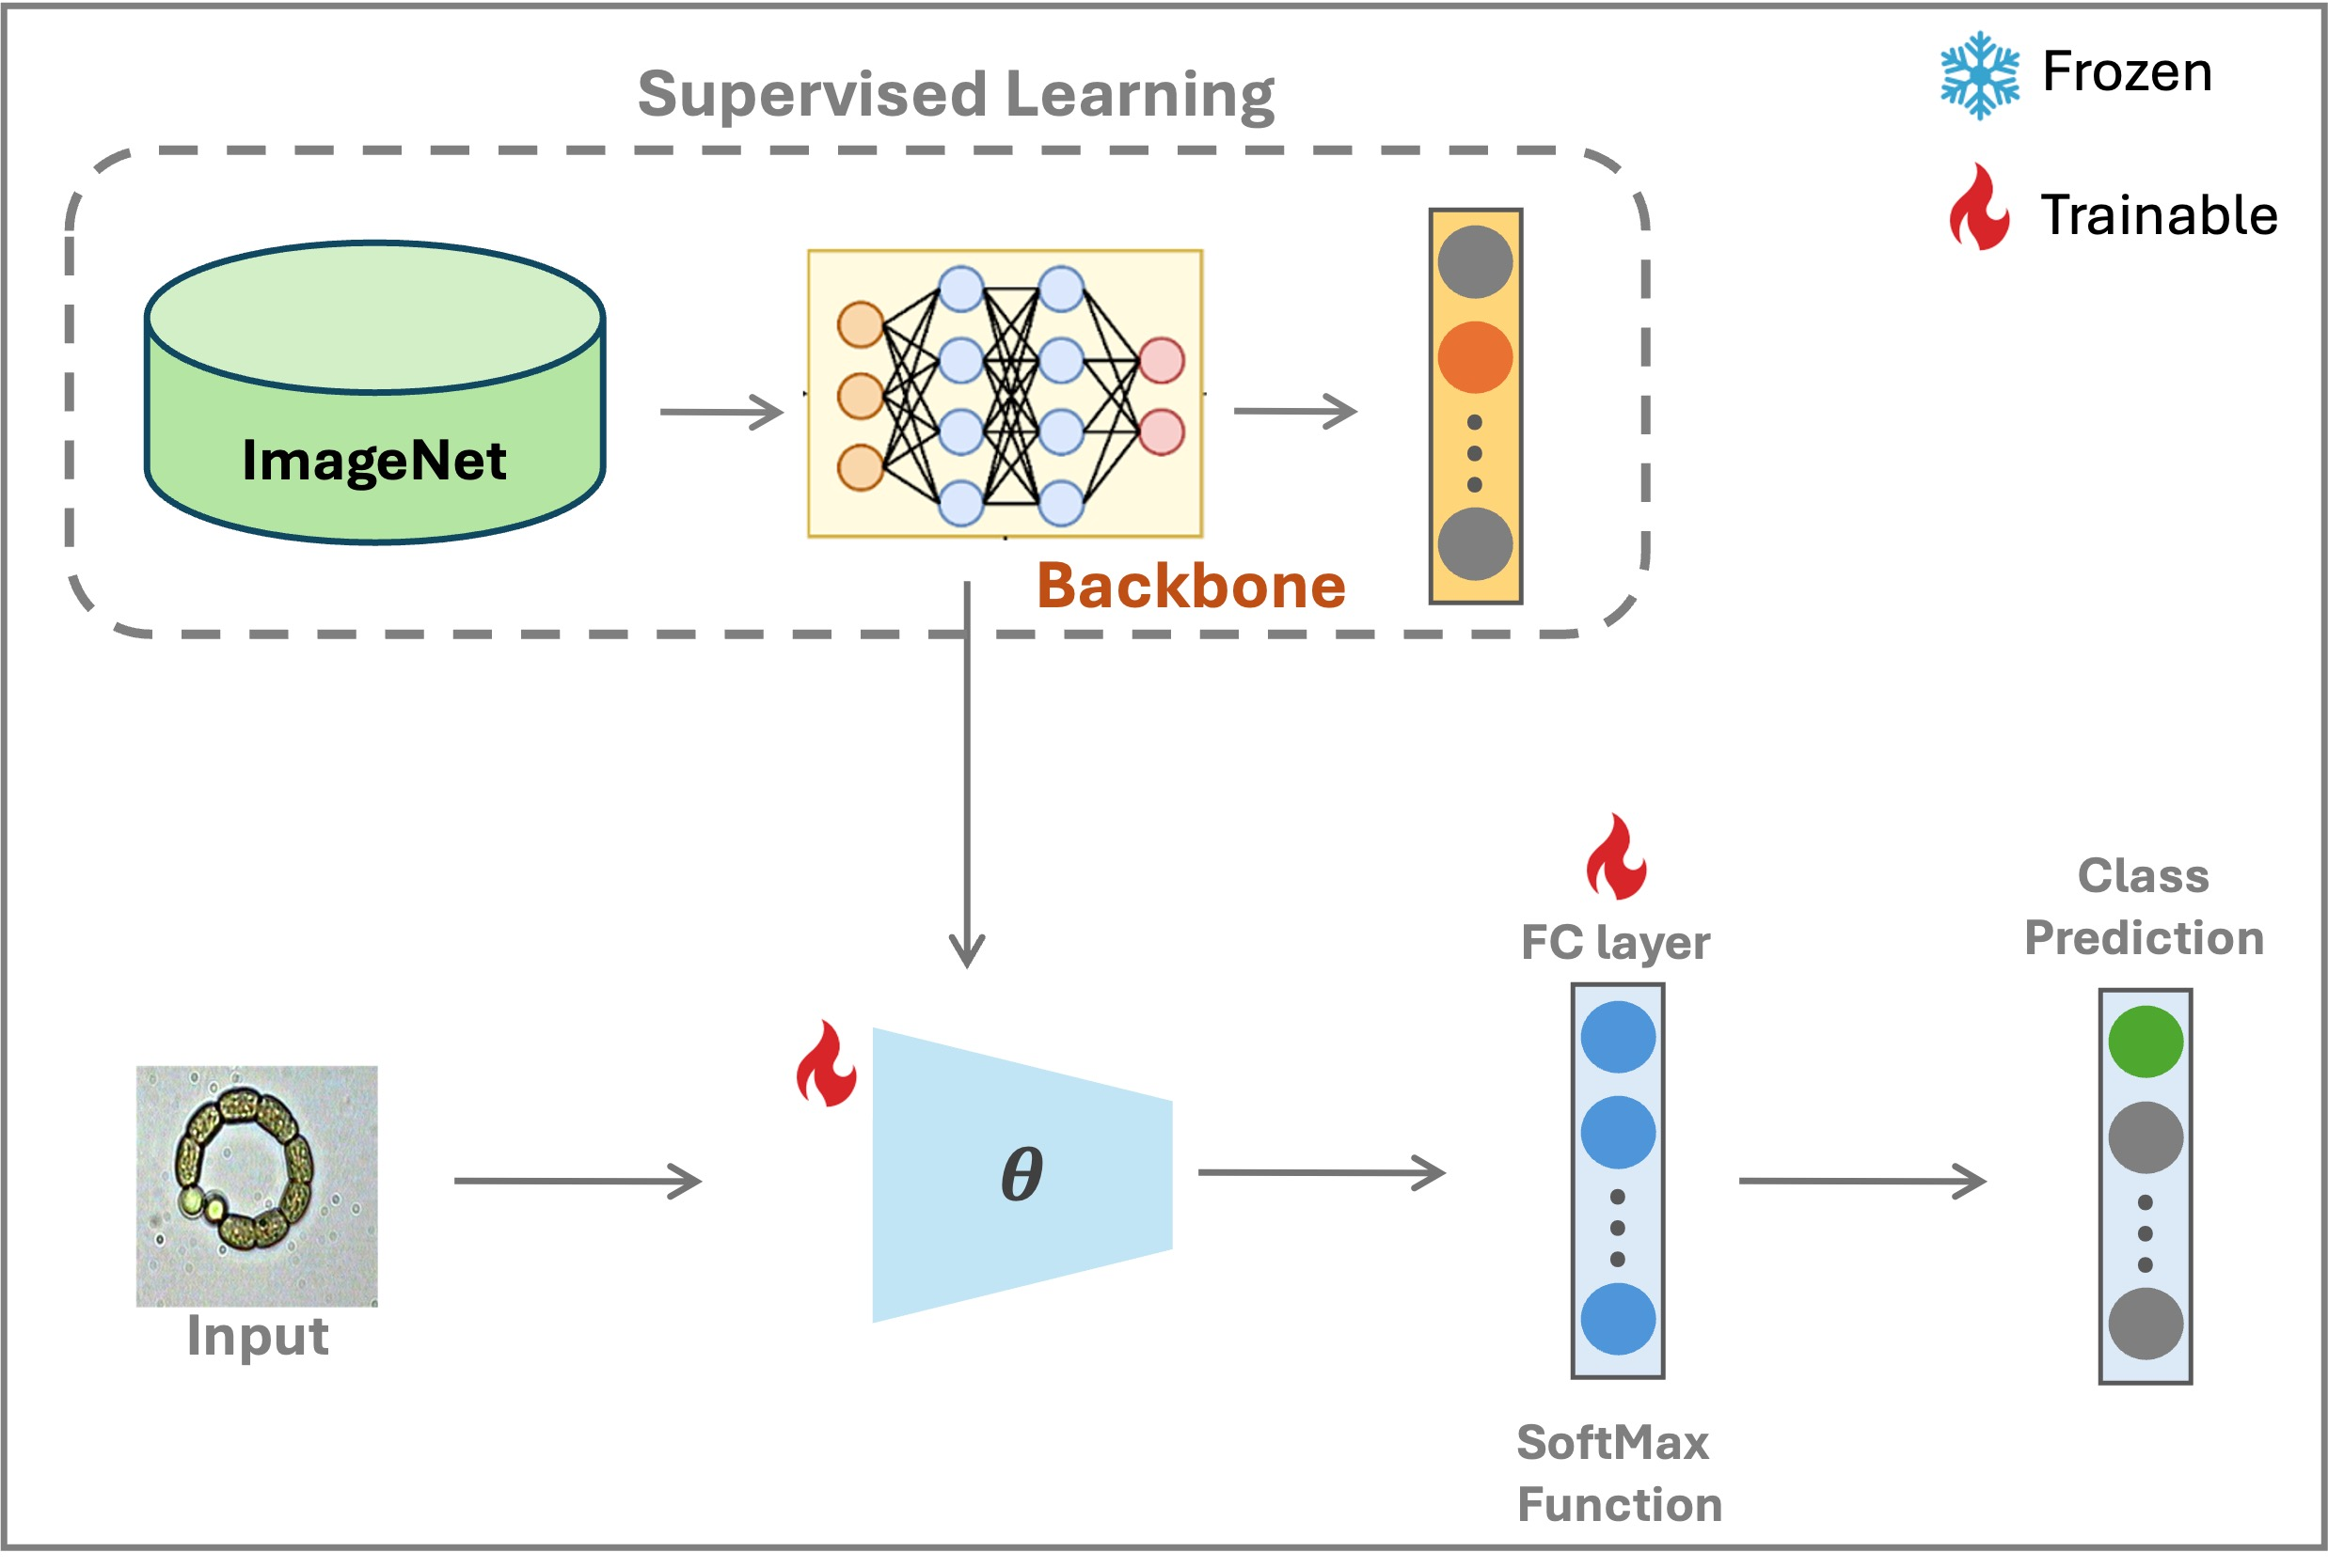
Contributions
Developed an automatic phytoplankton recognition system using transfer learning and explored three approaches: Linear Probing, Fine-Tuning, and a Combined Approach.
Learning approach using linear probing
Learning approach that integrates both linear probing and fine-tuning
Learning approach utilizing Fine-Tuning

Slide 7
Contributions
Tested different CNN backbones, batch sizes, and learning rates, with all models pretrained on ImageNet and optimized using Adam. The classifier heads were adapted for a multiclass classification task involving eleven phytoplankton classes.
To evaluate the model's performance, we used three metrics: precision to measure classification accuracy, recall to assess how well the model retrieved instances, and accuracy to evaluate overall correct classifications.

Slide 8
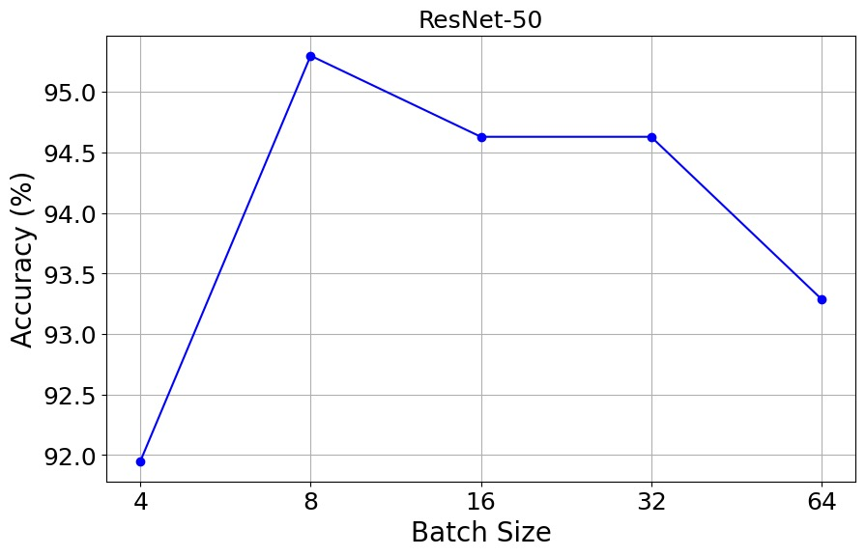
Results
The ResNet-50 model achieved optimal validation accuracy (95.3%) using a batch size of 8 images with the combined transfer learning strategy as shown in figure.
The highest performance, with an accuracy of 95.97%, was obtained using the fine-tuning approach with an initial learning rate of 0.0001

Slide 9
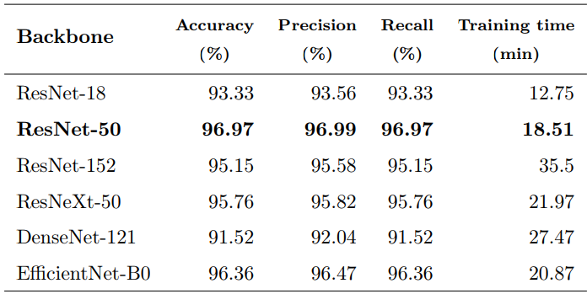
Results
The test results for various CNN backbones trained using the fine-tuning approach with a batch size of 8 images and an initial learning rate of 0.0001. The best performance was achieved by ResNet-50, which attained an accuracy of 96.97%, a precision of 96.99%, a recall of 96.97%, and a training 4 time of 18.51 minutes are shown in table.

Slide 10
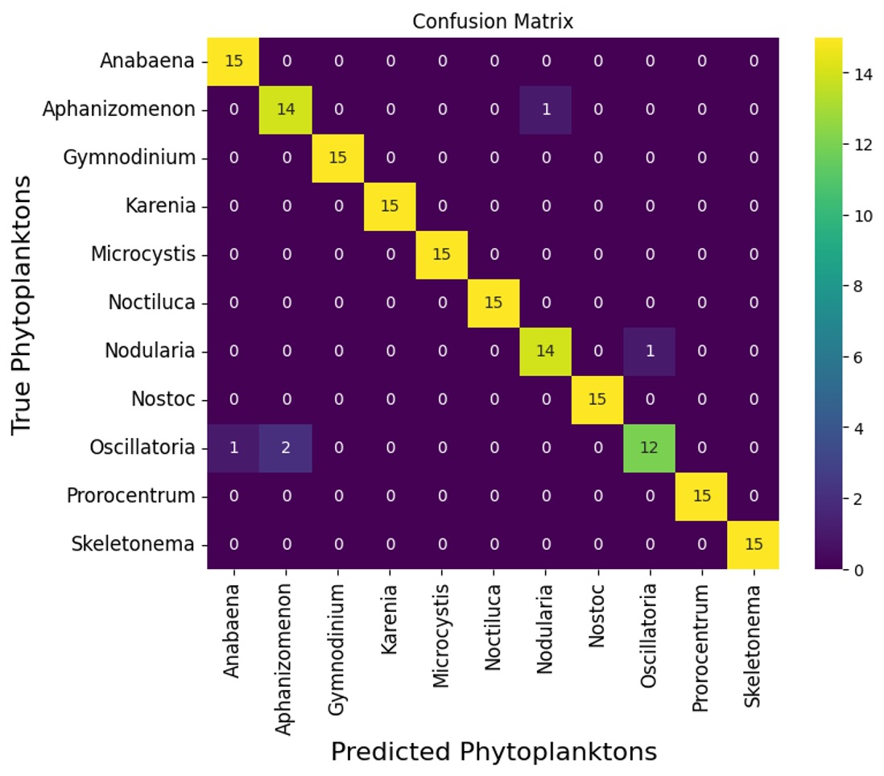
Critical Analysis
The ResNet-50 model, using the fine-tuning approach, achieved the highest accuracy of 96.97%. However, it struggled to distinguish between four phytoplankton species with similar morphological features. While the system provides a valuable tool for automating species identification and reducing manual effort, expanding the dataset to include a broader range of harmful phytoplankton is recommended. This would enhance the system's generalization and improve its effectiveness in water quality monitoring.

Slide 11
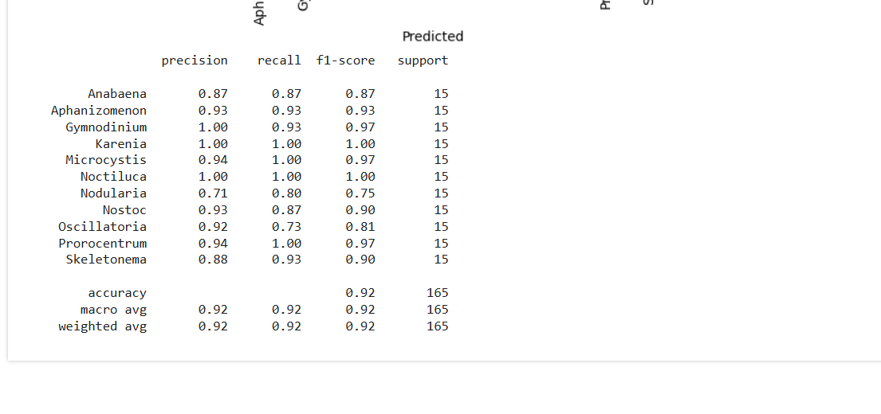

SiMULATION Results
The best performance was achieved by ResNet-50 with the fine-tuning approach, yielding an accuracy of 93.94%.
Used batch size of 8, learning rate as 1e-5 for adam optimizer and reduced the epochs to 50.

Slide 12
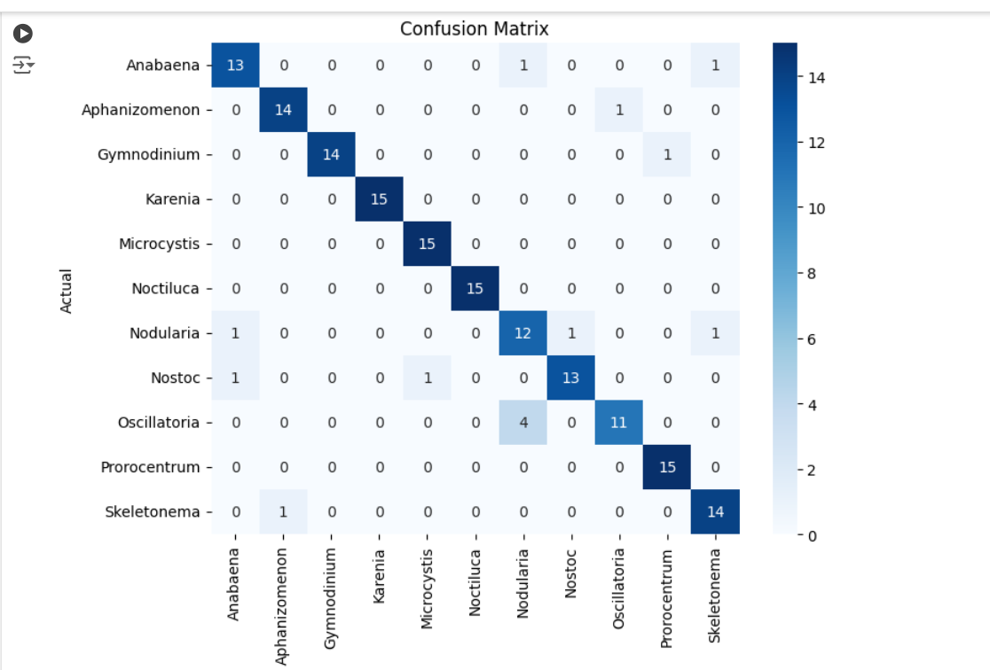
Analysis
The model has achieved 90 – 100% of accuracy for all the phytoplankton microscopic images except for Anabaena, Nodularia, Nostoc and Oscillatoria.
The models has difficulty in distinguishing between four phytoplankton types with similar morphological characteristics

Slide 13
References
[1] Figueroa, J., Rivas-Villar, D., Rouco, J., & Novo, J. (2024). Phytoplankton detection and recognitionin freshwater digital microscopy images using deep learning object detectors. Heliyon, 10.
[2] Kyathanahally, S. P., Hardeman, T., Merz, E., Bulas, T., Reyes, M., Isles, P., Pomati, F., & Baity-Jesi, M.(2021). Deep learning classification of lake zooplankton. Frontiers in microbiology, 12 , 746297.
[3[ Lumini, A., & Nanni, L. (2019). Deep learning and transfer learning features for plankton classification. Ecological informatics, 51 , 33–43.
[4] Paerl, H. W., Fulton III, R. S., Moisander, P. H., & Dyble, J. (2001). Harmful freshwater algal blooms, with an emphasis on cyanobacteria. TheScientificWorldJournal, 1 , 76–113.
[5] Rachman, A., Suwarno, A. S., & Nurdjaman, S. (2022). Application of deep (machine) learning for phytoplankton identification using microscopy images. In 7th International Conference on Biological Science (ICBS 2021) (pp. 213–224). Atlantis Press.
[6] Suthers, I. M., Richardson, A. J., & Rissik, D. (2019). The importance of plankton. Plankton: a guide to their ecology and monitoring for water quality, (pp. 1–13).
[7] Yang, M., Wang, W., Gao, Q., Zhao, C., Li, C., Yang, X., Li, J., Li, X., Cui, J., Zhang, L. et al. (2023).
[8] Automatic identification of harmful algae based on multiple convolutional neural networks and transfer learning. Environmental Science and Pollution Research, 30 , 15311–15324.
[9] Zhao, F., Lin, F., & Seah, H. S. (2010). Binary sipper plankton image classification using random subspace. Neurocomputing, 73 , 1853–1860.

