Slide 1

Hands-free phone control by hum, pop and hiss.
PROJECT OVERVIEW · VOX / CANTI

Slide 2
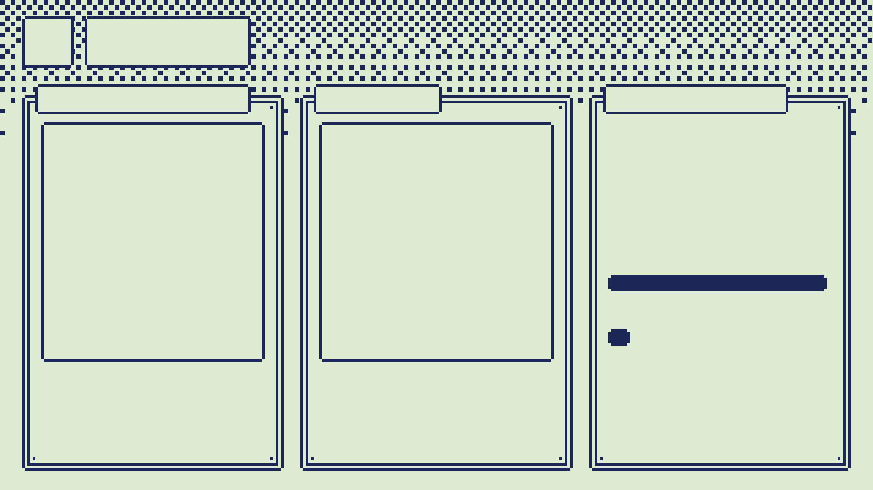

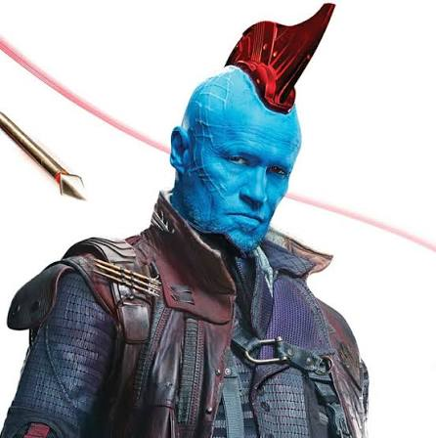
01
Why
CANTI · FLCL
YONDU
THE SPARK
Augmental VOX: a $200 mic you wear to whisper-type. It is just a mic pointed at yourself, so I built my own.
AUGMENTAL
$200
CANTI
~$15–20
The look: FLCL's robot gives the app its name and colours.
The feeling: whistle, and something across the room moves.
And I always wanted an auto-scroller for reels.
Photos: Marvel; Production I.G / Gainax.

Slide 3
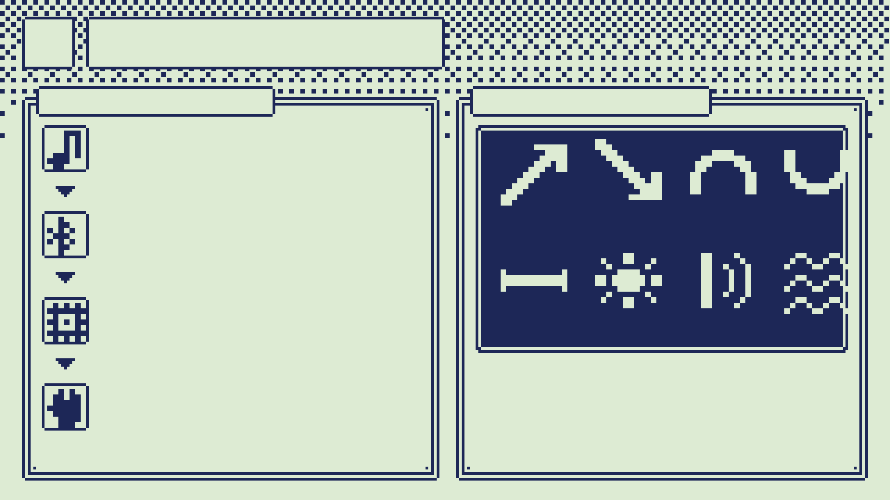
02
What it is
HOW IT WORKS
EIGHT SOUNDS
HEAR
The pendant or the phone mic hears a sound.
DESCRIBE
RISE
FALL
ARCH
DIP
It becomes one line of text, sent over Bluetooth.
DECIDE
Rules first; a small model for spoken phrases.
FLAT
POP
CLICK
HISS
rise/fall swipe up/down · arch/dip swipe sideways · hiss back · click click home · pop pop listens for a phrase
ACT
Android swipes, taps or goes back, then checks.

Slide 4
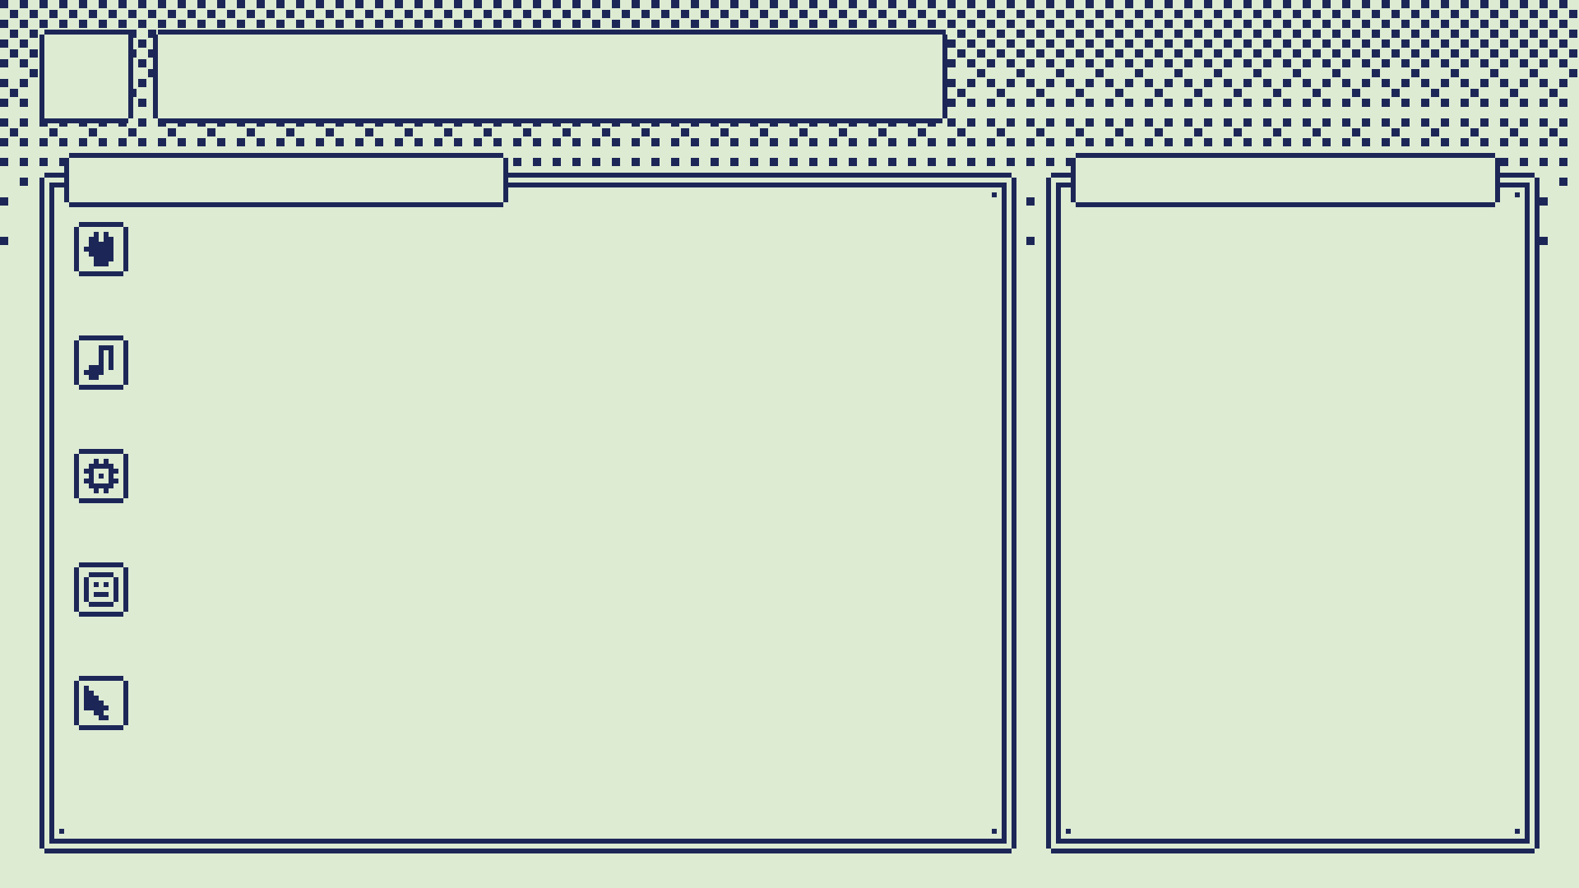
03
Who it helps
ACCESSIBILITY
LIKE A WIZARD
NO TOUCH
Whistle, and it moves.
Scroll a recipe with flour on your hands.
Skip a video from across the couch.
Let reels auto-scroll while you do something else.
Next: the desktop and the web.
Limited hand use, tremor, or busy hands: swipe, tap and scroll by sound.
NO WORDS
Hums, pops and clicks work where speech is hard to recognise; your own sounds count too.
YOUR RANGE
Calibration and training fit each voice. Pitch is relative, never an absolute note.
ONE BUTTON
Arm, stop and pair with presses. Stopping never depends on the mic.
REACH IT ALL
The cursor and "tap the search button" reach what gestures cannot.
Designed for this; not yet tested with disabled users.

Slide 5

04
Demo
UNDER 60 SECONDS
SHOT LIST
0:00
rise, fall: scroll a list
0:10
arch, dip: swipe sideways
0:18
hiss: back
VIDEO
0:24
click click: home
drop the recording here
0:30
pop pop, "open YouTube"
0:40
in Shorts: pop pop, then rise
0:50
pop pop, "tap search"
Phone mic. While a video plays, only "pop pop" gets through.

Slide 6
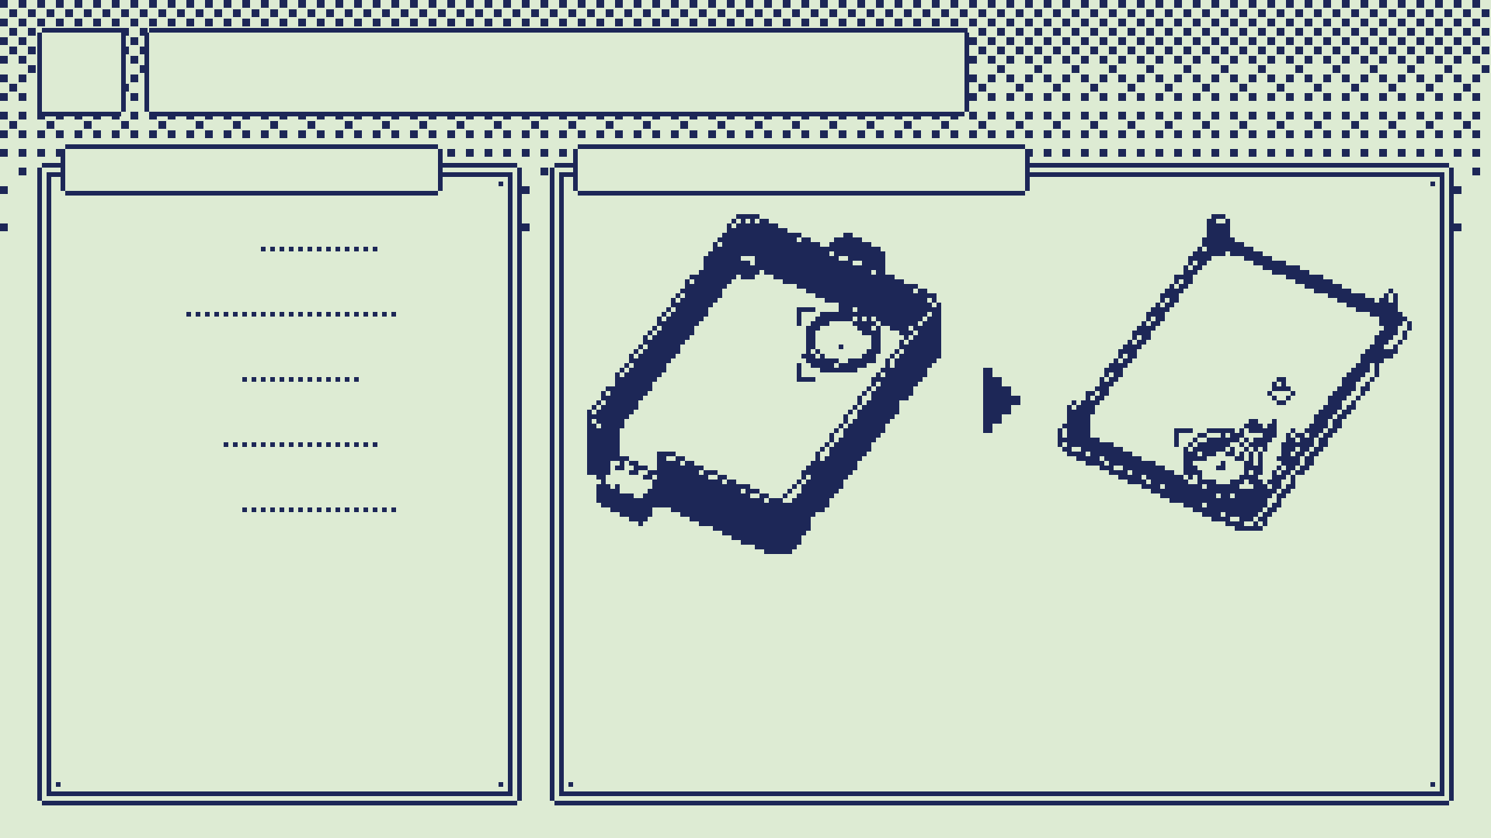
05
How it's built
THE PENDANT
MOVING THE MIC
BOARD
Pico 2 W
MIC
INMP441
INPUT
one button
CASE
OpenSCAD
TOTAL
~$15–20
Worn as a necklace, lid against the chest. Or skip it: the phone mic works too.
V1: under the board. Way too hard to work with.
V2: in the lid, on Dupont wires. Unplug the lid and swap the mic.

Slide 7
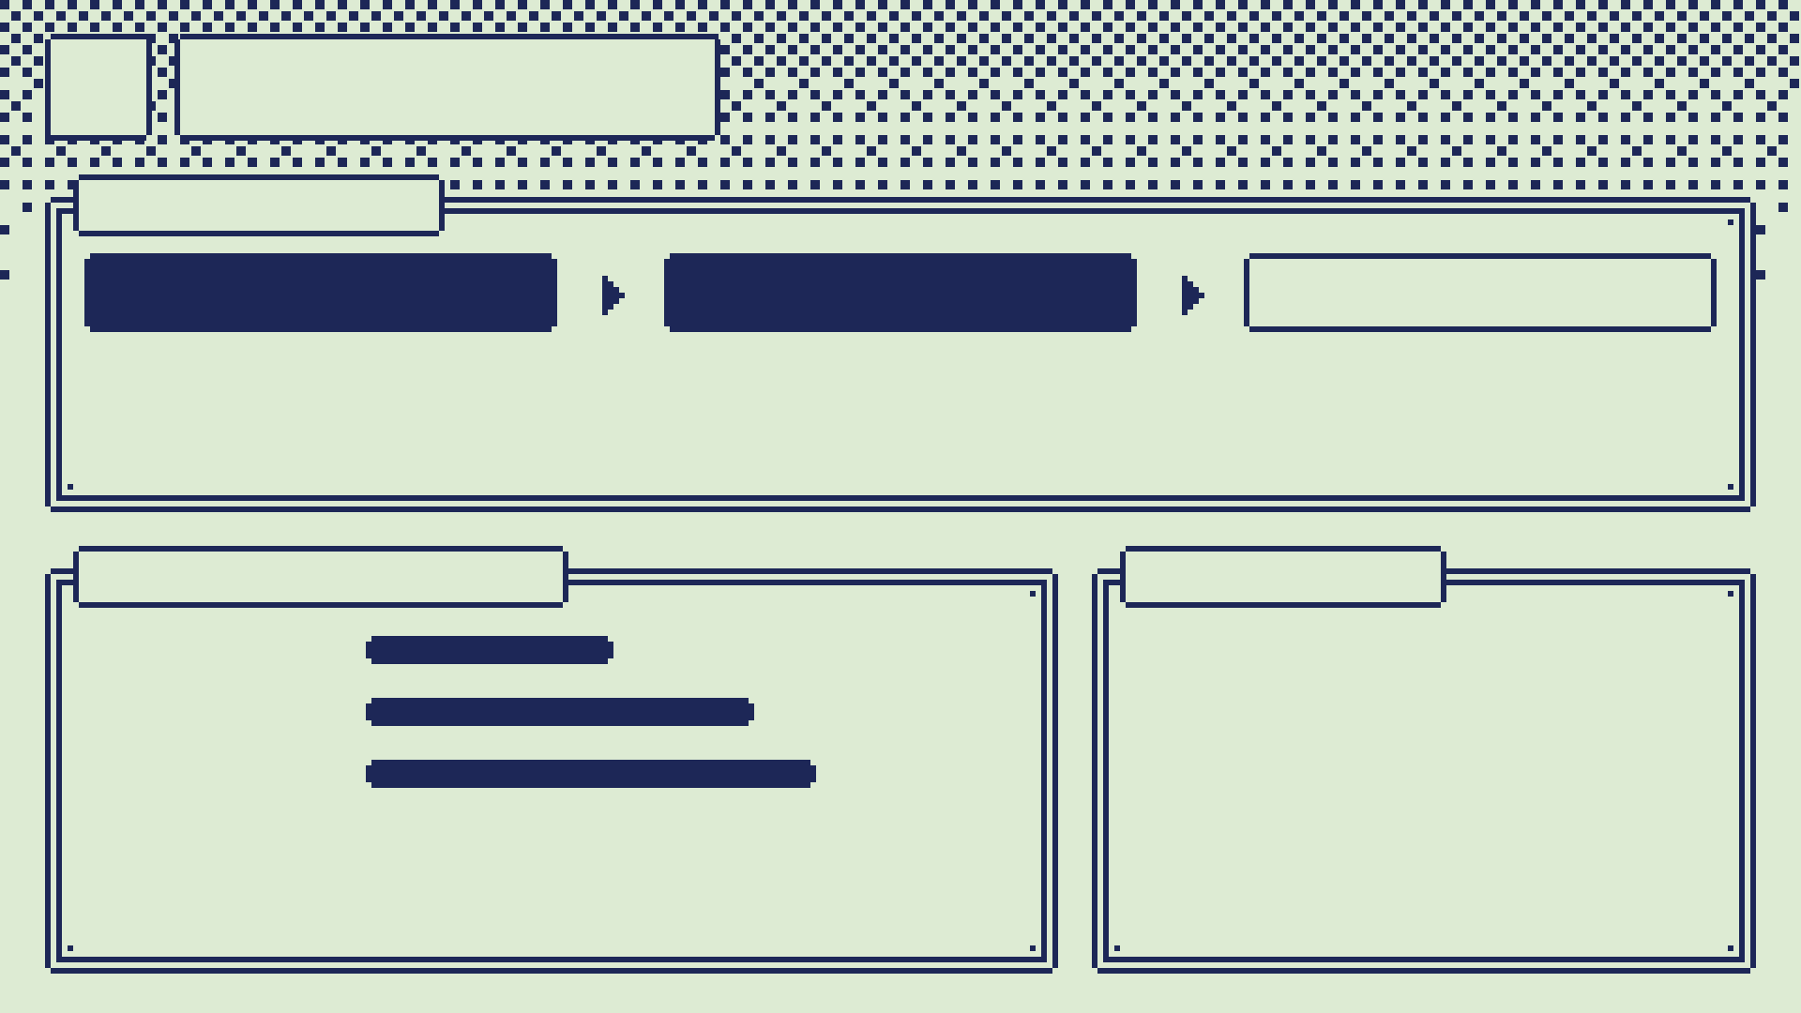
06
Models
THE CHAIN
CODE
VERDICT
CLOUD
gestures: instant, exact. No LLM needed.
phrases: 118M, fully on the phone*
the rest: Jev API or Ollama, slower
REAL SCREENS
PRIVACY
JEVLIKE
0.465
Verdict: nothing leaves the phone.
Ollama, $20/mo: as long as you don't mind giving your info away to China.
*Not shipped yet: "none" recall 0.62, gate 0.8.
VERDICT
0.738
CLOUD
0.852
jevlike first → Verdict chosen for phrases → jevlike as teacher → ~12–14 h on the Strix Halo.

Slide 8
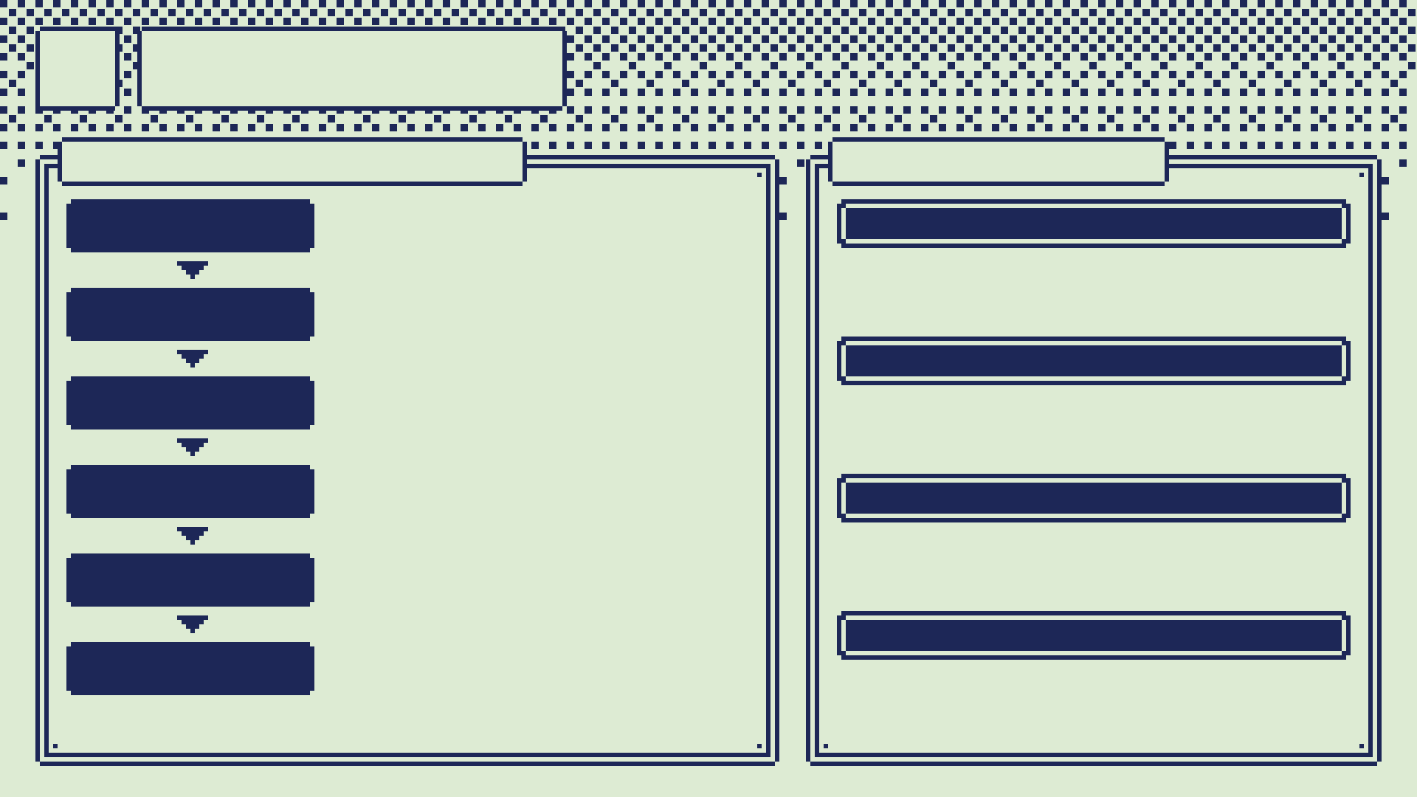
07
Method
MY AGENTIC LOOP
CHALLENGES
ASK
find the hidden edges; confirm before acting
MOBILE DEV
New to Android and Dart.
PLAN
graph out and document everything first
FINE-TUNING
DECIDE
I pick designs and libraries
0.447 on real screens at first.
DISPATCH
Claude plans; Eidolon + DeepSeek execute
PHONE MIC
Videos made gestures: six layers of guards.
VERIFY
tests, parity checks: "looks done" isn't done
CALIBRATION
ITERATE
measure, loop, hand off
A final step per voice; holds up across profiles.

Slide 9

Try it today***
FOSS, MIT licensed: github.com/dxcently/Canti
*** HUGE asterisks: you still build the APK and turn on the accessibility service. With an Android phone it should just work. Probably. The pendant is optional: the phone mic works.
Questions?

Slide 10

APPENDIX
The details, for questions.

Slide 11
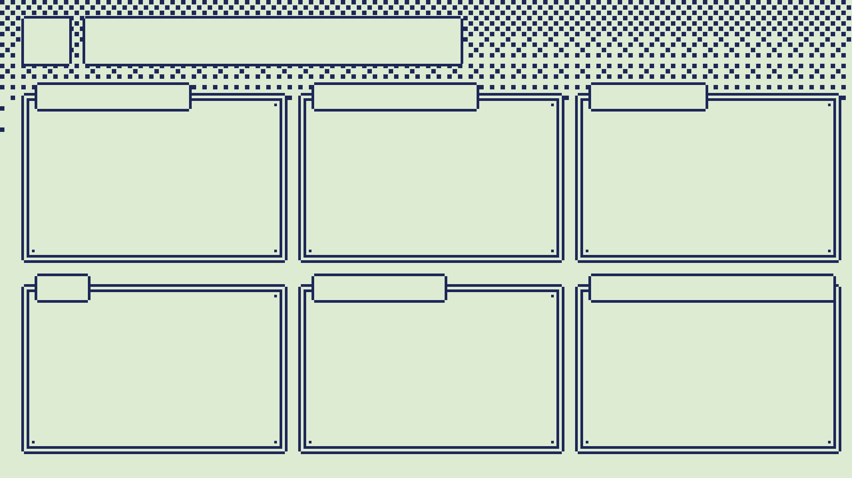
10
Tech stack
PENDANT
FIRMWARE
PHONE
Pico 2 W: RP2350, BLE
INMP441 I2S mic
OpenSCAD case, PLA
C++, arduino-pico 6.1.1
BTstack GATT, LESC
extractor on core 1
Kotlin 2.2, no AndroidX
NDK + JNI: same C++
AccessibilityService
on-device speech
UI
MODELS
CLOUD + TOOLS
Flutter add-to-app
Material 3, no packages
pixel kit + shader
PyTorch on ROCm
transformers, ONNX int8
e5: jevlike, Verdict
Jev API, Ollama
DeepSeek executors
Claude agents, Eidolon
NixOS flakes

Slide 12
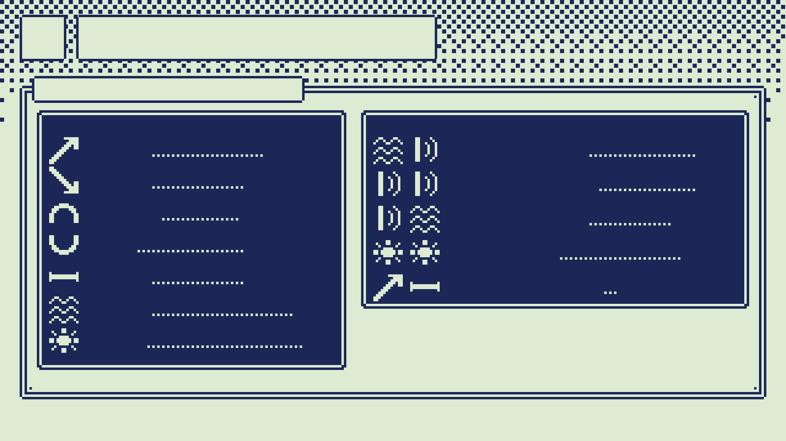
11
The sounds
DEFAULT BINDINGS
ONE SOUND
SEQUENCES
RISE
swipe up
HISS CLICK
back
FALL
swipe down
CLICK CLICK
home
ARCH
swipe right
CLICK HISS
forward
DIP
swipe left
listen
POP POP
FLAT
long press
RISE + HOLD
keep scrolling
HISS
back
tap
A lone pop taps only from the pendant; phone-mic pops do nothing. Every binding can be changed per app.
POP

Slide 13
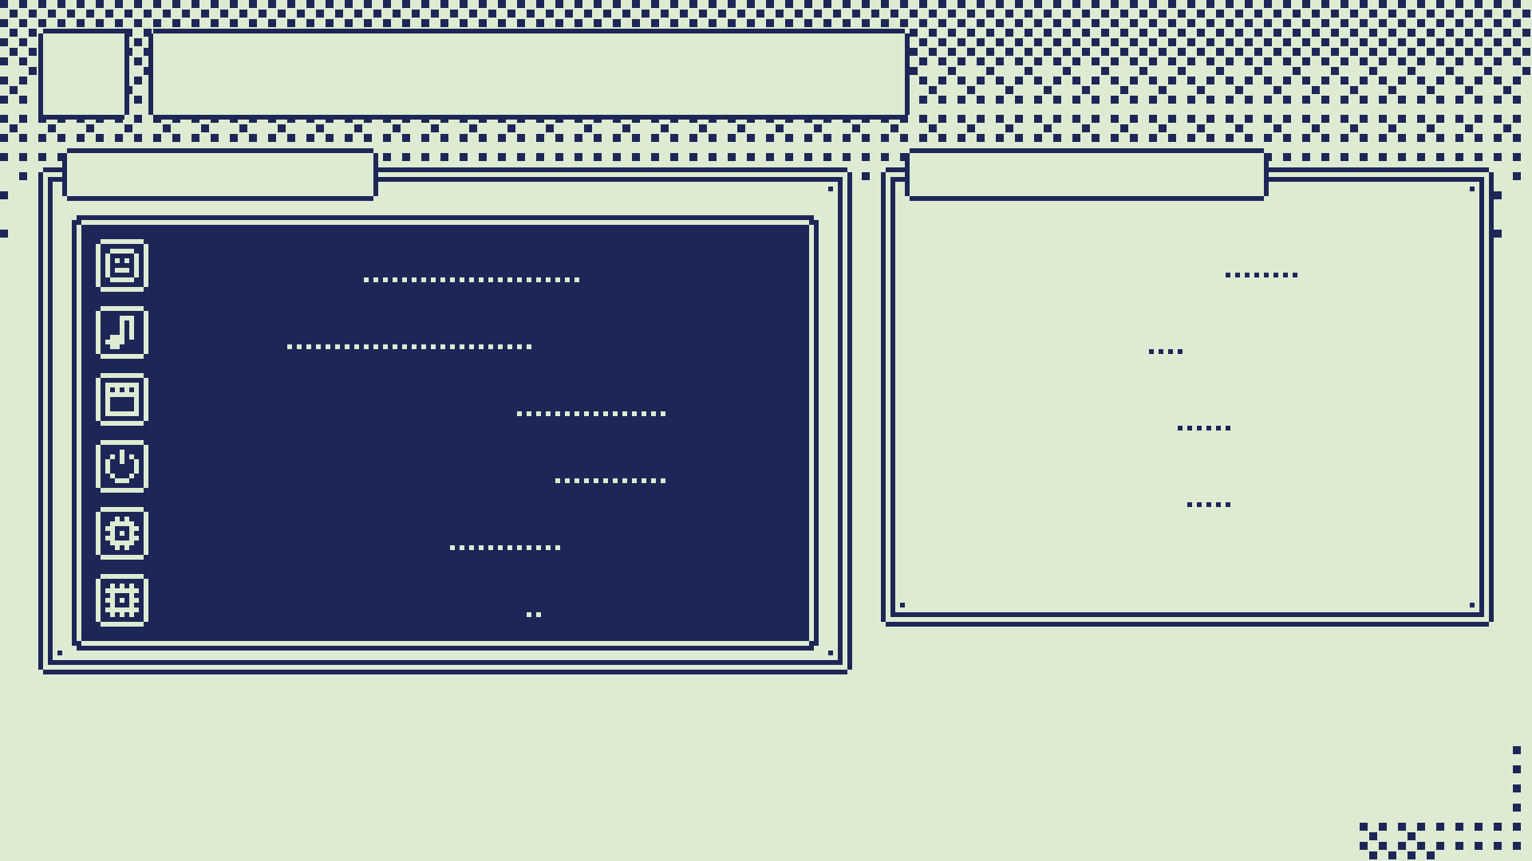
12
The pendant
HARDWARE
ONE BUTTON
BOARD
Pico 2 W · $7
5 PRESSES
arm / off
MIC
INMP441 I2S MEMS
1 CLICK
gesture ⇄ cursor
WIRED BUILD
~$15–20
disarm, sleep
HOLD 1 S
WITH BATTERY
~$25–32
HOLD 5 S
pair for 60 s
FIRMWARE
vox_node 0.2.2
FLASH / RAM
519 KB / 270 KB
A sound cannot reliably stop the thing that is misreading sounds, so stop lives on the button.
Worn as a necklace in a 3D-printed case. It runs from a USB power bank.

Slide 14
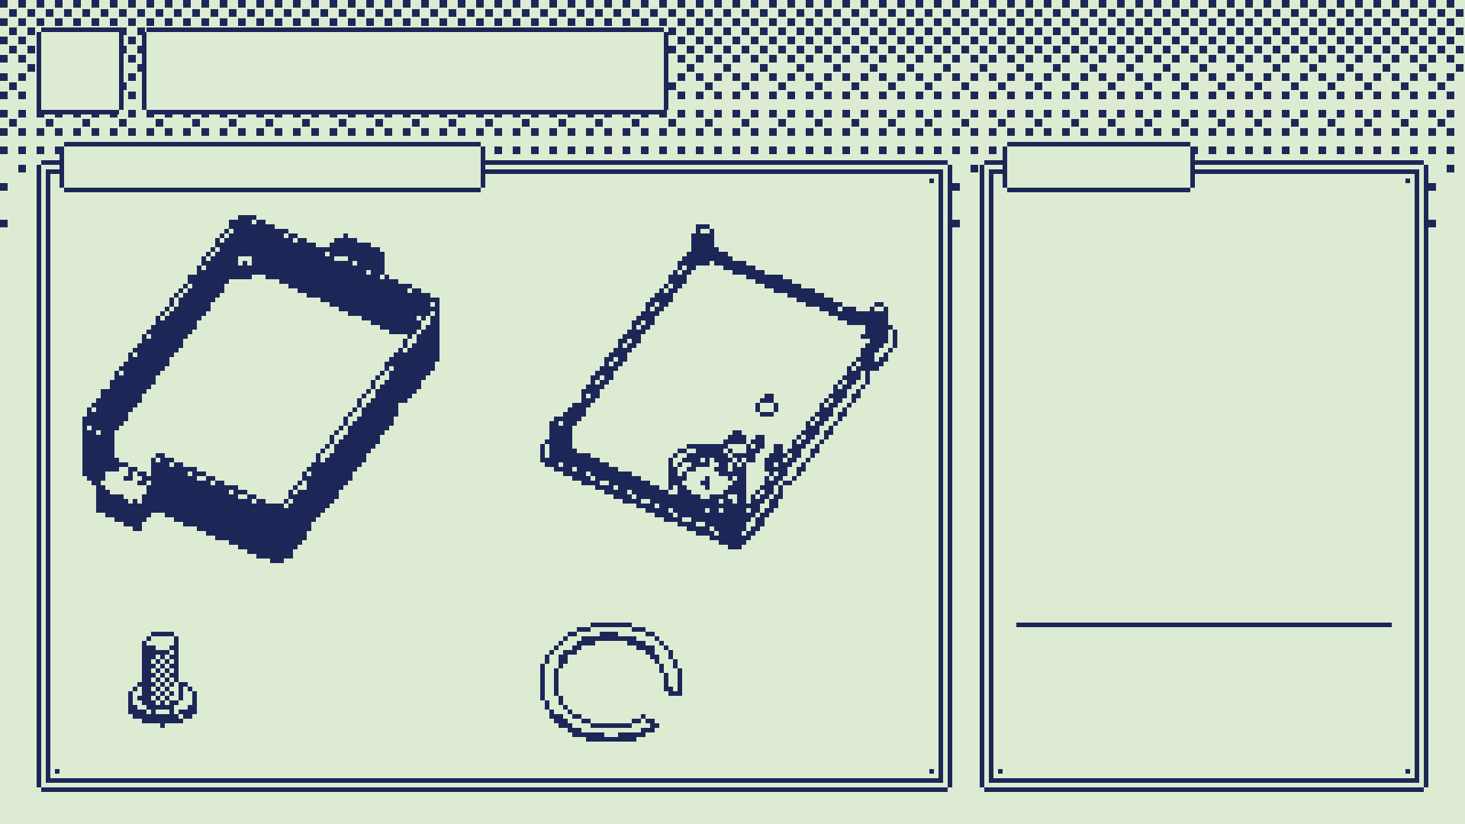
13
The case
PRINTED PARTS
PRINT
BASE
back face down · 1
LID
outer face down · 1
PLUNGER
flange down · 1
MIC CLIP
flat · print 2–3, tiny
FIT TEST
optional: board fit
MIC TEST
BASE
LID, INSIDE UP
optional: pocket, 10 min
PLUNGER
MIC CLIP
PLA, 0.2 mm layers, no supports. About 55 × 75 × 20 mm plus the necklace loop.
presses the button through the lid
holds the mic in the lid

Slide 15
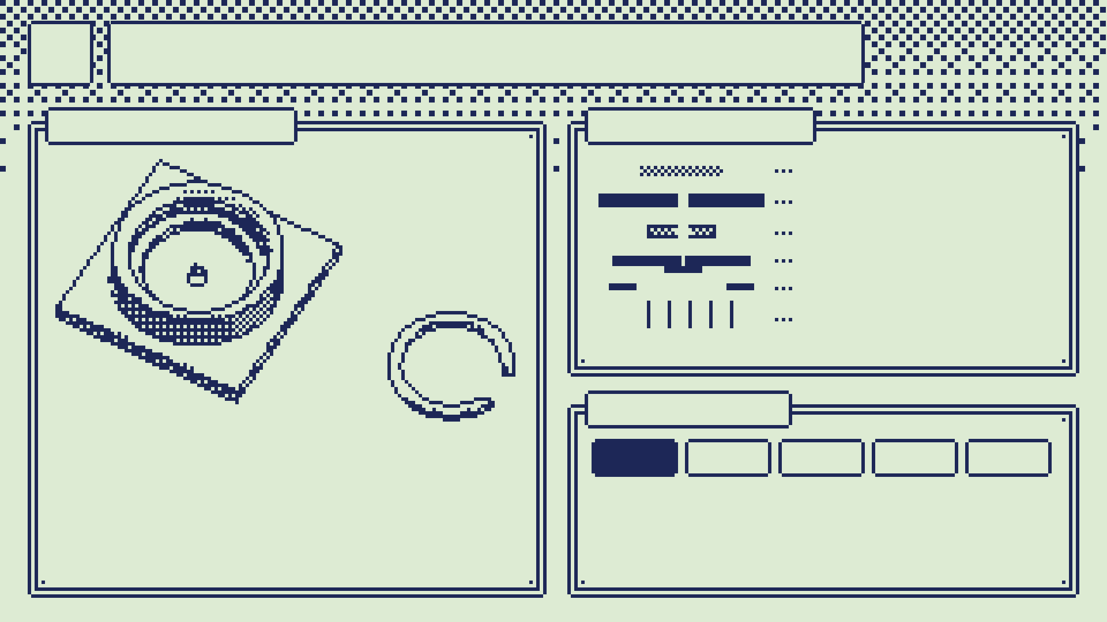
14
The mic in the lid
MIC POCKET
THE STACK
fabric disc
lid, 2 mm hole
foam ring
mic, label side up
C-CLIP
C-clip
5 wires to the board
THE PLUG
The lid's pocket, printed on its own as mic_test.stl (about 10 minutes) to check the module, foam and clip fit before the whole lid.
GND
3V3
SD
WS
SCK
A right-angle header, column 9, rows 3–7: the plug lies flat under the lid.
8–9 cm of cable: the lid sets down beside the case, still plugged in.
L/R is bridged to GND on the module, so 5 wires, not 6.

Slide 16
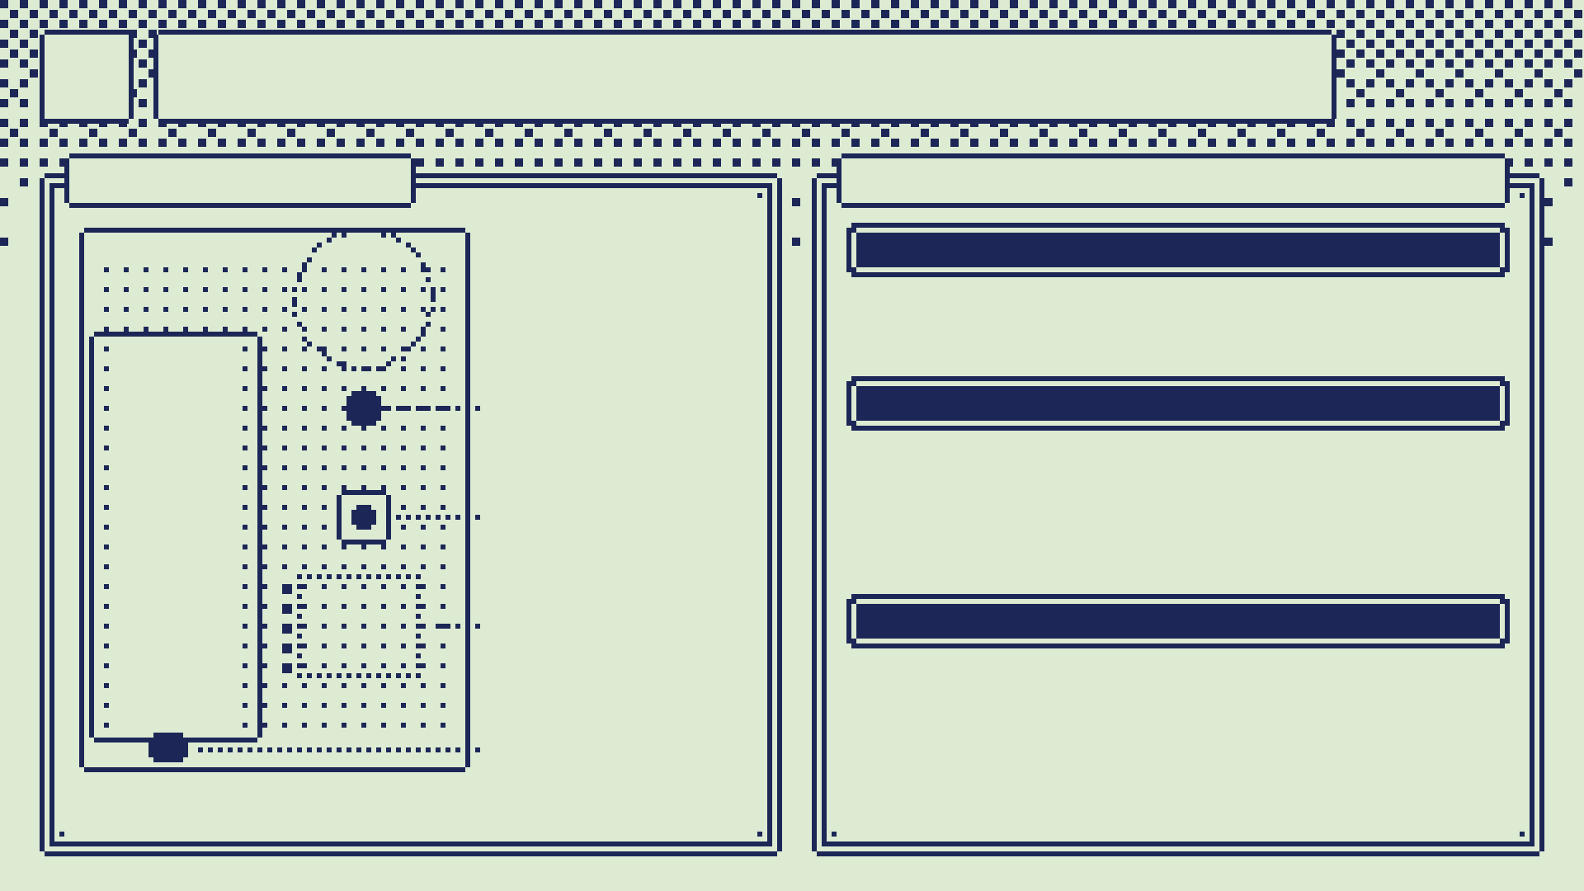
15
Mapped, then built
BOARD MAP
BUILD BOOK · 28 STEPS
BREADBOARD · 1–10
MIC ZONE
parts under 4 mm
1–4 Pico headers, button, LED, flash and test.
5–10 rails, mic wires, L/R bridge, mic level.
LED
NECKLACE · 11–28
GP13
11–15 template, place and solder the Pico.
16–21 LED, button, mic header, beep test.
22–28 measure, print, foam ring, plug, mic into the lid, close.
PICO
BUTTON
GP14
MIC PLUG
MEASURE FIRST
col 9, rows 3–7
Measured values drive every hole in the OpenSCAD model. Asserts stop a change that breaks a fit, and the clash check must come out empty.
USB
A 1:1 template (layout.svg): print it, check the 40 mm bar, build the board on it.

Slide 17
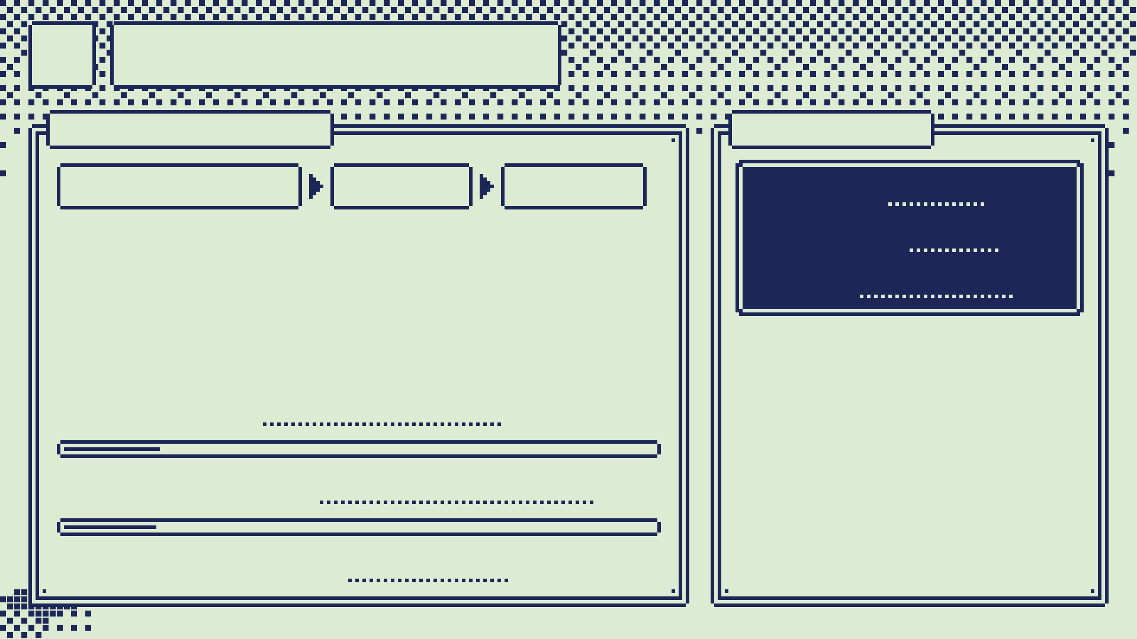
16
Listening
EVERY 10 MS
BLE LINK
16 KHZ MIC
PITCH
LABEL
EVENT
notify
Every 10 ms the pendant looks at the last 32 ms of sound, tracks pitch (MPM) and the noise floor, and labels each finished sound: rise, fall, arch, dip, flat, pop, click, hiss or unknown. The code is a C++ port of the Python reference extractor, on the Pico's second core.
CONFIG
write
INFO
read
Encrypted bonding; new bonds only in a 60 s window.
Every command gets one reply, or times out at 1.5 s.
A dropped link disarms.
HOP COST
16% of budget
CORE 1 LOAD
15.6%
TEST VECTORS
19 / 19 pass

Slide 18
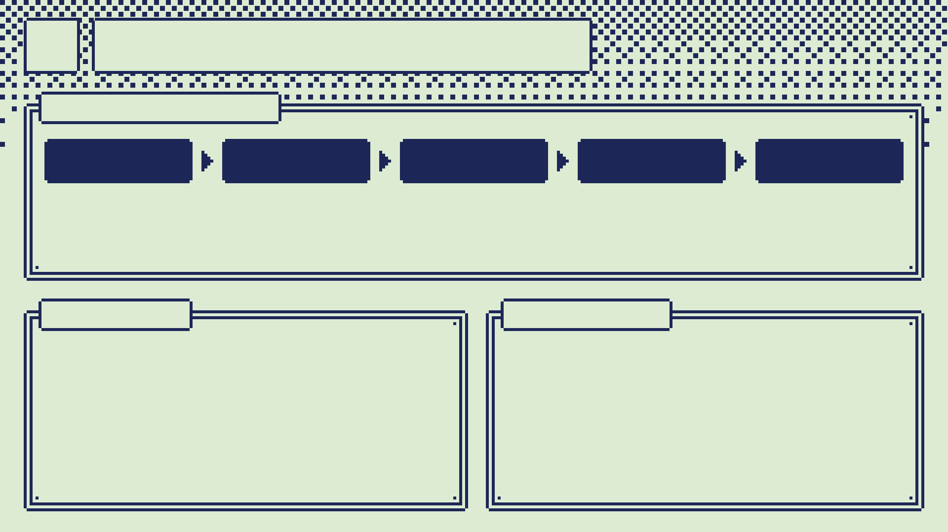
17
On the phone
ANDROID APP
SOURCE
GROUP
MATCH
DECIDE
ACT
pendant, phone mic or USB mic
groups sounds on the device clock
matches your enrolled sounds
rules first, a model for hard cases
gestures via accessibility
GUARDS
PHRASES
Likes, follows and shares need a confirm pop.
A stale screen tree is refused.
Model calls time out; late answers are dropped.
"pop pop" opens a 6 s window.
On-device speech recognition, offline.
Timers, volume, open app, tap a target, type.

Slide 19
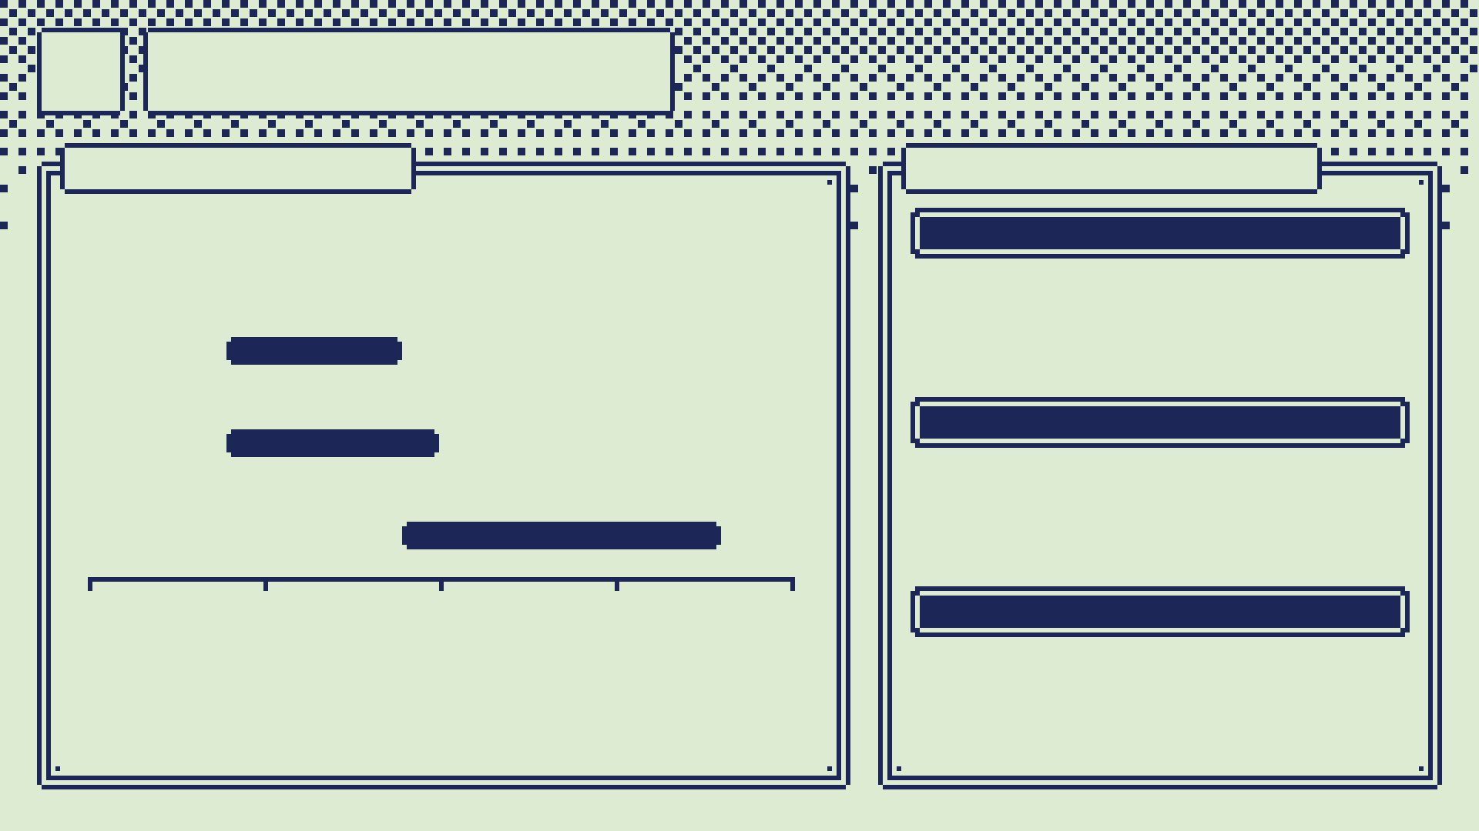
18
Deciding
RULES FIRST
WHY CODE WON
Seconds from the end of a sound to the action (estimates):
FIRST PLAN
A model on the phone picks each next move from your voice training data.
FAST PATH
PHONE MODEL
WHAT I FOUND
Once a sound is labelled, a rule is exact and instant. The errors come from hearing, not deciding.
CLOUD MODEL
0
0.25 s
0.5 s
0.75 s
1.0 s
SO
A 225 ms lag tripled pointing errors (MacKenzie & Ware 1993). So fixed bindings act locally, and models only get what rules cannot settle.
Gestures run on plain code, much quicker and easier. No special LLM needed.

Slide 20
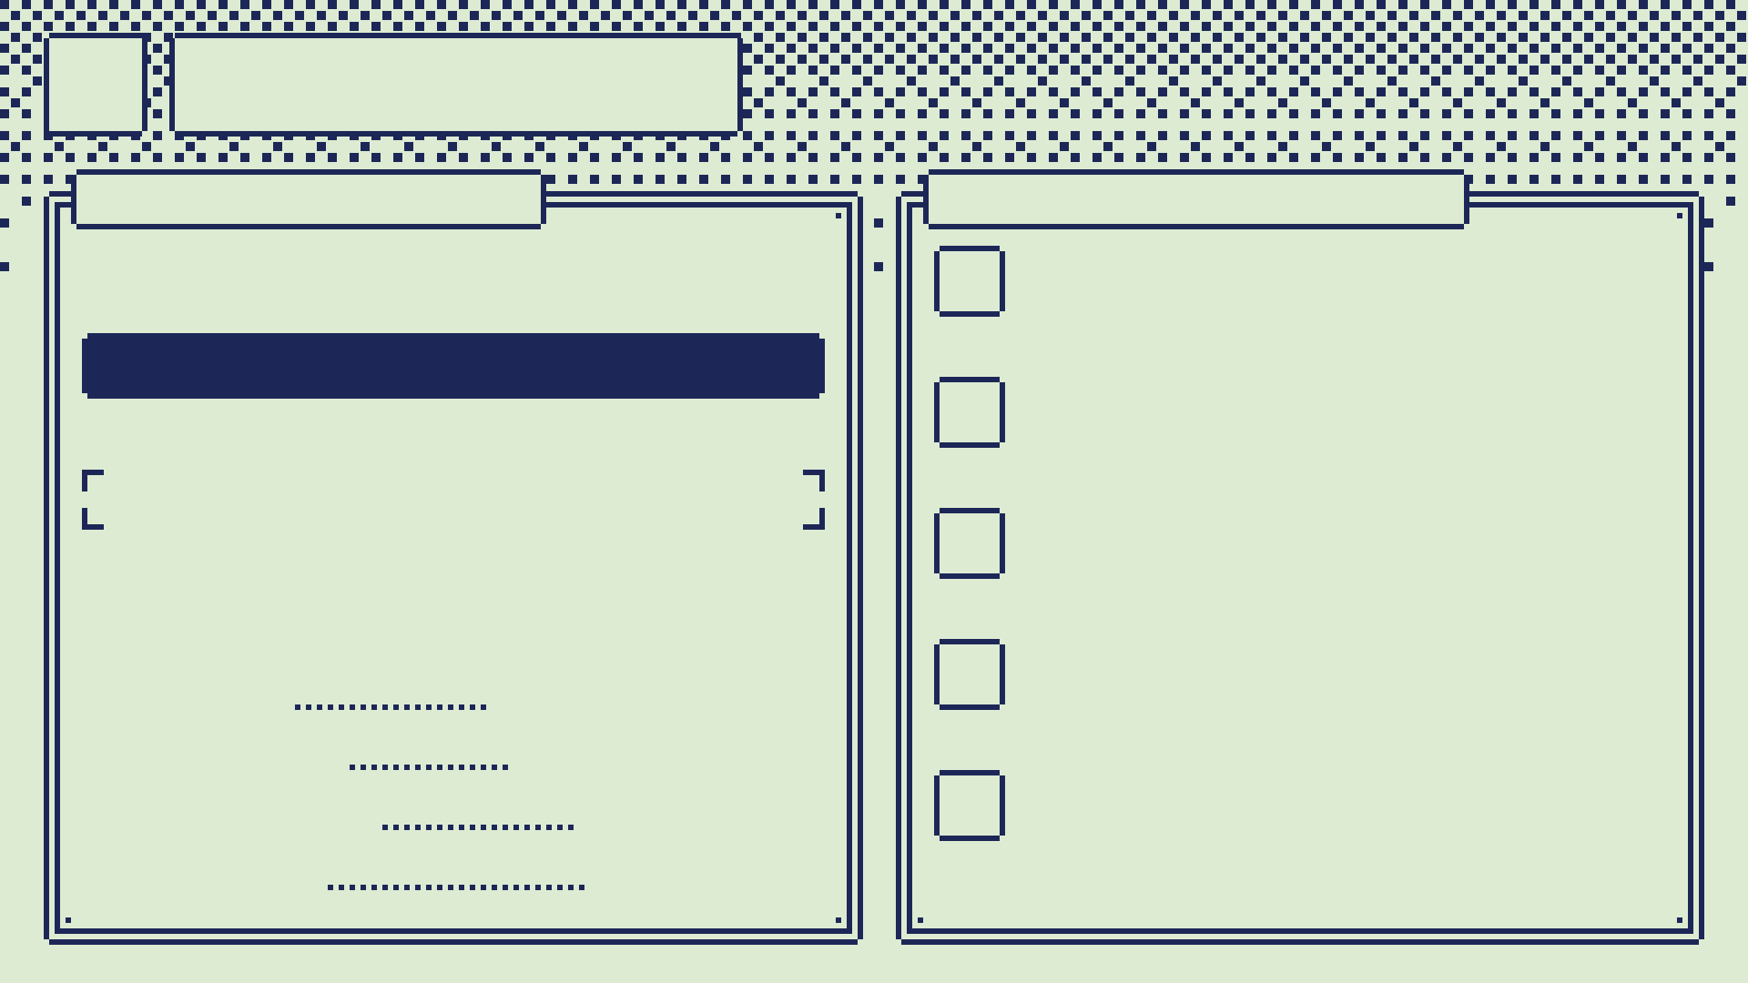
19
Verdict
ON THE PHONE
HOW IT GOT HERE
You say what to tap; Verdict picks one thing on the screen, or none.
1
Trained jevlike first: fast, 0.978 on synthetic phrases, but 0.447 on real screens.
"tap the search button"
2
Verdict did better at picking things by phrase: 0.646 on the same real screens.
Home (button, top left)
Search (button, top right)
3
So Verdict became the model to train and fine-tune.
Shorts (tab, bottom)
none
4
jevlike, fine-tuned earlier, served as its teacher.
MODEL
118M, 2.1 ms on the PC
ON DISK
118 MB, 45 MB pruned
NETWORK
none: 100% local
5
Fine-tuned on real screens: ~12–14 h total on the Strix Halo (8.75 h of it logged).
STATUS
not shipped yet

Slide 21
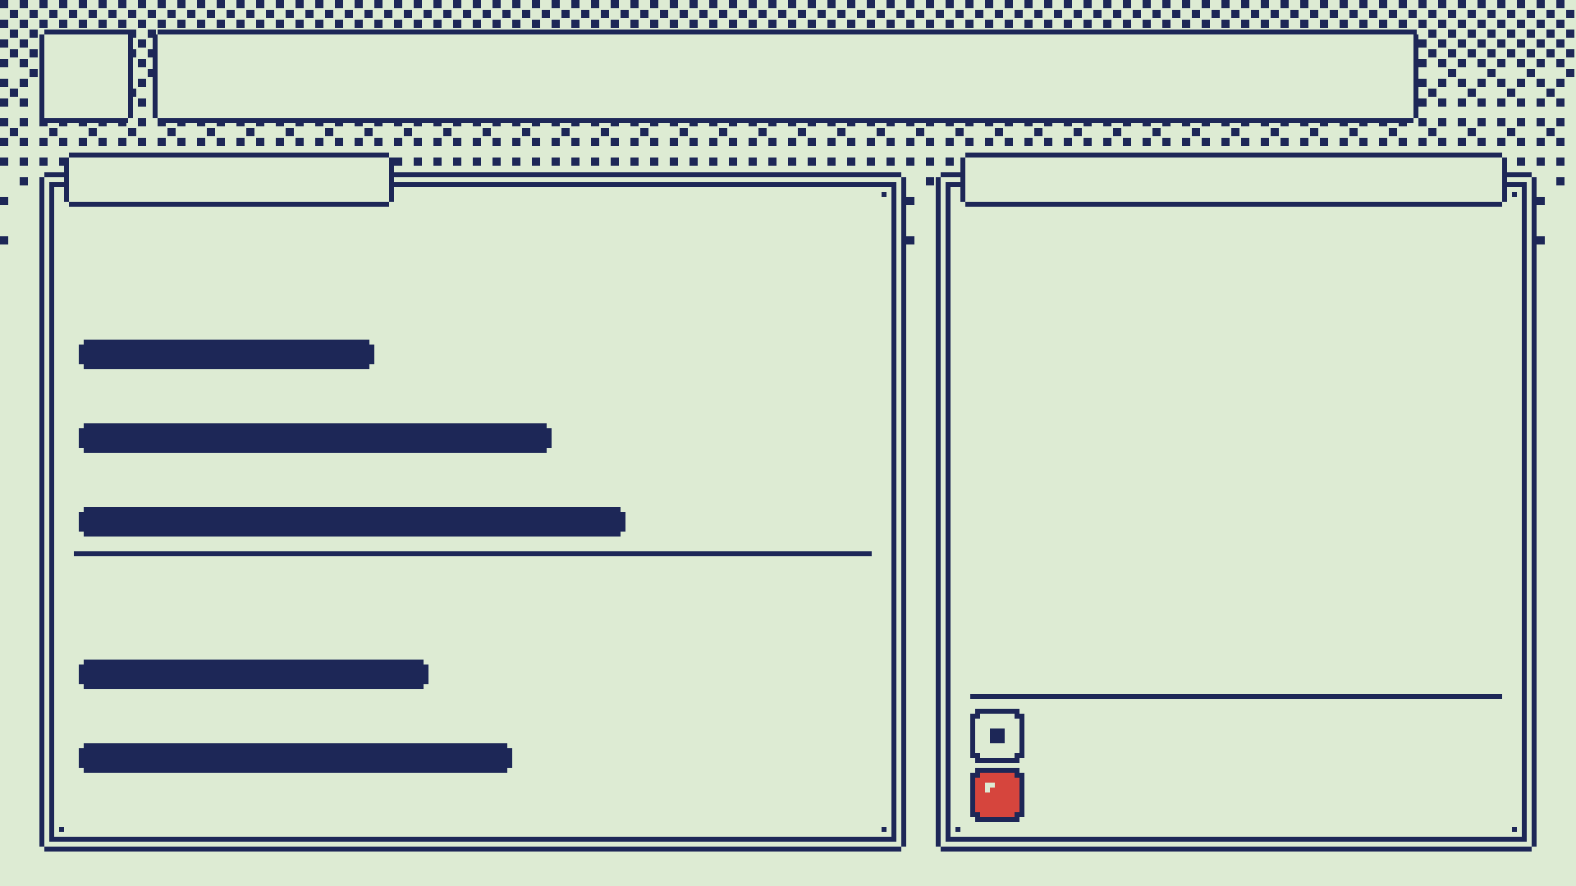
20
Raising the numbers
ACCURACY
WHAT RAISED THEM
Picking the right target on real screens (dev-test, 344 rows):
Real screens: 4,648 rows from 613 screens in 57 apps.
A blind second labelling pass: 97% agreement.
Frozen embeddings and a higher learning rate (v1d).
Filler words cut "none" recall to 0.25; a normaliser brings it back to 0.80.
Hidden elements dropped from the options.
Honest scoring: held-out apps, 5-fold cross-fit, a sealed locked test.
JEVLIKE
0.465
VERDICT V1D
0.738
CLOUD, FOR SCALE
0.852
Unseen phrasings (synthetic):
BEFORE
0.545
AFTER
wrong taps 0.036, under the 0.05 bound
0.675
"none" recall 0.62, gate is 0.8
Cloud is smarter but slower (p50 0.7 s) and misses "none" more often (0.43 vs 0.53).

Slide 22
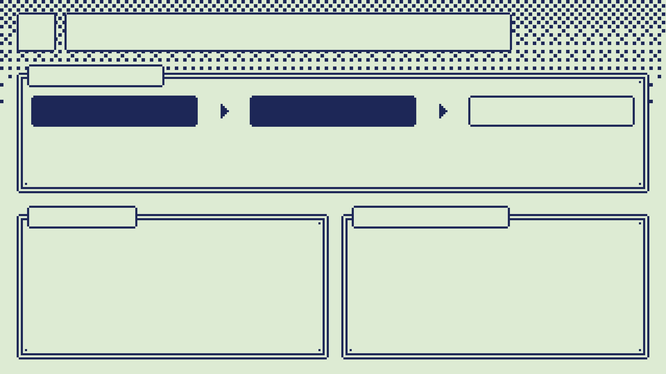
21
When it's unsure
THE CHAIN
RULES
VERDICT
CLOUD
gestures: instant and exact
phrases: on the phone, milliseconds
what neither understands: slower, smarter
JEV API
OLLAMA KEY
TypeSafe's typed-decision API (Jev).
Put your key in the app's settings; it asks the same /v1/systemone endpoint.
Jev answers in 253 ms median, 437 ms p95 (published desktop figures).
$20 a month: really cheap DeepSeek, plus whatever other models you can use.
As long as you don't mind giving your information away to China.
Smarter than Verdict on real screens (0.852 vs 0.738), but slower: 0.7 s p50.
Cloud answers are unscored, so risky taps wait for a confirm pop.

Slide 23
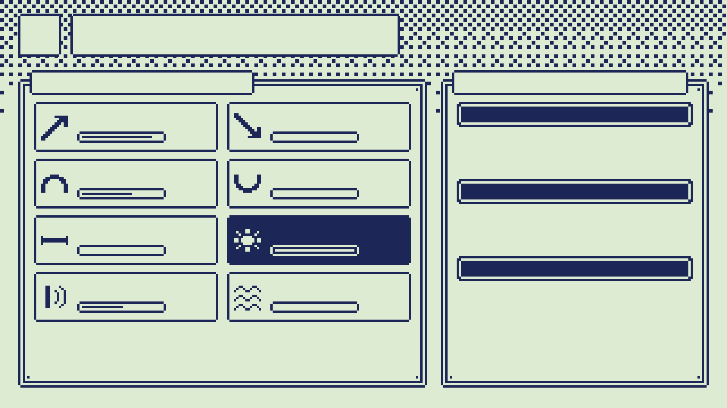
22
Your voice
TRAIN GESTURES
ENROL YOUR OWN
RISE
FALL
CUSTOM SOUND
7/8
0/8
Invent one (a meow, a trill). It becomes my sound "meow"; bind it with a rule.
ARCH
DIP
5/8
0/8
IGNORE SOUND
Your sneeze, the kettle. Always does nothing.
FLAT
POP
0/8
4/4
YOUR GESTURE
CLICK
HISS
Your own rise or pop, trusted over the default.
2/4
0/4
Each take is one variation: hummed or whistled, low or high, slow or quick. Takes save as you go.
3–5 examples each, matched on the phone before any model.

Slide 24
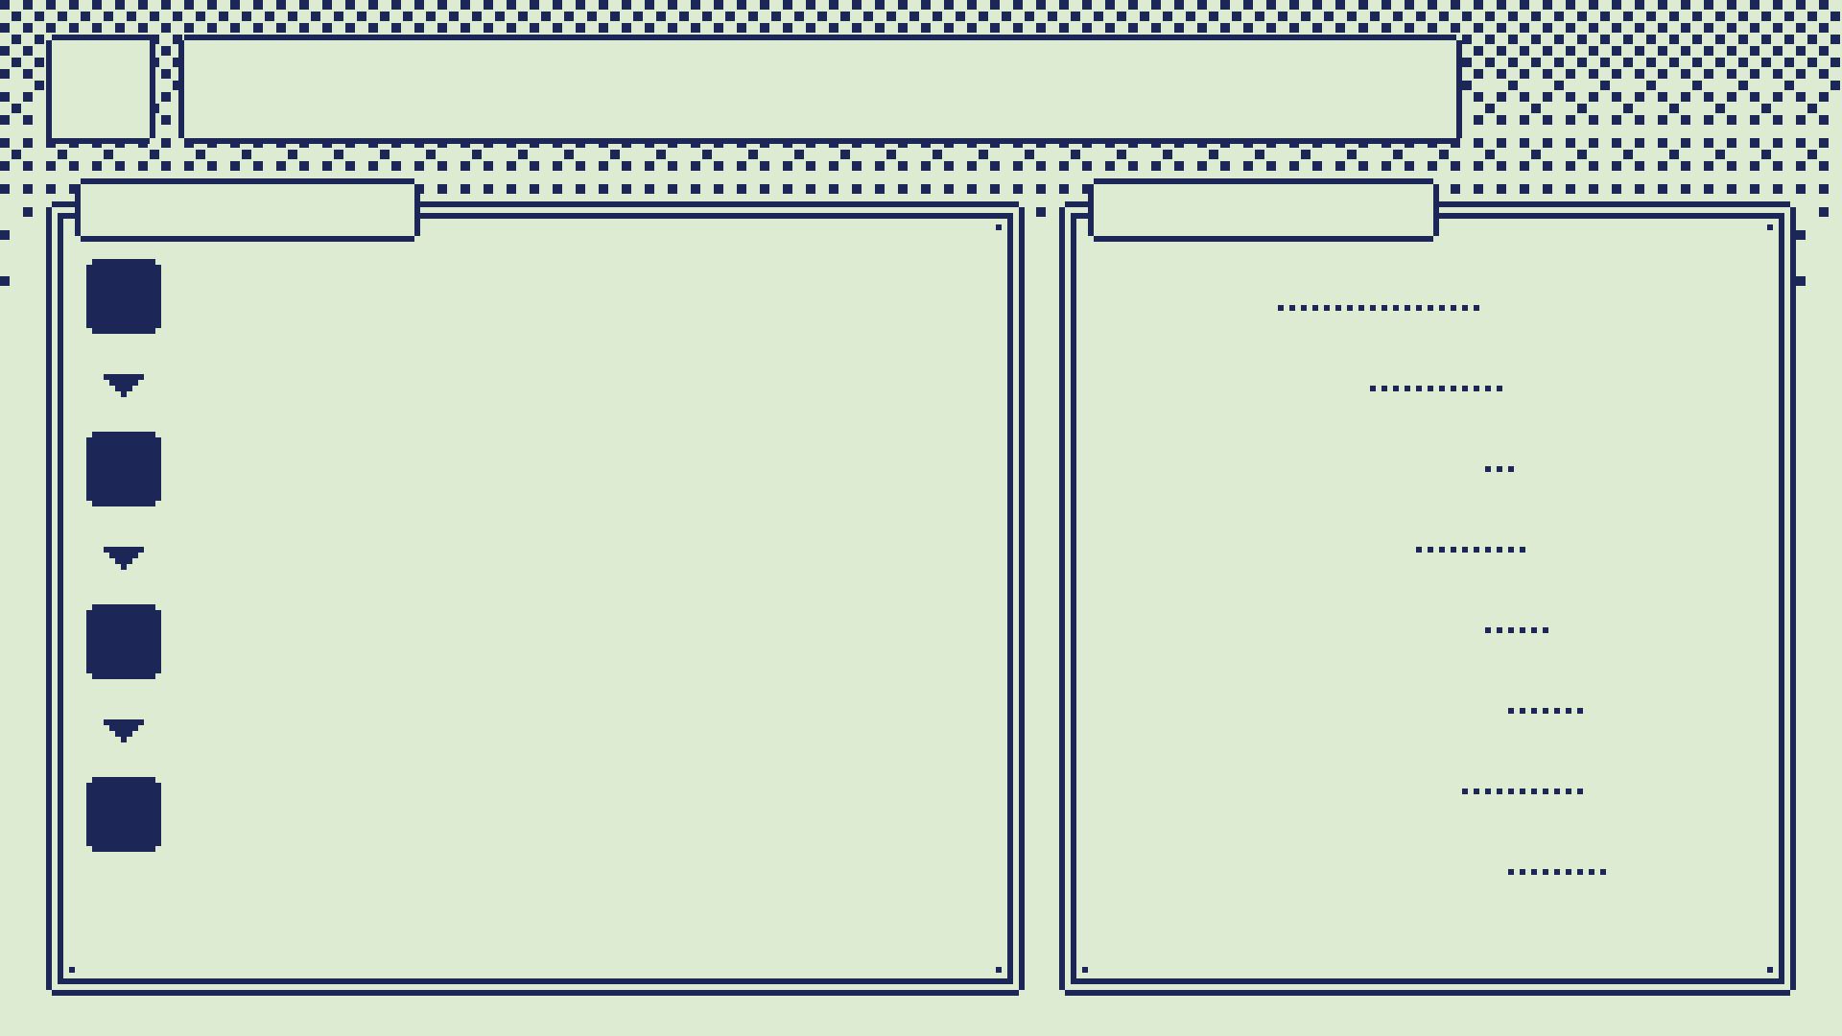
23
Built with agents
THE LOOP
THE CREW
1
PLAN
LEAD
Claude (Anthropic)
Graph out and document everything first: the wiki, a decision log, the risks.
AGENTS
up to ~12 at once
2
SUBAGENTS
62 for labelling
DECIDE
I pick the designs and libraries from the options the agents lay out.
HARNESS
Eidolon, custom
EXECUTORS
DeepSeek V4.1
3
BUILD
Agents each own one folder and its tests; subagents fan out the grunt work.
OLLAMA PRO
$20 a month
DECISIONS
140+ logged
4
ITERATE
FIRST BUILD
~24 hours
Try it on the phone, measure, and loop.

Slide 25

24
Challenges
THE PHONE MIC
ALSO HARD
Videos made gestures: 30–47 would-act sounds a minute, even with Android's echo cancelling. So, layers:
MOBILE DEV
New to Android and Dart: accessibility, BLE, a launch crash. Now: emulator suite + launch check before any install.
NDK: the pendant's C++ extractor
FINE-TUNING
level gate
Strong on synthetic data, weak on real screens (0.447) until real screens, blind labels and cross-fit.
media lock, "pop pop" unlocks
DATASETS
no taps from phone-mic pops
4,648 real rows from 613 screens; phone data never leaves the box; a sealed test.
lone "up"/"down": pendant only
CALIBRATION
calibration at the end
A last step that fits the thresholds to each voice. It holds up well across profiles.
The video alone: 0 "pop pop"s in 5.4 min.

Slide 26
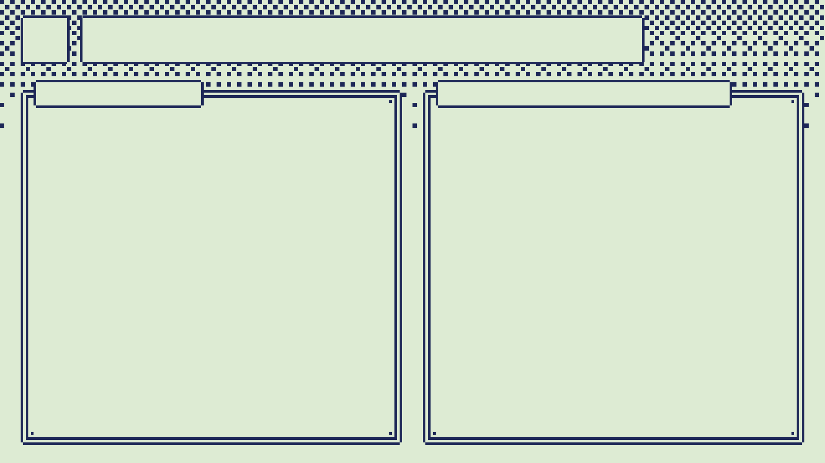
25
Could be cheaper
HARDWARE
COMPUTE + MODELS
Start with no pendant: the phone mic alone works, for $0 of parts.
Print the 10-minute fit tests first: v1 of the case was a whole wasted print.
Skip the LiPo ($8–12): a power bank you already own does the job.
Gestures ended up as plain code, so the gesture-model track could go: jevlike sweeps (8.75 h logged) and Kev 0.8B (dropped).
The teacher labellers scored 0.69–0.79 and never replaced the code labels.
Train only the model you ship. Once Verdict is on the phone, the $20/mo cloud key is optional.

Slide 27
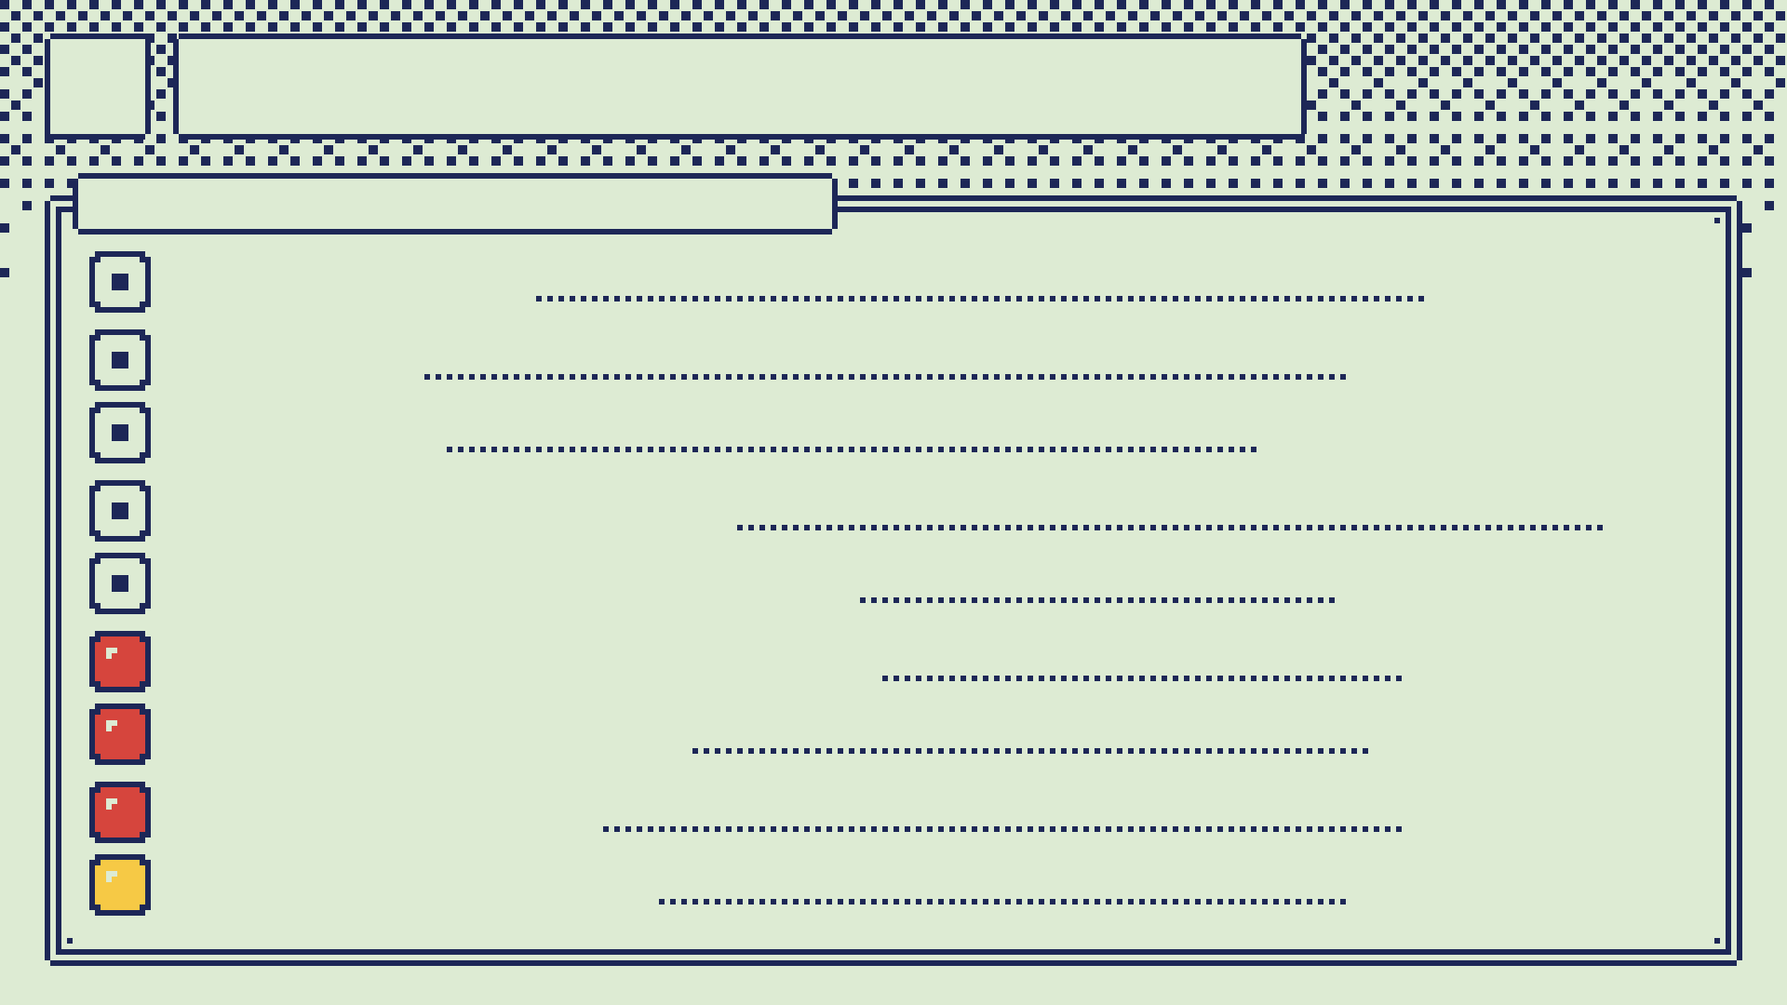
26
Where it stands
ROUND 6 · 2026-09-27
JVM TESTS
498 / 498 pass
PYTEST
145 pass + 8 xfail
FLUTTER
94 ui + 10 desktop pass
FIRMWARE PARITY
pass
VERDICT WRONG TAPS
0.036 (bound 0.050)
VERDICT NONE RECALL
0.62 (gate 0.8)
EMULATOR SUITE
12 pass · 11 fail
PENDANT MIC
reads all zeros
B4A CROSS-FIT
interrupted, rerun

Slide 28

27
Next
DO FIRST
HOUSE RULE
1
Find why 11 emulator tests fail: gesture confirmation and cursor taps.
Before any phone install: run the emulator suite and a launch check. Unit tests never build the real screen, and that let a launch crash through.
2
Check the pendant mic wiring on the lid header.
3
Rerun the Verdict b4a cross-fit and refit the phone thresholds.
4
Calibrate the phone mic: clicks, whistle, hiss, room.
5
Recapture three screen sets with the badge hidden.
6
Fold this session into the decision log.

