Slide 1


Re³: Generating Longer Stories With Recursive Reprompting and Revision
Kevin Yang, Yuandong Tian, Nanyun Peng, Dan Klein

Slide 2
Input
Premise
AI researchers Kevin, Yuandong, Nanyun, and Dan create a system for automatically generating high-quality long stories, aiming to submit their work to a prestigious conference.

Slide 3
Re³ Story (2000+ Words)
Premise
AI researchers Kevin, Yuandong, Nanyun, and Dan create a system for automatically generating high-quality long stories, aiming to submit their work to a prestigious conference.
...[80 words]...
Kevin walked over to his desk and sat down, looking at it with disgust. There was a pile of manila folders on top, which contained detailed notes of his latest experiments for writing programs using neural networks for language processing. ...[137 words]...
Kevin started to read through the file thoroughly, detailing his latest results on language processing that were designed to write reasonably long and coherent text automatically with minimal supervision or guidance from human inputs. ...[118 words]...
he recalled the effort that led to this final result. ...[54 words]...
They were lucky they managed to get their hands on two excellent researchers – Nanyun Zhang and Yuandong Li ...[222 words]...
Kevin's eye was caught by one number that was highlighted in the last report; this number represented the new algorithm's ability to create lengthy and coherent text on its own. The text contained more than 500 words, but the algorithm had generated many more than that – several thousands in fact. Kevin opened up two other files that contained several thousand words of AI generated text each. ...[52 words]...
Kevin rubbed his hands together as he decided to contact his supervisor immediately with these new findings; he also needed to work on an official presentation for their upcoming conference ...[753 words]...
they were going to submit a paper on their work at the next major conference. They were only going to submit one paper, which would be a joint paper by Nanyun and Kevin ...[119 words]...
Kevin felt like all his hard work was finally paying off, and he did not want to think about anything else; at this point, he simply wanted to focus on research and the upcoming conference. ...[551 words]...
Re³
Story

Slide 4
Major Challenges

Slide 5
Major Challenges
Long-range plot coherence
Relevance to premise
Long-range factual consistency

Slide 6
Major Challenges
Long-range plot coherence
Relevance to premise
Long-range factual consistency

Slide 7
Major Challenges
Long-range plot coherence
Relevance to premise
Long-range factual consistency

Slide 8
Long-Range Coherence
Premise
AI researchers Kevin, Yuandong, Nanyun, and Dan create a system for automatically generating high-quality long stories, aiming to submit their work to a prestigious conference.
...[80 words]...
Kevin walked over to his desk and sat down, looking at it with disgust. There was a pile of manila folders on top, which contained detailed notes of his latest experiments for writing programs using neural networks for language processing. ...[137 words]...
Kevin started to read through the file thoroughly, detailing his latest results on language processing that were designed to write reasonably long and coherent text automatically with minimal supervision or guidance from human inputs. ...[118 words]...
he recalled the effort that led to this final result. ...[54 words]...
They were lucky they managed to get their hands on two excellent researchers – Nanyun Zhang and Yuandong Li ...[222 words]...
Kevin's eye was caught by one number that was highlighted in the last report; this number represented the new algorithm's ability to create lengthy and coherent text on its own. The text contained more than 500 words, but the algorithm had generated many more than that – several thousands in fact. Kevin opened up two other files that contained several thousand words of AI generated text each. ...[52 words]...
Kevin rubbed his hands together as he decided to contact his supervisor immediately with these new findings; he also needed to work on an official presentation for their upcoming conference ...[753 words]...
they were going to submit a paper on their work at the next major conference. They were only going to submit one paper, which would be a joint paper by Nanyun and Kevin ...[119 words]...
Kevin felt like all his hard work was finally paying off, and he did not want to think about anything else; at this point, he simply wanted to focus on research and the upcoming conference. ...[551 words]...
Re³
Story

Slide 9
Long-Range Coherence
Premise
AI researchers Kevin, Yuandong, Nanyun, and Dan create a system for automatically generating high-quality long stories, aiming to submit their work to a prestigious conference.
...[80 words]...
Kevin walked over to his desk and sat down, looking at it with disgust. There was a pile of manila folders on top, which contained detailed notes of his latest experiments for writing programs using neural networks for language processing. ...[137 words]...
Kevin started to read through the file thoroughly, detailing his latest results on language processing that were designed to write reasonably long and coherent text automatically with minimal supervision or guidance from human inputs. ...[118 words]...
he recalled the effort that led to this final result. ...[54 words]...
They were lucky they managed to get their hands on two excellent researchers – Nanyun Zhang and Yuandong Li ...[222 words]...
Kevin's eye was caught by one number that was highlighted in the last report; this number represented the new algorithm's ability to create lengthy and coherent text on its own. The text contained more than 500 words, but the algorithm had generated many more than that – several thousands in fact. Kevin opened up two other files that contained several thousand words of AI generated text each. ...[52 words]...
Kevin rubbed his hands together as he decided to contact his supervisor immediately with these new findings; he also needed to work on an official presentation for their upcoming conference ...[753 words]...
they were going to submit a paper on their work at the next major conference. They were only going to submit one paper, which would be a joint paper by Nanyun and Kevin ...[119 words]...
Kevin felt like all his hard work was finally paying off, and he did not want to think about anything else; at this point, he simply wanted to focus on research and the upcoming conference. ...[551 words]...
Re³
Story

Slide 10
Long-Range Coherence
Premise
AI researchers Kevin, Yuandong, Nanyun, and Dan create a system for automatically generating high-quality long stories, aiming to submit their work to a prestigious conference.
...[80 words]...
Kevin walked over to his desk and sat down, looking at it with disgust. There was a pile of manila folders on top, which contained detailed notes of his latest experiments for writing programs using neural networks for language processing. ...[137 words]...
Kevin started to read through the file thoroughly, detailing his latest results on language processing that were designed to write reasonably long and coherent text automatically with minimal supervision or guidance from human inputs. ...[118 words]...
he recalled the effort that led to this final result. ...[54 words]...
They were lucky they managed to get their hands on two excellent researchers – Nanyun Zhang and Yuandong Li ...[222 words]...
Kevin's eye was caught by one number that was highlighted in the last report; this number represented the new algorithm's ability to create lengthy and coherent text on its own. The text contained more than 500 words, but the algorithm had generated many more than that – several thousands in fact. Kevin opened up two other files that contained several thousand words of AI generated text each. ...[52 words]...
Kevin rubbed his hands together as he decided to contact his supervisor immediately with these new findings; he also needed to work on an official presentation for their upcoming conference ...[753 words]...
they were going to submit a paper on their work at the next major conference. They were only going to submit one paper, which would be a joint paper by Nanyun and Kevin ...[119 words]...
Kevin felt like all his hard work was finally paying off, and he did not want to think about anything else; at this point, he simply wanted to focus on research and the upcoming conference. ...[551 words]...
Re³
Story

Slide 11
Long-Range Coherence
Premise
AI researchers Kevin, Yuandong, Nanyun, and Dan create a system for automatically generating high-quality long stories, aiming to submit their work to a prestigious conference.
...[80 words]...
Kevin walked over to his desk and sat down, looking at it with disgust. There was a pile of manila folders on top, which contained detailed notes of his latest experiments for writing programs using neural networks for language processing. ...[137 words]...
Kevin started to read through the file thoroughly, detailing his latest results on language processing that were designed to write reasonably long and coherent text automatically with minimal supervision or guidance from human inputs. ...[118 words]...
he recalled the effort that led to this final result. ...[54 words]...
They were lucky they managed to get their hands on two excellent researchers – Nanyun Zhang and Yuandong Li ...[222 words]...
Kevin's eye was caught by one number that was highlighted in the last report; this number represented the new algorithm's ability to create lengthy and coherent text on its own. The text contained more than 500 words, but the algorithm had generated many more than that – several thousands in fact. Kevin opened up two other files that contained several thousand words of AI generated text each. ...[52 words]...
Kevin rubbed his hands together as he decided to contact his supervisor immediately with these new findings; he also needed to work on an official presentation for their upcoming conference ...[753 words]...
they were going to submit a paper on their work at the next major conference. They were only going to submit one paper, which would be a joint paper by Nanyun and Kevin ...[119 words]...
Kevin felt like all his hard work was finally paying off, and he did not want to think about anything else; at this point, he simply wanted to focus on research and the upcoming conference. ...[551 words]...
Re³
Story

Slide 12
Long-Range Coherence
Premise
AI researchers Kevin, Yuandong, Nanyun, and Dan create a system for automatically generating high-quality long stories, aiming to submit their work to a prestigious conference.
...[80 words]...
Kevin walked over to his desk and sat down, looking at it with disgust. There was a pile of manila folders on top, which contained detailed notes of his latest experiments for writing programs using neural networks for language processing. ...[137 words]...
Kevin started to read through the file thoroughly, detailing his latest results on language processing that were designed to write reasonably long and coherent text automatically with minimal supervision or guidance from human inputs. ...[118 words]...
he recalled the effort that led to this final result. ...[54 words]...
They were lucky they managed to get their hands on two excellent researchers – Nanyun Zhang and Yuandong Li ...[222 words]...
Kevin's eye was caught by one number that was highlighted in the last report; this number represented the new algorithm's ability to create lengthy and coherent text on its own. The text contained more than 500 words, but the algorithm had generated many more than that – several thousands in fact. Kevin opened up two other files that contained several thousand words of AI generated text each. ...[52 words]...
Kevin rubbed his hands together as he decided to contact his supervisor immediately with these new findings; he also needed to work on an official presentation for their upcoming conference ...[753 words]...
they were going to submit a paper on their work at the next major conference. They were only going to submit one paper, which would be a joint paper by Nanyun and Kevin ...[119 words]...
Kevin felt like all his hard work was finally paying off, and he did not want to think about anything else; at this point, he simply wanted to focus on research and the upcoming conference. ...[551 words]...
Re³
Story

Slide 13
Premise Relevance
Premise
AI researchers Kevin, Yuandong, Nanyun, and Dan create a system for automatically generating high-quality long stories, aiming to submit their work to a prestigious conference.
...[80 words]...
Kevin walked over to his desk and sat down, looking at it with disgust. There was a pile of manila folders on top, which contained detailed notes of his latest experiments for writing programs using neural networks for language processing. ...[137 words]...
Kevin started to read through the file thoroughly, detailing his latest results on language processing that were designed to write reasonably long and coherent text automatically with minimal supervision or guidance from human inputs. ...[118 words]...
he recalled the effort that led to this final result. ...[54 words]...
They were lucky they managed to get their hands on two excellent researchers – Nanyun Zhang and Yuandong Li ...[222 words]...
Kevin's eye was caught by one number that was highlighted in the last report; this number represented the new algorithm's ability to create lengthy and coherent text on its own. The text contained more than 500 words, but the algorithm had generated many more than that – several thousands in fact. Kevin opened up two other files that contained several thousand words of AI generated text each. ...[52 words]...
Kevin rubbed his hands together as he decided to contact his supervisor immediately with these new findings; he also needed to work on an official presentation for their upcoming conference ...[753 words]...
they were going to submit a paper on their work at the next major conference. They were only going to submit one paper, which would be a joint paper by Nanyun and Kevin ...[119 words]...
Kevin felt like all his hard work was finally paying off, and he did not want to think about anything else; at this point, he simply wanted to focus on research and the upcoming conference. ...[551 words]...
Re³
Story

Slide 14
Premise Relevance
Premise
AI researchers Kevin, Yuandong, Nanyun, and Dan create a system for automatically generating high-quality long stories, aiming to submit their work to a prestigious conference.
...[80 words]...
Kevin walked over to his desk and sat down, looking at it with disgust. There was a pile of manila folders on top, which contained detailed notes of his latest experiments for writing programs using neural networks for language processing. ...[137 words]...
Kevin started to read through the file thoroughly, detailing his latest results on language processing that were designed to write reasonably long and coherent text automatically with minimal supervision or guidance from human inputs. ...[118 words]...
he recalled the effort that led to this final result. ...[54 words]...
They were lucky they managed to get their hands on two excellent researchers – Nanyun Zhang and Yuandong Li ...[222 words]...
Kevin's eye was caught by one number that was highlighted in the last report; this number represented the new algorithm's ability to create lengthy and coherent text on its own. The text contained more than 500 words, but the algorithm had generated many more than that – several thousands in fact. Kevin opened up two other files that contained several thousand words of AI generated text each. ...[52 words]...
Kevin rubbed his hands together as he decided to contact his supervisor immediately with these new findings; he also needed to work on an official presentation for their upcoming conference ...[753 words]...
they were going to submit a paper on their work at the next major conference. They were only going to submit one paper, which would be a joint paper by Nanyun and Kevin ...[119 words]...
Kevin felt like all his hard work was finally paying off, and he did not want to think about anything else; at this point, he simply wanted to focus on research and the upcoming conference. ...[551 words]...
Re³
Story

Slide 15
Premise Relevance
Premise
AI researchers Kevin, Yuandong, Nanyun, and Dan create a system for automatically generating high-quality long stories, aiming to submit their work to a prestigious conference.
...[80 words]...
Kevin walked over to his desk and sat down, looking at it with disgust. There was a pile of manila folders on top, which contained detailed notes of his latest experiments for writing programs using neural networks for language processing. ...[137 words]...
Kevin started to read through the file thoroughly, detailing his latest results on language processing that were designed to write reasonably long and coherent text automatically with minimal supervision or guidance from human inputs. ...[118 words]...
he recalled the effort that led to this final result. ...[54 words]...
They were lucky they managed to get their hands on two excellent researchers – Nanyun Zhang and Yuandong Li ...[222 words]...
Kevin's eye was caught by one number that was highlighted in the last report; this number represented the new algorithm's ability to create lengthy and coherent text on its own. The text contained more than 500 words, but the algorithm had generated many more than that – several thousands in fact. Kevin opened up two other files that contained several thousand words of AI generated text each. ...[52 words]...
Kevin rubbed his hands together as he decided to contact his supervisor immediately with these new findings; he also needed to work on an official presentation for their upcoming conference ...[753 words]...
they were going to submit a paper on their work at the next major conference. They were only going to submit one paper, which would be a joint paper by Nanyun and Kevin ...[119 words]...
Kevin felt like all his hard work was finally paying off, and he did not want to think about anything else; at this point, he simply wanted to focus on research and the upcoming conference. ...[551 words]...
Re³
Story

Slide 16
Premise Relevance
Premise
AI researchers Kevin, Yuandong, Nanyun, and Dan create a system for automatically generating high-quality long stories, aiming to submit their work to a prestigious conference.
...[80 words]...
Kevin walked over to his desk and sat down, looking at it with disgust. There was a pile of manila folders on top, which contained detailed notes of his latest experiments for writing programs using neural networks for language processing. ...[137 words]...
Kevin started to read through the file thoroughly, detailing his latest results on language processing that were designed to write reasonably long and coherent text automatically with minimal supervision or guidance from human inputs. ...[118 words]...
he recalled the effort that led to this final result. ...[54 words]...
They were lucky they managed to get their hands on two excellent researchers – Nanyun Zhang and Yuandong Li ...[222 words]...
Kevin's eye was caught by one number that was highlighted in the last report; this number represented the new algorithm's ability to create lengthy and coherent text on its own. The text contained more than 500 words, but the algorithm had generated many more than that – several thousands in fact. Kevin opened up two other files that contained several thousand words of AI generated text each. ...[52 words]...
Kevin rubbed his hands together as he decided to contact his supervisor immediately with these new findings; he also needed to work on an official presentation for their upcoming conference ...[753 words]...
they were going to submit a paper on their work at the next major conference. They were only going to submit one paper, which would be a joint paper by Nanyun and Kevin ...[119 words]...
Kevin felt like all his hard work was finally paying off, and he did not want to think about anything else; at this point, he simply wanted to focus on research and the upcoming conference. ...[551 words]...
Re³
Story

Slide 17
Premise Relevance
Premise
AI researchers Kevin, Yuandong, Nanyun, and Dan create a system for automatically generating high-quality long stories, aiming to submit their work to a prestigious conference.
...[80 words]...
Kevin walked over to his desk and sat down, looking at it with disgust. There was a pile of manila folders on top, which contained detailed notes of his latest experiments for writing programs using neural networks for language processing. ...[137 words]...
Kevin started to read through the file thoroughly, detailing his latest results on language processing that were designed to write reasonably long and coherent text automatically with minimal supervision or guidance from human inputs. ...[118 words]...
he recalled the effort that led to this final result. ...[54 words]...
They were lucky they managed to get their hands on two excellent researchers – Nanyun Zhang and Yuandong Li ...[222 words]...
Kevin's eye was caught by one number that was highlighted in the last report; this number represented the new algorithm's ability to create lengthy and coherent text on its own. The text contained more than 500 words, but the algorithm had generated many more than that – several thousands in fact. Kevin opened up two other files that contained several thousand words of AI generated text each. ...[52 words]...
Kevin rubbed his hands together as he decided to contact his supervisor immediately with these new findings; he also needed to work on an official presentation for their upcoming conference ...[753 words]...
they were going to submit a paper on their work at the next major conference. They were only going to submit one paper, which would be a joint paper by Nanyun and Kevin ...[119 words]...
Kevin felt like all his hard work was finally paying off, and he did not want to think about anything else; at this point, he simply wanted to focus on research and the upcoming conference. ...[551 words]...
Re³
Story

Slide 18
Long-Range Factual Consistency
Premise
AI researchers Kevin, Yuandong, Nanyun, and Dan create a system for automatically generating high-quality long stories, aiming to submit their work to a prestigious conference.
...[80 words]...
Kevin walked over to his desk and sat down, looking at it with disgust. There was a pile of manila folders on top, which contained detailed notes of his latest experiments for writing programs using neural networks for language processing. ...[137 words]...
Kevin started to read through the file thoroughly, detailing his latest results on language processing that were designed to write reasonably long and coherent text automatically with minimal supervision or guidance from human inputs. ...[118 words]...
he recalled the effort that led to this final result. ...[54 words]...
They were lucky they managed to get their hands on two excellent researchers – Nanyun Zhang and Yuandong Li ...[222 words]...
Kevin's eye was caught by one number that was highlighted in the last report; this number represented the new algorithm's ability to create lengthy and coherent text on its own. The text contained more than 500 words, but the algorithm had generated many more than that – several thousands in fact. Kevin opened up two other files that contained several thousand words of AI generated text each. ...[52 words]...
Kevin rubbed his hands together as he decided to contact his supervisor immediately with these new findings; he also needed to work on an official presentation for their upcoming conference ...[753 words]...
they were going to submit a paper on their work at the next major conference. They were only going to submit one paper, which would be a joint paper by Nanyun and Kevin ...[119 words]...
Kevin felt like all his hard work was finally paying off, and he did not want to think about anything else; at this point, he simply wanted to focus on research and the upcoming conference. ...[551 words]...
Re³
Story

Slide 19
Long-Range Factual Consistency
Premise
AI researchers Kevin, Yuandong, Nanyun, and Dan create a system for automatically generating high-quality long stories, aiming to submit their work to a prestigious conference.
...[80 words]...
Kevin walked over to his desk and sat down, looking at it with disgust. There was a pile of manila folders on top, which contained detailed notes of his latest experiments for writing programs using neural networks for language processing. ...[137 words]...
Kevin started to read through the file thoroughly, detailing his latest results on language processing that were designed to write reasonably long and coherent text automatically with minimal supervision or guidance from human inputs. ...[118 words]...
he recalled the effort that led to this final result. ...[54 words]...
They were lucky they managed to get their hands on two excellent researchers – Nanyun Zhang and Yuandong Li ...[222 words]...
Kevin's eye was caught by one number that was highlighted in the last report; this number represented the new algorithm's ability to create lengthy and coherent text on its own. The text contained more than 500 words, but the algorithm had generated many more than that – several thousands in fact. Kevin opened up two other files that contained several thousand words of AI generated text each. ...[52 words]...
Kevin rubbed his hands together as he decided to contact his supervisor immediately with these new findings; he also needed to work on an official presentation for their upcoming conference ...[753 words]...
they were going to submit a paper on their work at the next major conference. They were only going to submit one paper, which would be a joint paper by Nanyun and Kevin ...[119 words]...
Kevin felt like all his hard work was finally paying off, and he did not want to think about anything else; at this point, he simply wanted to focus on research and the upcoming conference. ...[551 words]...
Re³
Story

Slide 20
Recursive Reprompting and Revision

Slide 21
Recursive Reprompting and Revision
Premise
AI researchers Kevin, Yuandong, Nanyun, and Dan create a system for automatically generating high-quality long stories, aiming to submit their work to a prestigious conference.

Slide 22
Recursive Reprompting and Revision
Premise
AI researchers Kevin, Yuandong, Nanyun, and Dan create a system for automatically generating high-quality long stories, aiming to submit their work to a prestigious conference.
Plan
Draft
Rewrite
Edit

Slide 23
Recursive Reprompting and Revision
Premise
AI researchers Kevin, Yuandong, Nanyun, and Dan create a system for automatically generating high-quality long stories, aiming to submit their work to a prestigious conference.
Plan
LLM
Setting Characters Outline
Draft
Rewrite
Edit

Slide 24
Recursive Reprompting and Revision
Premise
AI researchers Kevin, Yuandong, Nanyun, and Dan create a system for automatically generating high-quality long stories, aiming to submit their work to a prestigious conference.
Plan
LLM
Setting Characters Outline
Draft
Rewrite
Edit

Slide 25
Recursive Reprompting and Revision
Premise
AI researchers Kevin, Yuandong, Nanyun, and Dan create a system for automatically generating high-quality long stories, aiming to submit their work to a prestigious conference.
Plan
LLM
Setting Characters Outline
Draft
Previous Story (if any)
Rewrite
Edit

Slide 26
Recursive Reprompting and Revision
Premise
AI researchers Kevin, Yuandong, Nanyun, and Dan create a system for automatically generating high-quality long stories, aiming to submit their work to a prestigious conference.
Plan
LLM
Setting Characters Outline
Draft
Previous Story (if any)
Prompt
(Structured Context)
Rewrite
Edit

Slide 27
Recursive Reprompting and Revision
Premise
AI researchers Kevin, Yuandong, Nanyun, and Dan create a system for automatically generating high-quality long stories, aiming to submit their work to a prestigious conference.
Plan
LLM
Setting Characters Outline
Draft
Story Continuations
Previous Story (if any)
Prompt
(Structured Context)
Story Continuations
LLM
Story Continuations
Rewrite
Edit

Slide 28
Recursive Reprompting and Revision
Premise
AI researchers Kevin, Yuandong, Nanyun, and Dan create a system for automatically generating high-quality long stories, aiming to submit their work to a prestigious conference.
Plan
LLM
Setting Characters Outline
Draft
Story Continuations
Previous Story (if any)
Prompt
(Structured Context)
Story Continuations
LLM
Story Continuations
Rewrite
Best Story Continuation
Rerankers
Edit

Slide 29
Recursive Reprompting and Revision
Premise
AI researchers Kevin, Yuandong, Nanyun, and Dan create a system for automatically generating high-quality long stories, aiming to submit their work to a prestigious conference.
Plan
LLM
Setting Characters Outline
Draft
Story Continuations
Story Continuations
Previous Story (if any)
Prompt
(Structured Context)
Story Continuations
LLM
Story Continuations
Rewrite
Best Story Continuation
Rerankers
Edit
LLM
Contradicted Facts

Slide 30
Recursive Reprompting and Revision
Premise
AI researchers Kevin, Yuandong, Nanyun, and Dan create a system for automatically generating high-quality long stories, aiming to submit their work to a prestigious conference.
Plan
LLM
Setting Characters Outline
Draft
Story Continuations
Story Continuations
Previous Story (if any)
Prompt
(Structured Context)
Story Continuations
LLM
Story Continuations
Rewrite
Best Story Continuation
Rerankers
Edit
LLM
Contradicted Facts
LLM
Final Edited Continuation

Slide 31
Recursive Reprompting and Revision
Premise
AI researchers Kevin, Yuandong, Nanyun, and Dan create a system for automatically generating high-quality long stories, aiming to submit their work to a prestigious conference.
Plan
LLM
Setting Characters Outline
Draft
Story Continuations
Story Continuations
Previous Story (if any)
Prompt
(Structured Context)
Story Continuations
LLM
Story Continuations
Rewrite
Best Story Continuation
Rerankers
Edit
LLM
Contradicted Facts
LLM
Final Edited Continuation

Slide 32
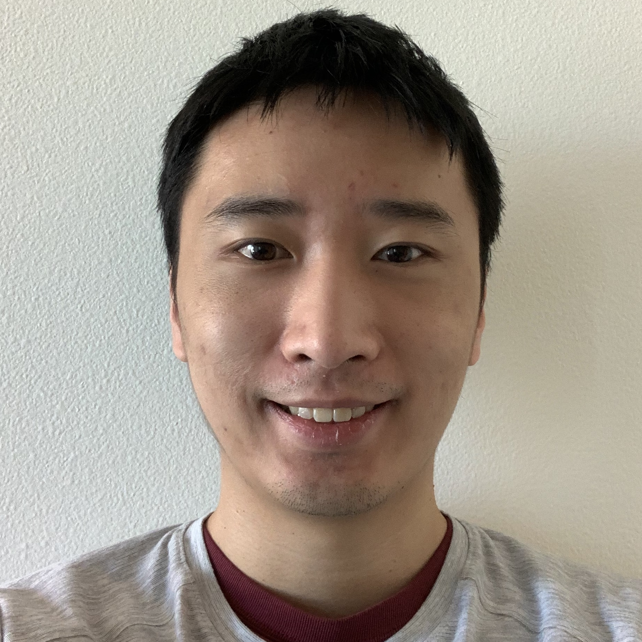
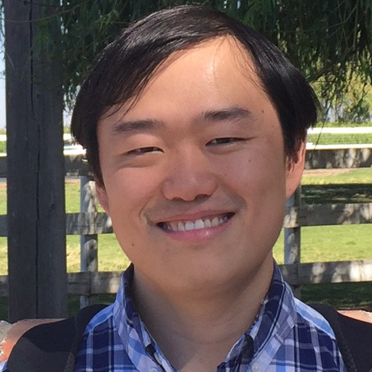
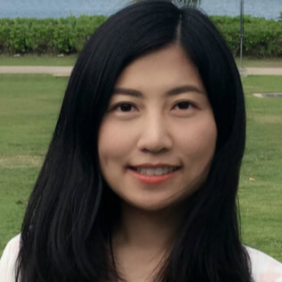
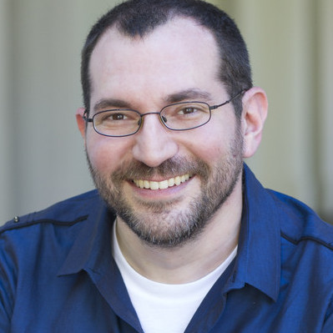
Thank you!
Paper: https://arxiv.org/abs/2210.06774
Code: https://github.com/yangkevin2/emnlp22-re3-story-generation

