Slide 1
CPIC OFFSHORE MULTI-ASSET PORTFOLIO SOLUTION
Sept. 13, 2017
Any disclaimer text

Slide 2
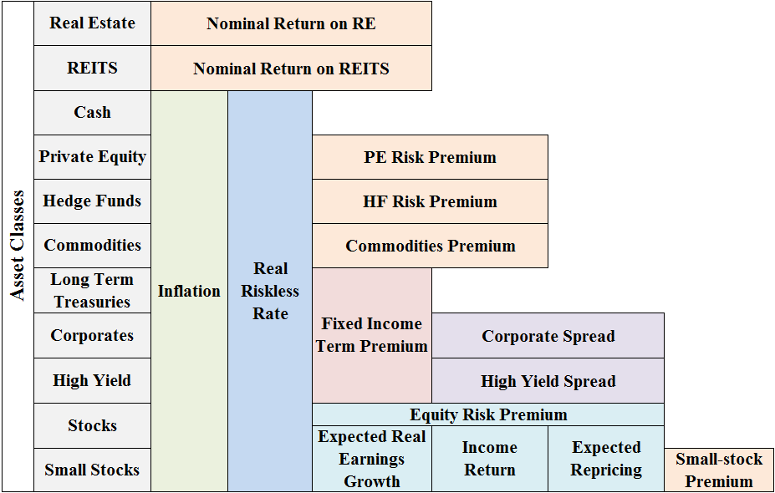
Long Term Capital Market Assumption

Slide 3
Long Term Capital Market Assumption
 | US_RealEstate | US_PrivateEquity | US_HighYield | US_LargeCap | US_SmallCap | EAFE | EM
Return | 7.00% | 8.80% | 3.77% | 7.21% | 8.06% | 7.07% | 8.03%
Volatility | 10.08% | 14.18% | 13.14% | 15.30% | 19.71% | 18.22% | 25.24%
Source: PGIM IAS, As of Date: 08/31/2017
Note: Geometric return and risk

Slide 4
Long Term Capital Market Assumption
Return Correlation
 | US_RealEstate | US_PrivateEquity | US_HighYield | US_LargeCap | US_SmallCap | EAFE | EM
US_RealEstate | 1.00 | 0.29 | 0.24 | 0.30 | 0.31 | 0.26 | 0.23
US_PrivateEquity | 0.29 | 1.00 | 0.38 | 0.68 | 0.67 | 0.60 | 0.57
US_HighYield | 0.24 | 0.38 | 1.00 | 0.50 | 0.49 | 0.46 | 0.46
US_LargeCap | 0.30 | 0.68 | 0.50 | 1.00 | 0.83 | 0.76 | 0.64
US_SmallCap | 0.31 | 0.67 | 0.49 | 0.83 | 1.00 | 0.70 | 0.69
EAFE | 0.26 | 0.60 | 0.46 | 0.76 | 0.70 | 1.00 | 0.67
EM | 0.23 | 0.57 | 0.46 | 0.64 | 0.69 | 0.67 | 1.00
Note: The return correlation estimator is based over shrunk covariance matrix, which was proposed in “A Well-Conditioned Estimator for Large-Dimensional Covariance Matrices”, Ledoit and Wolf, Journal of Multivariate Analysis, Volume 88, Issue 2, February 2004, pages 365-411.

Slide 5
Portfolios
 | Peer | Equal_Weight | ERC
Volatility | 12.48% | 13.08% | 11.00%

Slide 6
Imputed Return
 | US_RealEstate | US_PrivateEquity | US_HighYield | US_LargeCap | US_SmallCap | EAFE | EM
iRet_EqualWeight | 3.50% | 6.56% | 5.29% | 7.71% | 9.04% | 8.22% | 9.77%
iRet_Peer | 3.41% | 6.80% | 4.56% | 7.56% | 8.21% | 8.09% | 8.18%
iRet_ERC | 3.73% | 5.62% | 4.81% | 6.44% | 7.30% | 6.66% | 7.30%
Note: the imputing return methodology was proposed by Ardia, David, and Kris Boudt. "Implied expected returns and the choice of a mean-variance efficient portfolio proxy." Cahier de recherche/Working Paper 13 (2013): 28. The risk aversion factor Gamma is chosen as 4 (in the usual range of 2.5 to 4) due to the conservation of insurance offshore investment.
The low imputed return of real estate and private equity, compared to CMA, is due to the investment constrain to these assets (poor liquidity, limited access, etc.).

Slide 7
Optimal Portfolio
 | Long Only | Concentration Constrained and Long Only
Return | 8.03% | 8.27%
Volatility | 10.53% | 11.80%
Note: 1% active alpha with 3% tracking error is introduced for US_HighYield, US_LargeCap, US_SmallCap, EAFE and EM. The active alphas are mutually independent.
The concentration constrained optimization caps the weight of real estate and private equity at 25% and 40% respectively. Gamma is set to be 4 for both optimizations.

Slide 8
Black-Litterman, Posterior Expected Return (Gamma =4)
Views: CMA with Active Alpha
Prior and Posterior Expected Return
Views | US_RealEstate | US_PrivateEquity | US_HighYield | US_LargeCap | US_SmallCap | EAFE | EM | Asserted Expected Return
1 | 1 | 0 | 0 | 0 | 0 | 0 | 0 | 7.00%
2 | 0 | 1 | 0 | 0 | 0 | 0 | 0 | 8.80%
3 | 0 | 0 | 1 | 0 | 0 | 0 | 0 | 5.77%
4 | 0 | 0 | 0 | 1 | 0 | 0 | 0 | 8.21%
5 | 0 | 0 | 0 | 0 | 1 | 0 | 0 | 9.06%
6 | 0 | 0 | 0 | 0 | 0 | 1 | 0 | 8.07%
7 | 0 | 0 | 0 | 0 | 0 | 0 | 1 | 9.03%
 | US_RealEstate | US_PrivateEquity | US_HighYield | US_LargeCap | US_SmallCap | EAFE | EM
prior_ExpReturn | 3.41% | 6.80% | 4.56% | 7.56% | 8.21% | 8.09% | 8.18%
View | 7.00% | 8.80% | 5.77% | 8.21% | 9.06% | 8.07% | 9.03%
post_ExpReturn | 5.20% | 7.80% | 5.13% | 7.87% | 8.62% | 8.08% | 8.58%
Note: Assume 1% active alpha with 3% tracking error for US_LargeCap, US_SmallCap, EAFE and EM. The active alphas are mutually independent..
The uncertainty of prior, tau, is set to be 5%, following, He, Guangliang, and Robert Litterman. "The intuition behind Black-Litterman model portfolios." (1999).

Slide 9
Black Litterman, Optimal Portfolio (Gamma=4)
 | Long Only | Concentration Constrained and Long Only
Return | 7.11% | 7.23%
Volatility | 11.37% | 11.83%
Note:The optimization is based upon posterior expected return and variance, with risk aversion factor, Gamma, as 4.

Slide 10
Black-Litterman, Posterior Expected Return (Gamma =3.5)
Views: CMA with Active Alpha
Prior and Posterior Expected Return
Views | US_RealEstate | US_PrivateEquity | US_HighYield | US_LargeCap | US_SmallCap | EAFE | EM | Asserted Expected Return
1 | 1 | 0 | 0 | 0 | 0 | 0 | 0 | 7.00%
2 | 0 | 1 | 0 | 0 | 0 | 0 | 0 | 8.80%
3 | 0 | 0 | 1 | 0 | 0 | 0 | 0 | 5.77%
4 | 0 | 0 | 0 | 1 | 0 | 0 | 0 | 8.21%
5 | 0 | 0 | 0 | 0 | 1 | 0 | 0 | 9.06%
6 | 0 | 0 | 0 | 0 | 0 | 1 | 0 | 8.07%
7 | 0 | 0 | 0 | 0 | 0 | 0 | 1 | 9.03%
 | US_RealEstate | US_PrivateEquity | US_HighYield | US_LargeCap | US_SmallCap | EAFE | EM
prior_ExpReturn | 3.14% | 6.05% | 4.11% | 6.70% | 7.16% | 7.10% | 6.98%
View | 7.00% | 8.80% | 5.77% | 8.21% | 9.06% | 8.07% | 9.03%
post_ExpReturn | 5.07% | 7.42% | 4.91% | 7.43% | 8.10% | 7.58% | 7.98%
Note: Assume 1% active alpha with 3% tracking error for US_LargeCap, US_SmallCap, EAFE and EM. The active alphas are mutually independent..
The uncertainty of prior, tau, is set to be 5%, following, He, Guangliang, and Robert Litterman. "The intuition behind Black-Litterman model portfolios." (1999).

Slide 11
Black Litterman, Optimal Portfolio (Gamma=3.5)
 | Long Only | Concentration Constrained and Long Only
Return | 6.68% | 6.80%
Volatility | 11.06% | 11.44%
Note:The optimization is based upon posterior expected return and variance, with risk aversion factor, Gamma, as 4.

Slide 12
Black-Litterman, Posterior Expected Return (Gamma =3)
Views: CMA with Active Alpha
Prior and Posterior Expected Return
Views | US_RealEstate | US_PrivateEquity | US_HighYield | US_LargeCap | US_SmallCap | EAFE | EM | Asserted Expected Return
1 | 1 | 0 | 0 | 0 | 0 | 0 | 0 | 7.00%
2 | 0 | 1 | 0 | 0 | 0 | 0 | 0 | 8.80%
3 | 0 | 0 | 1 | 0 | 0 | 0 | 0 | 5.77%
4 | 0 | 0 | 0 | 1 | 0 | 0 | 0 | 8.21%
5 | 0 | 0 | 0 | 0 | 1 | 0 | 0 | 9.06%
6 | 0 | 0 | 0 | 0 | 0 | 1 | 0 | 8.07%
7 | 0 | 0 | 0 | 0 | 0 | 0 | 1 | 9.03%
 | US_RealEstate | US_PrivateEquity | US_HighYield | US_LargeCap | US_SmallCap | EAFE | EM
prior_ExpReturn | 2.88% | 5.30% | 3.66% | 5.83% | 6.12% | 6.10% | 5.79%
View | 7.00% | 8.80% | 5.77% | 8.21% | 9.06% | 8.07% | 9.03%
post_ExpReturn | 4.94% | 7.05% | 4.68% | 7.00% | 7.58% | 7.08% | 7.38%
Note: Assume 1% active alpha with 3% tracking error for US_LargeCap, US_SmallCap, EAFE and EM. The active alphas are mutually independent..
The uncertainty of prior, tau, is set to be 5%, following, He, Guangliang, and Robert Litterman. "The intuition behind Black-Litterman model portfolios." (1999).

Slide 13
Black Litterman, Optimal Portfolio (Gamma=3)
 | Long Only | Concentration Constrained and Long Only
Return | 6.26% | 6.38%
Volatility | 10.73% | 11.19%
Note:The optimization is based upon posterior expected return and variance, with risk aversion factor, Gamma, as 4.

Slide 14
Important Disclosure
PGIM, Inc. (“PGIM”) is the primary asset management business of Prudential Financial, Inc.(“PFI”) and is a registered investment advisor with the US Securities and Exchange Commission. PFI, a company with corporate headquarters in the United States, is not affiliated in any manner with Prudential plc, a company incorporated in the United Kingdom. PFI, the PGIM logo and the Rock design are service marks of PFI and its related entities, registered in many jurisdictions worldwide.
By your acceptance of this information, you acknowledge and agree that PGIM is not acting as a fiduciary in providing any recommendations, information or other communications (including without limitation asset allocation recommendations), and that such recommendations, information and communications (including without limitation any asset allocation recommendations) are not intended to serve, and will not serve, as a primary basis for your investment decisions. You also acknowledge and agree that in the event you adopt or follow all or part of PGIM’s asset allocation recommendations, that PGIM has not provided, and will not provide, any advice or recommendations with respect to the implementation of such asset allocation recommendations.
In addition, you acknowledge your understanding that PGIM is an affiliate of PFI and that you have entered into discussions with PGIM about services (including without limitation asset allocation services) at your sole discretion, which are services that PGIM provides separate and apart from your existing business relationships with PFI.
This document has been provided at your request and may contain confidential information and the recipient hereof agrees to maintain the confidentiality of such information. These materials represent the views, opinions and recommendations of the author(s) regarding the economic conditions, asset classes, securities, issuers, or financial instruments referenced herein. Distribution of this information to any person other than the person to whom it was originally delivered and to such person’s advisers is unauthorized, and any reproduction of this document, in whole or in part, or the disclosure of any of its contents, without PGIM’s prior written consent, is prohibited. This document contains the current opinions of the manager and such opinions are subject to change. Certain information in this document has been obtained from sources that PGIM believes to be reliable as of the date presented; however, the PGIM cannot guarantee the accuracy of such information, assure its completeness, or warrant such information will not be changed. PGIM has no obligation to update any or all such information; nor do we make any express or implied warranties or representations as to its completeness or accuracy. Any information presented regarding the affiliates of PGIM is presented purely to facilitate an organizational overview and is not a solicitation on behalf of any affiliate. These materials are not intended as an offer or solicitation with respect to the purchase or sale of any security or other financial instrument or any investment management services. These materials do not constitute investment advice and should not be used as the basis for any investment decision. Past performance is not a guarantee or a reliable indicator of future results.
The information contained herein is provided on the basis and subject to the explanations, caveats and warnings set out in this notice and elsewhere herein. Any discussion of risk management is intended to describe the PGIM’s efforts to monitor and manage risk but does not imply low risk. No investment strategy or risk management technique can guarantee returns or eliminate risk in any market environment. These materials do not purport to provide any legal, tax or accounting advice. These materials are not intended for distribution to or use by any person in any jurisdiction where such distribution would be contrary to local law or regulation.
Certain information contained in this document constitute "forward-looking statements," which can be identified by the use of forward-looking terminology such as "may", "will", "should", "expect", "anticipate", "target", "project", "estimate", "intend", "continue" or "believe" or the negatives thereof or other variations thereon or comparable terminology. Due to various risks and uncertainties, actual events or results or the actual performance of the investments may differ materially from those reflected or contemplated in such forward-looking statements.
Any projections or forecasts presented herein are as of the date of this presentation and are subject to change without notice. Actual data will vary and may not be reflected here. Projections and forecasts are subject to high levels of uncertainty. Accordingly, any projections or forecasts should be viewed as merely representative of a broad range of possible outcomes. Projections or forecasts are estimated, based on assumptions, and are subject to significant revision and may change materially as economic and market conditions change. PGIM has no obligation to provide updates or changes to any projections or forecasts.
© 2016 PFI and its related entities. PGIM, the PGIM logo, and the Rock symbol are service marks of PFI and its related entities, registered in many jurisdictions worldwide.

