Slide 1
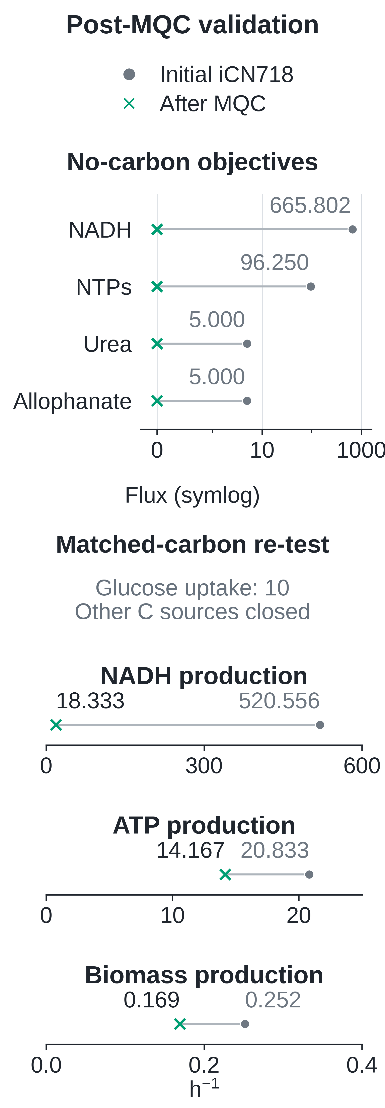
a
No-carbon
phenotype screen
b
Active pathways and targeted constraints
c
(1) FDR-dependent redox cycle
(2) ABAH-dependent redox cycle
5,10-methylene-THF
MTHFR2
(reverse)
2 ATP + NAD
+
→
carbon
source
MTHFR3
2 ADP + 2 Pi + NADH
iCN718
NAD
+
NADPH
+
2OMHMBL
OMMBLHX3
2OMMBL
→ NADH
5-methyl-THF
→ NADP
AdoHcy + H
+
Carbon-source uptake closed
ABAH
(reverse)
Objective screening
DMQMT
Cofactor
recycling
Reduced rubredoxin
closed
RDXR
FDR
(reverse)
Q
8
H
2
AdoMet
Q
8
Positive objectives
NADH →
closed
c
CYTBD
NAD
+
+ H
+
NADP
+
+ H
+
e
+
+
Reducing equivalents
Oxidized rubredoxin
→ NADPH
½ O
2
+ 2 H
(c) → H
2
O + 2 H
(e)
+
+
NADH output: 1.667
NADH
665.802
Net: H
+ NAD
→ NADH; output 500
(3) Proton-supported ATP synthesis
(4) Unsupported metabolite production
NTPs
96.250 each
uptake blocked
Methylmalonate
semialdehyde
ATP / CTP / GTP
UTP / ITP
EX_h_e
4 H
+
(e)
methylmalonate
extracellular
MADH
v = +5.000
closed
Urea
Allophanate
cytoplasm
3 H
+
(c)
NAD
+
NADH
CO
2
5.000
5.000
ADP
ATP
CO
2
pool
ATPS4r
Mass / charge imbalance
+ NH
4
+
UREA
(reverse)
ALPHNH
(reverse)
Trace active pathways
Pi
H
2
O
Proton uptake supports NTP production
Urea
Allophanate
mmol gDCW
-1
h
-1
ATPS4r flux: 2.500
5.000
5.000
Active pFBA route
Problematic reaction
MQC stop
Metabolite
Membrane
Model-derived link
Flux: mmol gDCW
-1
h
-1
c: cytoplasm; e: extracellular
Notes:
Refined from the accepted 6.1 layout. Panel c is generated from archived CSVs. No model optimization was run. See figure_legend.md and README.md for conditions, units, historical imbalance evidence, independent objective tests and provenance.

