Slide 1
myJournal
mental health tracker
Team 5
Matt Elpus, Daniel Guthart, Jade Tustin

Slide 2

Picture this…
Meet Jacob.
He’s 26 years old and works as a data entry specialist.
He’s overworked, underpaid and doesn’t have much free time in his schedule.
He struggles with his mental health, but can’t afford to spend the money or take the time off work to see a therapist…

Slide 3

There’s a lot of people like Jacob.
Our solution? myJournal.
Some people don’t have the time, money, or other resources needed to seek therapy or other mental health care.
Others just don’t feel comfortable seeing a therapist.
These are the people left behind by more traditional approaches to mental health care.

Slide 4
So, what is myJournal?
And what do we want to do for our users?

Slide 5

What is myJournal?
myJournal is a mental health monitoring webapp, accessible by web browser or mobile app.
It’s designed for people who want to manage their mental health without the help of a therapist or other professional, whether by choice or by necessity.
myJournal intends to go above and beyond a traditional journal, providing users with information on their trends in mood and integrating with wearable technologies to provide insights about their mental health.

Slide 6
What capabilities do we need to provide users?
In other words, what are the functional requirements?
Login
01
04
Create journal entries
Register
02
05
Edit journal entries
Journal dashboard
03
06
Delete journal entries

Slide 7

What other functionalities are necessary?
What are the non-functional requirements?
Data Encryption & Security Protocols
Keeping our users’ data safe is crucial, both as a matter of complying with regulations and fostering user trust in our product.
As the project progresses, more non-functional requirements may be discovered.

Slide 8
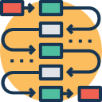
Let’s take a look at some diagrams showing how users may interact with the system.
Use Case Diagrams

Slide 9
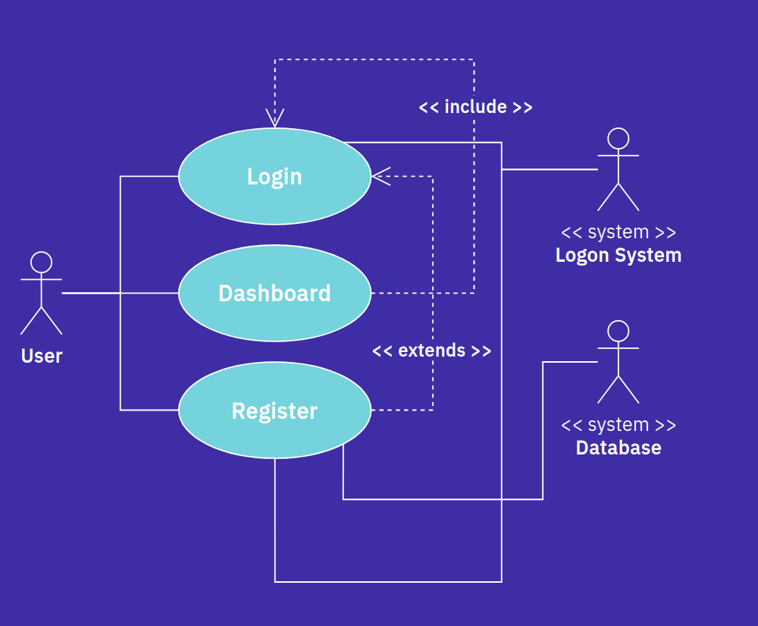
Use Case Diagram for System Entry and Dashboard

Slide 10
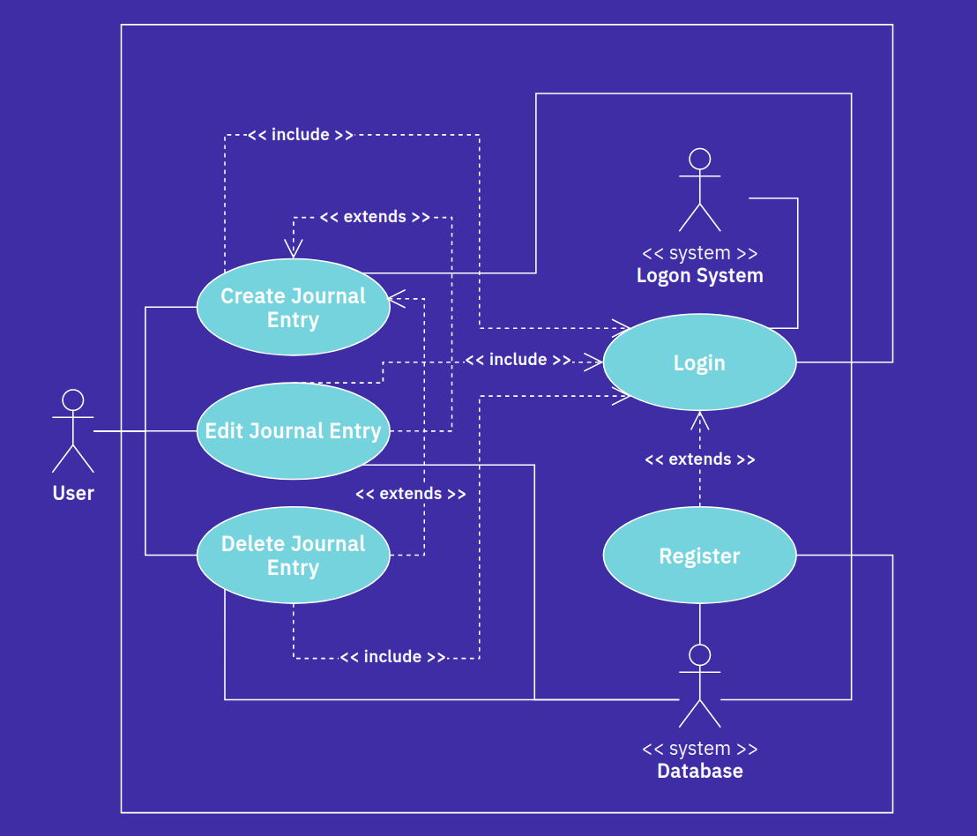
Use Case Diagram for Dashboard Functionality

Slide 11
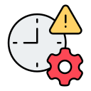
What limiting factors may affect the outcome of this project?
System & Project Constraints

Slide 12







What are the relevant system constraints?
Development Tools
Operating System
Compatibility
Version Control System
Processing Power
Programming Language
Networking Speed

Slide 13






What are the relevant system constraints?
Hosting Environment
Software Updates
Database Management
Documentation
Technical Support
Privacy

Slide 14




What other restrictions exist?
Team Member Availability
Academic Calendar
Budget Constraint

Slide 15

What other features and functionalities could we add in the future?
Evolutionary Requirements

Slide 16
What are the evolutionary requirements?
Here’s what we have in the pipeline so far…
Heart Monitor
Sleep Monitor
Therapy Scheduling
Heart rates often correlate to stress levels, so we plan to provide users the ability to monitor and track their heart rate.
Sleep quality and length can be impacted by one’s mental health. As such, it would be beneficial if users could track the length and quality of their sleep.
While our application is designed to help those not seeking mental health care, we would like to provide in-app functionalities for scheduling therapy appointments.

Slide 17
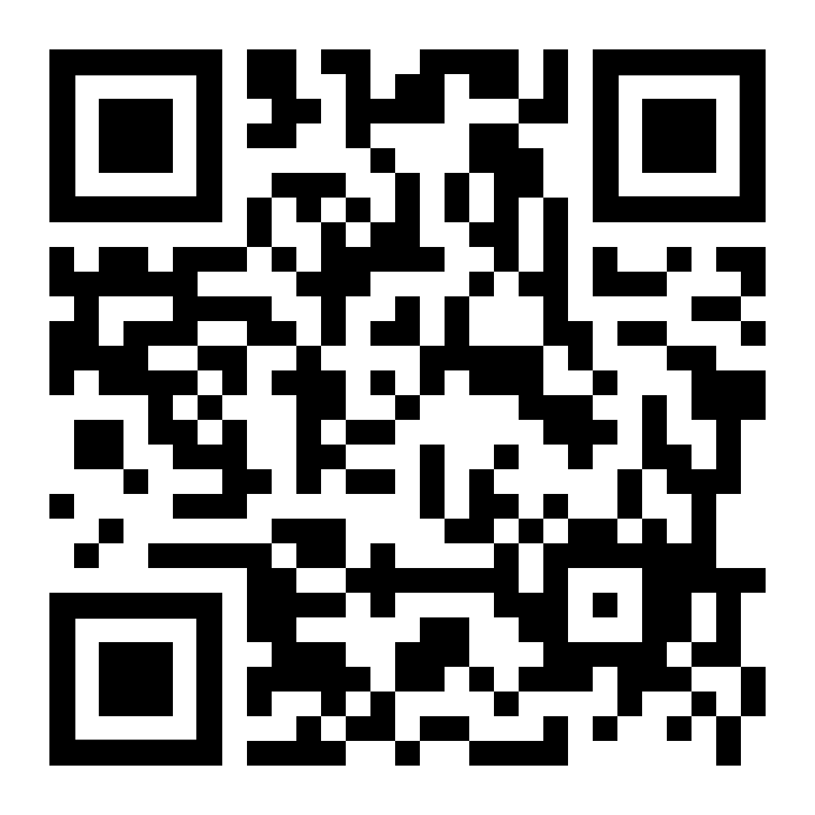
Want to see a feature we didn’t show?
Send us your feedback here!

Slide 18
Thank you for your time!
Any questions?

