Slide 1

Expanding Housing Price Prediction Model
Team 21
Dongyup Han, Alexander J Karwoski, Jacob Place, Ryan Weber, Sangbin Kwon

Slide 2
Background Information
Check to see if accurate predictions can be made based solely off house data
  Number/types of rooms
  Square footage
  Lot size
Check to see if additional outside-factors affect house prices
  Crime Rate
  Population Diversity
  Growth/Decline Rates

Slide 3
Hypothesis
Areas with higher crime rates would reflect in lower house prices
Certain demographic factors will affect house prices:
  Race
  Population Age
  Income

Slide 4

Approach
Created a linear regression model to estimate the cost of houses, given information about the houses and its surrounding area
Implemented the following to enhance our results:
  Random Forest
    Used to determine importance of features, which will allow us to focus on those identifying/generating new features around those characteristics
  Clustering
    Used to group certain parameters into buckets, based on shared characteristics
    Used to identify malformed records, to expand our data set

Slide 5

Encountered Problems
Housing data is split between house data and land lot data
High percentage of missing data
Noticeable outliers present in dataset
  Outliers removed
Certain zip codes fall between multiple counties
  Compared duplicate zip code rows and kept the highest populated

Slide 6
Data Cleaning Progress
Used 3 datasets from Kaggle.com
  Demographics
  Crime rates
  Real estate
Completed merging housing data set with crime rate and demographic data sets
Add lot flag for empty lots
Remove Strings that are too unique such as address.
Fill in data with median integer values and mode string values.
Remove outliers (i.e., homes with 40 rooms and 35 bathrooms, etc.)
  Using the normal outside of 2 standard deviations.
Use median numbers to fill in the NA values
If number of rows with missing data is low (percentage wise), remove

Slide 7
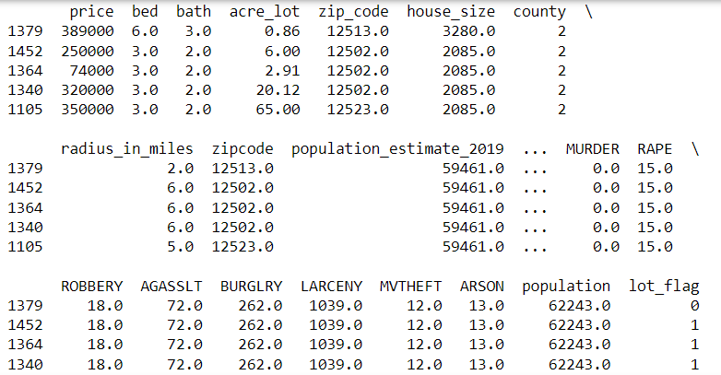
Data Set

Slide 8
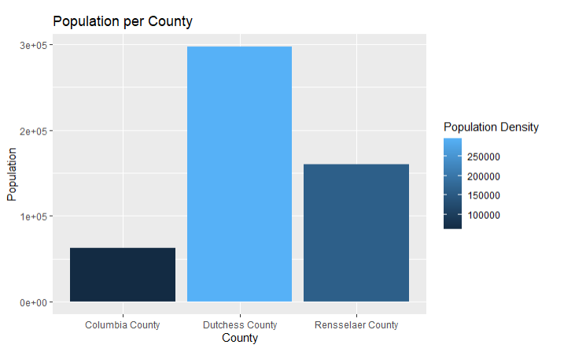
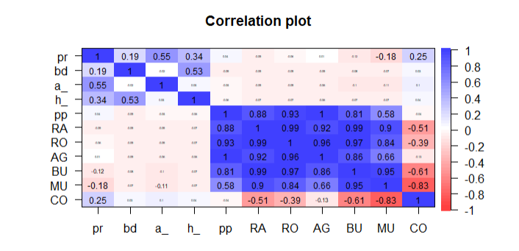
Exploratory Data Analysis

Slide 9
Preliminary Analysis
Create a full model using all the variables and converting most of the fields to factors, as they are few unique values.
The Linear Regression output showed many NA values for the coefficients of certain variables.
  This means there is heavy correlation between values.
Interpreted that this is because zip code is correlated to all population and crime-based data.
Determine the best way to eliminate the correlation in the model.

Slide 10
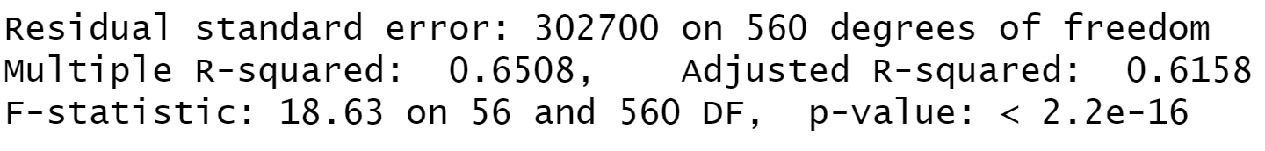
Discuss output
Used simple linear regression using the variables to predict price.
Majority of the variables came out as NA meaning there is a lot of correlations
R-squared of 0.6508 and Adjusted R-squared of 0.6158

Slide 11

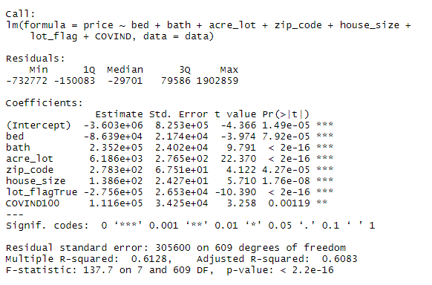
Stepwise Model
Create a stepwise regression model using both forward and backwards steps and VIF as the determining statistic.
Obtain the optimal model that minimizes VIF and maximizes Adj R square.

Slide 12
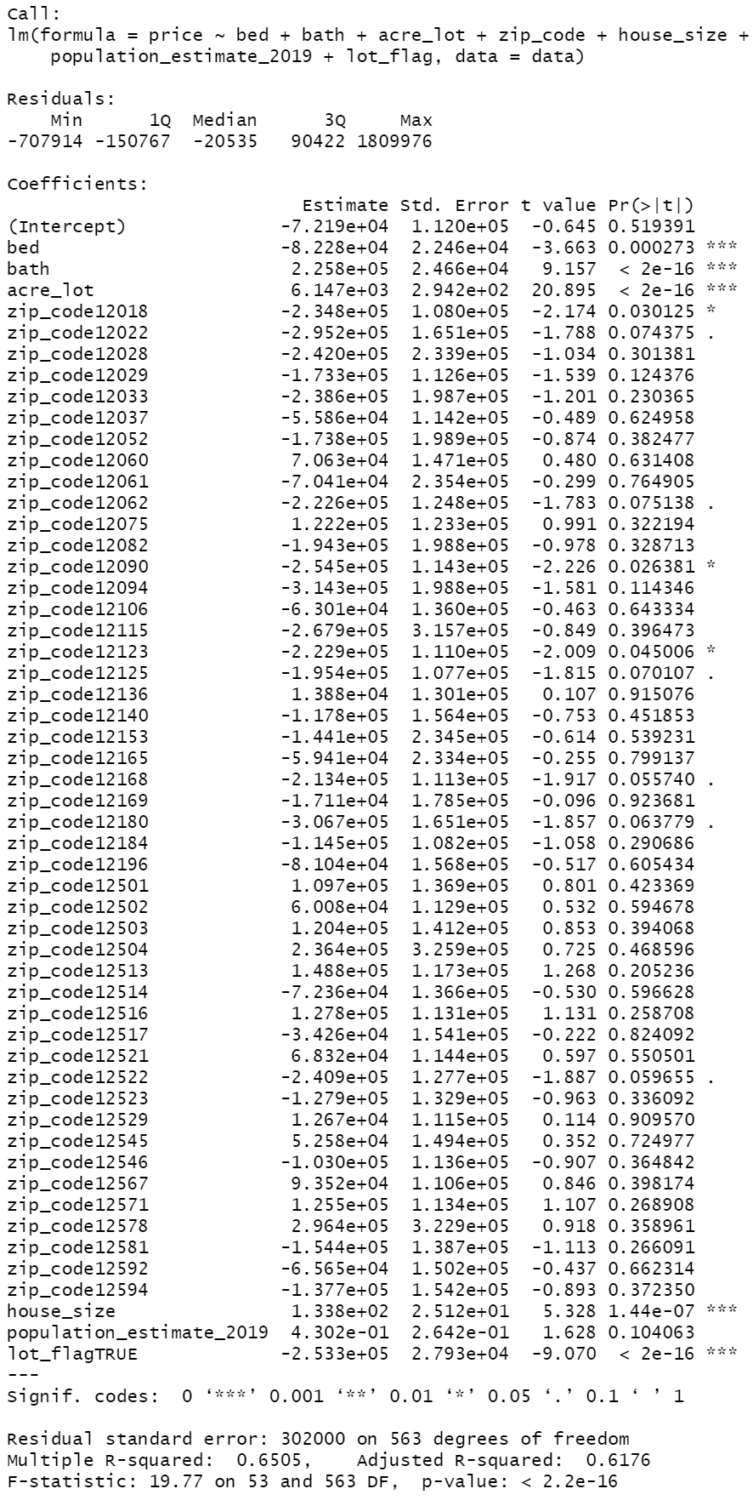
Discuss output
Most zip codes are not significant.
Bed, Bath, Acre lot, house size, and lot flag very significant
P value of overall model ~0.
R square of .6505
RSE of 302000

Slide 13
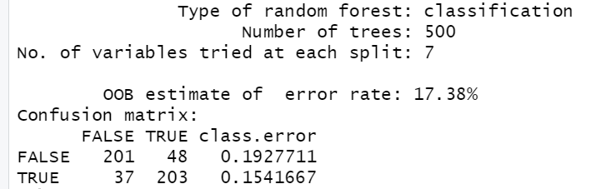
Random Forest Model
Now we will try to split the dataset using random forest model.
Split into "Expensive" and "Inexpensive" groups if price is greater or less than median house price.
Expensive house have 308 homes. Inexpensive has 309.
Use RF to classify if house is expensive or not.
Split data 80% Train, 20% Test.

Slide 14
Interpret model
Accuracy of 82.62 %
Very good for the amount of datapoints we have
500 trees for robustness
Better at classifying inexpensive houses accurately
We can now trust this model to feed into our final two models

Slide 15
Final Models
Create two Linear regression models using predicted expensive and inexpensive houses.
Use variables determined in stepwise regression seen earlier.
These models should have less Residual Standard Error.
We can use these models to check assumptions and make sure they are met.
We can then transform the data to make the model more accurate.
We can analyze which feature are more important for each model.

Slide 16
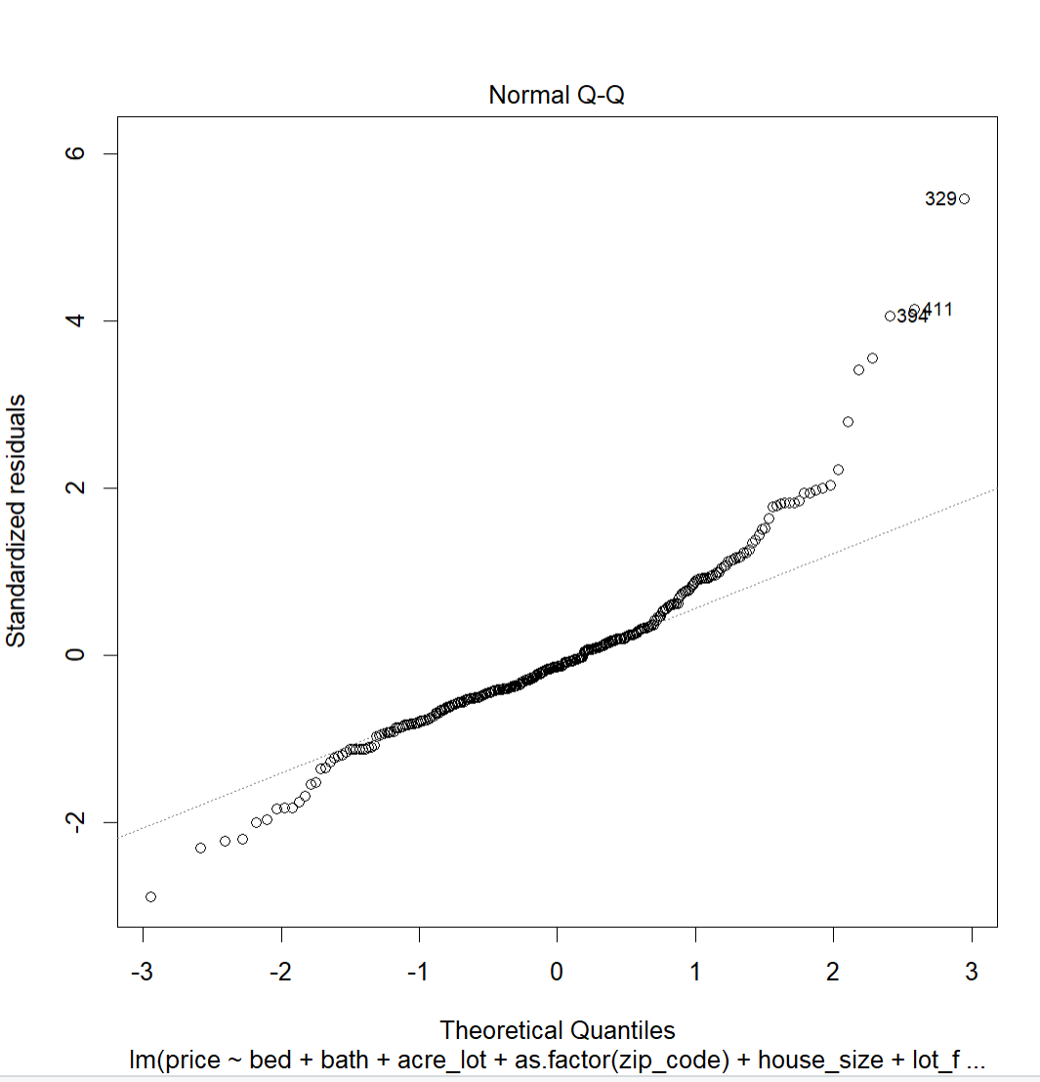
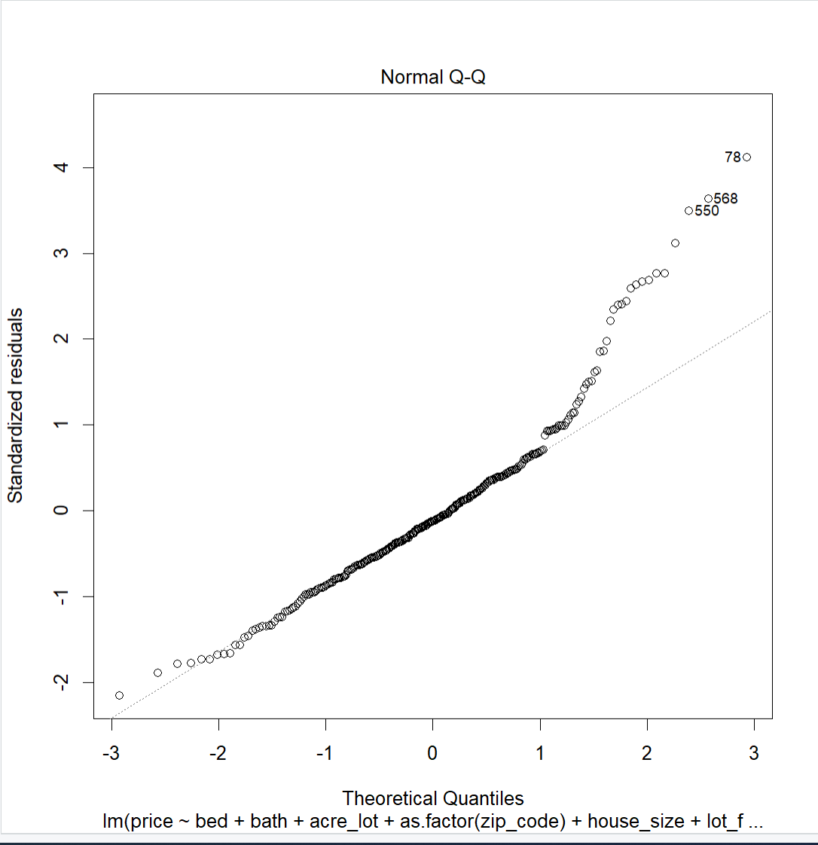
Final Model Cleaning
Inexpensive
Analysis
  Inexpensive and Expensive Normal QQ looks like the data is extreme at the ends.
    Means Normality assumption does not hold.
    Constant Variance does not hold.
  Box Cox Transformation says use log (lambda = 0)
    Fix Skewed Data
  Model become log(price) ~ bed + bath + acre_lot + as.factor(zip_code) + house_size + lot_flag, data = data_inexpensive
  Inexpensive plot on the top shows it has less variation, which is evidenced by the lower RSE which is discussed on the next slide.
  Expensive plot has heavy upper tail that is influencing the model and increasing the RSE, would likely lead to misleading predictions.
Expensive

Slide 17

Interpret final models
R square not as good but Residual error much lower for inexpensive model.
Better predictions.
More confident house prices.
Allows for more confident and predictable investments.
Less variables for easier interpretation and exploration of new datasets.
RSE:
  Full Model : 302000
  Inexpensive Model: 393100
  Expensive Model: 83520

Slide 18
Conclusion
Stepwise regression allowed us to eliminate about 90% of the variables.
The correlation in the predictors decreased dramatically.
The Random Forest allows us to first classify two categories of houses.
The final two models were used to transform the response variable so that the normality assumption holds.
Final Model for expensive houses has higher RSE, but much lower for inexpensive houses.
This will give more confidence in buying less expensive homes.

Slide 19
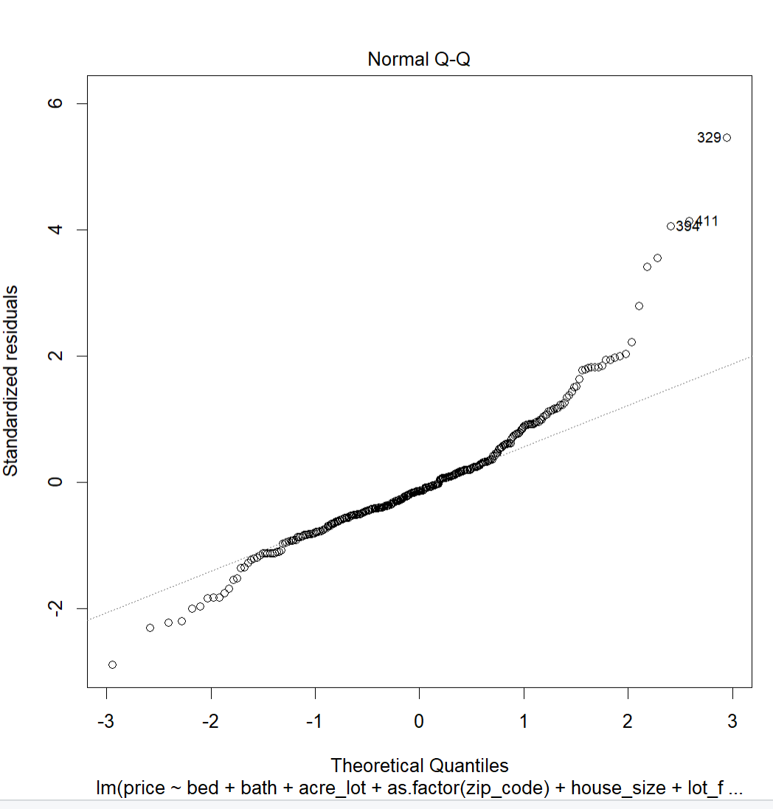
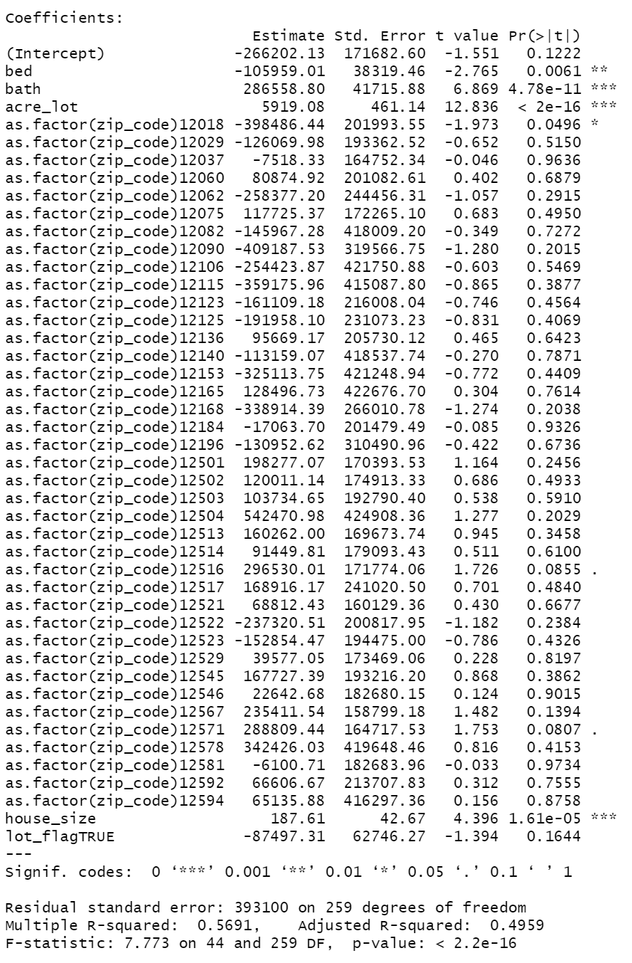
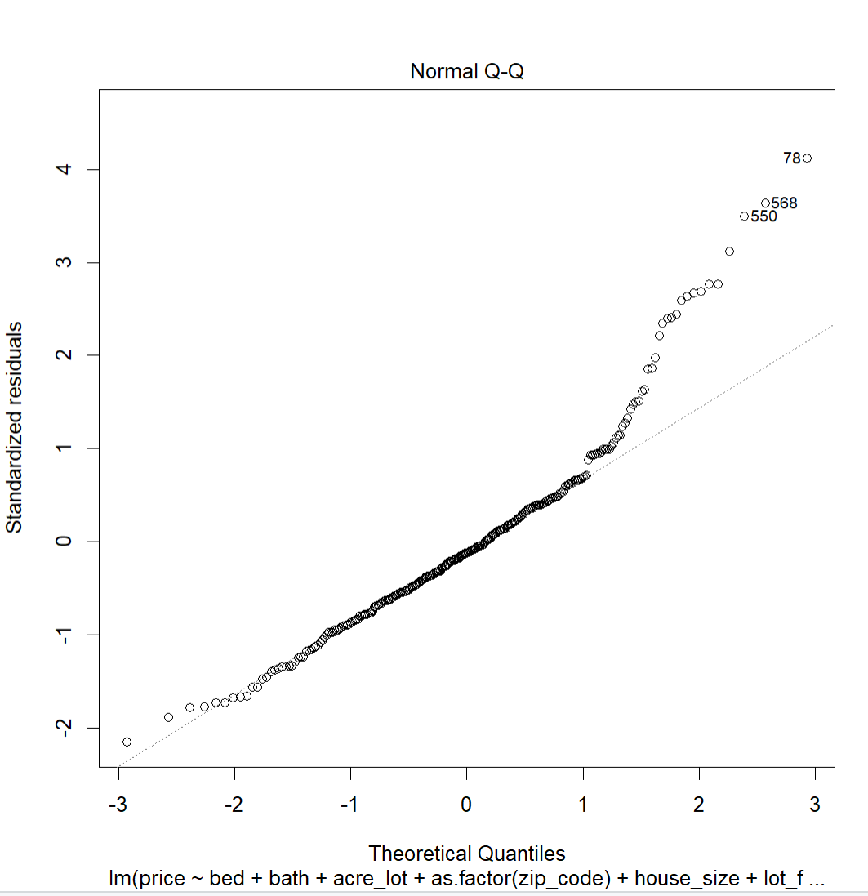
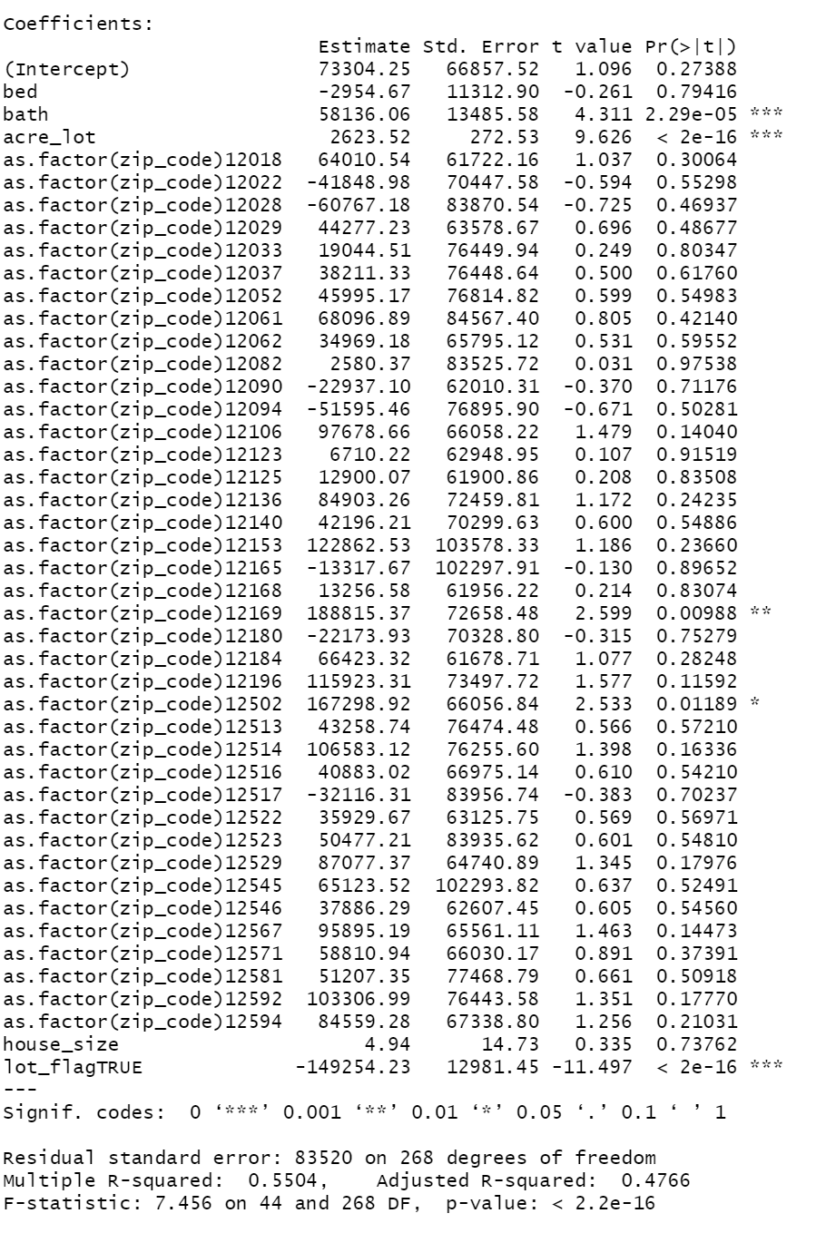
Tables & Graphs
Inexpensive
Expensive

Slide 20
Citations
Ceccato, V., & Wilhelmsson, M. (2019, September 12). Do crime hot spots affect housing prices? Taylor & Francis. Retrieved July 4, 2022, from https://www.tandfonline.com/doi/full/10.1080/2578983X.2019.1662595
Rockoff, J. E., & Linden, L. (2008). Estimates of the impact of crime risk on property values from Megan's laws. American Economic Review. Retrieved July 4, 2022, from https://www0.gsb.columbia.edu/faculty/jrockoff/aer.98.3.pdf
https://www.kaggle.com/datasets/ahmedshahriarsakib/usa-real-estate-dataset
https://www.kaggle.com/datasets/bitrook/us-county-historical-demographics?select=us_county_demographics.csv
https://www.kaggle.com/datasets/mikejohnsonjr/united-states-crime-rates-by-county/code

