Slide 1
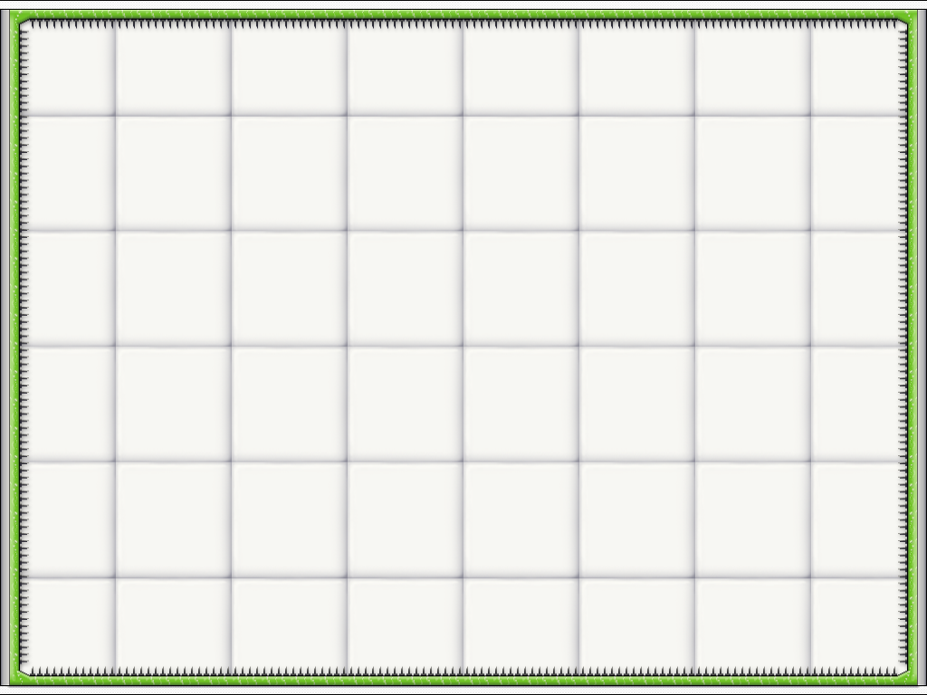




Psycho Bunnies

Slide 2
Psycho Team
Design
Kevin Yue
Eli Davis
Ziad Baaklini
Art and Sound
Turner Bohlen
Zach Segal
Evan Martinez (PM)
Development
Predrag Gruevski
David Xiao (PM)
Patrick Hulin

Slide 3
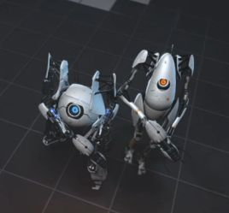
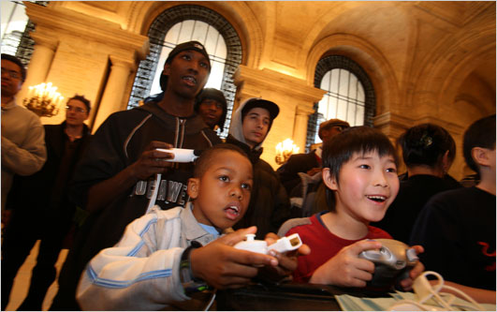
Cooperative Play
Psycho
Vision
Fun to Play and Watch
Unique Mechanic
?
Robots: courtesy of Portal 2, Valve Corp. http://news.bigdownload.com/2010/08/21/portal-2-co-op-campaign-preview-video-revealed/
Kids: courtesy Suzanne DeChillo, New York Times. http://mediadecoder.blogs.nytimes.com/2009/11/12/saturday-is-national-gaming-day-at-the-nations-public-libraries/

Slide 4
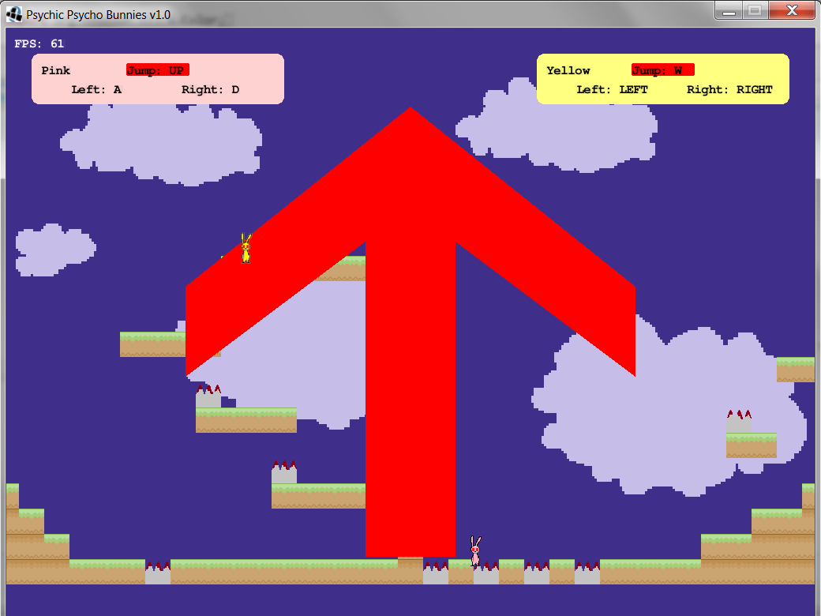
First steps

Slide 5
Three stages
Game Engine/Brainstorming
Parallel Prototypes
Theme and Iteration

Slide 6



Teamwork

Slide 7
Psycho Demo!!!

Slide 8
Psycho Physics
1. Consistent 60 fps
2. Intuitive behavior
3. Easily extendable

Slide 9
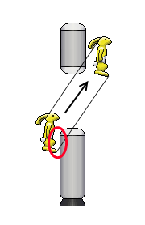
Psycho Physics
Vol. 1

Slide 10
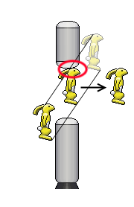
Psycho Physics
Vol. 2

Slide 11
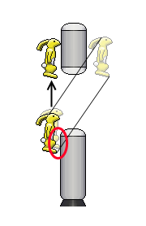
Psycho Physics
Vol. 3

Slide 12
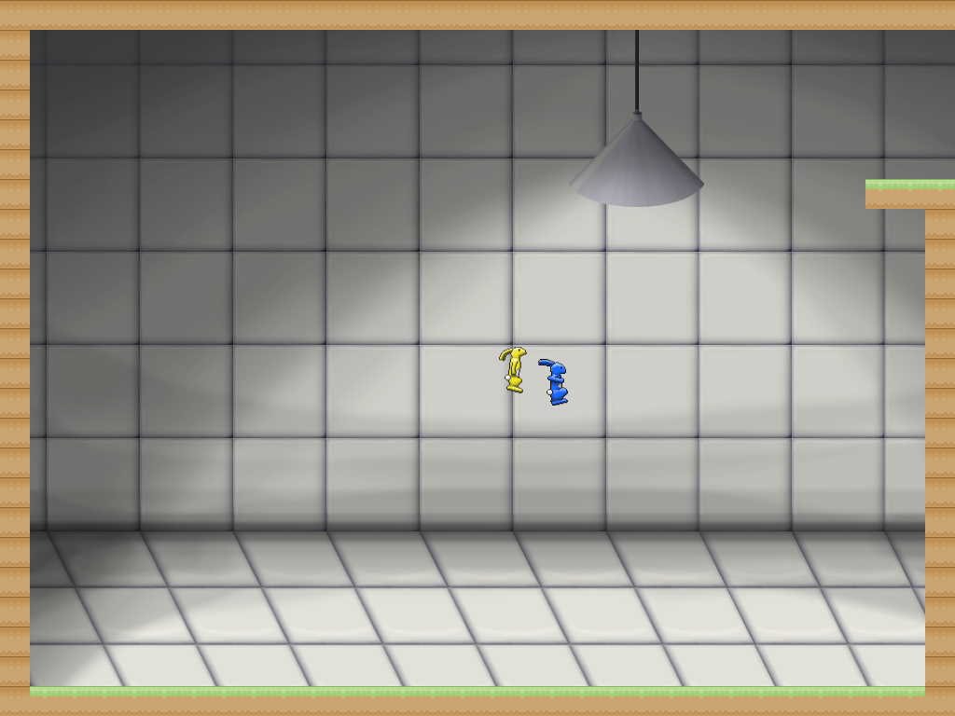
Design Iteration
1.0 - Original concept

Slide 13
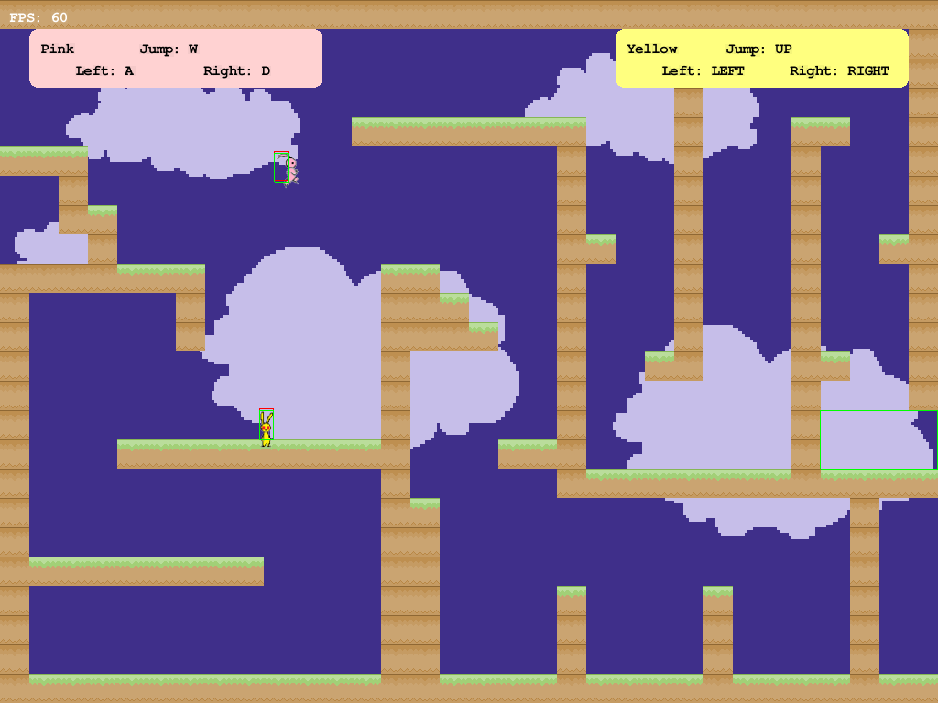
Design Iteration
2.0 – Reevaluation

Slide 14
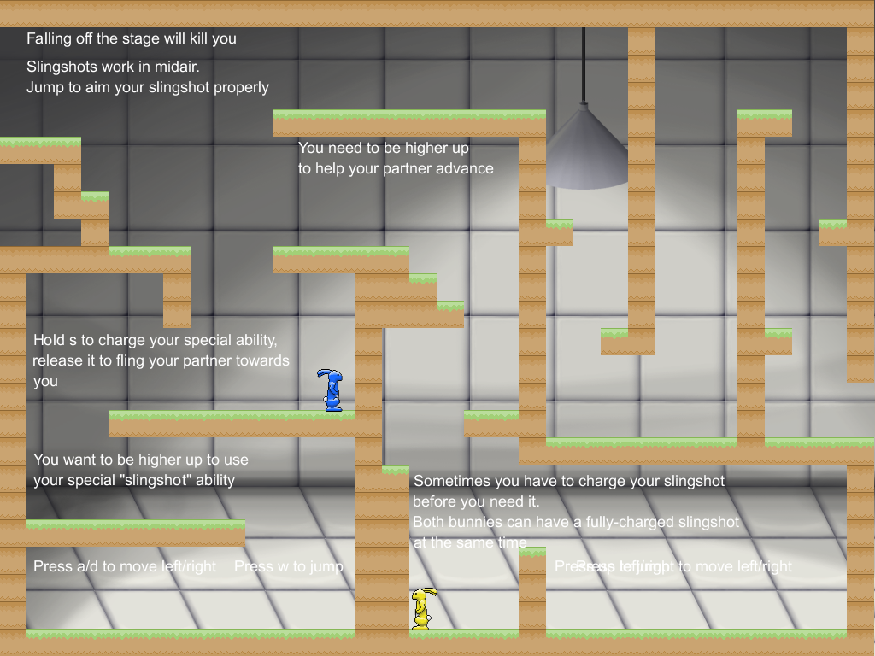
Design Iteration
3.0 – New Concept

Slide 15
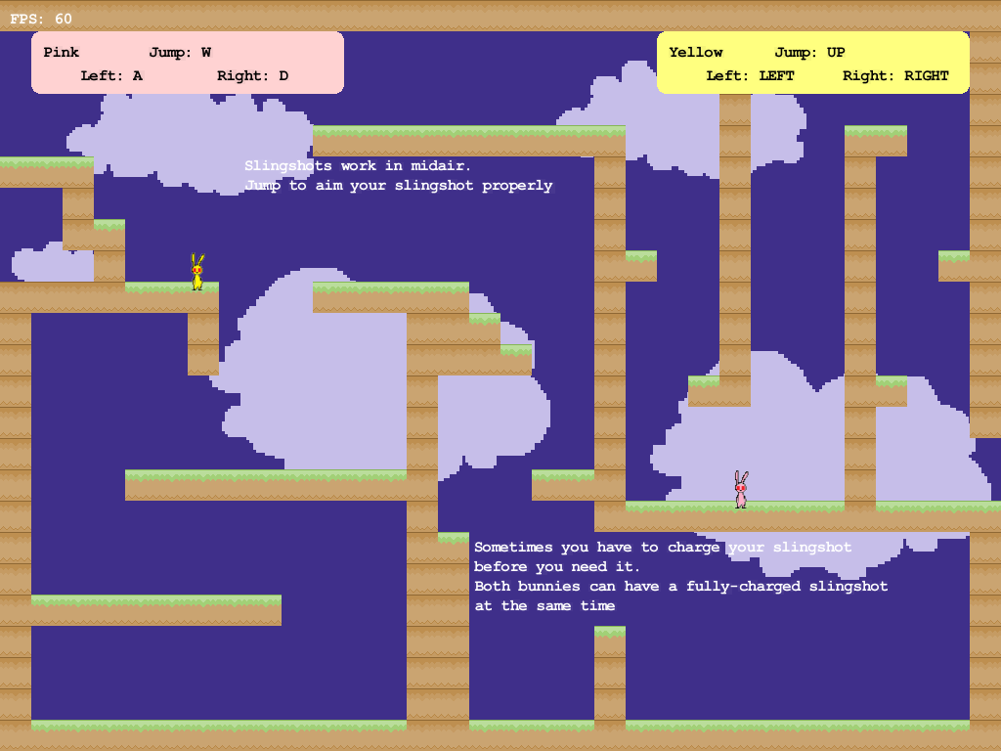
Design Iteration
3.1 –Necessary Polish

Slide 16
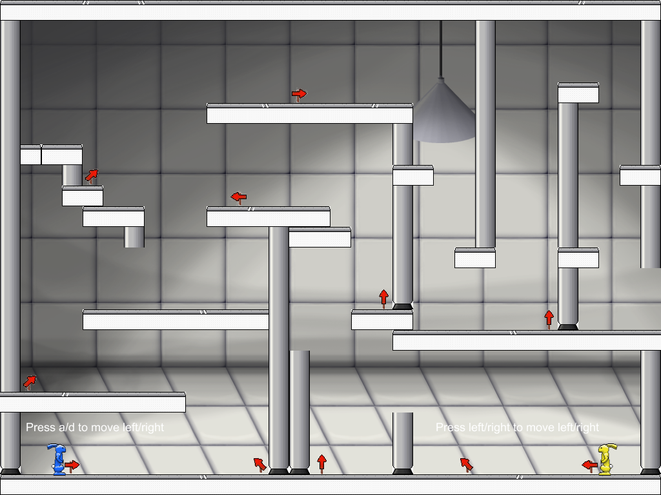
Design Iteration
4.0 – Art + Design Fixes

Slide 17
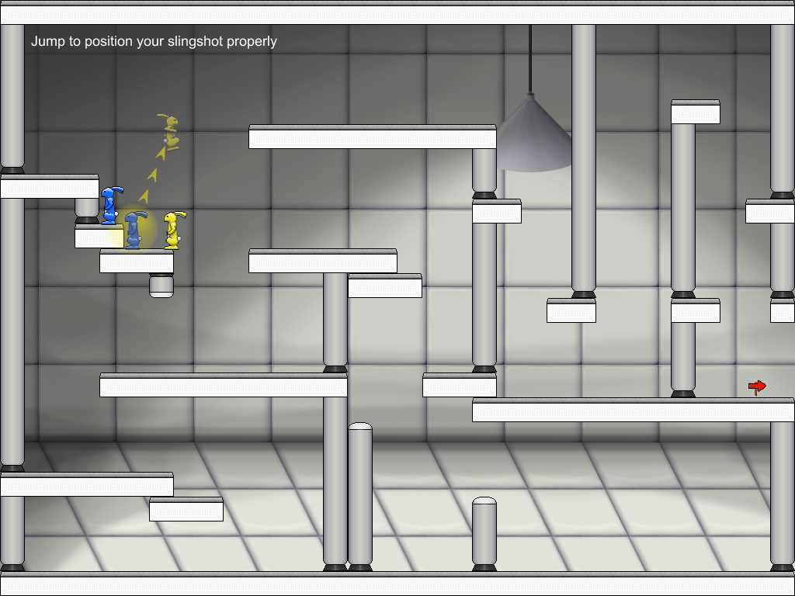
Design Iteration
5.0 - y u no read
instructions?!?!

Slide 18
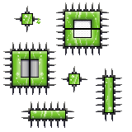

Psycho Theme

Slide 19

Psycho Story

Slide 20
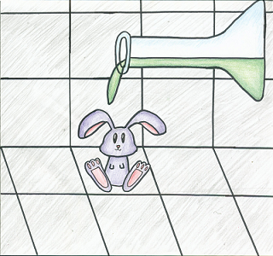
Psycho Story

Slide 21
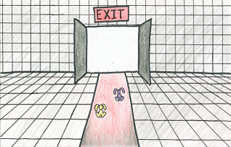
Psycho Story

Slide 22
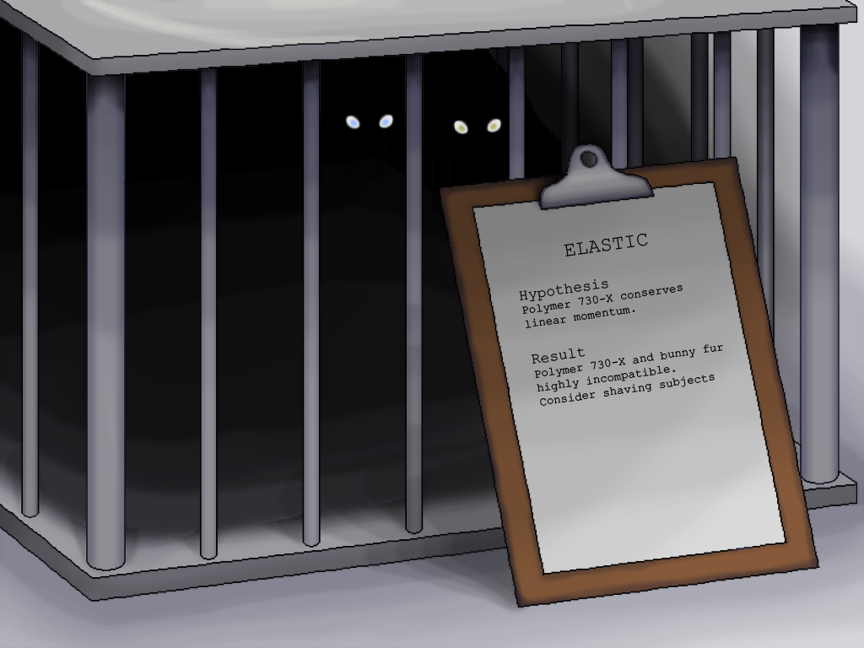
Psycho Polish

Slide 23
Psycho Polish

Slide 24
Questions?
psychobunnies (at) mit.edu

