Slide 1
LECTURE 4 • DAY 2, 10:00–10:30
Introduction to data analysis
SORT IT Module 3 • Data analysis and interpretation of results • Timor-Leste
Notes:
TIMING: This lecture is 30 minutes. That is 12 slides at roughly 2 minutes each, plus the card sort game. Do NOT try to teach statistics here. Your only job is to give them three rules they will use in the group work at 11:00.
Open by asking: 'Put your hand up if you already have data collected.' Most hands go up. 'Keep it up if you know exactly what your first table will look like.' Most hands go down. That gap is what this session is about.

Slide 2
Analysis is not statistics.
It is deciding what question you are answering — and then counting carefully.
Notes:
Say this slowly. Many participants are frightened of this session because they think it will be mathematics. Relieve that fear in the first two minutes or you will lose them for the rest of the day.
Nearly all operational research is descriptive: counts, percentages, medians. You do not need advanced statistics to change policy. You need the right denominator and an honest table.

Slide 3
WHAT YOU WILL LEAVE WITH
Three rules. That is the whole lecture.
▪ Know what type of variable you have — before you calculate anything
▪ Choose the right summary — mean and median are not interchangeable
▪ State your denominator — every single time, without exception
Notes:
Signpost clearly. Tell them there are exactly three rules and they will practise all three before lunch. People relax when they know the shape of what is coming.
Point to the three factsheets on their desk: FS1, FS2, FS3. One per rule.

Slide 4
Rule 1
Know your variable
Get this wrong and every number after it is wrong
Notes:
This is 8 minutes including the game.

Slide 5
RULE 1
The four types
Type | What it is | Example | How you summarise it
Nominal | Categories, no order | Sex, municipality, TB type | n (%)
Ordinal | Categories WITH order | Smear grade, education level | n (%) or median
Discrete | Counted whole numbers | Visits, days, household size | Median (IQR)
Continuous | Measured, can have decimals | Age, weight, distance | Mean (SD) or median (IQR)
Notes:
Do not read this table aloud - they have it on Factsheet 1. Spend your time on the next slide instead, which is where people actually get it wrong.

Slide 6
What is the average sex?
If your database stores sex as 1 = male and 2 = female, the mean is 1.4.
Notes:
THE key slide of Rule 1. Ask the question and wait. Let the silence sit for a full five seconds - somebody will laugh.
Then: 'The computer will happily calculate 1.4 for you. It will never warn you. This is why YOU have to know your variable types - Excel does not.'
Then go straight into the card sort game.

Slide 7
ACTIVITY 1 • 10 minutes
The Variable Type Race
1. In your table, sort all 24 cards under the four headers
2. First table to finish calls out — but do not expect to be right
3. Then challenge your neighbour's sort. Three challenges each
4. 2 bonus points for every successful challenge
Notes:
See A1_Variable-Type-Race_FACILITATOR for the full run sheet and answer key.
Keep the energy high and the clock visible. Do NOT confirm answers during round 1 - the uncertainty is what drives the challenge round.
Trap cards to debrief: sex coded 1/2, smear grade, number of children, postcode, pain score 0-10.

Slide 8
Rule 2
Mean or median?
The wrong average tells your reader something untrue
Notes:
6 minutes. If you ran the Human Histogram (A3) earlier, refer back to it constantly here - 'remember where I was standing?'

Slide 9
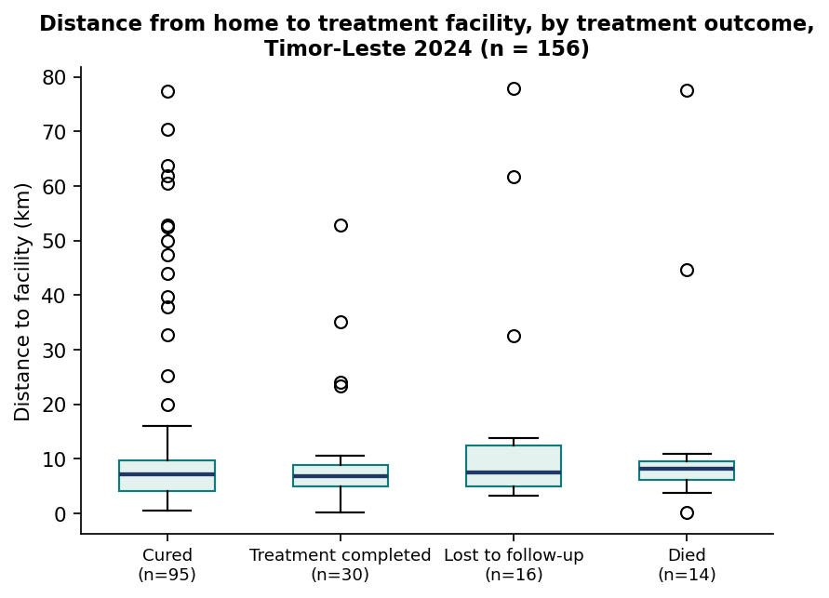
RULE 2
Same 180 patients. Two different 'typical' values.
Distance to facility, by treatment outcome — note how far the boxes overlap
Notes:
Point at the box plot. 'The line in the middle of each box is the median. The box is the middle half of patients. The dots are outliers.'
KEY POINT, and it is worth 60 seconds: if you drew this as a bar chart of MEANS, lost-to-follow-up patients would appear to live 16.5 km away versus 9.9 km for those who completed. That looks like a real finding you could write a paper about.
But look at the medians - 7.6 km and 6.9 km. Almost identical. The entire 'difference' is two or three very remote patients inside a group of 16. The mean invented a finding that is not there.
They will see this again as Chart Doctor Patient 4.

Slide 10
RULE 2
The rule, in one table
Your data are… | Use | Report as
Symmetric | Mean | Mean (SD) — e.g. 48.5 kg (SD 9.1)
Skewed, or has outliers | Median | Median (IQR) — e.g. 7.0 km (4.2–9.8)
Ordinal | Median | Or simply n (%)
Nominal | Neither | n (%) — e.g. 104 (57.8%)
Notes:
How do you know if your data are skewed? Three ways, and mention all three:
1. Compare mean and median - if far apart, it is skewed. Costs nothing.
2. Draw a histogram - ten seconds in Excel.
3. Look at min and max.
In our practice data: mean distance 12.4 km, median 7.0 km. That gap is your warning light.

Slide 11
Rule 3
State your denominator
The most common error in operational research — and the most damaging
Notes:
8 minutes. This is the most important part of the lecture. If you are running late, cut Rule 2 slides, never this one.

Slide 12
RULE 3
180 patients. 126 successes. What is the success rate?
Denominator | n | Answer | What you are really saying
All registered | 180 | 70.0% | Includes 8 still on treatment
Excluding still on treatment | 172 | 73.3% | Still includes 12 transferred out
WHO evaluated cohort | 160 | 78.8% | Hides the 12 you lost track of
Notes:
Build this slowly. Ask the room for the answer BEFORE you show the table. Somebody will say 70%. Somebody else will say 78.8%. Let them disagree.
Then: 'You are both right. That is exactly the problem.'
8.8 percentage points of difference, no arithmetic error anywhere. If the national target is 75%, this cohort has just passed or failed depending on a choice someone made in a spreadsheet.

Slide 13
A percentage without its denominator is not a result. It is a rumour.
Write 126/160 (78.8%). Never 78.8% alone.
Notes:
Let this land. This is the single sentence you want them to remember from the whole module.
Then the four fixes:
1. Decide the denominator in your PROTOCOL, before you see results
2. Use the standard definition where one exists and say so
3. Always report n and N
4. Account for everybody - the excluded patients are a finding, not a nuisance

Slide 14
RULE 3
The small-denominator trap
▪ In our data, 13 of 13 HIV-positive patients were treated successfully. That is 100%.
▪ Would you write that in your paper?
▪ One more death would make it 92.9%.
▪ Below n = 20–30, report the counts. Skip the percentage entirely.
Notes:
Ask question 2 out loud and wait for hands. Some will say yes.
This is the trap that catches people who have understood everything else. A percentage from a tiny denominator looks authoritative and is almost meaningless.
They will meet this again in the Denominator Hunt extension and in the Day 3 quiz.

Slide 15
WHERE THIS IS GOING
What happens next
▪ 11:00 — Group work: the Denominator Hunt, then your own analysis plan
▪ 12:00 — Lecture 5: using graphs and tables
▪ 13:30 — Group work: build your tables and charts for real
▪ Tomorrow 09:00 — recap and interpretation
Notes:
Close by pointing at the three factsheets again and at the Data Detective passport. Tell them Case 1 gets stamped at the end of the card sort.
Finish ON TIME. The group work is where the learning actually happens and you must not steal from it.

Slide 16
Know your variable. Choose the right average. State your denominator.
That is data analysis. Everything else is detail.
Notes:
Final slide. Leave it up during the break.

